Slide 1
Beam jitters
Mar. 14, 2018
Y. Seimiya

Slide 2
Outline
Introduction
Investigation of beam jitter source
  Dependence on flux concentrator, solenoid, bridge coil, pulsed magnet, and chicane.
  Charge dependence.
  Correlation between beam position before and after the target.
  Positron beam, that does not pass though the target hole.
  Dispersion leak dependence.
Conclusion

Slide 3
Outline
Introduction
Investigation of beam jitter source
  Dependence on flux concentrator, solenoid, bridge coil, pulsed magnet, and chicane.
  Charge dependence.
  Correlation between beam position before and after the target.
  Positron beam, that does not pass though the target hole.
  Dispersion leak dependence.
Conclusion

Slide 4
Requirement to LINAC for SuperKEKB
Low emittance & high charged beam transportation is required for SuperKEKB.
Transported beam to MR must be stable to the extent that the beam can be injected inside MR acceptance.
SuperKEKB requirement must be satisfied for emittance including jitter emittance, called as effective emittance.
In phase 3, 40/20 nor. emittance under 4 nC is required.
MR acceptance
SuperKEKB requirement for electron
Effective emittance
 | H/V nor. emittance (μm) | Charge (nC) | Energy spread (σ)
Phase 2 | 150/150 | 1 | 0.1%
Phase 3 (goal) | 40/20 | 4 | 0.07%
x’
Effective emittance have to be less than effective emittance.
x
Notes:
which is called as
Effective emittance, this blue circle must be smaller than MR acceptance, this orange circle.

Slide 5
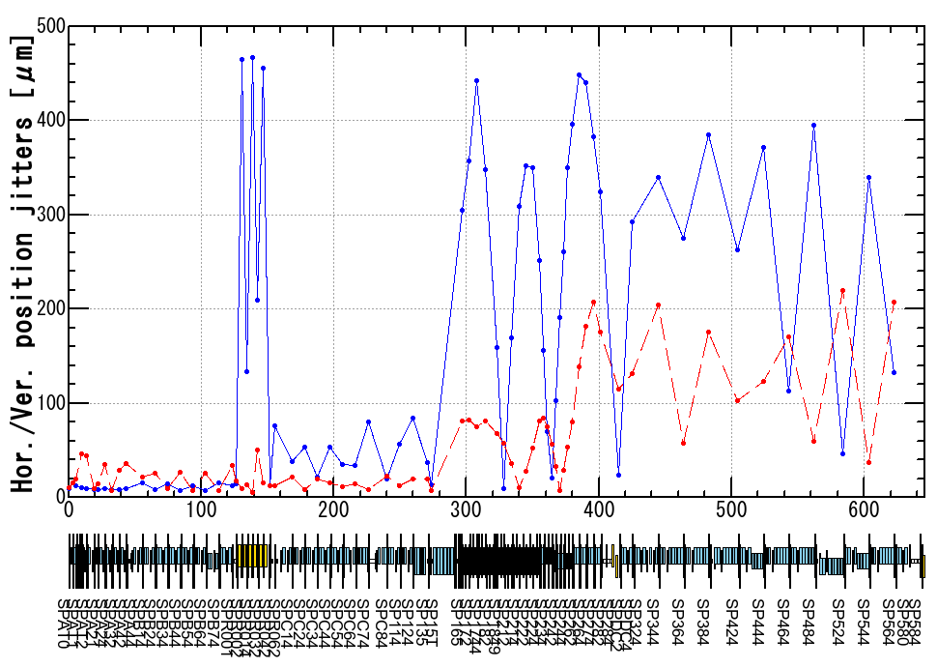
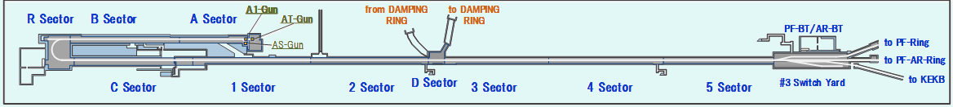
Measured beam position jitter (thermionic gun)
After J-ARC section, horizontal position jitter is enlarged because position jitter is proportional to both dispersion and energy jitter.
After target hole, hor. and ver. position jitters are enlarged.
Thermionic gun
1 nC.
BPM resolution ~ 10 μm.
η_{J-ARC} ~ 0.8 m
→ ΔP_{J-ARC}/P₀ ~ 0.06%.
1000 shot data
Dec. 2017
J-ARC
Target
Notes:
blue line red line …

Slide 6
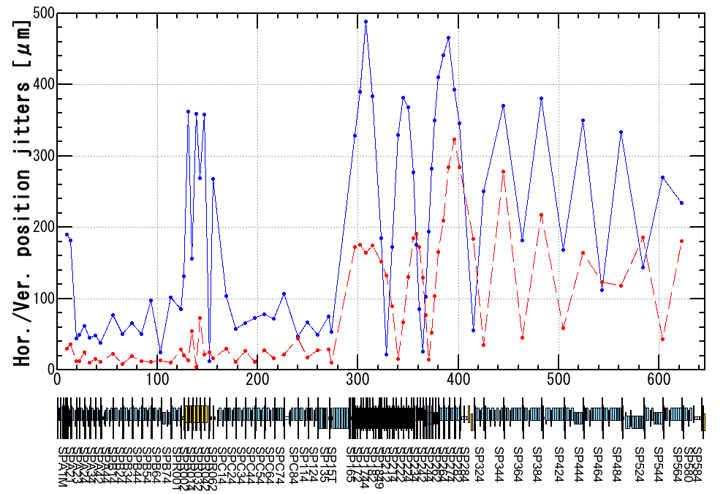
Measured beam position jitter (RF gun)
After target hole, hor. and ver. position jitters are enlarged.
This behavior is similar to that of thermionic gun.
RF gun
1 nC.
η_{J-ARC} ~ 0.8 m
→ ΔP_{J-ARC}/P₀ ~ 0.05%.
1000 shot data
Dec. 2017
J-ARC
Target

Slide 7
Jitter emittance (1)
Effective emittance = Nominal emittance + Jitter emittance
If beam position and transfer matrix between two BPMs is identified, we can derive beam angle. Using the position and angle, effective emittance is derived by
If beam jitter is independent of particle motion,
Jitter emittance
Nominal emittance

Slide 8
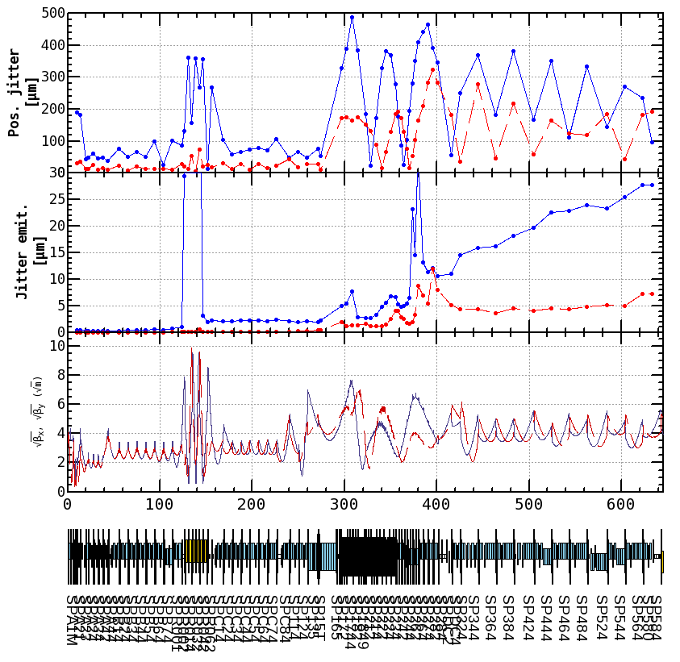
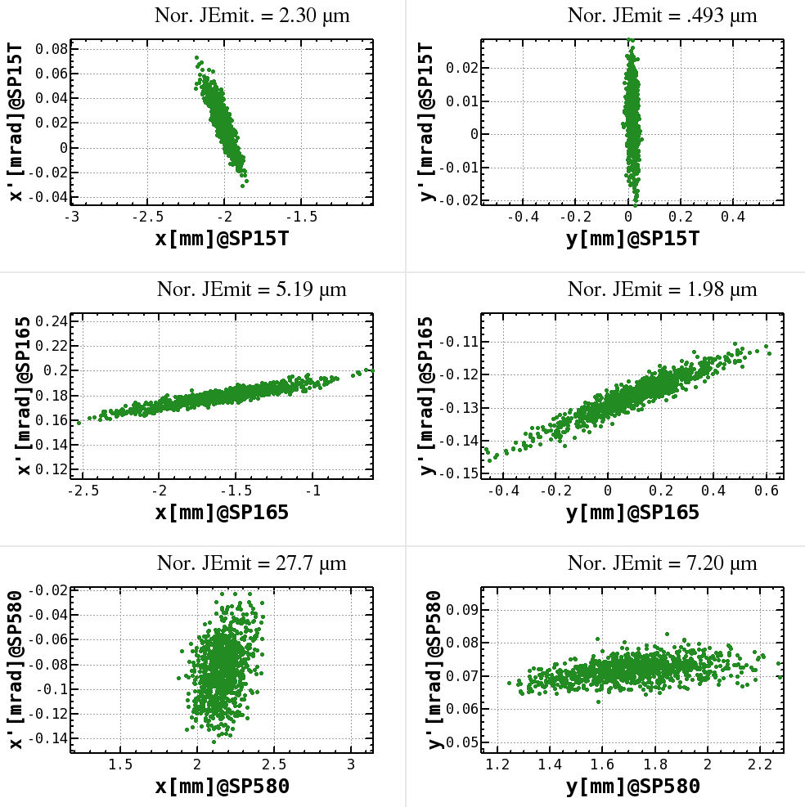
Jitter emittance (2)
Jitter emittance remarkably increases after the target.
This jitter emittance strongly affect the effective emittance.
RF gun, 1nC
 | Phase 3 requirement to effective emit.
εx | 40 μm
εy | 20 μm
 | jitter emit.
εx | 27.7 μm
εy | 7.2 μm
※Design beta functions
※Design beta
※phase space plot is not scaled by gamma factor.

Slide 9
What is the jitter source?
Does effective emittance satisfy the SuperKEKB requirement?
Unfortunately, jitter source is not clear for now. This presentation is progress report.

Slide 10
Outline
Introduction
Investigation of beam jitter source
  Dependence on flux concentrator, solenoid, bridge coil, pulsed magnet, and chicane.
  Charge dependence.
  Positron beam, that does not pass though the target hole.
  Correlation between beam position before and after the target.
  Dispersion leak dependence.
Conclusion

Slide 11
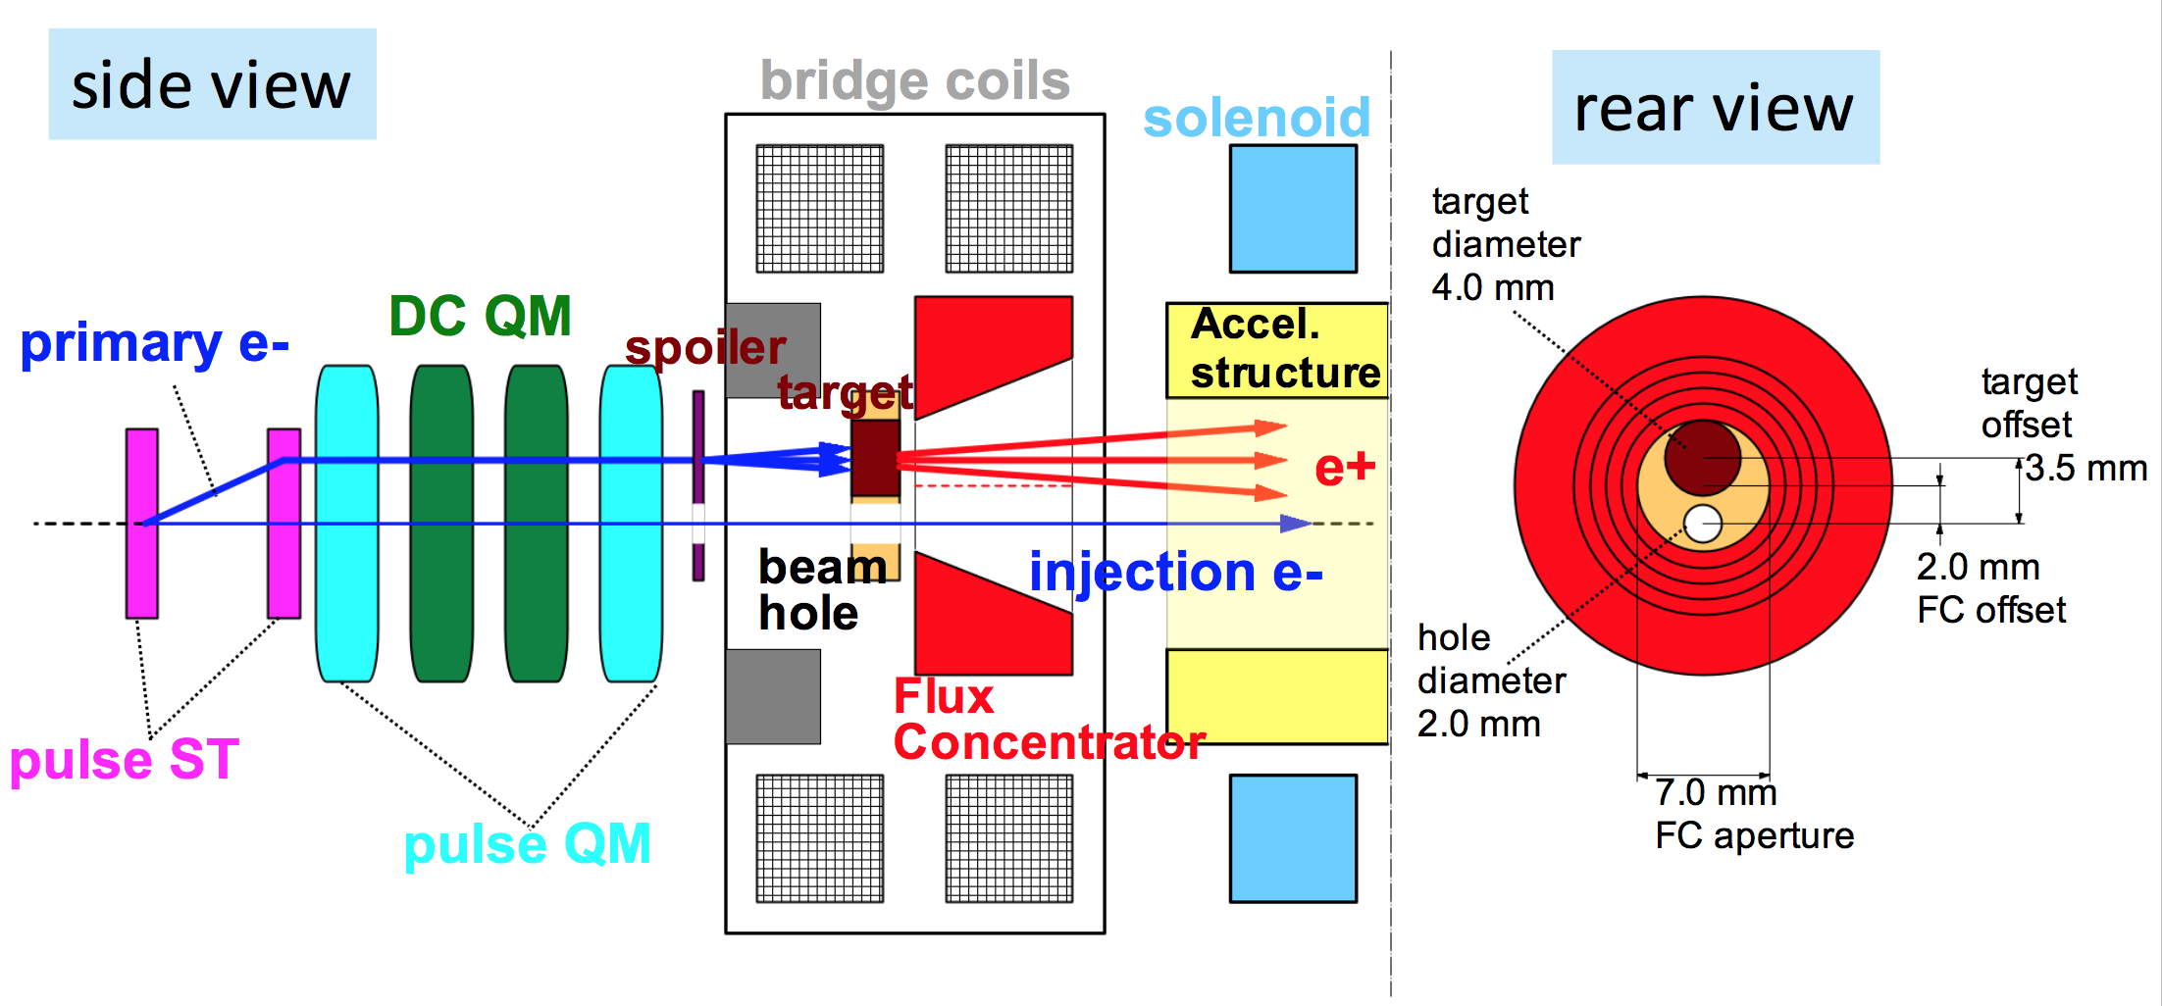
Positron generation target
As jitter source, components around target is suspected.
Schematic layout of component around target.
T. Kamitani slide
Target hole for electron beam
Electron beam straightly pass through the positron generation target hole, which diameter is 2 mm.

Slide 12
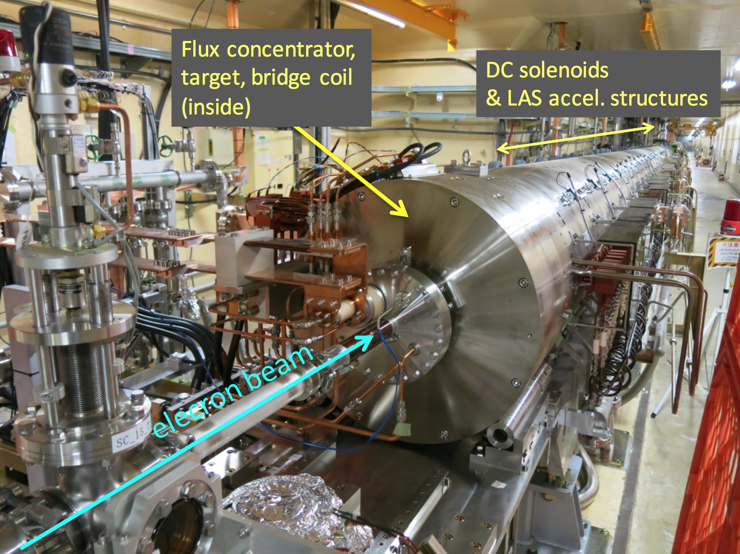
Configuration around the target
Electron come from upstream and pass through FC, target, bridge coil, and DC solenoid.
After the DC solenoid, chicane for dump electron beam, that is generated together with positron beam.
DC solenoid
& acc. structure
T. Kamitani slide

Slide 13
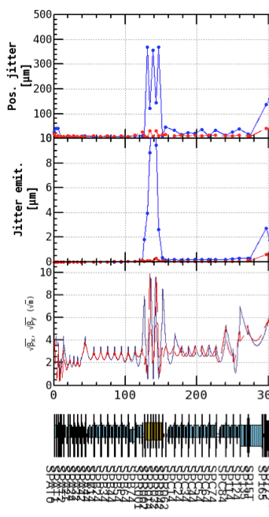
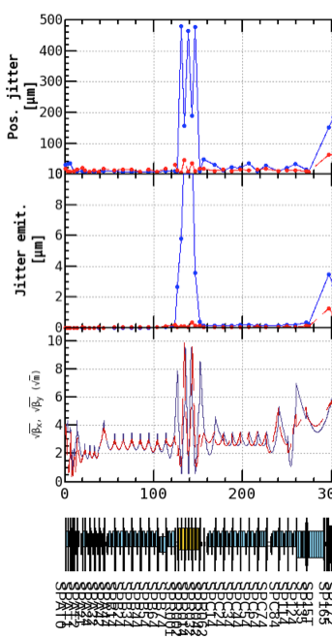
  Dependence on flux concentrator, solenoid, bridge coil, pulsed magnet, and chicane
We check whether these components are sources of jitter or not by turn off these components between BPMs before and after target.
Thermionic gun, 1nC
ON
OFF
No noticeable differences

Slide 14
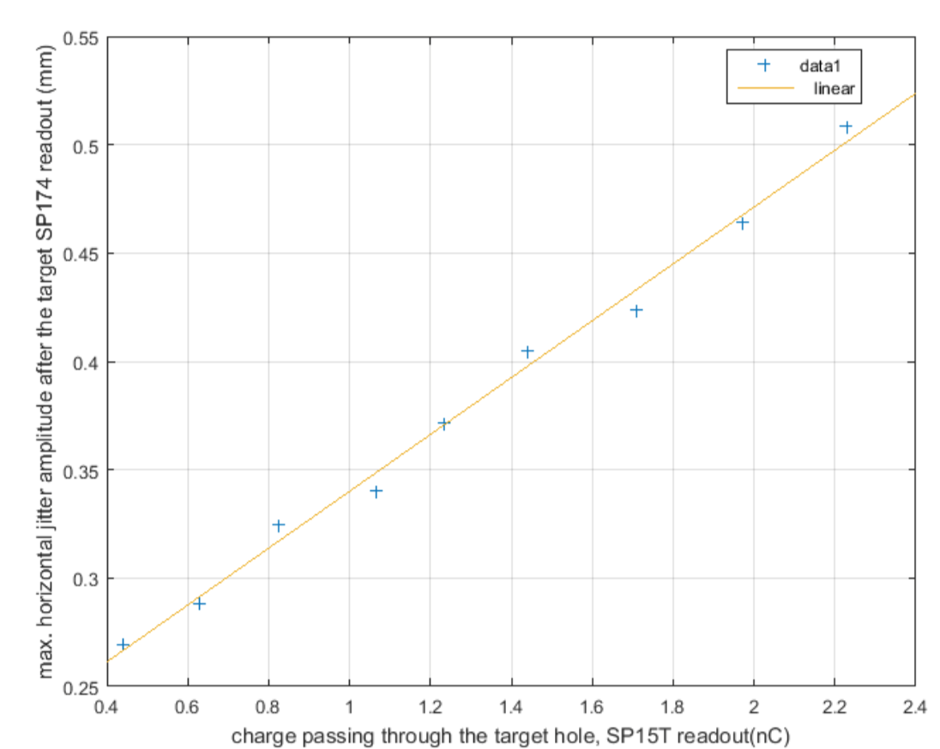
Charge dependence
Maximum horizontal jitter amplitude as a function of charge.
Linear charge dependence can be seen.
S. Ogur

Slide 15
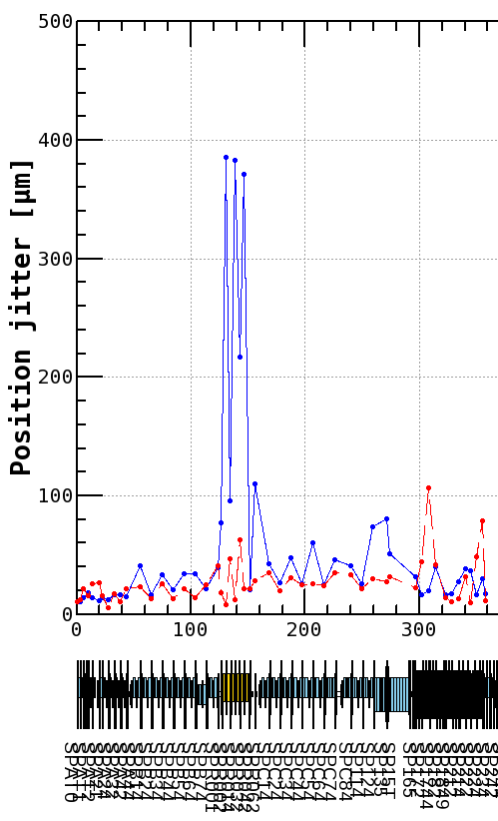
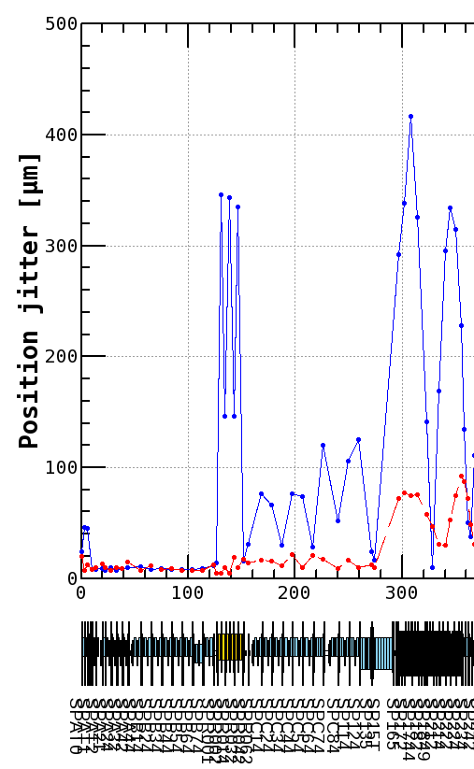
Positron beam, that does not pass though the target hole
Difference of positron beam (hits the target) and electron beam (through the target hole).
It seems that target hole enhance beam position jitter remarkably. Wake field effect is suspected.
After target
After target
Positron
Electron
Big differences.

Slide 16
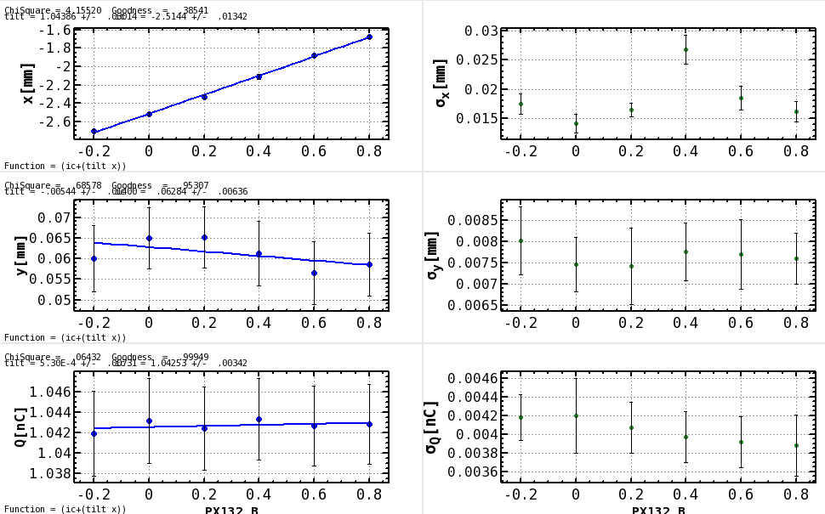
Before Target (SP15T)
Correlation between beam position before and after the target (1)
To find the wake field effect, beam position pass through the target hole was changed by steering magnet.
x jitter amp. [mm]
y jitter amp. [mm]
Q jitter amp. [nC]
Steering magnet current (A)
Steering magnet current (A)

Slide 17
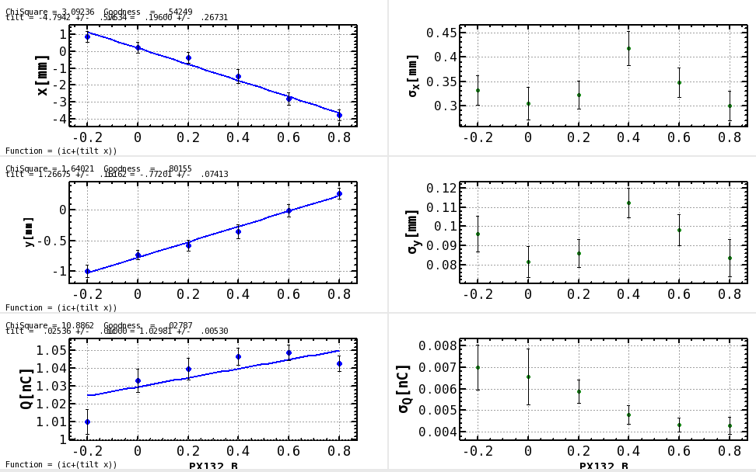
Correlation between beam position before and after the target (2)
It seems that there is not remarkable difference between beam position jitter amplitude and steering magnet current.
After Target (SP165)
x jitter amp. [mm]
y jitter amp. [mm]
Q jitter amp. [nC]
Steering magnet current (A)
Steering magnet current (A)

Slide 18
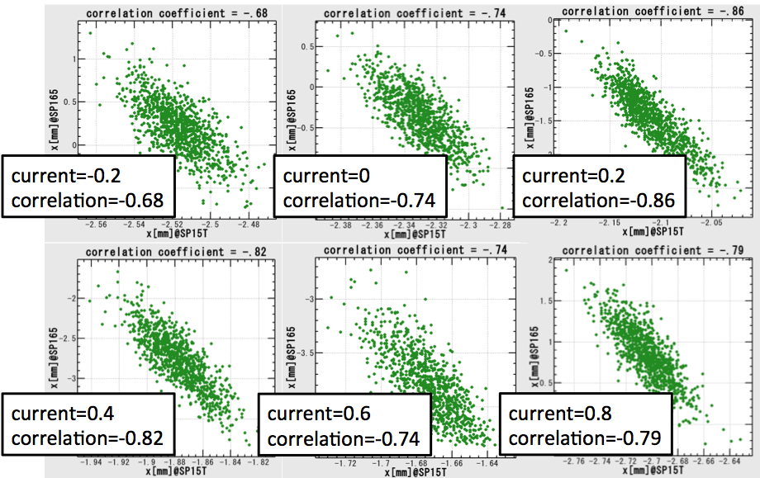
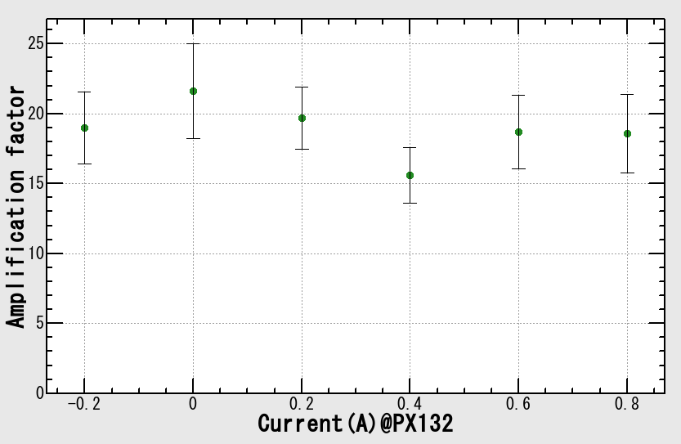
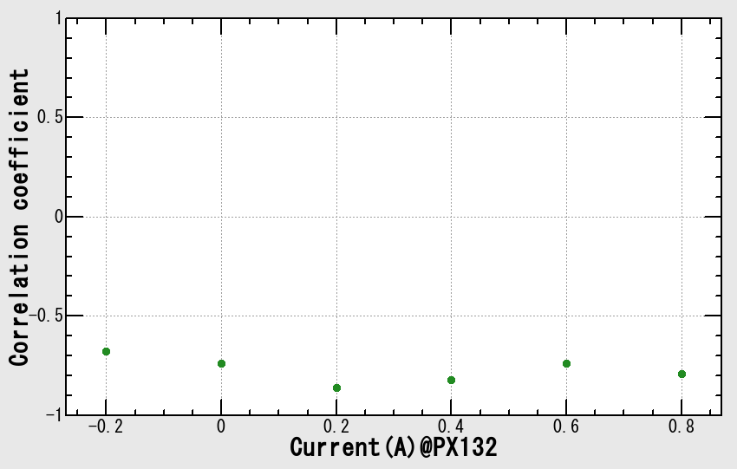
Amplification factor and correlation coefficients
From the beam position before and after target, amplification factor and correlation coefficients are derived.
It seems that beam jitter dependence on beam position pass through the target is small.
Wake effect is not found from this result.
Correlation plot
Amplification factor
Correlation coefficients
No noticeable differences.

Slide 19
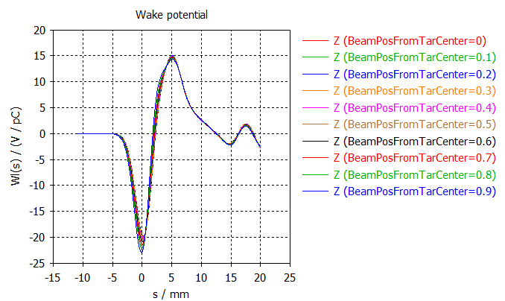
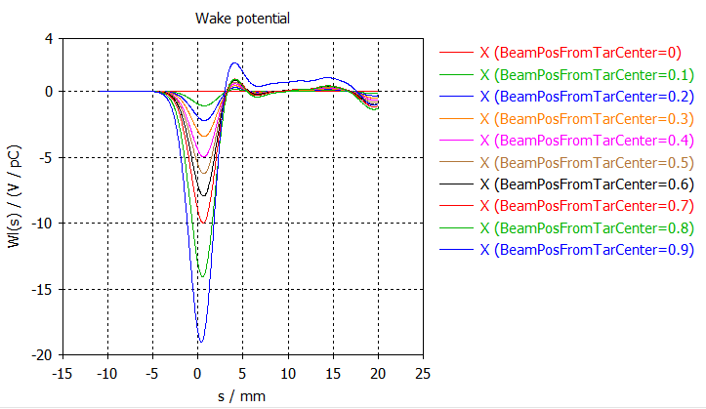

Simulation analysis
Wake potential in the target hole.
In order to reveal beam jitter problem, simulation analysis is also performing.
Though target hole size is small (φ2 mm), higher order wake field affect beam.
Color variation shows difference of beam position from the center of target hole.
This simulation is performed by CST studio.
Longitudinal wake has little position dependence. While, transverse wake increase nonlinearly.
K. Oide, K. Yokoya, and A. Novokhatski help to analyze beam jitter problem induced by wake field.
Longitudinal wake potential
Transverse wake potential
X = Beam position from the center of target hole.
Notes:
結論は出ていないが、計算は行っており、面白い結果が出ている

Slide 20
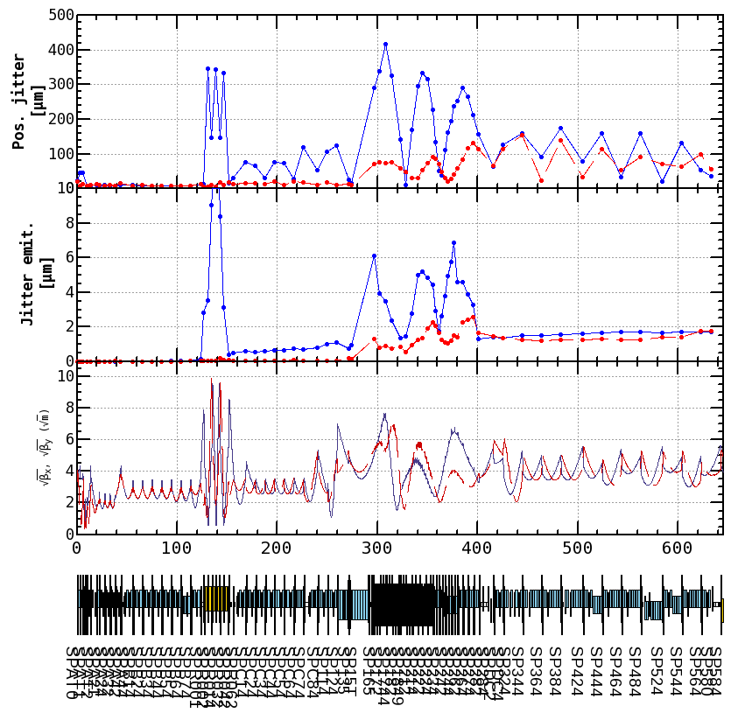
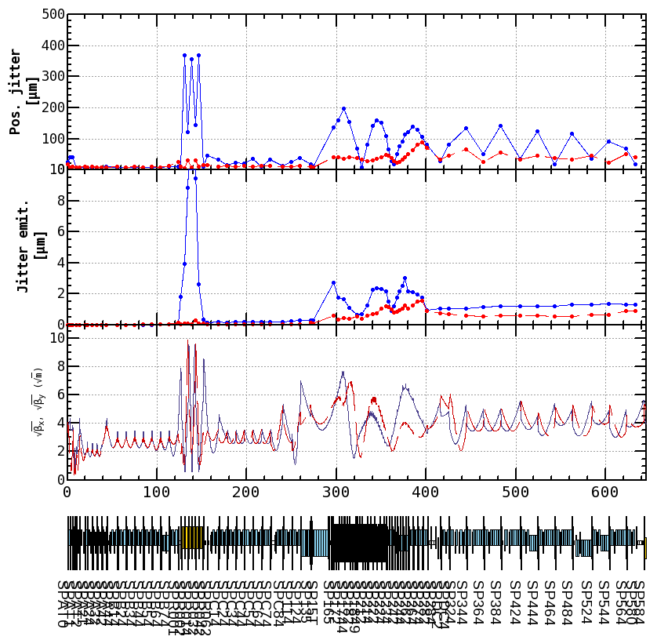
Dispersion leak (thermionic gun)
By dispersion leak suppression, jitter emittance is reduced.
1nC
 | Phase 3 requirement to effective emit.
εx | 40 μm
εy | 20 μm
Suppress dispersion leak.
 | Before | After
εx | 1.8 μm | 1.3 μm
εy | 1.8 μm | 0.9 μm

Slide 21
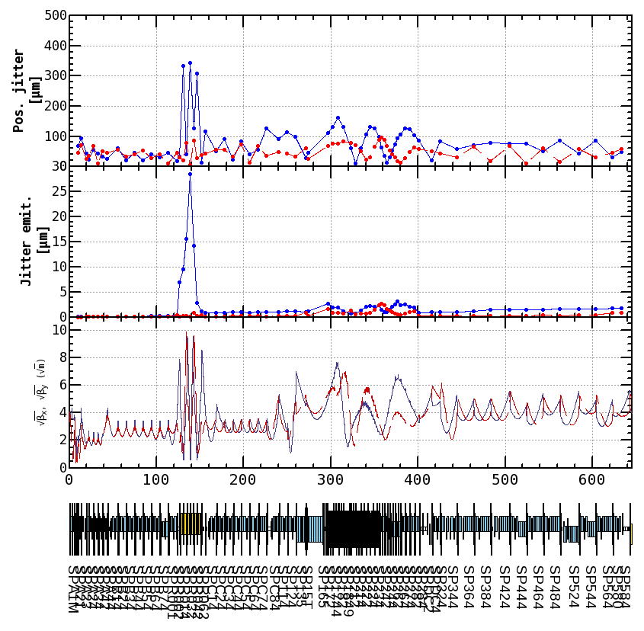
Dispersion leak (RF gun)
Jitter emittance is reduced to same level as thermionic gun.
1nC
 | Phase 3 requirement to effective emit.
εx | 40 μm
εy | 20 μm
Suppress dispersion leak.
 | Before | After
εx | 27.7 μm | 1.8 μm
εy | 7.1 μm | 0.9 μm

Slide 22
Conclusion
Jitter emittance enhanced by the target hole.
By dispersion leak suppression, jitter emittance is reduced.
In phase 2, beam jitter is not problem. Under 1 nC beam operation, the jitter emittance is small even for phase 3.
In phase 3, SuperKEKB requirement of beam charge is 4 nC. We have to check whether jitter emittance under the 4 nC beam is small or not with respect to phase 3 target emittance.

Slide 23
Thank you for your attention.

Slide 24
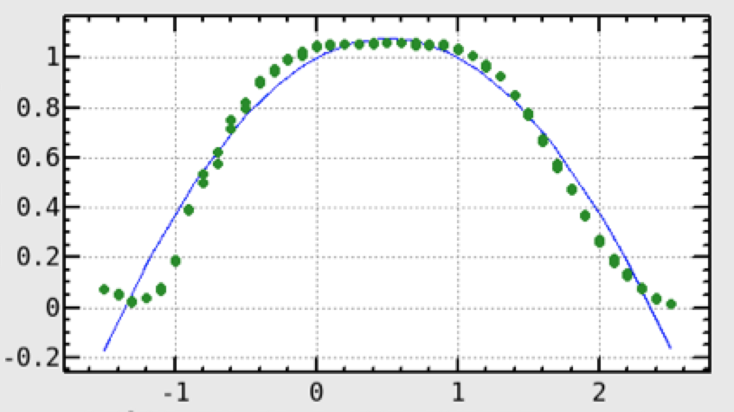
During the data acquisition, only lossless beams are considered. Charge dependence is small.
Current of steering magnet.

Slide 25
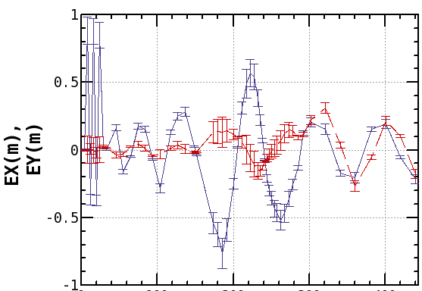
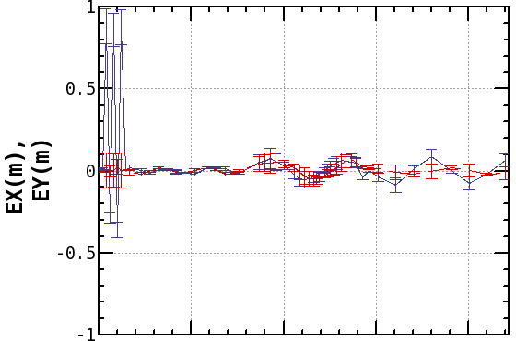
Dispersion leak (thermionic gun)
Suppress dispersion leak.
 | Before | After
εx | 1.8 μm | 1.3 μm
εy | 1.8 μm | 0.9 μm

Slide 26
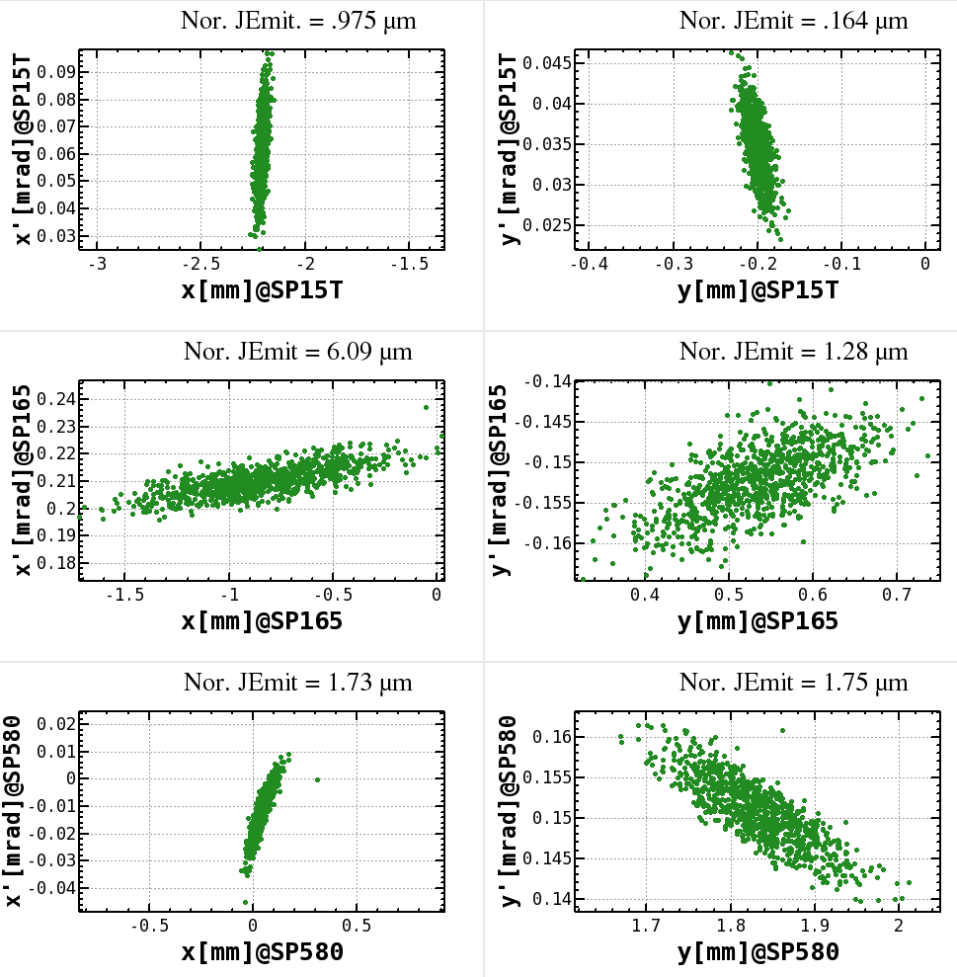
Thermionic gun 1nC
※phase space plot is not scaled by gamma factor.
If all of the linac quadrupole magnet readout is used for simulation, beta functions diverge. This is because initial beta function do not match real one.
In jitter emittance calculation, magnetic readout is used.

