Slide 1
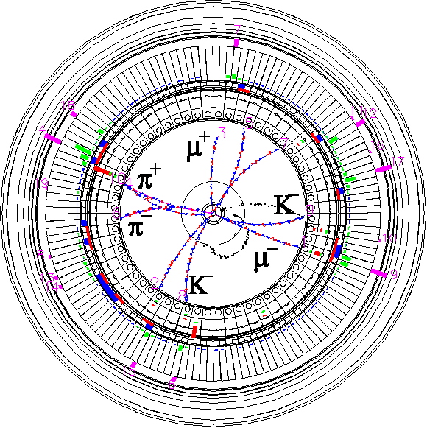
DR Vacuum
The 22nd KEKB Accelerator Review Committee
March 14, 2018
Kyo Shibata
(on behalf of KEKB Vacuum Group)
Inter-University Research Institute Corporation High Energy Accelerator Research Organization (KEK)
大学共同利用機関法人 高エネルギー加速器研究機構 (KEK)

Slide 2
Contents
Overview
Construction
& NEG activation
Dynamic pressure
& Vacuum Scrubbing
Concerns
Summary
“Updates of MR Vacuum system” will be presented by Suetsugu-san (3/14)
“IR assembly” will be presented by Kanazawa-san (3/15)

Slide 3
Overview
Vacuum system is divided into 7 sections by GVs.
East arc sect. : SR monitor, FB monitor & kicker, DCCT, RGA
West arc sect. : Inj. kicker, Ext. kicker
South straight sect. : Ext. septum, Beam stopper for safety system
North straight sect. : Inj. septum
RF sect. : RF cavities
LTR
RTL
Beam energy | 1.1 | GeV
Bunch number | 4
Circumference | 135.5 | m
Maximum stored beam current | 70.8 | mA
Maximum bunch charge | 8 | nC
Bunch length | 6.53 | mm
Bending radius | 2632/2967 | mm
Critical energy | 0.93/0.82 | keV
Total SR power | 7.2 | kW
Large-emittance beam from Linac
Target pressure : < 1×10⁻⁵ Pa
Required beam lifetime due to residual gas scattering : > 1000 sec.
Vacuum pumps : NEG & ion pumps
Low-emittance beam
To SuperKEKB LER via Linac & BT

Slide 4
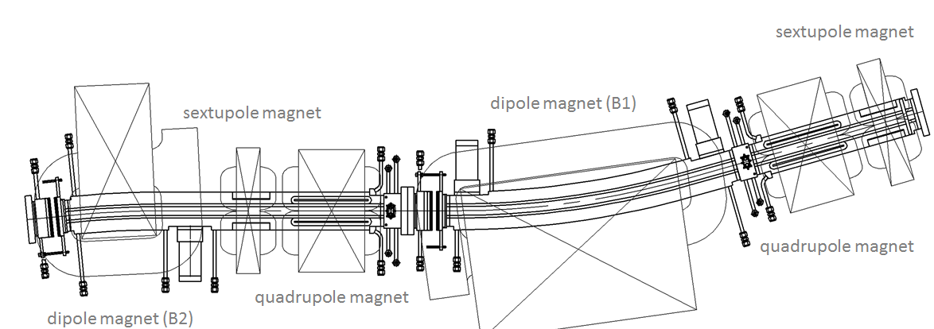
Overview (Arc sect.)
Beam pipes for arc sections (Al alloy)
Two types of beam pipes corresponding to B1&B2 magnets
Each beam pipe covers one dipole, one quadrupole and one sextupole magnet.
Designed to fit narrow spaces between the closely-located magnets
Having BPM blocks, pumping ports, RF-shielded bellows, CF flange with RF contact
Having antechambers on both sides of a beam channel to deal with SR which irradiates both side of the beam pipes and reduce beam impedance.
TiN coating & grooved surfacing are adopted as countermeasures against ECE.
Having water cooling channels on both sides of beam pipes
Total SR power with design beam current (70.8 mA) : 7.2 kW
SR
SR
SR
Layout of the beam ducts in one cell of the reverse-bend FODO lattice.

Slide 5
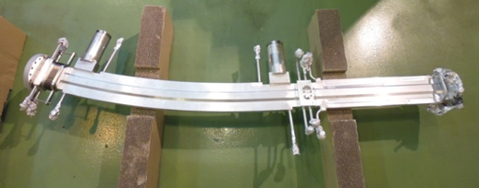
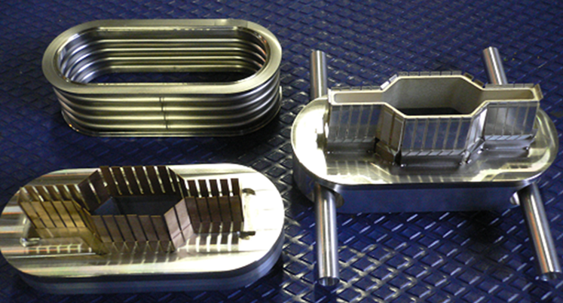
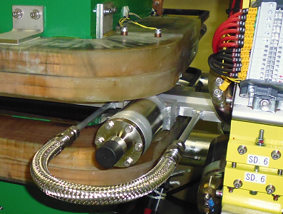
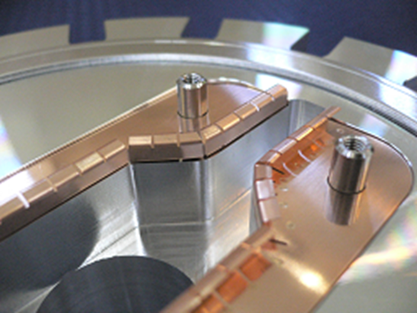
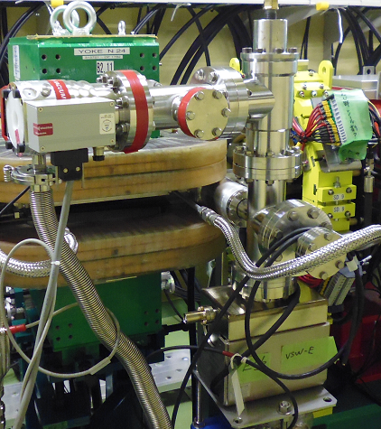
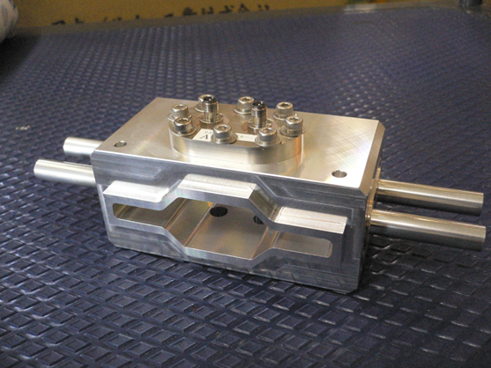
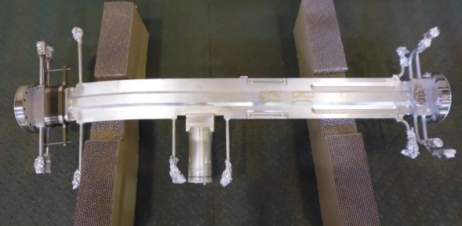
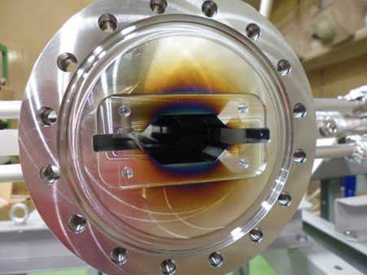
Overview (Arc sect.)
Aluminum beam pipes for arc sections :
Type I
RF shielded bellows
Space-saving connection flange
∼1.5 m
NEG
Pumping port
TMP
RF contact on Conflat flange
IP
Type II
Groove structure
∼1.2 m
BPM block
Cross-section
TiN coating

Slide 6
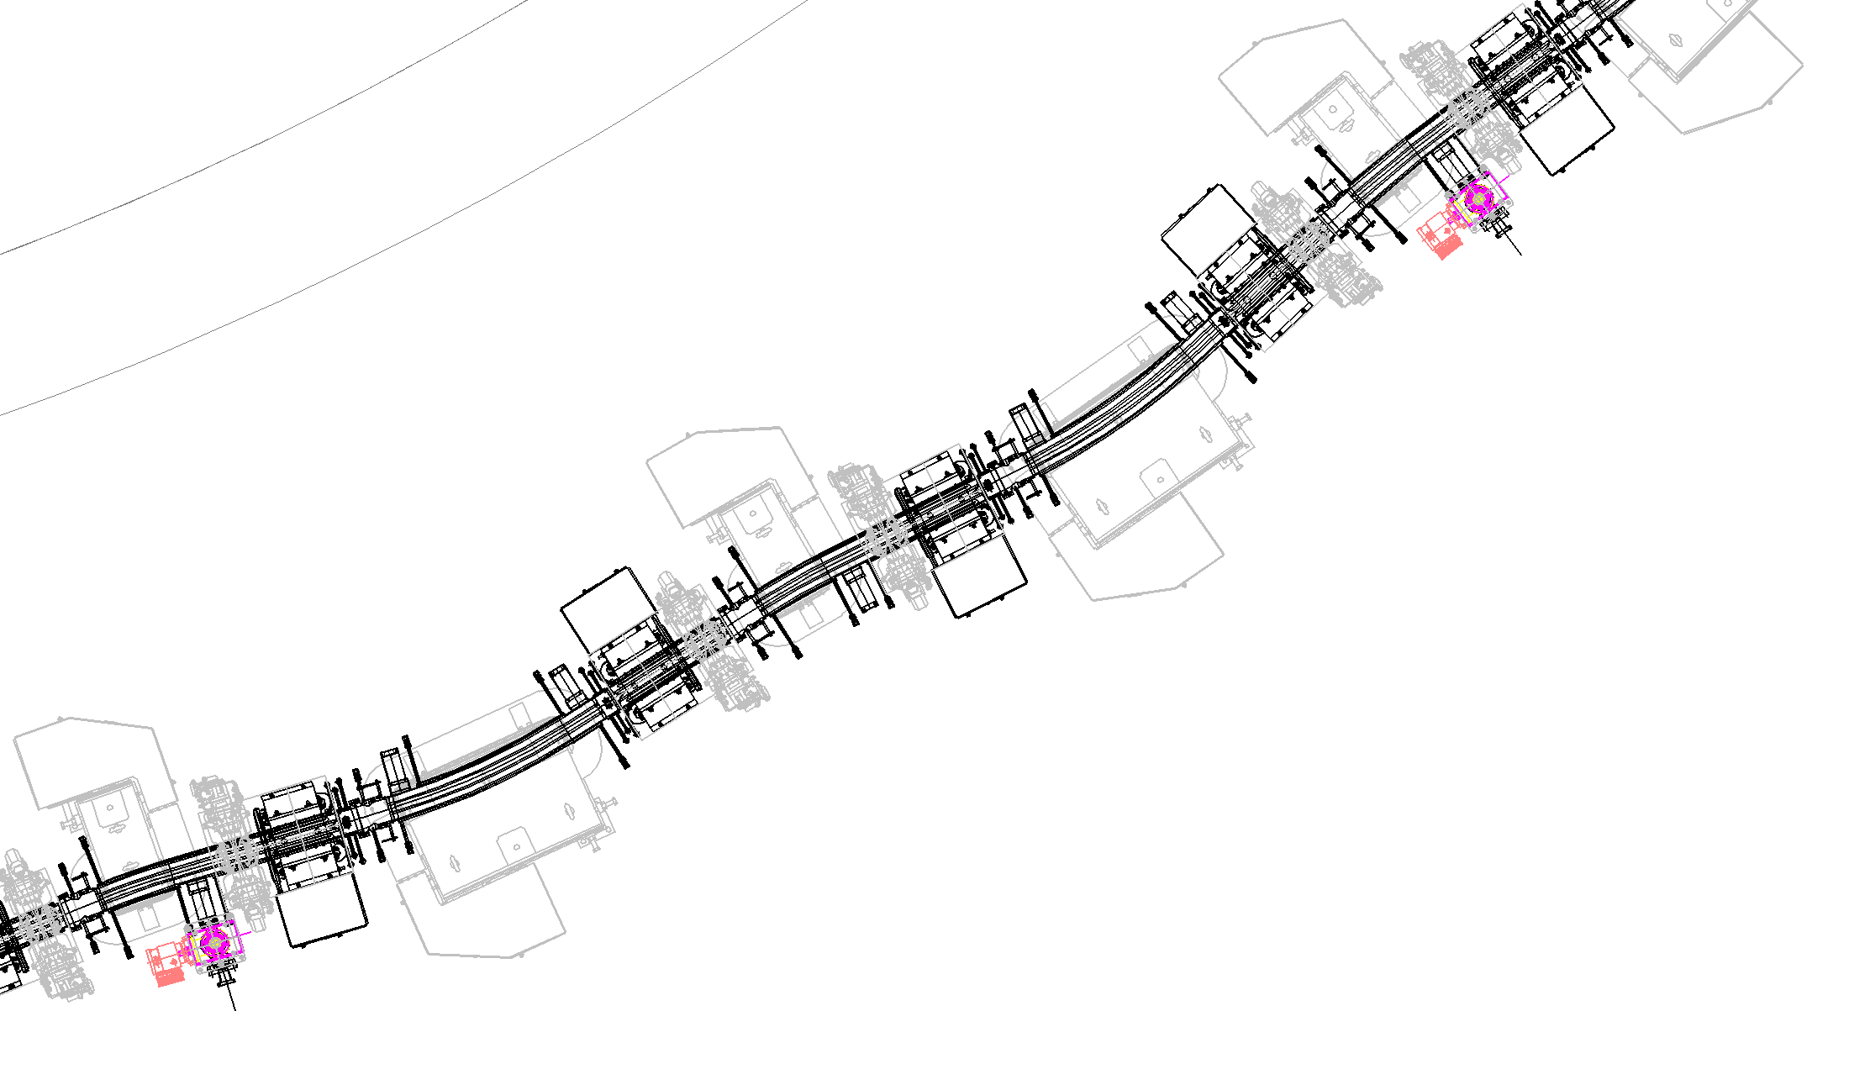
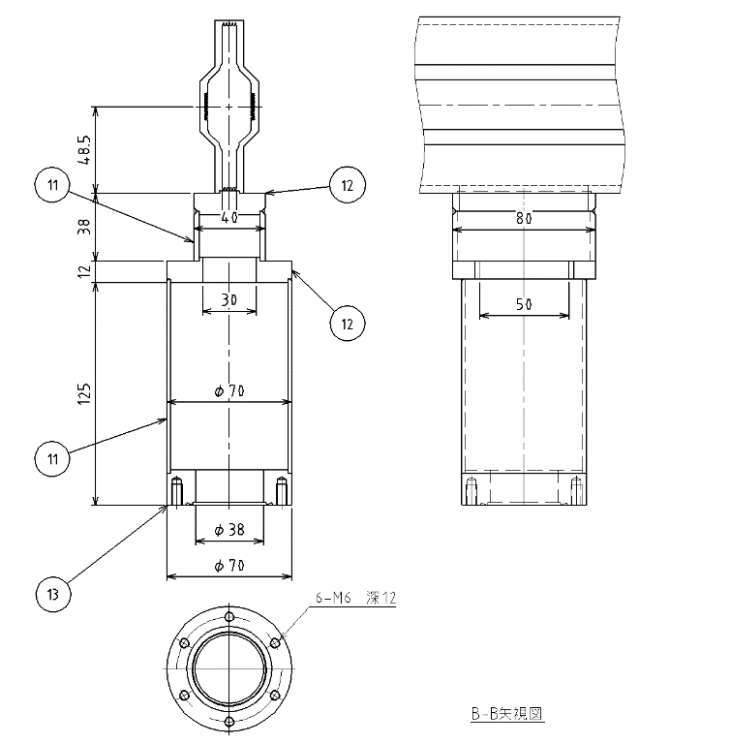
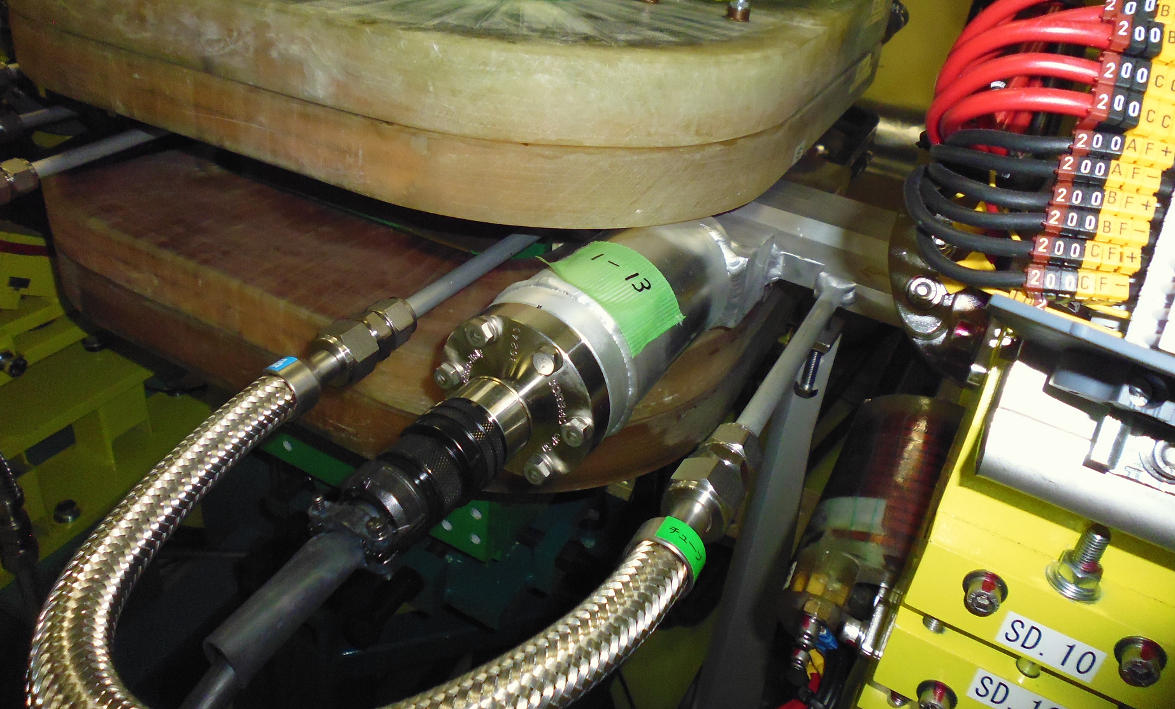
Overview (Arc sect.)
Pump location :
Two NEG pumps are installed in Type-I.
One NEG pump or ion pump is installed in Type-II alternately.
Distance between pumping ports : ∼0.7 m
S_{eff_NEG} : ∼0.01 m³/s (10 L/s) for CO
S_{eff_IP} : ∼0.008 m³/s (8 L/s) for CO
Type-I (∼1.5 m)
Ion pump, rough pump
NEG
NEG
Type-II (∼1.2 m)
Type-I (∼1.5 m)
Pumping port (NEG & IP)
NEG
NEG
NEG
Type-II (∼1.2 m)
Ion pump, rough pump
Type-II (∼1.2 m)

Slide 7
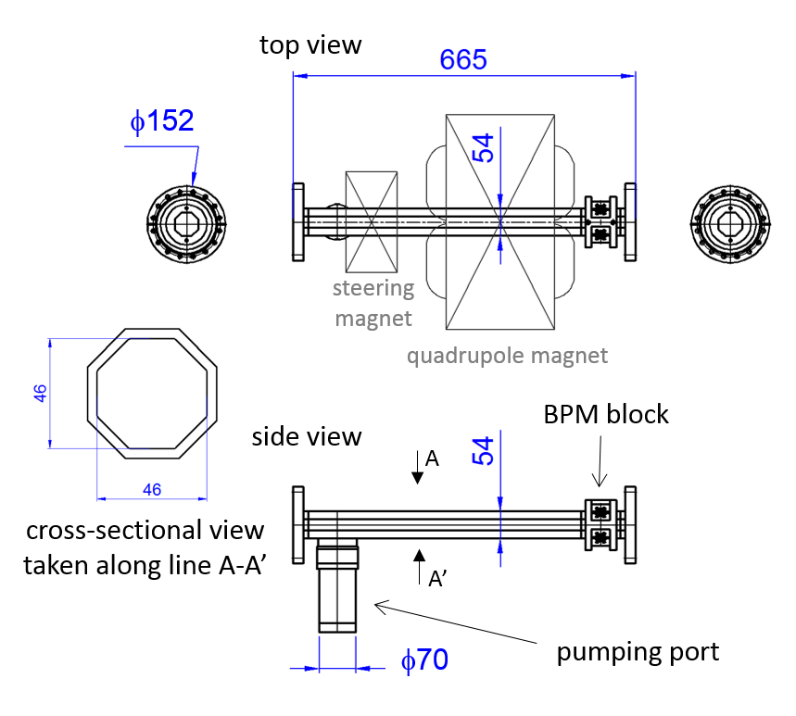
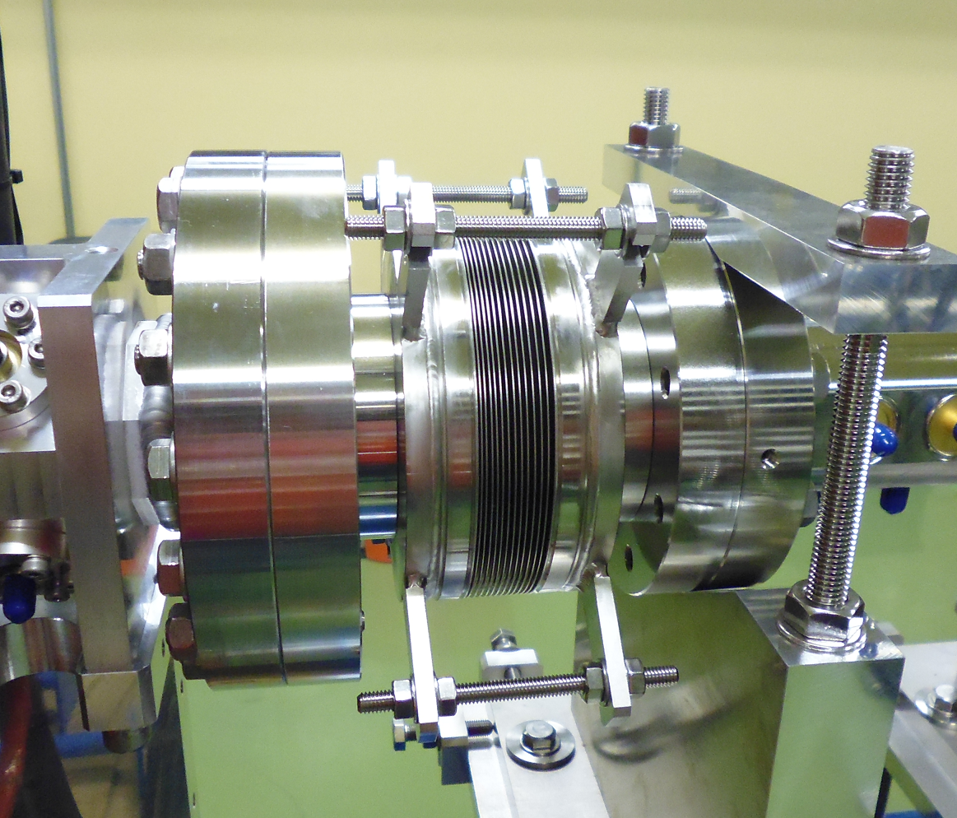
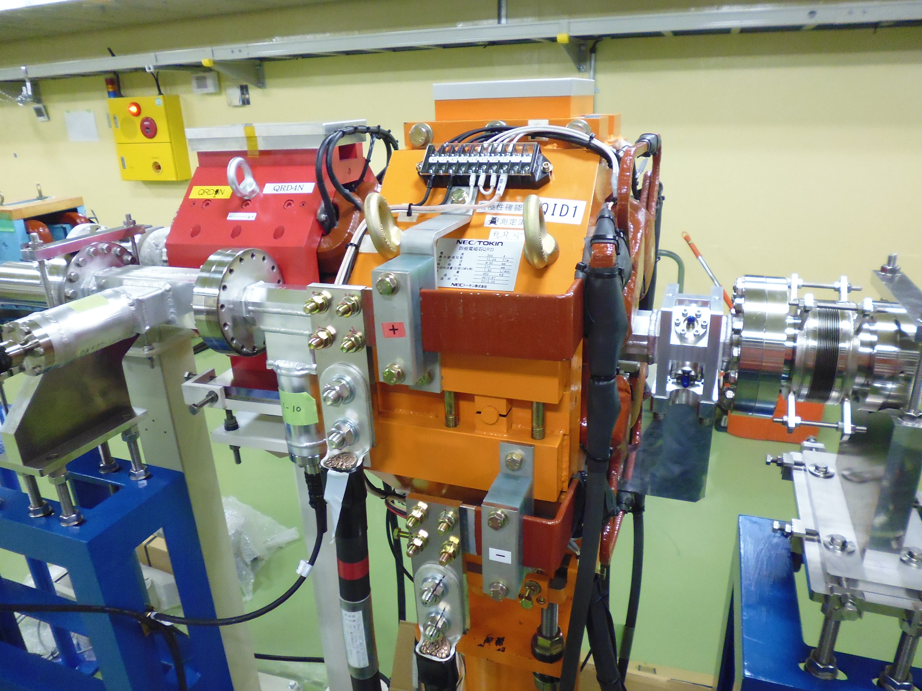
Overview (straight sect.)
Beam pipes for straight section. (Al alloy)
Much simpler than beam pipes in the arc sections.
No antechamber
No groove surfacing
No water cooling channel
Isolated bellows chambers instead of bellows part welded to the beam pipe
Having different cross-sections to fit special components installed in the straight sections.
Cross-sections of beam pipes change as smoothly as possible.
Example of beam pipe for the straight section
Cross-sections of vacuum components in the straight sections.
Isolated bellows chamber
RF section | Circular | φ150 mm
Feedback kicker | Octagonal | 62.8 mm (face-to-face)
Feedback monitor | Octagonal | 46 mm (face-to-face)
Inj. and Ext. kicker | Rectangular | 42 mm × 37 mm
Inj. and Ext. septum | Circular | φ41.2 mm
Adjacent area of the east arc section, etc. | Octagonal | 46 mm (face-to-face)

Slide 8
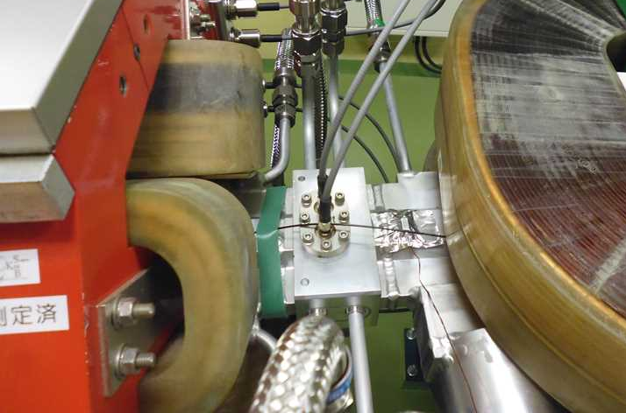
Overview (Control system)
Pressures are monitored by ion pumps.
Number of IPs :
East sect.; 11, West sect.; 11, North sect.; 4 + 4(septum), South sect.; 3
Installation interval of IP : ∼ 6 m
When the pressures exceed 1×10⁻⁴ Pa at several points at the same time in one section, the section is isolated by gate valves and beam injection is inhibited.
One CCG is also installed in each section. (4 CCGs in DR, 1 CCG in LTR, 1 CCG in RTL)
One RGA is installed in East arc section.
Temperatures of beam pipes are monitored.
Number of monitoring points :
East sect.; 13, West sect.; 12, North sect.; 4, South sect.; 1
When the temperature exceeds 80°C, an alarm is raised.
Temperature rise due to beam operation has not been observed so far.
Flow rates of cooling water are continuously monitored.
Water flows rate of every blanch is monitored by water flow switch. (10 blanches)
When the flow rate falls below the threshold value, an alarm is raised.
Since two flow switches occasionally malfunctioned due to the magnetic field from the magnet, they were wrapped in high permeability magnetic shield (Permalloy).
Thermometer
Flow switch wrapped in Permalloy

Slide 9
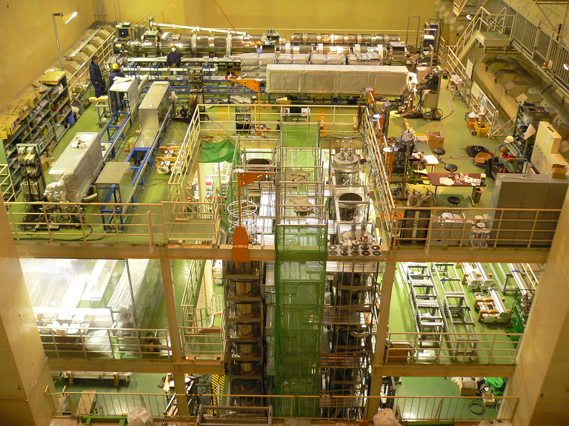
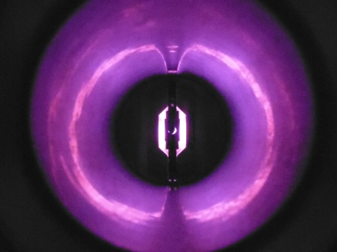
Construction 1
Pre-installation works :
Almost all beam pipes (105) were coated with TiN film (^{t}200 nm) and baked (150°C, 24 h) at the coating & baking facility in KEK.
Not including ceramics pipes for Inj. & Ext. kickers, Ext. septum, special beam pipes for RF sections, FB monitor & kicker, DCCT, Inj. & Ext. septums.
NEG pumps were activated during the baking.
Not baked in-situ after installation.
Coating & baking facility in KEK
TiN coated beam pipe for arc sections
Magnetron discharge sputtering

Slide 10
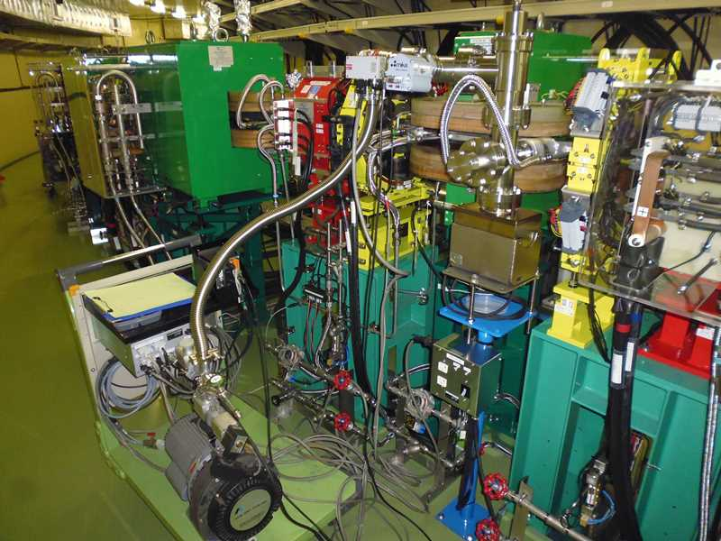
Construction 2
Installation works :
The installation of the beam pipes commenced in May 2016 and finished in January 2018.
Evacuation from atmospheric pressure :
Each section was evacuated by rough pumps (TMP + scroll pump) & ion pumps before and during NEG activation.
When the pressure decreased to ∼10⁻⁴ Pa, ion pumps were operated.
When the pressure decreased to ∼10⁻⁵ Pa, NEG activation was started.
It takes about several days before NEG activation.
After NEG activation, rough pumps were isolated by angle valves and removed.
Inserting beam pipe into B magnet
Connecting beam pipes
L type valve
TMP
IP
Scroll pump

Slide 11
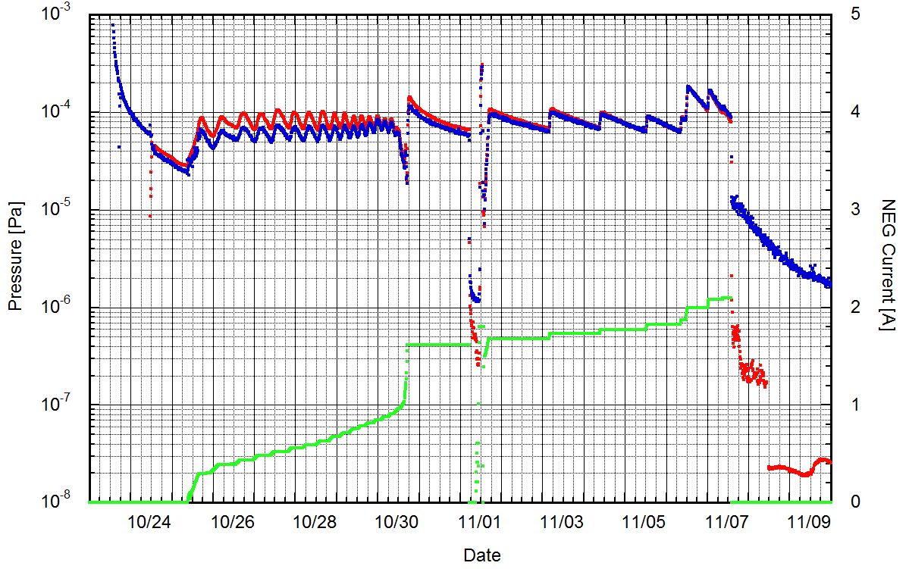
NEG activation
Heating power for NEG activation was controlled so that the pressure did not exceed 1×10⁻⁴ Pa.
The pressure was monitored by ion pumps and vacuum gauges at manifold between TMP and IP port.
Since the conductance of beam pipe and the conductance between pumping port and beam duct are small, the pressure in NEG port during activation is higher than measured value.
It takes about 3 weeks from the start of evacuation to the end of NEG activation.
Pressure during NEG activation (East arc section)
Vacuum gauge
Angle valve
Start of rough pumping
Angle valves closed
Pressure (vacuum gauge)
TMP
Pressure (IP)
Current for NEG activation
IP on
NEG activation (13 days)
IP

Slide 12
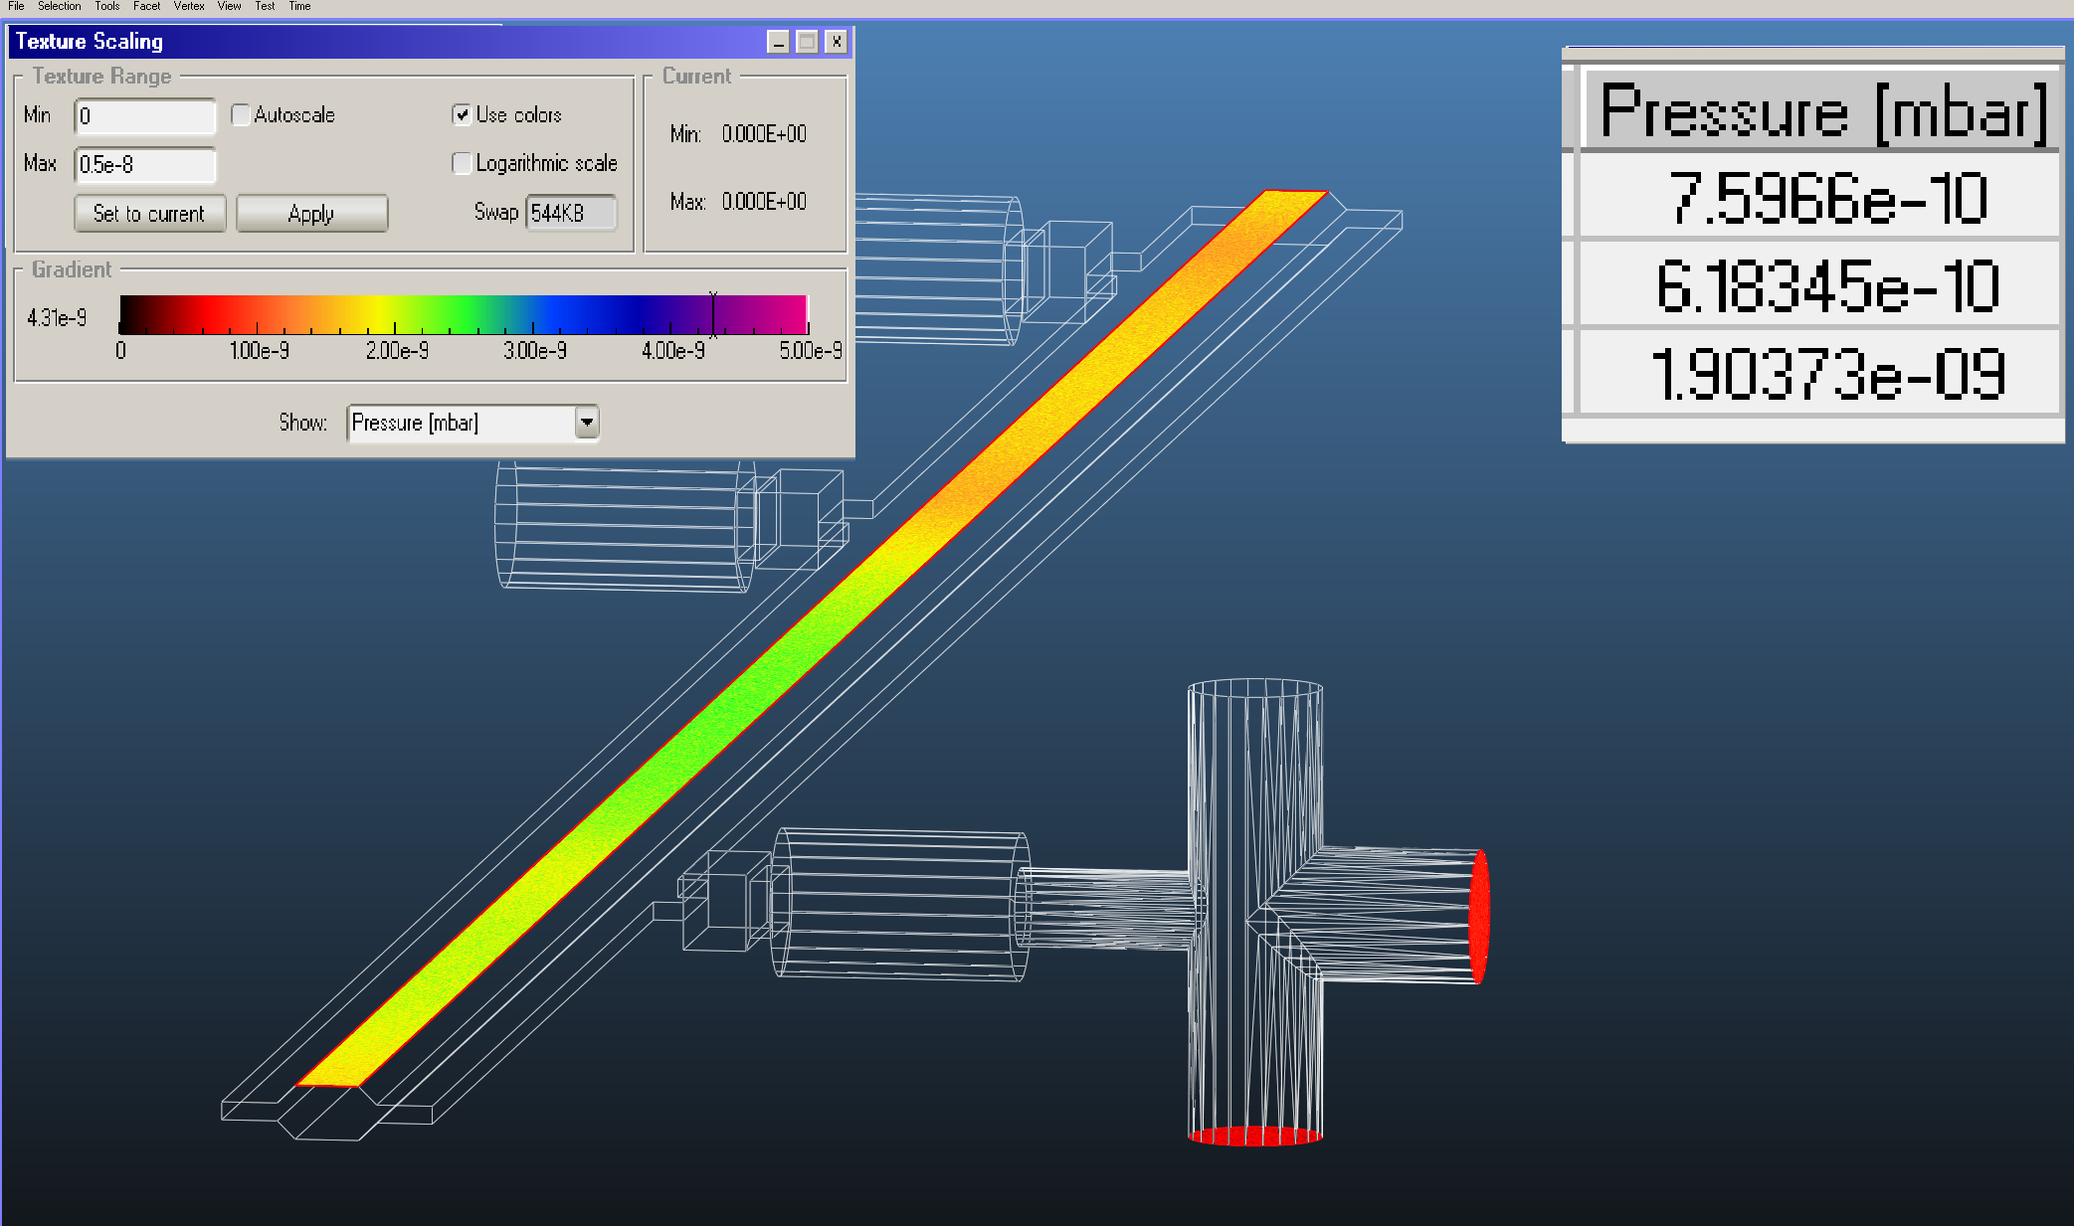
Pressure estimation
Pressure in the beam pipes was estimated by Molflow+ (Monte-Carlo Simulator developed at CERN)
Model : 1 Type-I beam pipe + 1 Type-II beam pipe
Pumps : 2 NEG pumps (0.05 m³/s) in Type-I, 1 ion pump (0.04 m³/s) in Type-II.
Mass : 28, Temp. : 20 °C, Thermal gas desorption rate : 1×10⁻⁹ Pam³/s/m² = 1×10⁻¹¹ mbarL/s/cm²
PSD rate : η=0 molec./photon (No stored beam)
CCG port
IP port
Average in beam channel
Result is similar to the measured pressure before beam operation.
CCG port
IP port

Slide 13
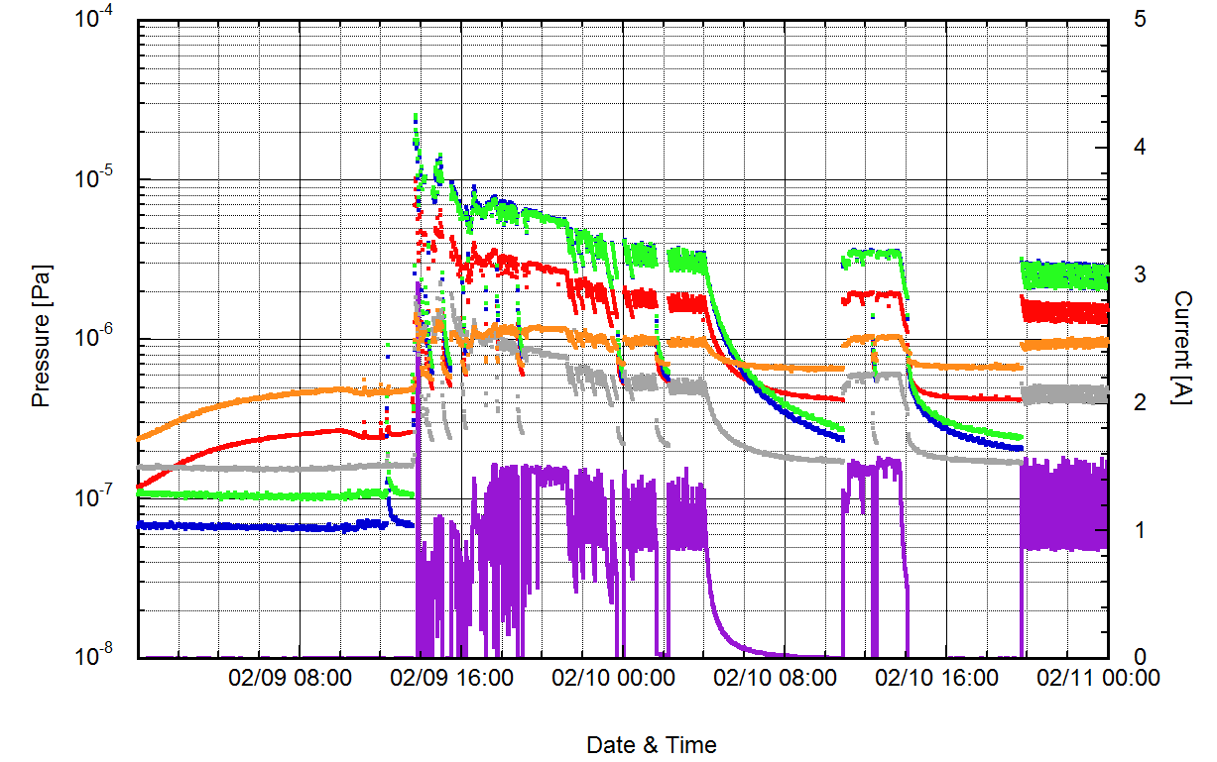
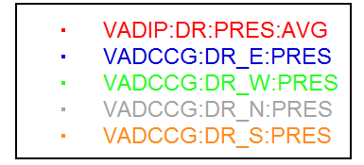
Dynamic pressure 1
Beam operation started on Feb. 8th.
Storage of beam started on Feb. 9th.
The pressure exceeded 1×10⁻⁵ Pa, when the beam was accumulated for the first time.
1 bunch, 1 Hz, 1.5 mA
Current [mA]
First storage day!!

Slide 14
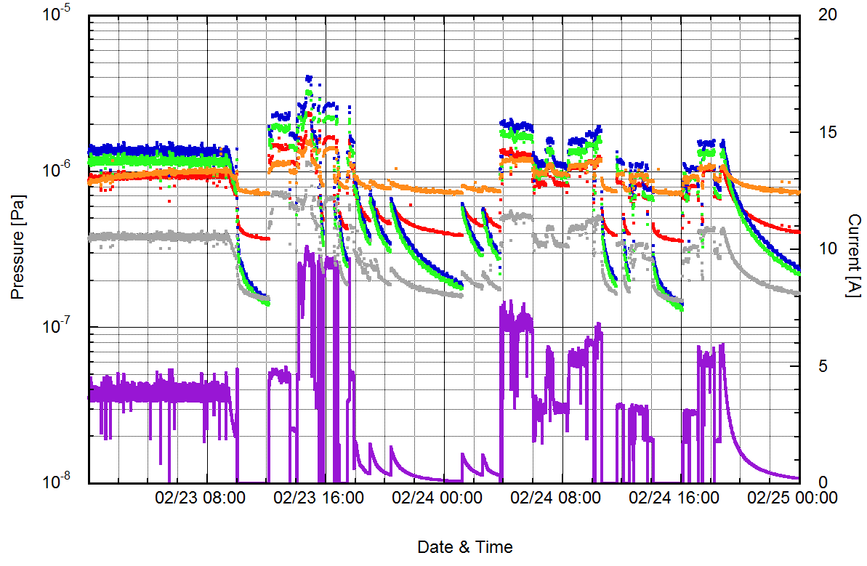
Dynamic pressure 2
Beam current gradually increased and pressure gradually decreased.
Maximum storage current reached 10 mA (4 bunch, 25 Hz) on Feb. 23rd.
Current [mA]

Slide 15
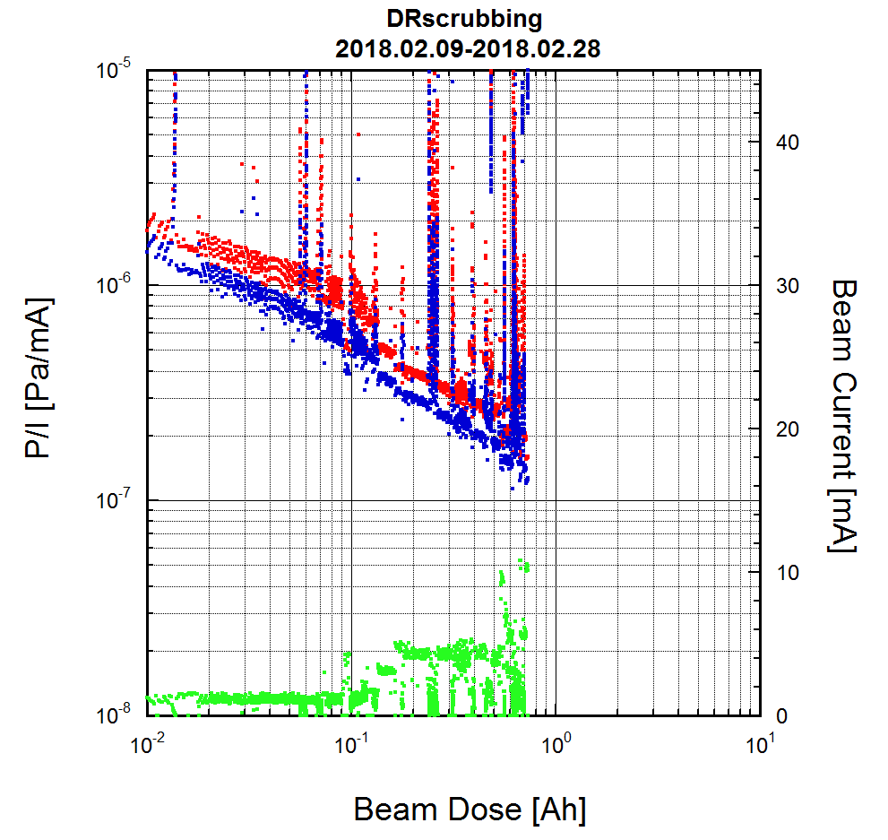
Vacuum scrubbing
Vacuum scrubbing has been progressing smoothly so far.
West arc
East arc
Beam current
Beam dose : 1 Ah =
Photon dose 5.2×10²² photon/m

Slide 16
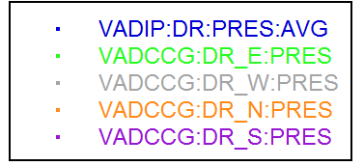
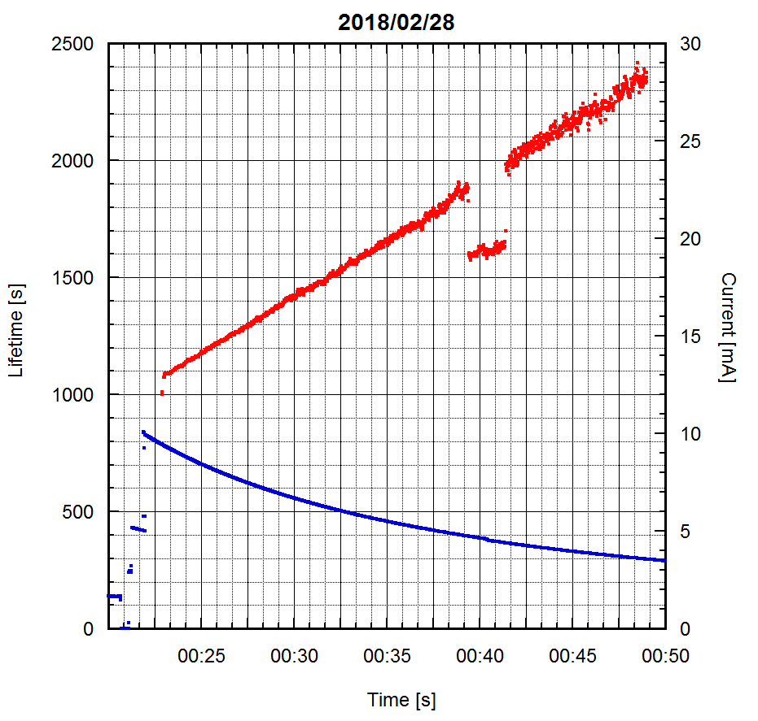
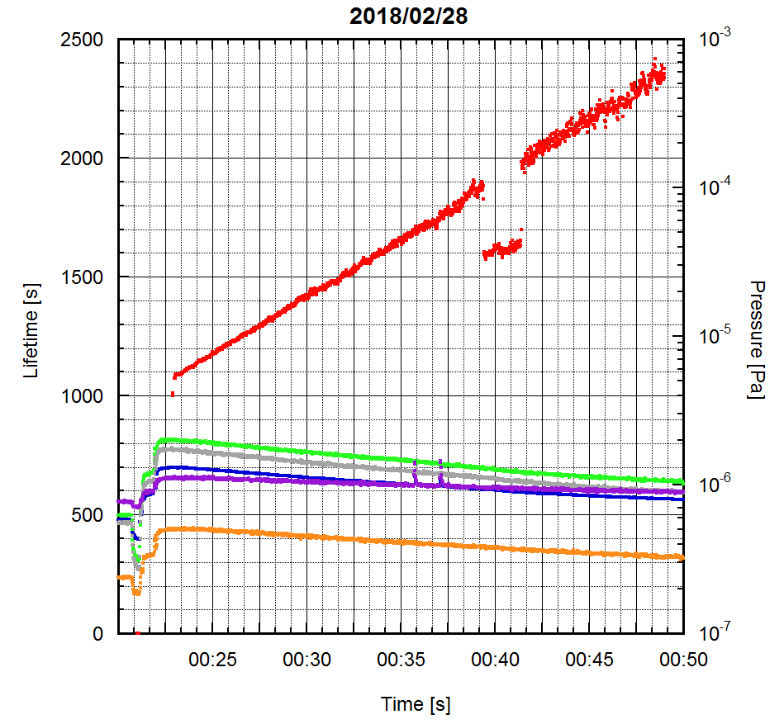
Beam lifetime
Beam lifetime was larger than 1000 s when beam current was 10 mA.
Operation mode : 4 bunch, storage mode
Beam dose : 0.7 Ah (Photon dose : 3.6×10²² photon/m)
Lifetime
Lifetime
Pressure
current
Time [hh:mm]
Time [hh:mm]

Slide 17
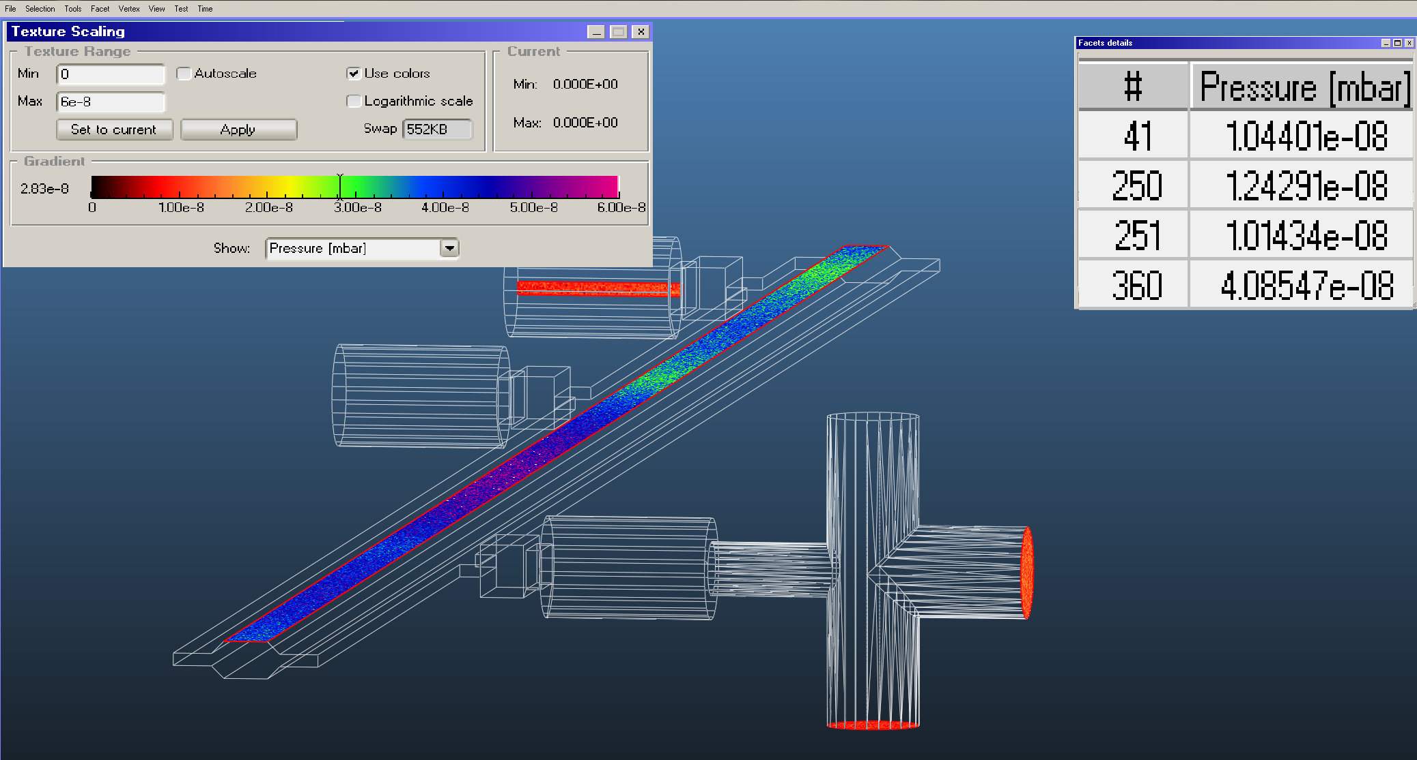
PSD rate estimation
Pressure in the beam pipes was estimated by Molflow+ (Monte-Carlo Simulator developed at CERN) to estimate PSD rate.
Pumps : 2 NEG pumps (0.05 m³/s) in Type-I, 1 ion pump (0.04 m³/s) in Type-II.
Mass : 28, Temp. : 20 °C, Thermal gas desorption rate : 1×10⁻⁹ Pam³/s/m² = 1×10⁻¹¹ mbarL/s/cm²
PSD : η=1×10⁻⁴ molec./photon, stored beam current = 8.85 mA
SR irradiates both sides of antechambers evenly.
NEG port
CCG port
IP port
Average in beam channel
The calculated pressure is close to the measured pressure.
(P_{measured_CCG} : 1∼2×10⁻⁸ mbar)
η ≈ 1×10⁻⁴ molec./photon (beam dose : 0.7 Ah, photon dose : 3.6×10²² photon/m)
Almost as expected!!
η ≈ 1×10⁻⁵ molec./photon is required to obtain enough lifetime (1000 s) with design beam current (70.8 mA).

Slide 18
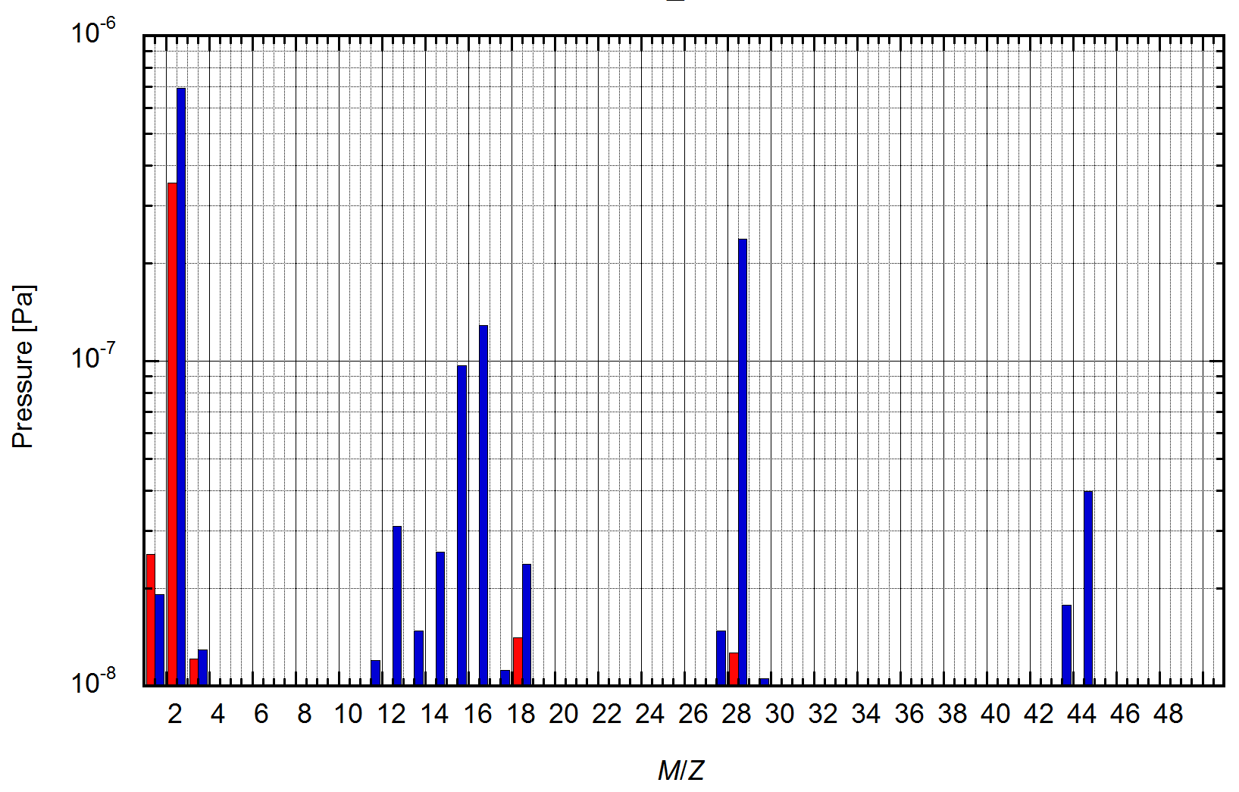
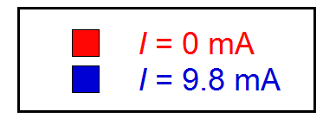
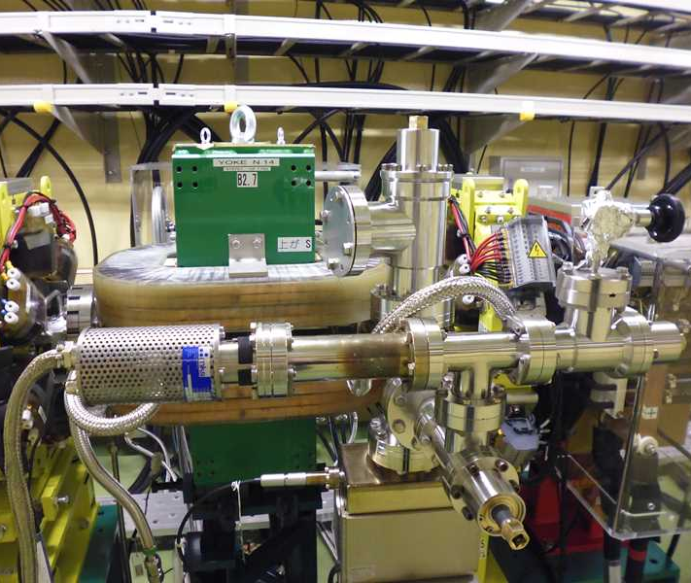
Residual gas components
RGA data of the dynamic pressure was taken at the east arc section.
Main gas components at beam dose = 0.7 Ah
H₂ (beam current = 0 mA, P_{IP} = 4.3×10⁻⁷)
H₂, CO, CH₄, CO₂ (beam current = 9.8 mA , P_{IP} = 1.4×10⁻⁶)
They are typical residual gas components in beam pipes irradiated by SR and evacuated by NEG.
H₂
CH₄
CO
CO₂
H₂O
RGA
IP

Slide 19
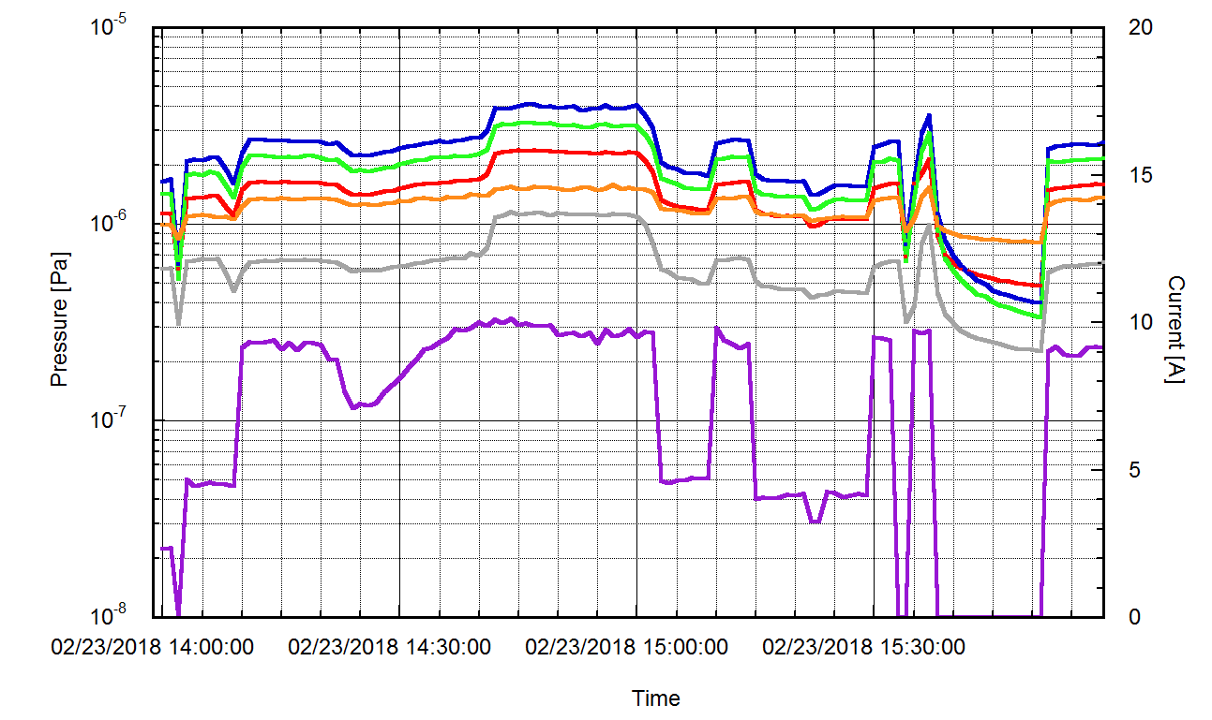
Concerns 1
Pressure rise during beam operation at a repetition rate of 25 Hz.
Pressure at a repetition rate of 25 Hz is larger than that of 1 Hz.
Vacuum scrubbing was performed by storage mode or at a repetition rate of 1 Hz, and time of beam operation at a repetition rate of 25 Hz is very short.
It may be caused by the increase in the time stored with large-size beam.
It seems there are places where only large-size beam can scrub.
It is expected that the vacuum scrubbing of such places will progress during Phase-II operation.
1 Hz
25 Hz
1 Hz

Slide 20
Concerns 2
Saturation of NEG pump
Re-activation (conditioning) of NEG pumps is required when pumping speed of NEG pump becomes small.
It takes several days to re-activate NEG pumps.
DR can not be operated during re-activation of NEG pumps.
There is no indication that the pumping speed of NEG decreases up to now.
Re-activation will be performed during long shutdown. (this summer?)
Electron cloud issue
Antechamber, TiN coating and Grooved surfacing are adopted as countermeasures against ECE.
It is expected that electron cloud density integrated over the ring is 0.13×10¹⁴ m⁻² by using TiN coating and antechamber (not including grooved surface) when stored beam current is 70.8 mA.
Assumption : δ_{max} of TiN coating = 1, photons irradiating beam channel/whole photon = 0.1
Threshold of electron cloud instability : 1.4×10¹⁴ m⁻²
Electron cloud instability will not occur in DR.
It is necessary to continuously observe whether the ECE occurs or not as the stored beam current increases.

Slide 21
Summary
Beam operation of DR started on Feb. 8th, and DR vacuum system have no problems so far.
Vacuum scrubbing has been progressing smoothly so far.
The pressure in the beam channel is estimated to be less than 1×10⁻⁵ Pa with a stored beam current of 10 mA at present. (beam dose = 0.7 Ah)
Currently, beam lifetime is larger than 1000 s when the stored beam current is 10 mA.
It seems that vacuum scrubbing by beam operation at a repetition rate of 25 Hz is insufficient.
∼10 times the beam dose is required to achieve enough lifetime (>1000 s) with design beam current (70.8 mA).
There is no indication of decrease in the NEG pumping speed.
Re-activation will not be required until this summer shutdown.
As countermeasures against ECE, antechamber, TiN coating and Grooved surface are adopted.
It is necessary to continuously observe whether the ECE occurs or not as the stored beam current increases.

Slide 22
Fin.
Thank you for your attention.

Slide 23
Back-up

Slide 24
Average pressure estimation
Rough estimation of average pressure in arc sections
Required averaged pressure is lower than 1×10⁻⁵ Pa to obtain enough beam lifetime.
Beam pipes have three pumping ports in one cell with a length of about 2 m. (d ≈ 0.7 m)
Two of them are for the NEG pumps and one is for ion pump.
Average effective pumping speed will be 0.01 m³s⁻¹ (just after activation) .
Photon stimulated desorption by SR is major dynamic gas load during beam operation.
After the sufficient scrubbing, η will drop to below less than 1×10⁻⁵ molec./photon.
1×10⁻⁵ Pa with a stored beam current of 70 mA is achievable goal with sufficient scrubbing.
Stored beam current : 70 mA

Slide 25
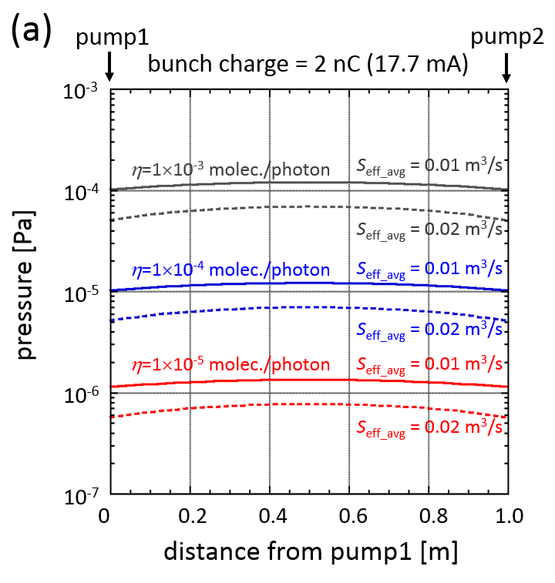
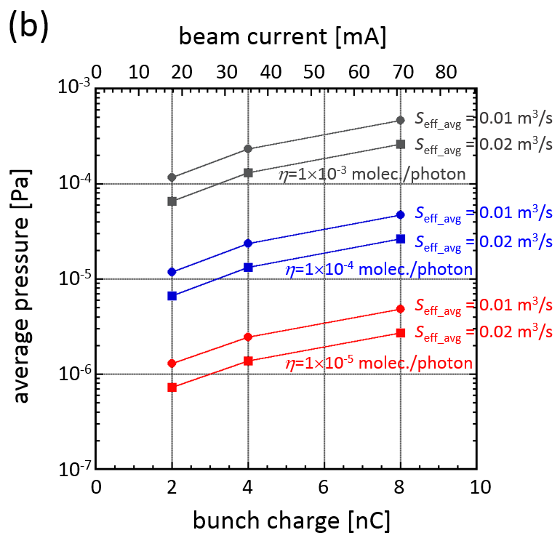
Average pressure estimation
Rough estimation of average pressure in arc sections
Required averaged pressure is lower than 1×10⁻⁵ Pa to obtain enough beam lifetime.
Beam pipes have three pumping ports in one cell with a length of about 2 m. (d ≈ 0.7 m)
Two of them are for the NEG pumps and one is for ion pump.
Average effective pumping speed will be 0.01 m³s⁻¹ (just after activation) .
Photon stimulated desorption by SR is major dynamic gas load during beam operation.
After the sufficient scrubbing, η will drop to below less than 1×10⁻⁵ molec./photon.
1×10⁻⁵ Pa with a stored beam current of 70 mA is achievable goal with sufficient scrubbing.

