Slide 1
Updates of SKEKB MR Vacuum System
Y. Suetsugu, KEK
on behalf of KEKB Vacuum Group
Contents
Two major topics: Countermeasures against;
Electron cloud effect in LER
Pressure bursts accompanying beam loss in LER
Other preparations for Phase-2 commissioning
Installation of new beam collimators
Replacement of beam pipes at LER injection region
Etc.
Summary

Slide 2
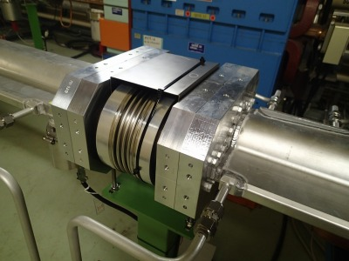
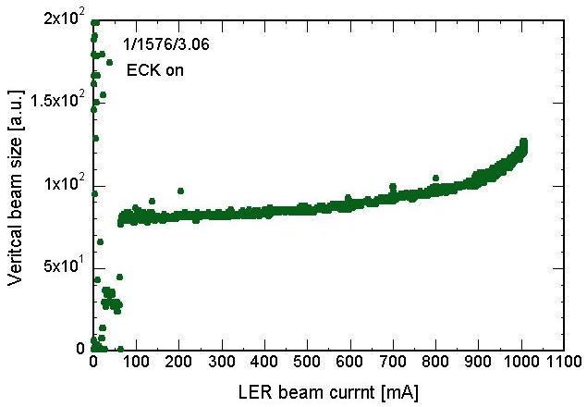
Electron cloud effect
Permanent magnet for bellows
Brief review:
The first ECE was observed at a beam current of ~600 mA (1/1576/3.06RF), which was caused by EC in the aluminum bellows chambers.
This ECE was cured by permanent magnets around the bellows chambers.
σ_{y} blowup
However, ECE was again observed at a beam current of ~900 mA (1/1576/3.06RF).
As a source of EC, the TiN-coated beam pipe with antechambers at drift spaces was suspected.
900 mA
Measured electron density is near to the threshold of the instability, ~3x10¹¹ e⁻ m⁻³
Permanent magnets around the beam pipes suppressed the non-linear pressure rise.
Any countermeasures were required before Phase-2.
The δ_{max} of TiN coating estimated from simulations was ~1.4, which is relatively higher than expected.
Further analysis was necessary on this point.

Slide 3
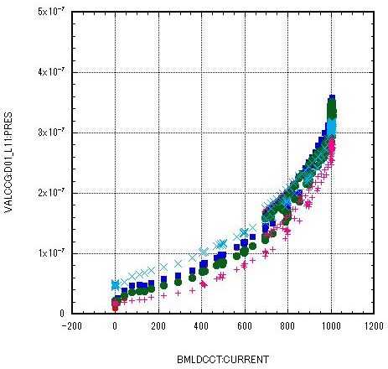
Electron cloud effect
Countermeasures
We checked the behaviors of pressure against the beam current all over the ring. (2016/6/27, 1/1576/3.06RF)
EC → Electron multipactoring → Non-linear behavior of pressure
Non-linear pressure rises were observed at
Al and Cu beam pipes with/without antechambers + TiN coating at Arc sections, IR (Interaction Region), Tsukuba straight section, Chicane sections, SRM (beam size monitor).
Al beam pipes reused from KEKB (without TiN coating) at Fuji straight section and injection section.
Not observed in wiggler section .
Example of pressure rise at an arc
900 mA
Pressure
Beam current
We decided to apply magnetic fields in the beam direction by using solenoids or permanent magnets to these beam pipes, which was planned from the design stage.

Slide 4
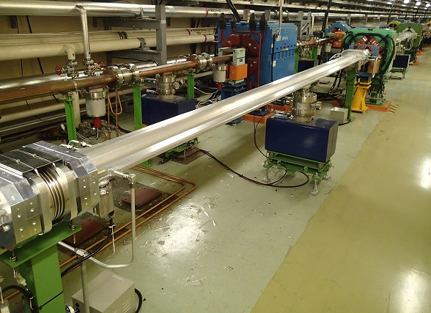
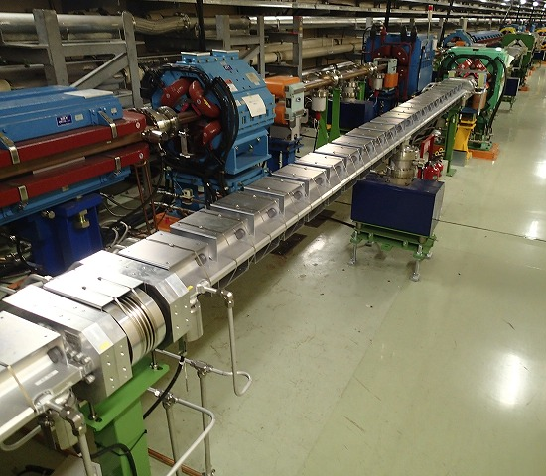
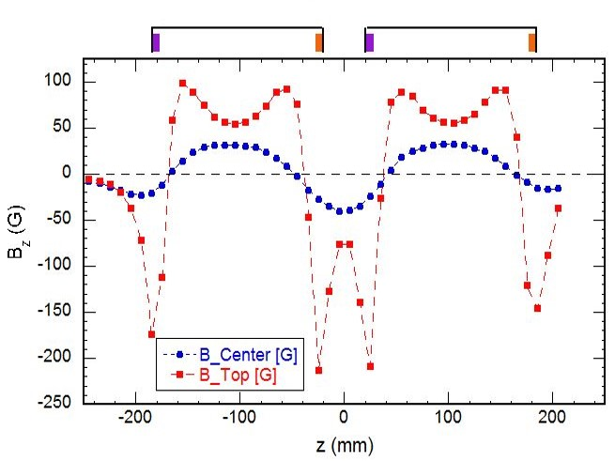
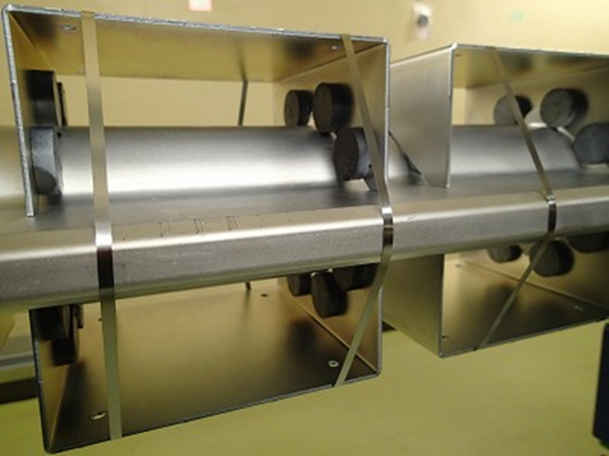
Electron cloud effect
Countermeasures
For drift spaces of Al or Cu pipes with antechambers + TiN coating
Type-1 unit: Permanent magnets with iron yokes; 8 ferrite magnets (φ30) + iron plate (L160 mm), aligned with 40 mm pitch.
This type was applied for the places more than 250 mm far from the ends of electromagnets (Q, SX, ST) to avoid the interference.
Application of Type-1 unit
Magnetic field of Type-1 unit
Typical strength ~ 60 G
Before
After
Permanent magnets
Type-1 unit
Iron yoke
(plate)

Slide 5
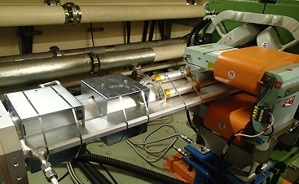
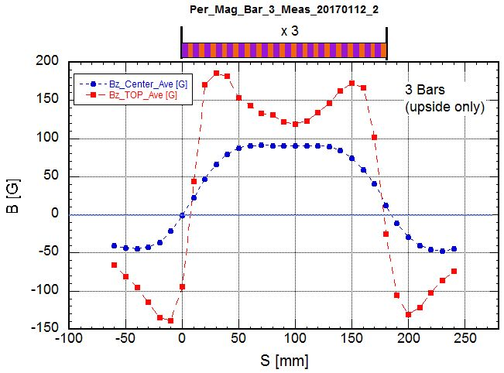
Electron cloud effect
Countermeasures
For drift spaces of Al or Cu pipes with antechambers + TiN coating
Type-2 unit: Permanent magnets in Al cylinders; 21 ferrite magnets (φ30) in each Al cylinder (L180 mm).
This type was applied for the places less than 250 mm from the ends of electromagnets (Q, SX, ST).
Type-1 and Type-2 units near Q magnet
Magnetic field of Type-2 unit
Typical strength ~ 100 G
Type-2
Type-1
Aluminum cylinder
Type-2 unit
Aluminum support

Slide 6
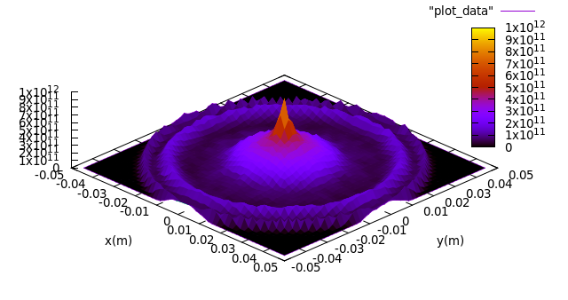
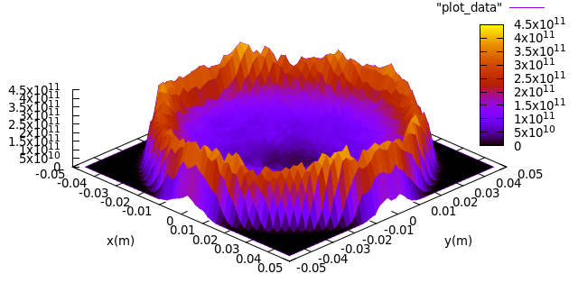
Electron cloud effect
Countermeasures
Expected electron density in the Type-1 unit was calculated (modeled by Fukuma-san) for the beam current of 3.6 A with 1/2500/2RF by CLOUDLAND.
δ_{max} = 1.0~1.4, photoelectrons = 0.07~0.01x0.1x0.16 p.e./m/e⁺/turn.
The central electron density is on the order of 10¹⁰ m⁻³ for the design current.
Magnetic free
1/2500/2RF, 3.6 A
4.5x10¹¹ m⁻³
(r<8 mm)
Type-1 unit
1/2500/2RF, 3.6 A
4x10¹⁰ m⁻³
(r<8 mm)
δ_{max}=1.2
δ_{max}=1.2
Note: the central electron density in Al bellows chamber with the permanent magnet is also estimated to be approximately 3.4x10¹⁰ m⁻³ for 3.6 A (δ_{max} = 2.0, photoelectrons = 0.01x0.1x0.16 p.e./m/e+/turn).

Slide 7
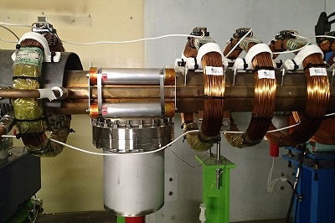
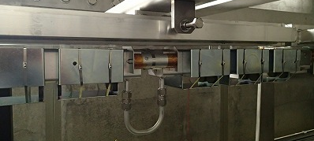
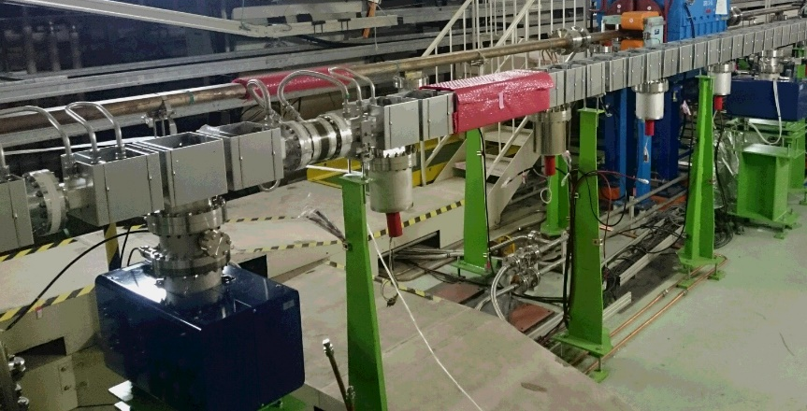
Electron cloud effect
Countermeasures
For Al pipes reused from KEKB (Fuji cross section)
Retrieve solenoids at KEKB era + Type-1 and 2 permanent magnets
Solenoid + Type-2 unit
Type-1 unit + Type-2 unit
Type-2
Solenoid
Type-2
Type-1
For new Al pipes with TiN coating for LER injection region
Type-1 and 2 permanent magnets
Type-1 unit
Type-2 unit
Type-1
Type-2

Slide 8
Electron cloud effect
Countermeasures
For places where ECE has not been observed, but will be important
Cu pipe at RF section without TiN coating: Retrieval of solenoids at KEKB era or Type-2 permanent magnets.
High β_{y} region at Tsukuba LC section: Adding more Type-2 units.
Type-2 units for RF section (Cu pipe)
Type-2 units for high β_{y} region
Type-2
Type-2
Type-2
Now, approximately 86 % of the drift space of the ring (~2000 m) was covered by the magnetic fields with a strength higher than 20 G.
Remained parts are around BPM, wiggler sections, ends of bending magnets. Permanent magnets will be prepared until Phase-3.

Slide 9
Electron cloud effect
Estimated high value of δ_{max}
Possible reasons of high δ_{max} ~1.4:
Aging is still insufficient.
No baking system, which usually shows high δ_{max}, etc.
Other than these reasons, another possibility was recently pointed out: More photoelectrons than expected in the beam channel.
The story is as follows:
The simulation starts from the premise that n_{e} = 3x10¹¹ m⁻³ (threshold of ECE at ~900 mA).
For n_{e} on these orders, n_{e} is not saturated. This means that the photoelectrons are important as well as the secondary electrons (δ_{max}). Actually, n_{e} is almost proportional to the number of photoelectrons in the beam channel.
If the number of photoelectron is different from that expected, the estimated value of δ_{max} should change.

Slide 10
Electron cloud effect
Estimated high value of δ_{max}
Possible reasons of high δ_{max} ~1.4:
Aging is still insufficient.
No baking system, which usually shows high δ_{max}, etc.
Other than these reasons, another possibility was recently pointed out: More photoelectrons than expected in the beam channel.
The story is as follows (cont’d):
So far, in the simulation using a circular pipe, the effectiveness of antechamber (α = photoelectrons in beam channel/whole photoelectrons) has been assumed to be 0.01, on the base of the experiment in KEKB LER.
However, recent simulation studies showed that α > 0.01 (0.03~0.1).
Calculation of photon distribution using Synrad-3D under the realistic SKEKB layout and conditions (Fukuma-san)
Calculation of photoelectrons going out from the antechamber part of actual beam pipe (Ohmi-san).
δ_{max} might be smaller….

Slide 11
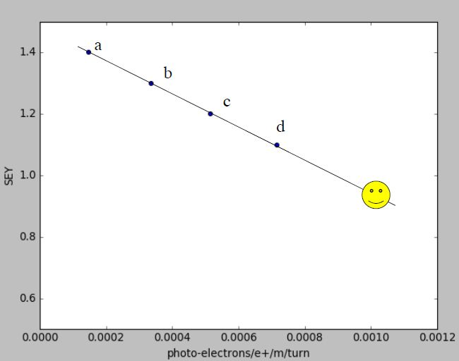
Electron cloud effect
Dependence of δ_{max} on α
δ_{max} vs α. Calculation by Fukuma-san
There are various combinations of δ_{max} and α to give the same density, n_{e} = 3x10 ¹¹ m⁻³.
α = 0.01
0.02
0.03
If α is 0.01, δ_{max} is ~1.4.
0.04
0.05
But, if α is 0.04, for example, δ_{max} is ~1.2.
δ_{max}
Present simulation
n_{e} = 3x10¹¹ m⁻³
Evaluation of actual numbers of photoelectrons (α) is very important for estimating δ_{max}!
Quantum efficiency (η_{e}) = 0.1
Number of photons = 0.16 /m/e⁺/turn
Number of p.e. in beam channel = α x η_{e} x 0.16
Number of photoelectrons in beam channel
We will try the following two methods to estimate α in the Phase-2 commissioning.

Slide 12
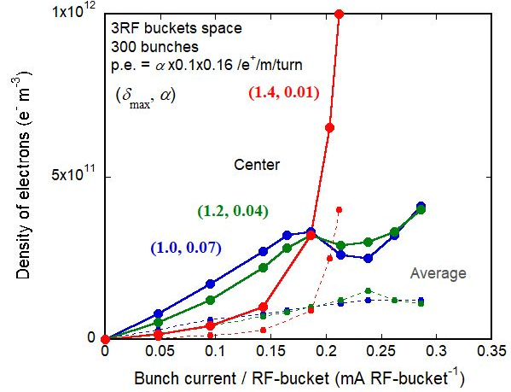
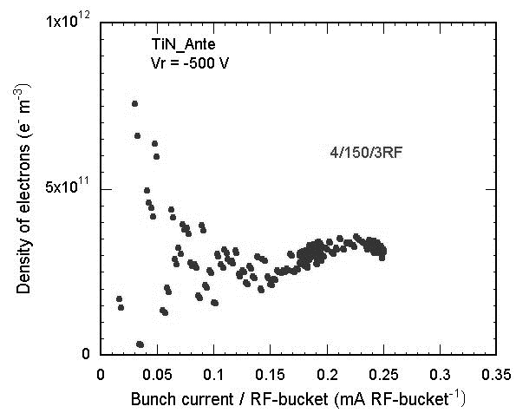
Electron cloud effect
Estimation of α : Method 1
From the behavior of electron density against beam current.
The behavior changes for the combinations of δ_{max} and α.
Calculated n_{e} for several combinations of δ_{max} vs α. Here n_{e} = 3E11 m⁻³ at 0.18 mA/RF-bucket is fixed (1/300/3RF).
Preliminary data:
Measured n_{e} in Phase-1 [2016/6/20] (4/150/3RF).
Fixed point
n_{e}~3x10¹¹ at 900 mA
The behaviors are similar to the cases of (δ_{max}, α) = (1.2, 0.04) ~ (1.0,0.07). But, more data are required.

Slide 13
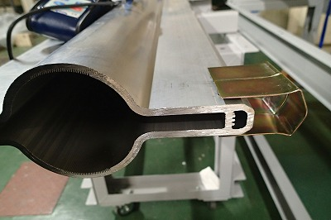
Electron cloud effect
Estimation of α : Method 2
From the difference of measured electron densities between the usual case (n_{e}) and the case where the effect of photoelectrons from antechamber is little (n_{e0})
Usual case
n_{e0}
X
n_{e}
photoelectrons
photoelectrons
We will be able to estimate α from the ratio of n_{e0} and n_{e}, assuming that the density is proportional to the number of photoelectrons.
Magnets
For example, we will be able to measure n_{e0} when weak magnetic fields are applied to only the antechamber.
We will continue the evaluation of properties of our TiN coating.
Electron monitor at bottom

Slide 14
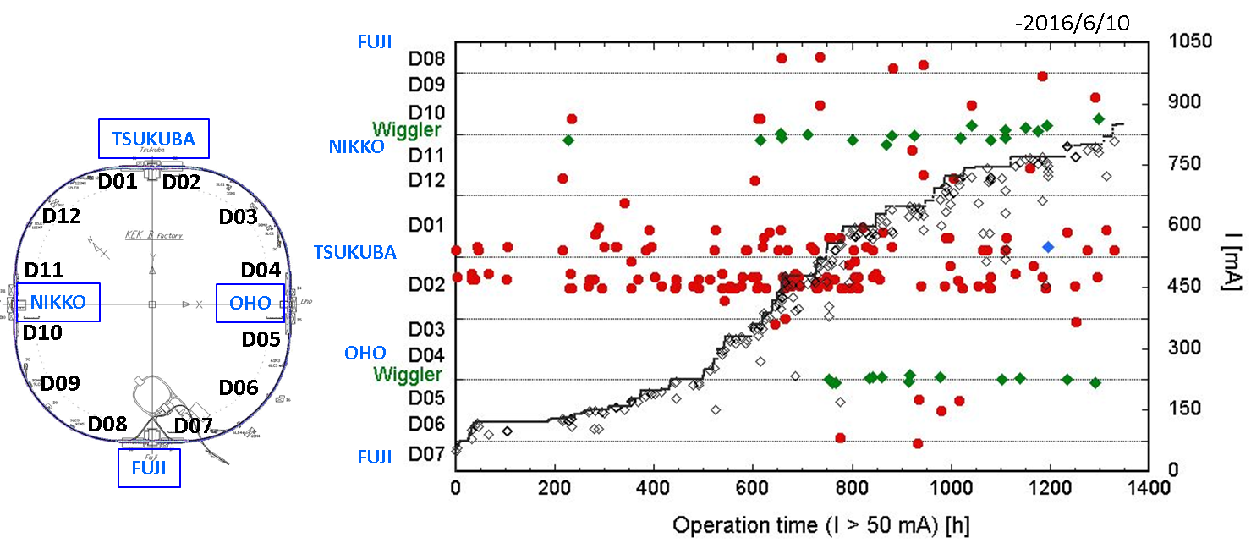
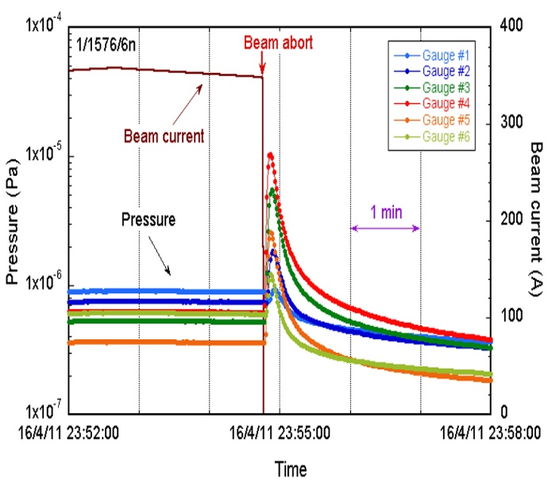
Pressure bursts accompanying beam loss
Brief review
Beam aborts accompanied by local pressure bursts have been frequently observed in the LER.
The locations of the pressure bursts have spread to more than 20 points along the ring. More frequent in the Tsukuba straight section.
Typical pressure burst
Locations of pressure bursts and the history

Slide 15
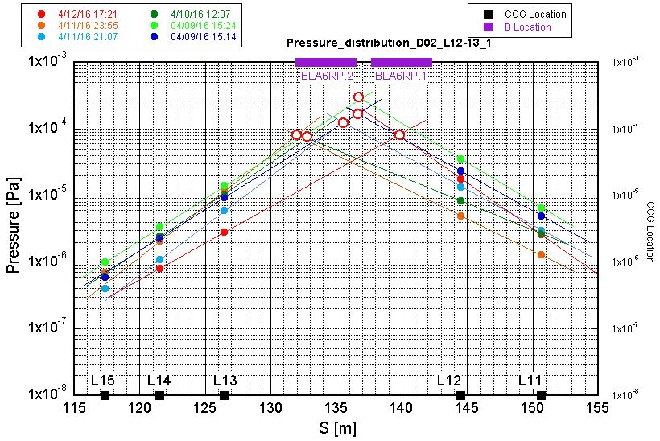
Pressure bursts accompanying beam loss
Brief review
Beam aborts accompanied by local pressure bursts have been frequently observed in the LER.
The locations of the pressure bursts have spread to more than 20 points along the ring. More frequent in the Tsukuba straight section.
In most cases, the bursts were observed near aluminum beam pipes in dipole magnets, with groove structure.
Estimated detailed locations of pressure bursts
Groove in the beam pipe
Bending magnets

Slide 16
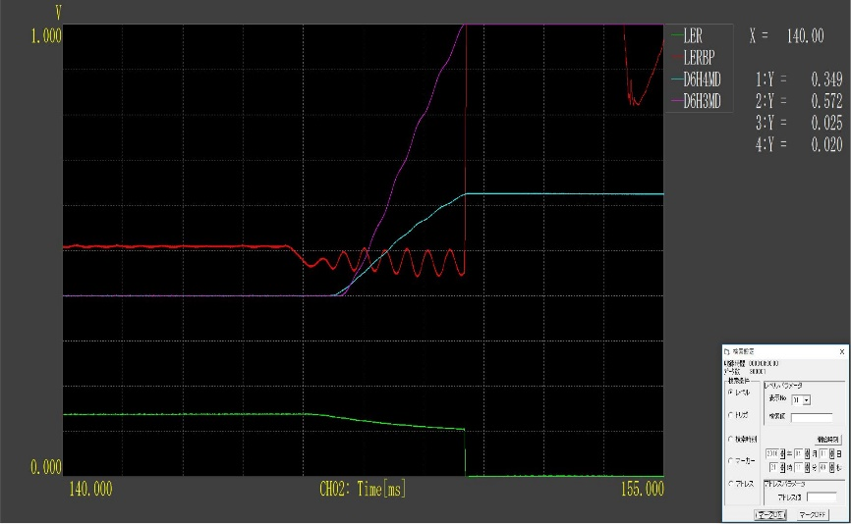
Pressure bursts accompanying beam loss
Brief review
Beam aborts accompanied by local pressure bursts have been frequently observed in the LER.
The locations of the pressure bursts have spread to more than 20 points along the ring. More frequent in the Tsukuba straight section.
In most cases, the bursts were observed near aluminum beam pipes in dipole magnets, with groove structure.
The beam-loss monitors at collimators triggered the beam aborts.
Beam loss lasted a few ms before the beam abort.
Typical abort log for the case pressure burst was observed. (Ikeda-san)
LM (PIN) signal
LM (PIN) signal
RF phase
1 ms
Beam current
Abort

Slide 17
Pressure bursts accompanying beam loss
Brief review
Beam aborts accompanied by local pressure bursts have been frequently observed in the LER.
The locations of the pressure bursts have spread to more than 20 points along the ring. More frequent in the Tsukuba straight section.
In most cases, the bursts were observed near aluminum beam pipes in dipole magnets, with groove structure.
The beam-loss monitors at collimators triggered the beam aborts.
Beam loss lasted a few ms before beam abort.
A possible cause: Collision of “dusts” with circulating beams.
Manufacturer of beam pipes in Tsukuba section is different from others.
Groove structure is likely to catch the dusts.
Aluminum grooves were formed at the first stage of beam pipe fabrication.
A “knocker” was set at a beam pipe in a bending magnet, where the burst had been observed frequently, and we could reproduce the phenomena by knocking the beam pipe.
How to deal with it?

Slide 18
Pressure bursts accompanying beam loss
Estimation of dust size
Hints:
Beam loss lasts for long time, ~ ms.
Short beam lifetime, < 10 ms.
Dust: sphere
radius = r
Gravity
[Cross section]
Beam
Large dusts, over 100 μm~1 mm?.
Crossing time ~3 ms for r = 500 μm, σ_{y} = 1 mm.
Dusts in reserved beam pipes were checked.
Dusts larger than 100 μm were actually found, although smaller dusts were dominant.
Example of a large dust (Al₂O₃) found in the reserved beam pipe.

Slide 19
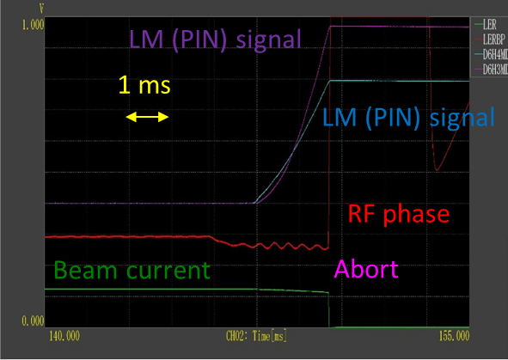
Pressure bursts accompanying beam loss
Estimation of dust size
Hints:
Beam loss lasts for long time, ~ ms.
Short beam lifetime, < 10 ms.
Small dust < 10 μm
[Cross section]
Note: there is another possible story:
Dust is small, < 10 μm, such as NEG powder.
The collision induces the synchrotron oscillation, and it grows to the large betatron oscillation. That leads to the beam loss.
Reason: the loss signal is observed behind the synchrotron oscillation, ~ ms.
Beam
Typical abort log
We have to know the dinamic aperture.
Further investigation is required, and some studies are planed in Phase-2.
Here, we tried to explain the phenomena assuming that the dust is large.

Slide 20
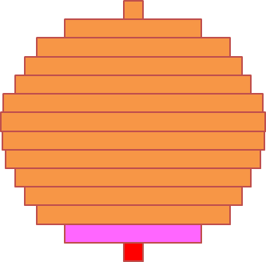
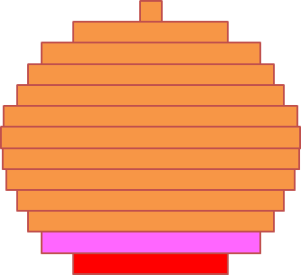
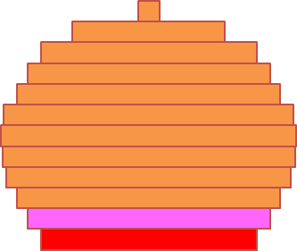
Pressure bursts accompanying beam loss
A simple model
Drop from above surface
Dust
simplification
r
r
Sliced sphere
Gravity
No charge up
[Cross section]
σ_{y}
Beam
σ_{x}
$$\sqrt{2π}σ_{y}$$
σ_{x} >> r
$$\sqrt{2π}σ_{x}$$
Calculate temperature of each slice every 10 bunches while the dust is interacting with beam. Height of one slice is ~ 55 nm.
Assume that the slice evaporates when the temperature exceeds the melting point or the vapor pressure exceeds 1x10⁻² Pa.
Bunch #1
Bunch #11
Bunch #21
Bunch #31
Bunch #41
10 bunches
Evaporate when the temperature exceeds melting point.

Slide 21
Pressure bursts accompanying beam loss
Calculation using the model
Increase in the temperature is calculated from the energy absorption at the overlapped region. (thermally insulated)
Decrease in the temperature is calculated from the black body radiation. (much smaller than the increase rate)
The beam lifetime is determined from the Bremsstrahlung, the Rutherford scattering and the Möllar scattering.
The beam intensity and the beam loss rate are calculated every 10 bunches.
These calculations followed the method used in the dust trapping analysis by F. Zimmermann. But, not trapped here.
Bunch #1
Bunch #11
Bunch #21
Bunch #31
Bunch #41
10 bunches
Evaporate when the temperature exceeds melting point.

Slide 22
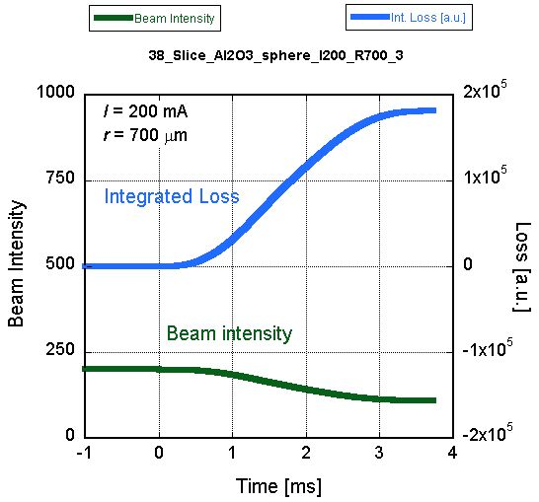
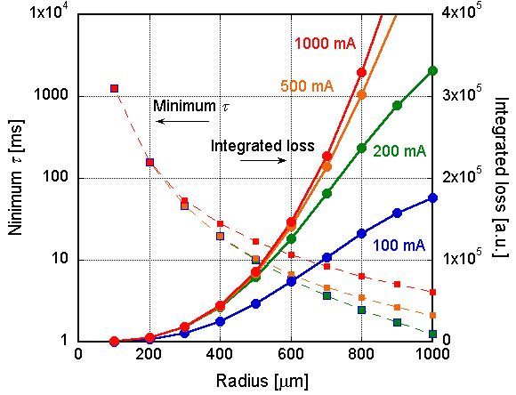
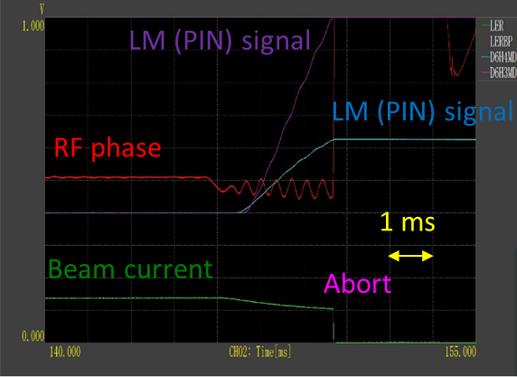
Pressure bursts accompanying beam loss
Typical result
For Al₂O₃, which is the most probable dust in Al beam pipe
Time change of integrated loss and beam intensity
Limit
Min. lifetime and integrated loss against dust radius for several beam currents.
Abort
Abort log
Limit for abort
(assumption)

Slide 23
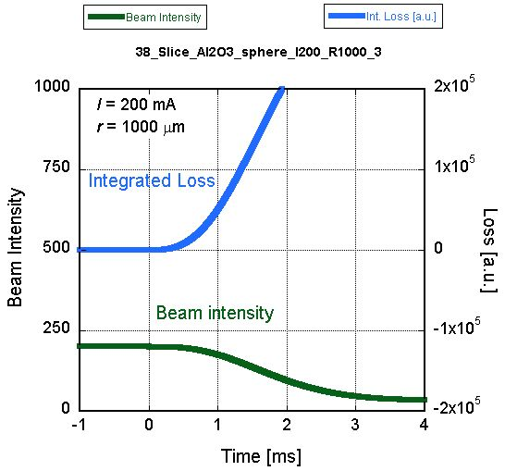
Pressure bursts accompanying beam loss
Typical result
For Al₂O₃, which is the most probable dust in Al beam pipe
Time change of integrated loss and beam intensity
Limit
Min. lifetime and integrated loss against dust radius for several beam currents.
Abort
Abort log
Limit for abort
(assumption)
We can reproduce the log qualitatively.

Slide 24
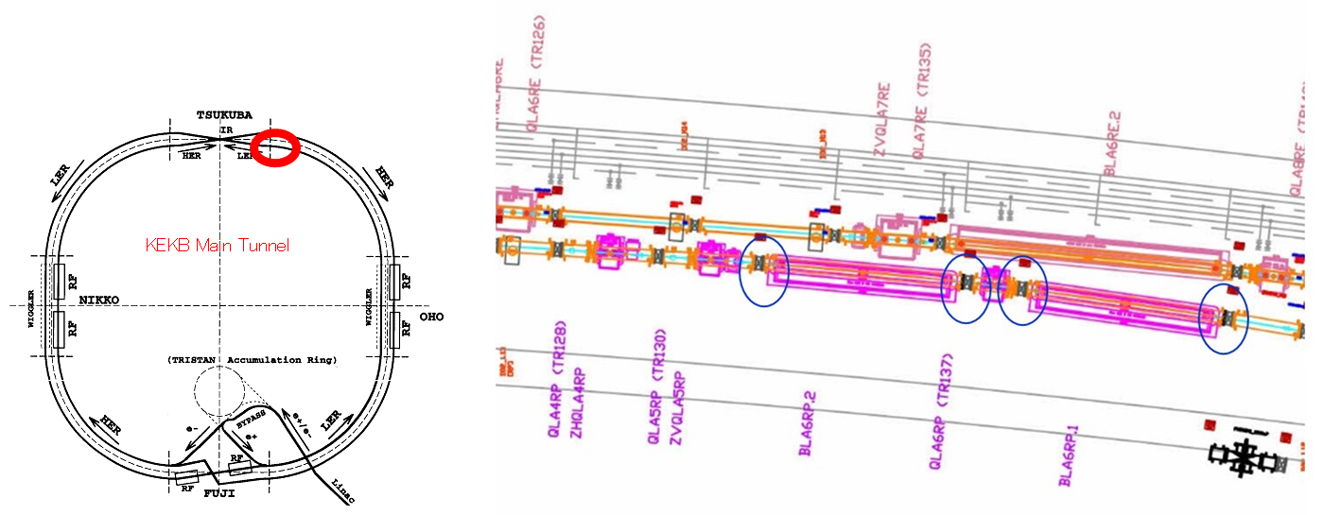
Pressure bursts accompanying beam loss
Gathering of dusts from actual beam pipes in the ring
The beam pipes where the bursts were frequently observed.
Location of beam pipe

Slide 25
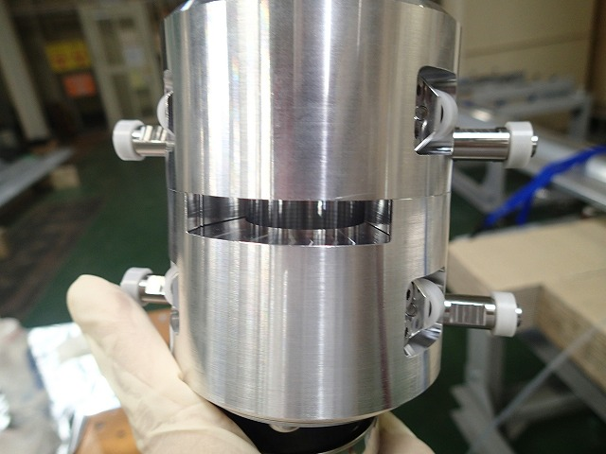
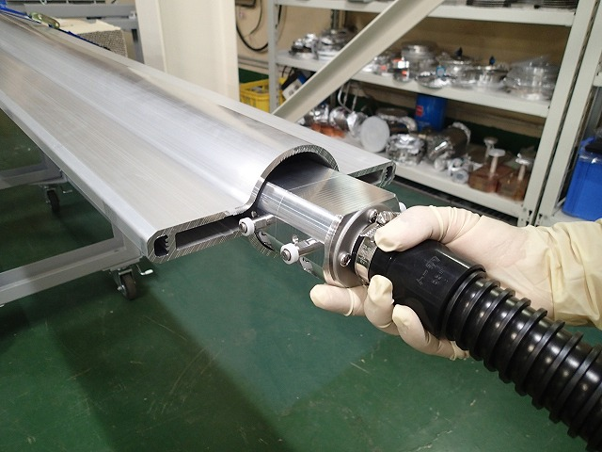
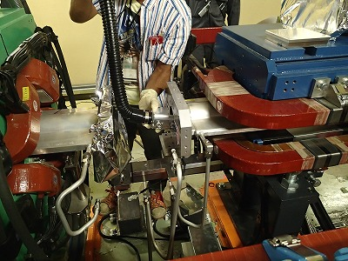
Pressure bursts accompanying beam loss
Gathering of dusts from actual beam pipes in the ring
The beam pipes where the bursts were frequently observed.
A special tool to cleanup the inside of beam pipes with antechambers was developed.
The dusts was gathered by a powerful vacuum cleaner.
After knocking the beam pipe, the beam pipe was slowly filled with N₂. Then the dusts at the bottom of beam channel was vacuumed.
Special tool to cleanup the bottom of beam channel

Slide 26
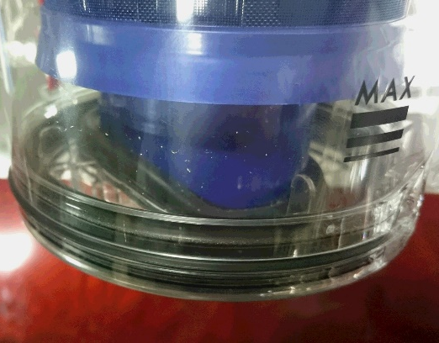
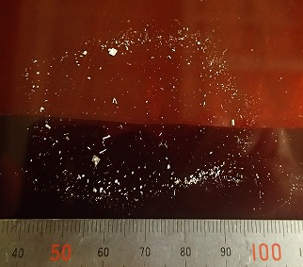
Pressure bursts accompanying beam loss
Gathering of dusts from actual beam pipes in the ring
The beam pipes where the bursts were frequently observed.
A special tool to cleanup the inside of beam pipes with antechambers was developed.
The dusts was gathered by a powerful vacuum cleaner.
After knocking the beam pipe, the beam pipe was slowly filled with N₂. Then the dusts at the bottom of beam channel was vacuumed.
Lots of large dusts were found from one of the two beam pipes!
We did not check the inside of other beam pipes in which the bursts were not observed.
But, this is one strong evidence for the assumption of large dusts.
Dust obtained from the beam pipe in question

Slide 27
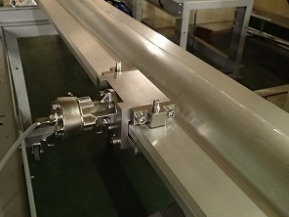
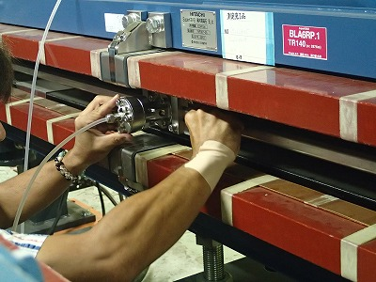
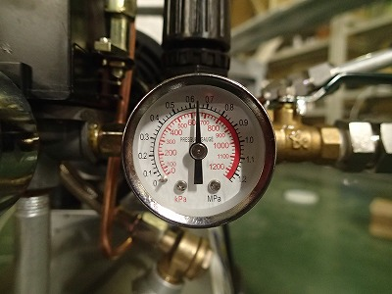
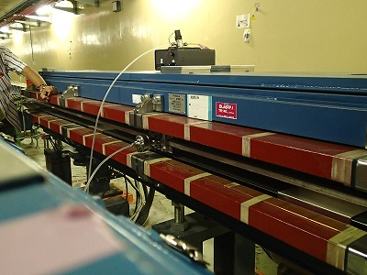
Pressure bursts accompanying beam loss
Countermeasures
It is hardly possible to cleanup the all dusts.
But if the sizes of dusts are large, it is quite unlikely to imagine that the dusts are picked up from the bottom of beam channel, which might be charged up by electrons(?).
We knocked 24 beam pipes for bending magnets (with groove) around Tsukuba straight section, where the pressure bursts were frequently observed, and dropped dusts from the top.
Knocked 150 times for each beam pipe.
We expect the reduction of the bursts in Phase-2 commissioning.
The study will be continued.

Slide 28
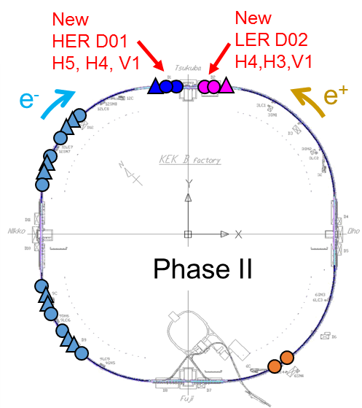
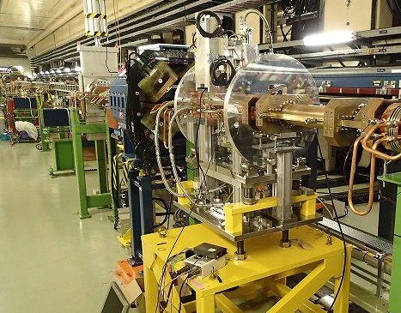
Other preparations for Phase-2
Installation of new 6 beam collimators
Two collimators, installed in the SuperKEKB positron ring for test in Phase-1 commissioning, worked well as expected.
Designed on the base of SLAC-type Low-impedance collimators.
Taking these promising results, six new collimators were manufactured and installed in the positron ring (LER) and the electron ring (HER) for Phase-2 commissioning.
A new vertical type collimator installed in the ring
Collimator system in Phase-II
HER
KEKB type
LER
D06 H3,H4

Slide 29
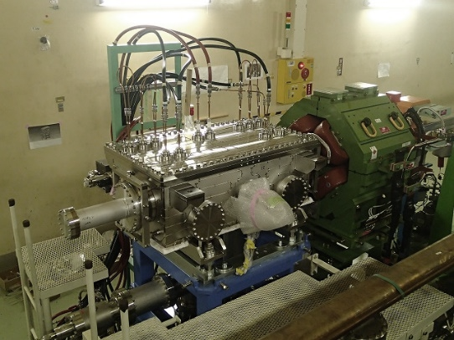
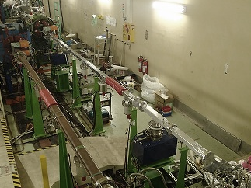
Other preparations for Phase-2
Replacement of beam pipes for LER injection region
In order to accommodate the injection of low-emittance positron beam, the septum magnet was renewed.
LER abort system including kicker magnets is also upgraded to tolerate the higher beam current with a smaller beam size.
The beam pipes were replaced to new ones accordingly, including the beam pipe inside the septum chamber.
septum and beam pipes for injection region

Slide 30
Other preparations for Phase-2
Countermeasures against problems found in Phase-1
Air leak from a flange of a tapered beam pipe at Fuji straight section.
Replace to a new beam pipe with a “beam mask” as well as SR mask.
Heating of flanges in wiggler sections
Re-alignment of beam pipes, and install new bellows chambers with SR masks at the entrance of antechambers.
Heating of beam pipes at the downstream of wiggler sections.
Cooling-water paths are optimized to increase the flow rate.
Others
Installation of bellows chambers with SR baffles to reduce photon scattering to the mirror of SR beam size monitor.
Installation of new test beam pipe for EC studies.
Inside check of some bellows chambers
Replacement of several vacuum gauges and ion pumps.

Slide 31
Summary
The MR vacuum system is now ready for the Phase-2.
Various countermeasures were taken for problems found in Phase-1.
Electron cloud effect
Approximately 86 % of the drift spaces of the ring were covered by magnetic fields using permanent magnets or solenoids.
The analysis of the properties of countermeasures are on going.
Pressure bursts
The beam pipes in questions were knocked to drop the dusts from the top of beam channel.
The investigation on this phenomena is continuing.
Other preparations
Installation of new beam collimators
Replacement of beam pies at LER injection region
Etc.

Slide 32
Thank you for your attention.

Slide 33
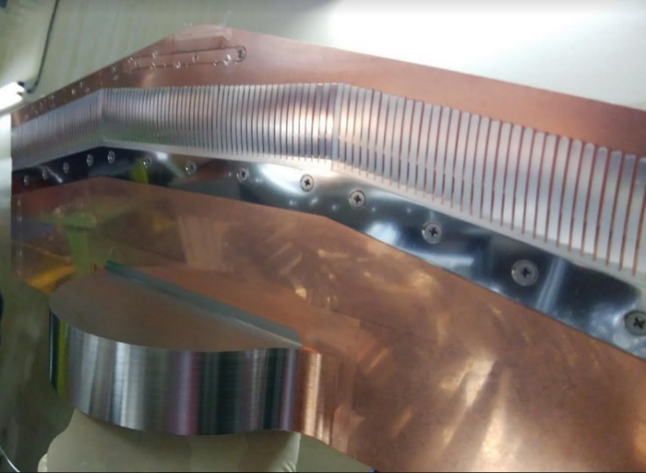
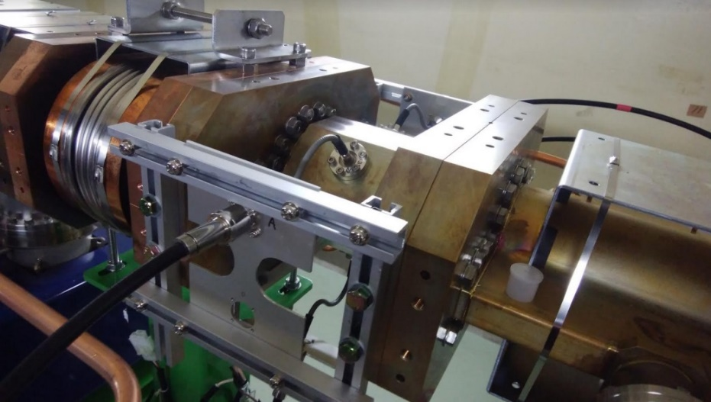
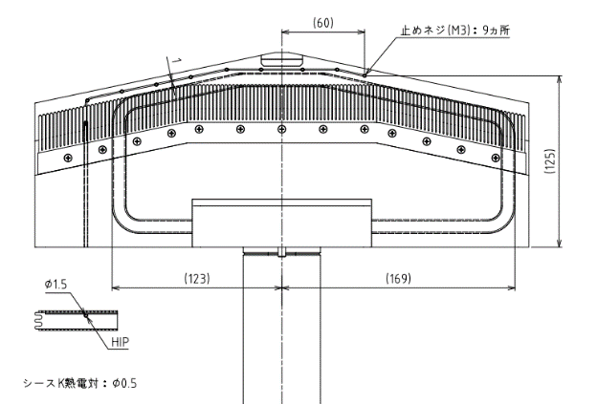
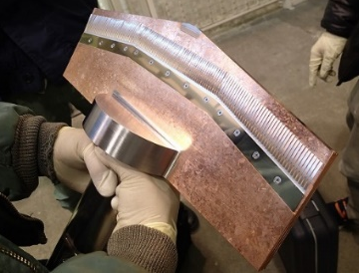
Other preparations for Phase-2
Installation of new 6 beam collimators
One of the new collimators was equipped with a thermo-sensor to measure the temperature at the tip of the head.
A special beam pipe with four pickup electrodes was installed just near a collimator for measuring the characteristics of HOM (Higher Order Mode) generated by the collimator.
Installation of lead shielding is also on going.
Collimator head equipped with thermo-sensor
Beam pipe with HOM pickups
Thermo-sensor
Pickup

Slide 34
Design of key components_8
Countermeasures against electron cloud (EC) effect [LER]
Serious issues for recent positron and proton storage rings.
Sections | L [m] | L [ %] | Countermeasure | Material
Total | 3016 | 100
Drift space (arc) | 1629 m | 54 | TiN coating + Solenoid | Al (arc)
Steering mag. | 316 m | 10 | TiN coating + Solenoid | Al
Bending mag. | 519 m | 17 | TiN coating + Grooved surface | Al
Wiggler mag. | 154 m | 5 | Clearing Electrode | Cu
Q & SX mag. | 254 m | 9 | TiN coating | Al (arc)
RF section | 124 m | 4 | (TiN coating +) Solenoid | Cu
IR section | 20 m | 0.7 | (TiN coating +) Solenoid | Cu or ?
By using these countermeasures, the average electron density on the order of 10¹⁰ e⁻/m³ will be obtained.
Threshold of head-tail instability: ~1.6×10¹¹ e⁻/m³

Slide 35
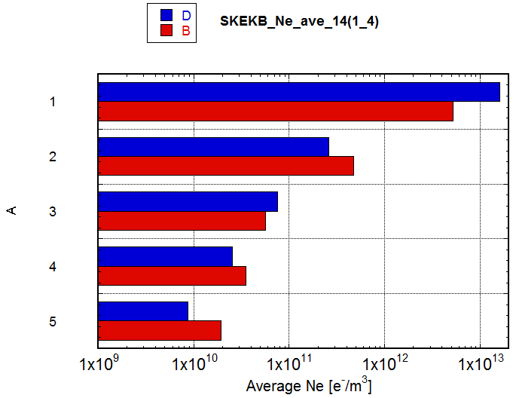
Expected electron density
n_{e} after applying measures described so far (Red)
n_{e} of approx. 1/5 of the threshold one is expected.
Compared with results of CLOUDLAND (Blue)
δ_{max}=1.2, Solenoid field=50G (→n_{e}=0), Antechamber; photoelectron yield =0.01 (1/10)
Condition | ne [m⁻³]
Circular Cu chamber [KEKB beam pipe] | 5.2E12
+Solenoid at Drift (1/50) | 4.7E11
+Antechamber (1/5)+TiN (3/5) | 5.7e10
+Electrode in Wiggler (1/100) | 3.5e10
+Groove in Bend (1/4) | 2.0E10
Single Bunch Instability Threshold (~1x10¹¹)
KEKB~3x10¹¹
Low density in the simulation ← ne=0 by solenoid. Careful solenoid winding is important.

Slide 36
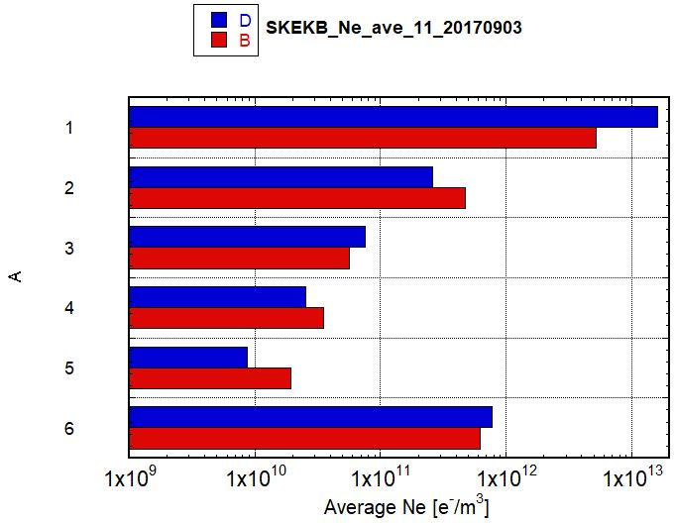
Expected electron density
Expected electron density without solenoid (from KEKB)
赤： n_{e} expected from experiments in KEKB
青： n_{e} calculated using CLOUDLAND
Conditions：φ 94 mm Cu pipe、δ_{max}=1.2, Solenoid field=50G (n_{e}=0), Antechamber (photoelectron yield =0.01:1/10 of circular pipe)、4ns spacing (2RF)、1 mA/bunch = 600 mA/600 bunch
Condition | ne [m⁻³]
Circular Cu chamber [KEKB beam pipe] | 5.2E12
+Solenoid at Drift (1/50) | 4.7E11
+Antechamber (1/5)+TiN (3/5) | 5.7e10
+Electrode in Wiggler (1/100) | 3.5e10
+Groove in Bend (1/4) | 2.0E10
No solenoid | 6.2E11
Single Bunch Instability Threshold (~1x10¹¹)
KEKB~3x10¹¹
Without solenoid, n_{e} is on the order of 10¹¹ m⁻³, near to the measured value.

Slide 37
Drift section_1
Beam pipe with antechambers
Effective to reduce photoelectrons
Adopted in PEP-II LER
Also effective to reduce photon scattering (with rough surface)
Contribute to decrease impedance
Reduction rate: ~ 1/5 at high current region
Depth: 65 mm
Height:14 mm
Arc
Conceptual drawing
Effect of antechamber
Pump
1/1284/3.07 (1284)
6~8 ns spacing
R = 4７ mm (Circular)
V_{r} = −30 V
Ph = 8×10¹⁵ Ph/s/m/ms
Circular chamber
~1/5
Beam
SR
~1/100
With
antechamber
Rough surface
(Ra10~20)

Slide 38
Electron cloud effect
Estimation of α : Method 1
From the behavior of electron density against beam current.
The behavior changes for the combinations of δ_{max} and α.
Calculated n_{e} for several combinations of δ_{max} vs α. (1/300/2RF).
Preliminary data:
Measured n_{e} in Phase-1 [2016/6/20] (4/150/2RF).
The behaviors are similar to the cases of (δ_{max}, α) = (1.2, 0.04) ~ (1.0,0.07). But, more data are required.

Slide 39
Electron cloud effect
Estimation of α : Method 2
From the difference of measured electron densities between the case where the effect of photoelectrons from antechamber is small (n_{e0}) and the usual case (n_{e}).
For example, we will measure the electron density when weak magnetic field is applied to only the antechamber.
Assuming that n_{e} is proportional to the number of photoelectrons in the beam channel, and also that the quantum efficiency is constant,
Apply weak magnets at ante-chamber near electron monitor
Magnets
$$\frac{n_{e0}}{n_{e}}=\frac{PE_{b}}{PE_{b}+β×PE_{a}}$$
PE_{b} and PE_{a}: number of photoelectrons in the beam channel and in the antechamber. β: probability that photoelectrons in the antechamber go out to the beam channel.
Electron monitor at bottom

Slide 40
Pressure bursts accompanying beam loss
Typical results
For Al₂O₃, which is the most probable dust in Al beam pipe
Time change of integrated loss and beam intensity
Limit
Integrated loss and min. lifetime against dust radius for seal beam currents.
Limit for abort
(assumption)
We can reproduce the log qualitatively.

Slide 41
Electron cloud effect
Model of permanent magnet Type-1 (Fukuma san)
1/8 model
Magnetic field
~40 G

Slide 42
Electron cloud effect
Density of electrons in the Type-1 unit
Central density of electrons inside of the Type-1 unit for δ_{max} = 1.0~1.4 and α =0.007~0.001.
2RF bucket, 2500 bunch, 4 A

Slide 43
Electron cloud effect
Effect of magnetic field
1A ~ 8G
~20 G

Slide 44
Electron cloud effect
Effect of Baking on δ_{max} of TiN coating (in laboratory)

