Slide 1
Vacuum System Status
T. Ishibashi, KEK
on behalf of KEKB Vacuum Group
Contents
・Updates of vacuum system before Phase-3
・Present status
- vacuum scrubbing
- electron cloud effect in LER
- problems
・Summary and plans

Slide 2
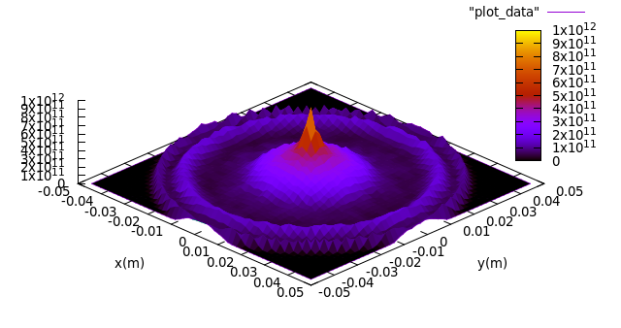
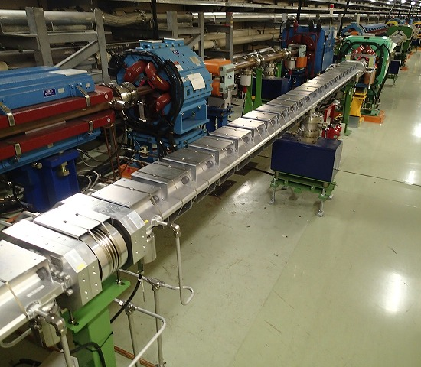
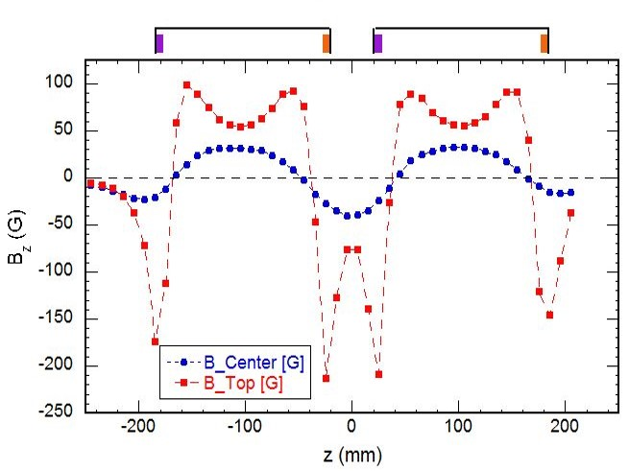
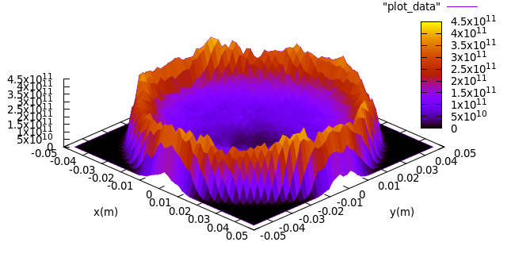
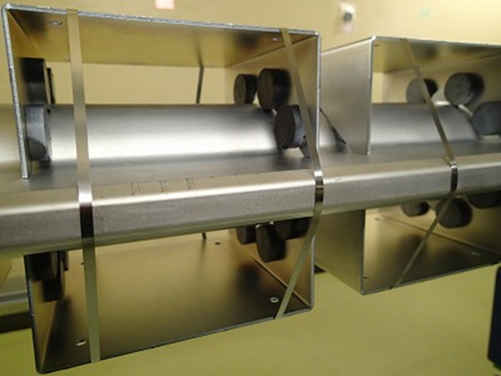
Updates of vacuum system - ECE
Countermeasures for Electron Cloud Effect(ECE)
Approximately 91% of the drift spaces of LER were covered by magnetic field in the beam direction with permanent magnets or solenoid coils before Phase-3.
In Phase-2, approximately 86% of that were covered as presented the previous KEKB Review.
Magnetic free
1/2500/2RF, 3.6 A
4.5x10¹¹ m⁻³
(r<8 mm)
Type-1 unit
Magnetic field of Type-1 unit
δ_{max}=1.2
Typical strength ~ 60 G
Type-1 unit
1/2500/2RF, 3.6 A
4x10¹⁰ m⁻³
(r<8 mm)
δ_{max}=1.2
Permanent magnets
Iron yoke
(plate)

Slide 3
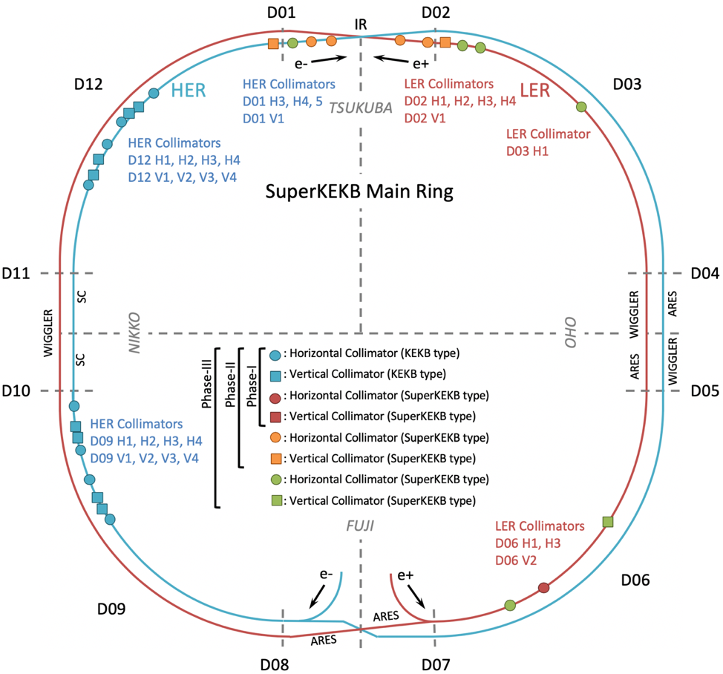
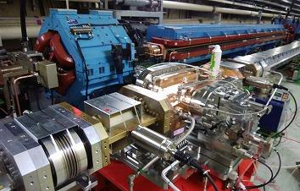
Updates of vacuum system - collimators
Installation of new beam collimators
LER: D02H1, D02H2, D03H1, D06V1
HER: D01H3
Moved a collimator from D06H4 to D06H1 in LER
H: horizontal
V: vertical
Collimator location
D02H1 collimator
Shematic drawing of the horizontal collimator

Slide 4
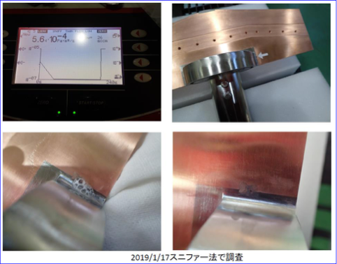
Updates of vacuum system - collimators
Trouble: water leakage from a movable jaw of D02H1 collimator.
Changed to a backup jaw.
Investigation by sniffer scheme and Snoop®

Slide 5
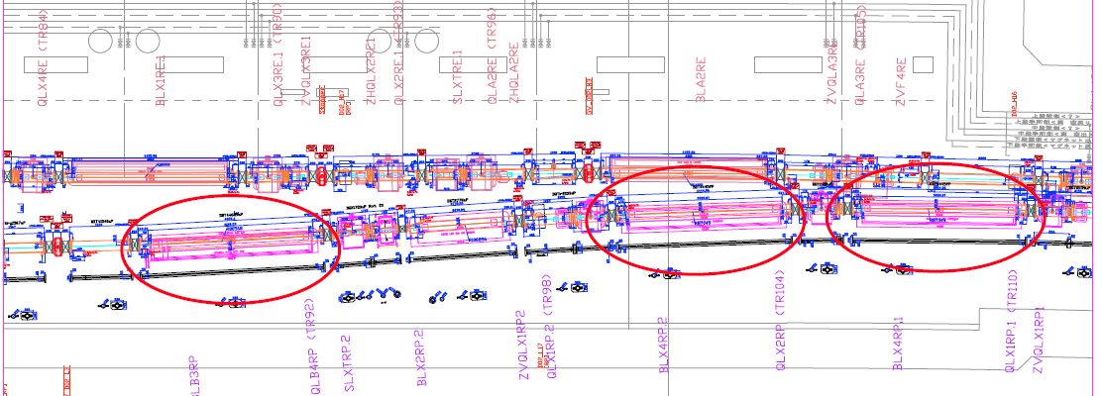
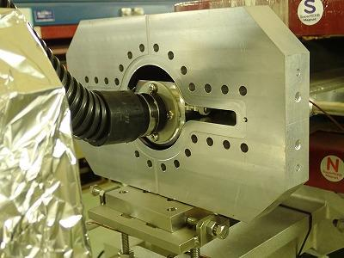
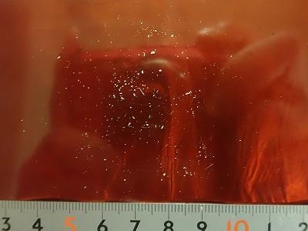
Updates of vacuum system - dusts
R14.2: Prepare a plan to mitigate the pressure bursts in case it turns out to be a limitation for the operation in Phase III.
Countermeasures for dust events with pressure bursts
Beam losses or aborts accompanied by local pressure bursts have been observed in LER since Phase-1.
Beam pipes, which had caused the events frequently, were knocked in order to drop dusts from the top of the beam channel.
In some regions that caused the event frequently, the dusts were removed by a vacuum cleaner.
BLB3RP, BLX4RP.2, BLX4RP.1
Cleaned region
Collected dusts from vacuum cleaner

Slide 6
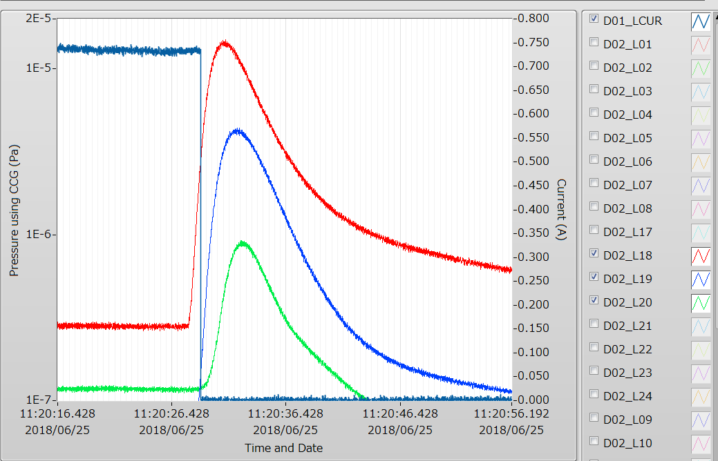
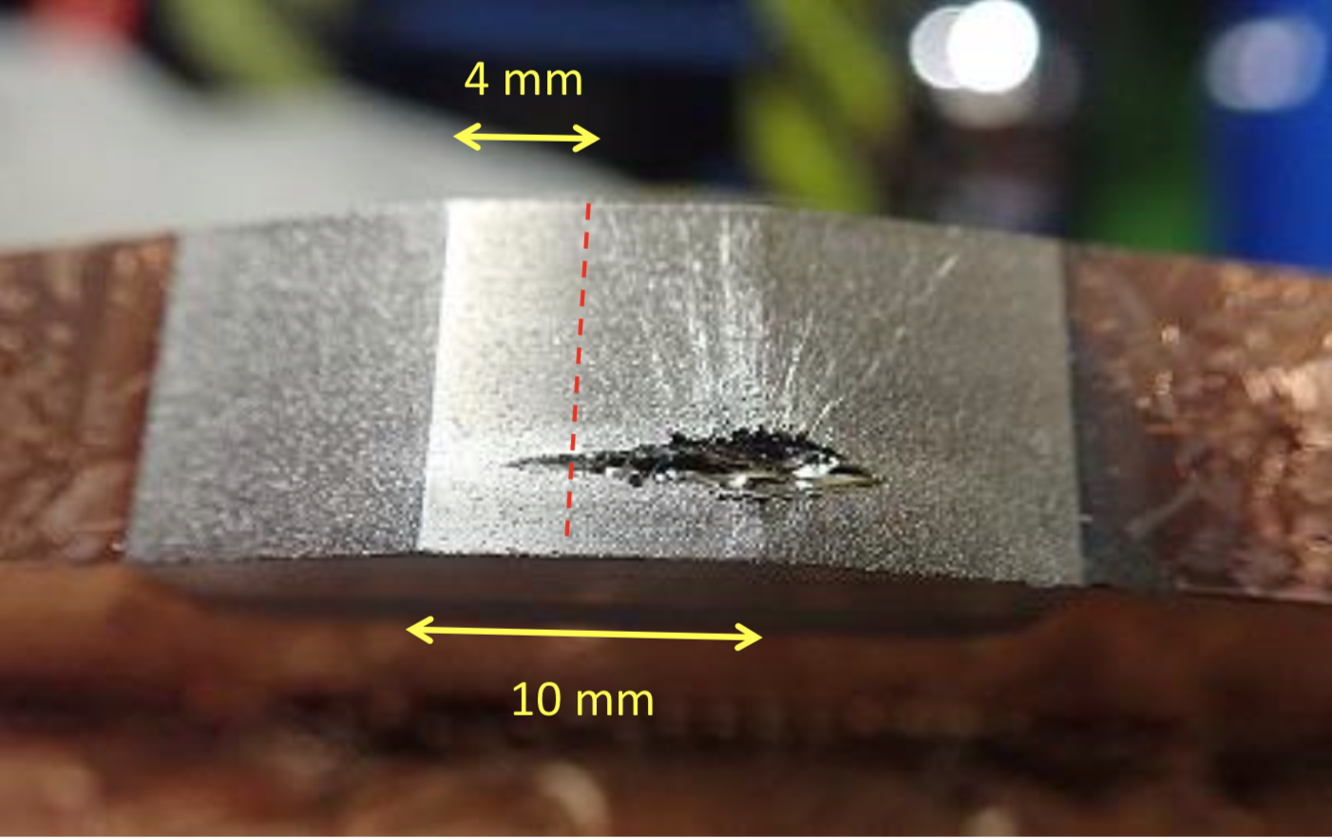
Updates of vacuum system – jaw damage
LER: A huge beam loss and pressure burst happened near D02V1 with a QCS quench at 11:20 June 25th, 2018 in Phase-2. Stored current was 728 mA. The tungsten tips of the jaws were damaged. After that we were not able to run the luminosity mode because of high backgrounds in this condition. → move the collimator
HER: A huge beam loss and pressure burst happened near D01V1 with a QCS quench at 11:20 June 9th in Phase-2, 2018. Stored current was 766 mA. Jaws were damaged. After that we were able to run the luminosity mode in this condition.
Pressure bursts near D02V1
Photo of a D02V2 bottom jaw.
Photo of a D02V2 top jaw.
beam
beam

Slide 7
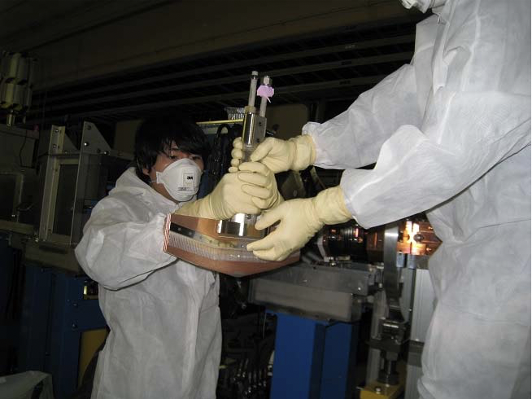
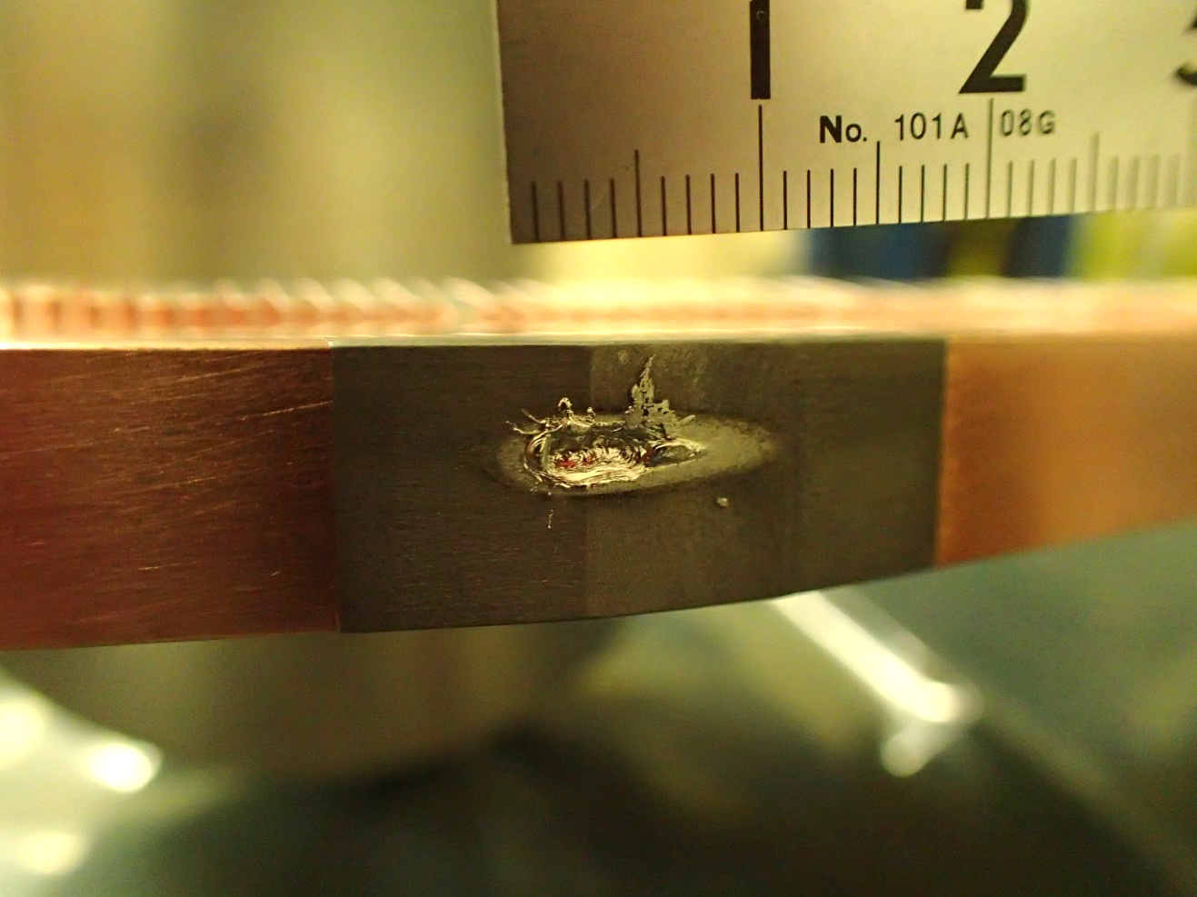
Updates of vacuum system – jaw damage
Jaws of D02V1 top, bottom and D01V1 top were changed to new ones in the presence of Radiation Science Center.
D02V1: ~10 μSv/h
D01V1: ~30 μSv/h
The damaged tungsten is likely to be crumbly by the embrittlement.
→ plan to change the material from tungsten to tantalum
Photo of a D01V1 top jaw.

Slide 8
Updates of vacuum system
others
Installation of longitudinal feedback kicker in LER.
Changed septum beam pipes to reduce the leakage field into MR.
Installation of bellows chambers with SR mask in HER downstream of IP because temperature rise was observed in a stainless chamber caused by SR in QCS.
Abort system by pressure burst besides collimators to avoid the jaw damage.
etc.

Slide 9
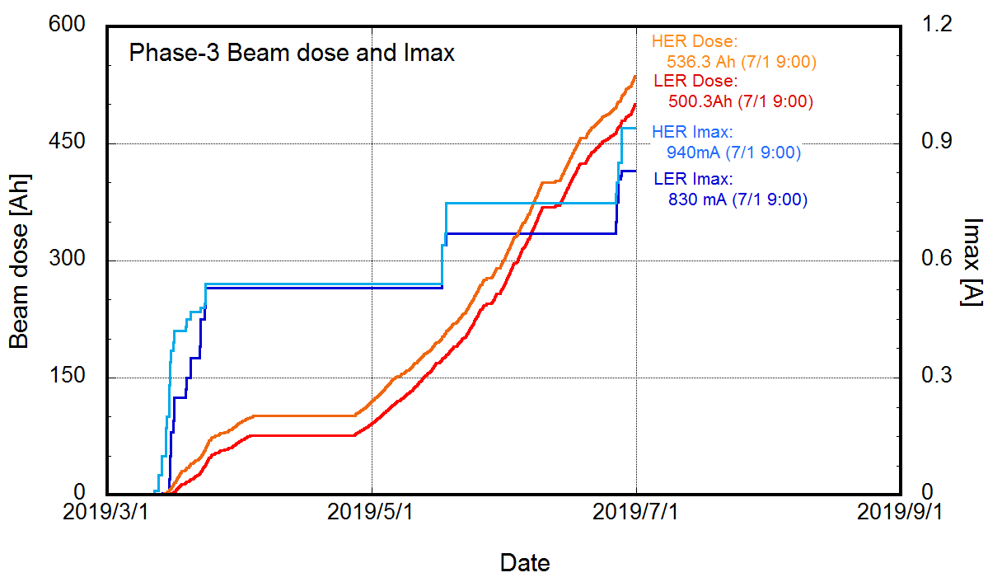
Present Status – vacuum scrubbing
MR
Maximum stored beam current in Phase-3: HER 940 mA, LER 830 mA
Beam dose in Phase-3: HER 536.3 Ah, LER 500.3 Ah

Slide 10
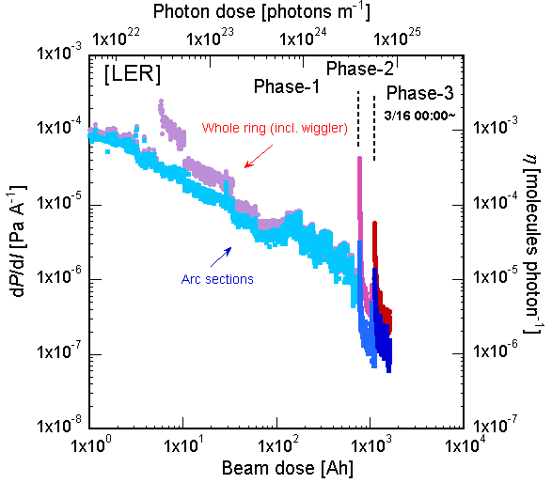
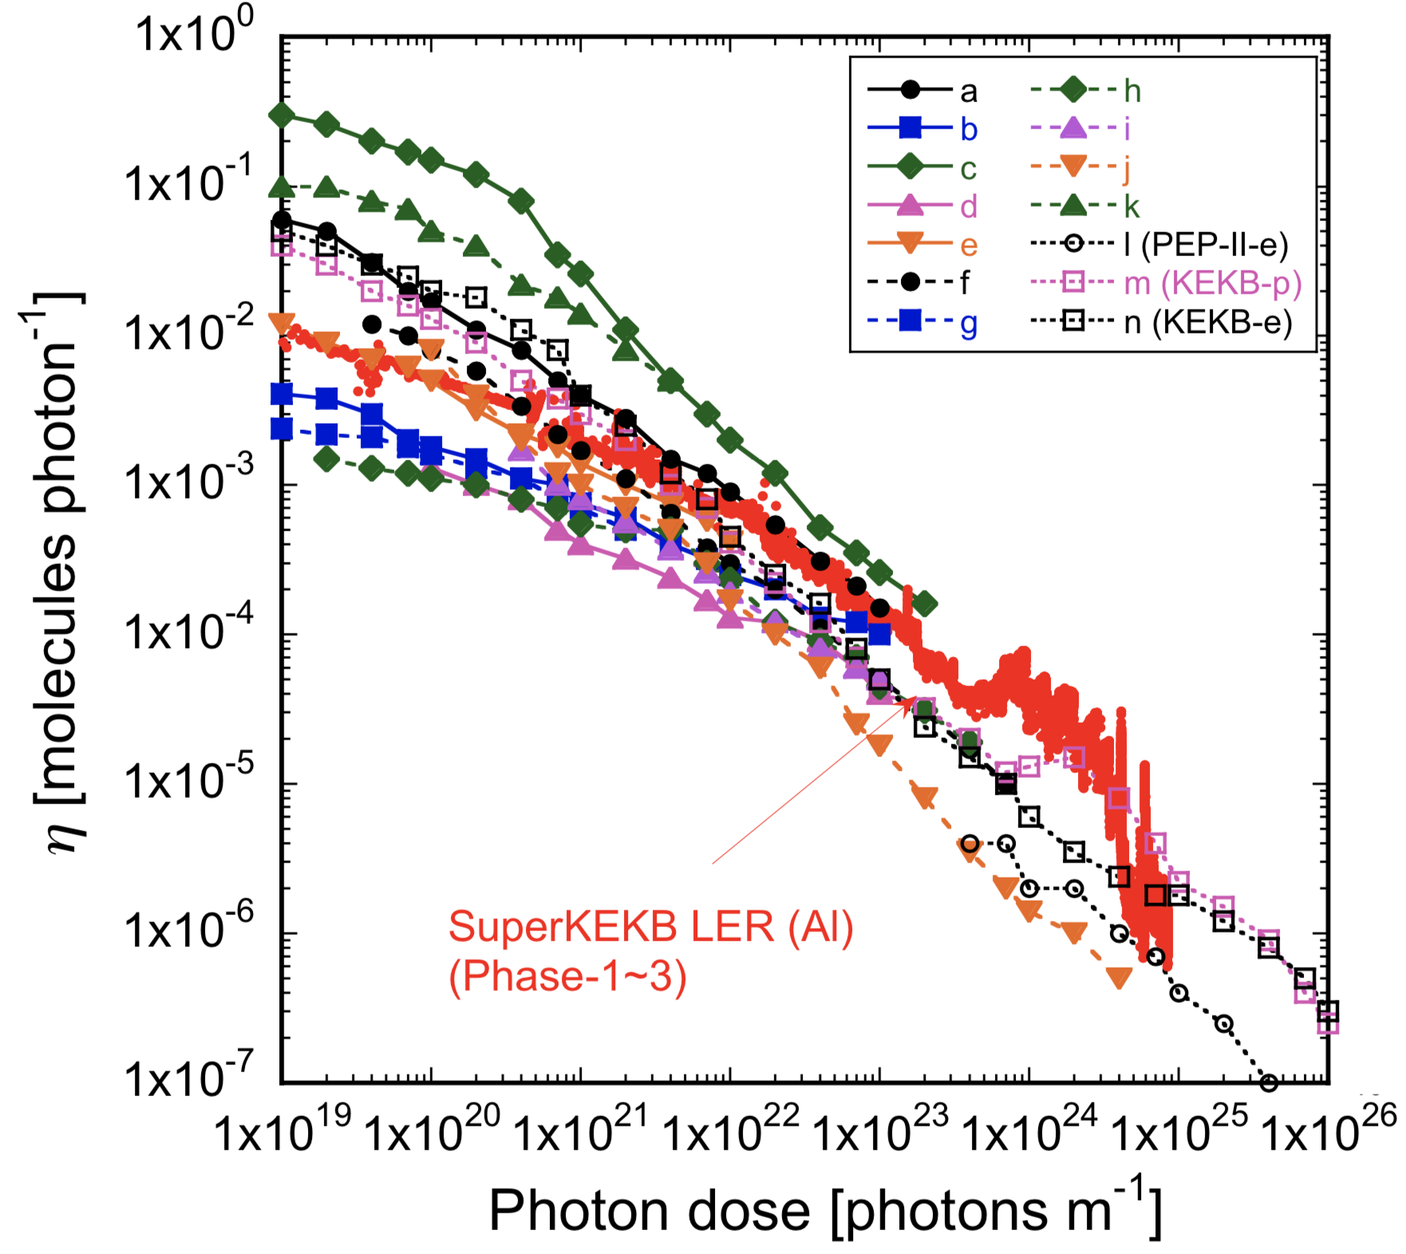
Present Status – vacuum scrubbing (LER)
The dP/dI in MR has been smoothly decrease by the vacuum scrubbing.
In LER, the dP/dI curve in Phase-3 is similar with that in Phase-2 because some regions were exposed to the atmosphere for vacuum works. The dP/dI at the end of Phase-3 is below that of Phase-2.
Cu chamber in KEKB LER

Slide 11
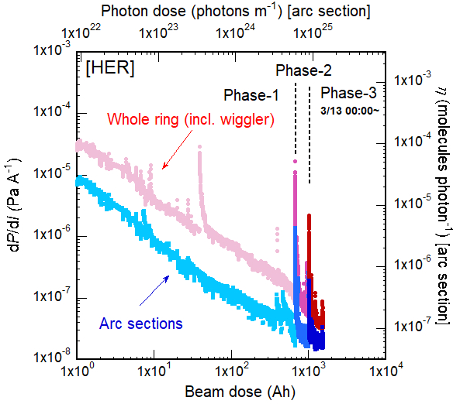
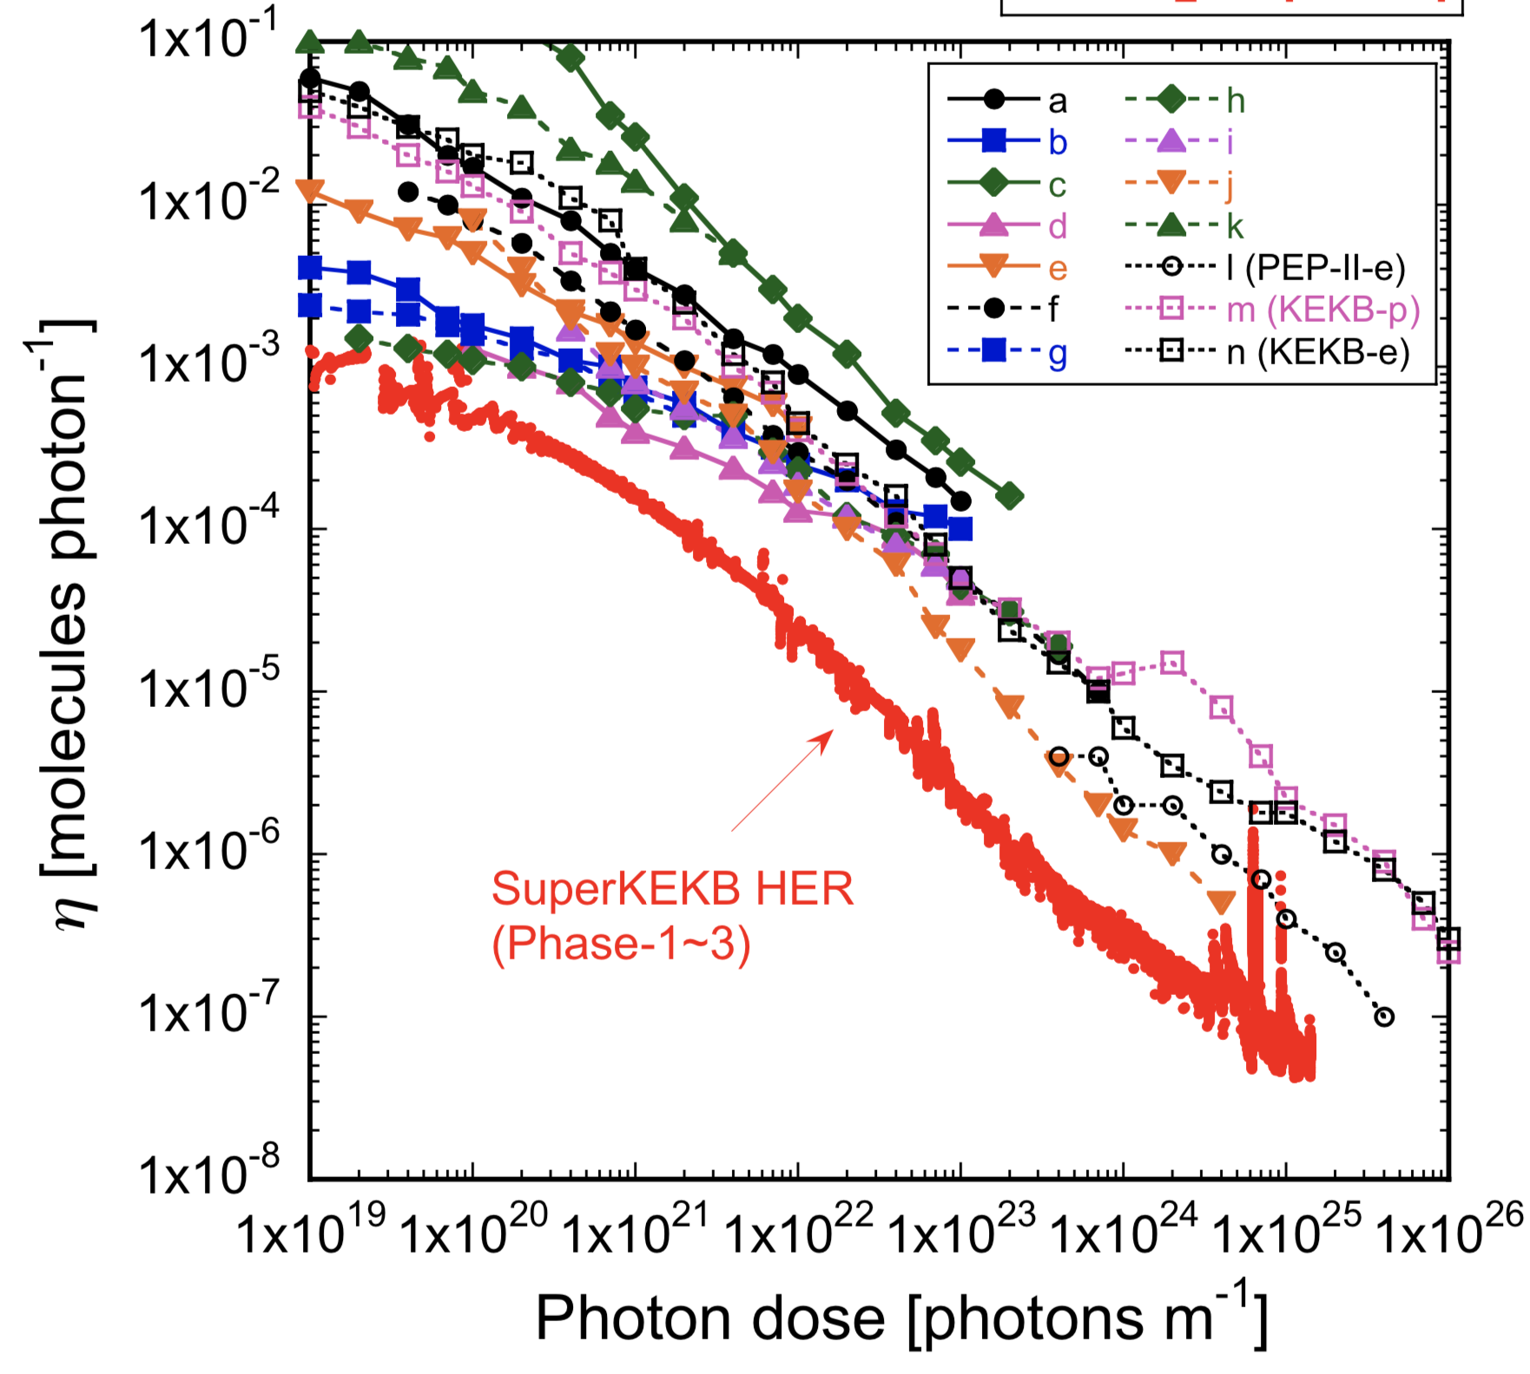
Present Status – vacuum scrubbing (HER)
The dP/dI in MR has been smoothly decrease by the vacuum scrubbing.
In HER, the dP/dI in SuperKEKB is below that in KEKB at the final stage by the historical effect.
Cu chamber in KEKB HER

Slide 12
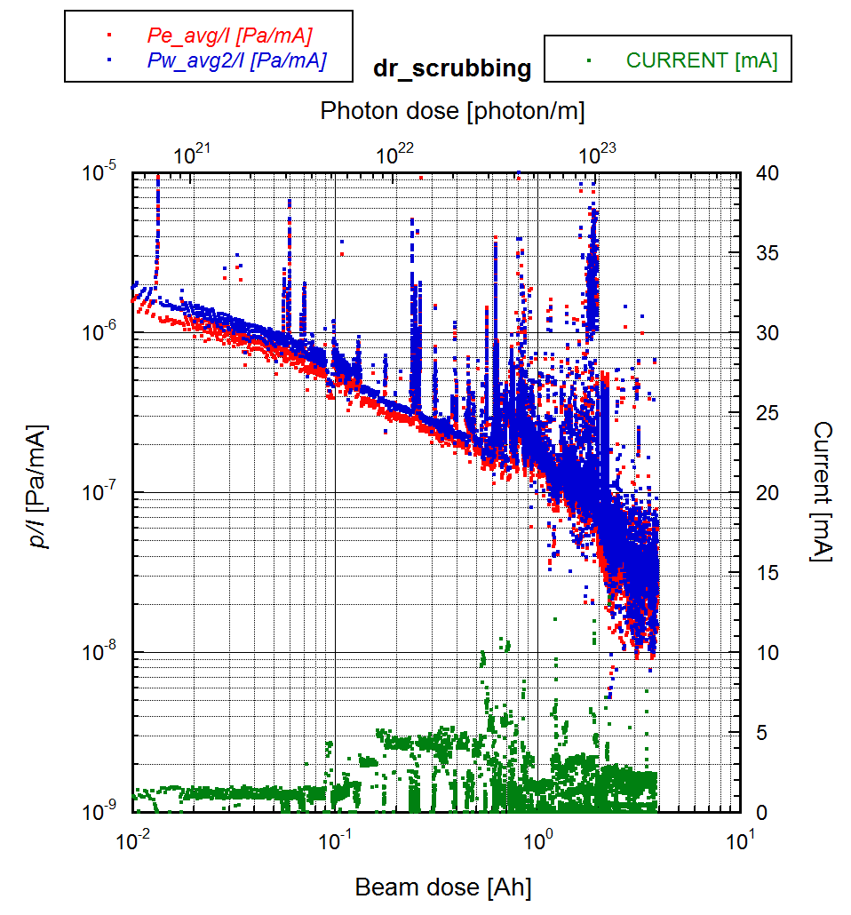
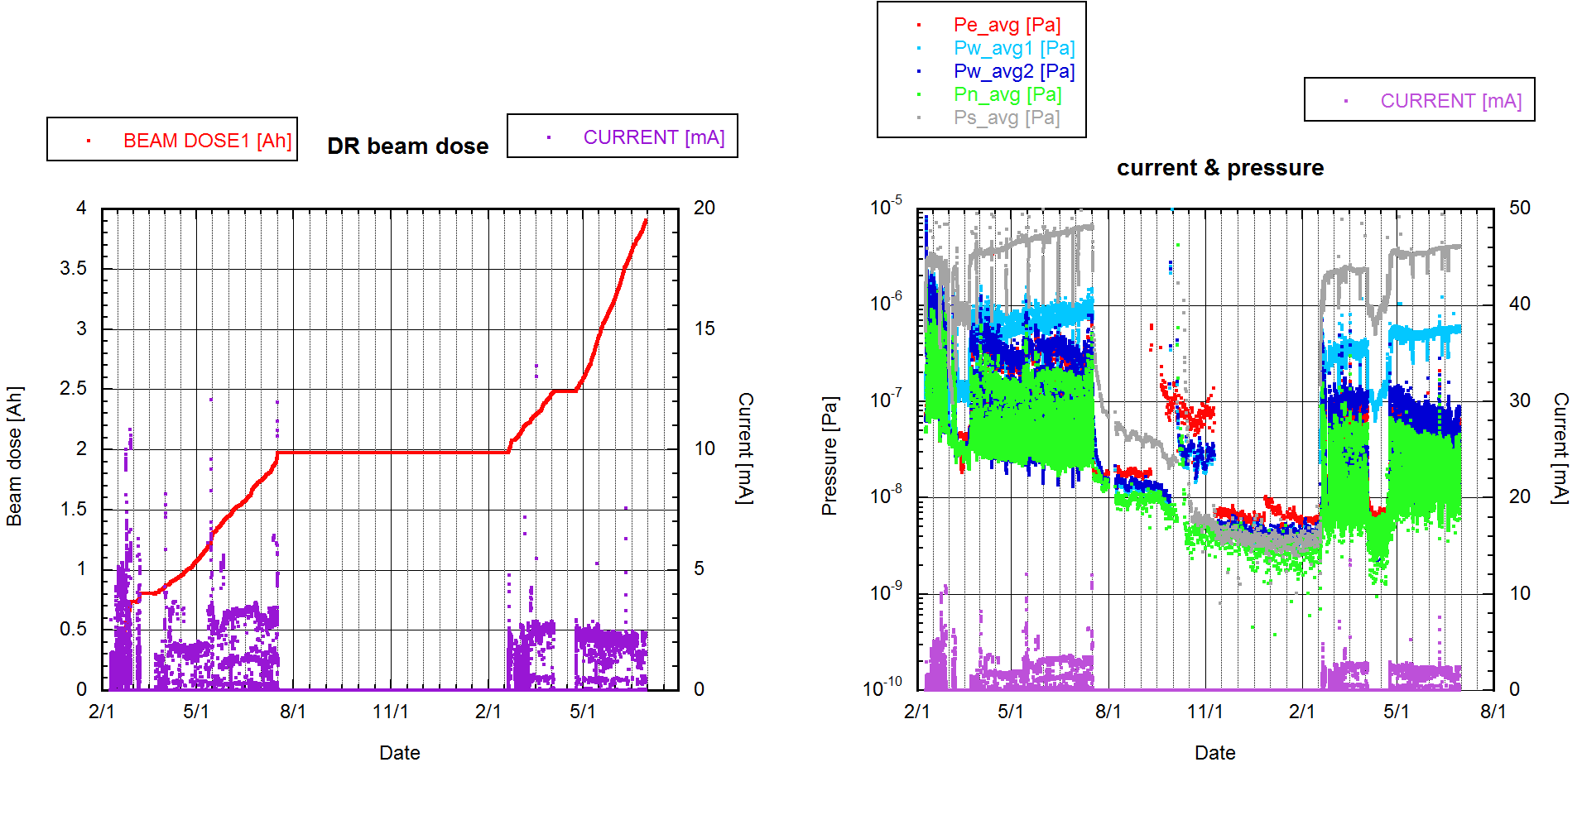
Present Status – vacuum scrubbing (DR)
DR
Beam dose: 3.9 Ah.
No trouble.

Slide 13
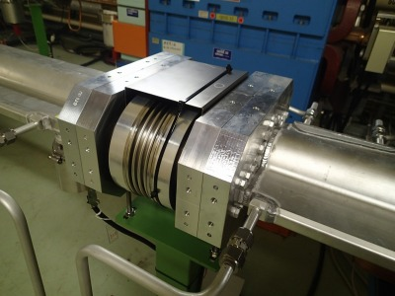
Present Status – ECE
R14.1: Continue the experimental investigation of electron cloud and the conditioning of the TiN coating. Implement the proposed test with permanent magnets on the antechamber of the drift beampipes.
In Phase-1, vertical beam size blow up and nonlinear behavior of pressures from I_{d}~0.1 by ECE were observed in LER.
The current linear density (I_{d}) is the bunch current divided by the bunch spacing.
The threshold was relaxed to I_{d}~0.2 by an installation of permanent magnets on bellows chambers.
A threshold in KEKB without solenoids was approximately I_{d}=0.04.
Permanent magnets and iron yoke on a bellows chamber
ECE in Phase-1 with/without permanent magnets in bellows chambers

Slide 14
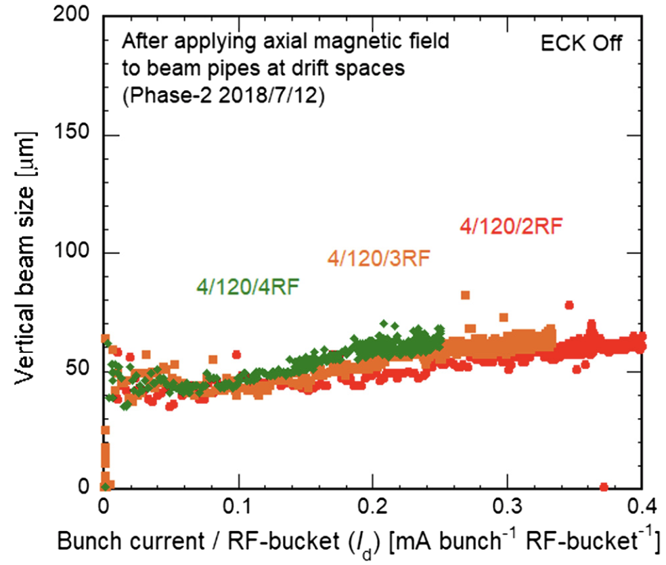
Present Status – ECE
Permanent magnets were installed on ~86% of the drift spaces before Phase-2.
The blowup was not observed by I_{d}=0.4 in Phase-2.
Approximately 91% of the drift spaces were covered with them before Phase-3.
The blowup was not observed by I_{d}=0.55 in Phase-3.
The design value is I_{d}=0.72 (3.6 A, 2500 bunches, 2 RF-bucket spacing)
ECE study in Phase-2
ECE study in Phase-3 (preliminary).
courtesy of H. Fukuma

Slide 15
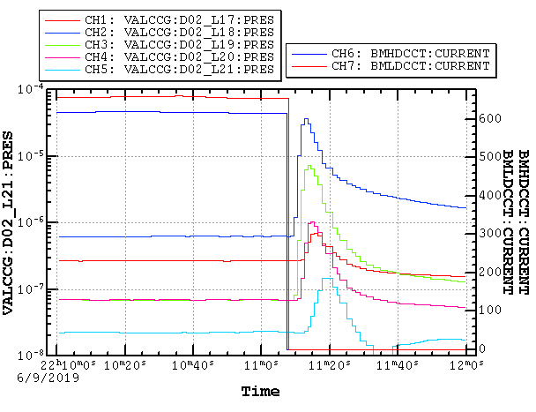
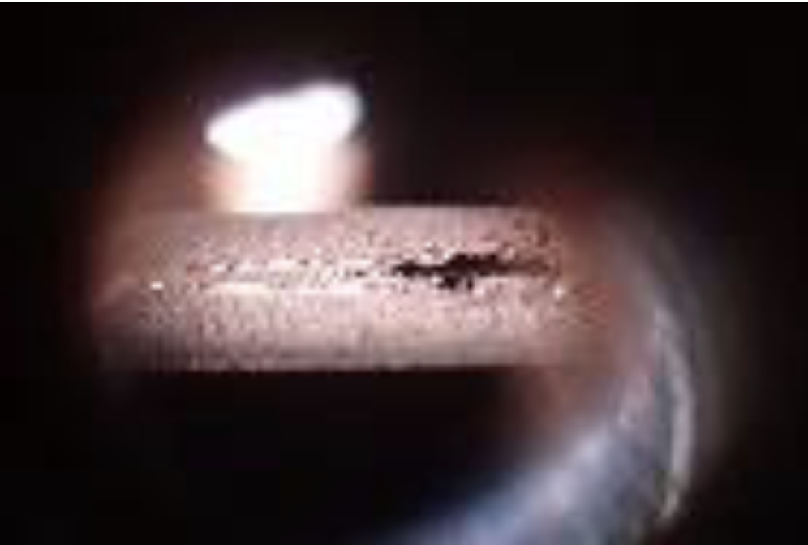
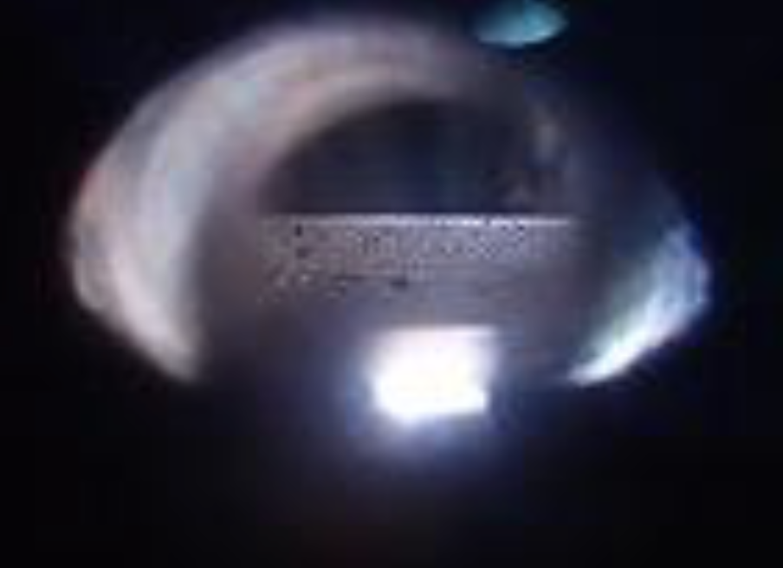
Present Status – problems
Collimators are quite effective to reduce BG.
Collimator damage
LER: A huge beam loss and pressure burst happened near D02V1 with a QCS quench at 22:11 June 9th, 2019 in Phase-3. Stored current was 660 mA. The tungsten tips of the jaws were damaged. After that we were not able to run the physics mode because of high backgrounds in this condition.
This is a similar situation as a QCS quench event in Phase-2, and we need the detailed analysis about this incident. One of the candidates that caused this incident is a dust event.
Photo of a bottom jaw in D02V1 taken from a view port
Photo of a top jaw in D02V1 taken from a view port
Pressure bursts near D02V1 collimator
beam
beam

Slide 16
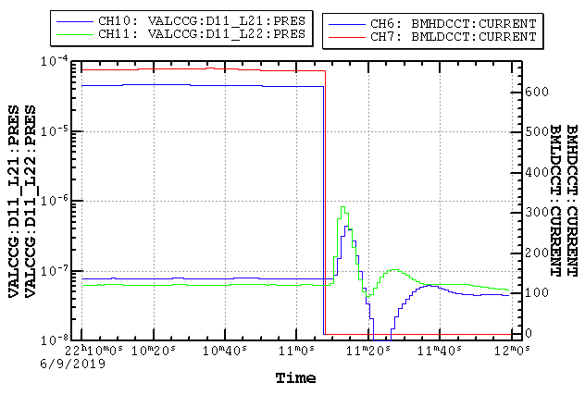
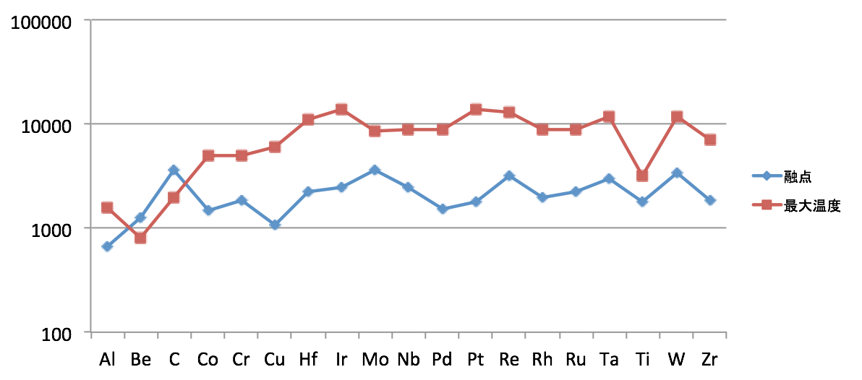
Present Status – problems
Collimator damage
At the same time, pressure bursts were observed in a beam pipe with a clearing electrode. → a dust event caused the beam energy loss?
We are plan to knock the beam pipes in wiggler section by next commissioning.
Any materials would melt if whole beams hit the jaw.
→ Need fast abort to avoid the damage!
Pressure bursts in NIKKO wiggler section
Maximum temperature induced by beam hit
(1×10¹² e-/pulse (16 mA), effective bunch radius: 50 μm, R.L. = 0.5)
Temperature [℃]
Melting point
Max. temp

Slide 17
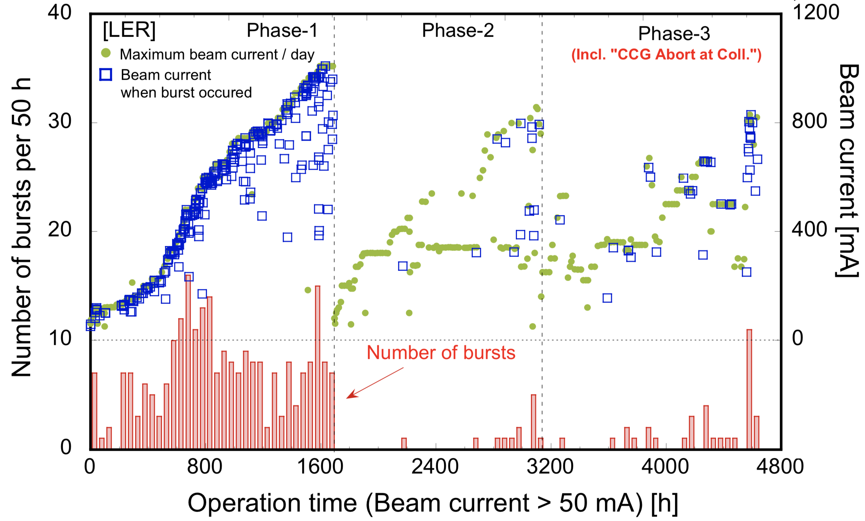
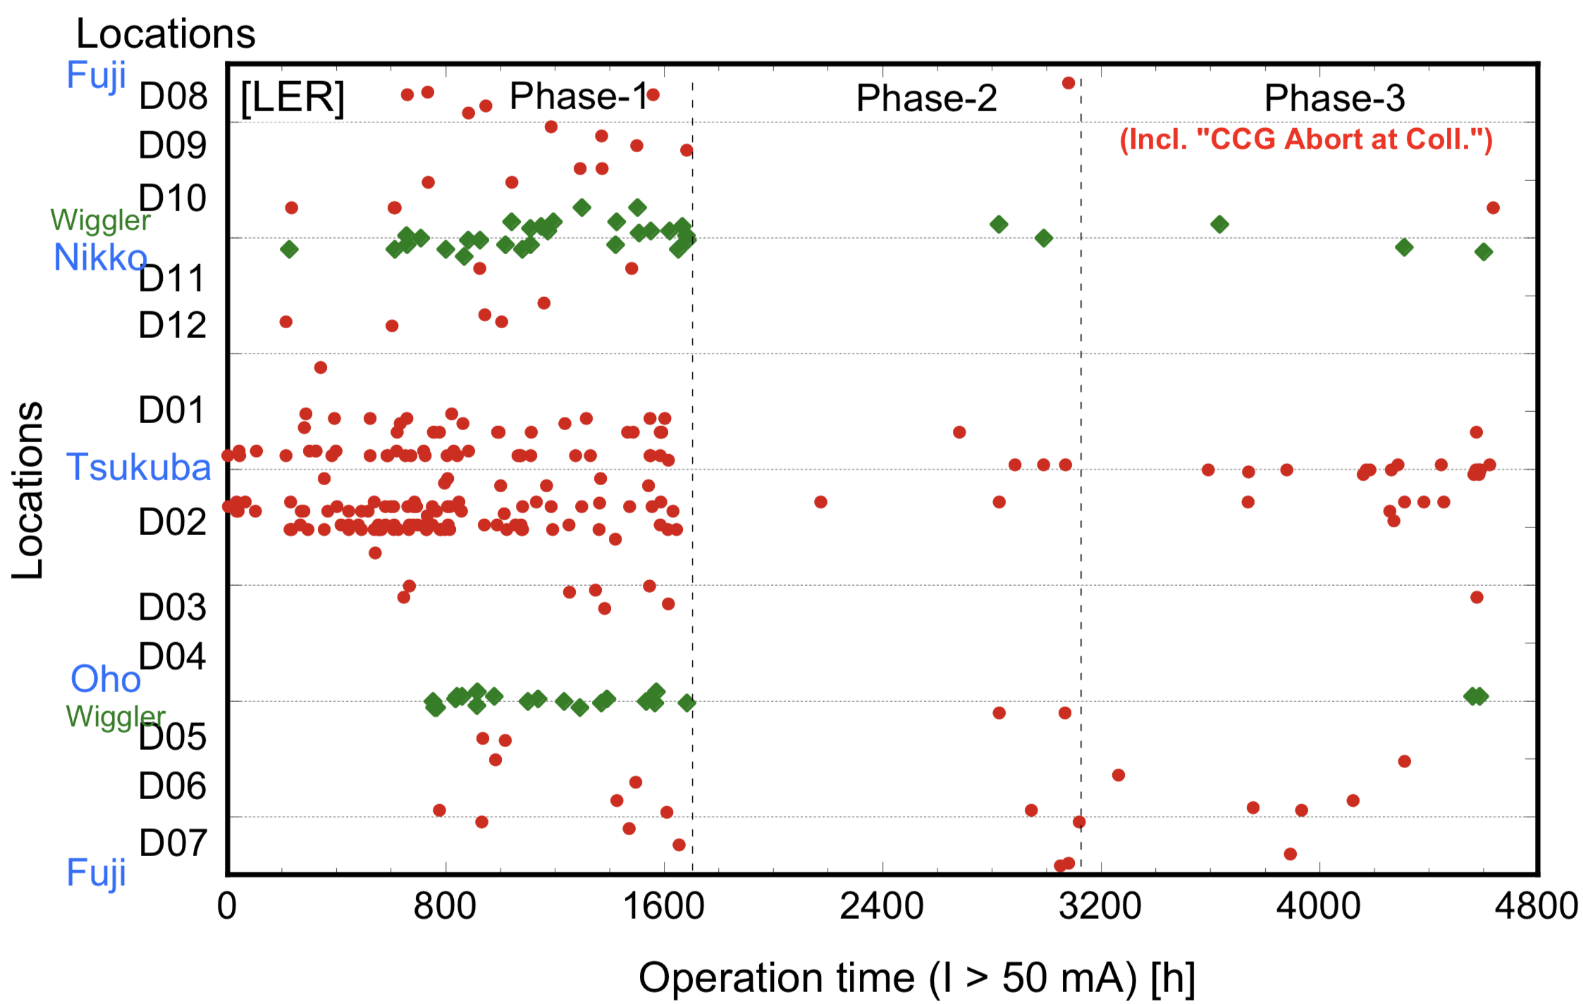
Present Status – problems
Dust events
The number of dust events has been decreasing with the operation time.
Aging effect by low current operation
Quick abort before a burst occurs
Dust drop by a knocker
However, it can cause beam energy loss.
→ drop dusts using the knocker before next commissioning
→ proposed an aging operation with high current before a physics run

Slide 18
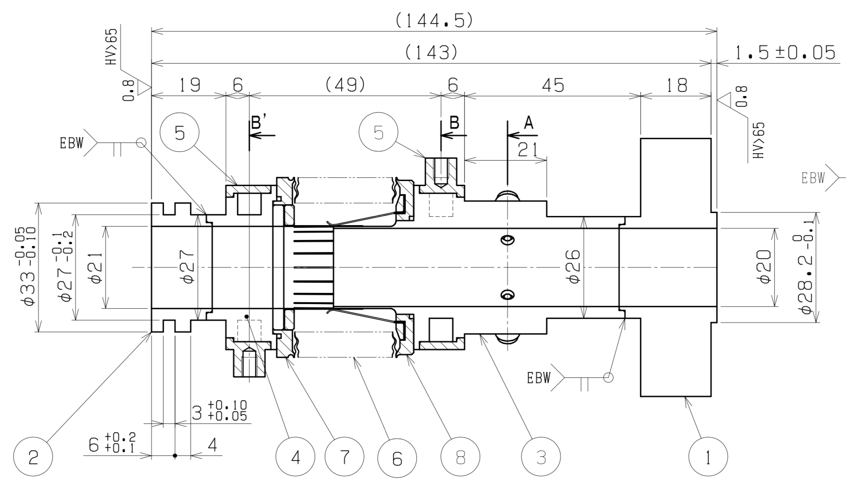
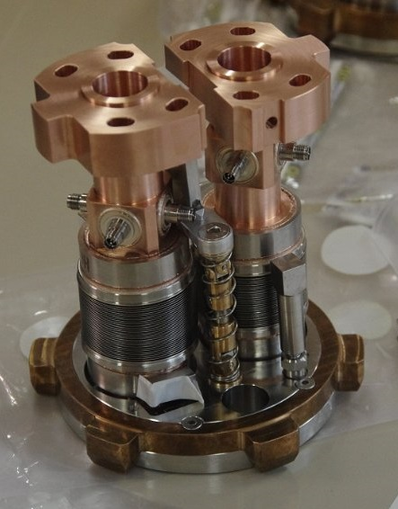
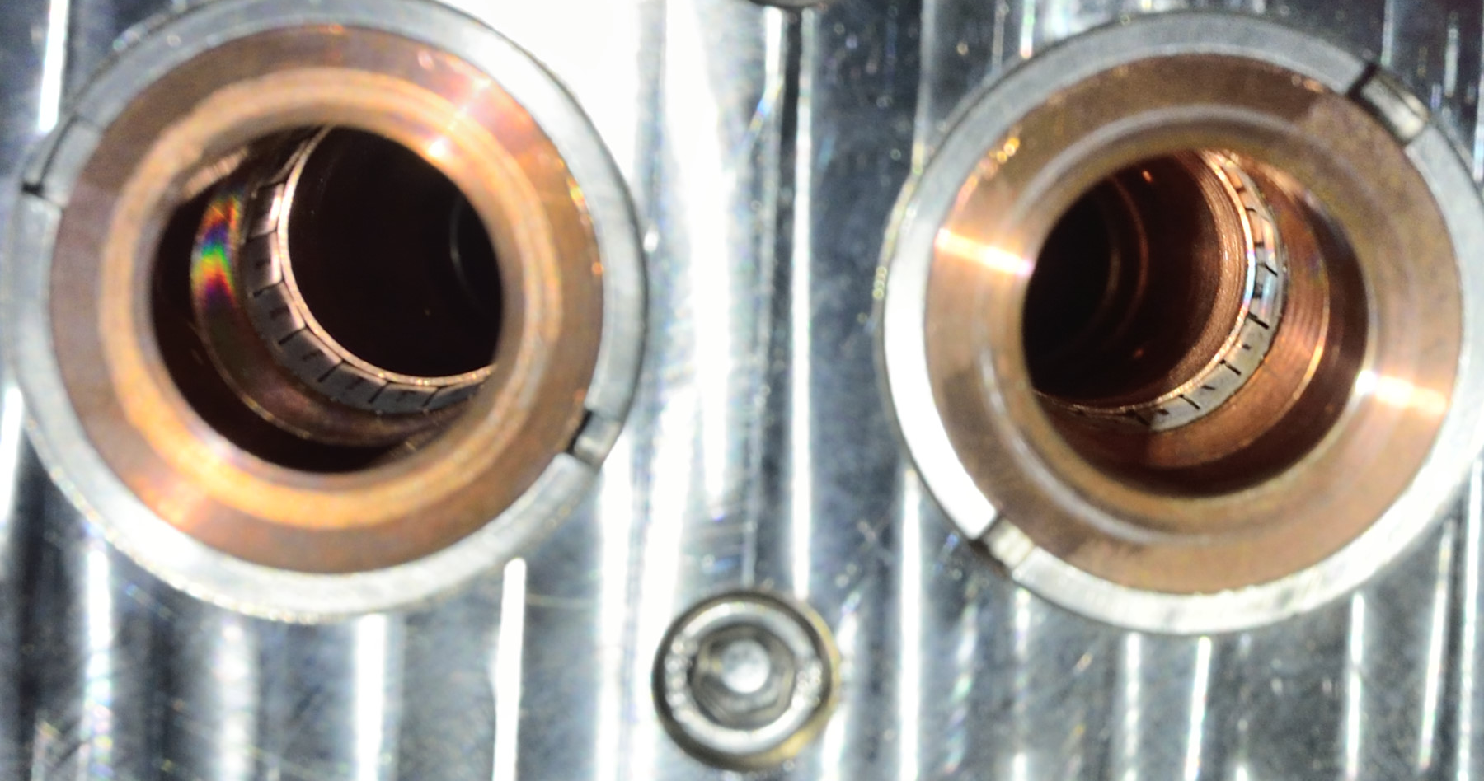
Present Status – problems
Temperature of IP bellows chamber in HER in Phase-3, which is between a QCS beam pipe and an IP chamber. ~60℃ （850 mA, 3.06RF, 1578 bunches）. This happened in 1 of the 4 bellows chambers.
The similar heating on an another one had also been seen in Phase-2. It was changed to new one before Phase-3.
The RF shield is a conventional fingers type. Fault of the electrical contact?
→ We have a plan to replace it with new one in this summer shutdown.
Temperature of IP bellows chamber
3.06sp, 1576 bunch
6.12sp, 789 bunch
Detached IP bellows chamber after Phase-2
Discharged mark
・This finger was off after the installation and put it back before Phase-2.
・This happened in 1 of the 4 chambers.

Slide 19
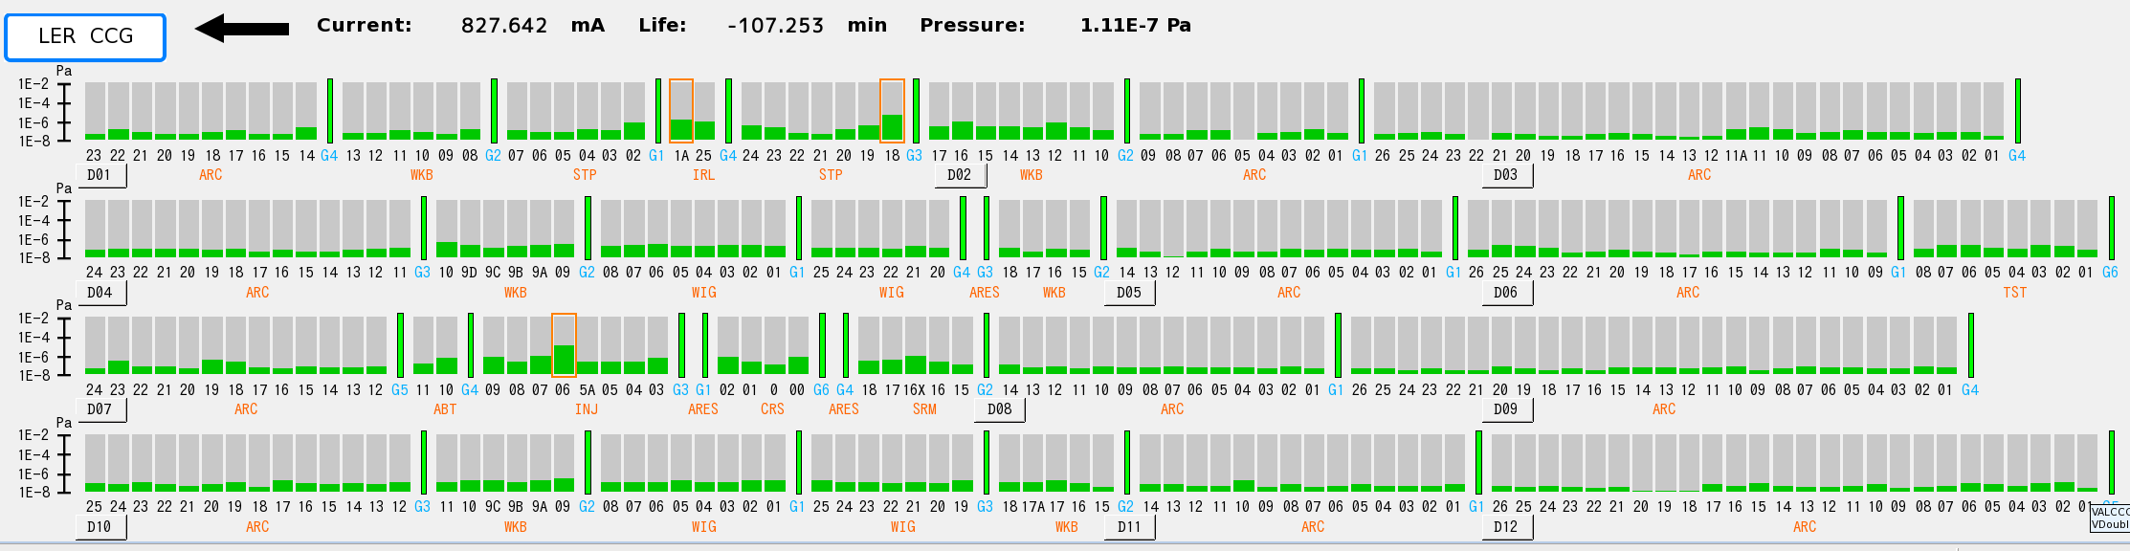
Present Status – problems
Pressure upstream of IP in LER.
Vacuum component is dominant for BG in LER.
Especially, pressures near D02V1 and D02H1 are high.
D02H1 collimator had a water leakage trouble before Phase-3, so it could raise the pressure.
→ try baking these collimators and beam pipes in tunnel
IR
D02V1
D02H2
D02H1 (water leakage)
D03H1
D06V2
D06H1

Slide 20
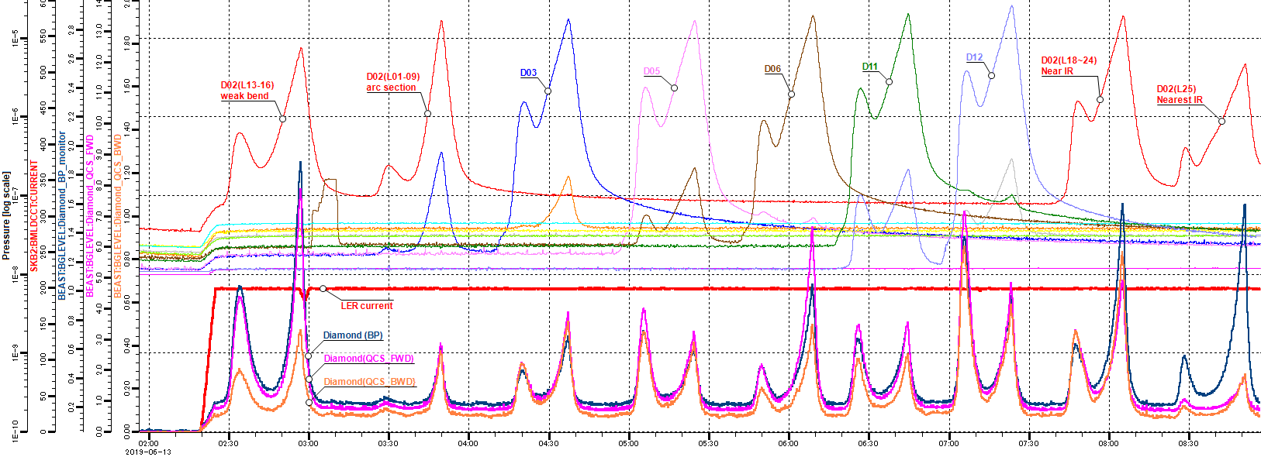
Present Status – problems
Pressure upstream of IP in LER.
Vacuum bump study using NEG pump heating in Phase-3
D02, D06, D12 seem to be sensitive to BG.
courtesy of H. Nakayama

Slide 21
Summary and plans
Vacuum scrubbing is going well.
Countermeasures for ECE in LER are quite effective.
Problems:
Collimator damage
Dust events
BG in derived from vacuum
IP bellows chamber heating
Near Future Plans:
Change the damaged collimator(D02V1 bottom) in the summer/winter.
Knock beam pipes in LER.
Try baking collimators in tunnel.
Change IP bellows chamber in this summer shutdown.
Add a vertical collimator at D06V1 in LER in the winter shutdown.

