Slide 1
Main Ring Magnet System
Phase 2 & Phase 3
Magnet group
T. Adachi, K. Egawa, T. Kawamoto, R. Sugahara,
M. Masuzawa, Y. Ohsawa,
S. Nakamura, T. Oki, R.Ueki

Slide 2
Contents
Introduction to the MR Magnet System
Operation and work summary
  Magnets
  Power supplies (MR normal & QCS)
  Survey and tunnel motion
Summary

Slide 3
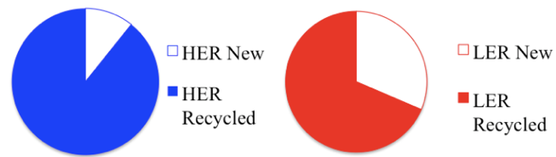
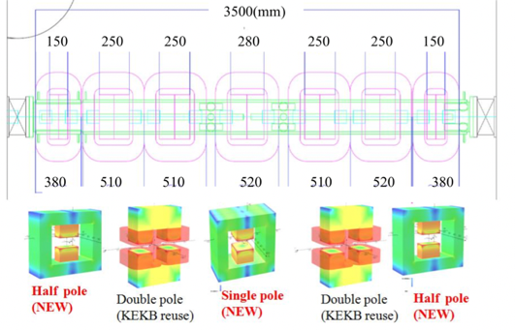
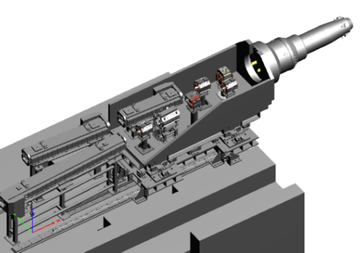
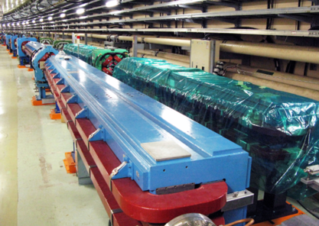
Introduction to the MR Magnet System
Ring | # of larger magnets Water-cooled/air cooled | Corrector magnets (air-cooled)
HER | 740/6 | ~420
LER | 986/12 | ~410
More than 1700 water-cooled magnets
More than 800 air-cooled corrector magnets
Integration of this large system went well,
which contributed to a smooth start-up of the MR in Phase 1.
Breakdown
Recycled & Newly fabricated
Examples of new magnets
IR and the straight sections at both sides of the IP
(HER and LER)
LER wiggler section
New layout
LER B

Slide 4
Magnets

Slide 5
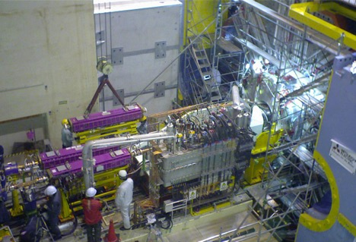
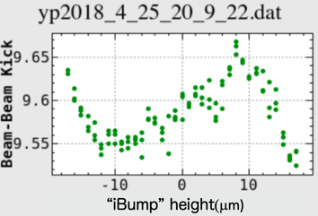
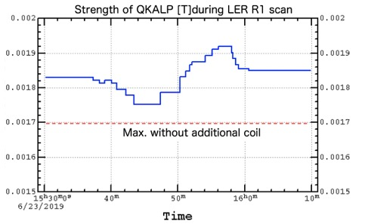
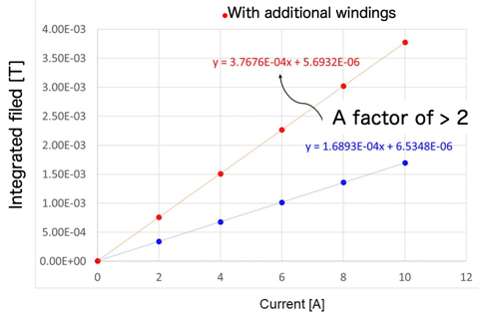
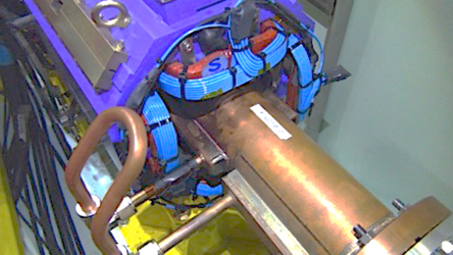
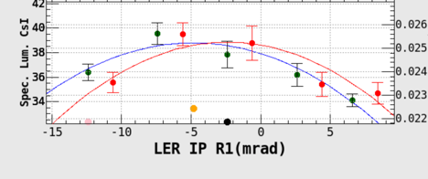
Operation and work summary
Magnets
IR construction (Phase 2) & Re-construction (Phase 3)
The 1st beam-beam deflection signal, obtained by shifting the electron beam (HER) by ~30 μm using a set of dipole corrector magnets in the HER.
From Phase 2 to Phase 3: IR skew quads
Skew quad strength increased from 0.0017 to 0.0038 [T] by adding more turns, for a larger knob tuning range (R. Ueki).

Slide 6
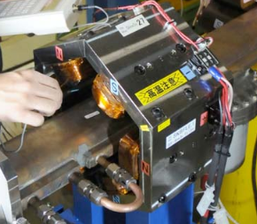
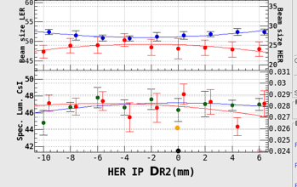
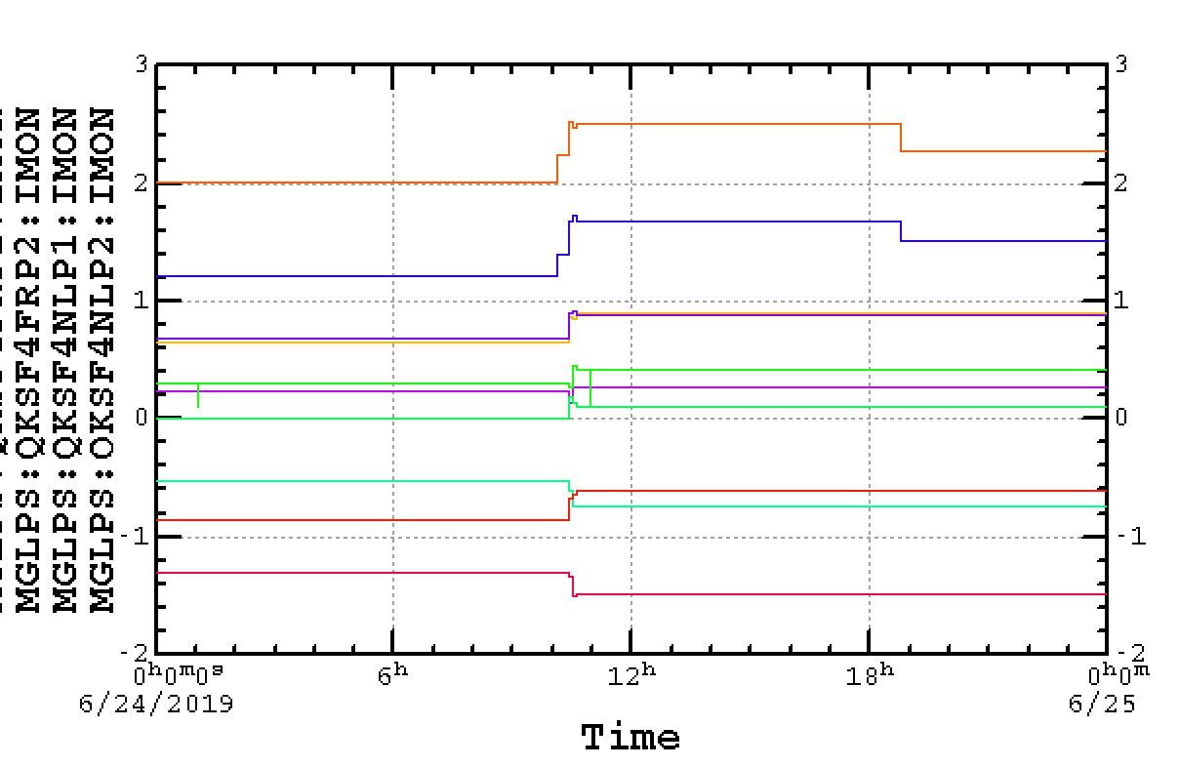
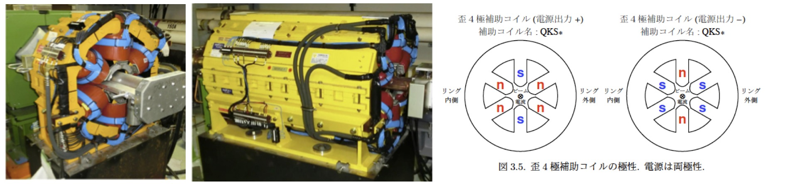
Operation and work summary
Magnets
From Phase 2 to Phase 3: Skew sextupoles
The skew sextupole magnets used for KEKB luminosity tuning were hocked back up in HER.
This is done partially to determine the specifications for the SuperKEKB skew sextupoles magnets.
From Jun 22 swing shift report:
HER IP chromaticity scan
→Not sensitive, limited by hardware tolerances
More study is probably needed to determine the specifications.
We would also like to see the effects of the LER tilting sextupole magnets in Phase3-2.
From Phase 2 to Phase 3:
# of skew quadrupole correctors in the arc sections was doubled by installing more power supplies the skew windings on the sextupole magnets.
Example:
Skew quad coils on sextupoles used (LER optics correction)

Slide 7
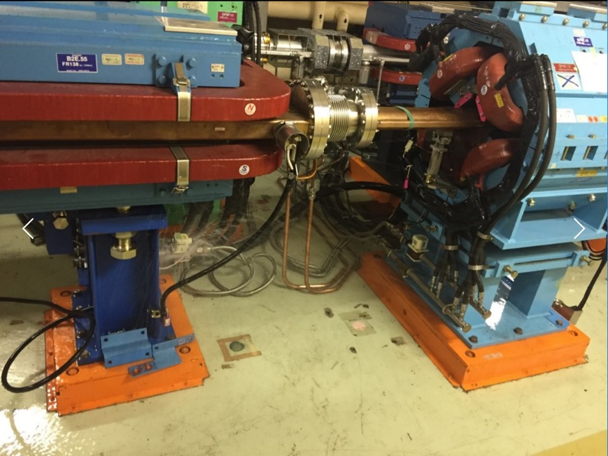
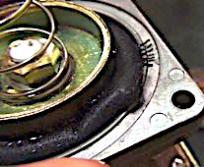
Operation and work summary
Magnets
Troubles : Water leak from the flow switch of an HER dipole magnet
→ Interlock → Beam abort on April 15, 2018 (Phase 2)
Diaphragm type flow switch
Photo by Y.Ohsawa
Degraded over time (~20 years since KEKB startup) is the cause of this. All of the water-cooled magnets recycled from KEKB (more than 1000 !) face this aging issue
We replaced all the flow switches of the HER dipoles in the fall of 2018, as a start.
We will replace the flow switches of the HER quads in this summer.

Slide 8
Power Supplies

Slide 9
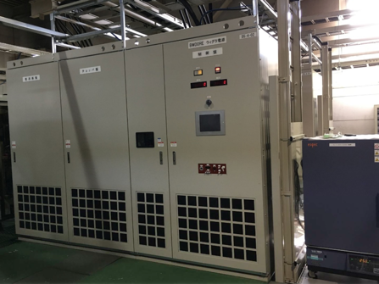
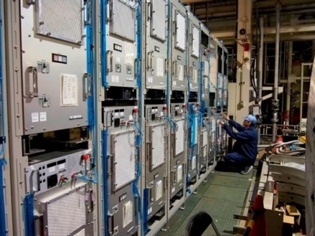
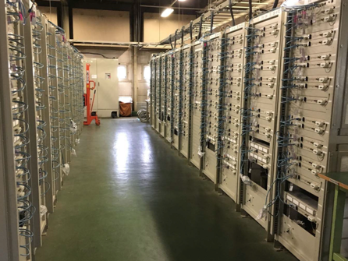
Operation and work summary
Power supplies
Main Ring power supplies
Output power | New | From KEKB (# overhauled) | Magnets
0.95 MW | 2 | 0 | Main dipoles
0.4-1 MW | 9 | 0 | Wigglers
0.1-0.5 MW | 0 | 18# | Main quadrupoles
2-105 kW | 92 | 335# | Bend./Quad./Sext.
0.3-2.4 kW | 138 | 1681 | Steering magnets/correction coils
Total | 359 | 2034 | 2393 power supplies (as of June 2016)
Large class PS
Medium class PS
Small class PS

Slide 10
Operation and work summary
Power supplies
MR PS: # of Failures in Phase 1, 2 and 3 (by S. Nakamura)
Failures in Large class PS (BM / Wiggler) | # of event (P1→P2→P3) | comment
AC input over current | 13 → 1 → 0 | AC Line distortion
AC input Stop, CB Fault | 6 → 0 → 0 | Earthquake
Thermostat | 1 → 2 → 0 | High ambient temperature
Failures in Medium class PS (Quad. / Sext. / local Bend) | # of event (P1→P2→P3) | comment
IGBT module fault / Over current | 6 → 1 → 0 | Modules were replaced.
Cable GND fault | 1 → 0 → 0 | Cable fault.
AC over current | 0 → 2 → 0 | Most likely false alarm.
External I/L | 3 → 1 → 6 | Low magnet water flow.
Tracking error / Over voltage | 3 → 0 → 2 | Fault in the polarity inversion circuit(P1). Fault in the control board(P3).
Thermostat | 7→ 13 → 1 | High ambient temperature & Failure in the thermostat.
Magnet cooling water flow switch level set too high (human error)
Workers not well trained…we will be careful next time.
Failures in small class PS | # of event (P1→P2→P3) | comment
DC-DC board failure Output over voltage etc. | 10 → 2 → 0 | Power supplies themselves were replaced.

Slide 11
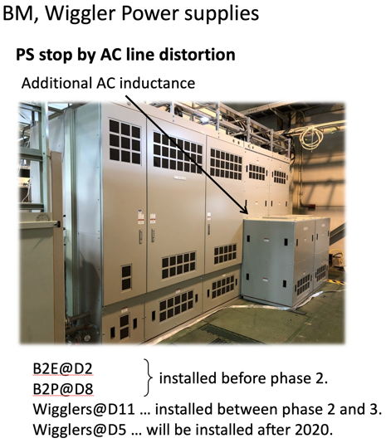
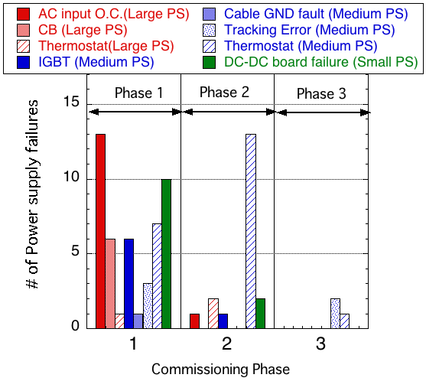
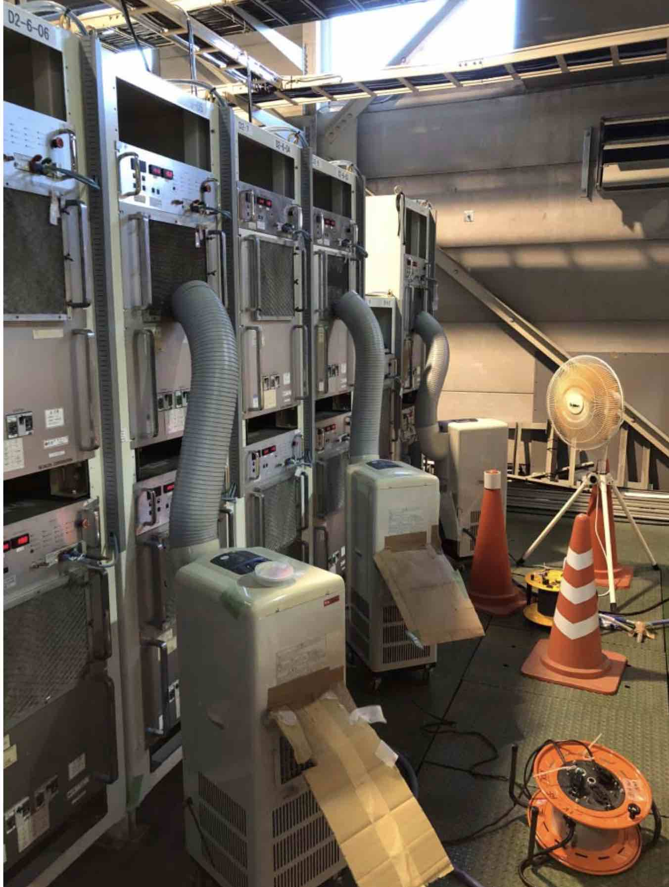


Operation and work summary
Power supplies
MR PS: # of Failures in Phase 1, 2 and 3 (by S. Nakamura)
PS stop due to AC line distortion
# of thermostat interlocks
(due to overheating) are reduced after increasing the # of outside air intake fans to the utility buildings and spot coolers etc.
No more “AC input O.C. ” due to AC line distortion after we installed additional inductance

Slide 12
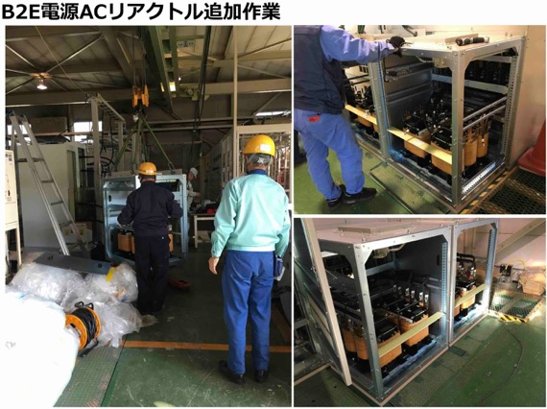
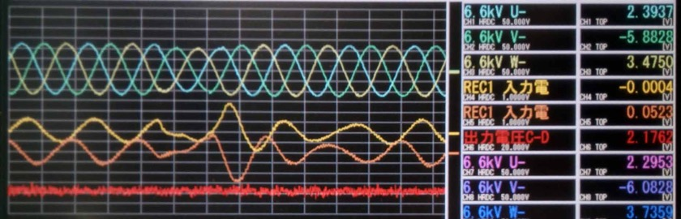
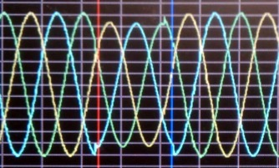
Operation and work summary
Power supplies
No more PS failure from “AC input O.C. ” caused by AC line distortion.
Adding reactance to the circuit
PS stop due to AC line distortion
The current surge due to a voltage drop becomes smaller.
PS failure from O.C. (over current) does not happen.
Coils
Stable operation
  Example of AC distortion, RF crowbar work
13% drop

Slide 13
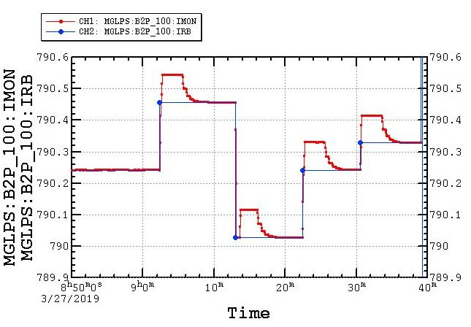
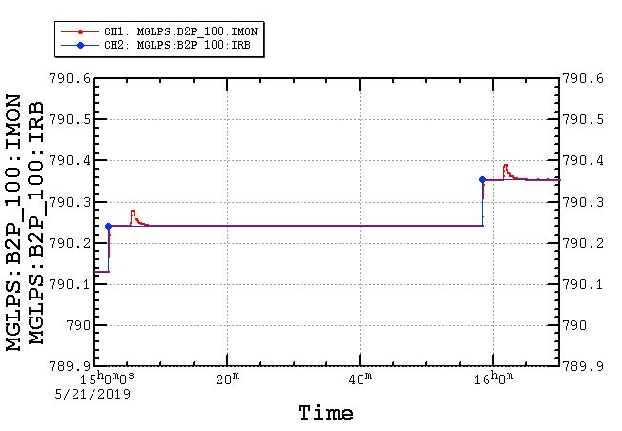

Operation and work summary
Power supplies
Overshoot problem with Large Scale power supplies (Hitachi) and QCS power supplies (Nichikon)
Digital feedback program is modified.
(LER Dipole power supply case is shown as an example)
Still some overshoot is seen in the Hitachi power supplies.
The new program is being tested now.
There is no overshoot problem any more with the QCS power supplies (Nichikon).

Slide 14
QCS Power supplies

Slide 15
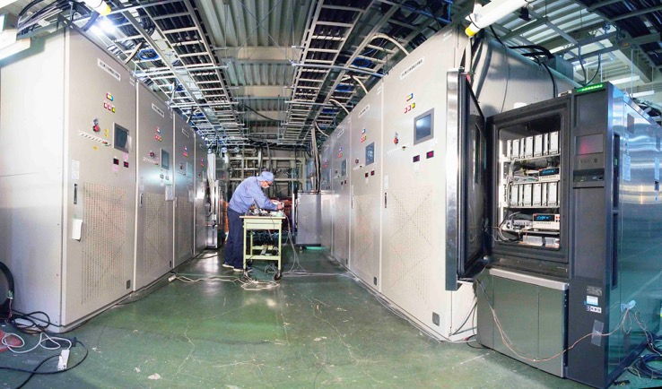
Operation and work summary
Power supplies
QCS power supplies
Magnet | Rated Output | # of PS’s
Main Quads | 2000A, 15V | 8
Correctors | ±70A, ±10V | 43 + 2 (Spare)
ESL (Compensation solenoid) | 410A, 30V | 1
ESR1 (Compensation solenoid) | 455A, 45V | 1
ESR23 (Compensation solenoid) | 155A,15V | 1
Main quadrupole magnet:
Stability : 2 ppm/8 hours
Ripple: 1 ppm
Correction coils:
Stability : 5 ppm/8 hours with low cost
From T. Oki (KEKB Review 2018)
More work still needed to realize this stability

Slide 16
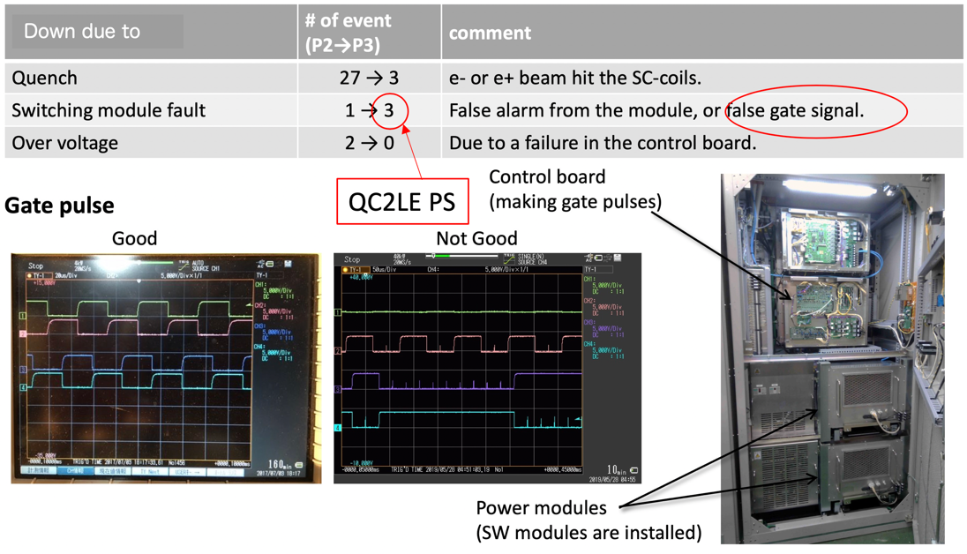
Operation and work summary
Power supplies
QCS power supplies
We replaced these modules, but that did not cure the "gate signal going nuts suddenly” disease. The control board sent back to Nichikon has not shown any problems so far. Investigation continues.
For the fall run, we will prepare a fast abort signal (10 + a few μs and transmission time from the IP to the abort kicker) for the case where the QCS power supply self-diagnoses a problem.
Trigger signal can be issued within (10 + a few) μs

Slide 17
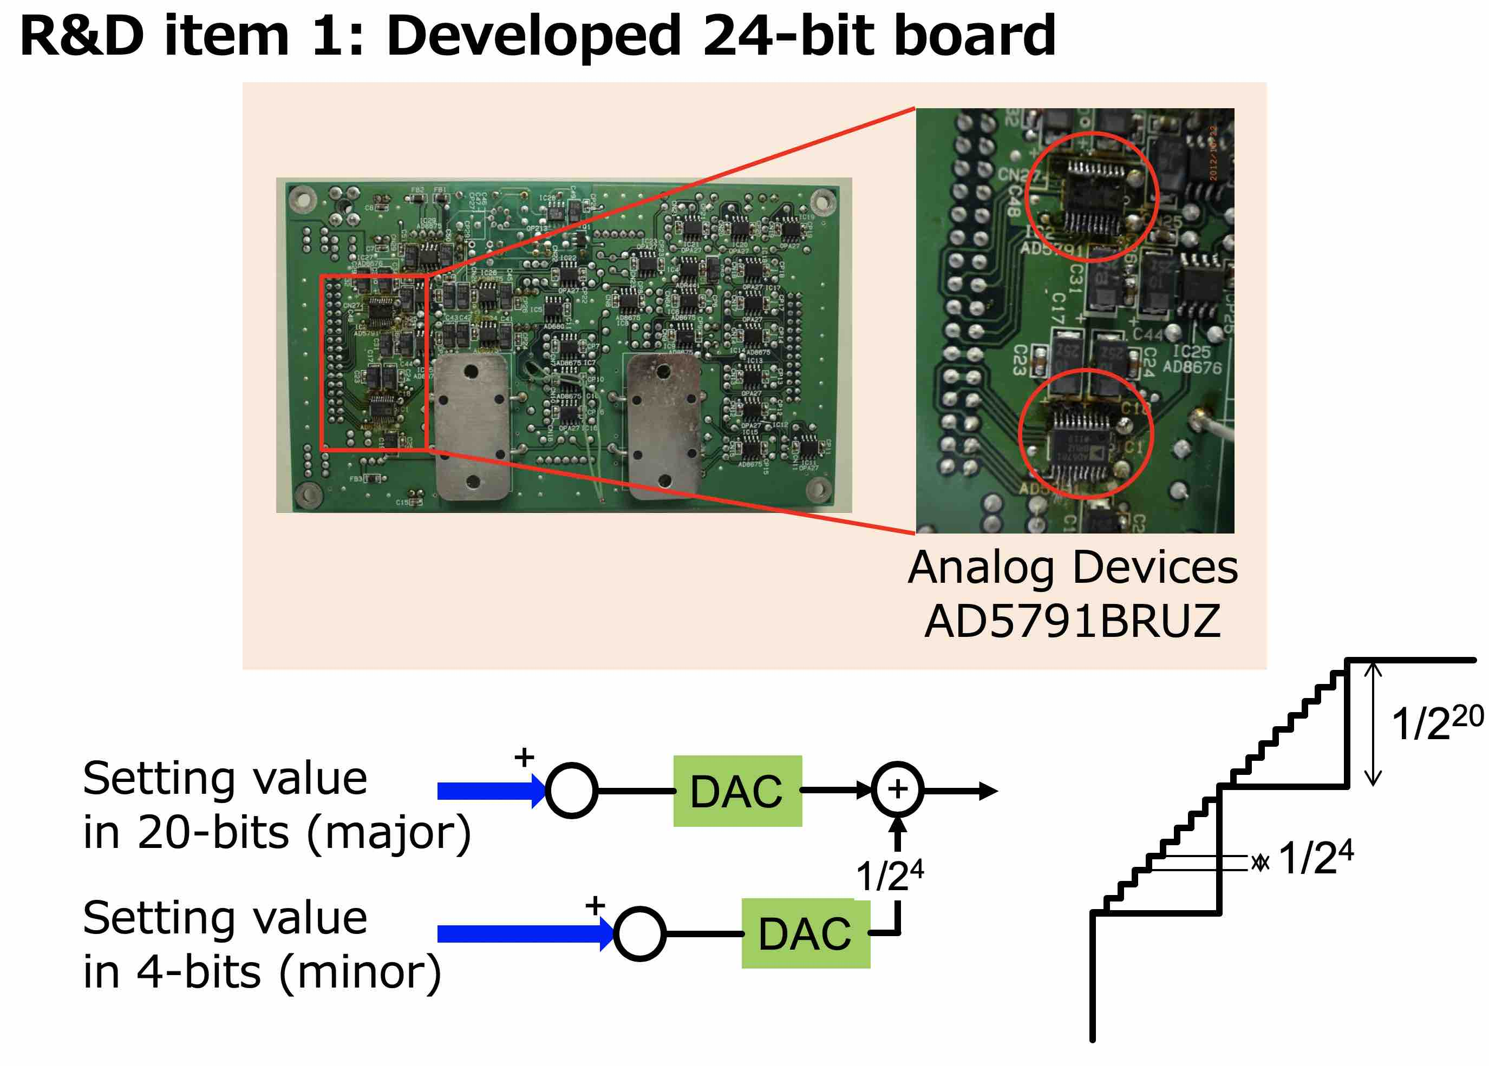
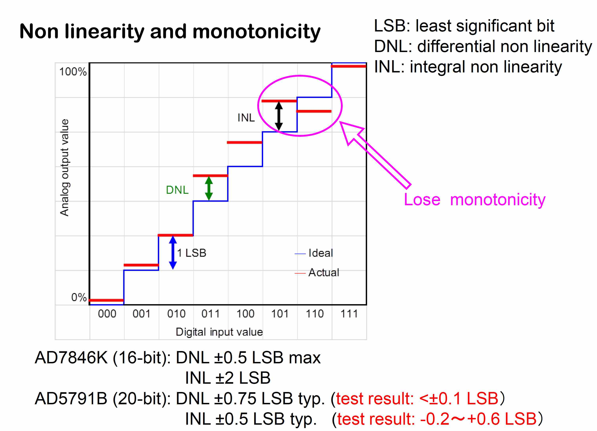
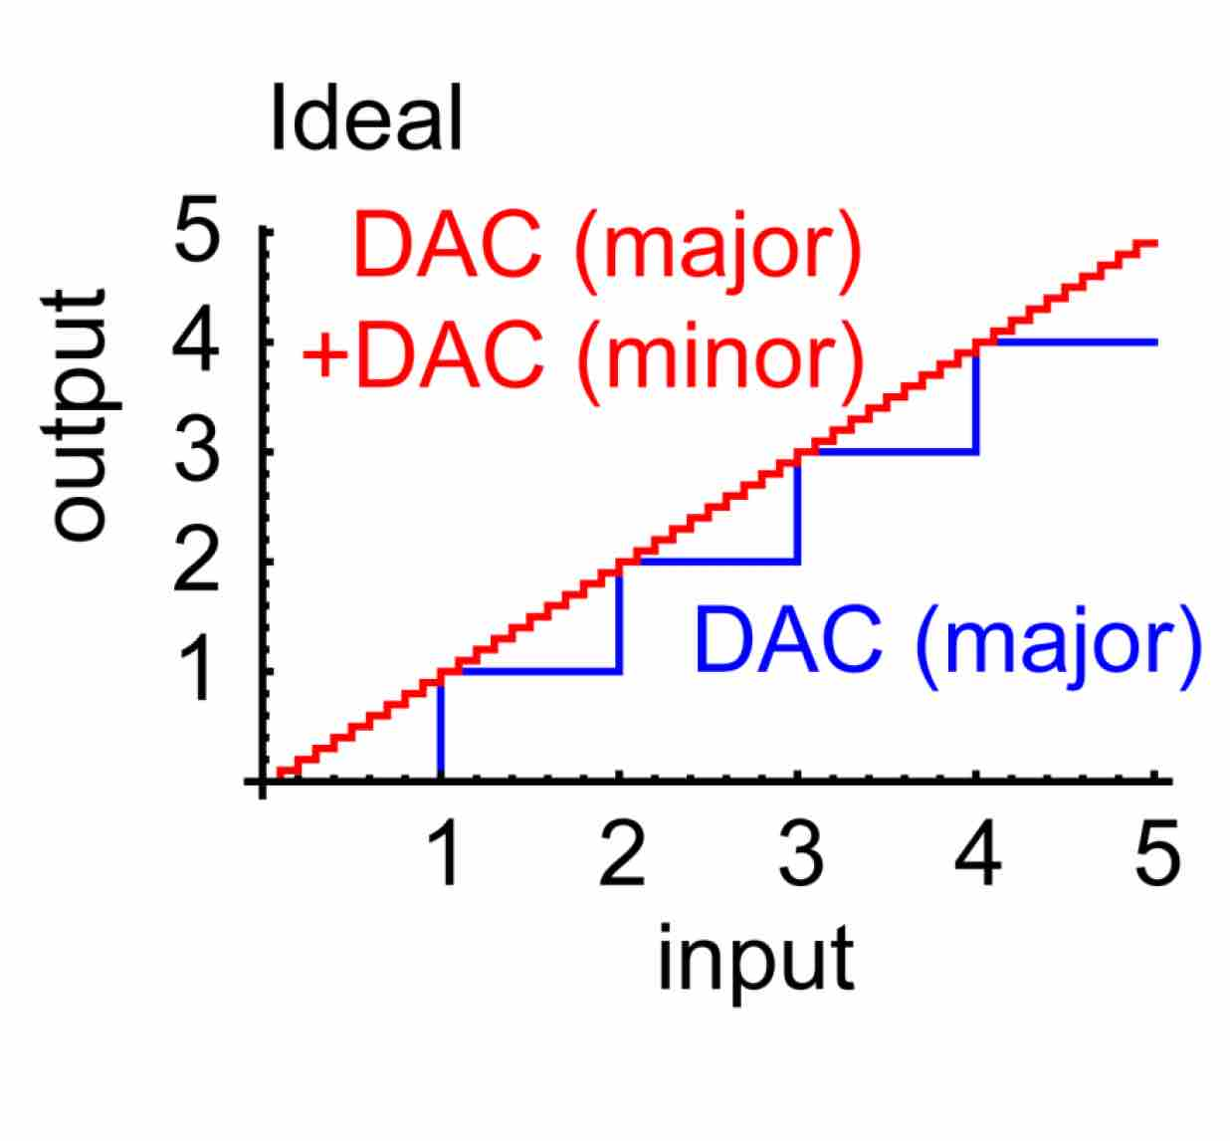
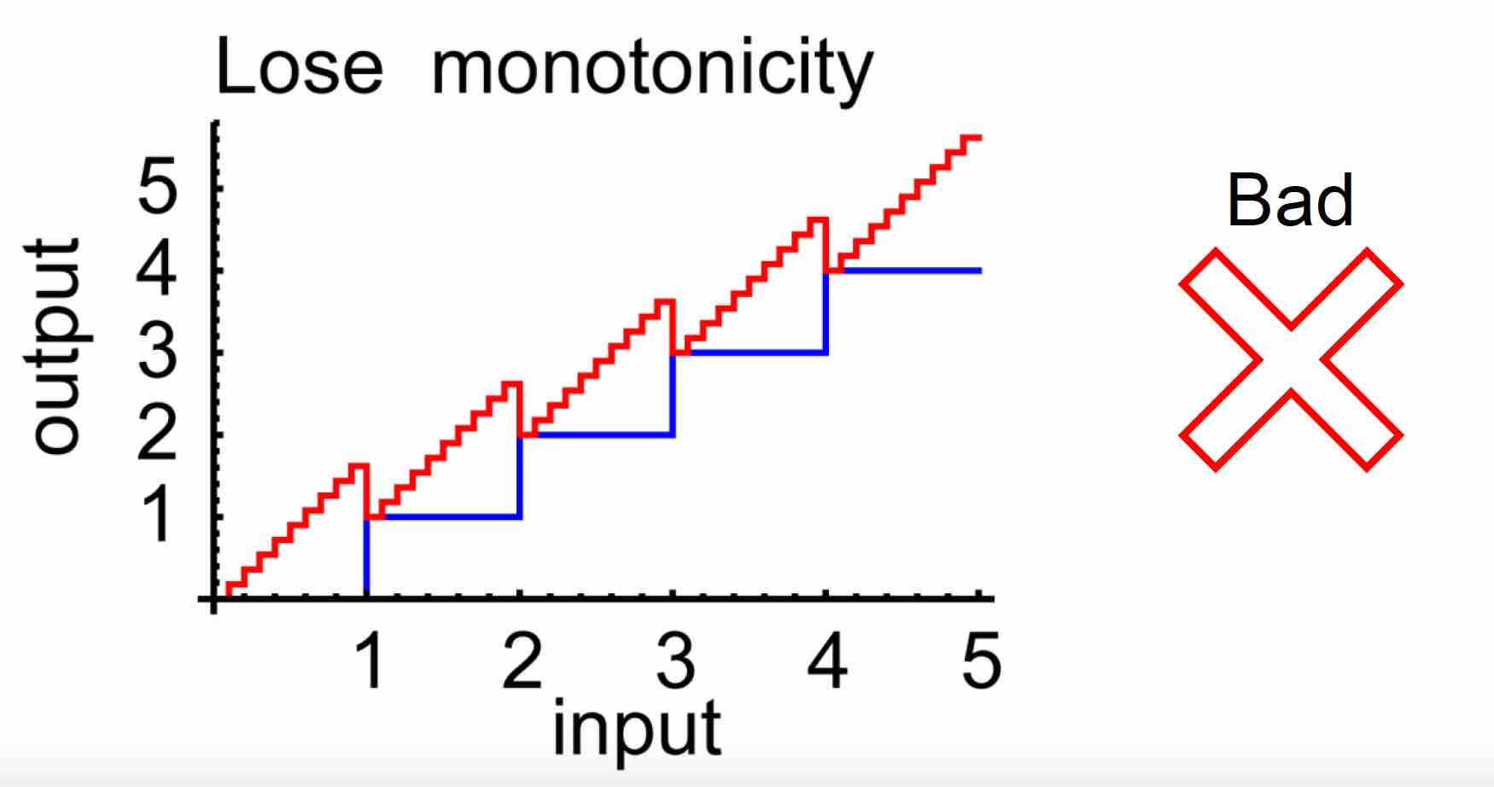
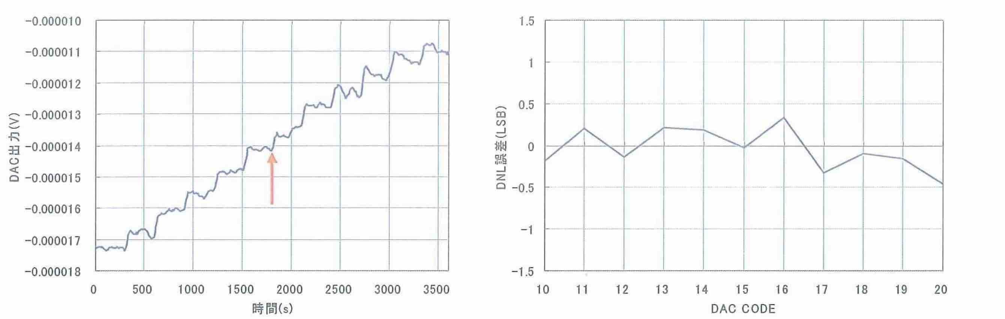
QCS power supplies (in response to the 22nd KEKB Review)
R19.1: A significant test should be made on the monotonicity of the digital feedback path with the two 20-bit DACs, extending over the change-over between the 2 DAC systems (i.e with more than 16 counts, and including studies over a significant dynamic range of the output).
Test carried out on the monotonicity with the actual PS
Monotonicity confirmed

Slide 18
Survey and tunnel motion

Slide 19
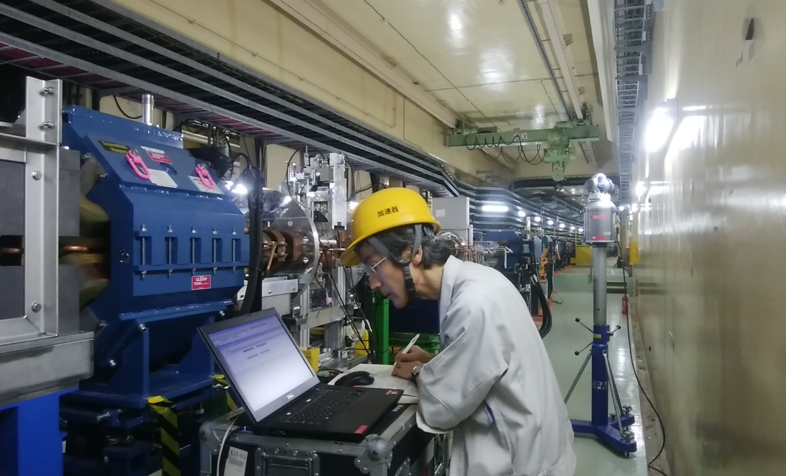
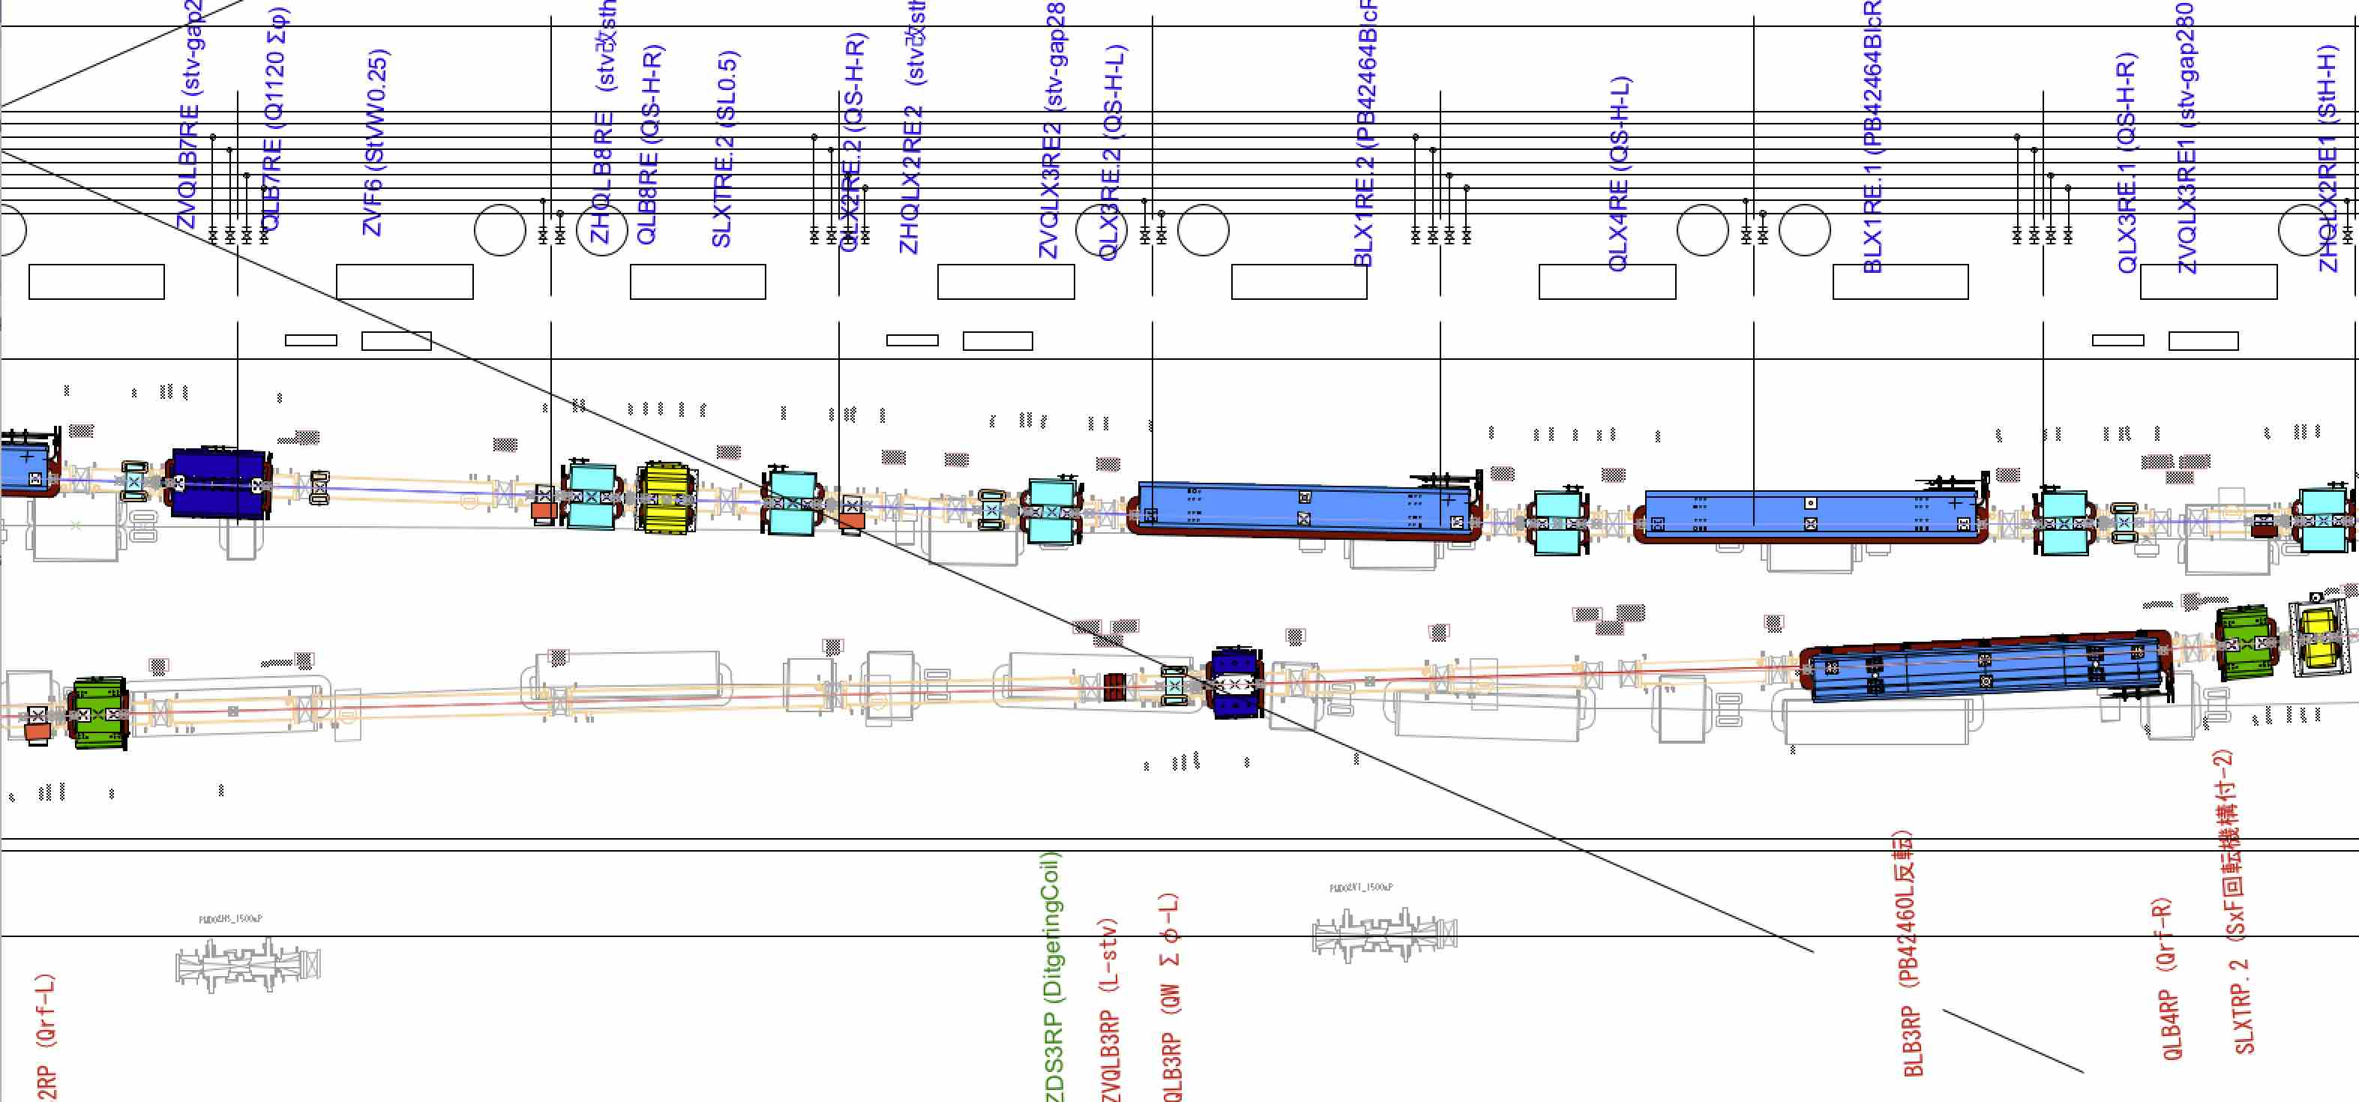
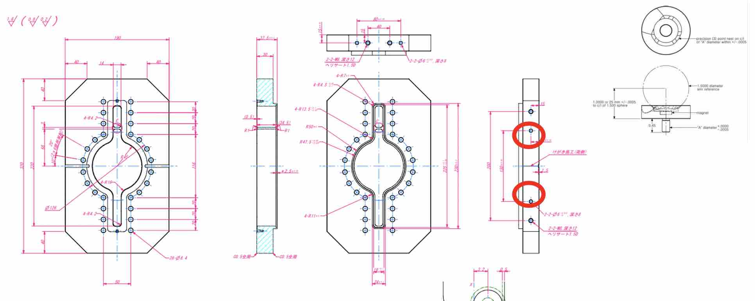
Operation and work summary
Survey & tunnel motion
Requested to survey and help re-aligning the collimators by the vacuum group after Phase 2.
We did a survey using a laser tracker and found out that
D2V1 collimator was off by a few millimeters.
D1V1 collimator was off by about 1mm.
Defining the beam line in such a place (between a dipole and quadrupole) is not really possible without a laser tracker.
Vacuum group will prepare holes for holding a LT target.
Photo by S. Terui

Slide 20
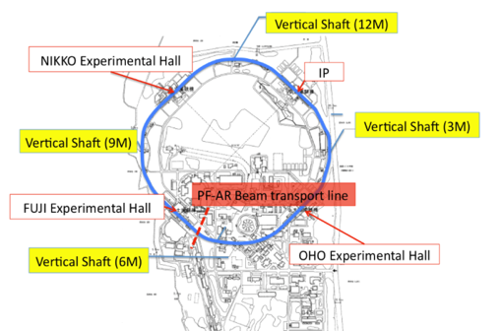
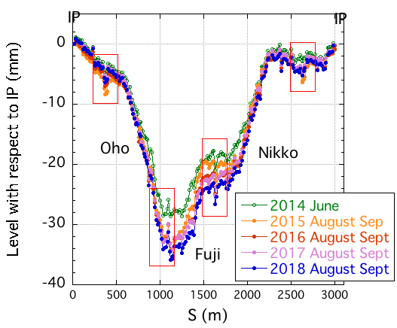
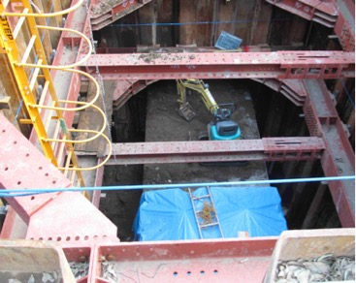
Operation and work summary
Survey & tunnel motion
Vertical shaft at 12C
Effects of the construction of the new facility buildings are still seen by tunnel level survey.
Average rate of sinking is ~ 1.9 mm/year.
Photo by Y.Ohsawa

Slide 21
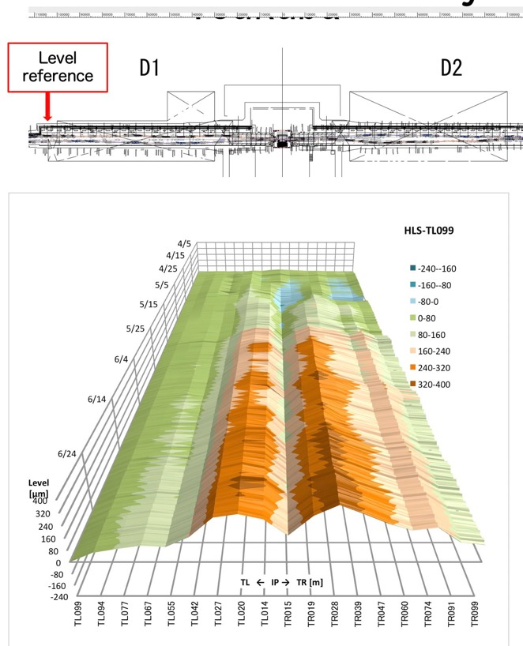
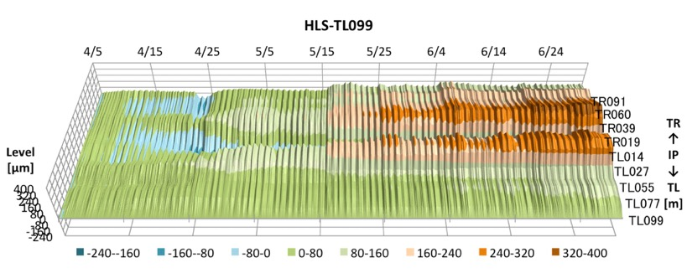
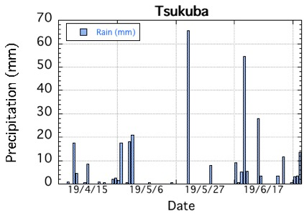
Operation and work summary
Survey & tunnel motion
HLS sensor by BINP
(Hydrostatic water Leveling System)
There are 18 HLS sensors at the Tsukuba straight section.
Some seasonal effects are seen.
We suspect that the level change has something to do with the ground water (rain, pumping for rice planting…).
The floor level changed during Phase 3.
IP has become a local minimum.
by T. Kawamoto

Slide 22
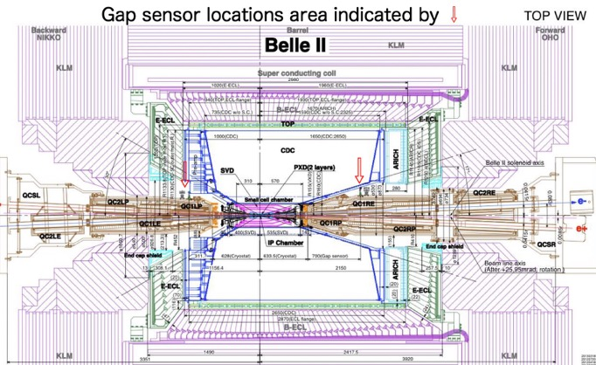
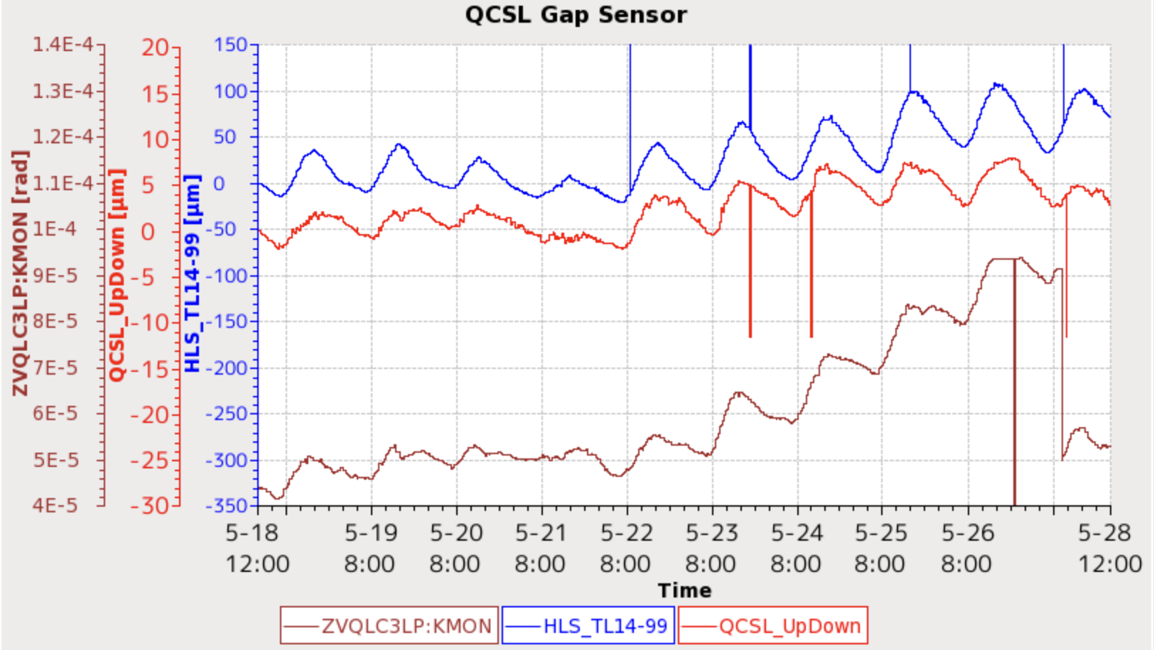
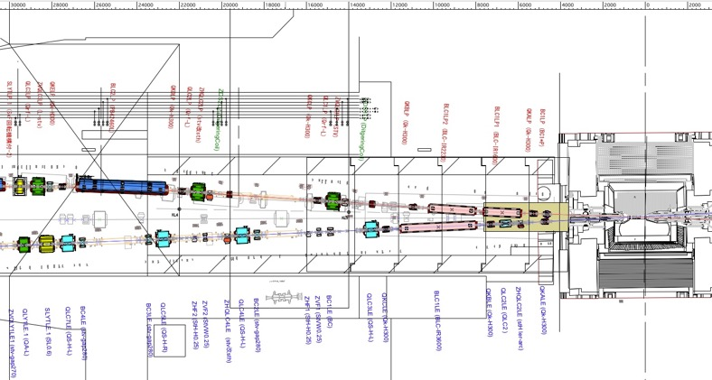
Operation and work summary
Survey & tunnel motion
HLS@14m from IP
Gap sensor
Vertical steering (ZVQLC3LP)
kick angle
Gap sensors measure the distance between QCS cryostat and CDC
by T. Kawamoto

Slide 23
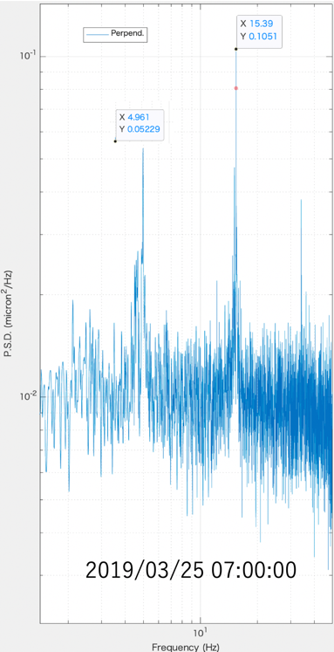
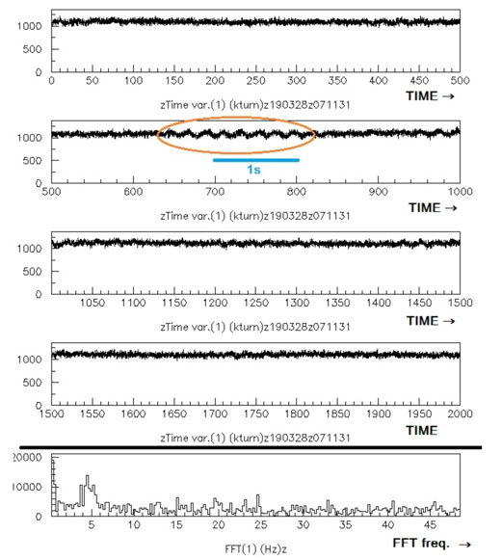
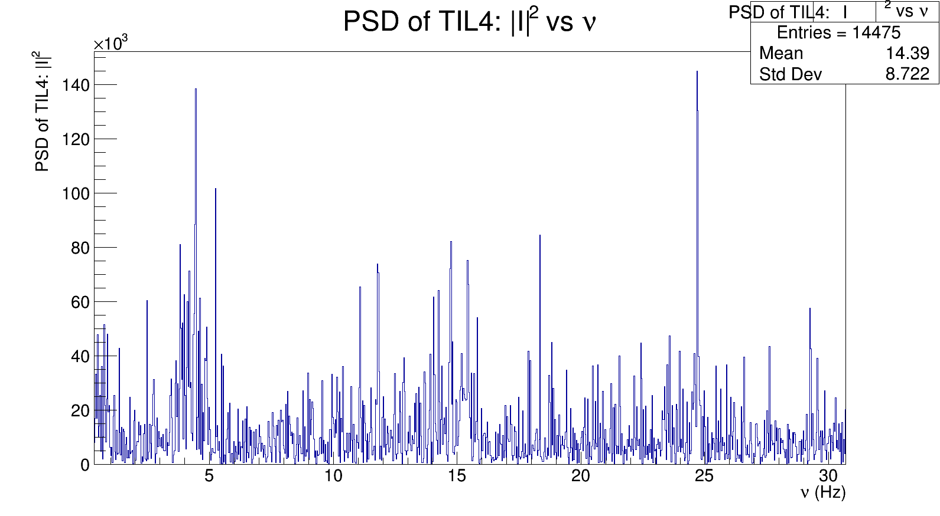
Operation and work summary
Survey & tunnel motion
Luminosity variation and floor/cryostat vibration are seen and they are sometimes correlated.
Gap sensor (R-side)
LumiBell2 3/28 ~7:00
ZDLM 3/28 7:11
~5Hz vibration, as an example.
There are also vibration at ~1.7 Hz and 15 Hz and...
Luminosity : S. Uehara(ZDLM), S. Di Carlo, et al. (LAL)
Floor motion : L. Brunetti and G. Balik (LAAP), under the framework of FJPPL
& KEK

Slide 24
MR Magnet System Summary
The IR construction went well, which lead to a smooth 1st collision in Phase 2.
The IR re-construction for Phase 3 also went well, with good reproducibility of the IR orbit.
Additional coils in the IR skew quads made it possible to scan a wider range in the IR coupling knob scans.
A water leak from a ~20-year-old flow switch led us to start replacing the flow switches used in the KEKB magnets.
  This could be a very costly operation so we will do it over time.
  Flow switch is just one of the magnet subsidiary components.
  What about rubber hoses? Will they last for the next ~10 years? Everybody ages.
The # of power supply failures decreased from Phase 1 to Phase 3.
Investigation of the QCS (QC2LE) power supply failure due to distorted gate signals is on-going. This is one of our highest priority items for the summer shutdown.
Adding a fast abort signal from the QCS power supplies looks feasible, and we will try to implement a fast abort signal from the QCS PS for the fall run.
The south arc of the MR continues to sink, at an average rate of 1.9 mm/year.
A correlation is seen between the HLS, the cryostat motion and the steering currents.
Some correlation is seen between the fast luminosity signal and vibration data. We will keep looking into the vibration issues.

