Slide 1

RF GUN, LASER & ELECTRON BEAM COMMISSIONING
The 23rd KEKB Accelerator Review Committee
Rui Zhang 2019.07.09
Accelerator Laboratory Division V, Injector G

Slide 2
SuperKEKB REQUIREMENTS
 | Electron HER 7 GeV | Positron LER 4 GeV
Normalized Emittance | 40 / 20 [μm] | 100 / 15 [μm]
Energy Spread | 0.07% | 0.16%
Bunch Charge at Injection Point | 4.0 nC | 4.0 nC
Stable electron beam with high charge and low emittance is required for SuperKEKB

Slide 3
SuperKEKB RF Gun
Requirements
4 nC electron charge generation
10 μm emittance preservation
Long term operation
Operating at 4 nC
Less space charge effect
  Longer pulse: 20-30 ps
Necessary strong focusing field
  Preserves the emittance
Stable long time operation
  Lower electric field: < 100 MV/m
Side coupler or Disk and washer is preferred

Slide 4
S-band RF Gun System for SuperKEKB
RF gun cavity: strong focusing electric field
Disk and washer (DAW): tested in 3-2
Quasi travelling wave side coupler (QTWSC): A1 primary RF gun
Cut disk structure (CDS): A1 secondary RF gun
Photocathode: long life time
Medium QE with long life time: 10⁻⁴~10⁻³ @266nm > 1 year
Metal composite: Ir₅Ce
Laser: simple, stable with temporal and spatial manipulation
Laser active material pumped by laser diode
  Yb doped fiber & Neodymium (Nd) doped laser crystal: A1 ground laser hut
  Yb doped fiber & Ytterbium (Yb) doped laser crystal: A1 underground laser hut
Temporal and spatial reshaping for minimum energy spread and emittance
04-17

Slide 5
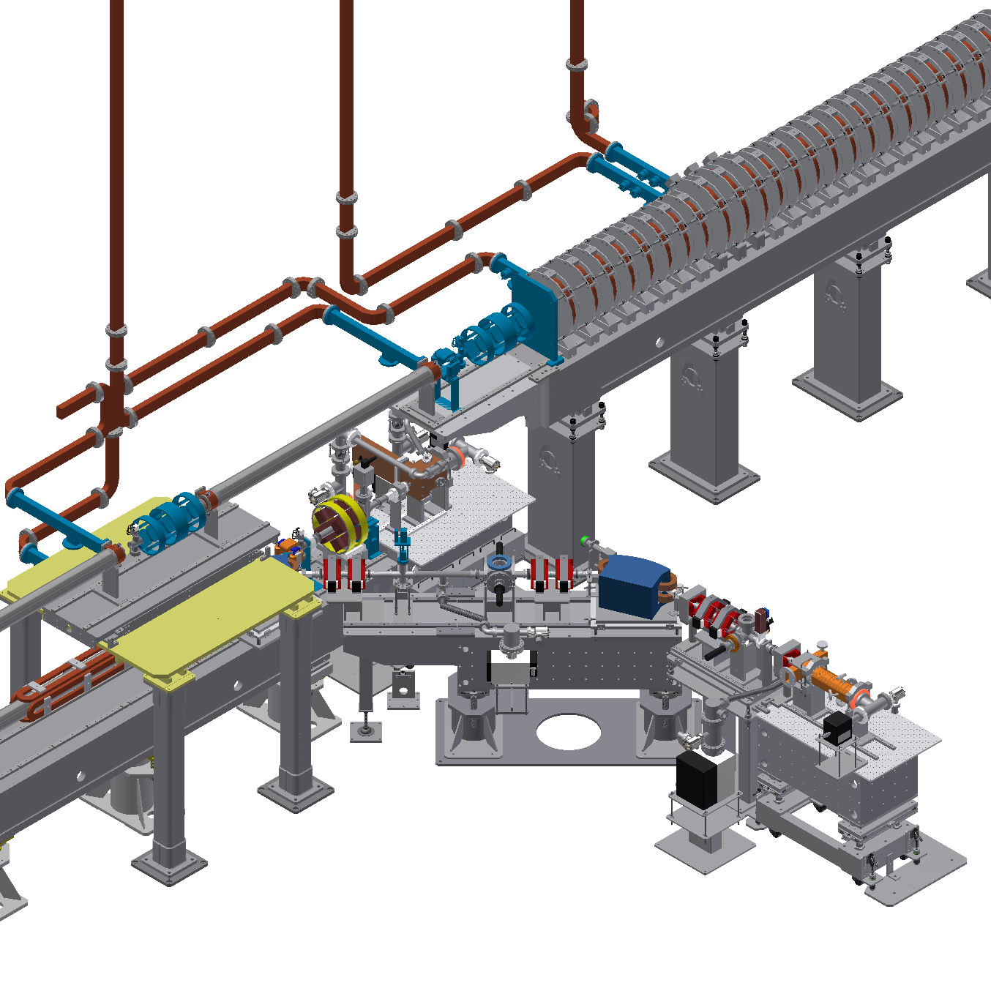
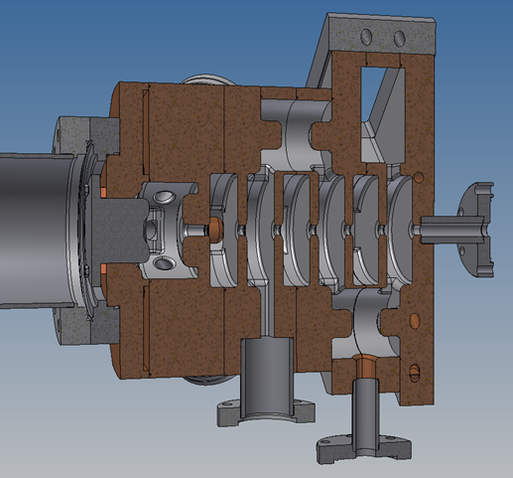
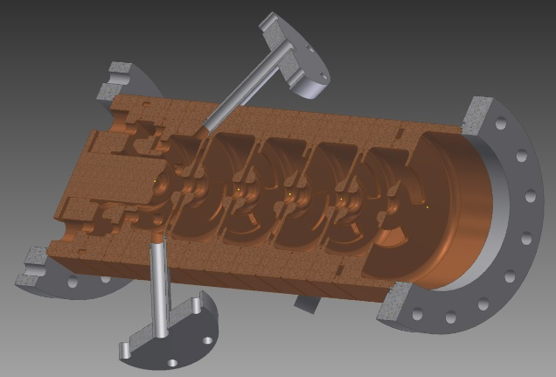
Injector Section for SuperKEKB
Thermionic gun
In the 2nd layer
Used for positron target, PF and PF-AR
Primary RF gun
QTWSC cavity
Adopted in this stage
1st milestone: full regular operation for the injection of HER (R4.3)
Secondary RF gun
CDS cavity
Never used in this stage
05-17

Slide 6
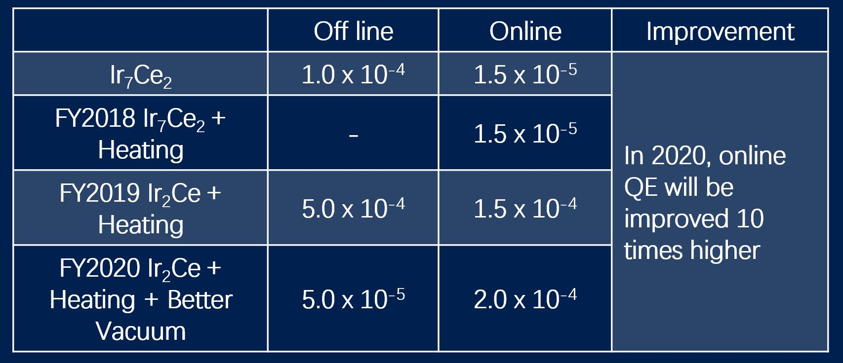
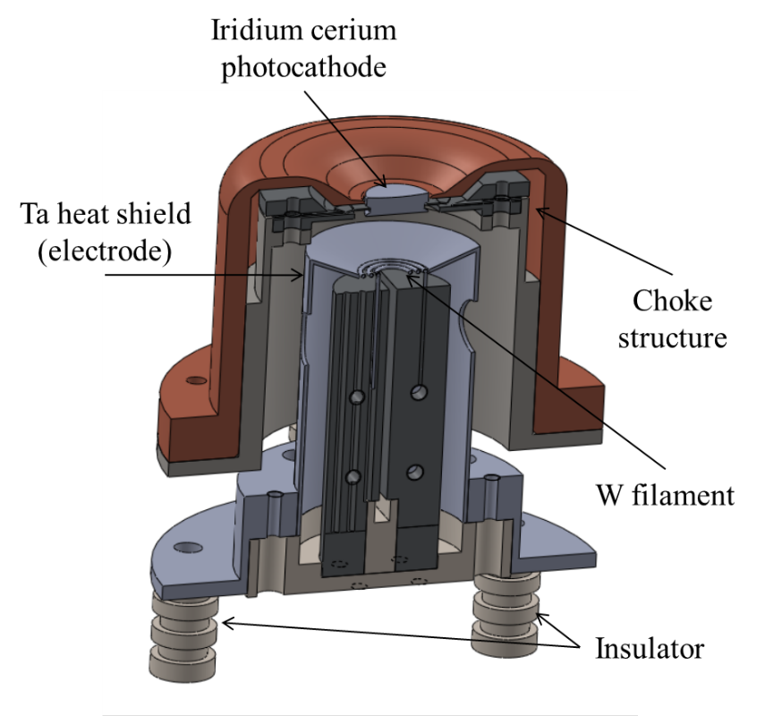
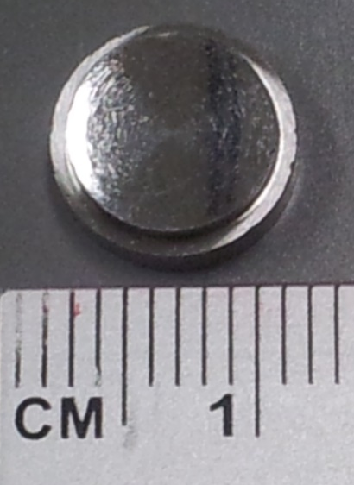
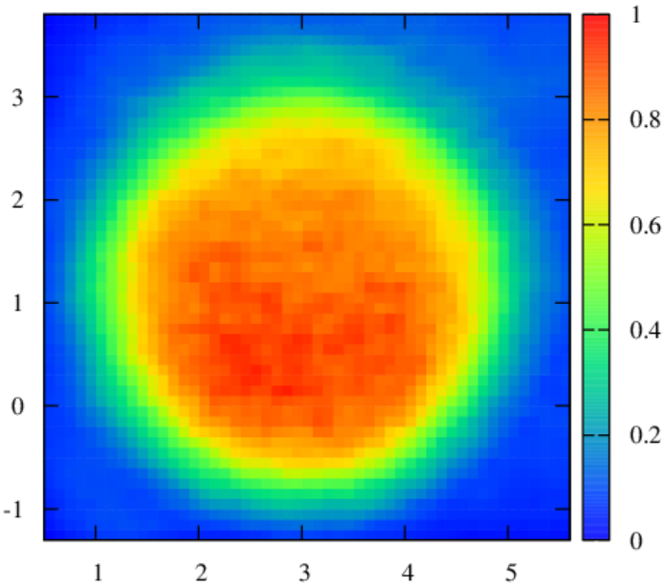
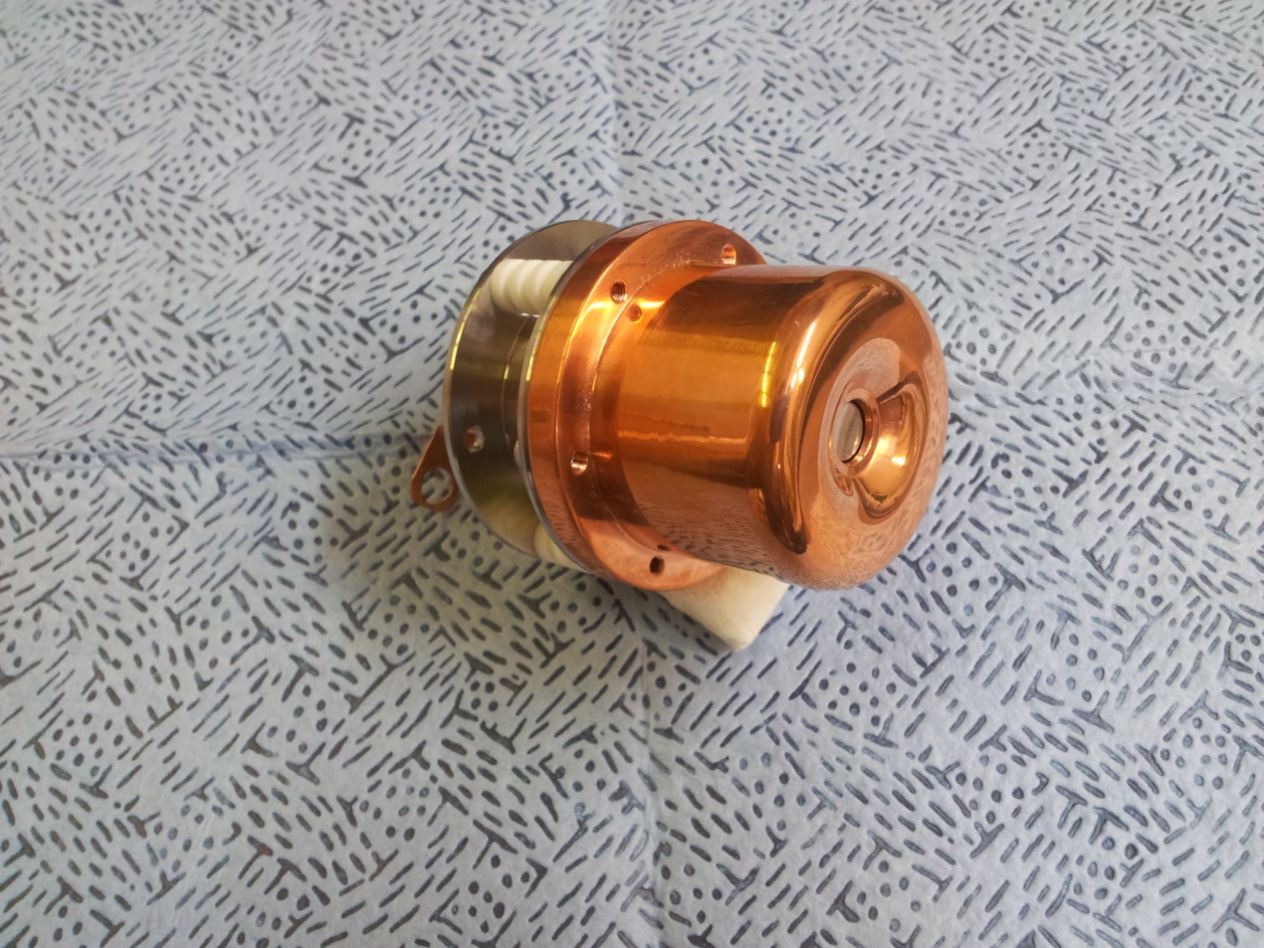
Photocathode in Primary RF Gun
Ir₇Ce₂ photocathode & QE map
Novel type cathode plug in this stage
e⁻
y (mm)
QE(x,y)/QE_{Max}
x (mm)
QE > 10⁻⁴ in off-line measurement (10⁻⁶ Pa)
QE = 10⁻⁵ in operation condition because of vacuum level (10⁻⁵ Pa)
Electron beam heating: the main cathode is bombarded by an accelerated electron beam
Successful heating over 1000 ℃
QE increased 3 times after cleaning
06-17

Slide 7
Current Nd/Yb Hybrid Laser System (R4.1)
Fiber
Oscillators (114 MHz)
Menlo Orange 1 (1064 nm by SPM)
MEMS Switch
3 In 1 Out
4 months 0 fault operation!
Menlo Orange 2 (1064 nm)
→
Home made ANDi type 1064 nm
Fiber
Amplifiers
Yb Single mode Fiber
Amplifier 1
Semiconductor optics Amplifier (SOA)
114 MHz → 10 MHz
Yb Single mode Fiber
Amplifier 2
Yb Single mode Fiber
Amplifier 3
→
→
→
Nd:YAG Rod Laser
Amplifiers
EO Pulse Picker
10 MHz → 1-50 Hz
Double bunch
Beam splitter 50:50
→
1st Nd:YAG Laser Line with 5 Stages Rod Amplifiers
4 months 0 fault operation!
→
2nd Nd:YAG Laser Line with 5 Stages Rod Amplifiers
Wavelength
Conversion
YCOB in 1st Laser Line 1064 nm → 532 nm
BBO in 2nd Laser Line 1064 nm → 532 nm
Beam Polarizer
Combination for Two Laser Lines
Beam Polarizer
Division for Two Laser lines
BBO in 1st Laser Line 532 nm → 266 nm
BBO in 2nd Laser Line 532 nm → 266 nm
→
→
→
→
Transporting Line for
Two Lasers (11 m long)
Ground Laser Hut
→ Tunnel RF gun box
→
RF Gun
From Two Injection Windows

Slide 8

Current Nd/Yb Hybrid Laser System (R4.1)
Fiber
Oscillators (114 MHz)
Menlo Orange 1 (1064 nm by SPM)
MEMS Switch
3 In 1 Out
Menlo Orange 2 (1064 nm)
→
Home made ANDi type 1064 nm
Fiber
Amplifiers
Yb Single mode Fiber
Amplifier 1
Semiconductor optics Amplifier (SOA)
114 MHz → 10 MHz
Yb Single mode Fiber
Amplifier 2
Yb Single mode Fiber
Amplifier 3
→
→
→
Nd:YAG Rod Laser
Amplifiers
EO Pulse Picker
10 MHz → 1-50 Hz
Double bunch
Beam splitter 50:50
→
1st Nd:YAG Laser Line with 5 Stages Rod Amplifiers
→
2nd Nd:YAG Laser Line with 5 Stages Rod Amplifiers
Wavelength
Conversion
YCOB in 1st Laser Line 1064 nm → 532 nm
BBO in 2nd Laser Line 1064 nm → 532 nm
Beam Polarizer
Combination for Two Laser Lines
Beam Polarizer
Division for Two Laser lines
BBO in 1st Laser Line 532 nm → 266 nm
BBO in 2nd Laser Line 532 nm → 266 nm
→
→
→
→
Transporting Line for
Two Lasers (11 m long)
Ground Laser Hut
→ Tunnel RF gun box
→
RF Gun
From Two Injection Windows

Slide 9
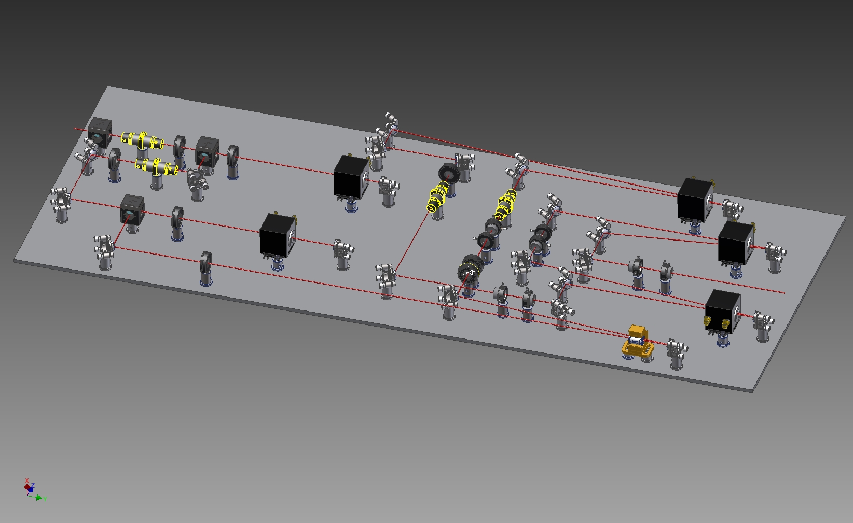
Stable & Efficient Nd:YAG Amplifier (R4.2)
Layout of Nd:YAG rod amplifier
High amplification efficiency with sample configuration
Lower pump currents by use of high dopant Nd:YAG crystals (2018 summer)
Trouble shooting in short time for stable and smooth commissioning
No problem occurred during stage (more than 4 months)
Input @1064 nm (<1 μJ)
1st stage
3rd stage
2nd stage
5th stage
Output
(10 mJ)
4th stage
Pockels cell
4 m x 0.8 m
Optical path: 22 m
09-17

Slide 10
Two Lasers Injection Mode (R4.1)
A1 ground laser hut
Tunnel RF gun box
90º RF gun
2nd line
BBO
Delay line
Flip mirror
e-
HWP
BBO
0º RF gun
1st line
Polarizer
HWP
11 m long
transporting line
HWP
Polarizer
BBO
Irradiated by two lasers
Laser with vertical polarization, laser with horizontal polarization, HWP: half wave plate
Possible to generate high e⁻ charge
Better emittance
Backup for the smooth commissioning
10-17

Slide 11
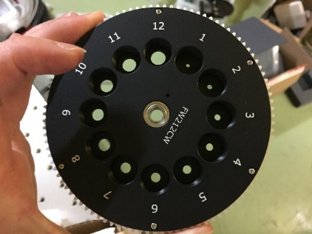
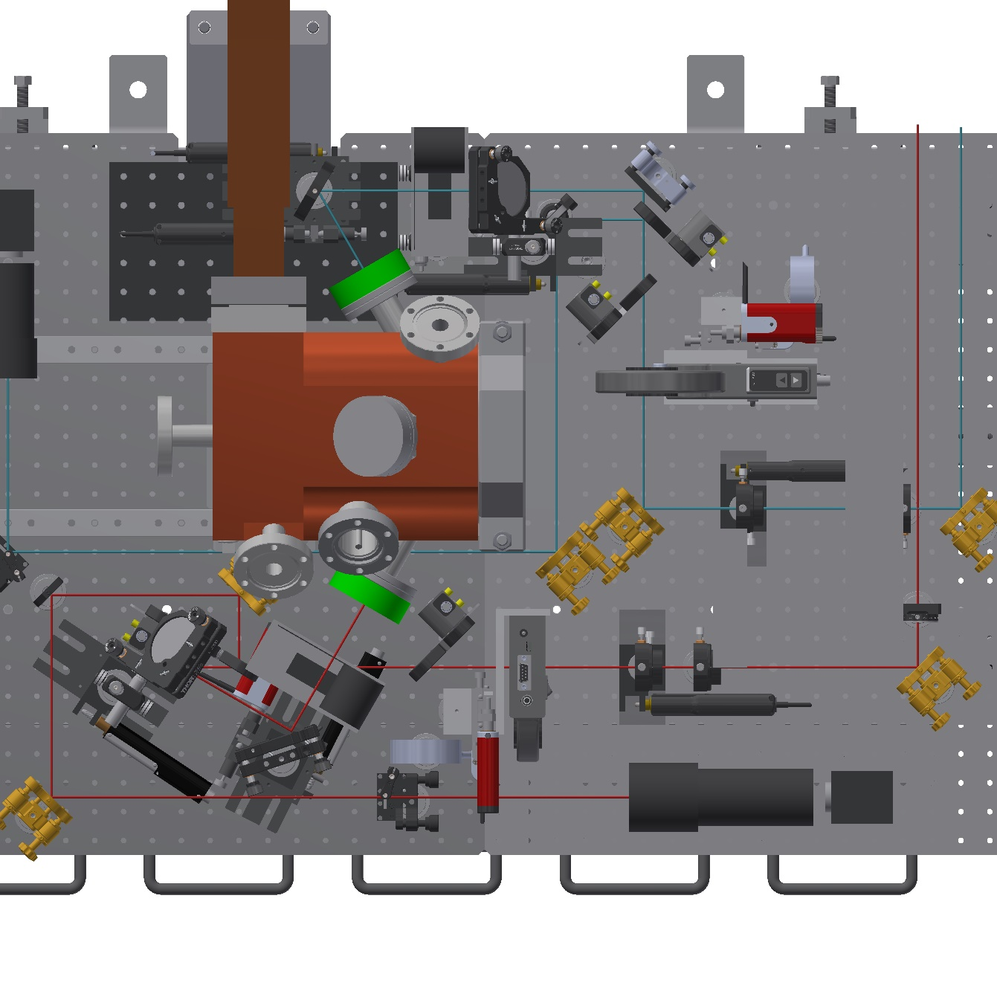
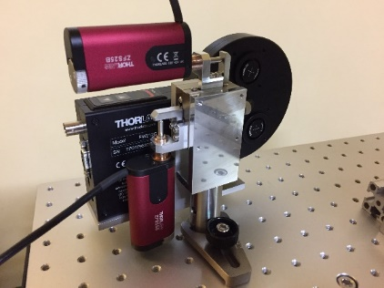
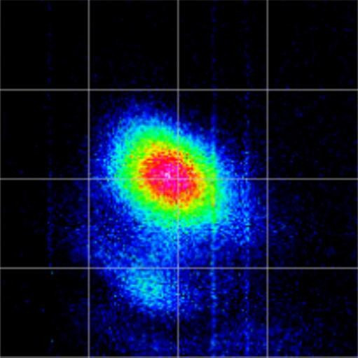
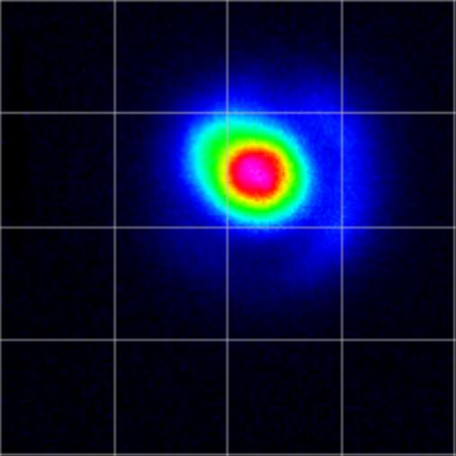
Controllable and Monitorable Laser (R4.2)
1st laser
2nd laser
UV laser aperture
1.3 nC
Temporary setup for laser beam shaping
Remote control
UV laser beam profile
CCD setup at the virtual cathode position
Net energy meter
Remote control actuators for fine adjustment (20 pieces)
UV laser beam profile
Optics layout in RF gun box
11-17

Slide 12
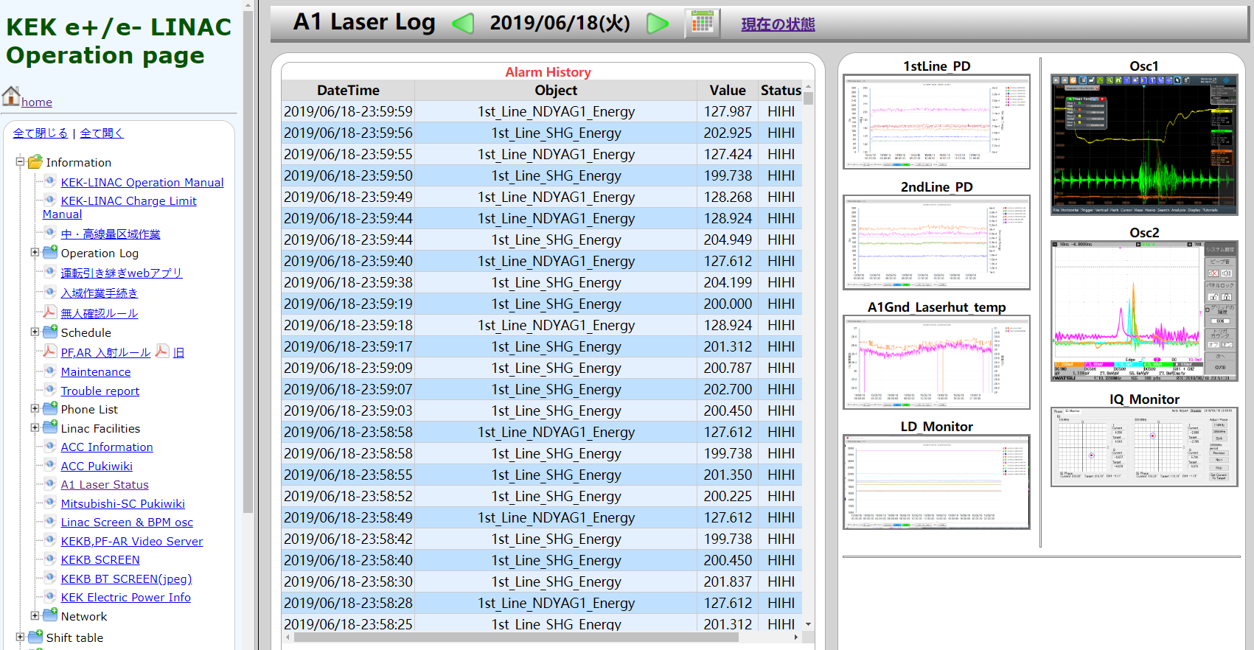
Laser Status Monitoring System
http://www-linac.kek.jp/ope/opelog2/opelog.html
12-17

Slide 13
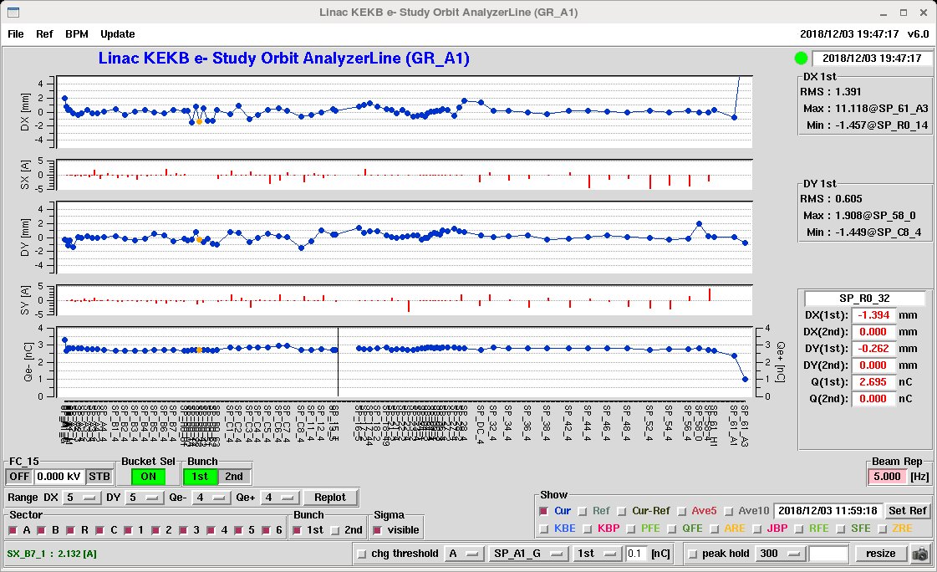
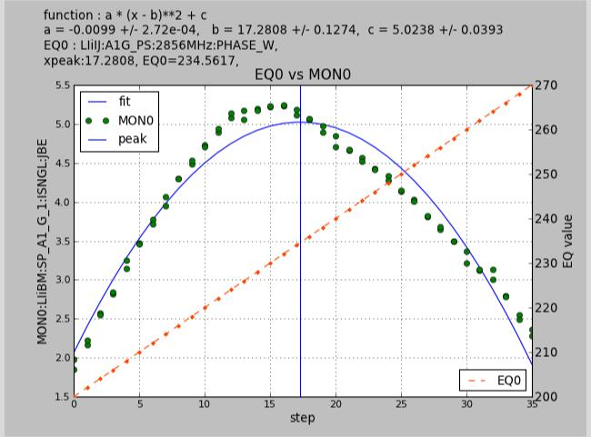
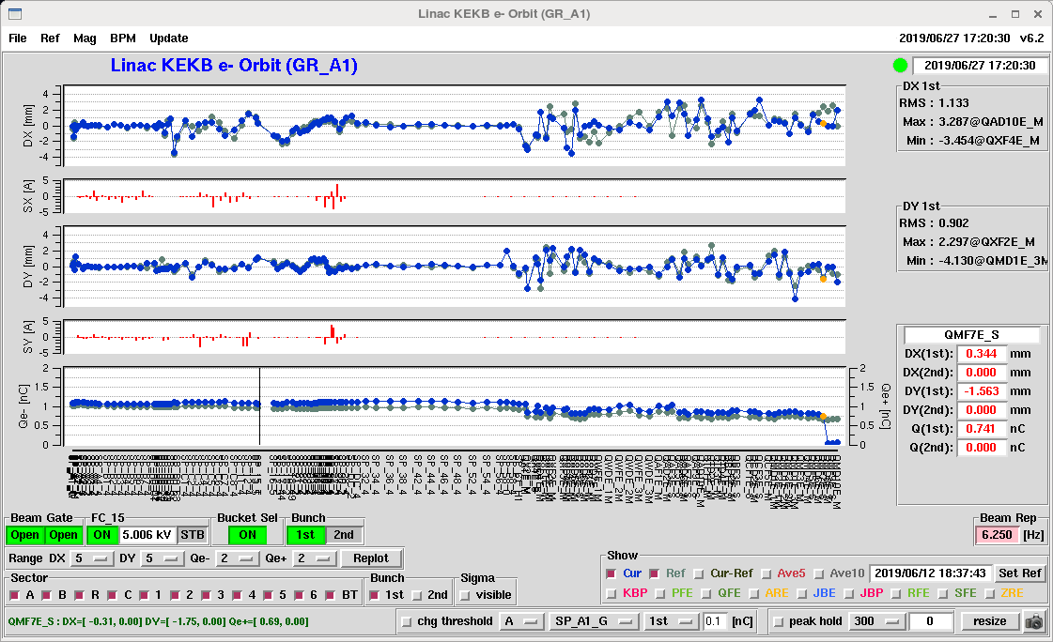
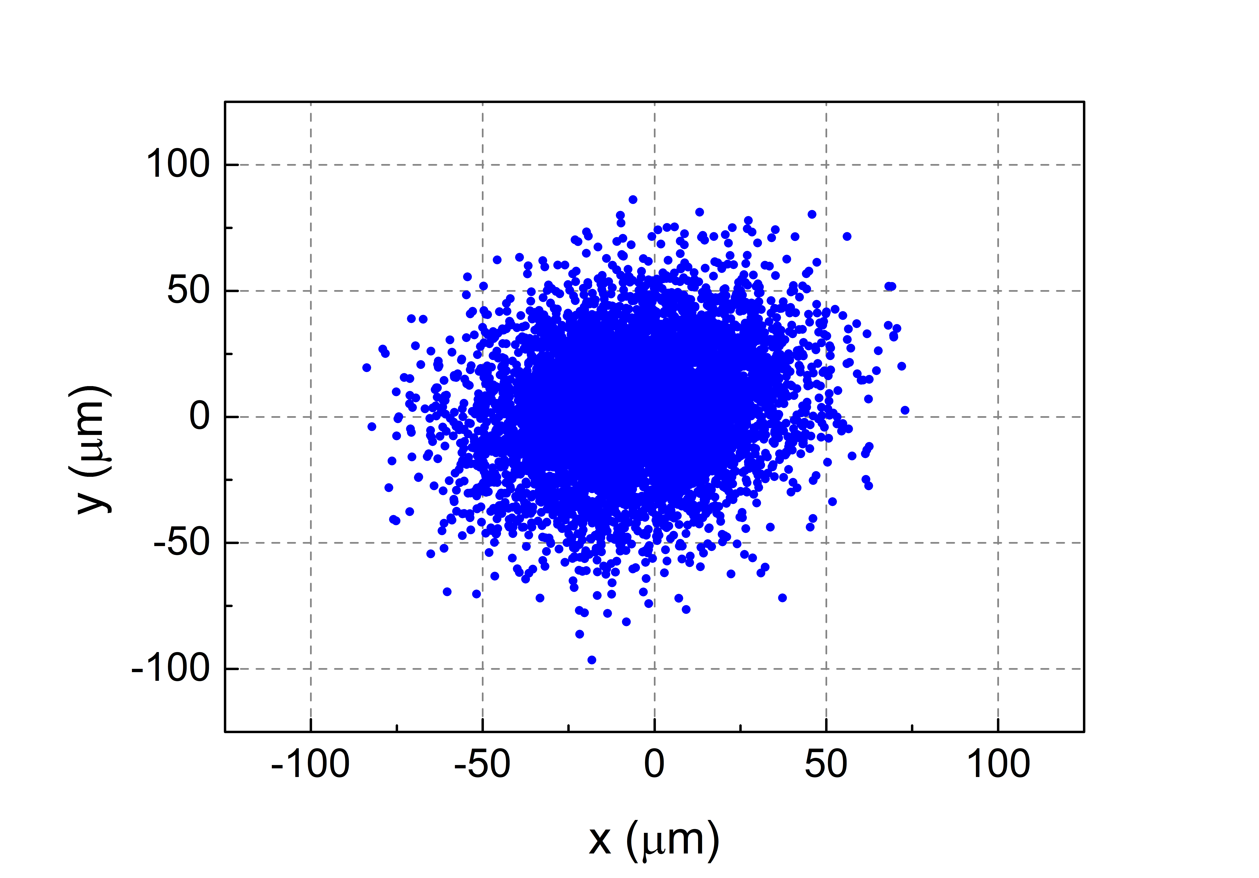
Electron Beam Commissioning (R4.2 & R4.4)
High Charge Test under Full Laser Energy
SP_A1_G Charge
>4 nC
2.8 nC
2856 MHz phase
Laser pointing stability at the virtual cathode position
B-sector Wire Scanner 2019.06.27
1.2 nC @ SP_A1_G
4-wire ABCD: γε_{x}=12.655 μm,
γε_{y}=11.225 μm
For
Commi-ssioning

Slide 14
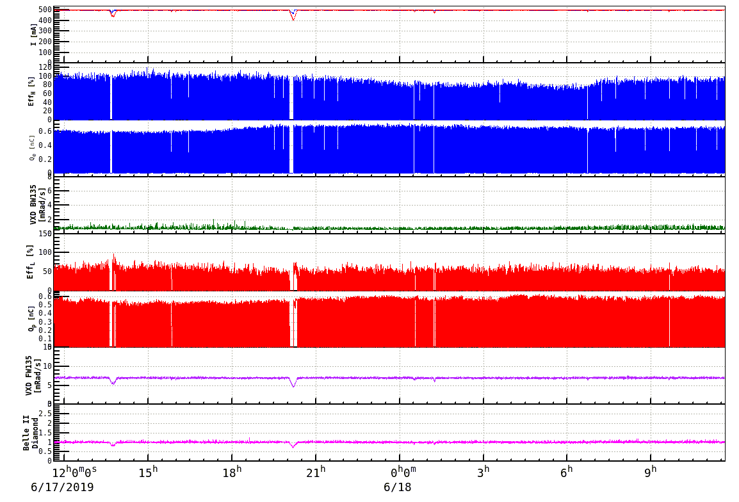
Stable & Continuous Operation in the Commissioning
More than 4 months stable and continuous regular injection (R4.3)
Comparable low injection background
Availability rate is 98.8% (MTBF: 394.1 h, MTTR: 4.6 h) (R4.3)
Different correspondence for different study by altering e⁻ charge only a few seconds (R4.2)
14-17

Slide 15
Updates (R4.1 & R4.2)
Install new Menlo fiber oscillator (1030 & 1064 nm) (2019 summer)
Photocathode development for higher QE (2019 summer)
  Ir₇Ce₂ → Ir₂Ce
Rebuild transporting line by use of relay imaging system (2019 summer)
Improve temperature stability in the laser hut (2019 summer)
Realize real time UV laser beam profile monitor (2019 summer)
  Available during continuous injection
New RF gun for better vacuum level and higher RF power (from 2020)
15-17

Slide 16

Laser for Middle & Later Stages of Phase III
Laser temporal reshaping for low emittance, low energy spread, and injection noise suppression
I
t₁
t₂
Coherent pulse stacking technology by use of the birefringent effect of crystal
Demonstrated in Nd laser system (Supported by Dr. Honda in 2018, R4.2)
Due to the narrower spectrum width of the current Nd laser system (wider temporal width), the real rectangular shape is impossible (Fourier transform limit)
t
I
I
Laser temporal distribution
x’
t₁
E
t₂
x
t
t
t
Nd laser system: 17 ps
Yb laser system: 2.5 ps
Phase space
Energy spread
Yb laser system is the best and only candidate for low energy spread and low emittance electron beam generation in Phase III
 | 2019 Q1 | 2019 Q2 | 2019 Q3 | 2019 Q4 | 2020 Q1 | 2020 Q2 | 2020 Q3 | 2020 Q4 | 2021 Q1 | 2021 Q2 | 2021 Q3 | 2021 Q4
Nd Laser System | Primary laser for RF gun and HER injection |  |  |  |  |  |  |  | Backup laser system for SuperKEKB
Yb Laser System | Laser & monitoring system preparation with stacking |  |  |  |  |  | e⁻ beam test |  | For RF gun and HER injection
16-17

Slide 17
Summery
Continuous and stable full RF gun operation in this stage
Simple and precise laser and electron beam adjustment thanks to the available monitors and remote control components
Increase the stability of laser and electron beam
Will focus on improving the quality of electron beam by the Yb laser system
THANKS
17-17

Slide 18
Backup

Slide 19
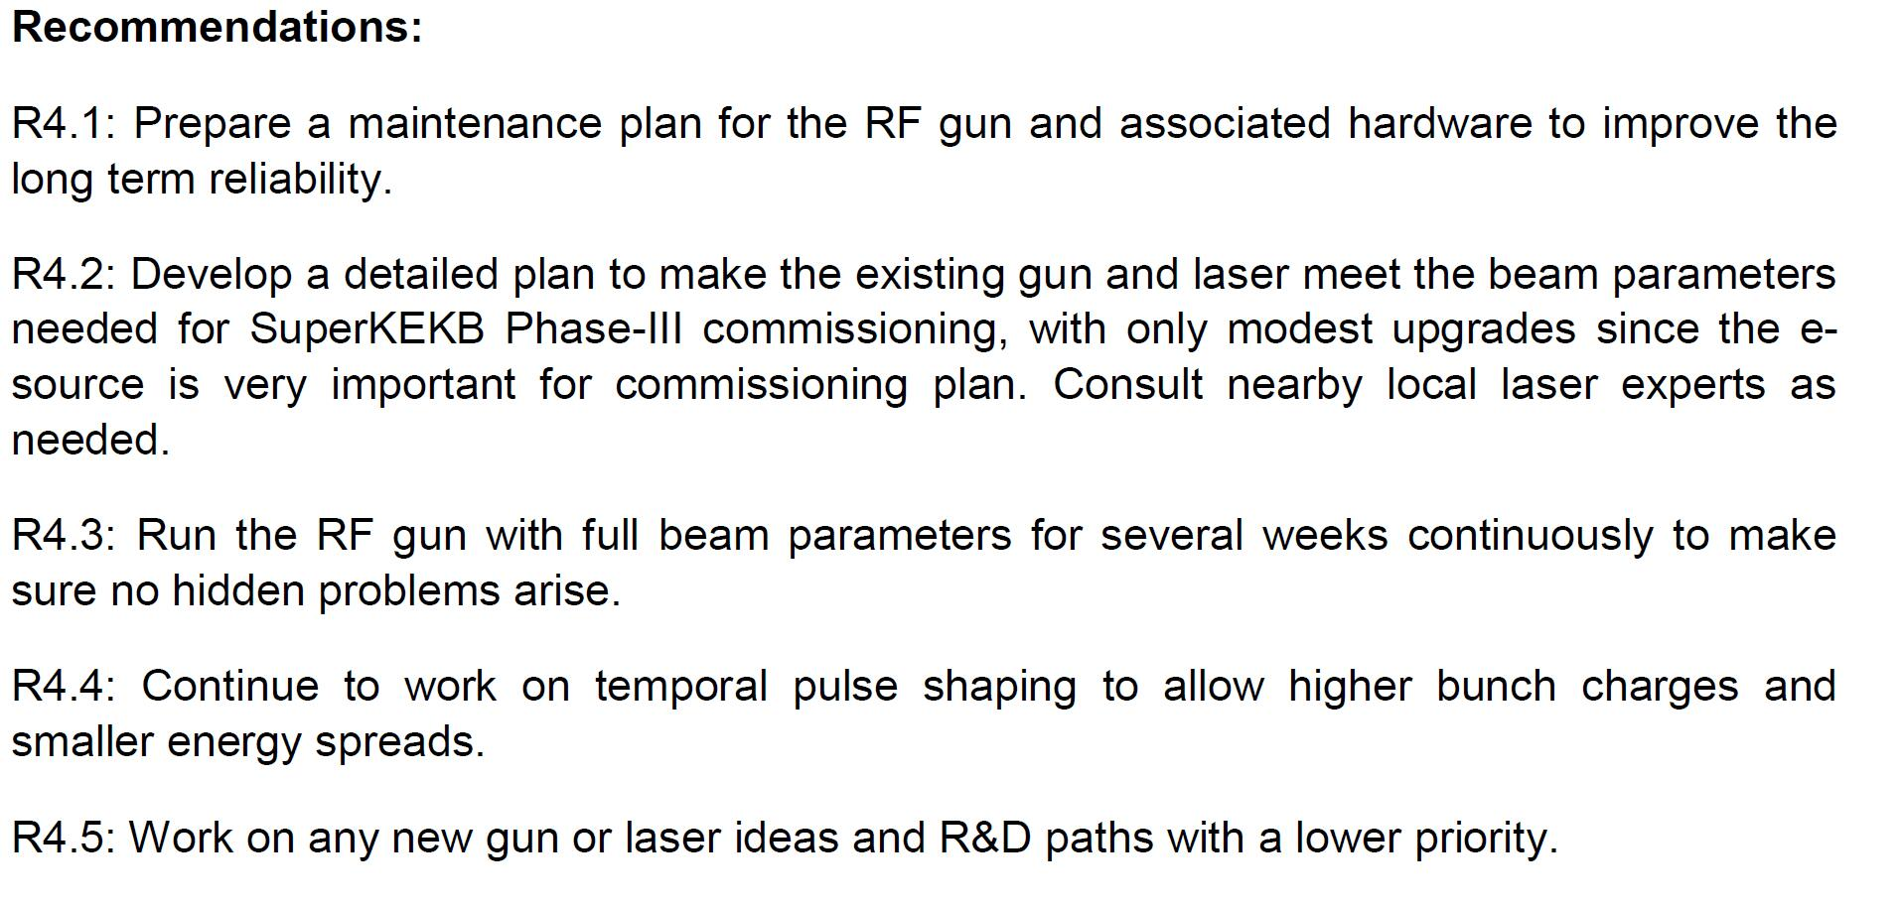
Recommendations of the 22nd Review

Slide 20
Plan
2019 summer: Improve stability of laser system and performance of photocathode
2020 summer (2019 winter): Improve the quality of electron beam
  Laser pulse temporal reshape: rectangular pulse shape
  Laser pulse spatial reshape: flat-top beam pattern
15-20

Slide 21
Updates in 2019 Summer
Install new Menlo fiber oscillator
Rebuild transporting line by use of relay imaging system
Improve temperature stability in the laser hut
  Water cooling for optics table
  Exchange powerful air-conditioner
  Add insulation layer for the west wall of laser hut
Realize real time UV laser beam profile monitor
  Available during continuous injection
16-20

Slide 22
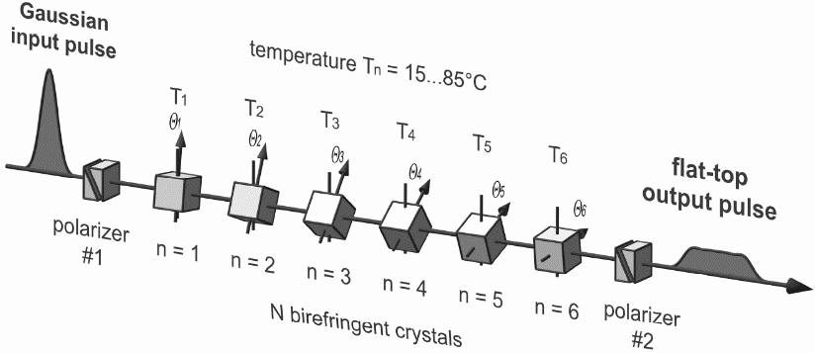
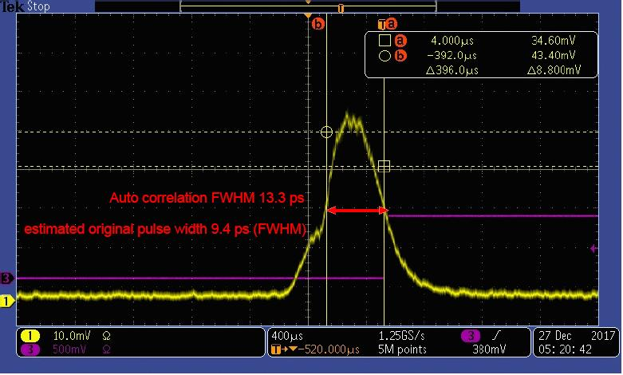
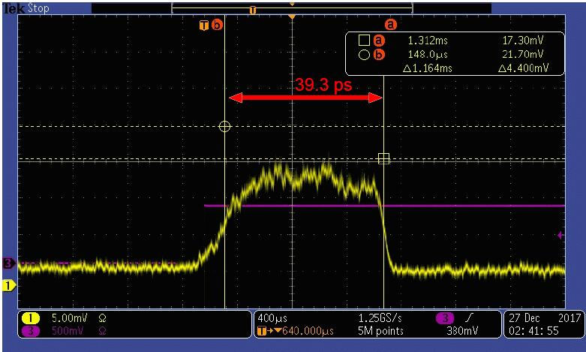
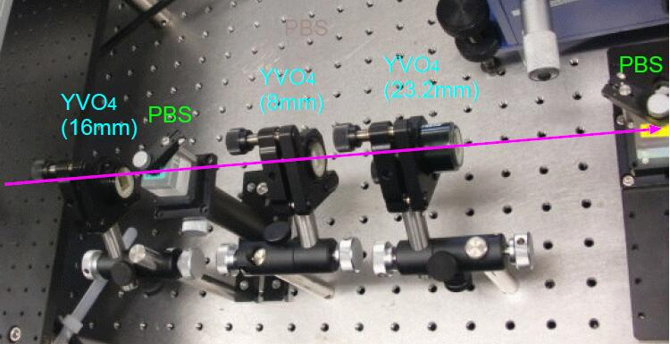
Updates in 2020
Temporal reshape: Pulse stacking for low energy spread
Input laser pulse with temporal Gaussian shape (FWHM~10 ps)
Pulse stacking setup made by a crystal array
(birefringent effect of crystal)
Output laser pulse with temporal rectangular shape (FWHM~40 ps)
Two stages stacking system made by YVO4 crystals
Input Nd:YLF mode lock laser pulse with 9.4 ps FWHM width
Achieved laser pulse by stacking
* Supported by Dr. Yosuke Honda
17-20

Slide 23
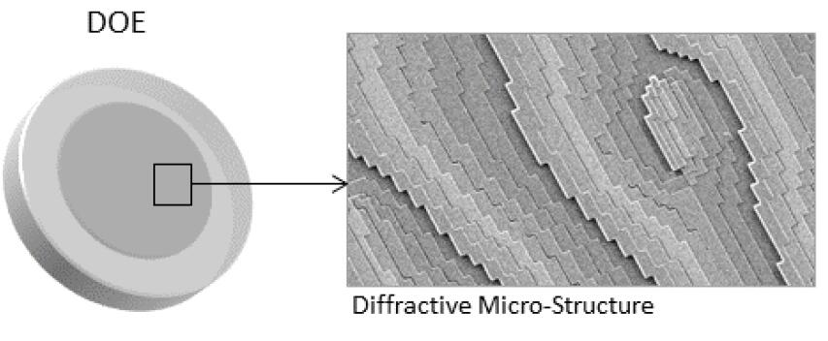
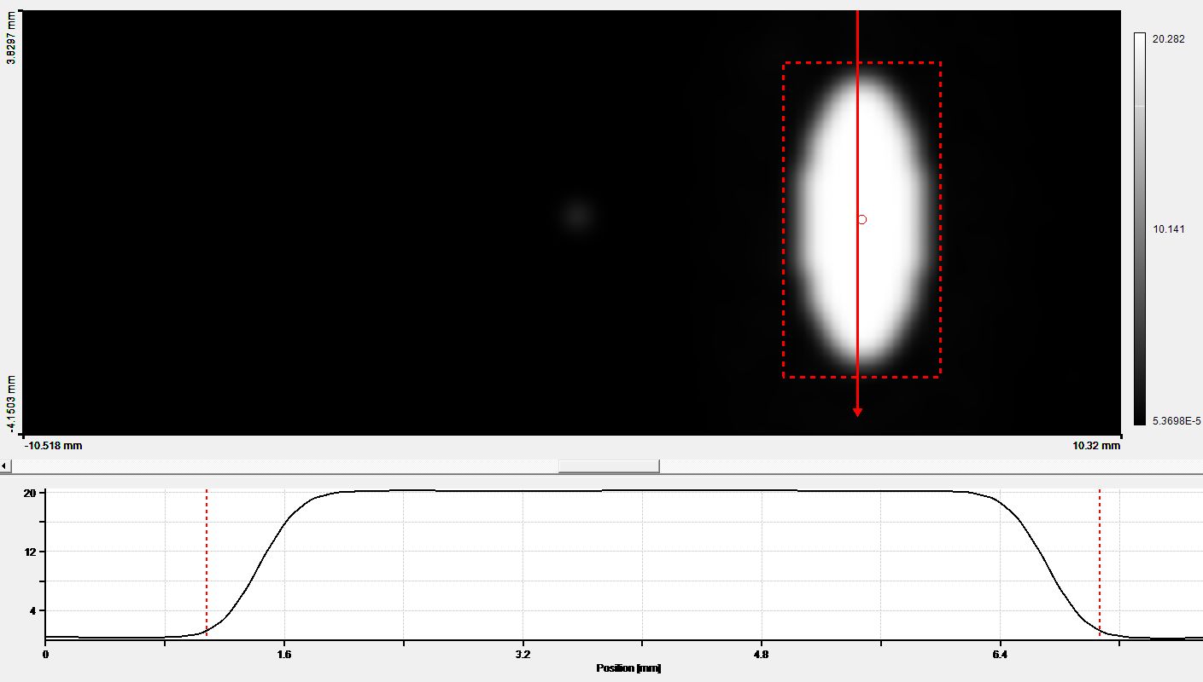
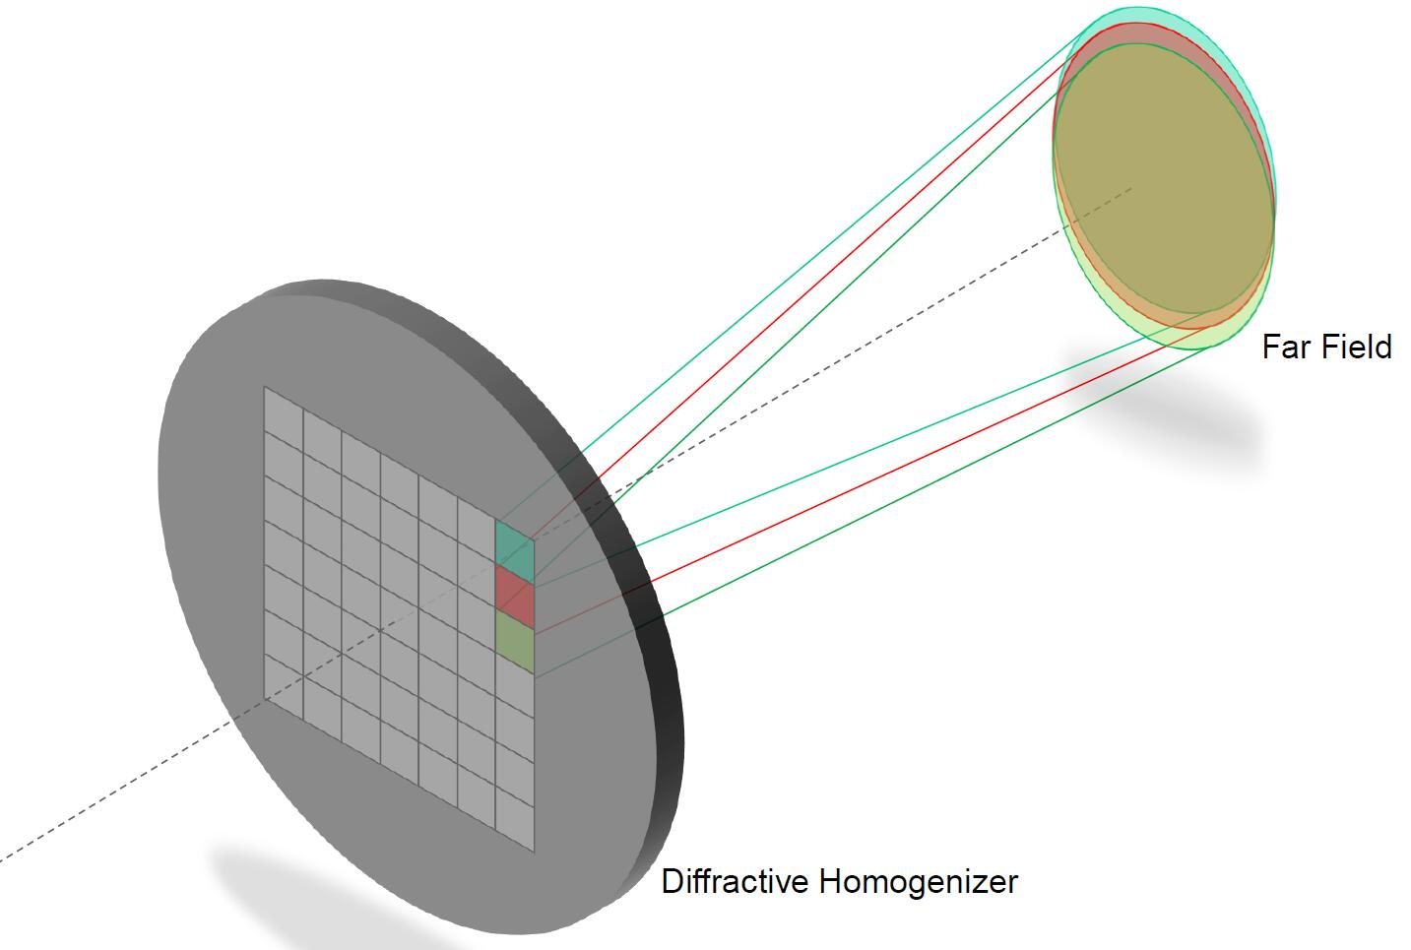
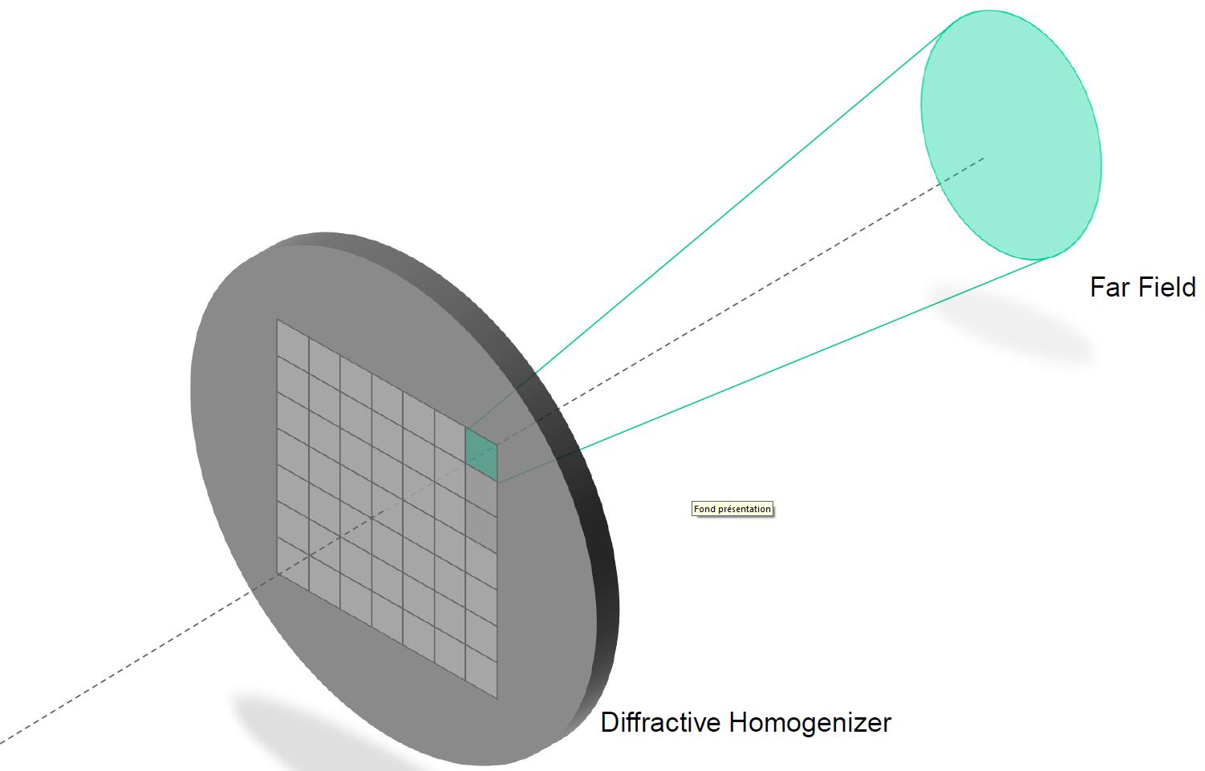
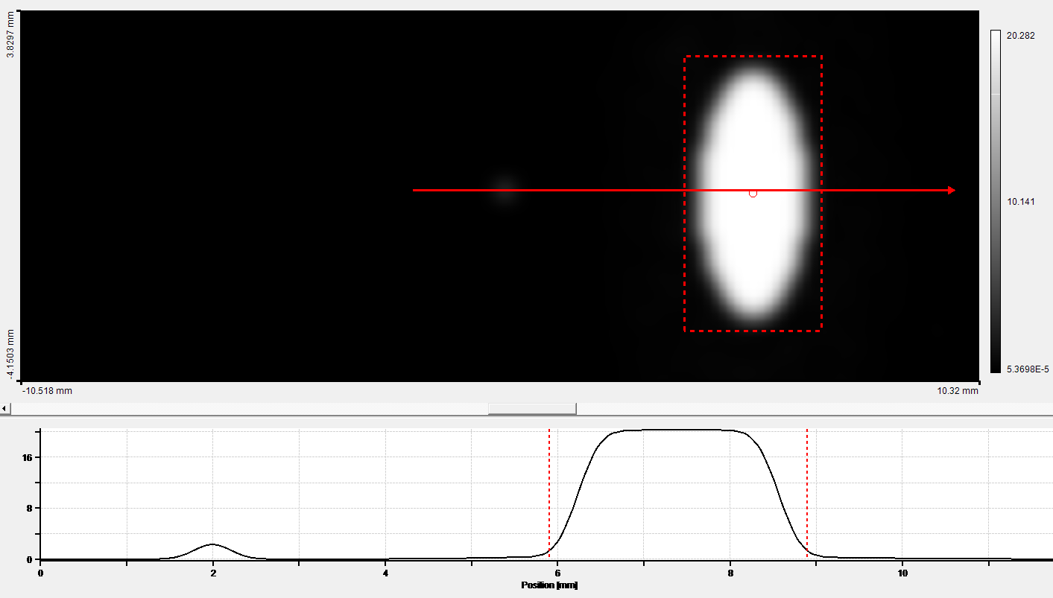
Updates in 2020
Spatial reshape: Diffractive optics element (DOE) for low energy spread and emittance
Simulation results: elliptical beam pattern
DOE with micro configuration as homogenizer
6 mm
3 mm
The homogenization is obtain with the sum of the
N*N sub-elements contributions
18-20

Slide 24
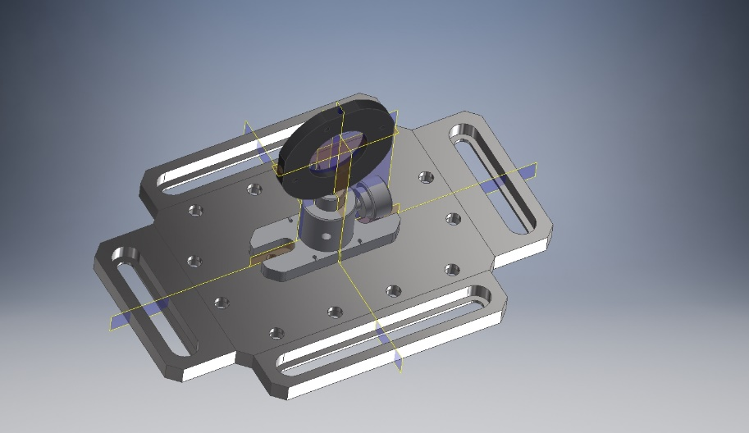
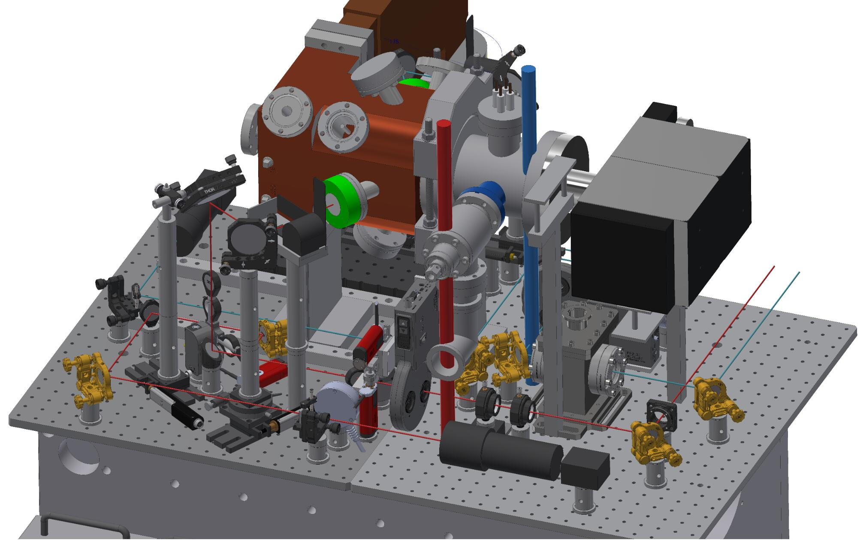
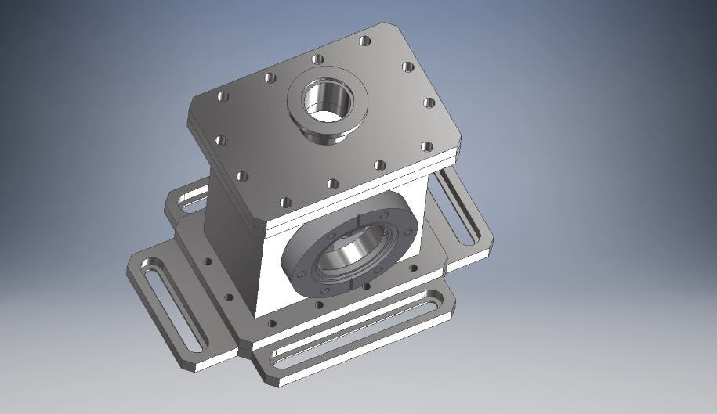
Updates in 2020
Transverse reshape (spatial domain): Diffractive optics element (DOE)
  Two pieces of DOE are purchased (delivery date is September )
  One will be used for testing in 2020
19-20

Slide 25
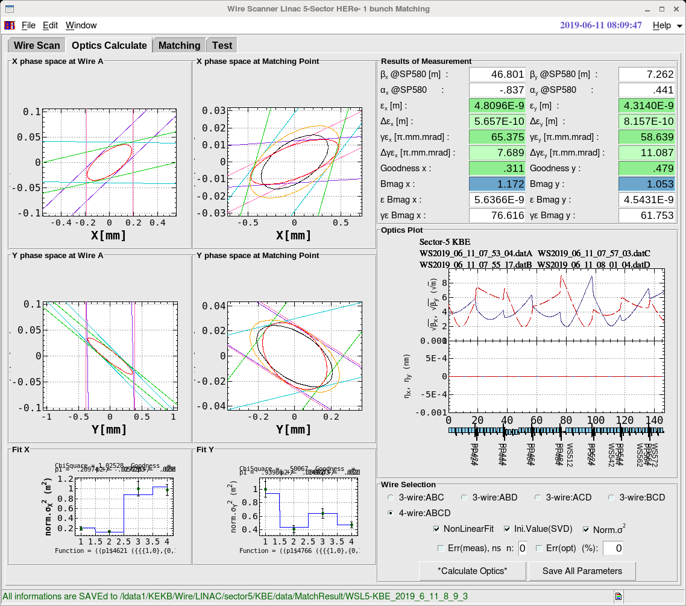
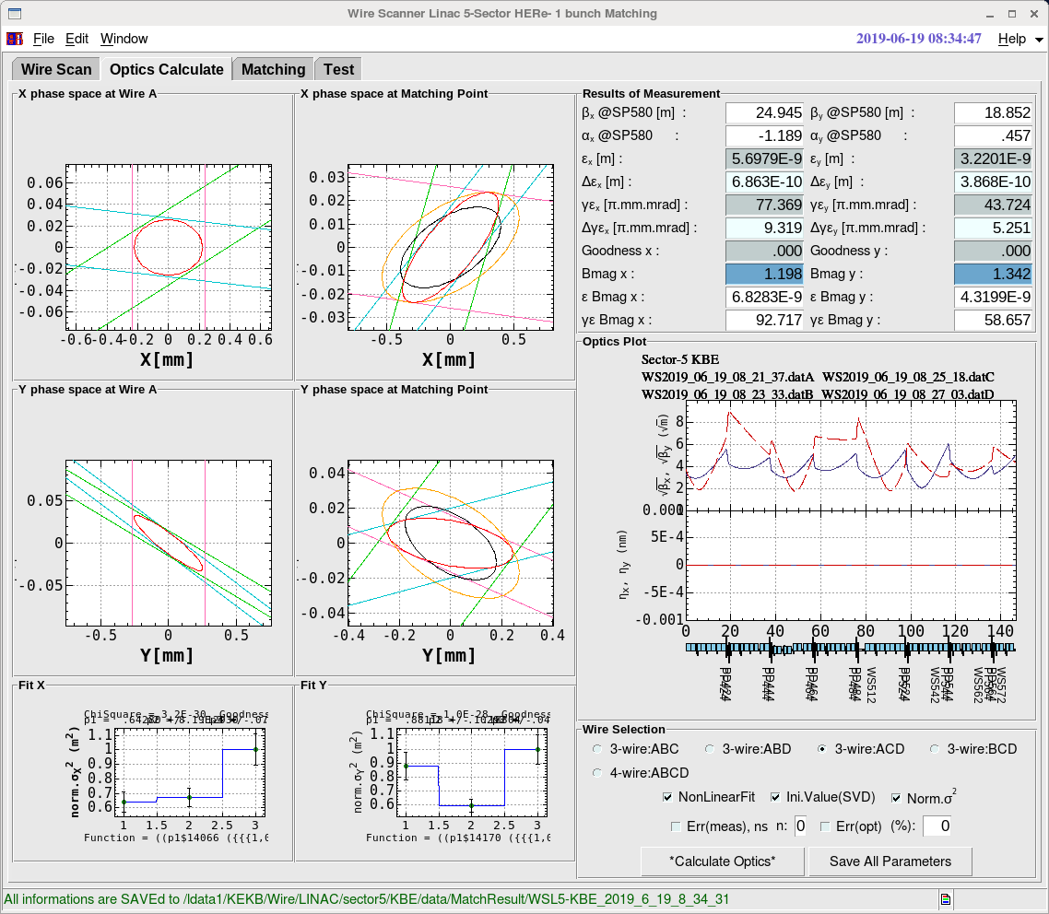
Wire Scanner Result @ 5 Sector

Slide 26
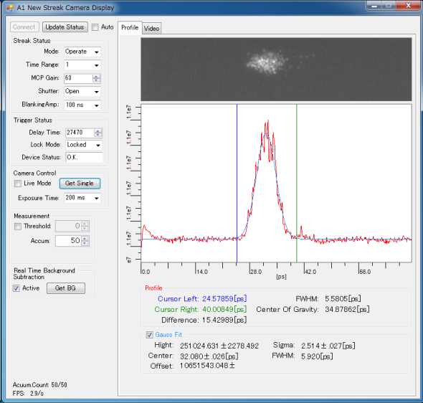
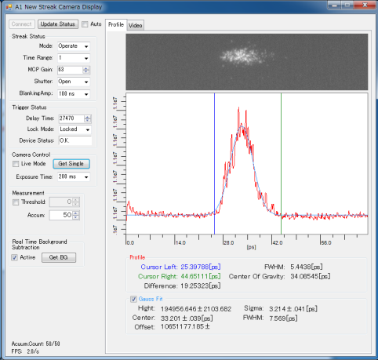
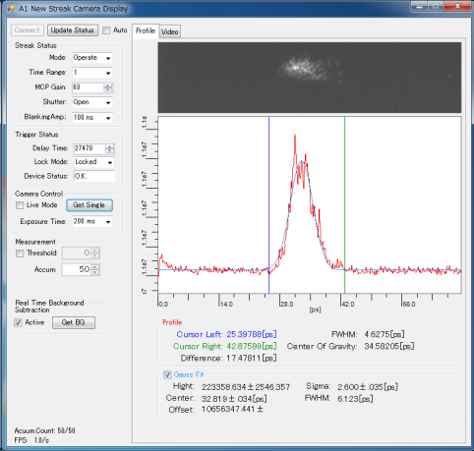
Streak Camera Test Data by 2 Lasers
2 lasers mode
1st laser
2nd laser

Slide 27
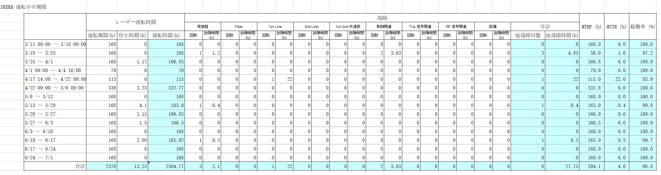
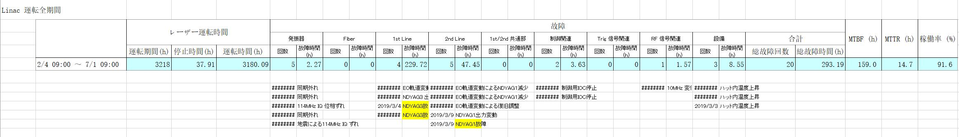
Statistics
MTBF (Mean Time Between Failure、平均故障間隔) MTTR (Mean Time To Repair、平均修理時間)
稼働率＝MTBF ÷ (MTBF+MTTR)

Slide 28
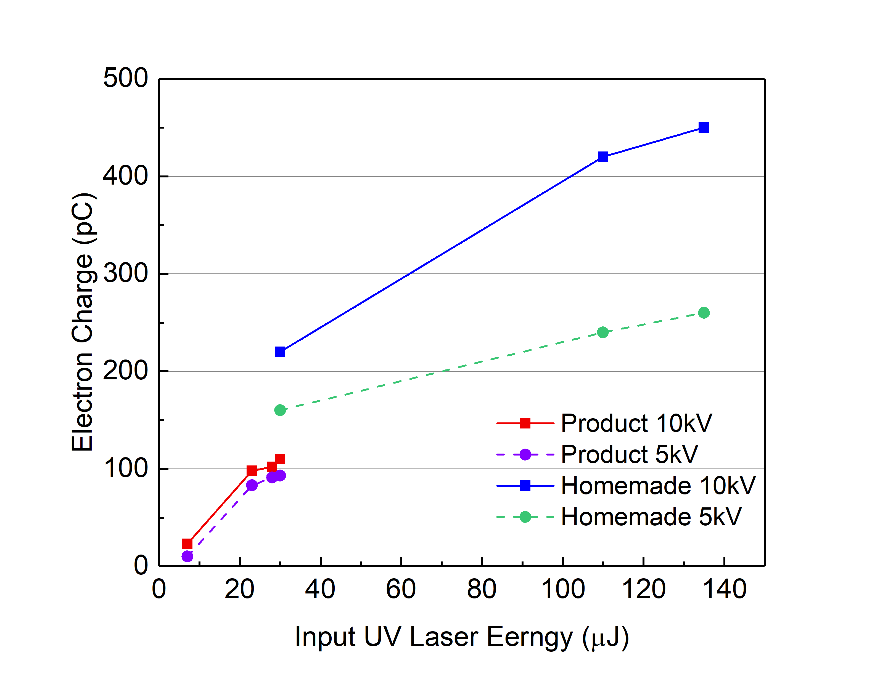
Ir2Ce: Simple Test Result

Slide 29
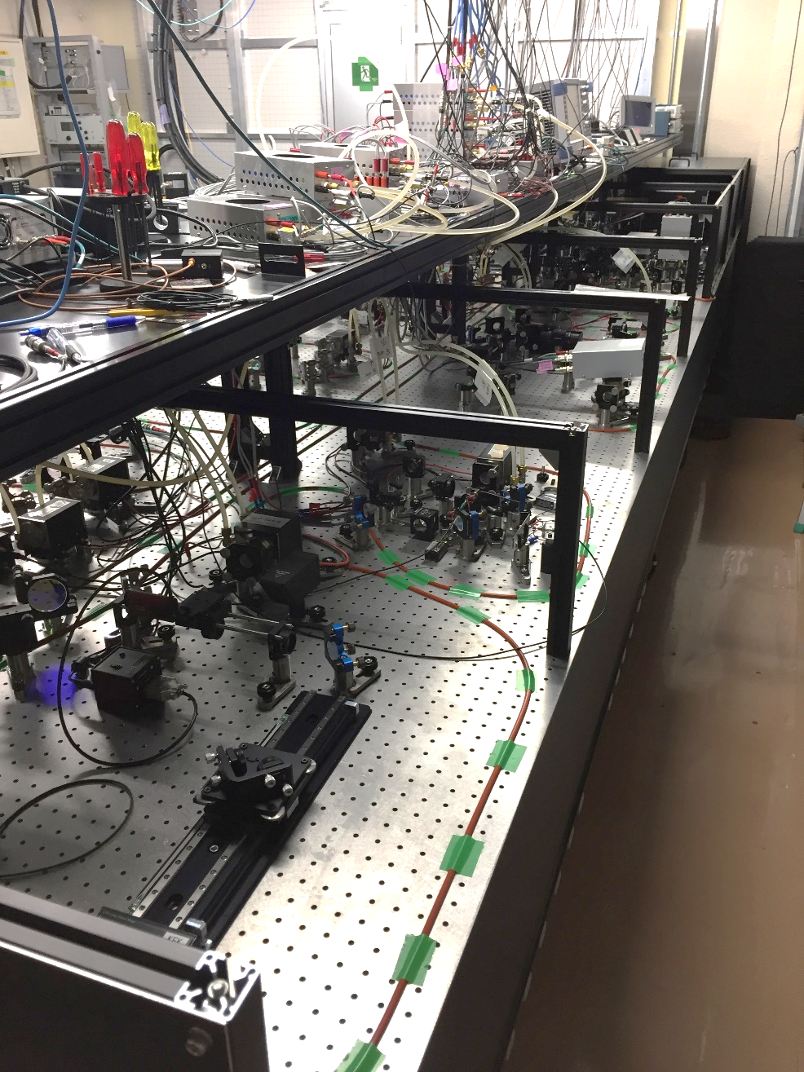
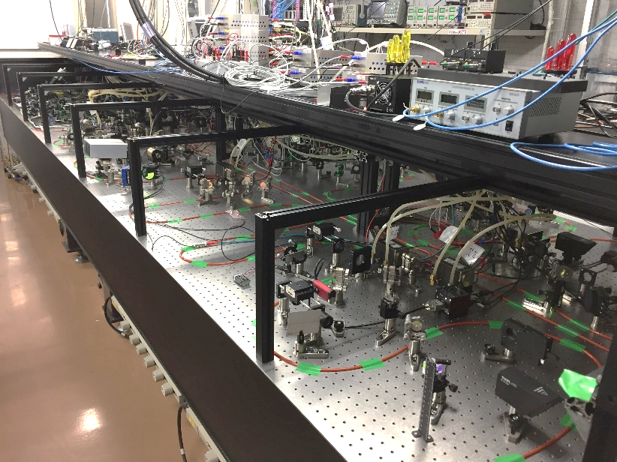
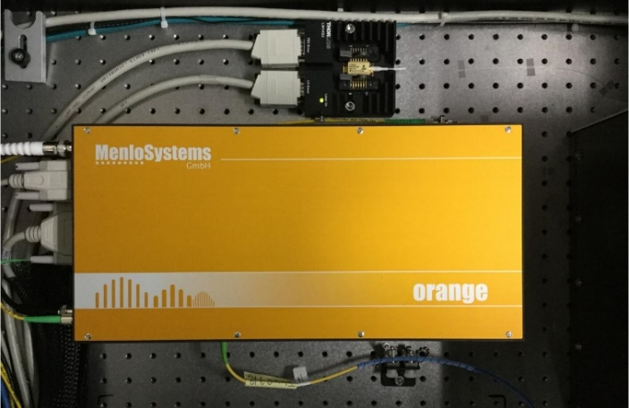
Yb:fiber/Nd:YAG laser in Phase II
~0.1 nJ
10 mJ (Amp factor: ~ 10⁸ )
Oscillator 1
Nd:YAG 1st line
Oscillator 2
Yb:fiber Amplifier
Transporting line
RF gun
Nd:YAG 2nd line
Delay line
Oscillator 3
Stable long time operation
High charge
Stable long time operation
12-26

Slide 30

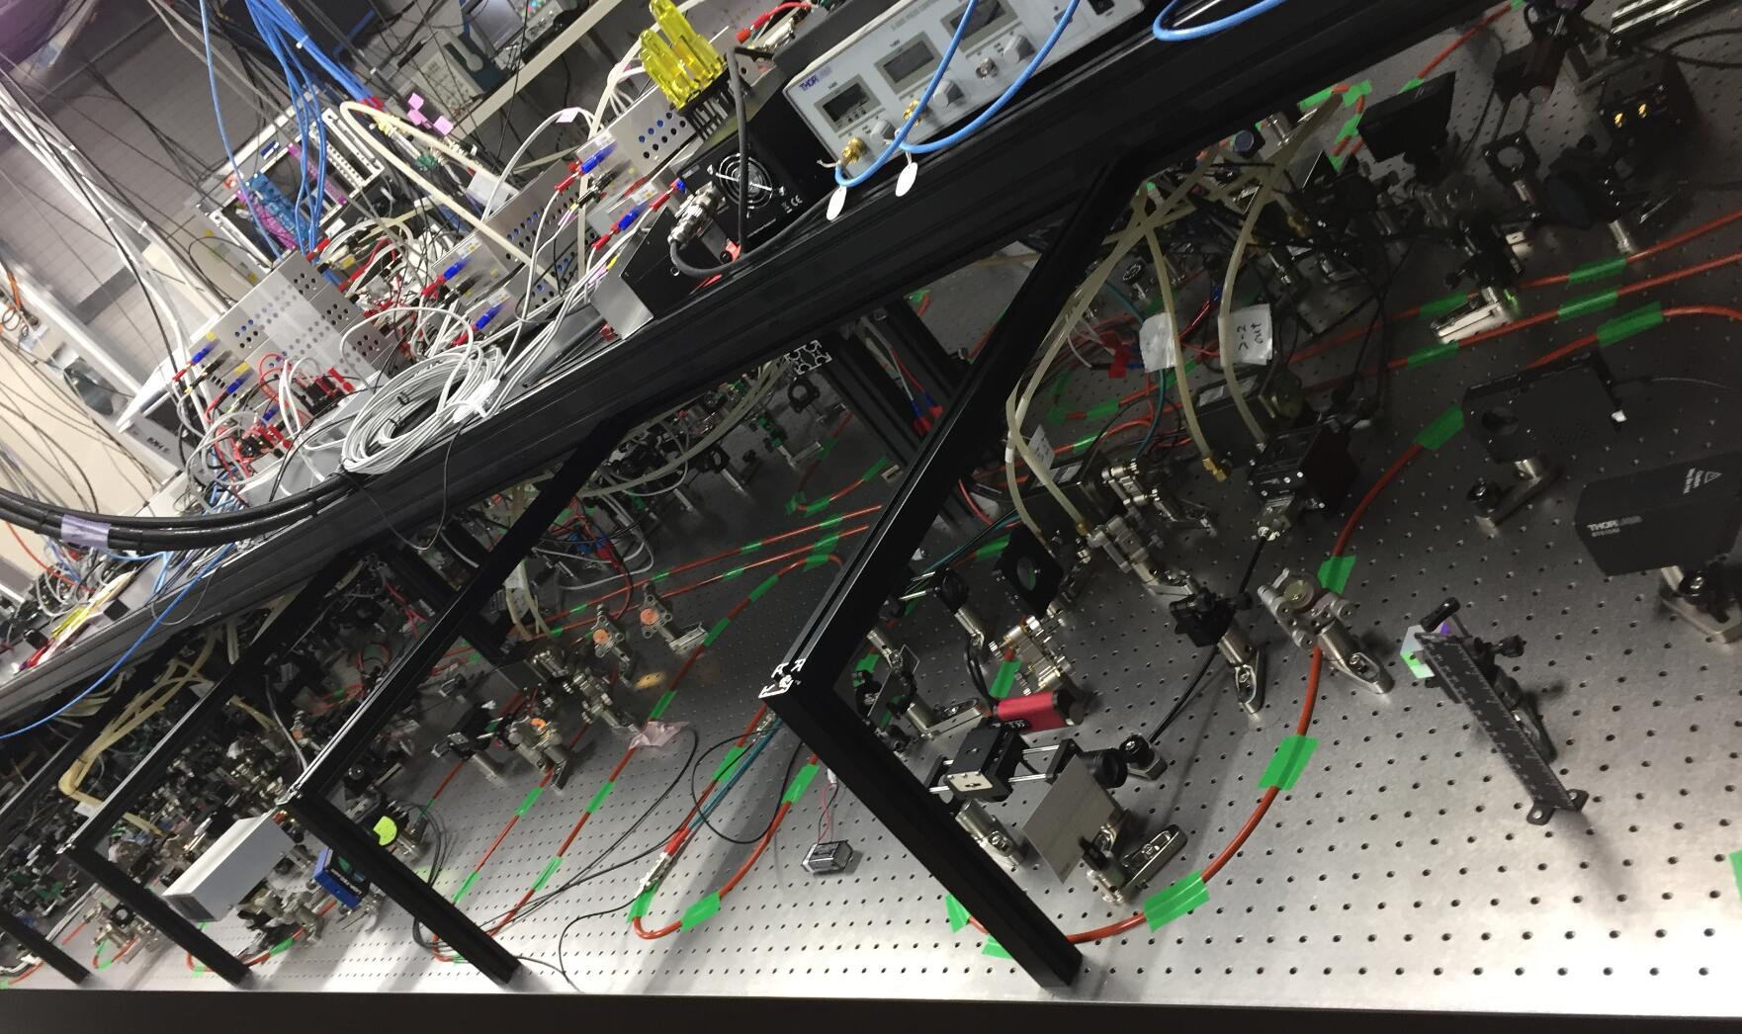
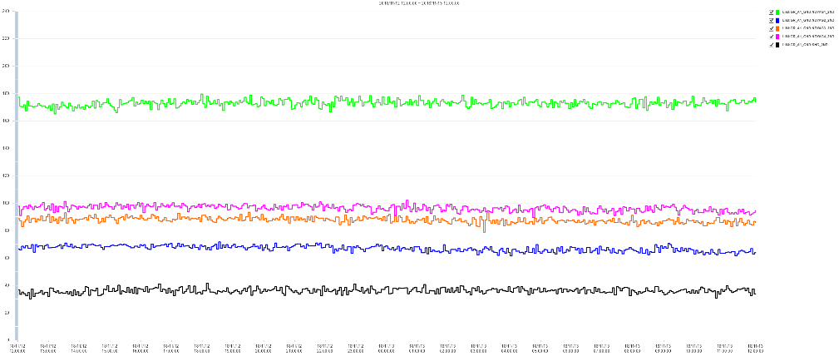
Improvement of e⁻ Stability in Phase III
Stable e⁻ → Improved the laser stability by water cooling for optics table
Two days laser operation history
Laser output
1st Amp
2nd Amp
3rd Amp
4th Amp
5th Amp
Time
Temperature stability for laser environment
Flexible silicon tube for cooling
Better stability for long time laser operation (fluctuation<5%)
Less adjustment for continuous e⁻ generation
19-26

Slide 31
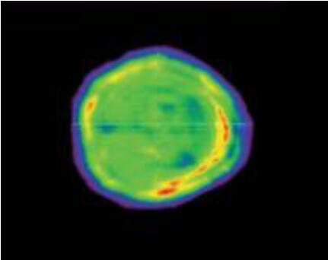
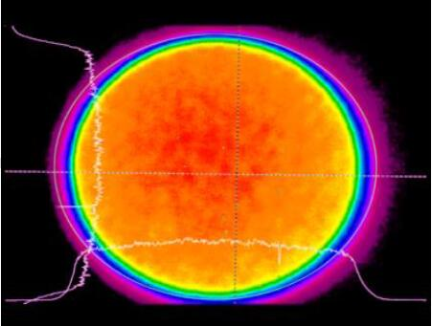
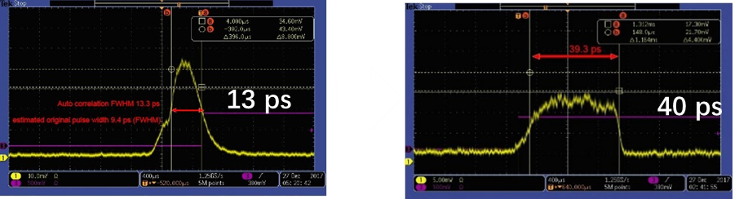
For High Quality e⁻
Laser Spatial Reshaping
Laser Temporal Reshaping
I
x’
Emittance
I
t₁
t₂
x’
t₁
t₂
x
x
Linearity
r
t
Laser spatial distribution
Phase space
Laser spatial distribution
Phase space
I
I
t
t
Nd:YAG laser
Yb:YAG laser
Laser beam shaper for flat-top
For Nd and Yb laser
Under purchasing
Pulse stacking by birefringent crystals
Demonstrated in Nd laser
Will be used in Yb:YAG laser for real flat
24-26

Slide 32
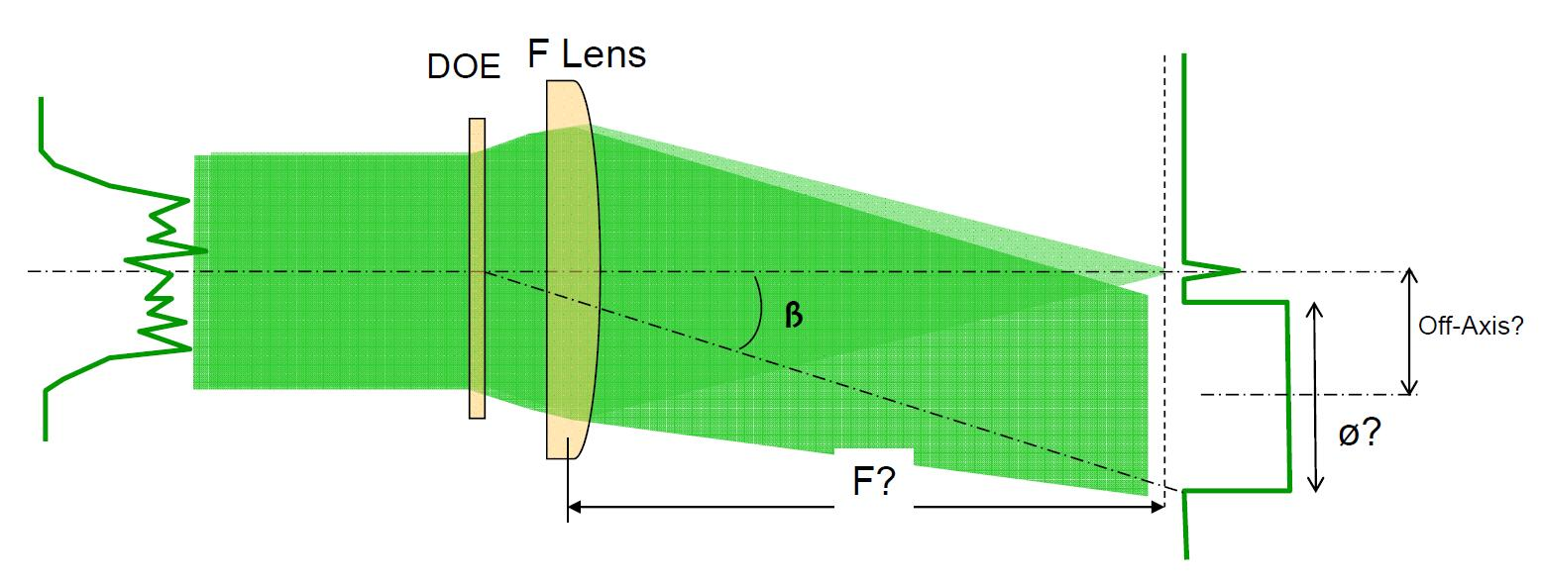

Beam homogenizer
F: 1 m (Focal length of F lens)
Ф: 6 mm (on target surface)
Off-axis: 6 mm (distance between optical axis and center of target spot)
β≈1º

Slide 33

Beam homogenizer
Simulation result
peak to valley modulations on the top hat: ±10%~15%
Transmitting rate> 80%

Slide 34


Slide 35
RF-Gun for 5 nC
Space charge is dominant.
  Longer pulse length : 20 - 30 ps
Stable operation is required.
  Lower electric field : < 100MV/m
Focusing field must be required.
  Solenoid focus causes the emittance growth.
  Electric field focus preserve the emittance.
Total
Space charge
RF
Epaxial coupled cavity : BNL
Annular coupled cavity : Disk and washer / Side couple

Slide 36
Required laser pulse energy
Current laser energy(500μJ)
Charge( C )
Ce₂Te
QE=10⁻⁴
QE=10⁻³
Offline measurement
S-polarization
Offline measurement
P-polarization
QE=10⁻⁵
5nC
ATF
Inclined injection
Normal injection (old 3-2)
Laser power ( J )

Slide 37

Pill-box cavity
Annular coupled cavity with nose
Accelerating field
Accelerating field
Beam
Beam
=> 集束力
Field
Field
Focusing field
Accelerating field
Focusing field
Accelerating field
Accelerating field
Given force
Accelerating field
Given force
Focusing
field
Focusing field

Slide 38




Design of a quasi traveling wave side couple RF gun
Normal side couple structure
Quasi traveling wave sidecouple structure
Long drift space is problem.
Quasi traveling wave side couple has stronger focusing and accelerated gradient than DAW.

Slide 39


Electron beam (EB) heating type cathode plug
【Design of EB heating type cathode plug】
EB heating is …
a main cathode is bombarded by an accelerated electron beam as a thermal source behind the cathode.
e⁻
【 RF shielding structure 】

Slide 40




Heating Test
【Cathode plug】
【Experimental Setup & Results】
Radiation
Thermometers
W wire (0.7φ)
Heater Current (A) | 16
Heater Voltage (V) | 3.38
Intermediate electrode (V) | -25
High Voltage (kV) | 2.3
Beam current (mA) | 23
Beam Power (W) | 52.9
Surface Temperature (degC) | 1029
Heating a photocathode over 1000℃ by EB heating method was succeeded.

Slide 41

YCOB CRYSTAL at LINAC
From Prof. YQ Zheng’s Slide, the 1st KEK and SICCAS nonlinear optics forum, Tsukuba, May 28, 2018

Slide 42

Phase II Nd laser module

