Slide 1
Collimator Issues
2022-12-14
The 26th KEKB Accelerator Review Committee
T. Ishibashi

Slide 2
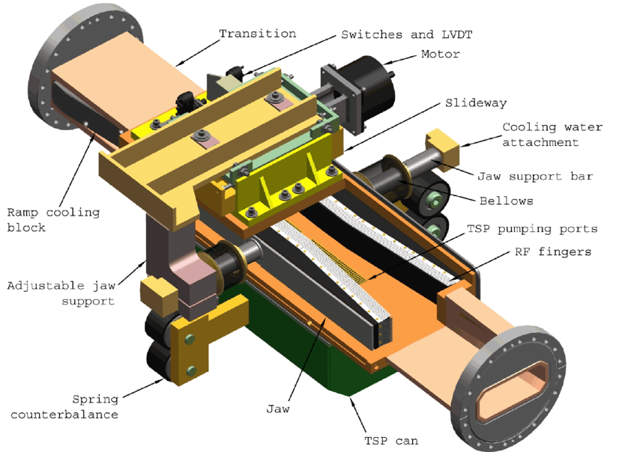
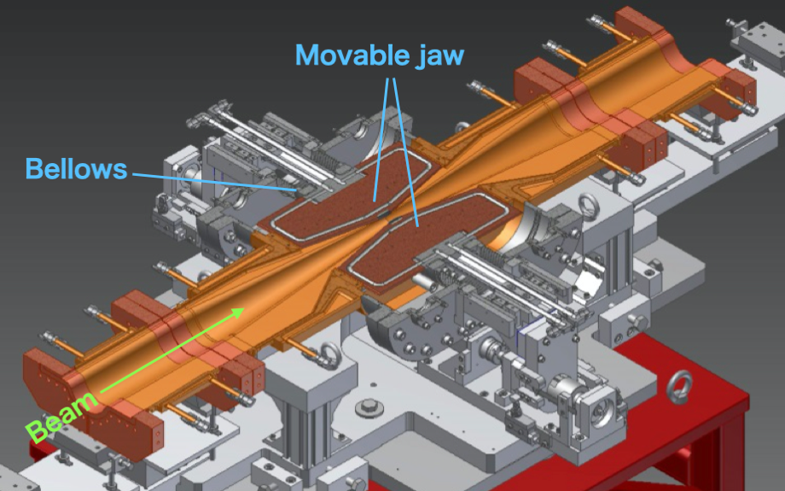
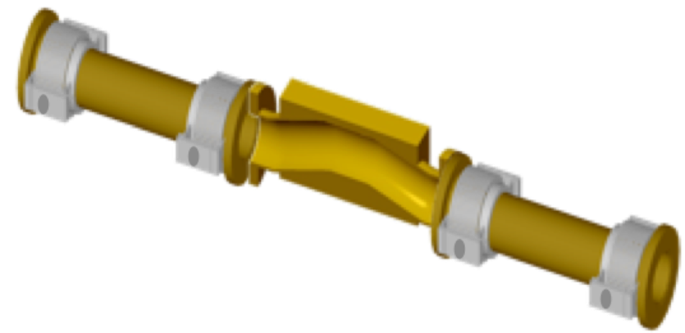
Design
KEKB type
KEKB type collimator has been used since KEKB era.
It has a tapered beam-pipe and approaches the beam through 4 bellows chambers on both sides.
These have been reused in 2 arc sections in HER.
The tip is made of copper coated titanium with a length of 40 mm.
SuperKEKB type
We referenced movable collimators for PEP-II in SLAC for the basic design of the SuperKEKB type.
A collimator chamber has two movable jaws with RF-shields.
Part of the movable jaws is hidden inside the antechambers to avoid trapped modes in gaps between the movable jaw and the chamber. The chamber is also tapered to the center of the collimator in order to avoid excitation of trapped-modes around the jaws.
Materials at the tip of the jaws are tungsten (1st ver.), tantalum (2nd ver.), carbon (low-Z, special ver.), and hybrid (C+Ta, special ver.).
KEKB type
Collimator in PEP-II
SuperKEKB type collimator (horizontal)
[Y. Suetsugu et al., NIM A 513, 465 (2003)]
2
[S. DeBarger et al., SLAC-PUB-11752]
[T. Ishibashi et al., PRAB 23, 053501 (2020)]

Slide 3
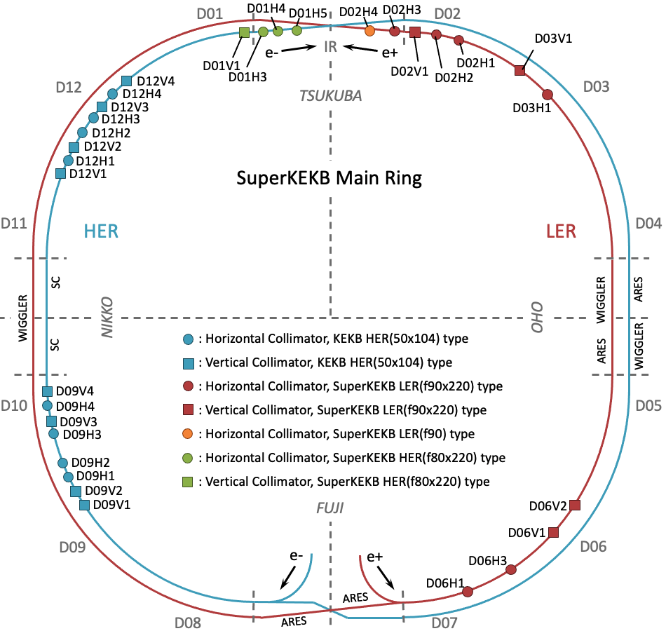
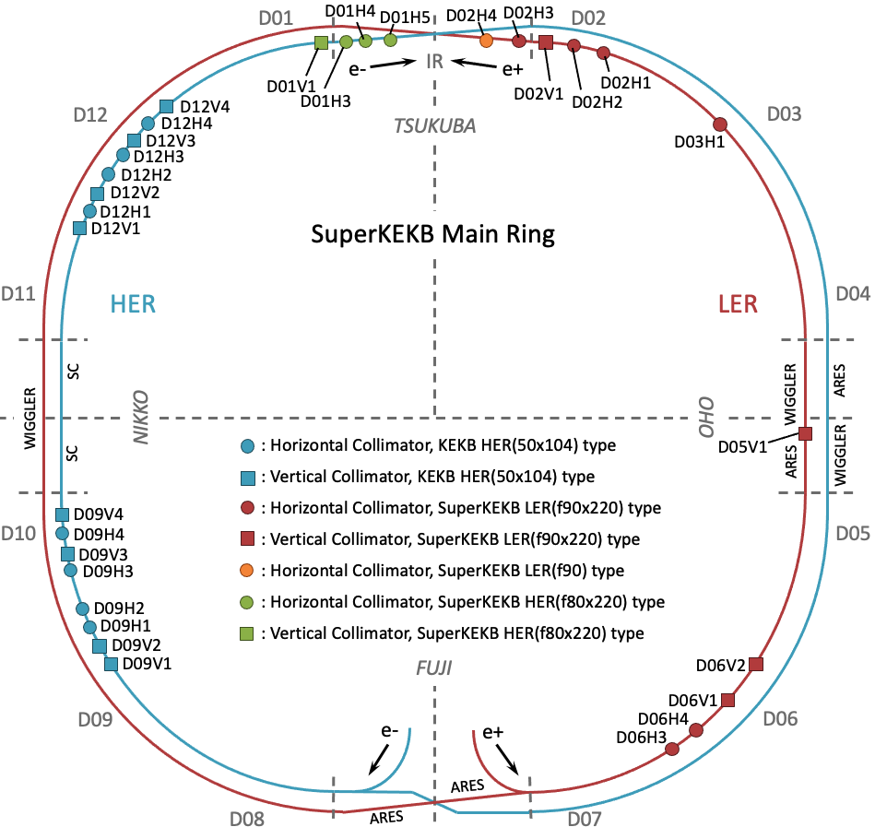
Location
2022ab
after LS1
LER
D06V1: primary collimator to suppress the injection BG
D02V1: collimator closest to interaction point (IP) and very important to suppress the detector BG.
D06V1, D03V1: backups
D06H3: absorber against accidental firings of the injection kickers
During LS1
D03V1 will move to D05V1, that is a non-linear collimator.
D06H1 will move to D06H4 that used for an absorber (countermeasure for accidental firings of injection kickers. D06H3 will be used as the spoiler by installing carbon jaws in it).

Slide 4
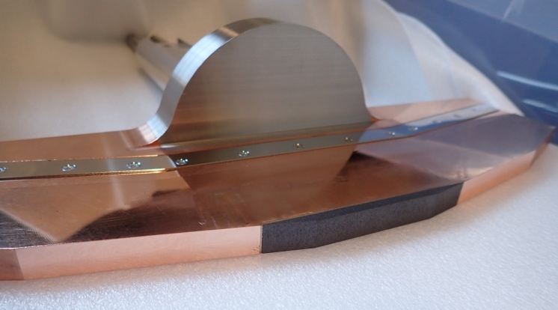
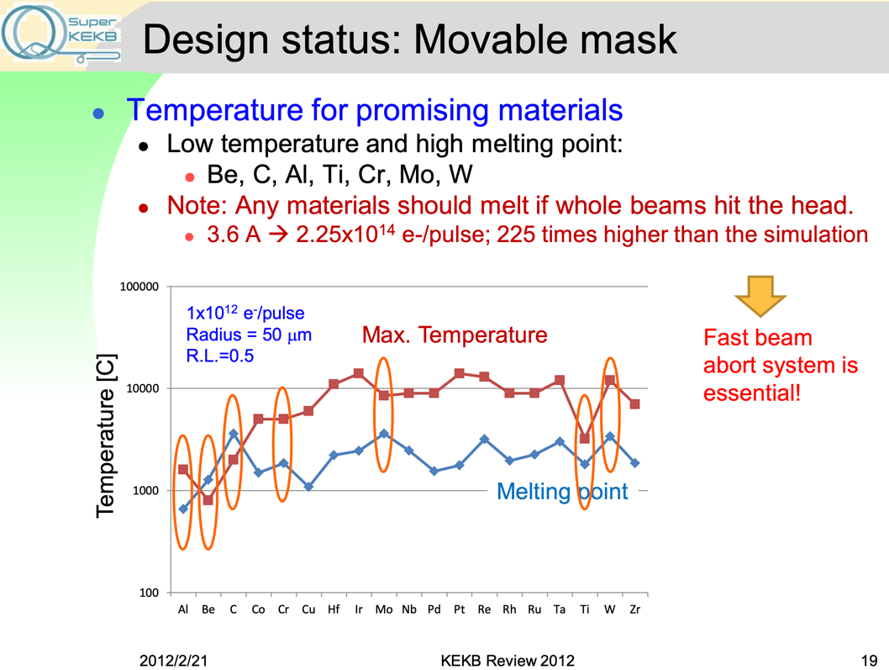
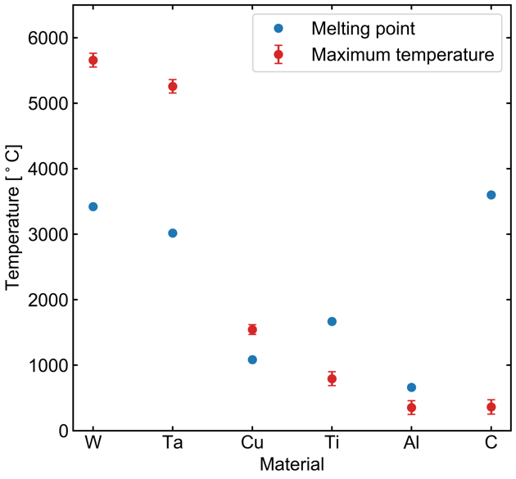
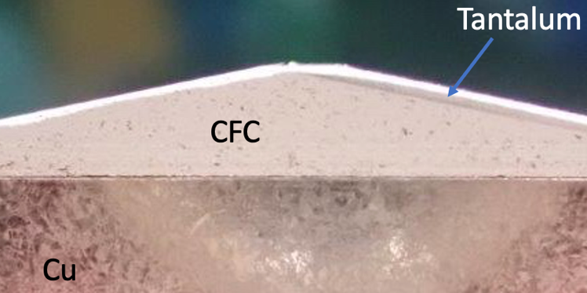
Material
Any materials should melt if high current beam hit the jaw.
Tungsten (W) was used for the material of the tip at first, but it was found that if it was damaged by the beam hit, it become embrittled and generate a lot of radioactive dusts.
After that, tantalum (Ta) have been used as a default material of the tip.
A special type of jaws named low-Z/carbon made from carbon fiber reinforced carbon (CFC) was developed for a more robust collimator, but the impedance problem arose in 2020c and was removed (the radiation length of the carbon is long (~19.32 cm) compared with W/Ta (~0.35 cm/0.41 cm, and its conductivity is low (~3.0e5 S/m @ 5.044 GHz) ), so we need longer jaw to suppress the background).
A special type of jaws named hybrid made from CFC and Ta was developed for the robust collimator. This jaw has been used without being damaged and so on, if a high beam current induced in, it will break, and we don't know what state it will be in if it breaks (In the worst case, cracks may be formed at the junction and discharges may occur.).
Carbon jaw
Hybrid jaw (CFC+Ta)
[T. Ishibashi]
Maximum temperatures within 1 RL and melting points for each material, induced by the positron beam. The beam profile and energy are respectively Gaussian and 4 GeV. Dx=y and the injected current are 0.5 mm and 50 mA (3.12 × 1012 positrons), respectively.
[T. Sanami]

Slide 5
Investigation of Materials for more robust collimators
High-Z (Ta, W)
The radiation length is short (Ta: 0.41 cm, W: 0.35 cm), and we can decrease the length at the tip of the jaw to a few mm.
The electric conductivity is acceptable (Ta: 7.61e6 S/m, W: 18.9e6 S/m). [Ref. Cu: 59.6e6 S/m]
Easy to damage. Jaws with a short tip length of ~4 mm has been installed in the vertical collimators in the arc section for the robustness because the scratch mark caused by the beam hit starts after one radiation length in the beam traveling direction. A tip length of 10 mm has been installed in only D02V1 and D01V1.
Large effect to raise the IR background when it’s damaged (This is derived from the mass density of the protrusions on the tip surface?)
Generate radioactive dusts when it’s damaged. Radiation Science Center has commented that the half-life time of the Ta may be longer compared to that of W. However, it’s very easy to generate the dusts for W when it’s damaged…
In the future, the radioactivity can limit the replacement work. We may have to wait the decay of the radioactivity and be not able to replace during runs.
Low-Z (Carbon)
The radiation length is long (C: 19.32 cm) . We need longer tip (>60 mm) to shield the halo, and this raise the geometrical impedance.
The electric conductivity is very low (C: ~3.0e5 S/m @ 5.044 GHz), and the resistive wall also raises the impedance. However, we can avoid this by adopting Cu plate on the carbon.
The melting point is high.
Very difficult to damage.
Mid-Z (Ti)
The radiation length is intermediate (Ti: 3.56 cm), and we can adopt a dozen mm for the tip length.
The electric conductivity is acceptable (Ti: 2.38e6 S/m). If we need Cu plating, we can do it as with the jaws of KEKB type collimators.
Easy to damage from the experiences of KEKB type collimators in HER.
Nevertheless, we’ve used damaged Ti jaws in HER without major impact on the IR backgrounds. (This is derived from the mass density?)
(→ Titanium jaws may have good balance in terms of the durability and the impedance.)
Difficult to generate the radioactive dusts when it’s damaged from the experiences of KEKB type collimators in HER.
We are developing carbon, hybrid (C+Ta), titanium, and MoGr jaws as collimators that are hard to damage or have little effect on the background even if they are damaged.

Slide 6
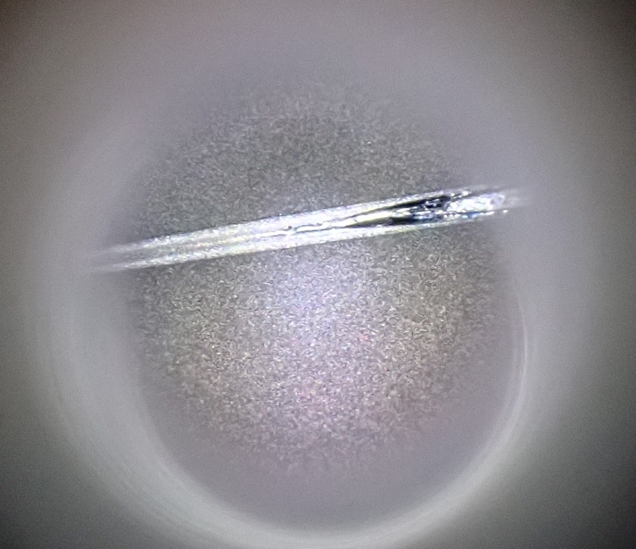
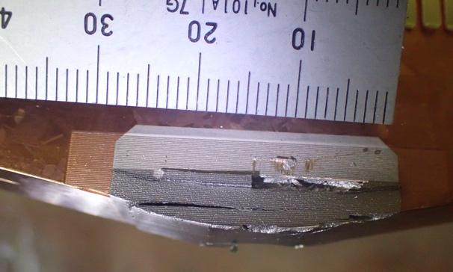
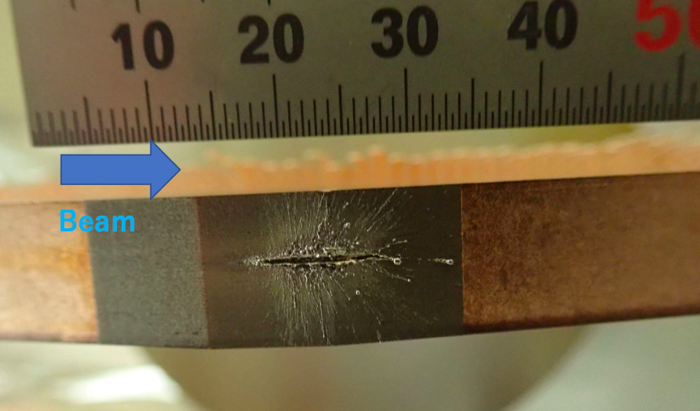
Major Issues – damage
The collimators have been frequently damaged due to beam hits.
The source of beam instability that causes damage to the vertical collimators is still unknown (sudden beam loss, H. Ikeda will report the details later).
On the other hand, there are damaged events for known reasons, and that is the damage to a horizontal collimator (D06H3) caused by accidental-firings of injection kickers in LER. As countermeasures against this,
Carbon jaws will be installed in D06H3 and used as a spoiler for the uncontrollable beams.
D06H1 will move to D06H4 and used as an absorber.
Damaged tip of D09V1 (KEKB type) in HER due to the sudden beam loss during 2022b.
Damaged jaw of D06H3 in LER due to the accidental-firings
Damaged jaw of D02V1 in LER due to the sudden beam loss

Slide 7
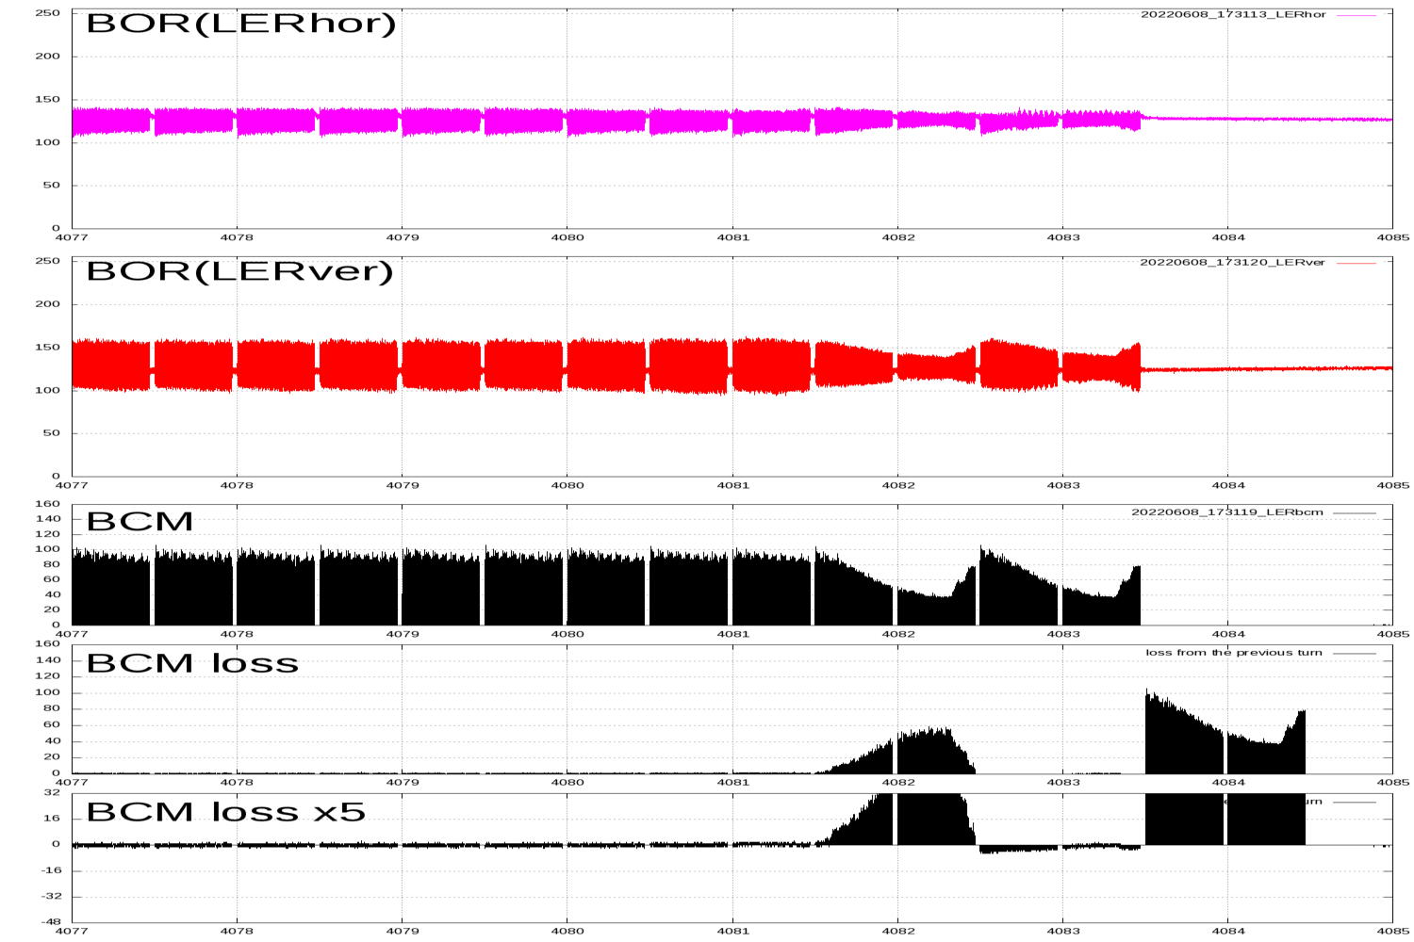
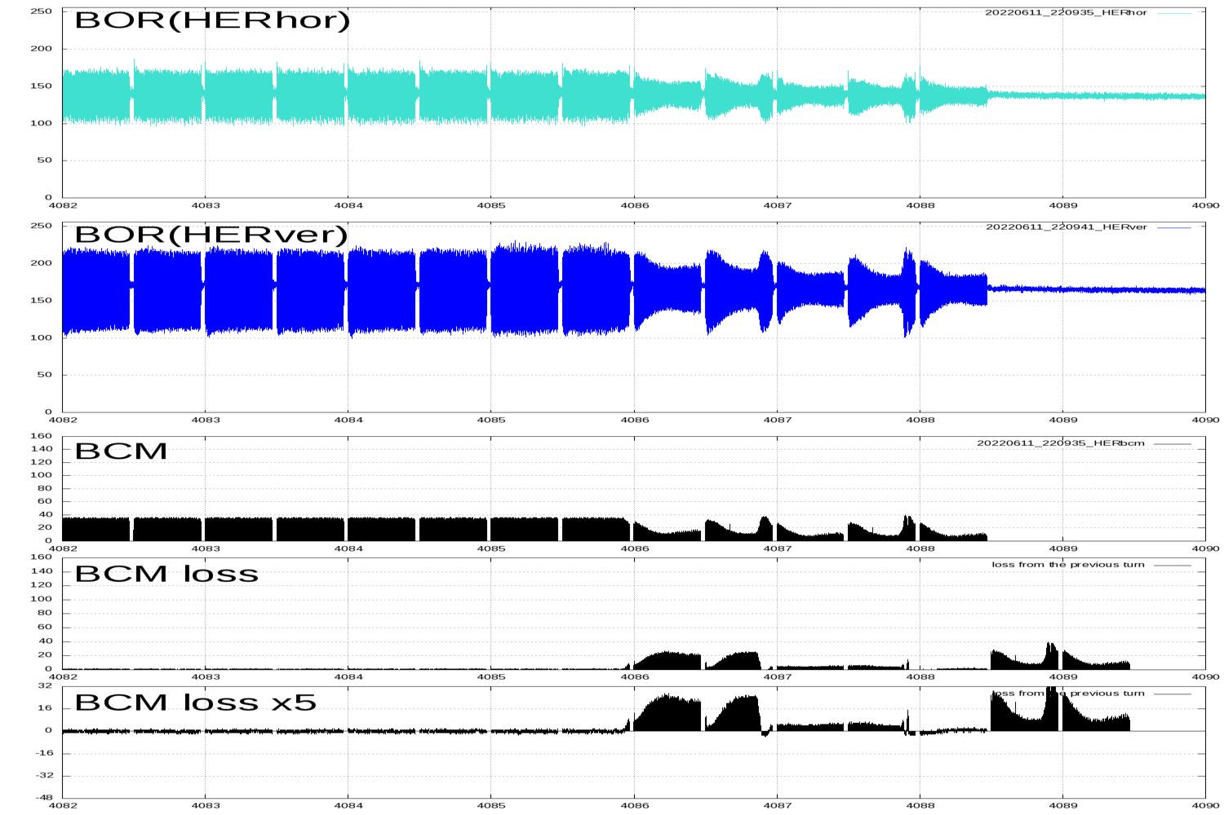
Major Issues - damage (sudden beam loss)
Sudden beam loss has occurred within approximately 2-turn (~20 μs) before the beam abort.
Beam orbit displacements in horizontal and vertical direction has been observe [H. Fukuma and S. Terui].
No increase in the beam size has been observed by a fast beam size monitor [G. Mitsuka].
This beam loss has never happened in single beam operation (because the short operation time with single beam?).
It is more common in LER, but has also occurred in HER.
Candidates of the cause [kick-off meeting of ITF sudden beam loss working group, https://kds.kek.jp/event/43499/]:
X-abort, dust, fire-ball in collimators, electron cloud in vertical collimators …
1st train
2nd train
a turn
Bunch oscillation recorder (BOR) and bunch current monitor (BCM), BOR signal is proportional to (bunch displacement)×(bunch intensity).

Slide 8
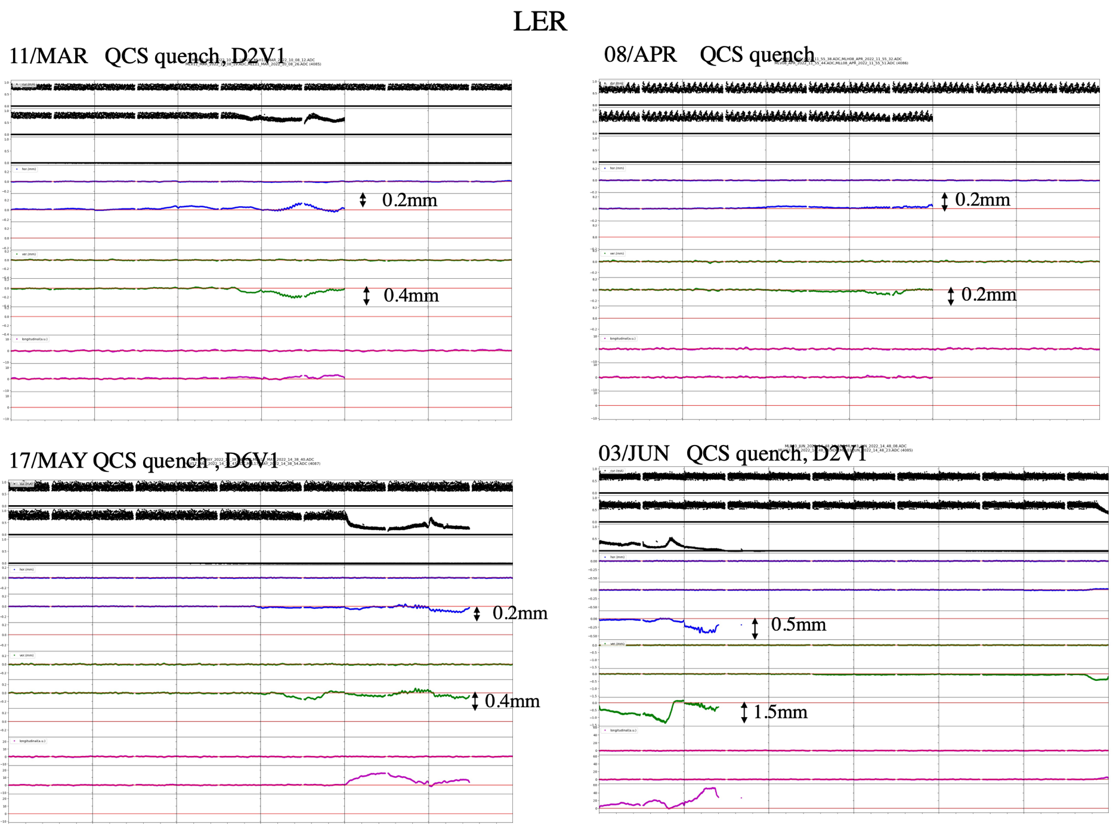
Major Issues - damage (sudden beam loss)
Beam orbit displacements in horizontal and vertical direction has been observed.
Current [mA]
[H. Fukuma]
Horizontal [mm]
Vertical [mm]
Longitudinal [a.u.]

Slide 9
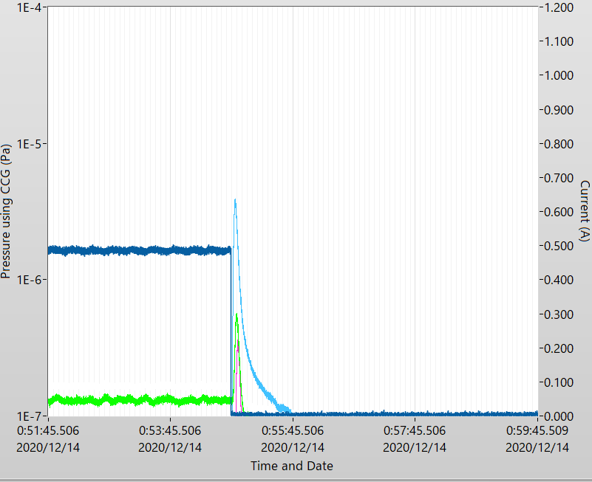
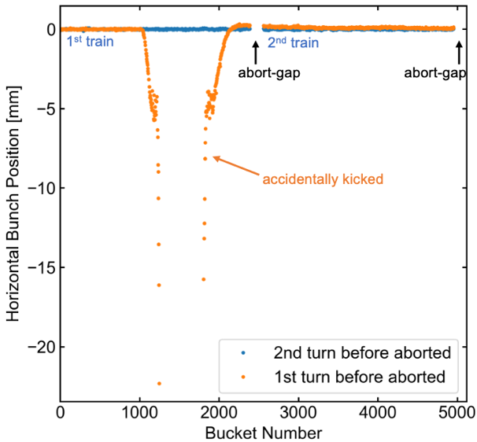
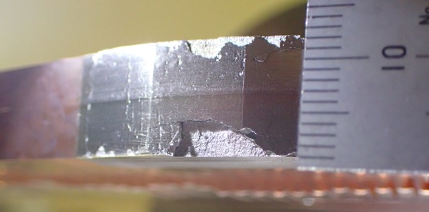
Major Issues - accidental firings of injection kickers
Accidental firings of injection kickers have happened in LER.
(It seems that the accidental firings tend to occur more frequently after the shutdown period somehow.)
When this event occurs, pressure burst near a horizontal collimator named D06H3 is observed due to the beam hit.
In the current system, we cannot make the probability of the accidental firing zero, so some horizontal collimators in each ring has been used to protect components against the accidentally kicked beams.
As countermeasures against this,
Carbon jaws will be installed in D06H3 and used as a spoiler for the uncontrollable beams.
D06H1 will move to D06H4 and used as an absorber.
The number of the accidental firings on each run period.
Pressure burst near D06H3 collimator.
Horizontal position of the center of gravity for each bunch measured with BOR and the bucket number when an accidental firing of an injection kicker occurred.
LS1
shutdown
shutdown
shutdown
shutdown
LER current
CCG D06_L03
Damaged jaw in D06H3 by accidental firings.＿

Slide 10
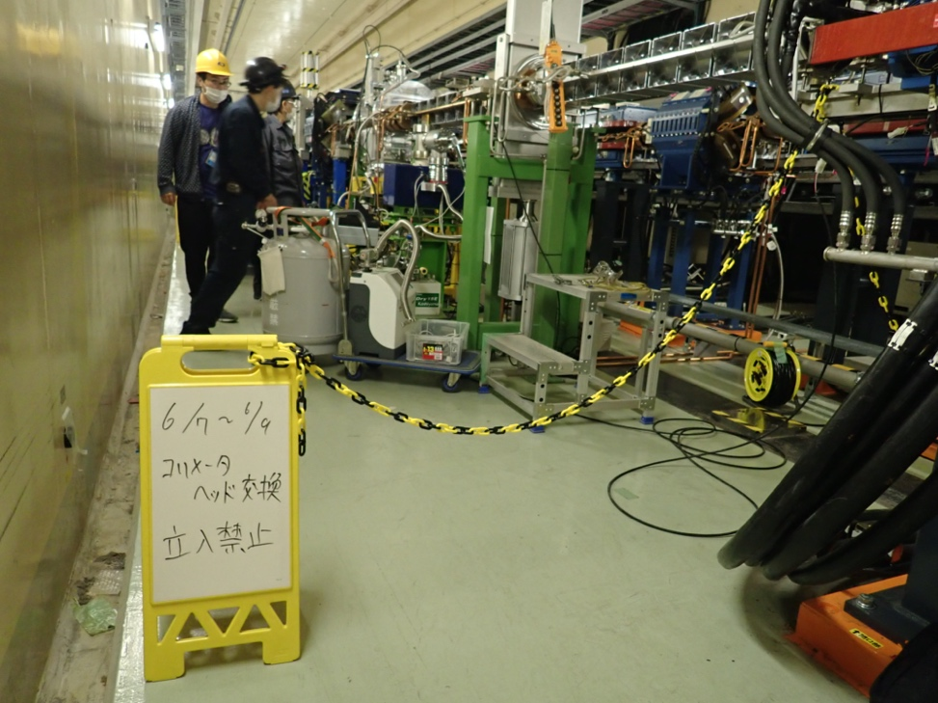
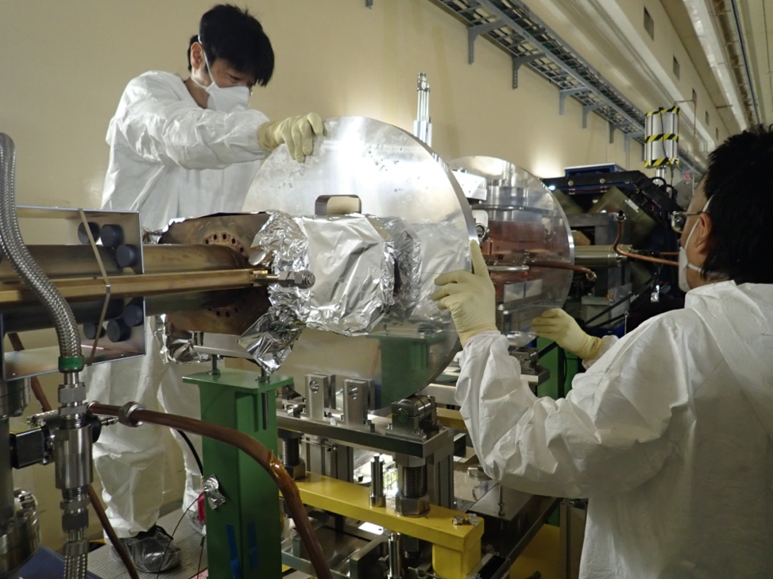
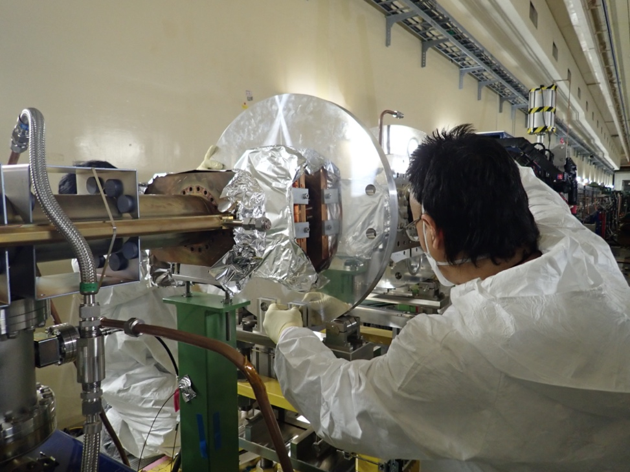
Replacement Work (vertical collimator)
Before the replacement, we purge the beam pipes in the section where the collimator is located with nitrogen and remove the drive mechanisms and cooling water pipes.
It is also necessary to investigate the cooling water whether it’s radio activated.
Clearing out people
Remove the beam-pipes nearby, and rotate the chamber 90 degrees

Slide 11
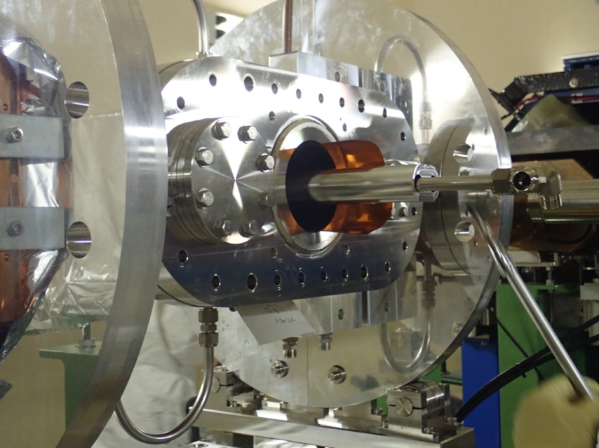
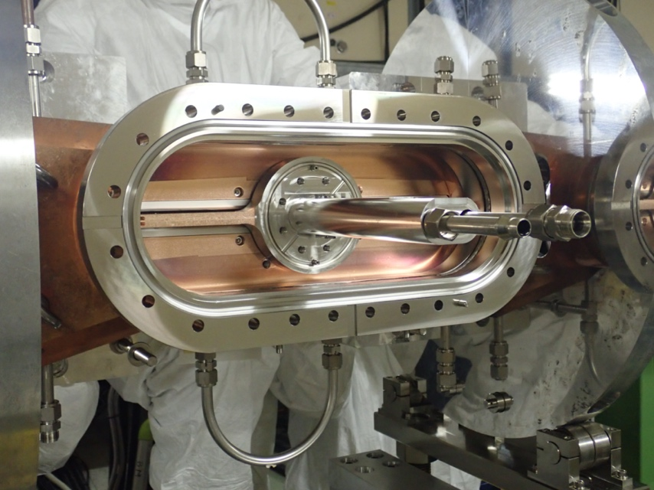
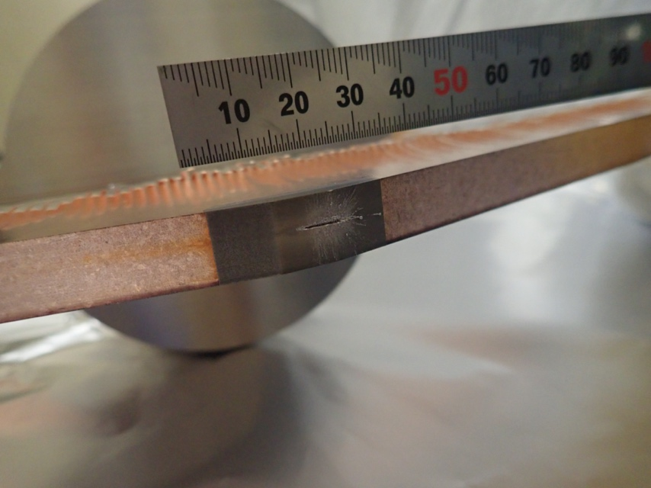
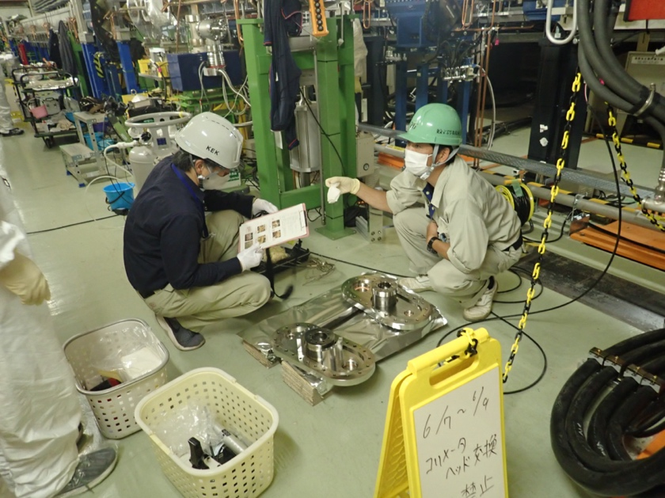
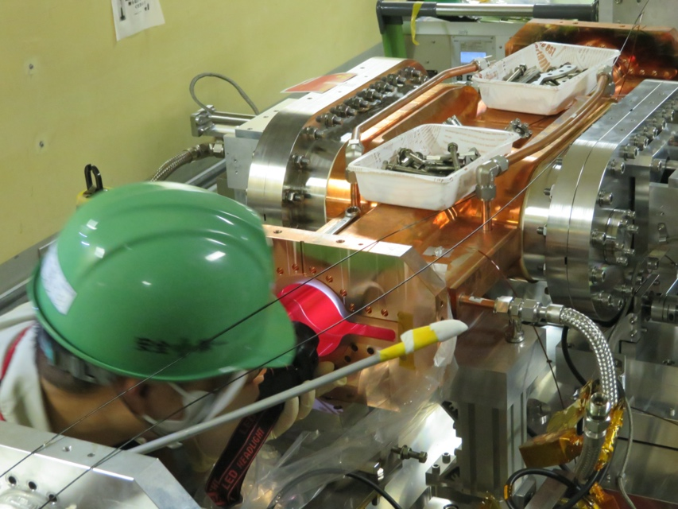
Replacement Work
Remove the racetrack type flanges in where the jaws are inserted.
Remove the damaged jaws.
(← this photo shows a cleaning work for D06H3. I was not able to find the photo for D02V1.)
Clean the inside of the flange and chamber to remove deposits such as activated dust.

Slide 12
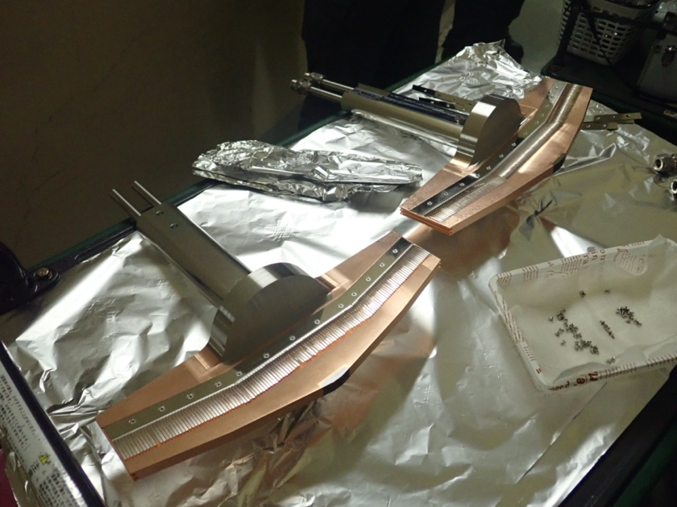
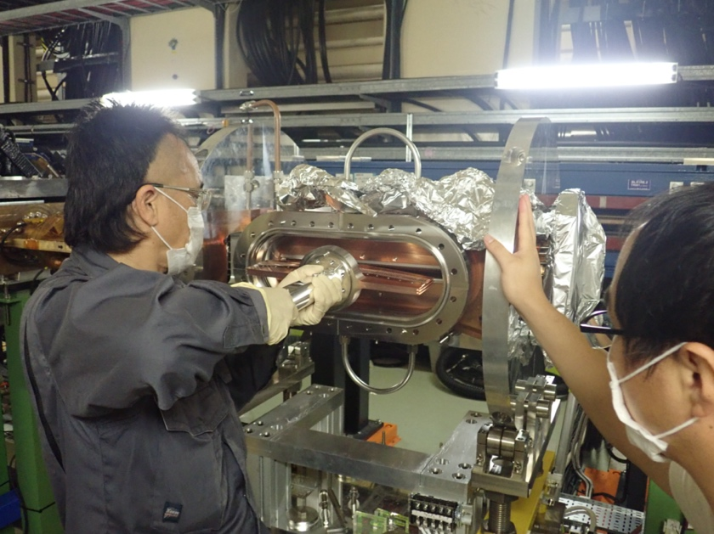
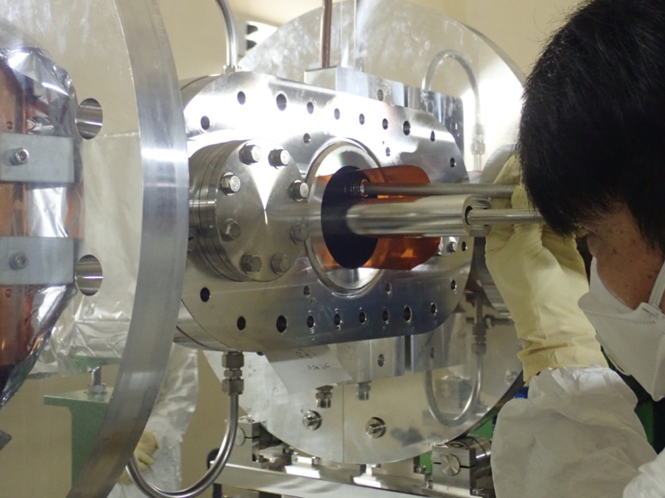
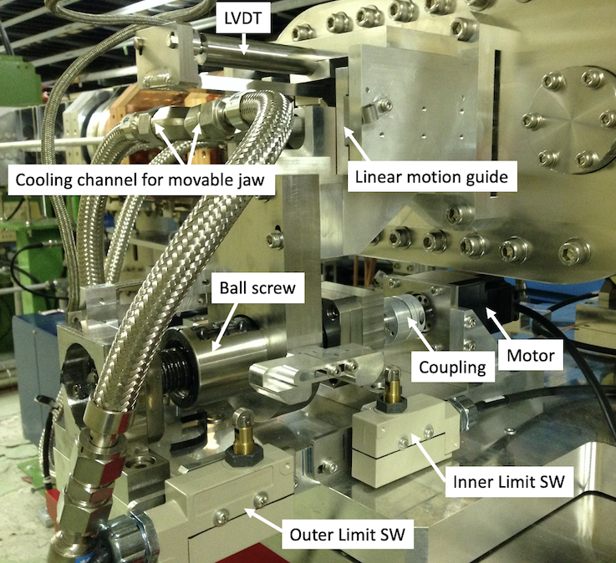
Replacement Work
Insert them carefully so as not to break the fingers and so on.
Attach RF-fingers to the spare jaws.
Tighten the flanges.
After that, we rotate the chamber -90 degrees and connect the beam-pipes nearby and cooling water pipes. Then, after the leak check pass, we re-install the drive mechanisms and fine tune them.
Align using a laser tracker with the help of Magnet Group if necessary.
Drive mechanism

Slide 13
Current condition – HER
Name | Type | Tip Material (): longitudinal length in mm | Tip Condition | Drive Mechanism | Work Plans during LS1
D09H1 | KEKB | Cu coated Ti (40) | damaged
D09H2 | KEKB | Cu coated Ti (40) | damaged
D09H3 | KEKB | Cu coated Ti (40) | damaged
D09H4 | KEKB | Cu coated Ti (40) | damaged
D12H1 | KEKB | Ti (40) | healthy
D12H2 | KEKB | Cu coated Ti (40) | damaged
D12H3 | KEKB | Ti (40) | healthy
D12H4 | KEKB | Cu coated Ti (40) | healthy
D01H3 | SuperKEKB | W (10) | healthy | -
D01H4 | SuperKEKB | W (10) | healthy | -
D01H5 | SuperKEKB | W (10) | healthy | -
D09V1 | KEKB | Cu coated Ti (40) | damaged |  | jaw replacement (Cu coated Ti (40)), drive mechanism upgrade?
D09V2 | KEKB | Cu coated Ti (40) | healthy
D09V3 | KEKB | Cu coated Ti (40) | healthy
D09V4 | KEKB | Cu coated Ti (40) | healthy
D12V1 | KEKB | Cu coated Ti (40) | damaged | upgraded
D12V2 | KEKB | Cu coated Ti (40) | damaged
D12V3 | KEKB | Cu coated Ti (40) | healthy |  | drive mechanism upgrade
D12V4 | KEKB | Cu coated Ti (40) | healthy | upgraded
D01V1 | SuperKEKB | W (10) | damaged (only BTM) | - | jaw replacement (Cu coated Ta (10))
arc
Tsukuba
straight
arc
Tsukuba
straight
D09V1 was damaged during 2022b and will be replaced with new one during LS1.
There was a problem with the displacement sensor in D12V3 during 2022ab, and the drive mechanism will be upgraded during LS1.
There is a request to upgrade the drive mechanism of D09V1 for the precise positioning.
We plan to coat spare jaws for D01V1 with Cu and install them as a countermeasure for fire-balls during LS1.

Slide 14
Current condition- LER
Name | Type | Tip Material (): longitudinal length in mm | Tip Condition | Work Plans during LS1
D06H1 | SuperKEKB | W (10), fully opened | healthy | move to D06H4, jaw replacement (Ta (10?))
D06H3 | SuperKEKB | OUT: Ta (10), IN: W (10) | damaged | jaw replacement (Cu coated C (160))
D03H1 | SuperKEKB | W (10) | healthy
D02H1 | SuperKEKB | W (10) | healthy
D02H2 | SuperKEKB | W (10) | healthy
D02H3 | SuperKEKB | W (10) | healthy
D02H4 | SuperKEKB | W (10) | healthy
D06V1 | SuperKEKB | Ta (4) | damaged | jaw replacement (Cu coated Ti (10?))
D06V2 | SuperKEKB | Cu coated C-Ta hybrid (3) | healthy
D03V1 | SuperKEKB | Ta (10) | healthy | move to D05V1 (currently installed jaws will be spares)
D02V1 | SuperKEKB | Ta (10) | damaged | jaw replacement (Cu coated Ta (10))
arc
Tsukuba
straight
arc
Tsukuba
straight
D06H1 will move to D06H4 and used as an absorber of uncontrollable beams due to accidental firings of injection kickers. The jaws will also be replaced with new ones.
Carbon jaws will be installed in D06H3 and used as a spoiler of the uncontrollable beams.
Cu coated Ti jaws, which are one of candidates of durable jaws, will be installed in D06V1 and can be also used as a spoiler for sudden beam loss (D05V1 can be used for the absorber) [A. Natochii, https://kds.kek.jp/event/42881/].
D03V1 will move to D05V1 (non-linear collimator), and the jaws will also be replaced with new ones (Cu coated Ta, the length depends on the radiation safety in OHO-section).
We plan to coat spare jaws of the vertical collimators with Cu as a countermeasure for fire-balls and install them in D02V1 and D05V1.

Slide 15
Major Issues – impedance (summary of -1 mode instability in vertical direction)
In single-beam operation (no collision) in LER:
Vertical beam size blow-ups have been observed at ~1.0 mA/bunch, and the threshold of the -1 mode instability depends on the aperture setting of the vertical collimators, tuning of the vertical bunch-by-bunch feedback and so on.
ITF TMCI working group (contact person: Mauro Migliorati, sub-contact person: me) had tackled to find countermeasures against this and investigation of the mechanism through simulations and machine studies.
ITF TMCI working group: https://kds.kek.jp/category/2247/
ITF meetings: https://kds.kek.jp/category/2322/
A peak around ν_{y}-ν_{s} appears when the blow-ups occur (so we’ve called this “-1 mode instability in the group).
Tune surveys indicate that this instability is not derived from a stop band of ν_{y}-ν_{x}-2ν_{s}=N.
The dipole oscillation due to the -1 mode instability is spontaneously damped.
The growth time is 3.5 ms to 8 ms.
The 0- and -1-mode seem to be coupled at around ~2.0 mA (ordinary TMCI) from a linear regression in a measurement.
We’ve found some effective countermeasures to the -1 mode instability.
Tuning of the vertical bunch-by-bunch feedback (BxB FB),
Increase the vertical tune,
Increase the vertical chromaticity,
Reducing the impedance in the vertical direction by opening vertical collimators.
The forth item is one of motivations to construct a non-linear collimator, and we’ve decided to construct it (A. Morita will report about the non-linear collimator later).
K. Ohmi has reproduced this instability in simulations taking transverse wake and high gain feedback system with a multi-tap FIR filter in to account (K. Ohmi will report later).

Slide 16
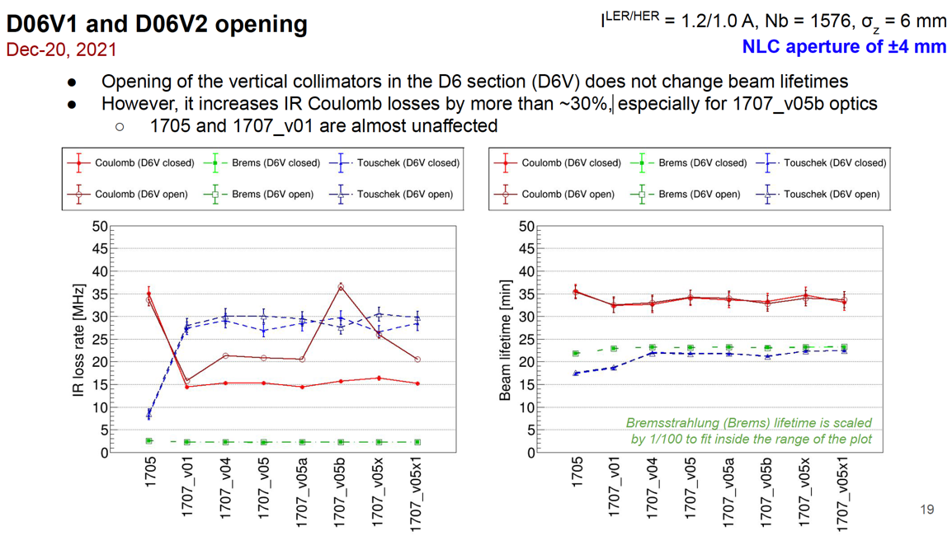
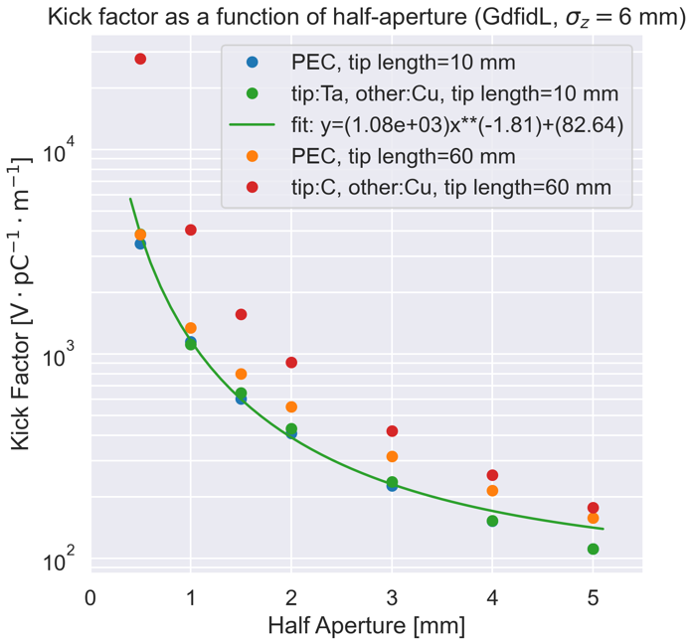
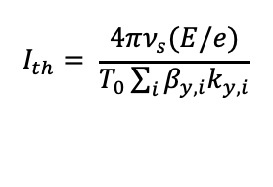
Non-linear collimator
[A. Natochii]
[example] collimator setting and β_{y}k_{y} for βy*=1 mm optics.
Collimator | β_{y} [m] | Half-aperture [mm] ^{a)} | β_{y}k_{y} [×10¹⁵, V/C] ^{b)}
D06V1 | 67.35 | 2.9 | 16.15
D06V2 | 20.57 | 2.6 | 5.64
D03V1 | 16.96 | 8.0 | 1.83
D02V1 | 11.89 | 1.1 | 11.76
D05V1 | 4.05 ^{c)} | 4 | 0.69
averaged value of top and bottom half-aperture at 2021-12-22
ky is a kick-factor obtaind by GdfidL simulations and a fit for σ_{z}=6 mm and Ta-jaw of 10 mm in the longitudinal length.
sler_1707_80_1_cw80_NLC_04
Bunch current threshold of TMCI
$$I_{th}= \frac{4πν_{s}(E/e)}{T_{0}\sum_{i}{β_{y,i}k_{y, i}}}$$
D05V1 is a vertical collimator in the non-linear collimation system.
D06V1 has been used to suppress the injection backgrounds (primary collimator) and has a large β_{y}k_{y} because the β_{y} is large, and the aperture is narrow.
D05V1 can have a small β_{y} and almost the same performance of the background reduction as D06V1 with the wider aperture.
→ It can decrease the β_{y}k_{y} to approximately 1/20 if we can use D05V1 instead of D06V1.

Slide 17
Summary - Major Issues
Collimators have been frequently damaged due to
accidental firings of injection kickers in LER,
For a measure against this, we will develop and install carbon jaws in D06H3, and it will be used as a spoiler. Then, we will move D06H1 to D06H4 that used for an absorber for the uncontrollable beams.
sudden beam loss in the both rings.
For a measure against the sudden beam loss,
there is a possibility that the Cu coating on the tip of the jaw can avoid the sudden beam loss if they are triggered by fire-balls (T. Abe). We will coat the tip in all of the vertical collimators with Cu.
we will install short titanium jaws in D06V1 and use it as a spoiler, and use D05V1 (non-linear collimator) as an absorber for the uncontrollable beams [A. Natochii, MDI taskforce meeting, https://kds.kek.jp/event/42881/].
Large β_{y} of ~67 m at D06V1 is unwanted for the vertical impedance, but good for the spoiler.
We have to set narrow aperture in D06V1, so the impedance situation remains unchanged.
If there is a possibility that electron cloud in the collimators can cause the sudden beam loss (under investigating), we may put solenoid coils around them.
Vertical beam size blow-ups in LER have been observed caused by the impedance and feedback in the vertical direction.
This instability can be reproduced by simulations taking transverse wake and high gain feedback with a multi-tap and FIR filter system into account [K. Ohmi].
The impedance can be dramatically reduced by adopting a non-linear collimation system instead of D06V1, and this will increase the threshold of the bunch current.

Slide 18
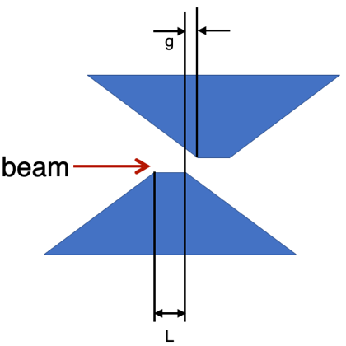
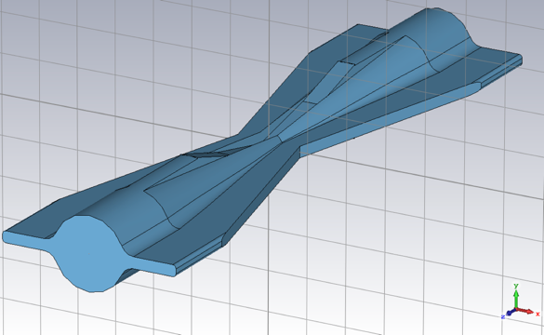
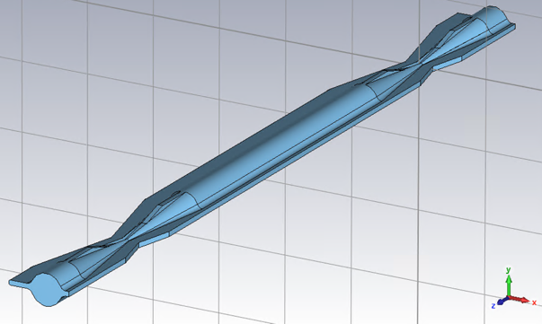
Summary - Status and Future Plans
We’ve developed new jaws (C, hybrid, Ti, and MoGr) for a more robust system in terms of the beam hits.
However, even if these are realized, they are only tentative measures, because any materials should melt if high current beam hit the jaw.
It is essential to eliminate sources that causes the uncontrollable beam (sudden beam losses and accidental-firings in injection kickers).
In addition, several ideas have been proposed to make the collimator system more robust.
alternate jaws to prevent deposition of metal on the opposing surface at tip (impedance increase and trapped mode)
wider jaws to make room for the horizontal shift (impedance increase)
operation of double D02V1 in tandem (trapped mode)
vertical collimator at downstream of IP, that is D01 for example, to install jaws that have ultra-thin tips (BG reduction)
(): concerns
alternate jaws
wider jaws
vertical collimator in tandem

Slide 19
back-up

Slide 20
Spares that we have as of now
Tip Material (): longitudinal length in mm | Collimator to be installed (assumed) | Work Plans during LS1
HER vertical: W (10) | D01V1
HER vertical: Ta (10) | D01V1 | plan to coat with Cu
HER vertical: Ta (10) | D01V1 | plan to coat with Cu
HER vertical: Cu coated Ti (40) | D09V1-V4, D12V1-V4
LER vertical: Ta (10） | D02V1 | plan to coat with Cu and install on D02V1
LER vertical: Ta (10） | D02V1 | plan to coat with Cu and install on D02V1
LER vertical: Ta (10） | D02V1 | plan to coat with Cu and install on D05V1(?)
LER vertical: Ta (10） | D02V1 | plan to coat with Cu and install on D05V1(?)
LER horizontal: Ta (10） | D01H3-H5, D02H1-H4, D06H4

Slide 21
Scheduled to be manufactured (FY2022)
Tip Material (): longitudinal length in mm | Collimator to be installed (assumed) | Remaks
LER vertical: Cu coated Ta (3.5-10） | D05V1 | longitudinal length depends on the radiation safety in OHO-section
LER vertical: Cu coated Ta (3.5-10） | D05V1 | longitudinal length depends on the radiation safety in OHO-section
LER vertical: Cu coated Ti (10?） | D06V1 | can be used for spoiler against sudden beam loss (D05V1 can be the absorber)
LER vertical: Cu coated Ti (10?） | D06V1 | can be used for spoiler against sudden beam loss (D05V1 can be the absorber)
LER horizontal: Ta (10?） | D06H4 | absorber for crazy beam due to accidental firings in inj. kickers
LER horizontal: Ta (10?） | D06H4 | absorber for crazy beam due to accidental firings in inj. kickers
LER horizontal: Cu coated C (160?） | D06H3 | spoiler for crazy beam due to accidental firings in inj. kickers
LER horizontal: Cu coated C (160?） | D06H3 | spoiler for crazy beam due to accidental firings in inj. kickers
HER vertical: Cu coated Ti (40） | D09V1-V4, D12V1-V4 | KEKB type jaw
HER vertical: Cu coated Ti (40） | D09V1-V4, D12V1-V4 | KEKB type jaw
In addition to these, we plan to investigate MoGr [M. Pasquali et al., https://doi.org/10.1007/s40870-019-00210-1] as one of candidates of the durable jaws,

Slide 22
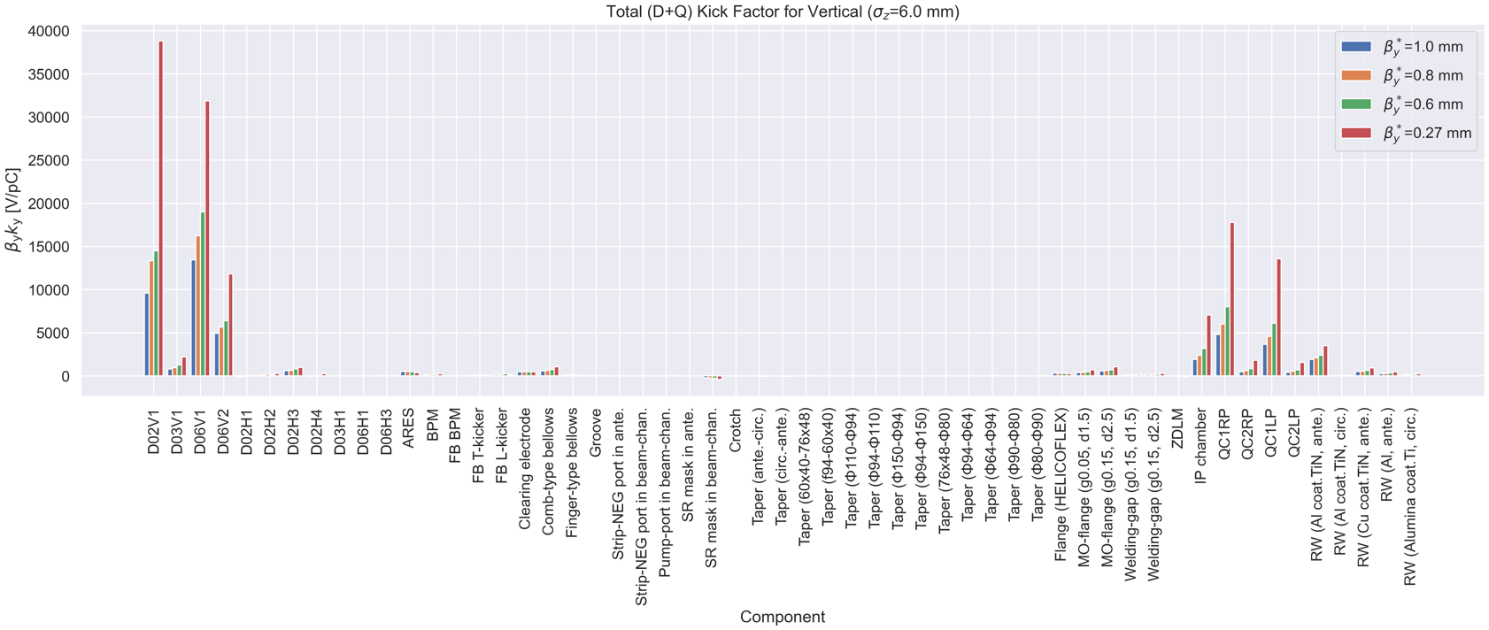
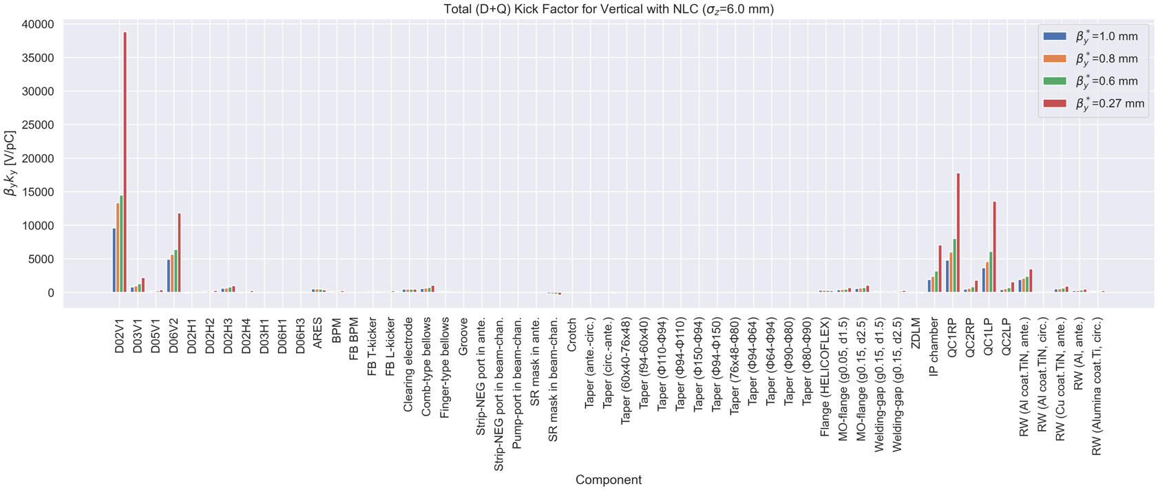
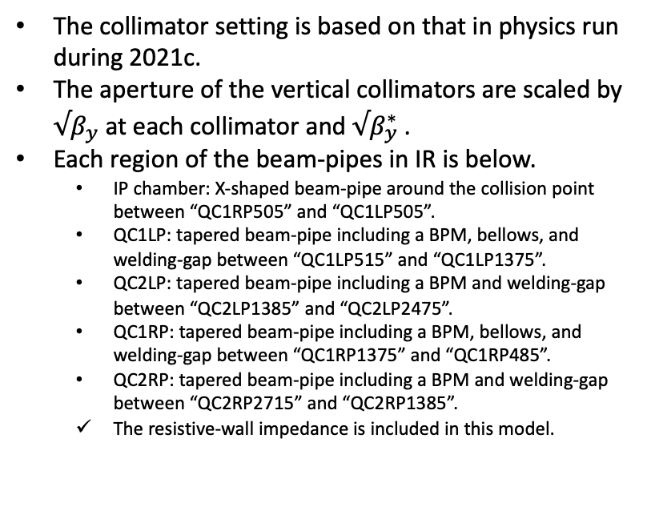
Major Issues (impedance - β_{y}* dependence)
D06V1
The collimator setting is based on that in physics run during 2021c.
The aperture of the vertical collimators are scaled by $√β_{y}$ at each collimator and $√β_{y}^{∗}$ .
Each region of the beam-pipes in IR is below.
IP chamber: X-shaped beam-pipe around the collision point between “QC1RP505” and “QC1LP505”.
QC1LP: tapered beam-pipe including a BPM, bellows, and welding-gap between “QC1LP515” and “QC1LP1375”.
QC2LP: tapered beam-pipe including a BPM and welding-gap between “QC2LP1385” and “QC2LP2475”.
QC1RP: tapered beam-pipe including a BPM, bellows, and welding-gap between “QC1RP1375” and “QC1RP485”.
QC2RP: tapered beam-pipe including a BPM and welding-gap between “QC2RP2715” and “QC2RP1385”.
The resistive-wall impedance is included in this model.
vertical collimator
IR
D05V1
(non-linear collimator)
vertical collimator
IR

Slide 23
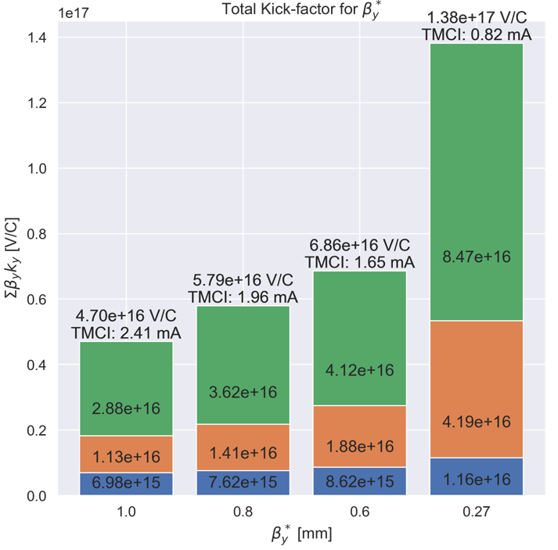
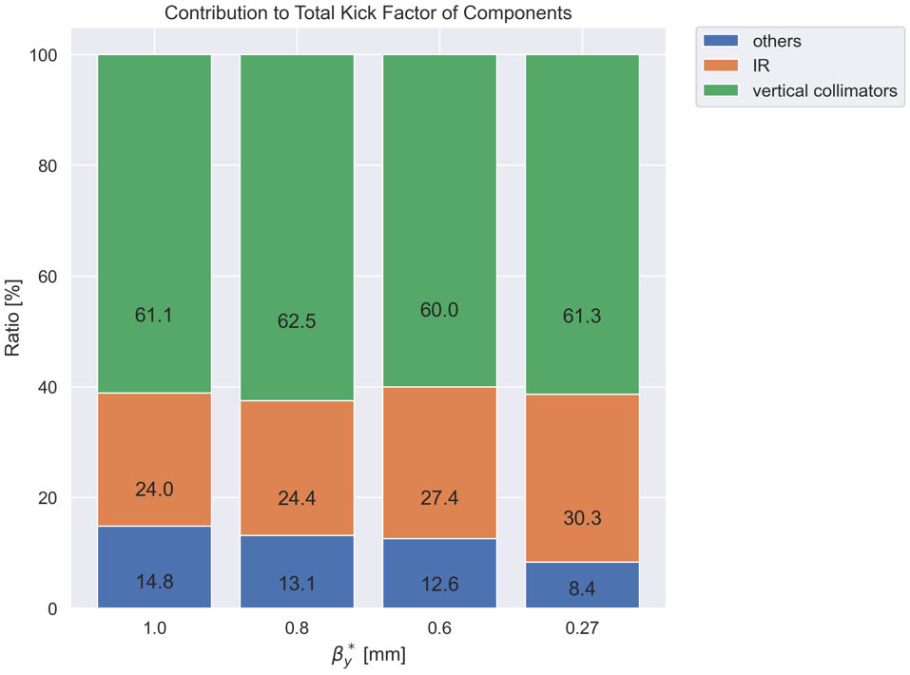
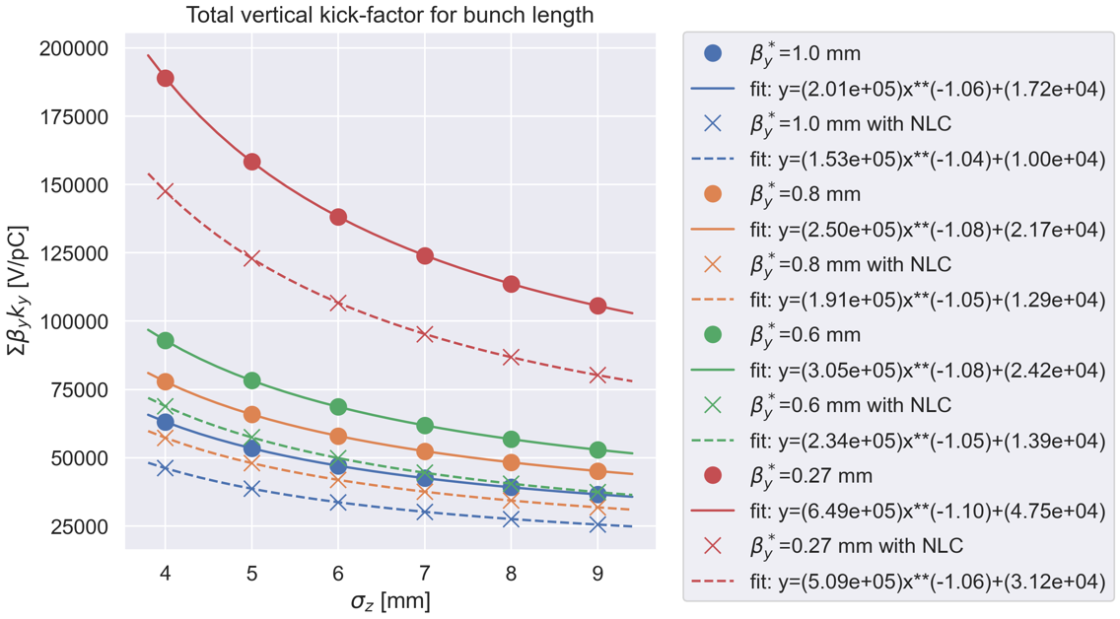
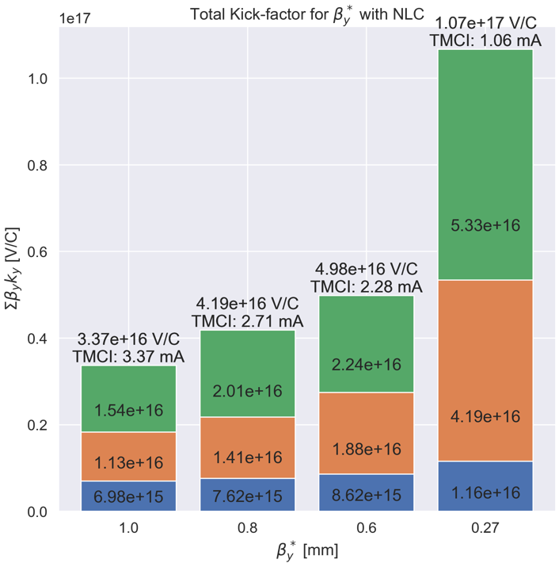
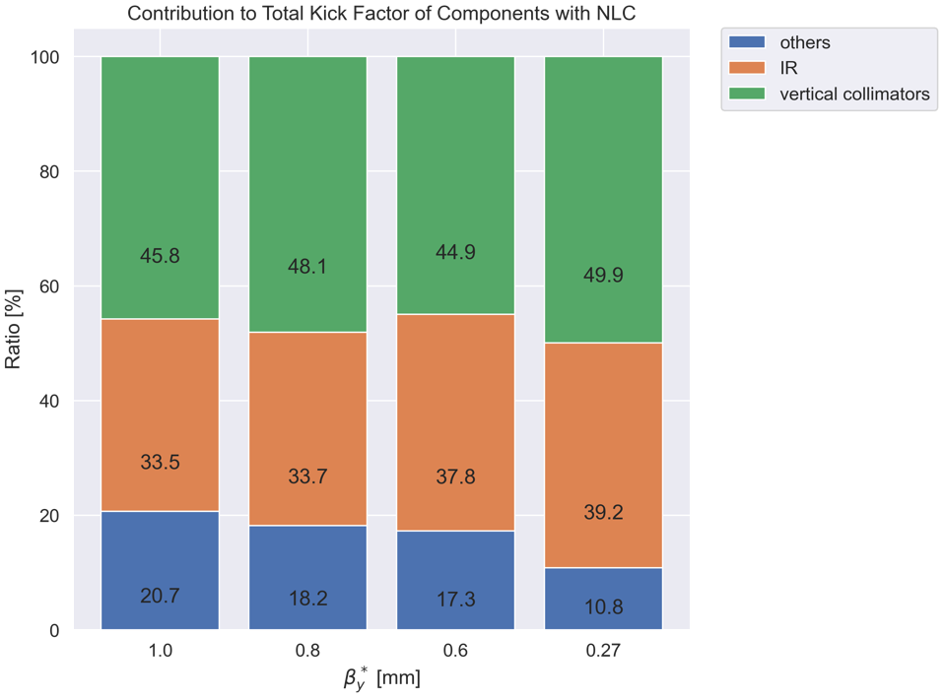

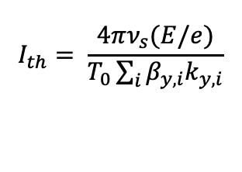
Major Issues (impedance - β_{y}* dependence)
Without NLC
$$I_{th}= \frac{4πν_{s}(E/e)}{T_{0}\sum_{i}{β_{y,i}k_{y, i}}}$$
$ν_{s}=0.022, E/e=4$ GV, $T_{0}=$ 1e-5 s
With NLC

