Slide 1
Overview of Commissioning in 2021c - 2022b
December 13, 2022
Y. Ohnishi / KEK
The 26th KEKB Accelerator Review Committee

Slide 2

Contents
Overview of 2021c and 2022ab beam commissioning
Achievements in 2021c - 2022b
Obstacles to luminosity improvement
Procedure of increasing beam currents and number of bunches with safe way
Luminosity performance
Specific luminosity
Beam-Beam parameter
Stability of Machine
Beam Lifetime and Dynamic Aperture

Slide 3
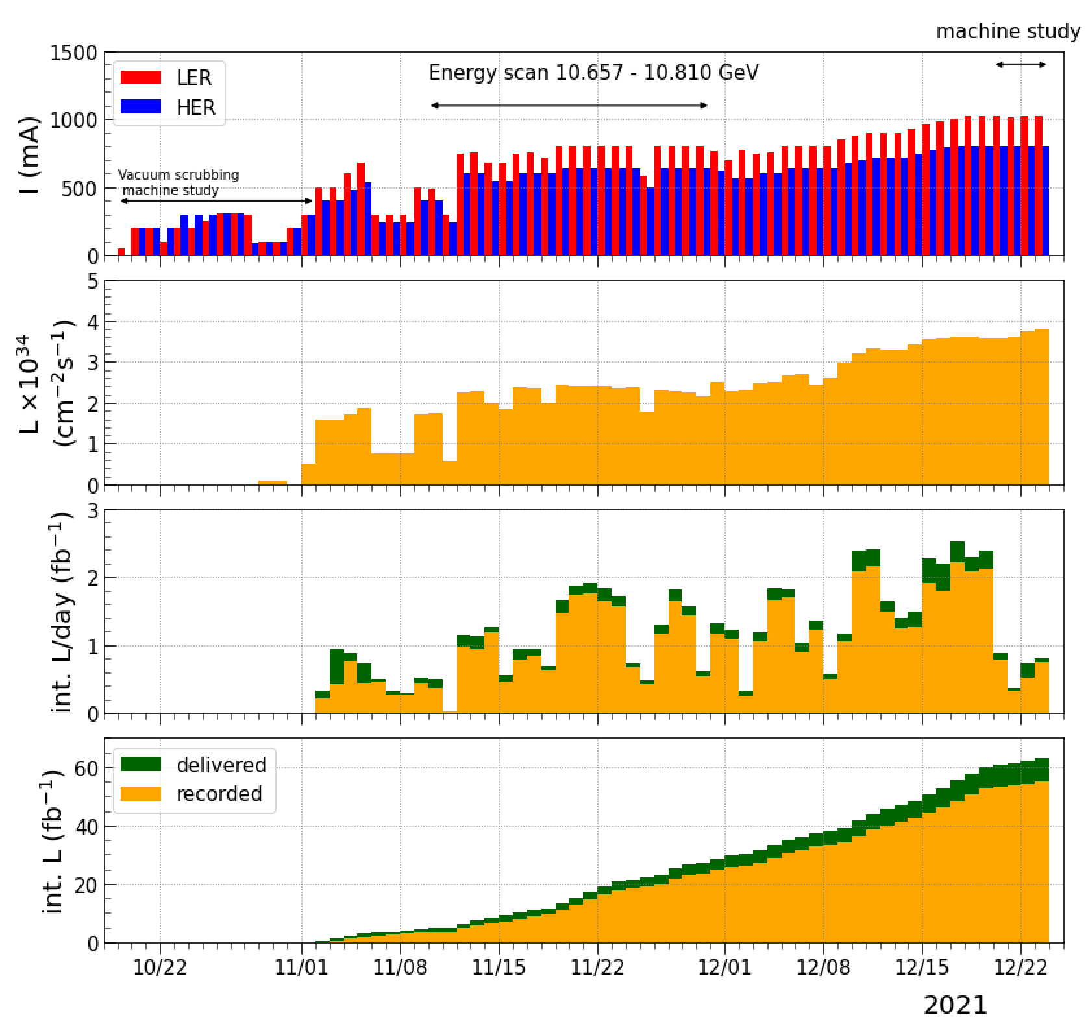
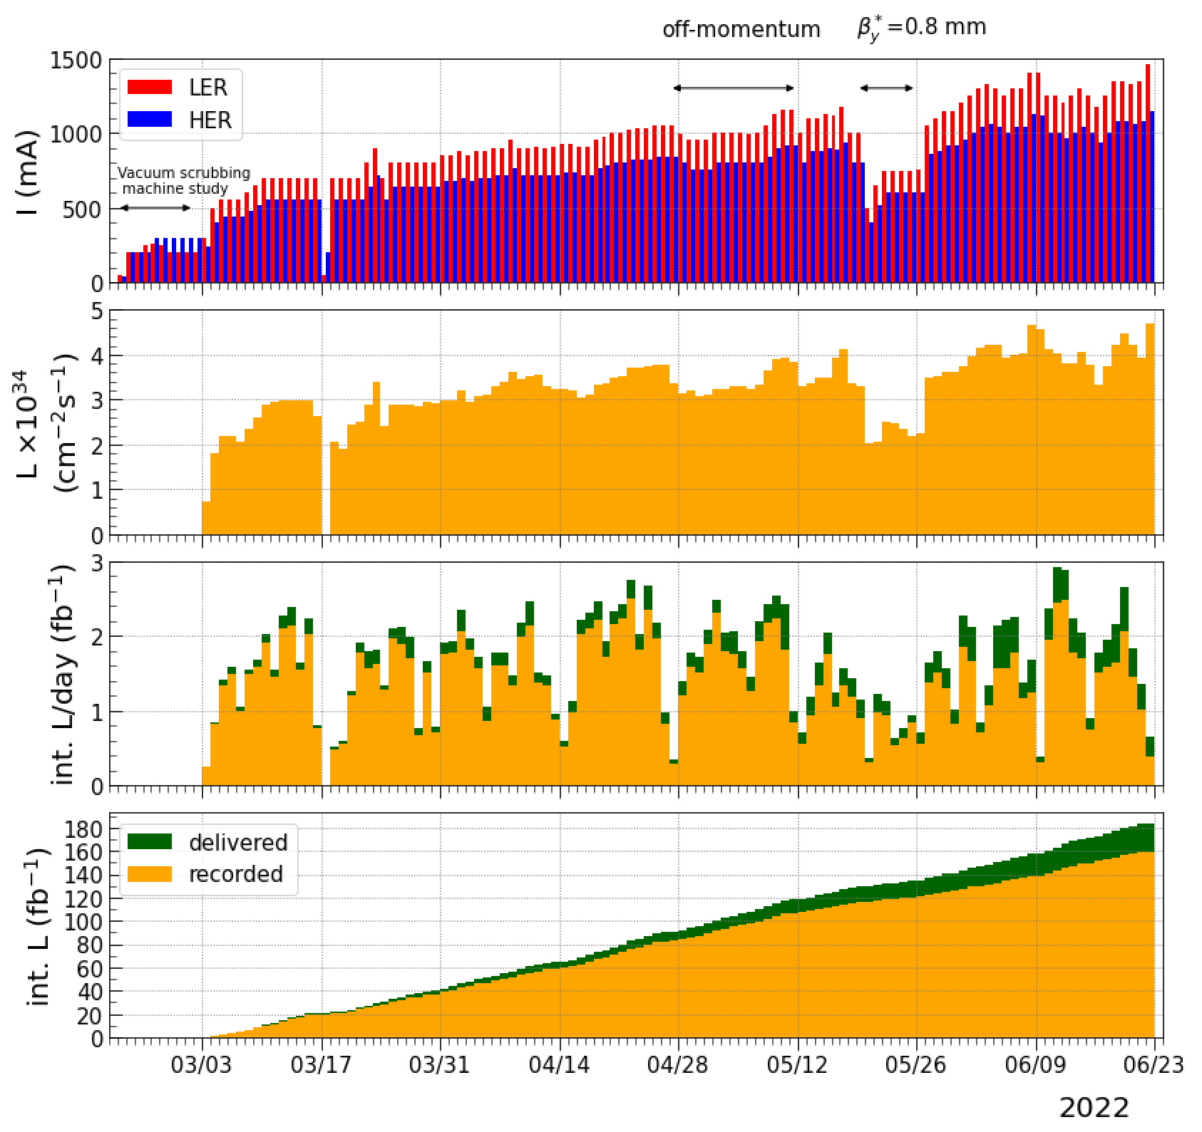
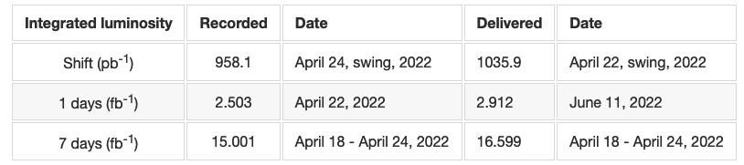
2021c and 2022ab Run
2021c
2022ab
injection kicker
accidental fire
in LER (Mar.18)
injection kicker
accidental fires
in LER (Oct.28-Nov.5)
We reduced beam currents
after replacing the thyratrons
for their conditioning.

Slide 4
Machine Parameters : 2021c - 2022b
 | Dec. 23, 2021c |  | June 8, 2022b |  | May 22, 2022b |  | Unit
Ring | LER | HER | LER | HER | LER | HER
Emittance | 4.0 | 4.6 | 4.0 | 4.6 | 4.0 | 4.6 | nm
Beam Current | 1015 | 797 | 1321 | 1099 | 744 | 600 | mA
Number of bunches | 1370 |  | 2249 |  | 1565
Bunch current | 0.741 | 0.582 | 0.587 | 0.489 | 0.475 | 0.383 | mA
Horizontal size σx* | 17.6 | 16.6 | 17.9 | 16.6 | 17.9 | 16.6 | μm
Vertical cap sigma Σy* | 0.339 |  | 0.303 |  | 0.250 |  | μm *¹
Vertical size σy* | 0.240 |  | 0.215 |  | 0.177 |  | μm *²
Betatron tunes νx / νy | 44.524 / 46.589 | 45.530 / 43.572 | 44.525 / 46.589 | 45.532 / 43.573 | 44.525 / 46.589 | 45.532 / 43.574
βx* / βy* | 80 / 1.0 | 60 / 1.0 | 80 / 1.0 | 60 / 1.0 | 80 / 0.8 | 60 / 0.8 | mm
Piwinski angle | 10.7 | 12.7 | 10.7 | 12.7 | 10.7 | 12.7
Crab waist ratio | 80 | 40 | 80 | 40 | 80 | 40 | %
Beam-Beam parameter ξy | 0.0433 | 0.0315 | 0.0407 | 0.0279 | 0.0309 | 0.0219
Specific luminosity | 6.45 x 10³¹ |  | 7.21 x 10³¹ |  | 8.74 x 10³¹ |  | cm⁻²s⁻¹/mA²
Luminosity | 3.81 x 10³⁴ |  | 4.65 x 10³⁴ |  | 2.49 x 10³⁴ |  | cm⁻²s⁻¹
*¹⁾ estimated by luminosity with assuming design bunch length
*²⁾ divide *¹ by √2

Slide 5
Achievements until 2022 (1)
Peak luminosity : 4.65 x 10³⁴ cm⁻²s⁻¹ (4.71 x 10³⁴ cm⁻²s⁻¹ w/o Belle II data taking and HV OFF)
Integrated luminosity : 424 fb⁻¹ (491 fb⁻¹)
Peak currents : 1.46 A (LER) / 1.14 A (HER), 2346 bunches (2-bucket spacing)
$β_{y}^{*}$ : 1 mm (0.8 mm) << bunch length ~6 mm $→$ proof of the nano-beam scheme
Crab waist scheme has been applied (80 % in the LER, 40 % in the HER). $→$ luminosity improvement
Beam-Beam parameter : 0.035 at 0.7 mA (0.045 at 1.1 mA for small number of bunches as machine study)
Bunch-by-bunch FB tuning (gain, noise reduction) in the HER $→$ luminosity improvements
Bunch-by-bunch FB tuning (number of taps) in the LER $→$ suppress single bunch blowup, luminosity improvements
Chromatic X-Y coupling correction with rotatable sextupoles in the LER $→$ luminosity improvements

Slide 6
Achievements until 2022 (2)
Long-term drift of QCS magnetic field (beta-beat) $←$ reduced by new QCS initialization procedure
Orbit deviation due to IP knob tuning (beta-beat) $←$ suppressed with QCS corrector (ZHQC2RP)
Increase of positron charge for the LER injection : 3 nC at the end of e⁺ beam transport line
2-bunch injection for the LER and HER $→$ improve injection efficiency (Bunch equalization is difficult.)
Adjustment of injection orbit in the HER (septum, kicker) $→$ improve injection efficiency (not enough)
Leakage orbit from injection kickers $←$ reduced by 60 % with additional inductance for the coils

Slide 7
What Limits Luminosity Performance ?
Classification |  | Remarks | Items
A | A1 | Single-beam causes. Luminosity becomes lower as increasing bunch current. (single-bunch) | -1 mode instability
 | A2 | Single-beam causes. Luminosity becomes lower as increasing total current. (multi-bunch) | coupled-bunch, degradation of optics (linear parameters) due to beamline deformation
B |  | Single-beam causes, but interference of beam-beam interaction makes luminosity lower. | lattice nonlinearity (QCS fringe, chromatic X-Y couplings, etc.)
C |  | Pure beam-beam interaction limits luminosity. Beam-Beam limit, etc. | crab-waist, resonances, coherent beam-beam head-tail instability, parasitic collision

Slide 8
Obstacles to Luminosity Improvement
Beam blowup in the LER (single beam, non-collision) : "-1 mode instability" (A1)
Sudden beam loss (both rings, more serious in the LER) $→$ "fireball hypothesis"
Damage of collimator head and/or QCS quench if large beam loss
Optics degradation due to beam current dependence of beam orbit (A2)
Orbit deviation at strong sextupoles is caused by beam line deformation due to intense SR heating.
Lower beam-beam parameter: 0.035 at 0.7 mA for physics run (0.045 at 1.1 mA) (B)
Short beam lifetime (dynamic aperture, physical aperture) : LER 8 min(1.25 A) / HER 25 min(1 A) nb=2346
Beam related background (optimization of collimators, QCS aperture and IR orbit)
Beam injection (small physical aperture of injection region, emittance growth in the beam transport line)
Earthquake : The beam aborts invariably. The $ε_{y}$ becomes large in the HER. The optics correction is needed.
Lower online luminosity monitor during LER injection (Beam backgrounds affect the measured value.)

Slide 9
Executive Summary from the 25th KEKB ARC Report
The most important challenges are:
Top-up injection efficiency and injection stability, including HER beam blow up in the transfer line, mitigating the consequences of accidental kicker-pulser misfiring, problematic HER two-bunch injection, septum drifts, etc.
Collimation and machine protection strategy, including overcoming the present bunch intensity limitations due to TMCI $→$ -1 mode instability; developing a strategy for safe beam current increase; and understanding and avoiding the as yet unexplained sudden large beam losses in the LER.
Medium and long-term planning including possible upgrade paths; with an overall plan of increasing the beam currents, increasing the number of bunches, and lowering $β_{y}^{*}$ to maximize the luminosity.

Slide 10
Accidental Fire of Injection Kicker in LER
2021c: We got several accidental fires in the LER at the early commissioning (Oct.28, Oct.30, Nov. 5). There is no accidental fire after the replacement of thyratrons and further conditioning.
Before starting 2022a, the thyratrons were rearranged and replaced with new one.
2022a: We observed large beam loss in the LER on March 18 due to accidental fire of injection kicker in the LER. Then, the collimator head of D06H3 was damaged (broken). The thyratron was replaced and conditioned.
2022b: No accidental fire of the injection kickers
Accidental fire of injection kicker is caused by a lack of the thyratron conditioning or early failure.
If we use a well conditioned thyratron, there will be no accidental fire.
There is no accidental fire in the HER even though the applied voltage is higher than the LER. The thyratrons in the HER are well conditioned.
Robust Low-Z (C) head is installed into D06H3 collimator during LS1. (used as the spoiler)
D06H1 on the upstream side is moved to the downstream side (D06H4) to collimate beam scattered by D06H3.

Slide 11
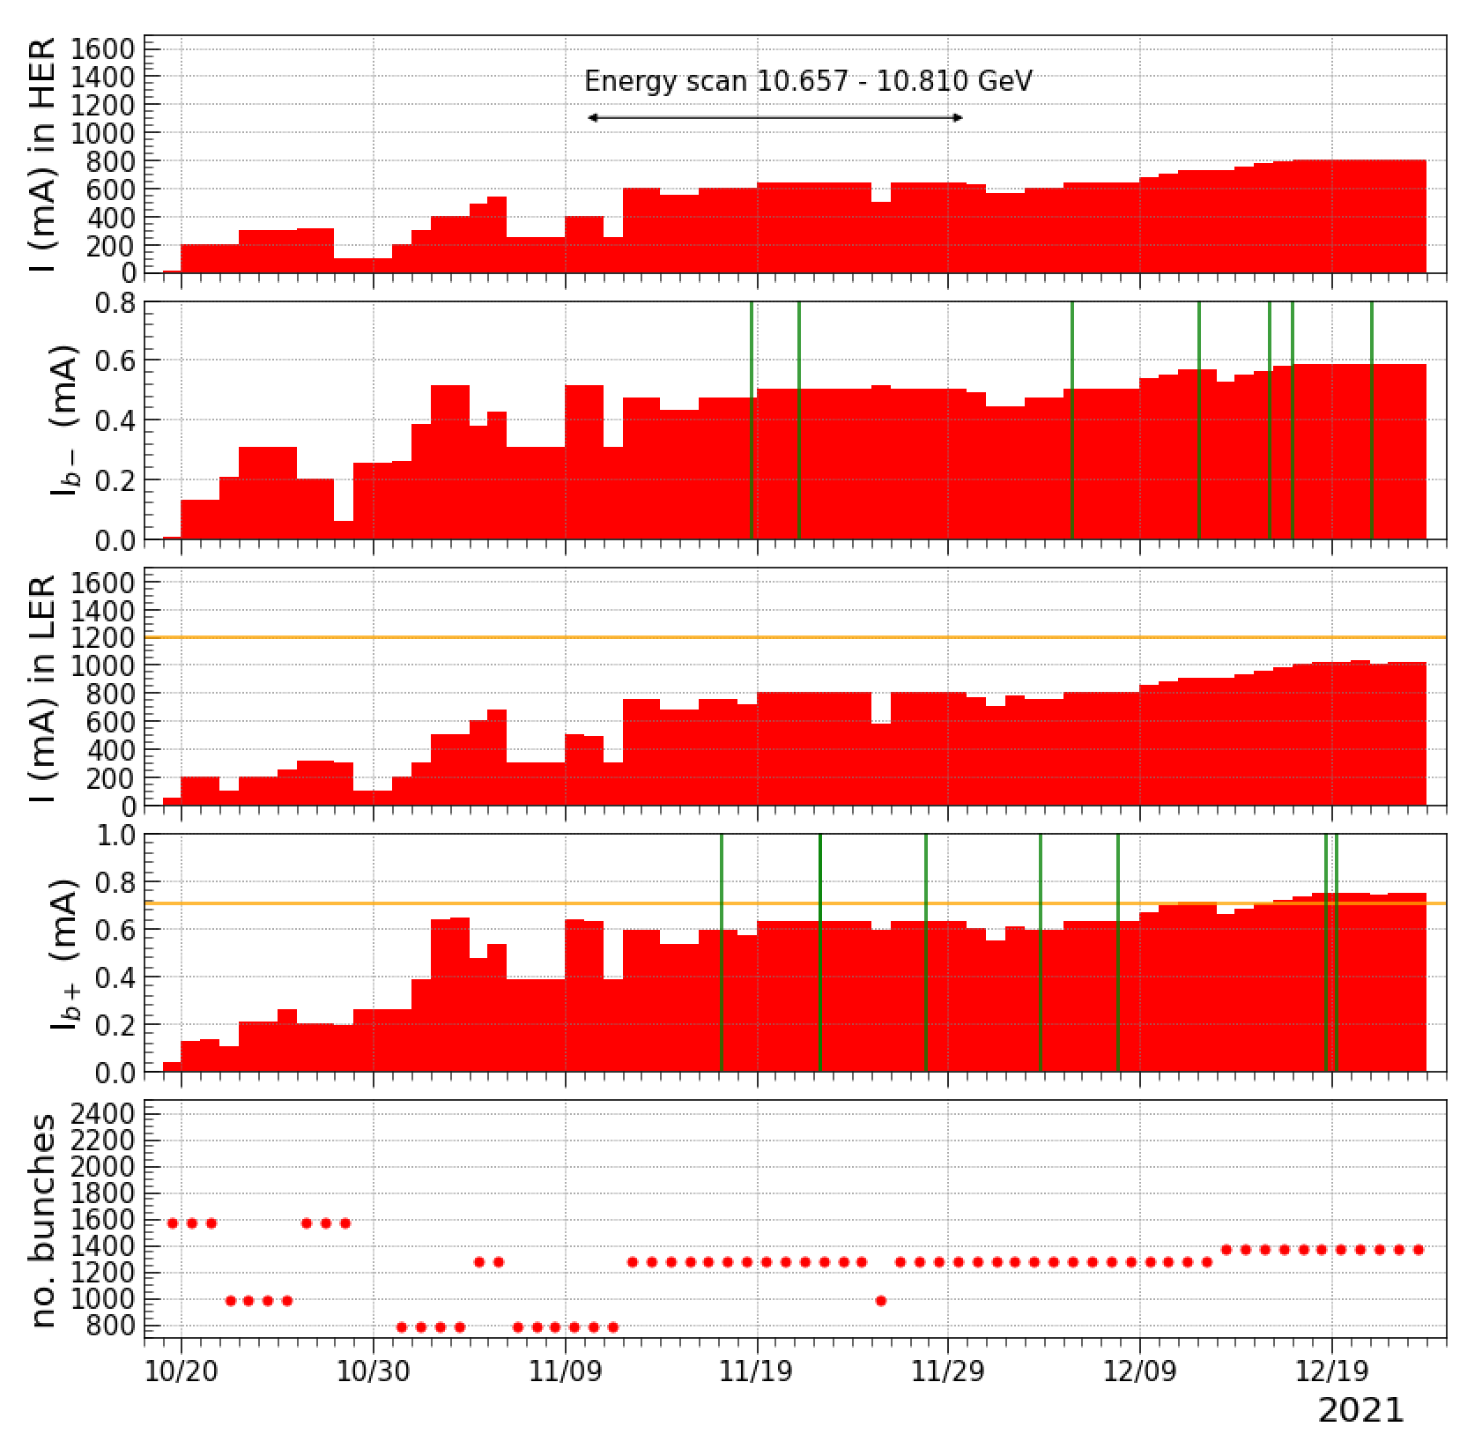
No Fatal Accident due to Large Sudden Beam Loss in 2021c
2021c
We had sudden beam loss for both rings.
Sudden Beam Loss
in HER
$←$ 1.2 A
$←$ 0.7 mA/bunch
Sudden Beam Loss
in LER

Slide 12
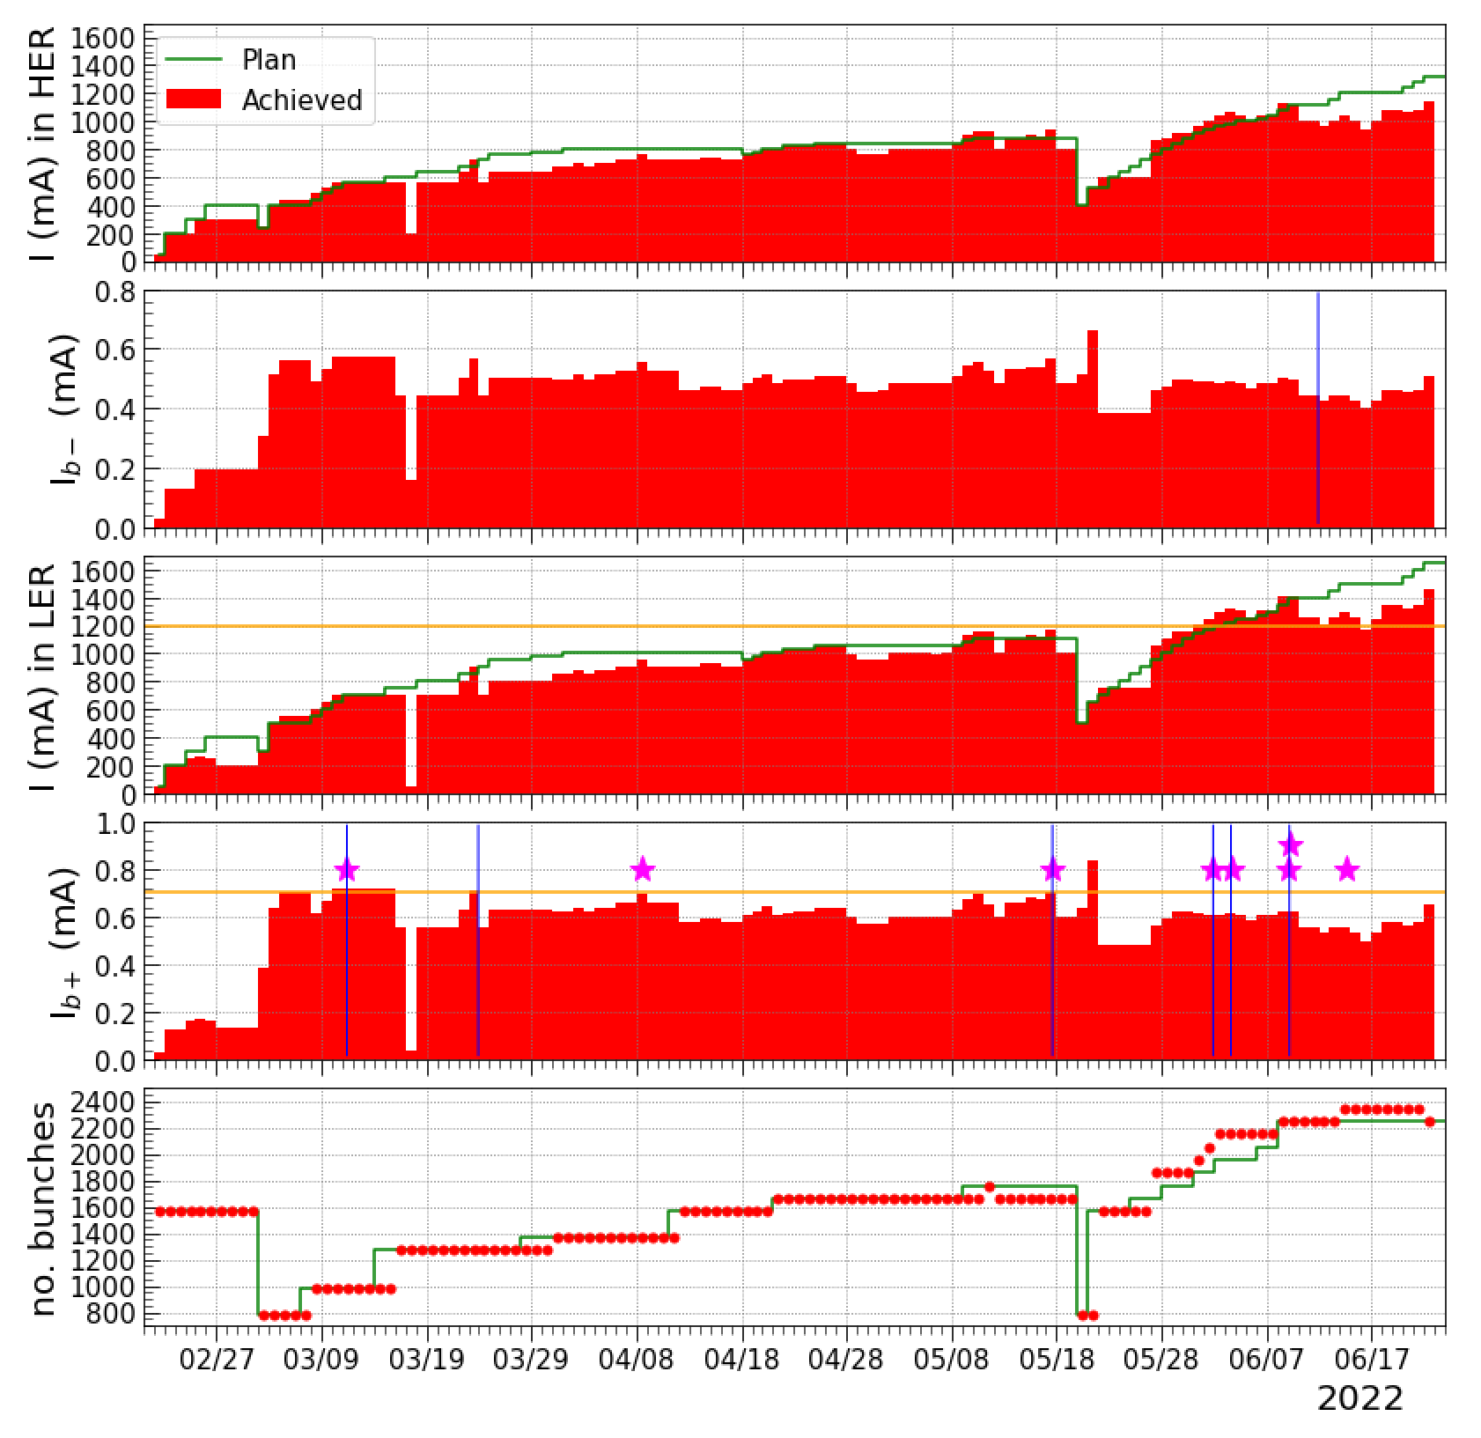
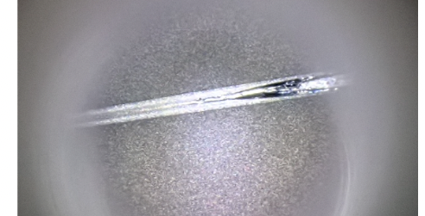
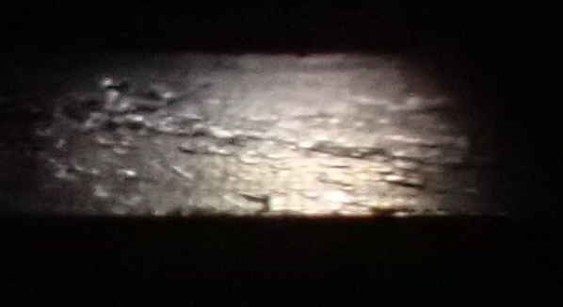
QCS Quench and Collimator Damage due to Sudden Beam Loss in 2022ab
2022ab
D09V1
June 11
D09V1
D06V1
D09V1
$←$ 1.2 A
deviation from plan
$←$ 0.7 mA/bunch
June 3
D06V1, D02V1
D06V1
QCS (LER) quench
D02V1
D06V1
D06V1
D06V1
D06V1
D02V1
collimator damage
We introduced Matsuoka Limit $I_{b+}<0.7mA$ to avoid sudden large beam loss
which causes QCS quench and collimator damages as much as possible.
Sudden beam loss becomes a serious problem to increase total beam current.

Slide 13
Luminosity Performance

Slide 14
Specific Luminosity
The geometrical
luminosity
is good.
"estimated" means $β_{y}^{*}$ is calculated by the horizontal orbit deviation
at SLY(strong sextupoles) in HER due to beam-line deformation.
Luminosity drop
is too steep.
20 %
12 %

Slide 15
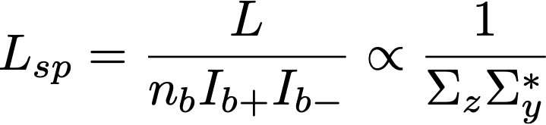
Specific Luminosity
The definition of specific luminosity:
It was found that even if the setting is 1 mm, $β_{y}^{*}$ can be shifted due to beta-beat caused by a deviation of the horizontal beam orbit at the strong sextupoles in the local chromaticity correction.
The orbit deviation is caused by beam line deformation due to intense SR heating.
This effect is more significant for the HER rather than the LER.
Higher specific luminosity for $β_{y}^{*}$ = 0.8 mm is obtained at a bunch current product of 0.05 mA², but the specific luminosity rapidly decreases around 0.1 mA².
Lsp for $β_{y}^{*}$ = 0.8 mm is about 20 % higher than 1 mm at 0.05 mA² and decreases to about 12 % at 0.1 mA² and above.
This implies that the corrections of the chromatic X-Y coupling and other parameters are not optimized yet for $β_{y}^{*}$ = 0.8 mm which affect beam-beam blowup.

Slide 16
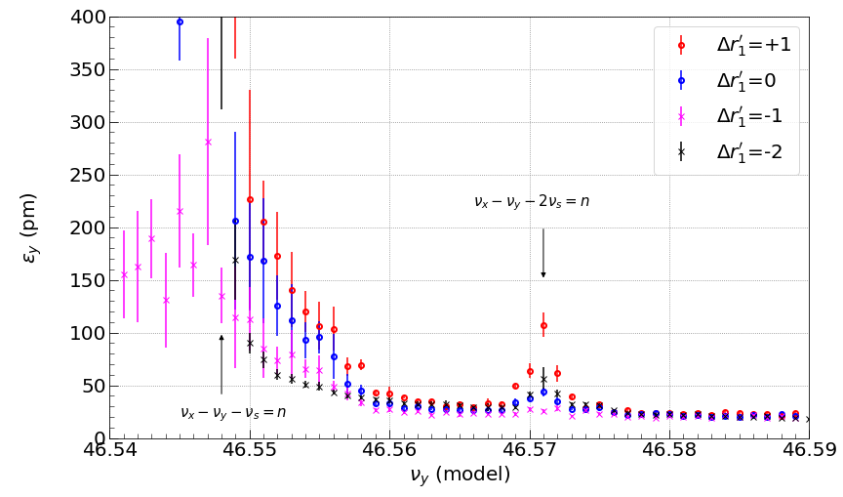
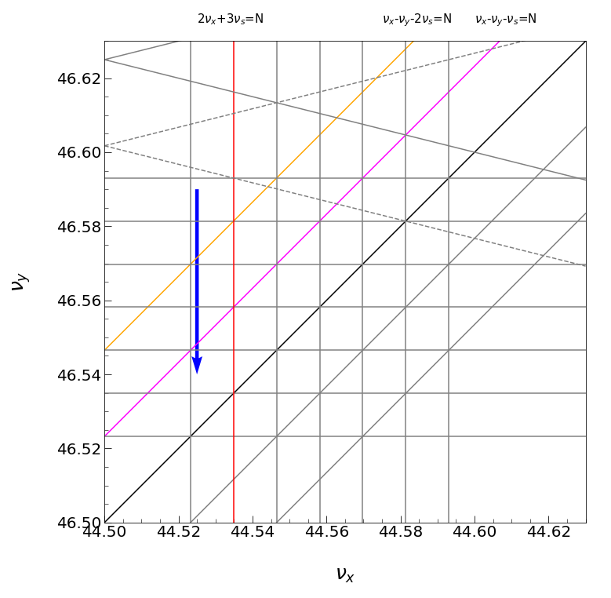
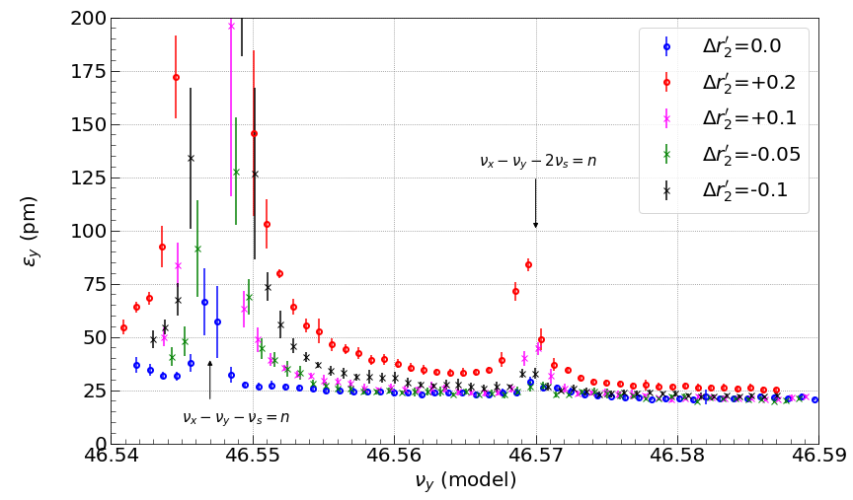
Chromatic X-Y Coupling Correction with Rotatable Sextupoles in LER
Dec. 20, 2021
$$β_{y}^{*}=1mm$$
single beam
working point
March 14, 2022
$$β_{y}^{*}=1mm$$
$$Δr_{1}^{′}=-1$$
single beam
The rotatable sextupoles (6 families for right and left side of IP) are
used to make the first synchro-beta coupling resonance weak
together with the second resonance.
$Δr_{2}^{′}=0$
is optimal.
SLYTLPs and SLYTRPs were not used here.
Rotatable sextupoles:
M. Masuzawa, T. Kawamoto et al.

Slide 17
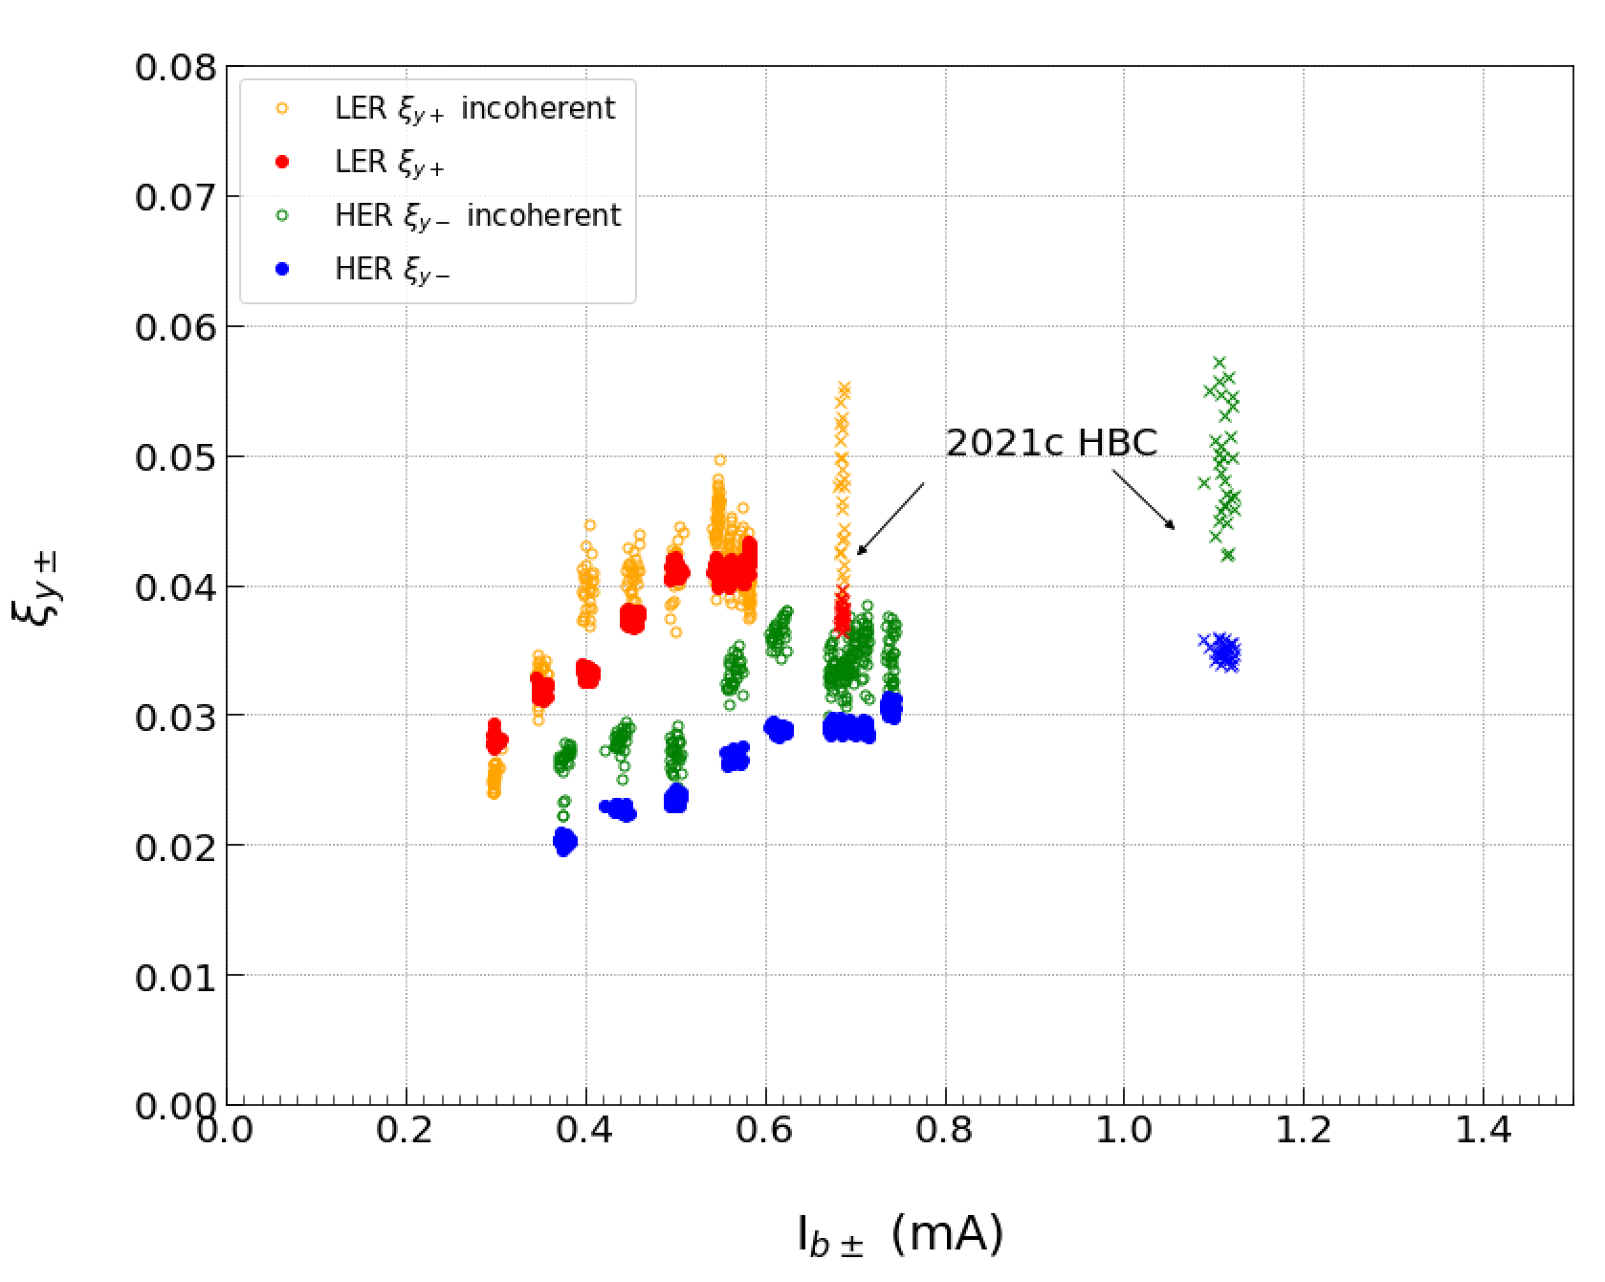
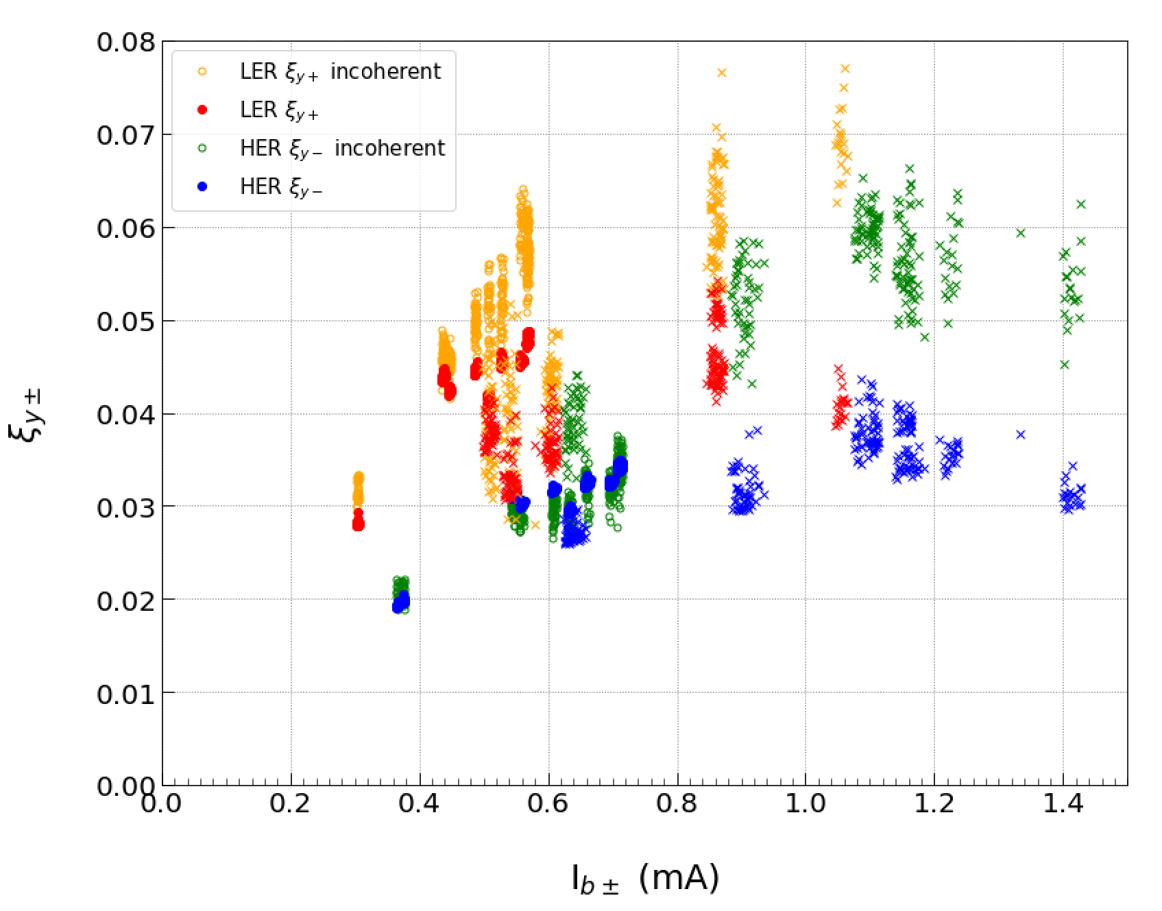
Beam-Beam Parameter
$$β_{y}^{*}=1mm$$
2021c
2022ab
2022a HBC
(nb = 393)
The current
ratio : 6.5/4
$ξ_{y-}$~ 0.035 at Ib+ = 1.1 mA
$ξ_{y-}$~ 0.045 at Ib+ = 1.1 mA
physics run
physics run
Beam-Beam parameter has been improved compared to the 2021c run for higher bunch currents.
The chromatic X-Y couplings (r1' and r2') are corrected in the LER.
HBC = High Bunch current Collision

Slide 18
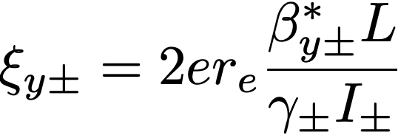
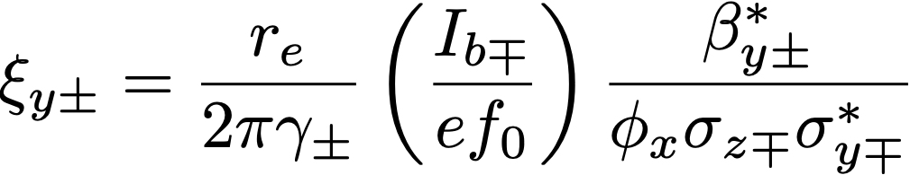
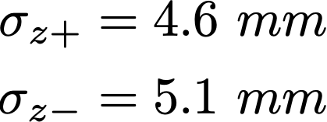
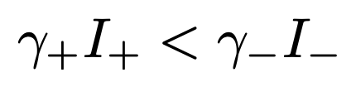
Beam-Beam Interaction
Vertical beam-beam parameter (from luminosity)
Vertical beam-beam parameter (incoherent)
nominal bunch length
Lower beam current in the HER tends to cause beam blowup.
This means that the HER beam size is more easy to blow-up when the beam current of the HER decreases.
The beam current of the HER is larger than the energy ratio (4 GeV / 7 GeV).
The optimum ratio of LER to HER beam current is 5:4 from luminosity tuning.
The beam-beam parameter of the LER are larger than that of the HER.
The current ratio is kept constant for daily operation in principle.
The beam-beam parameter is sluggish with LER beam currents of around 0.6 ~ 0.8 mA.

Slide 19
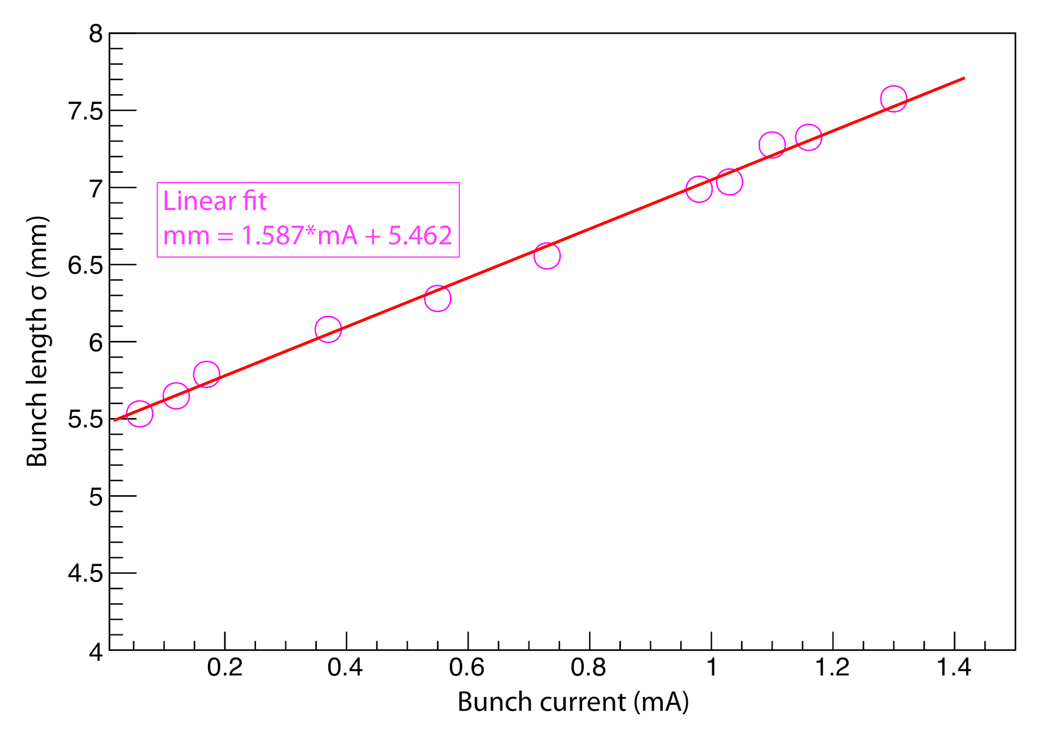
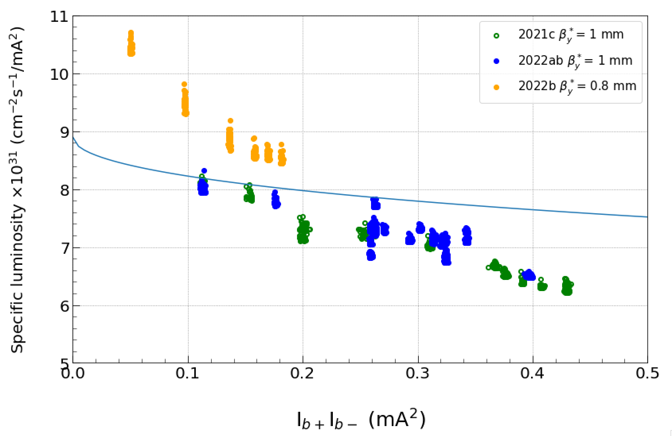
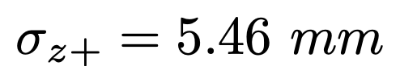
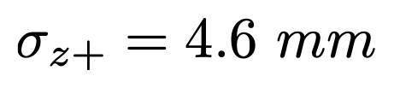
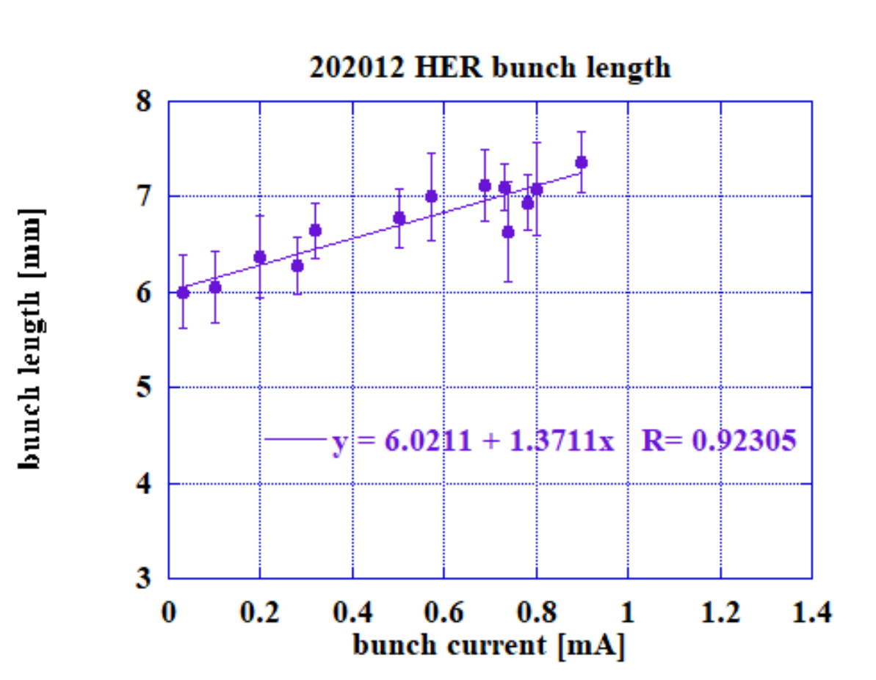

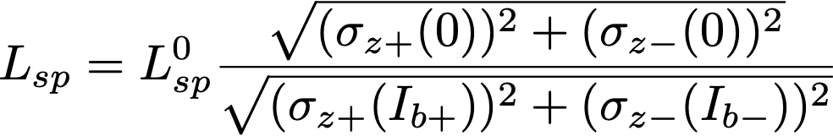
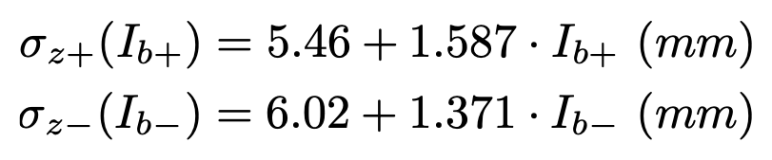

Contribution from Bunch Length
LER
bunch lengthening
design bunch length
beam blowup
HER
design bunch length
Ib+ : Ib- = 5 : 4

Slide 20
Stability of Machine

Slide 21
Stability of Beam Orbit
Control of beam orbit as well as stability is very important.
The beam orbit cannot be considered in isolation from the beam optics.
BPM gain calibration is performed before optics correction, Quad-BPM (BBA) is sometimes performed if necessary (after cabling work of BPMs).
Optics correction is scheduled every two weeks (maintenance day) or when we found luminosity degradation. Magnet initialization is performed every maintenance.
We set the reference orbit, so called "GOLD orbit" when the optics correction is performed. But it is difficult to adjust a measured orbit to the GOLD orbit in several days after the registration.
Residual of measured orbit from GOLD orbit is typically 30 $μm$. This is not enough to keep optics stable.
Beam position at the strong sextupole is important to correct X-Y couplings and vertical dispersions.
Degradation of consistency, beam-line deformation, change of BPM cable length due to temperature at day and night, etc.
There are many sources to induce orbit fluctuation. Cooling water cycle, all environment as well as earthquake
Moreover, SR becomes intense and the heating might deform the beam-line. Difficulties arise how to treat of the orbit.
Orbit in the vicinity of the IP is not well understood as well as QCS magnetic field.

Slide 22
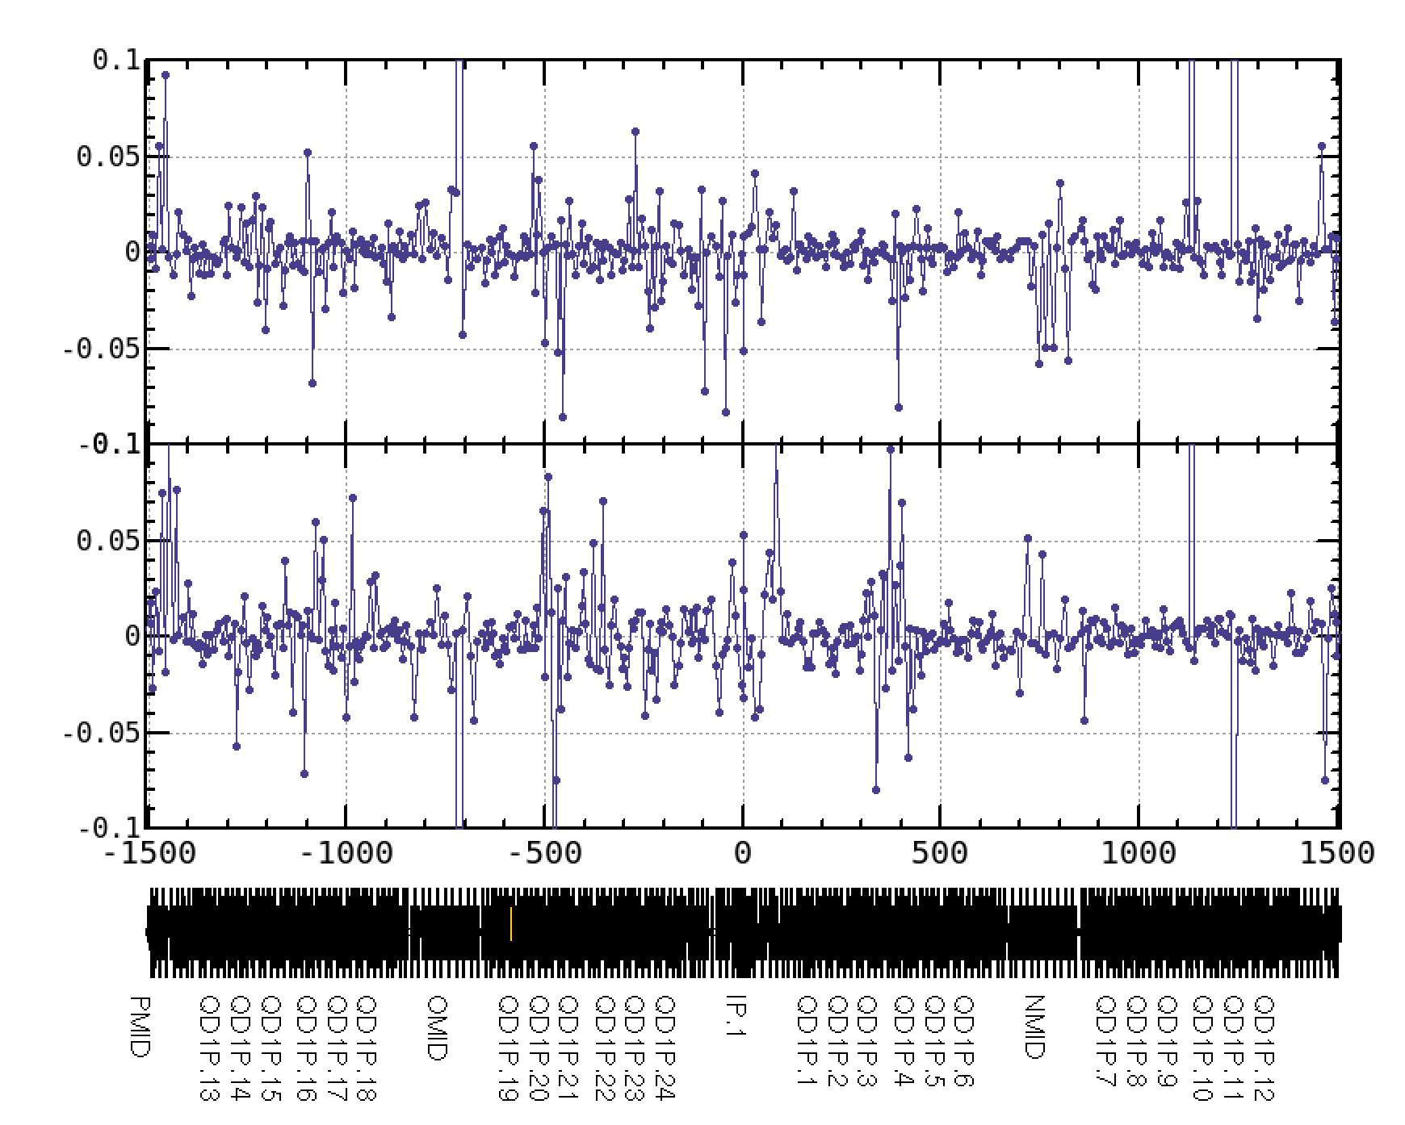
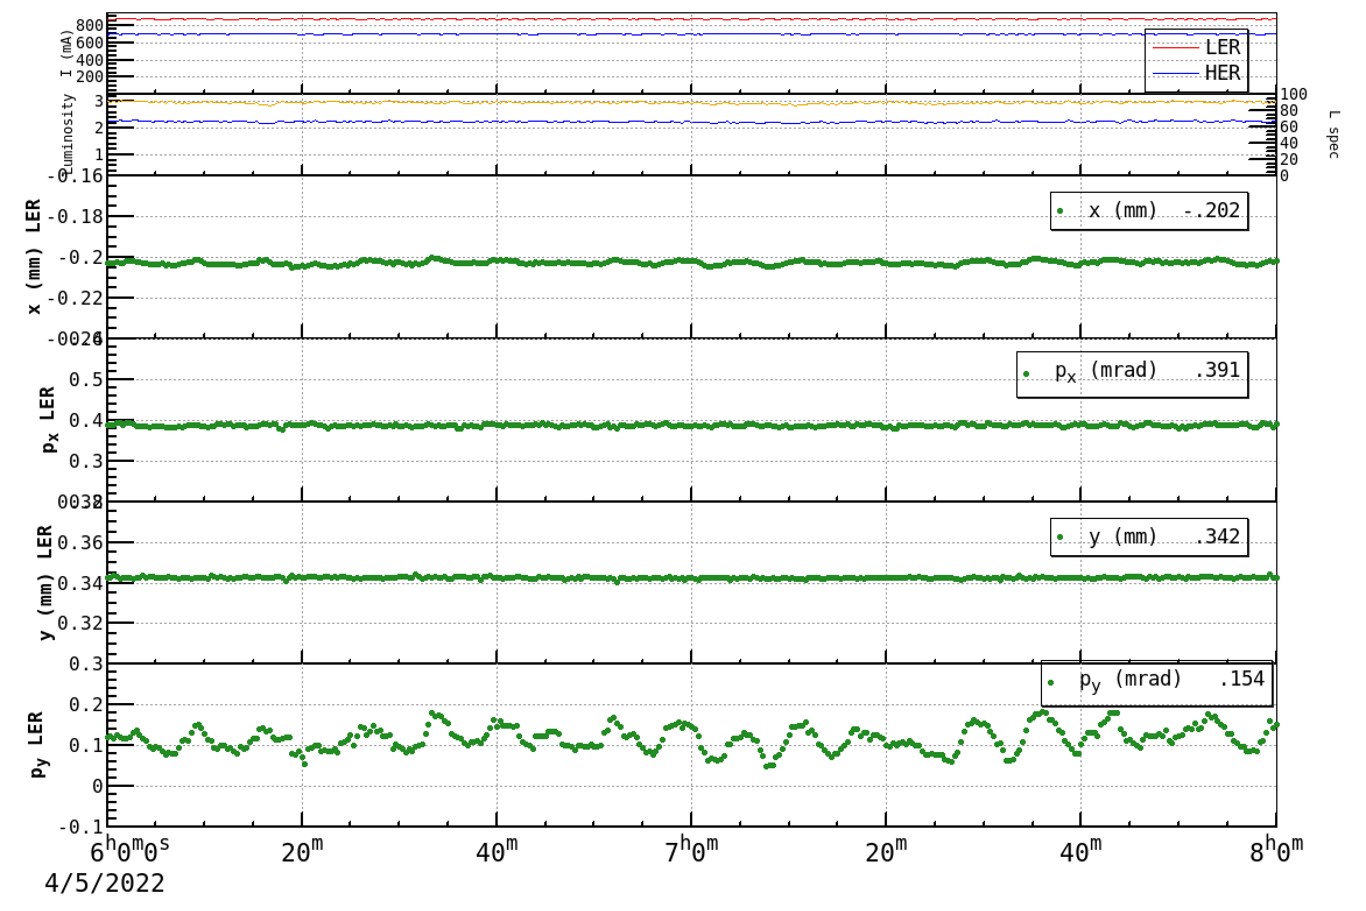
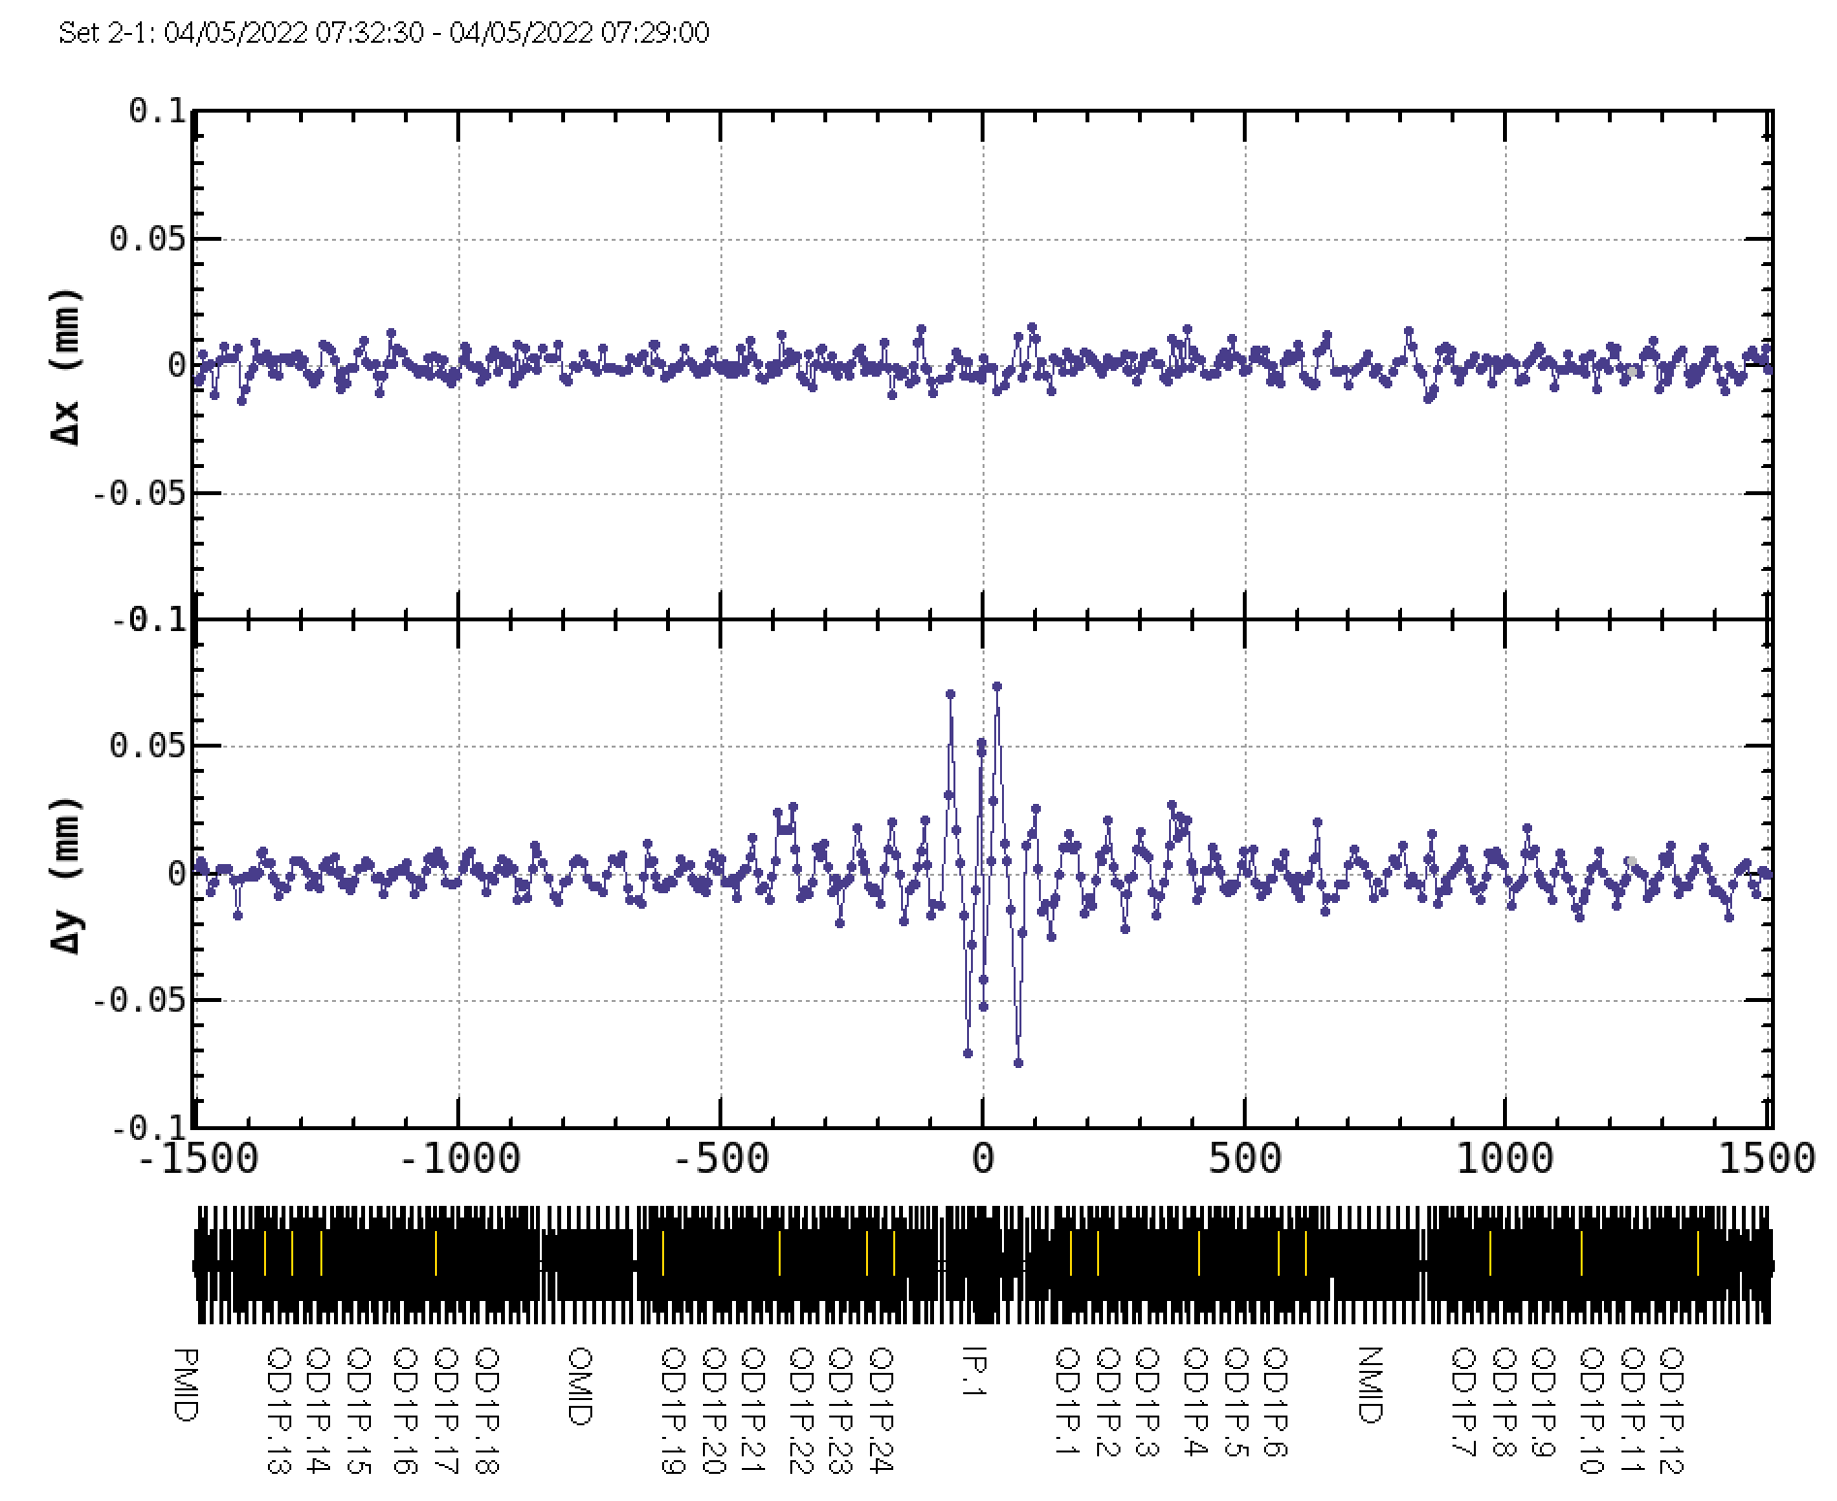

LER
Estimated orbit at the IP
$$Δx(mm)$$
A - GOLD
$$Δy(mm)$$
A
The difference between the measured orbit and the GOLD orbit becomes large in several days after optics corrections.
B
B - A
$$Δx(mm)$$
B - GOLD
$$Δy(mm)$$
We can correct B-A, but neither A-GOLD nor B-GOLD can be corrected.

Slide 23
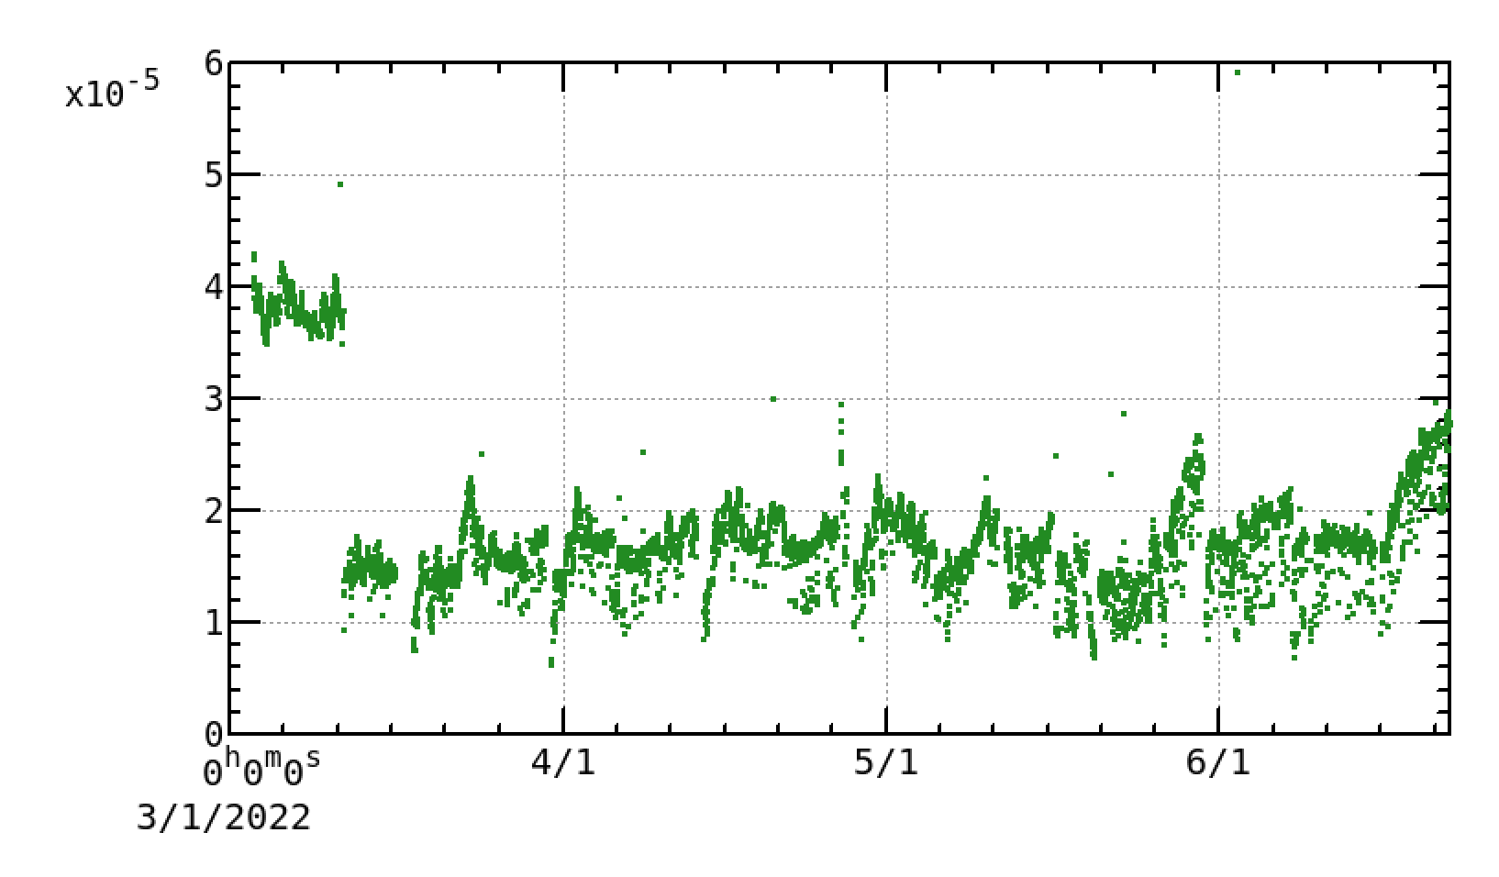
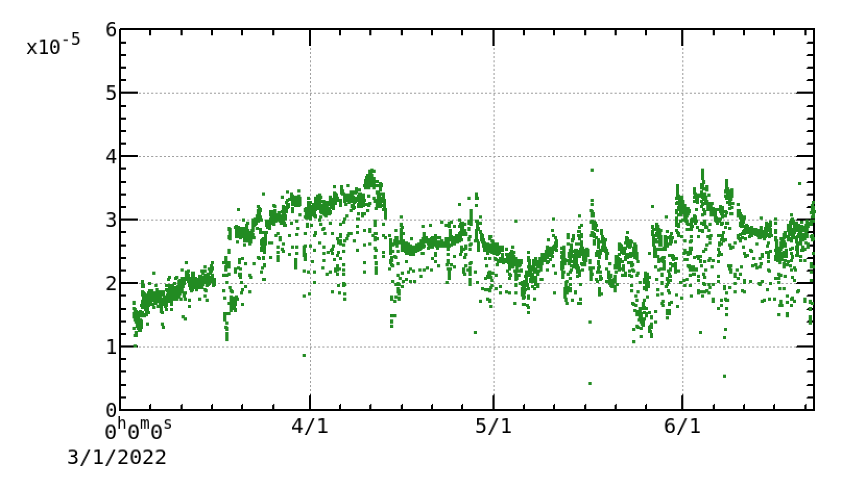
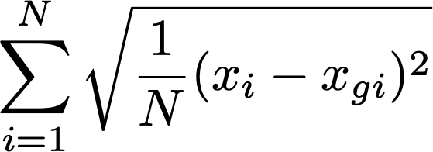
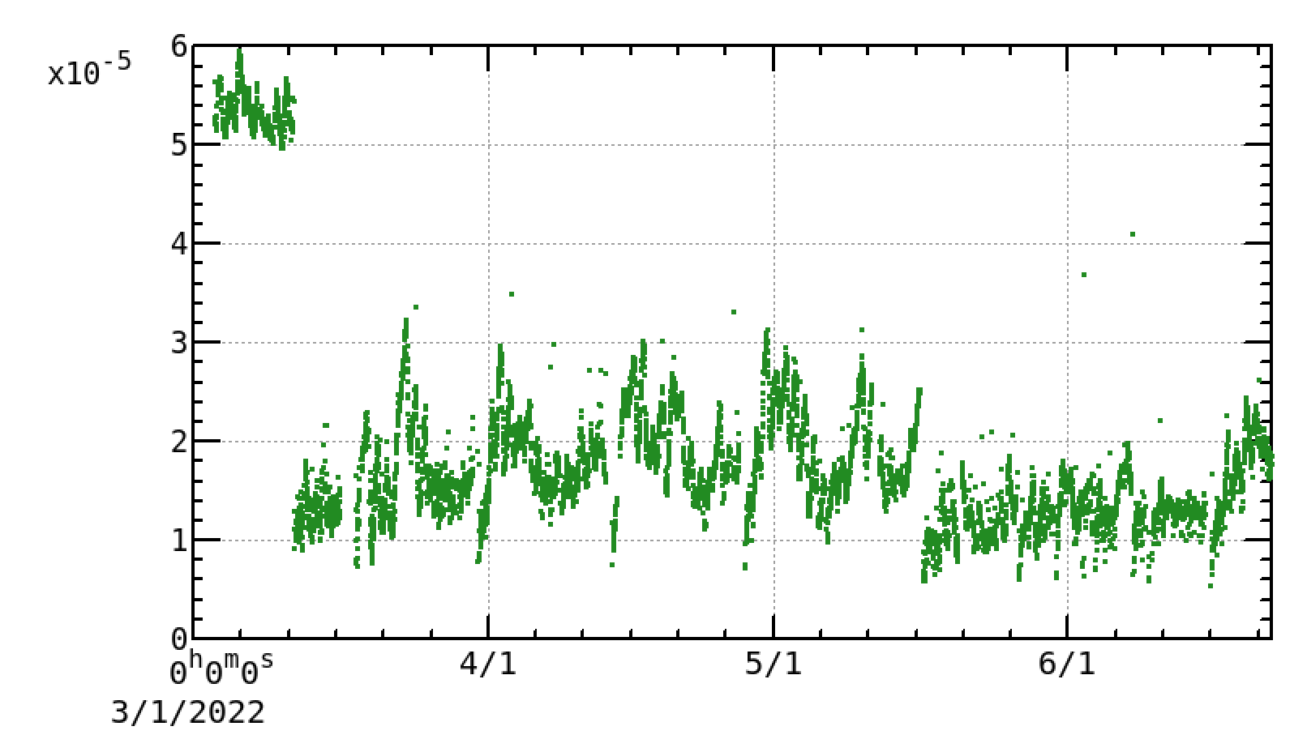
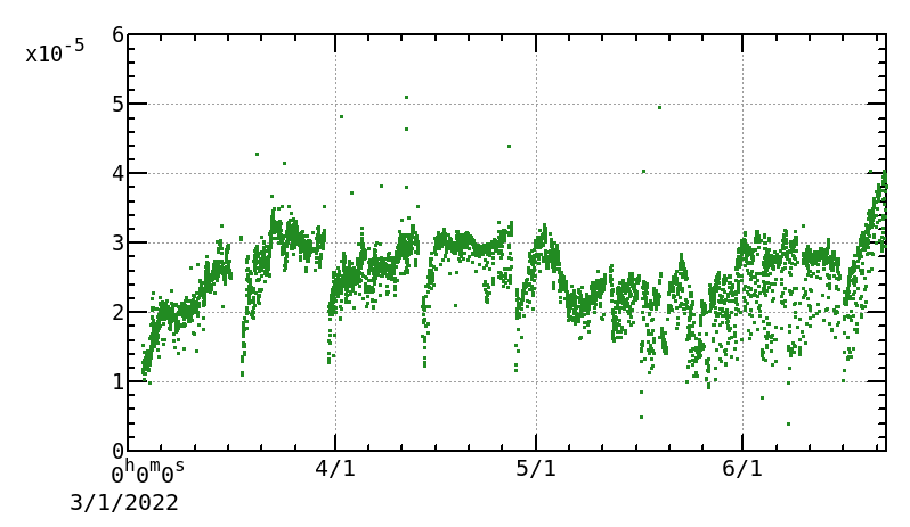
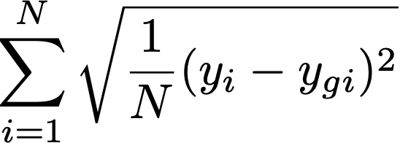
Residual of Measured Orbit from GOLD Orbit in 2022ab
LER
HER
optics correction,
GOLD is registered.
optics correction,
GOLD is registered.
/users/onishi/svn-work/SuperKEKB/operation/2022ab/momentum

Slide 24
Beam Lifetime and Dynamic Aperture

Slide 25
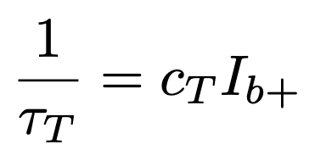
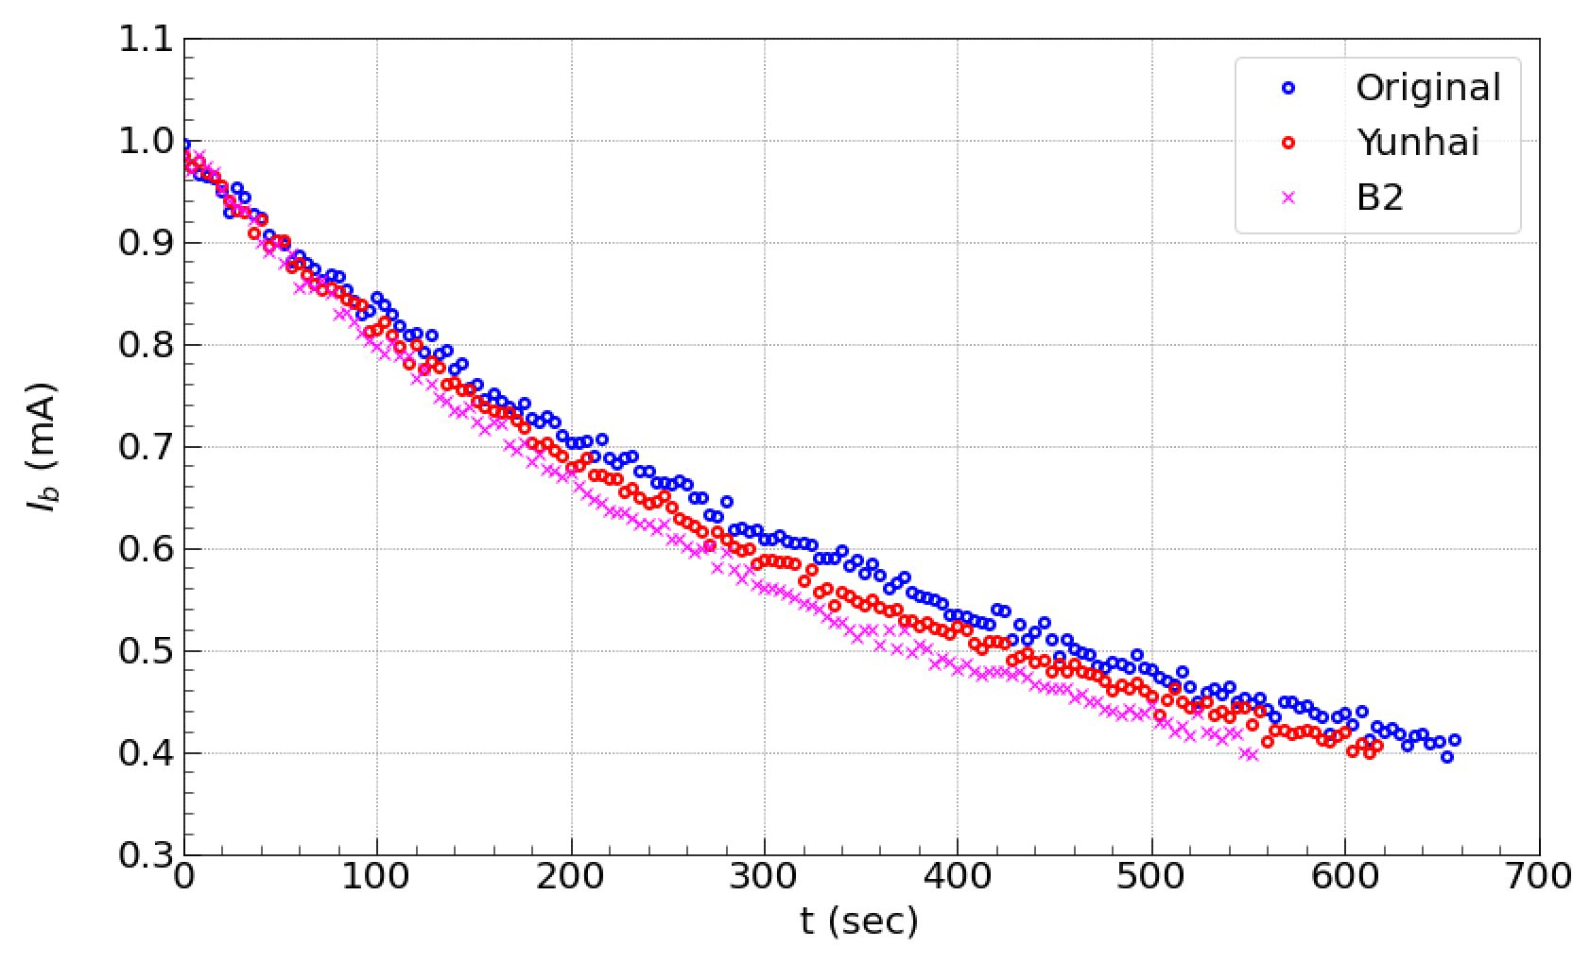
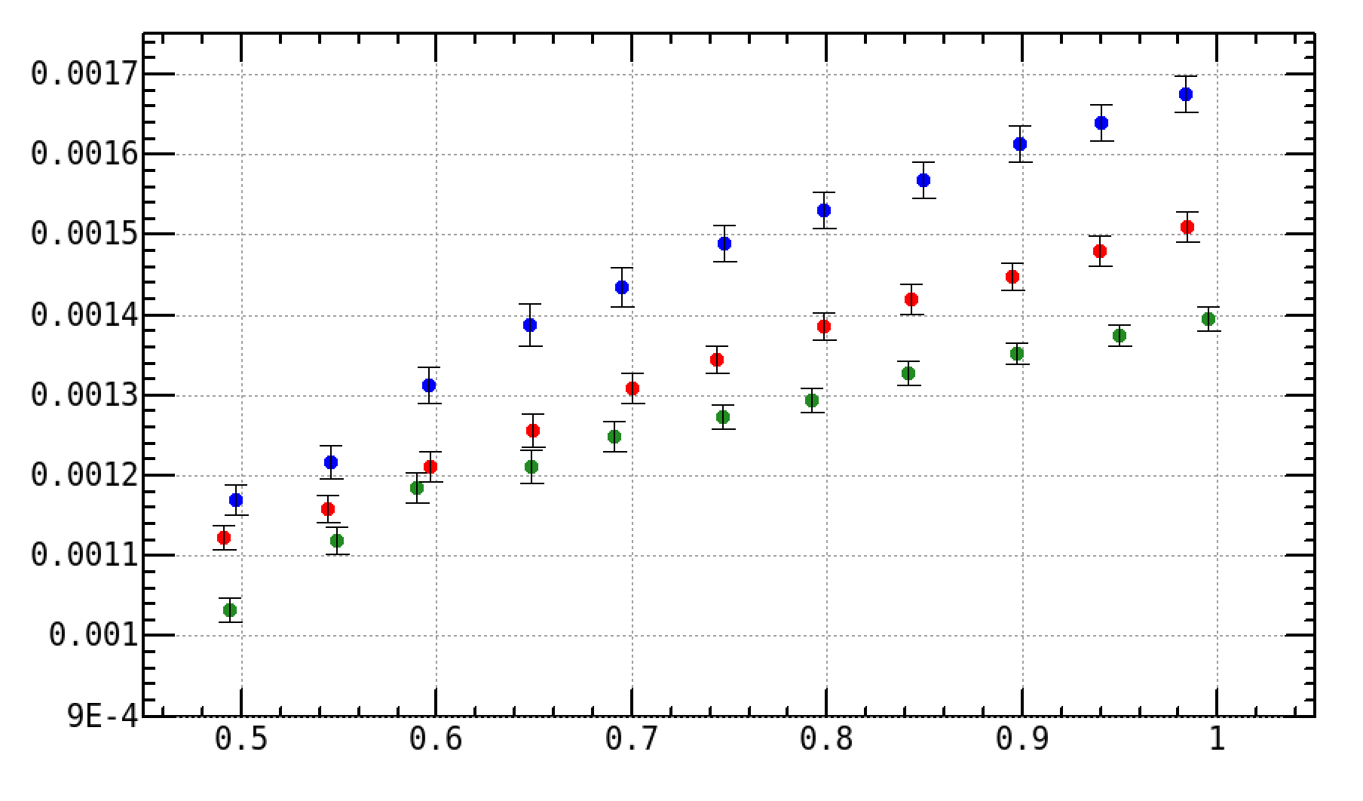
Lifetime Evaluations in LER
We tested three different kinds of sextupole settings in the LER. (Original, proposed by Y. Cai, B2)
2021c
Assuming constant gas pressure and beam emittances during the measurements, the fitting out lifetimes (w/ bunch current of 1 mA) are
Optics parameters (I= 50 mA, 1370 bunches)
 | (Δβ/β)y [%] | Δηy [mm] | εy [pm] | ξx/y | IP knobs
original | 4.2 | 4.5 | ~20 | -1.24/3.58 | ≠0
Yunhai | 5.3 | 3.7 | ~20 | -1.24/3.66 | 0
B2 | 6.5 | 7.9 | ~20 | 0.1/1.9 | 0
Lifetime (sec)
 | Ib = 0.6 mA | Ib = 1 mA
original | 843 ± 14 | 716 ± 7
Yunhai | 825 ± 14 | 662 ± 8
B2 | 761 ± 13 | 596 ± 8
$1/τ$ is not a straight line,
it is different between lower
and higher than 0.6~0.7 mA.
$1/τ$ (1/s)
Bunch current (mA)
Single bunch current was measured by DCCT.
No information of beam size from XRM.
Vertical emittance is uncertain at high bunch current
due to beam blowup (-1 mode instability).

Slide 26
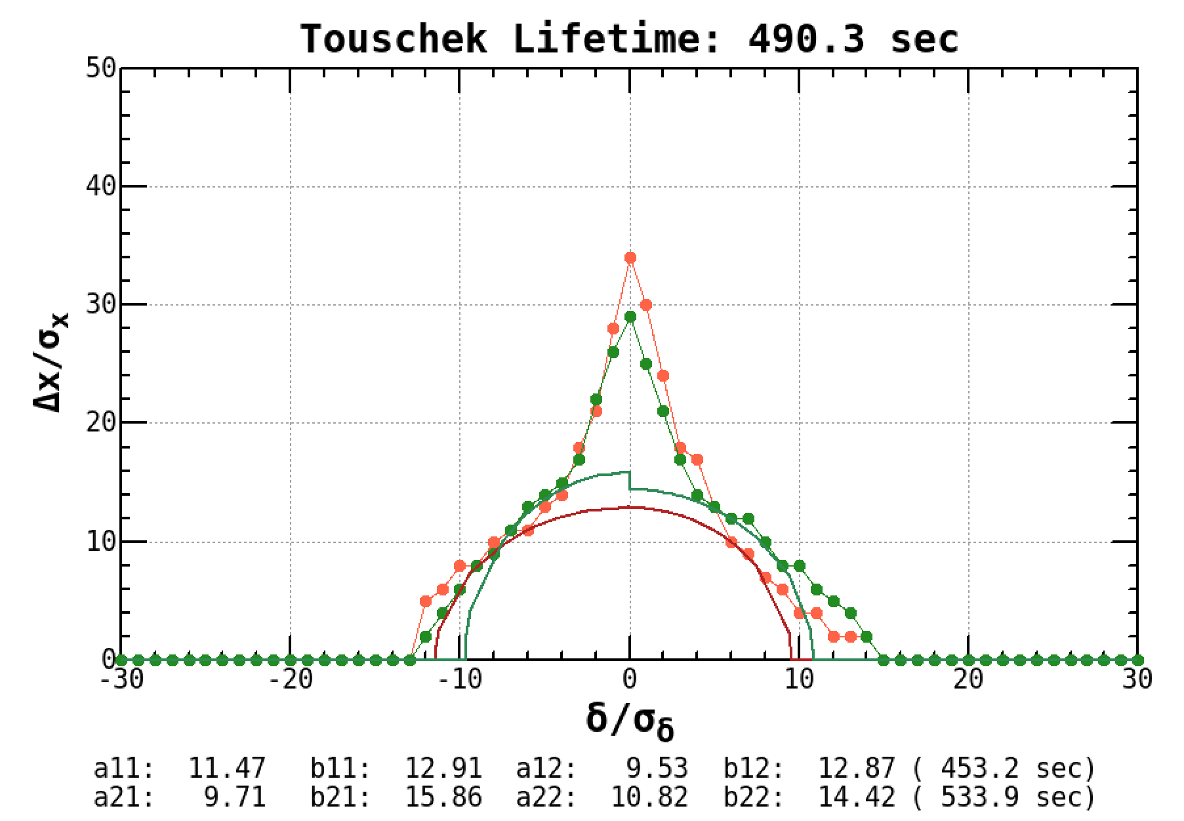
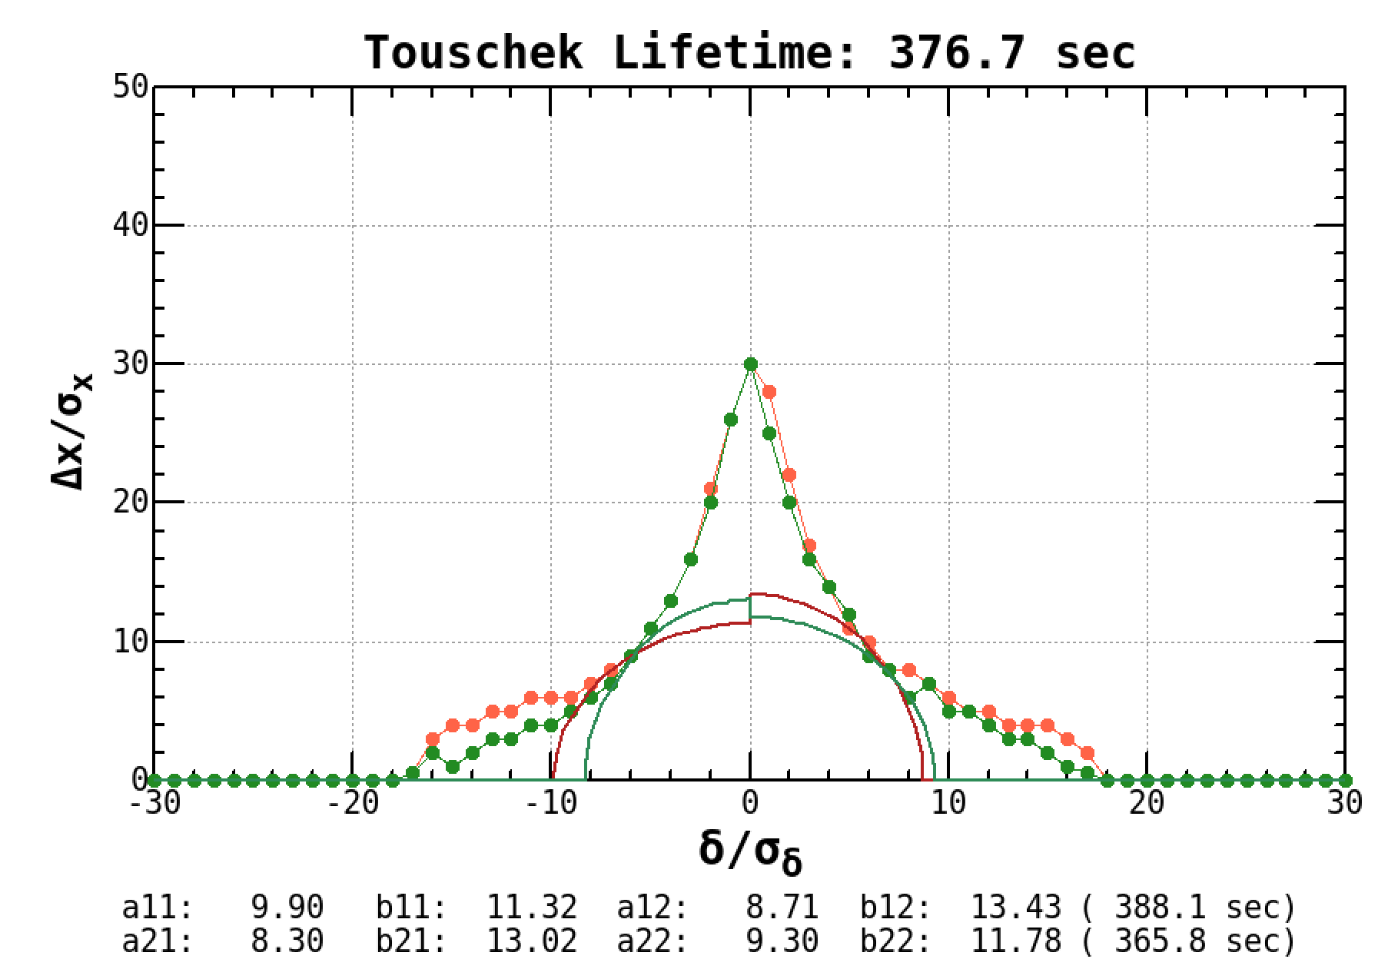
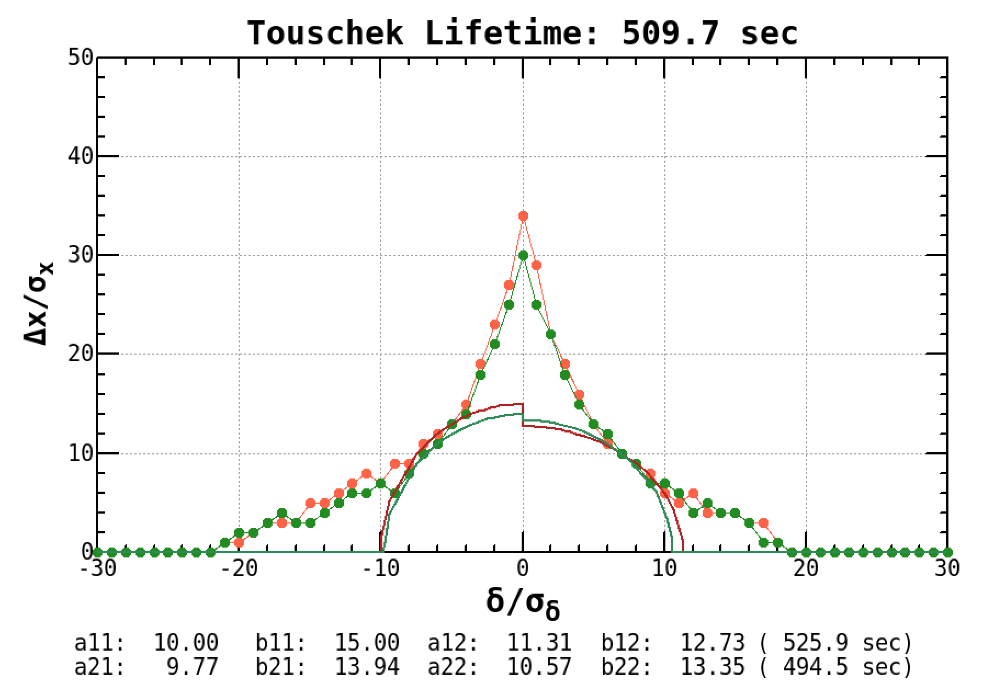
Simulation of Dynamic Aperture in the LER
Crab-Waist : 80 %
Emittance: $ε_{x}=4nm/ε_{y}=20pm$
$$I_{b+}=0.6mA$$
without collimator aperture (QCS only)
initial phase = 0, $π/2$
Original
300 sec @ 1 mA
Yunhai
B2
larger momentum acceptance than original
8.2 min
6.3 min
8.5 min
The Touschek lifetime is evaluated by an ellipse inscribed in the dynamic aperture (stable region).
$→$ too short lifetime
There are various methods of evaluation and lifetime depends on the method from DA.
Lifetime (sec)
 | Ib = 0.6 mA | Ib = 1 mA
original | 843 ± 14 | 716 ± 7
Yunhai | 825 ± 14 | 662 ± 8
B2 | 761 ± 13 | 596 ± 8
Vertical emittance is uncertain at 1 mA bunch current (larger than 20 pm or bunch lengthening).

Slide 27
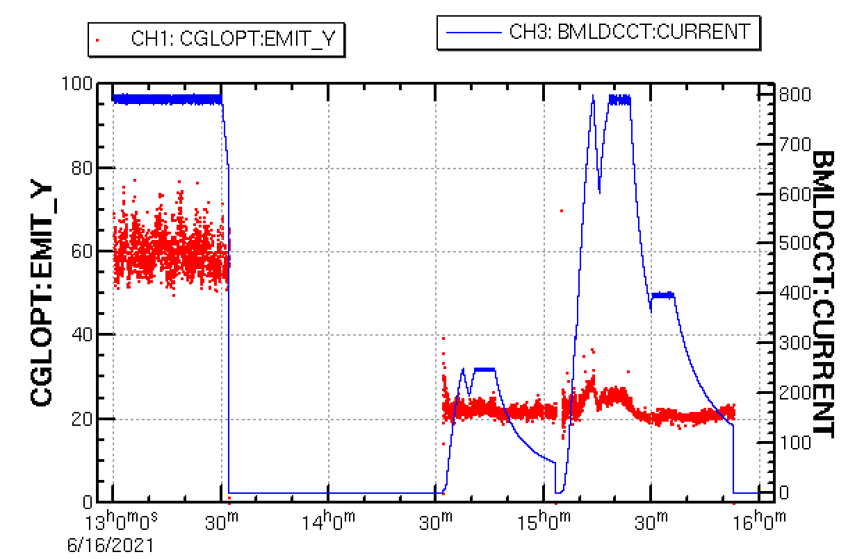
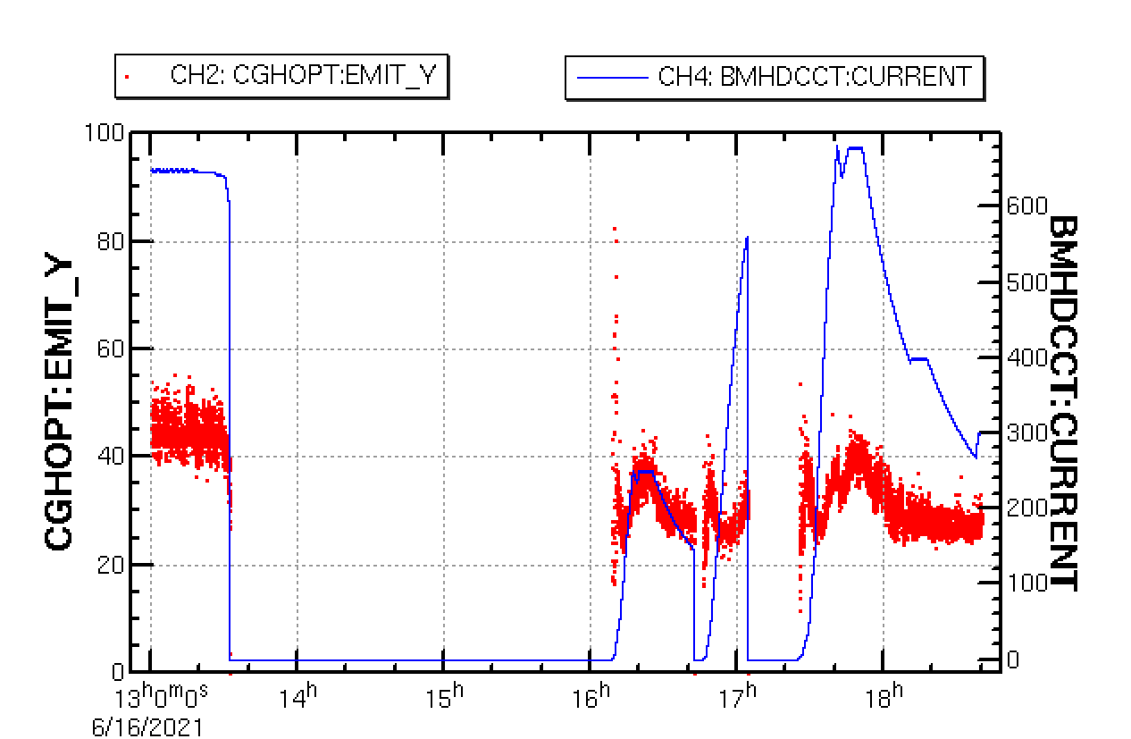
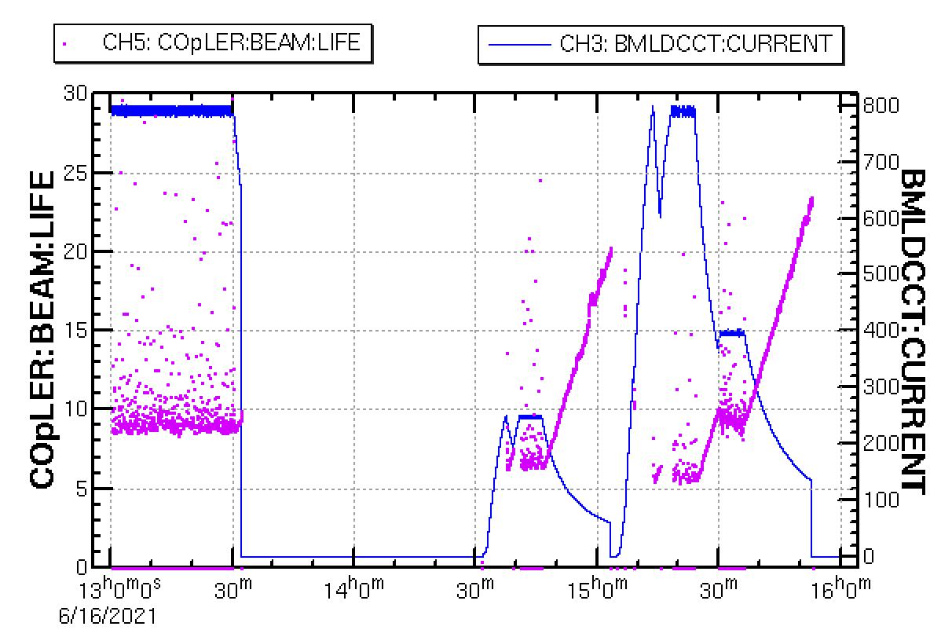
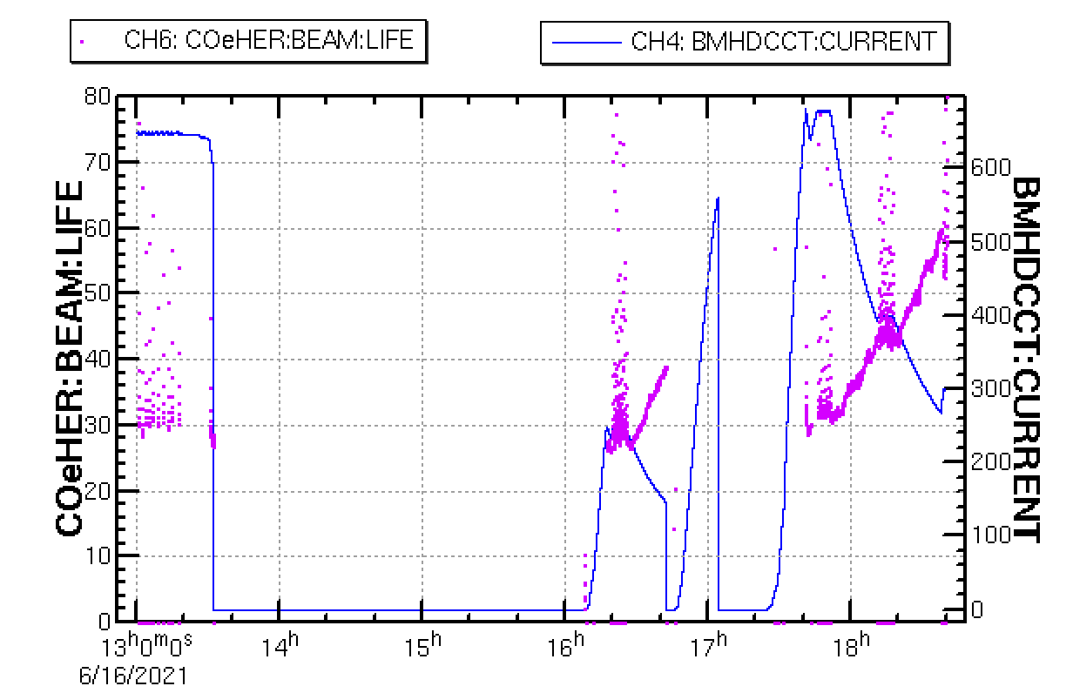
LER
HER
Beam Lifetime and Vertical Emittance
2021b
nb:1174
current
nb:1174
1174
 | LER | HER
βx* | 80 mm | 60 mm
βy* | 1 mm | 1 mm
I | 800 mA | 650 mA
nb | 1174 | 1174
Ib | 0.681 mA | 0.545 mA
εy collision | 60 pm | 45 pm
εy single | 25 pm | 40 pm
life collision | 8 min | 30 min
life single | 6 min | 32 min
ver. emittance
60 pm
nb:393
40 pm
nb:393
25 pm
45 pm
22 pm
28 pm
1174
collision
single beam
collision
single beam
εy depends on bunch current.
Lifetime
30 min
26 min
8 min
32 min
e⁺inj: 2.3 nC x 2 x 12.5 Hz x 80 %
Imax= 1.5 A for lifetime: 8 min
7 min
6 min

Slide 28
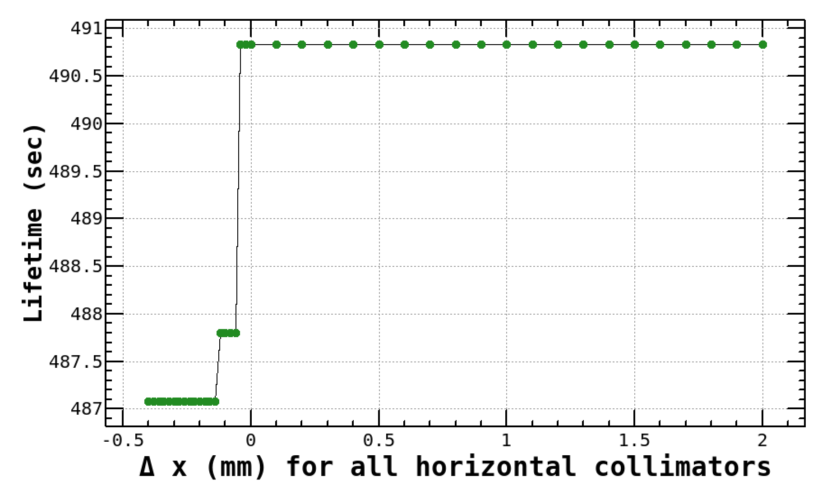
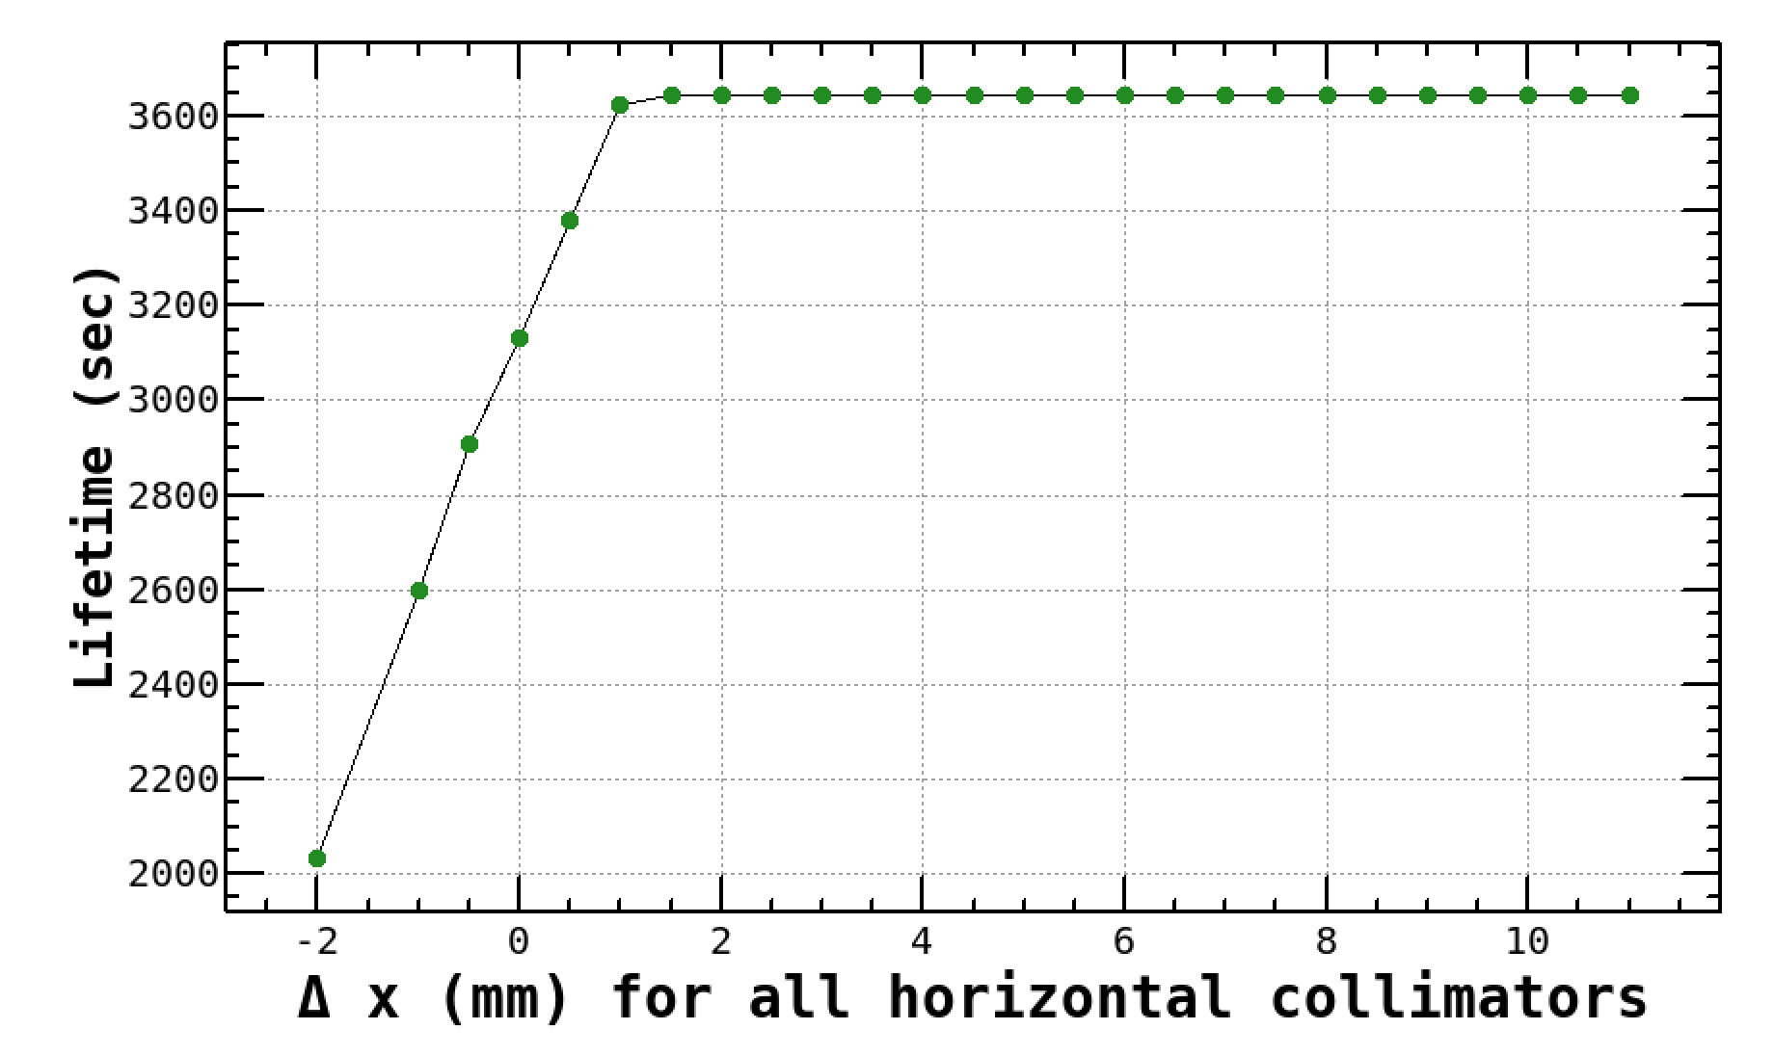
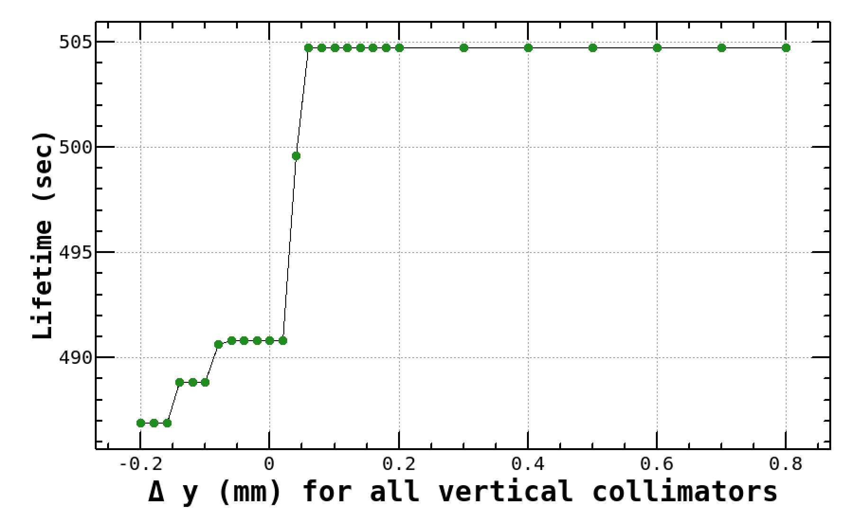
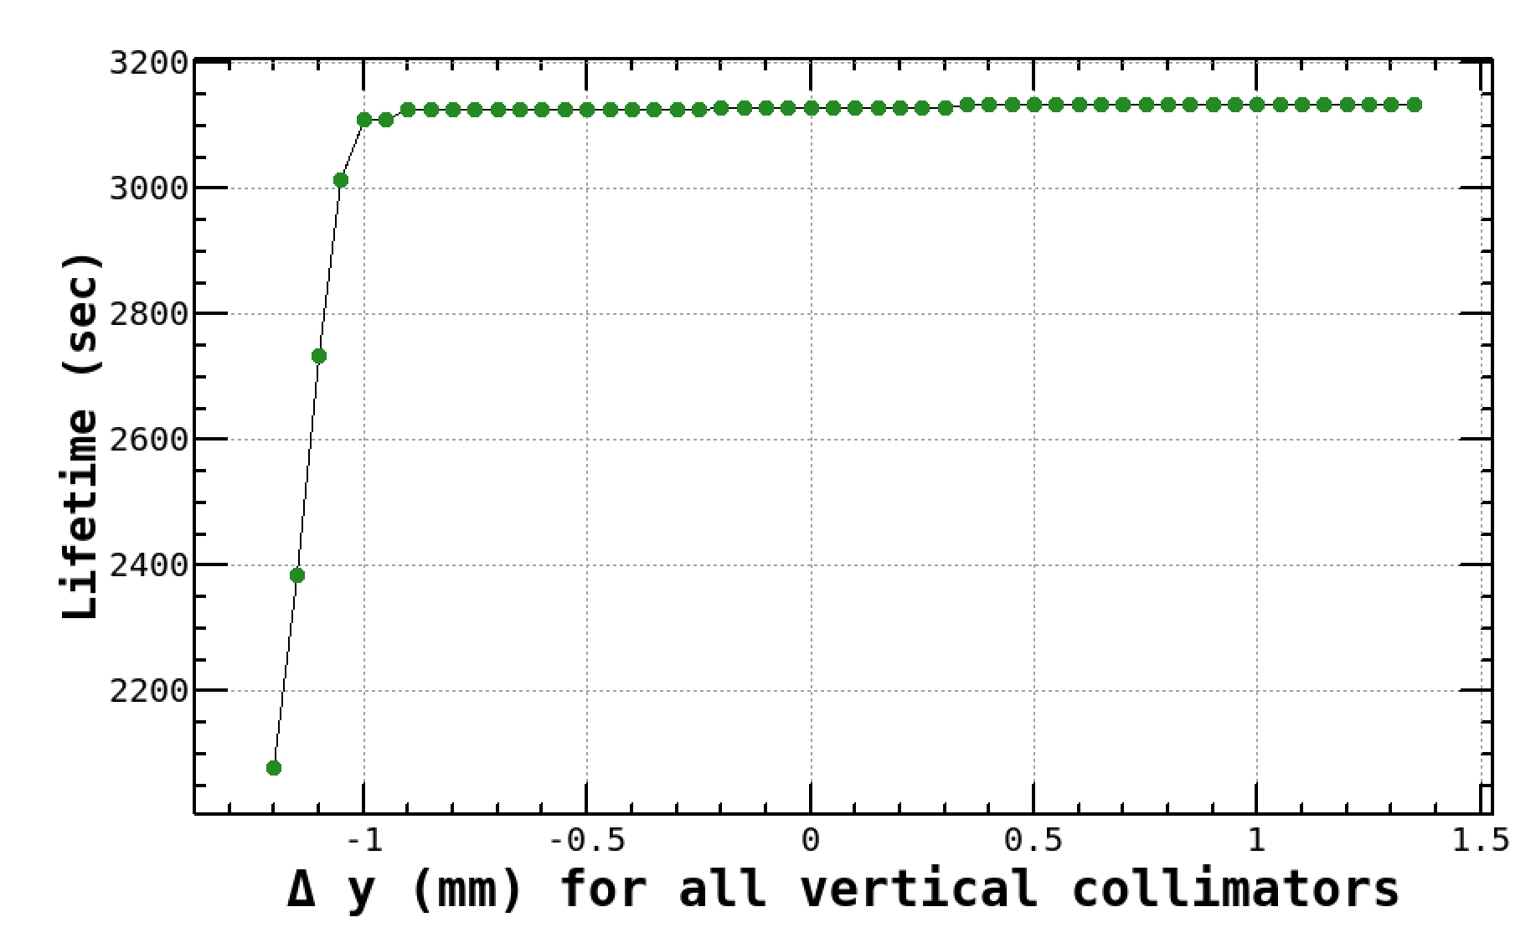
Simulation of Dynamic Aperture and Lifetime
Open and close the collimator uniformly from the nominal setting to examine the change in lifetime.
LER
Zero means the nominal setting for the collimators.
HER
Horizontal
DA ~ PA
Horizontal
DA > PA
$$1mm$$
$$200μm$$
$τ=$8 min
(meas. 6 min,
vac. lifetime inc.)
$τ=$52 min
(meas. 32 min,
vac. lifetime inc.)
Vertical
DA > PA
Vertical
DA < PA
The simulation is
almost consistent with measurement.
Dynamic aperture is
smaller than what
we expected ?
$$100μm$$
$$100μm$$
Or machine error ?

Slide 29
No Summary
-1 mode instability | K.Ohmi | "Impedance issues (BxB FB, etc.)" | Dec. 14
Sudden beam loss | H. Ikeda | "Sudden Beam Loss" | Dec. 14
Optics degradation and others | H. Sugimoto | "Optics issues" | Dec. 14
Beam-Beam simulations, interference of lattice nonlinear, etc. | D. Zhou | "Beam-Beam, comparison of Beam-Beam interaction between simulations and experiments" | Dec. 14
Collimators | T. Ishibashi | "Collimator issues" | Dec. 14
Issues of beam injection | N. Iida | "Injection" | Dec. 13

Slide 30
Appendix

Slide 31
Operation statistics
2019 -2022

Slide 32
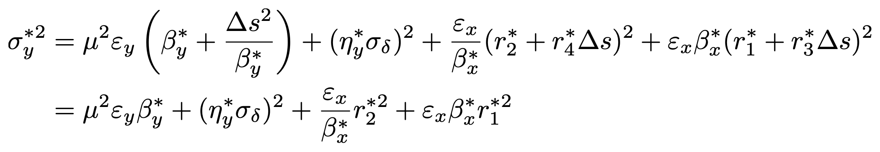
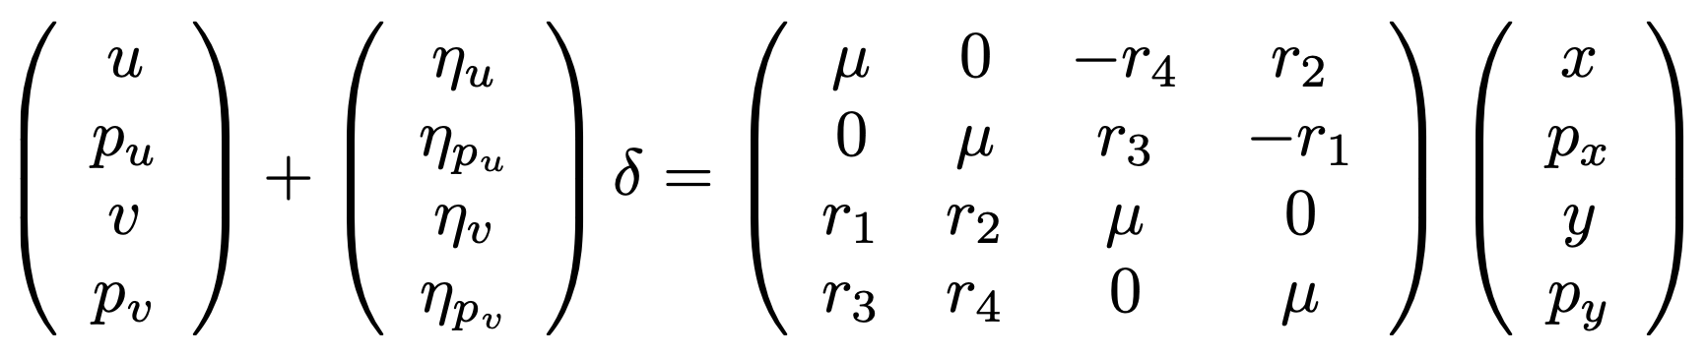
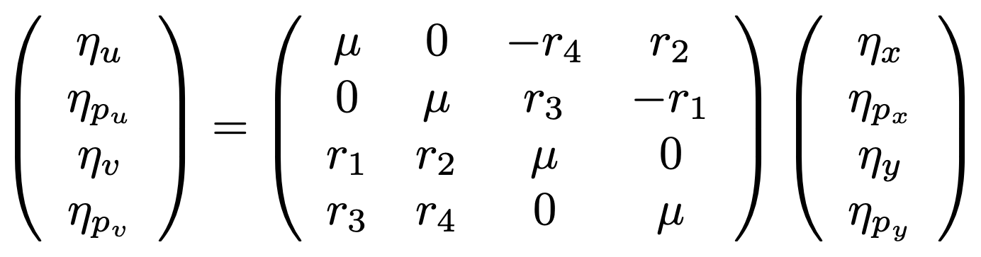
Vertical Beam Size at IP
X-Y couplings
normal coordinate
(decoupled coordinate)
physical coordinate
Vertical emittance, vertical dispersion, coupling parameters r1 and r2 at the IP are fundamental parameters for luminosity performance.

Slide 33


Beam-Beam Parameters
single beam
emittance
2022ab
$$β_{y}^{*}=1mm$$
$$ε_{y-}^{0}=40pm$$
Vertical beam-beam parameter
$$ε_{y+}^{0}=25pm$$
Vertical beam-beam parameter (incoherent)
Beam-Beam parameter
appears to be saturated
at 0.6 mA.
Here, the nominal bunch length is used.
Bunch lengthening is important parameter.

Slide 34


Beam Size in 2021c
2021c
2021c
2021c HBC
ΔR1', LER νy
$←$ 6.0 nm
$←$ 4.5 nm
2021c HBC
$←$ 3.6 nm
lower $ν_{x}$ in the LER
lower $ν_{x}$ in the LER
bunch current product
bunch current

Slide 35



Location of Movable Collimators
Collimators and Radiation Dose (measured on June 22, 2022)
measured by Radiation Safety Group
LER
HER
D06H3
17 m
D02H3
D09H1
D12V4
Injection
Point
e⁺ $→$
IP
$←$ e⁻
Injection
Point
D06H3 damaged
due to accidental fire of
injection kicker on March 18
D02H3 is 17 m downstream of D02V1
which is damaged on March 11.
The radiation dose at the injection point is very high in HER.
The bottom jaw of D06V1 was opened from the usual setting due to
damage of the collimator head. In stead of D06V1, D06V2 was used to
protect D02V1 and QCS from mid. of June.

Slide 36


Local Chromaticity Correction: Strong Sextupoles (SLY)
LER
$$β_{y}^{*}=1mm$$
HER
Right-side
Left-side
Right-side
Left-side
-I'
-I'
-I'
-I'
K2: 1.23 1/m²
K2: 3.48 1/m²
K2: 1.33 1/m²
K2: 3.53 1/m²
K2: -8.76 1/m²
K2: -9.62 1/m²
K2: 8.36 1/m²
K2: 7.66 1/m²
$$β_{y}=521m$$
$$β_{y}=525m$$
$$β_{y}=702m$$
$$β_{y}=675m$$
$$Δν_{y}=\frac{β_{y}}{4π}K_{2}Δx$$
~0.0028 for $Δx=20μm$
Horizontal orbit in-phase for each pair
induces large beta-beat which changes $β_{y}^{*}$.
$Δν_{y}$ ~0.01 for $Δx=20μm$
Horizontal tune shift can be ignored.
3.6 times larger than LER

Slide 37

Beta-Beat due to Orbit Deviation
H. Sugimoto, 2022ab Summary Meeting
The SR heating deforms the beam line.
The horizontal orbit deviation induces tune shift and beta-beat. As the result, $β_{y}^{*}$ also changes.
The orbit deviation in the local chromaticity correction (SLY) is always in the outward direction of the ring.
This implies a squeezing of $β_{y}^{*}$.
The HER is larger effects rather than the LER.
In order to reduce optics degradation, the local bumps correct the orbit at the strong sextupoles.
(Horizontal bump for beta-beat and vertical bump for X-Y couplings)

Slide 38





Measurement of Resistive-Wall Tune Shift
(no crab waist)
HER
$$β_{x}^{*}/β_{y}^{*}=200mm/8mm$$
The bunch current is fixed to be 0.2 mA.
$$10μm$$
$$10μm$$
nb: 978
nb: 1565
nb: 783
nb: 393
reference
$$2μm$$
$$2μm$$
reference
$$10μm$$
$$10μm$$
tune shift due to
resistive wall
impedance:
$$Δν_{x}/I=+2.2×{10}^{-5}(1/mA)$$
$$Δν_{y}/I=-2.0×{10}^{-5}(1/mA)$$
$$→-1.64×{10}^{-5}(1/mA)$$
corrected value
18:50 - 23:10, October 26, 2021

Slide 39






Dynamic Aperture in the LER
CW 80 %
Collimators : full open, QCS aperture only
initial amplitude at injection point
QC1
$$δ_{0}=-σ_{δ}$$
$$δ_{0}=0$$
$$δ_{0}=+σ_{δ}$$
QC2
AQC1: AY =20.0 mm
Tested three different
vertical apertures for
QC1
Horizontal dynamic aperture is reduced by the crab waist scheme.
AQC1: AY =18.0 mm
If the vertical physical aperture of QC1P is increased to 17 mm, the stable region is extended in the small horizontal amplitude.
(Above 17 mm is limited by the dynamic aperture.)
AQC1: AY =13.5 mm
CW 0 %
is determined by the physical aperture of QC1 and QC2
$$δ_{0}=-σ_{δ}$$
$$δ_{0}=0$$
$$δ_{0}=+σ_{δ}$$

Slide 40

Intra-Beam Scattering in LER
Ib = 0.6 mA
$$ε_{y}(pm)$$
$$ε_{x}(nm)$$

