Slide 1
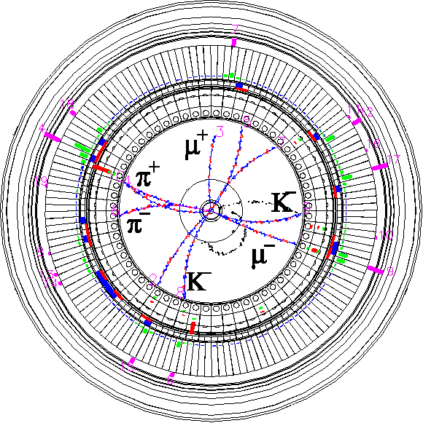


LS1 Status
The 26th KEKB Accelerator Review Committee
14th Dec. 2022
Kyo Shibata
Inter-University Research Institute Corporation High Energy Accelerator Research Organization (KEK)
大学共同利用機関法人 高エネルギー加速器研究機構 (KEK)

Slide 2
Contents
Introduction
  Challenges and countermeasures
  LS1 schedule
IR status (Tsukuba straight section)
NLC status (Oho straight section)
Others
Summary

Slide 3
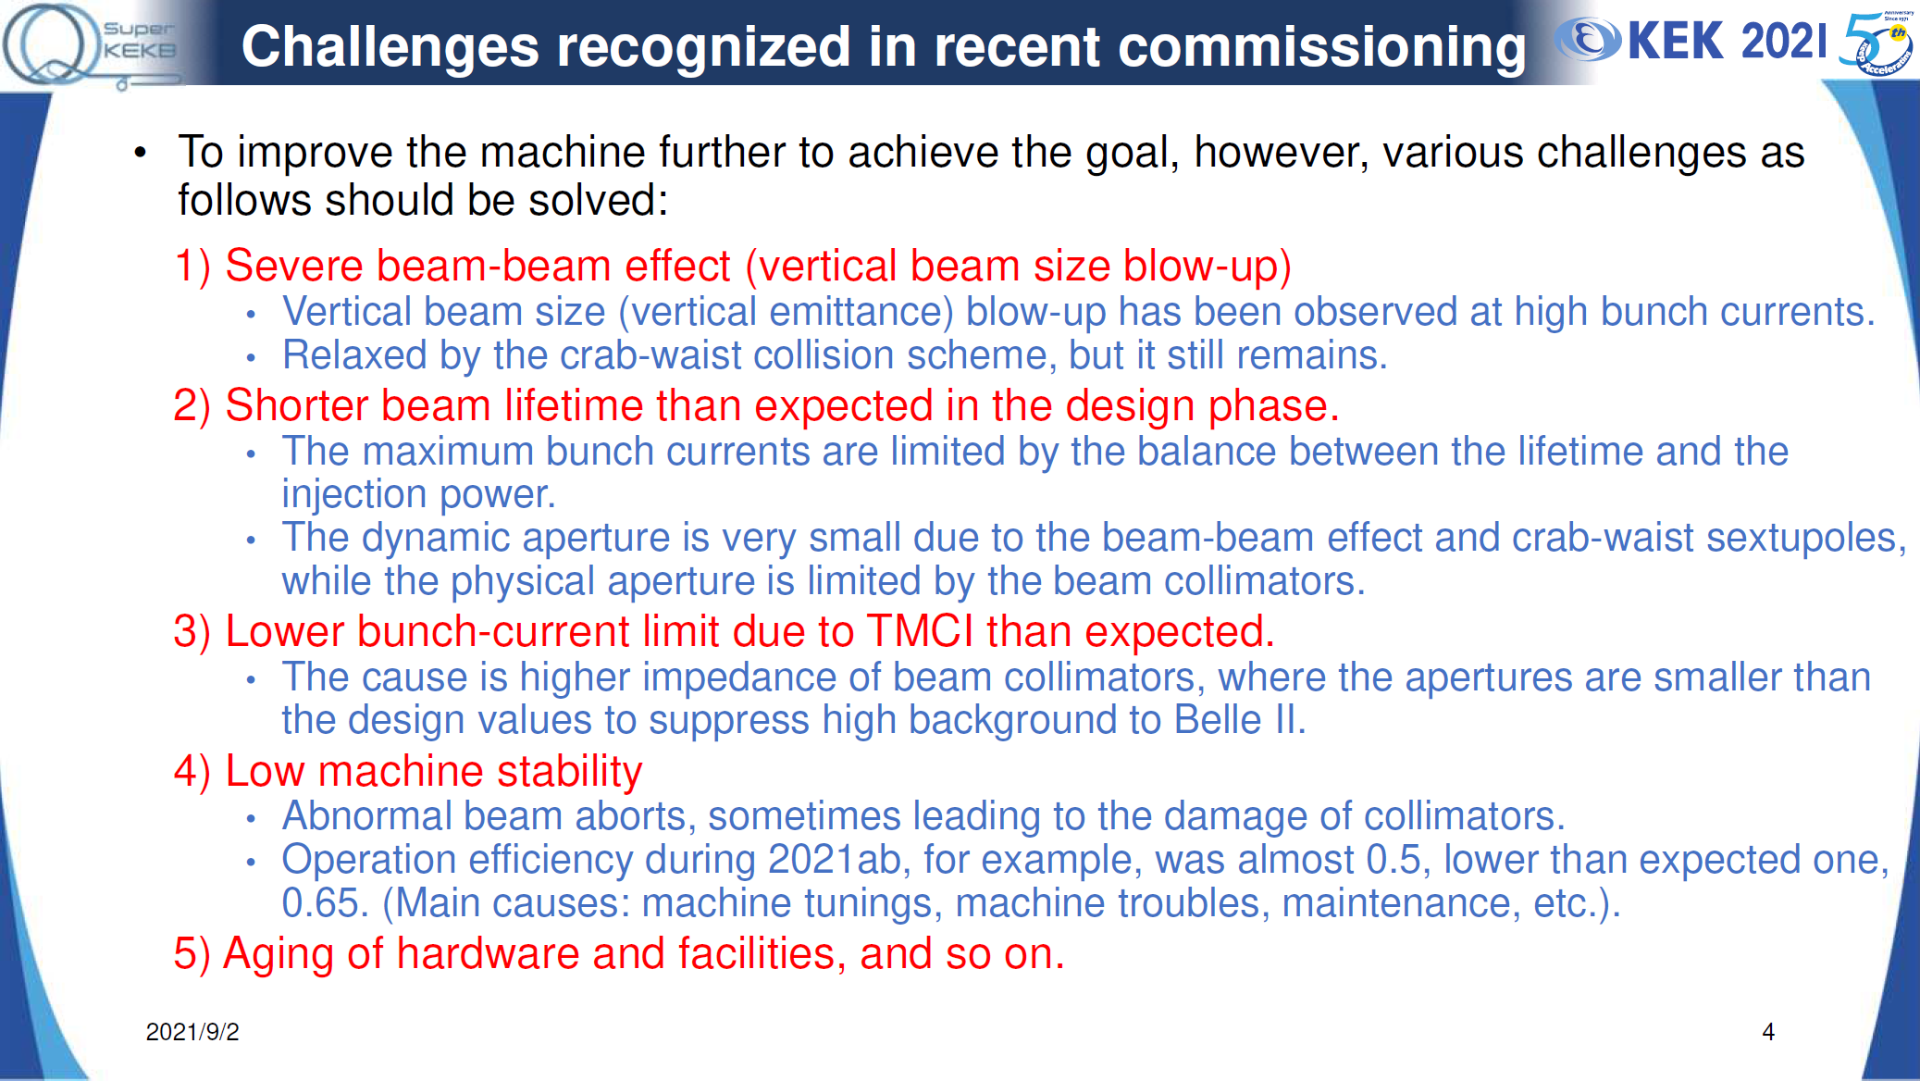
Challenges as a luminosity frontier machine
Y. Suetsugu (2021.09.02)
The 25th KEKB Accelerator Review Committee
+ 6) Low injection efficiency especially in HER.

Slide 4
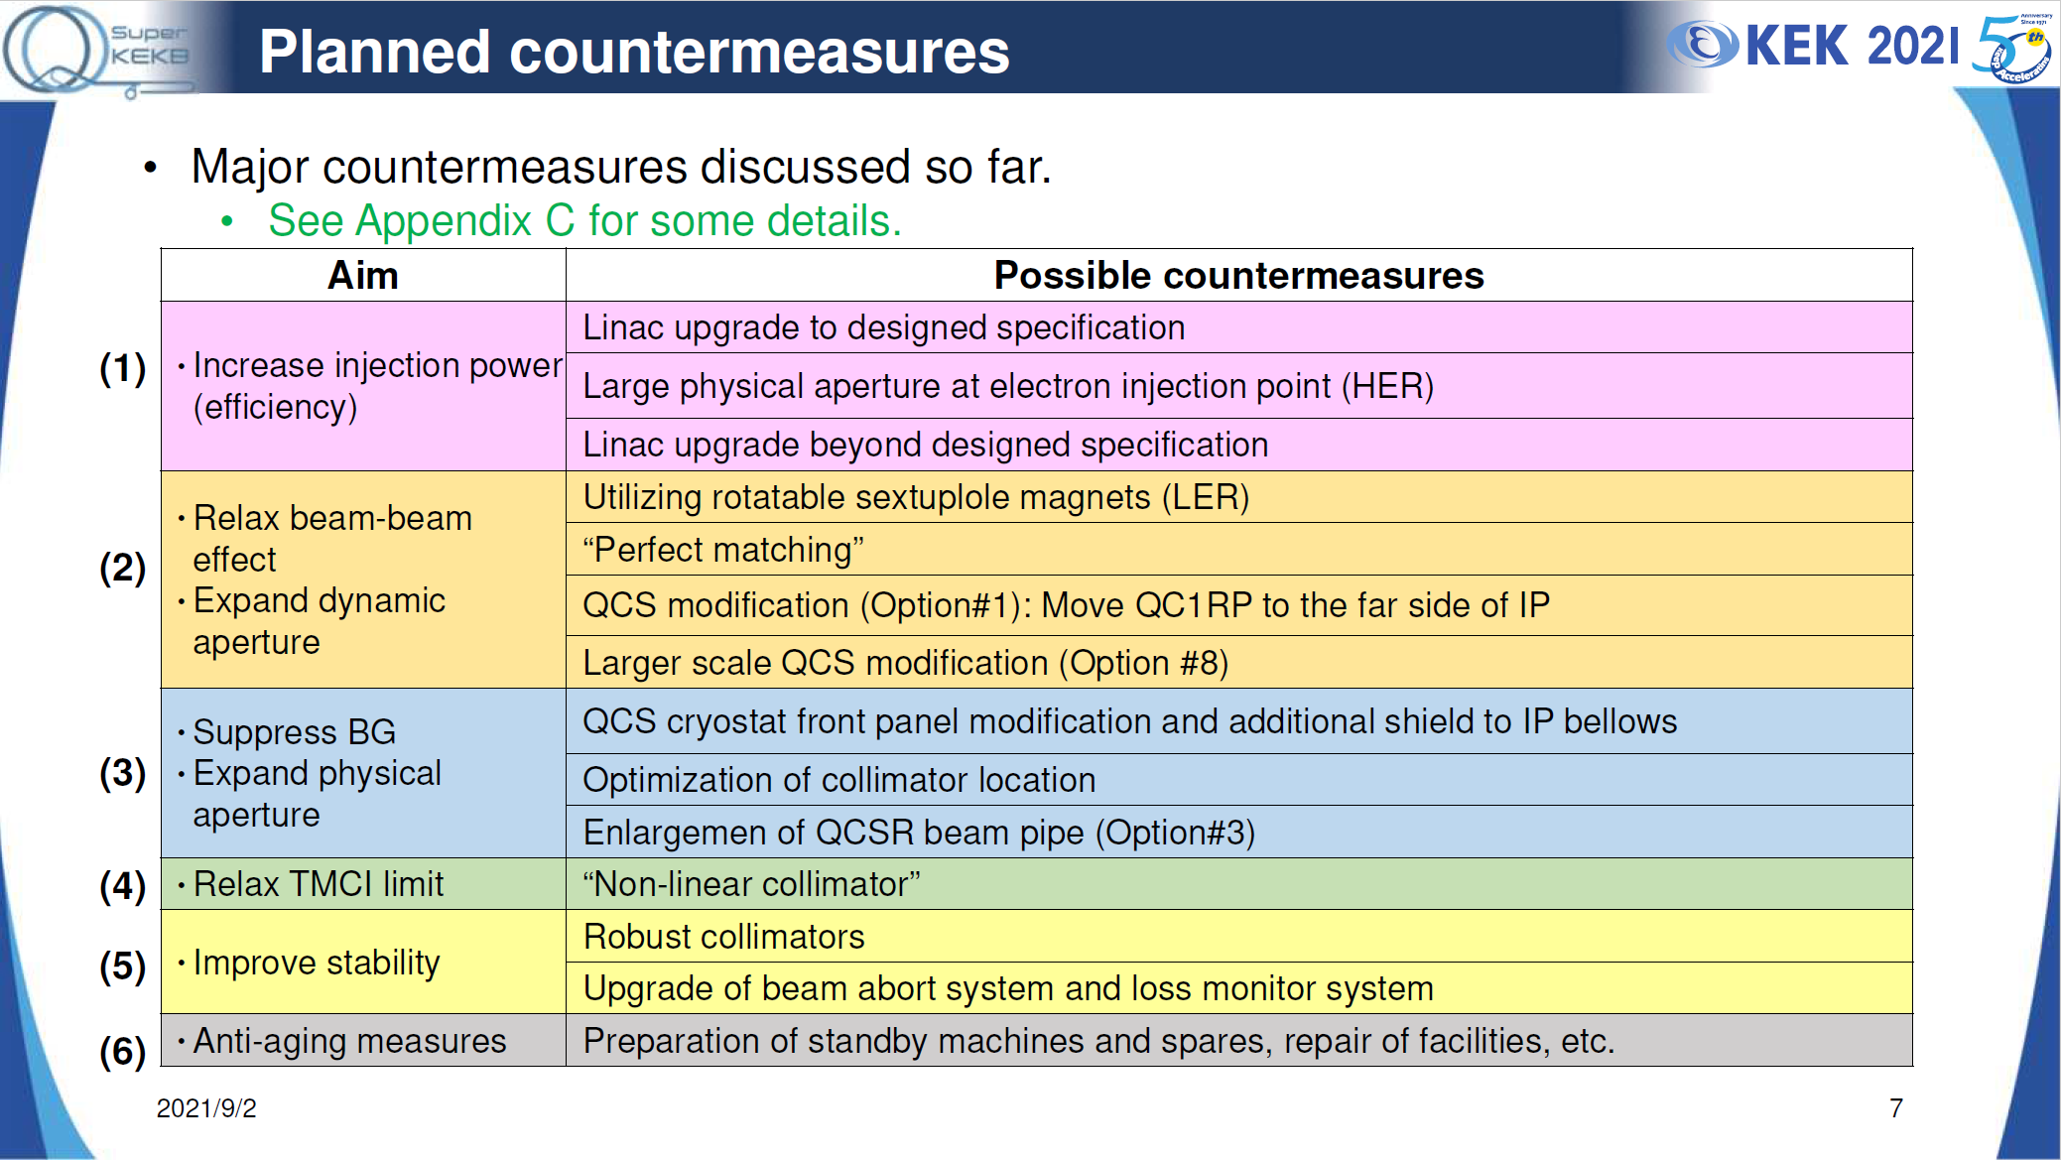
Countermeasures against challenges
Y. Suetsugu (2021.09.02)
The 25th KEKB Accelerator Review Committee
During LS1
Done before LS1
Under consideration
(It was found that it is not easy.)
Under consideration
During LS1
Done before LS1
Under consideration
During LS1
During LS1 (Partially)
During LS1 (Partially)
During LS1 (Partially)

Slide 5
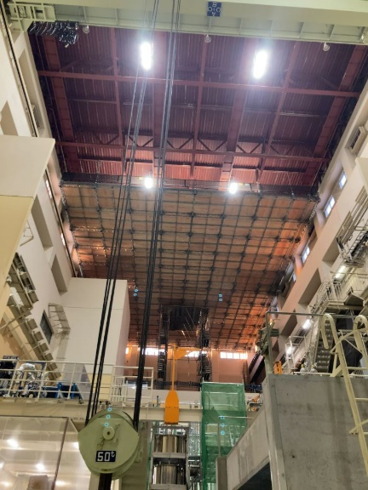
Schedule
LS1 : 15 months from July 2022 to September 2023
  2022b run stopped earlier than planned due to high electricity costs (22nd June), but LS1 major works began on 11th July as scheduled.
  Beam operation will restart from October 2023.
Major works during LS1 other than accelerator upgrade:
  Belle II maintenance and reinforcement
    Replacement of PXD and TOP MCP-PMTs, new IP beam pipes, and so on.
    IR works are required, including QCS extraction & reinstallation, disassembly & reinstallation of magnets, beam pipes, radiation shields, etc.
  Aseismic reinforcing work of the ceiling of the laboratory building (Oho Lab. & Fuji Lab.)
    It takes about 5 months and it can be done only during long shutdown.
    During this work, we can not use ceiling crane required for NLC construction at Oho Lab.!!
Ceiling aseismic reinforcing work
S. Nakamura
LS1 schedule
JFY2022 | 2022 |  |  |  |  |  |  |  |  | 2023
 | 4 | 5 | 6 | 7 | 8 | 9 | 10 | 11 | 12 | 1 | 2 | 3
JFY2023 | 2023 |  |  |  |  |  |  |  |  | 2024
 | 4 | 5 | 6 | 7 | 8 | 9 | 10 | 11 | 12 | 1 | 2 | 3
We are here now!!
2022b run
Long Shutdown 1 (Accelerator upgrade)
Ceiling aseismic reinforcing work
Belle II maintenance & reinforcement
Long Shutdown 1 (Accelerator upgrade)
2023c run
2024a run
Belle II
maintenance & reinforcement

Slide 6
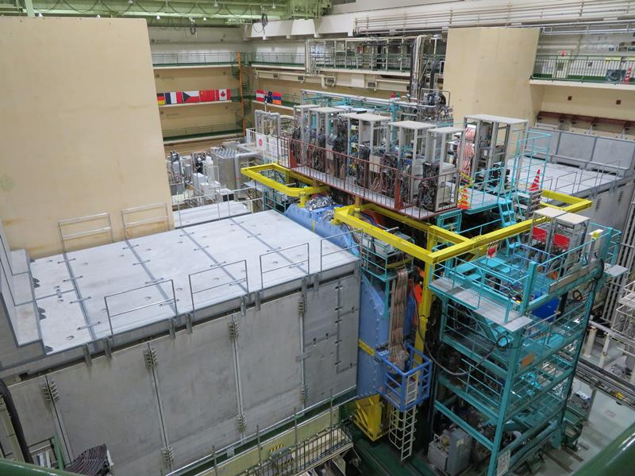
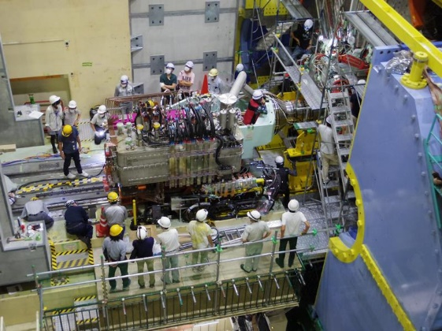
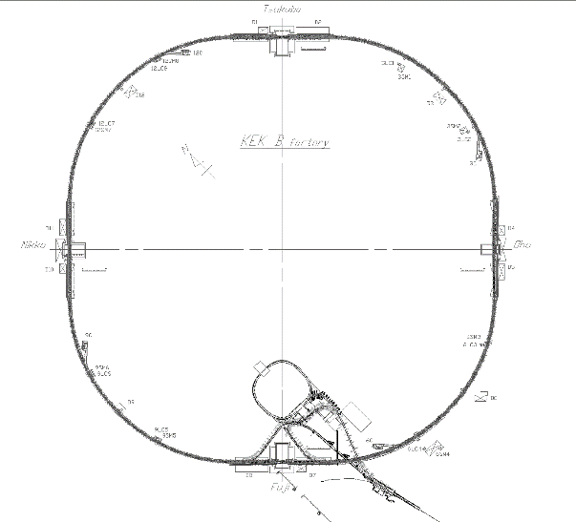
IR (Tsukuba straight section) #1
Belle II
QCS movable platform
IR
Tsukuba lab.
Major work items in accelerator tunnel:
  Disassembly and reinstallation of concrete radiation shields
  Belle II maintenance & reinforcement work
  Disassembly and reinstallation of magnets, beam pipes for QCS work
  QCS extraction & reinstallation
  QCSR cryostat leak test
  QCS cryostat modification
Electron beam
Positron beam
Concrete radiation shield
QCS cryostat
IR (Tsukuba straight section)
JFY2022 | 2022 |  |  |  |  |  |  |  |  | 2023
 | 4 | 5 | 6 | 7 | 8 | 9 | 10 | 11 | 12 | 1 | 2 | 3
JFY2023 | 2023 |  |  |  |  |  |  |  |  | 2024
 | 4 | 5 | 6 | 7 | 8 | 9 | 10 | 11 | 12 | 1 | 2 | 3
We are here now!!
Concrete shield disassembly
QCS extraction
QCS cryostat modification
2022b run
Belle II work
QCSR cryostat leak test
Belle II maintenance & reinforcement
QCS reinstallation
Concrete shield reinstallation
Magnet & beam pipe disassembly
2023c run
2024a run
Belle II
Belle II work
maintenance & reinforcement

Slide 7
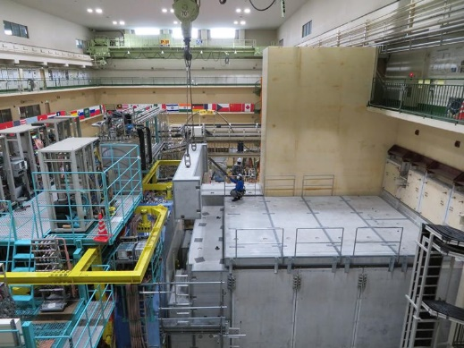
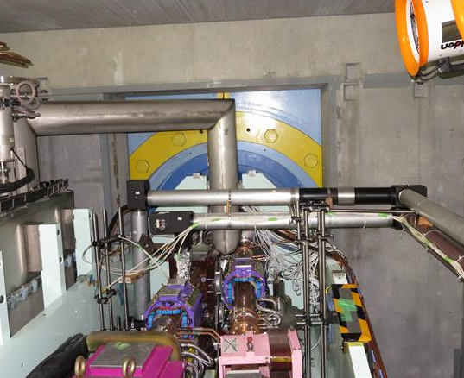
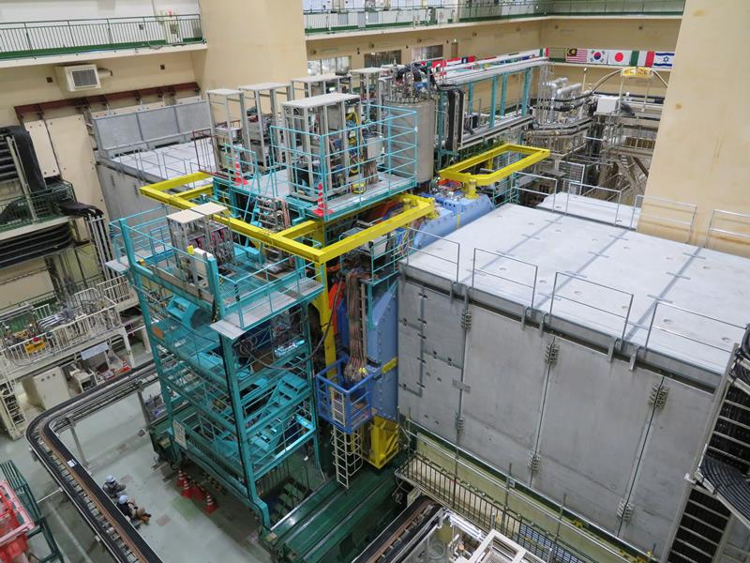
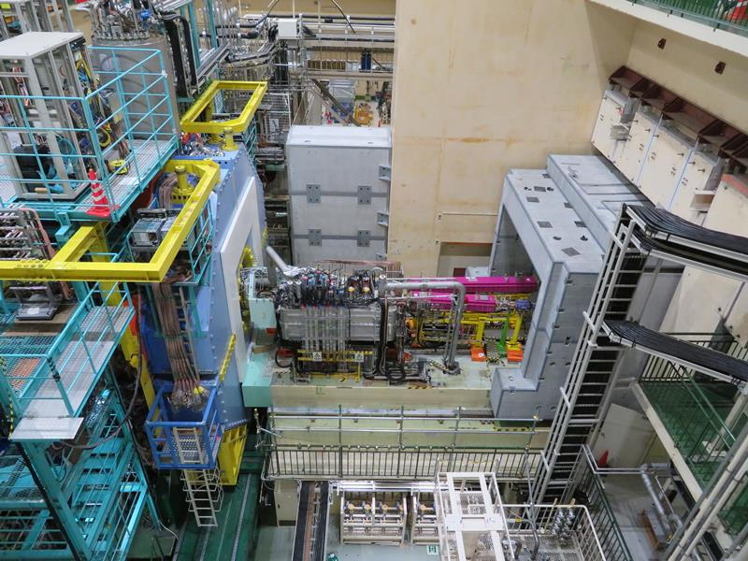
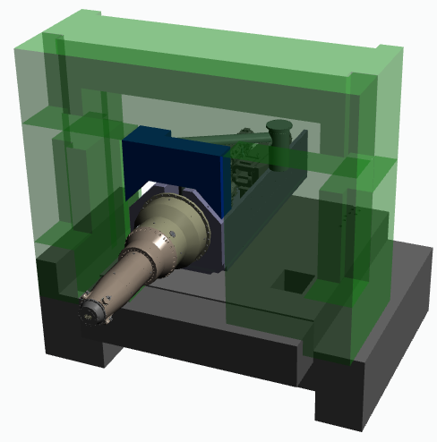
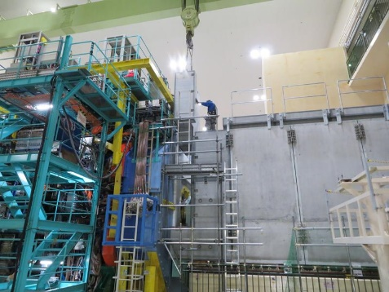
IR (Tsukuba straight section) #2
IR
Tsukuba lab.
Concrete radiation shields disassembly (already done)
  Concrete radiation shields were temporarily removed for IR works.
  They will be reinstalled in mid September 2023.
    To suppress background noise of Belle II, 2 concrete shields will be replaced with new ones.
    New shields will be delivered in February 2023.
Electron beam
Positron beam
This shield will be replaced with new one.
This space will be filled with concrete.
Concrete shield disassembly work
New concrete shield
H. Yamaoka

Slide 8
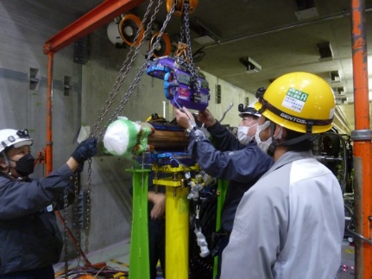
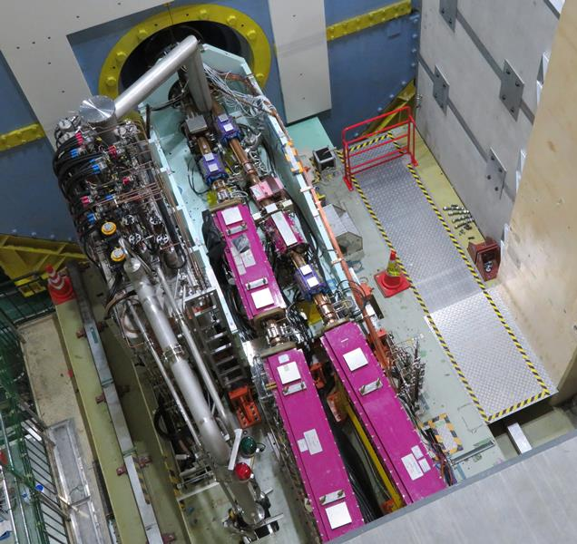
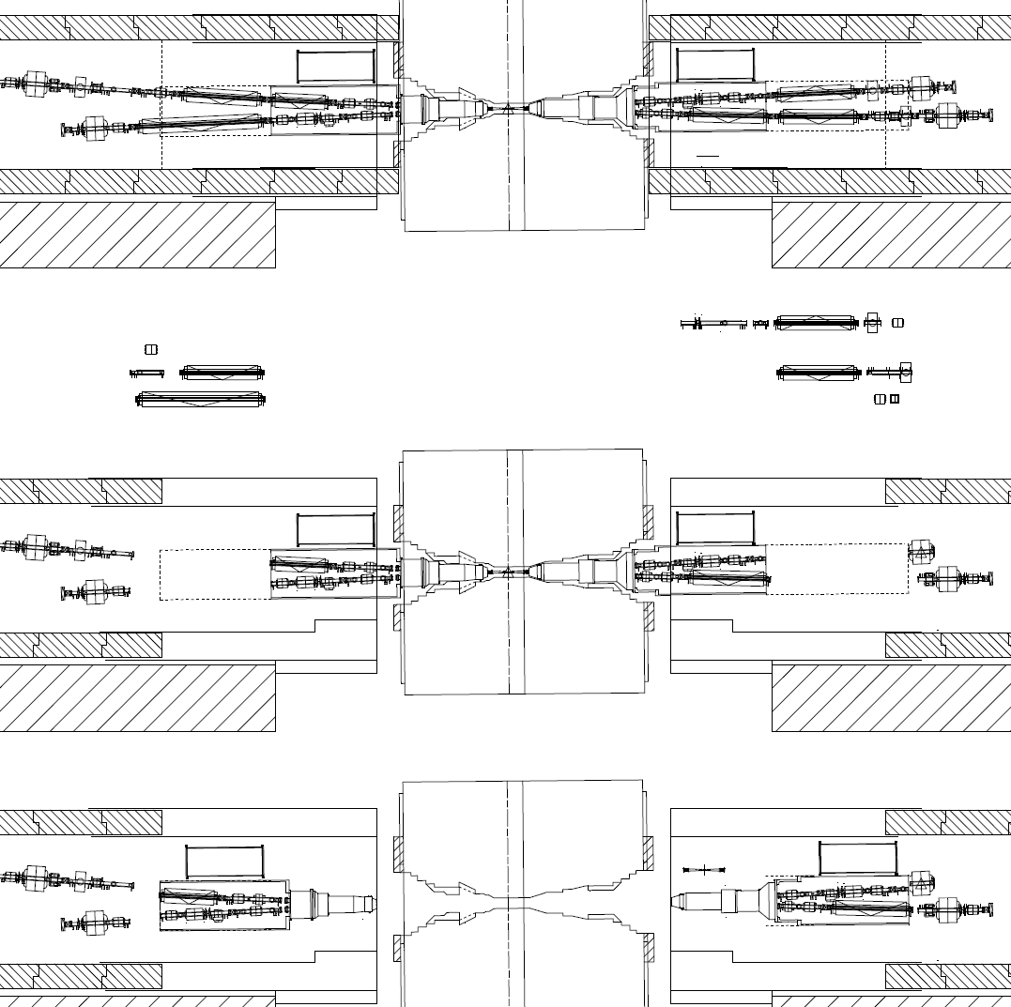
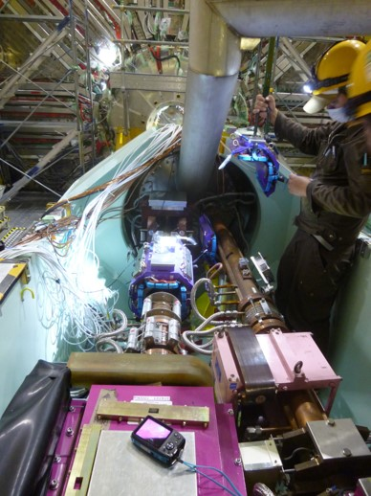
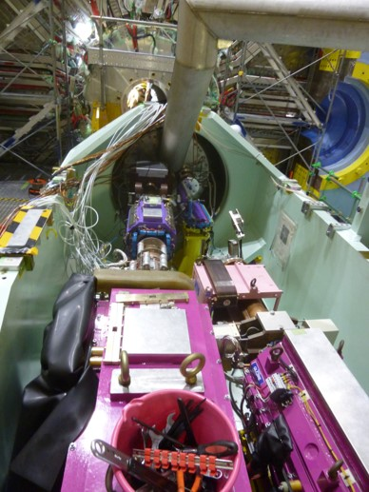
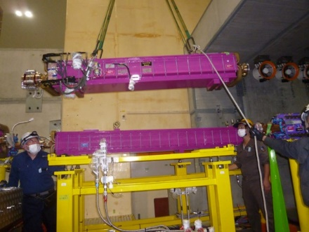
IR (Tsukuba straight section) #3
IR
Tsukuba lab.
Disassembly of magnets & beam pipes for QCS extraction (already done)
  To make space for QCS extraction, magnets and beam pipes were removed.
  For QCS cryostat work, some magnets and beam pipes on QCS movable platform were also removed.
Electron beam
Positron beam
Magnets & beam pipes should be disassembled
QCS movable platform
QCS extraction
QCS extraction
QCS movable platform
Disassembly work

Slide 9
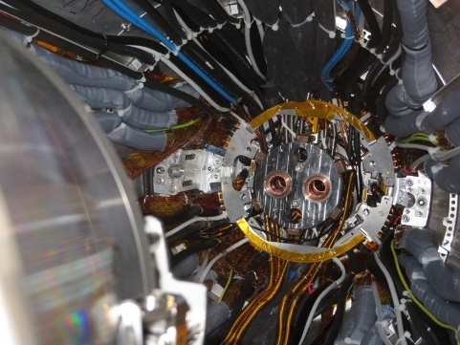
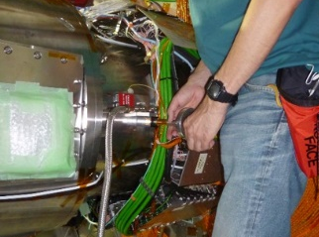
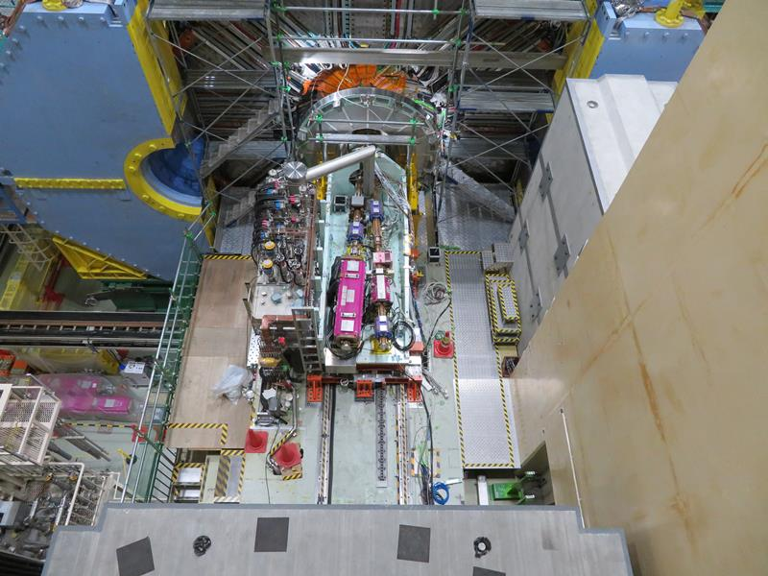
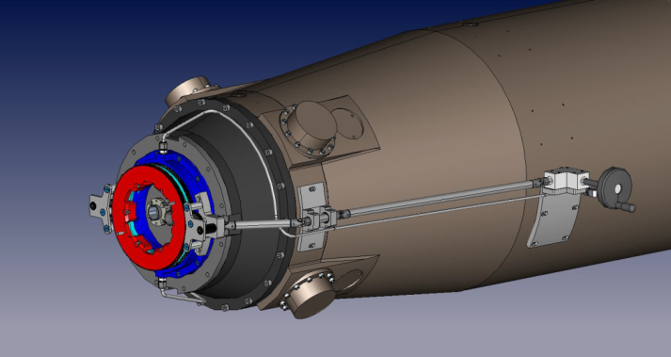
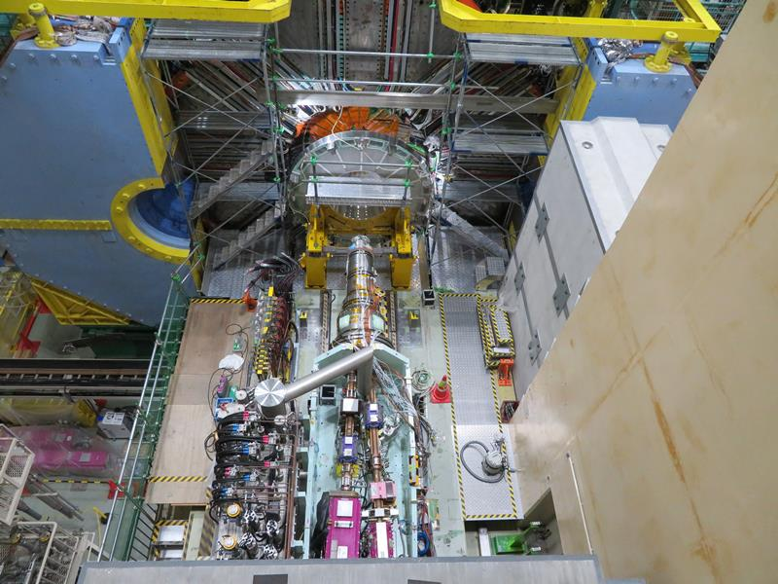
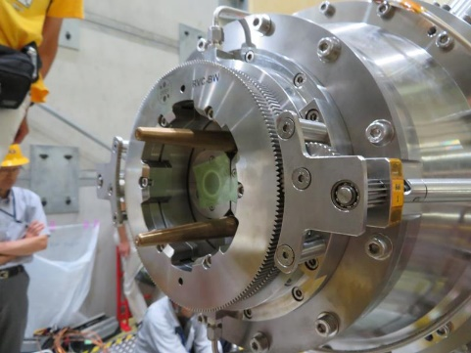
IR (Tsukuba straight section) #4
QCS extraction (already done)
  RVC disassembly was performed by Belle II and SuperKEKB for the first time.
    RVC : Remote Vacuum Connection between IP bellows chambers and QCS beam pipes
    DESY, who is RVC developer and has been in charge of RVC disassembly so far, also joined the work online. Thank you very much for the kind work manual and cooperation!!
    Although camera for monitoring the RVC movement did not work, disassembly work went well.
  QCS extraction of both sides was completed successfully in one day!!
IR
Tsukuba lab.
Electron beam
Positron beam
RVC lock flange of IP bellows chamber
K. Gadow (DESY)
Remote manipulation wheel
QCS extraction
RVC mechanism

Slide 10
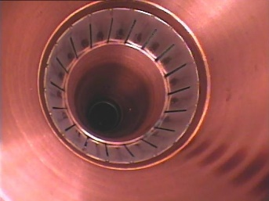
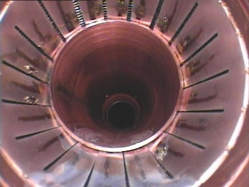
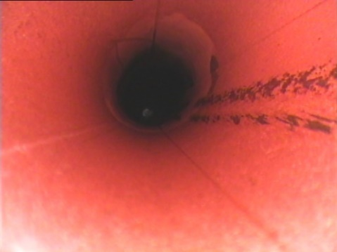
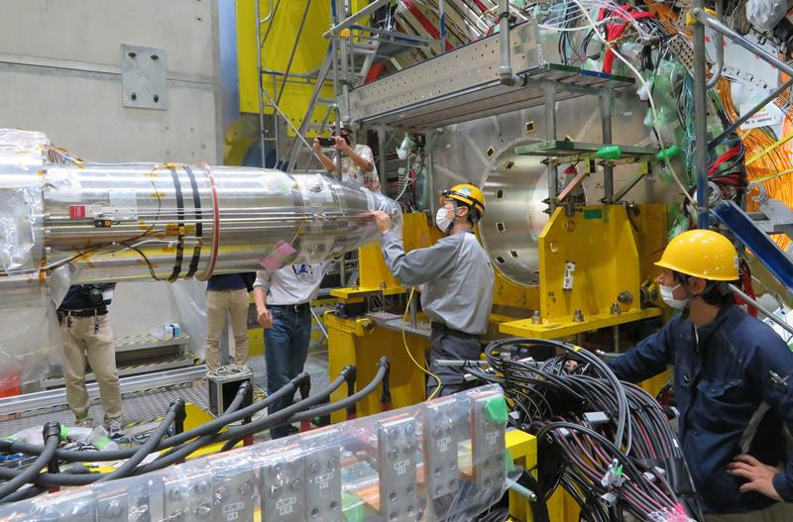
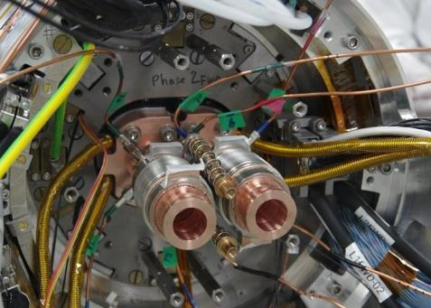
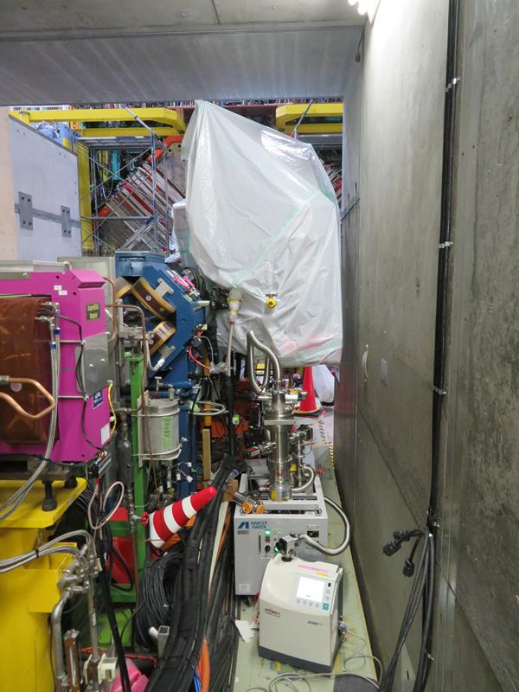
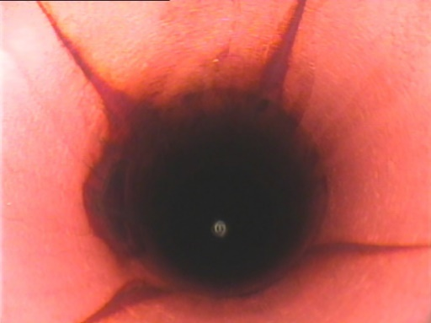
IR (Tsukuba straight section) #5
IR
Tsukuba lab.
QCSR cryostat leak test (already done)
  Pressure in QCSR cryostat has been higher than that in QCSL cryostat.
    Residual gas analysis showed that vacuum leak has occurred in QCSR cryostat.
    However, vacuum leak test before LS1 did not detect any vacuum leak.
  Thorough vacuum leak test was performed after QCS extraction.
    At last, the location of the vacuum leak was identified!!
    Vacuum leak will be stopped during LS1.
Inside observation of beam pipes
  Inside of IP bellows, QCS beam pipes were observed by fiberscope.
    Fiberscope observations showed that RF fingers of IP bellows and QCS beam pipes are discolored but healthy.
Electron beam
Positron beam
QC1RP
Vacuum leak test of QCSR cryostat
QC1LE
IP bellows chamber with BPM

Slide 11
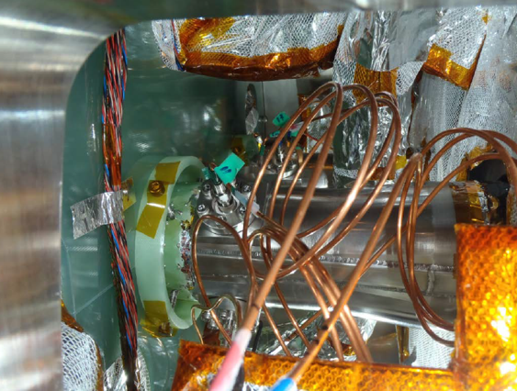
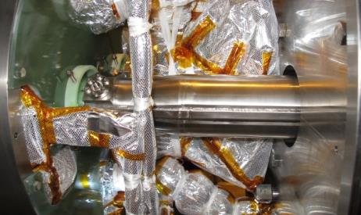
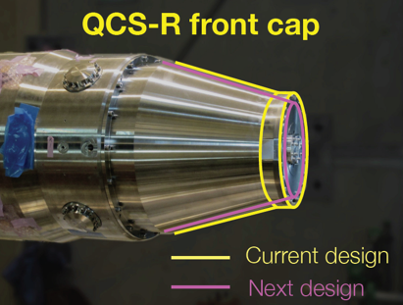
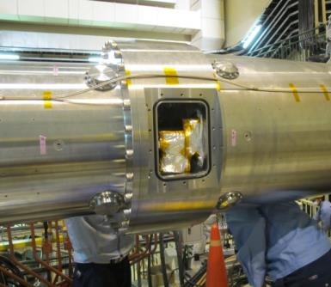
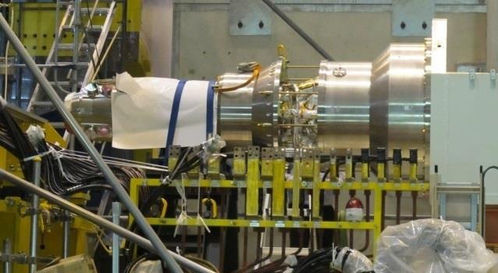
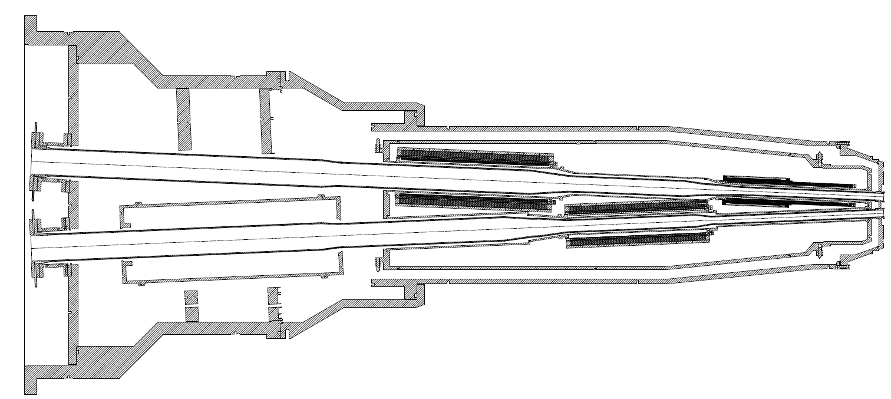
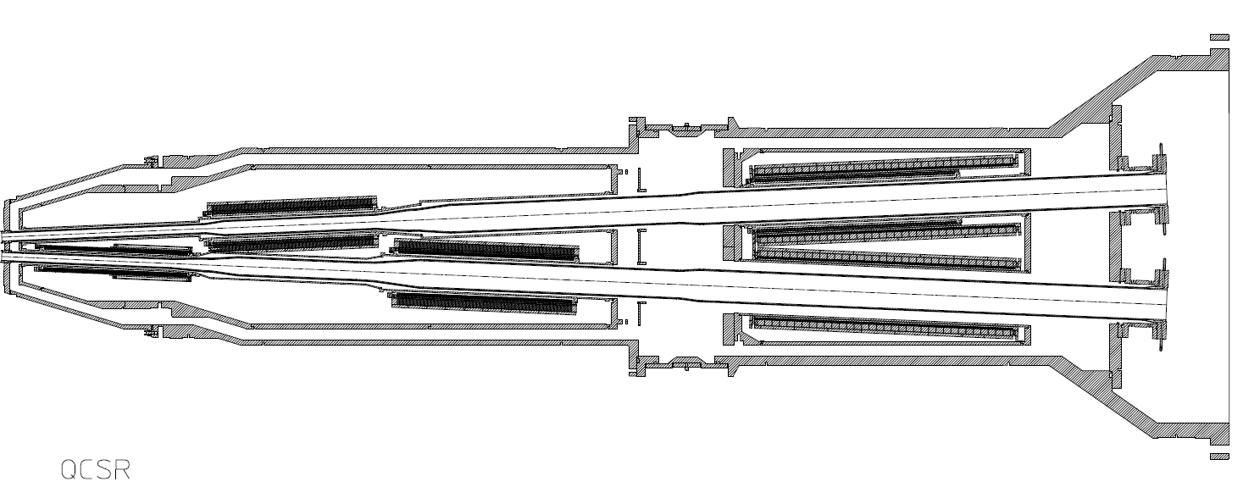
IR (Tsukuba straight section) #4
Future works
  QCS cryostat modification
    To reduce Belle II background noise, the material at the tip of QCS cryostat will be changed from W to SUS.
      QCSR front cap replacement
      QCSL front plate replacement
    To make more space for Belle II cables, the tip of QCSR cryostat will be thinner.
      QCSR cryostat modification including front cap replacement
    QCS cryostats will be disassembled for these works.
      It is necessary to shift QCS beam pipes in longitudinal direction.
IR
Tsukuba lab.
Electron beam
Positron beam
BPM feedthrough
BPM feedthrough
QCS beam pipe
QCS beam pipe
Y. Arimoto
To access QCS pipes & BPMs,
this part should be disassembled.
To access QCS pipes & BPMs, these windows should be open.
T. Oki
Y. Arimoto
QCSR front plate replacement
QCSL
QCSR front cap replacement
QCSR

Slide 12
IR (Tsukuba straight section) #5
IR
Tsukuba lab.
Remaining works in accelerator tunnel:
  Belle II maintenance & reinforcement (∼ June 2023)
  QCS cryostat modification (March 2023)
  QCS reinstallation (July ∼ August 2023)
  Concrete shield reinstallation (Sep. 2023)
All works can be completed by the end of September 2023.
  It is required to coordinate schedule with Belle II work and NLC construction.
Electron beam
Positron beam
IR (Tsukuba straight section)
JFY2022 | 2022 |  |  |  |  |  |  |  |  | 2023
 | 4 | 5 | 6 | 7 | 8 | 9 | 10 | 11 | 12 | 1 | 2 | 3
JFY2023 | 2023 |  |  |  |  |  |  |  |  | 2024
 | 4 | 5 | 6 | 7 | 8 | 9 | 10 | 11 | 12 | 1 | 2 | 3
We are here now!!
Concrete shield disassembly
QCS extraction
QCS cryostat modification
2022b run
Belle II work
QCSR cryostat leak test
Belle II maintenance & reinforcement
QCS reinstallation
Concrete shield reinstallation
Magnet & beam pipe disassembly
2023c run
2024a run
Belle II
Belle II work
maintenance & reinforcement

Slide 13
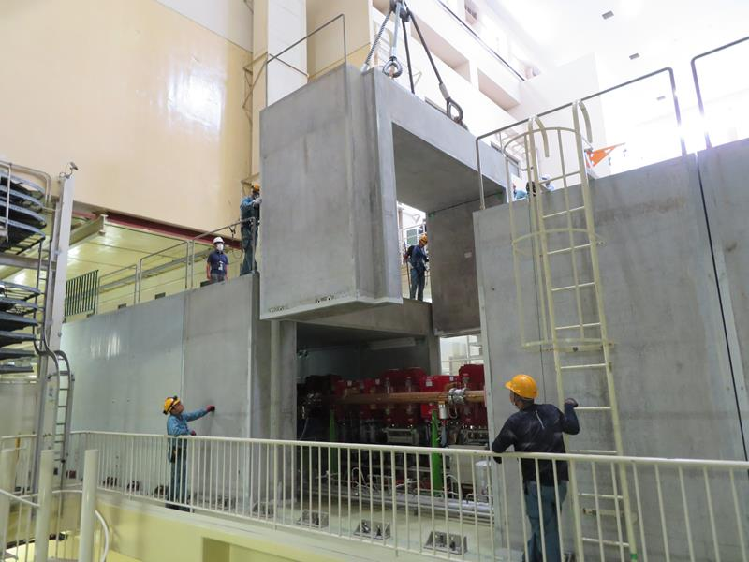
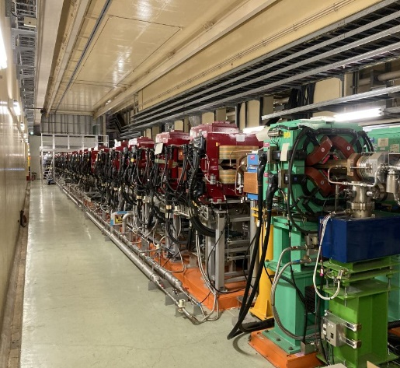
Oho straight section #1
Concrete radiation shield
D05 wiggler section
Tsukuba (Belle II)
Major work items in accelerator tunnel:
  Disassembly and reinstallation of concrete radiation shields
  NLC construction (LER)
  RF cavity replacement (LER)
  Ceiling aseismic reinforcing work
  Installation of new radiation shields
Oho lab.
D04
Oho
straight section
D05
Positron beam
S. Nakamura
Oho straight section (D05)
JFY2022 | 2022 |  |  |  |  |  |  |  |  | 2023
 | 4 | 5 | 6 | 7 | 8 | 9 | 10 | 11 | 12 | 1 | 2 | 3
JFY2023 | 2023 |  |  |  |  |  |  |  |  | 2024
 | 4 | 5 | 6 | 7 | 8 | 9 | 10 | 11 | 12 | 1 | 2 | 3
We are here now!!
RF cavity inspection
NLC construction
2022b run
Concrete shield removal
RF cavity replacement
Crane not available
Ceiling aseismic reinforcing work
NLC construction
New radiation shield installation
2023c run
2024a run
Concrete shield reinstallation

Slide 14
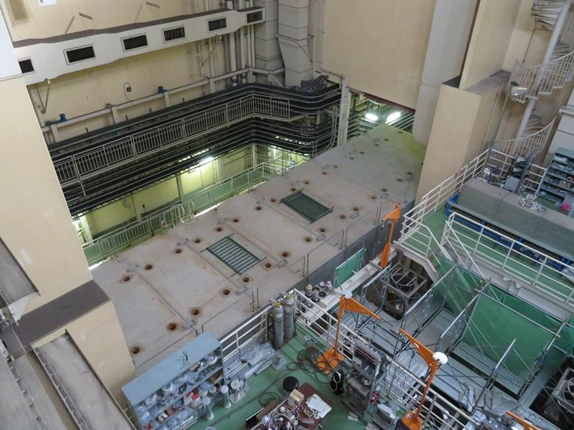
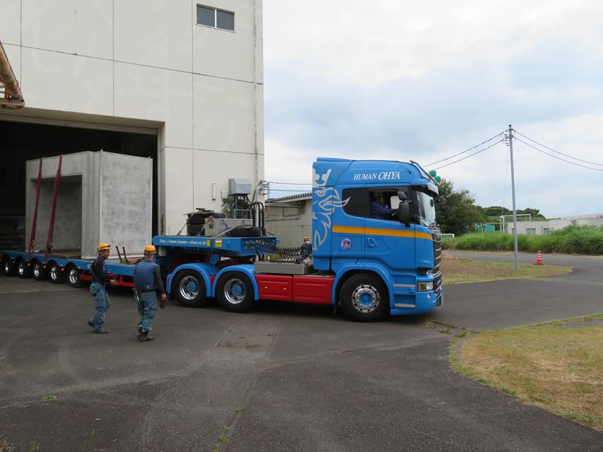
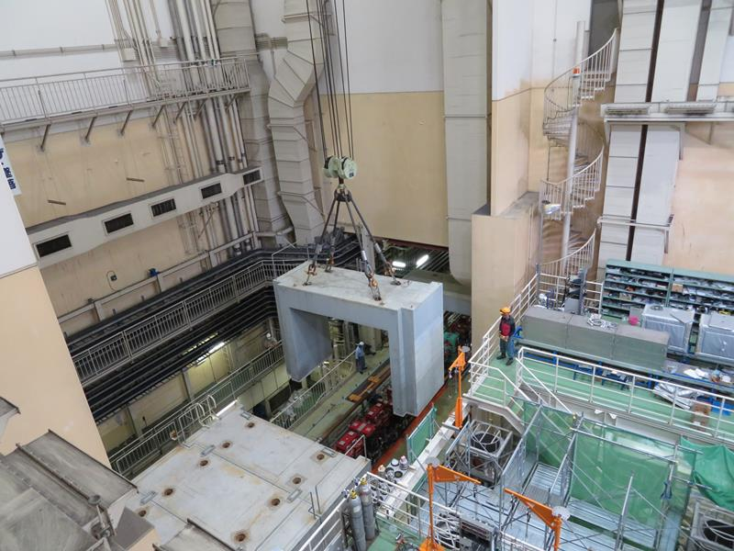
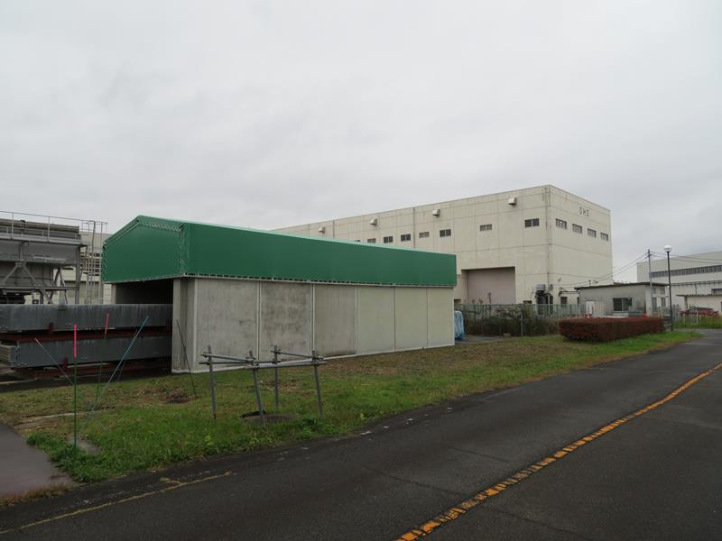
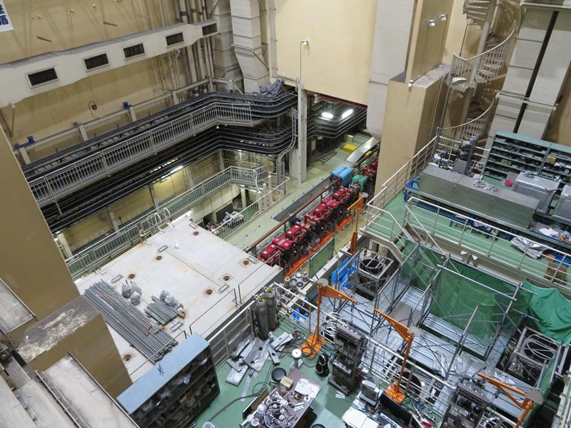
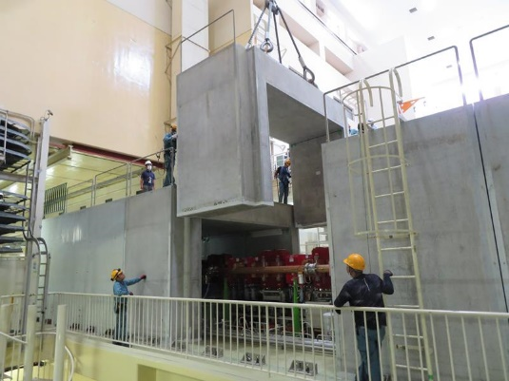
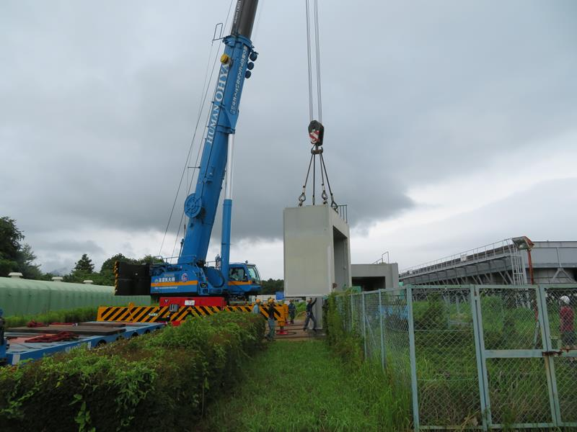
Oho straight section #2
Tsukuba (Belle II)
Concrete radiation shields disassembly (already done)
  Concrete radiation shields (6/12) were temporarily removed for NLC construction.
    Concrete shields were placed outside Oho laboratory building.
  They will be reinstalled in late August 2023.
D04
Oho
straight section
D05
Positron beam
Oho Lab.
Disassembled concrete shield
Concrete shield disassembly work

Slide 15
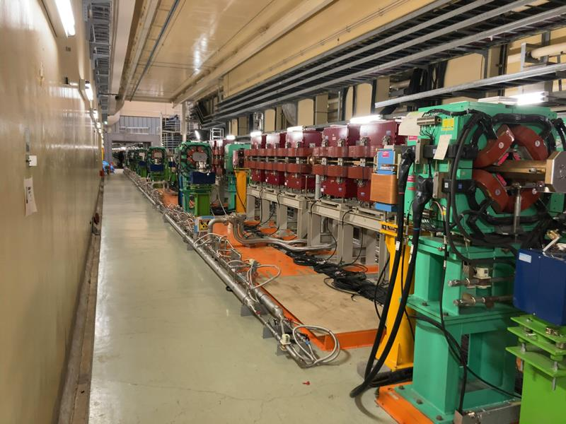
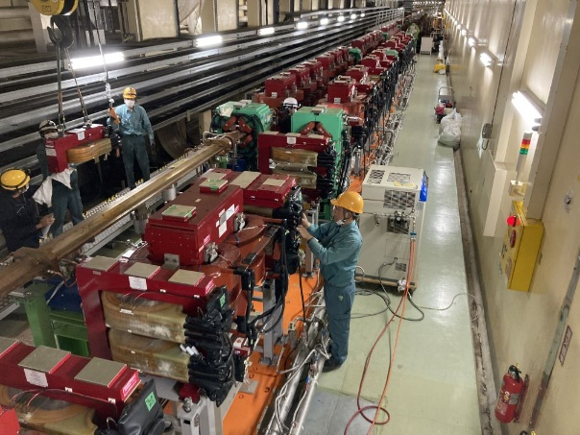




Oho straight section #3
Tsukuba (Belle II)
Wiggler magnets and beam pipe removal (already done)
  Removed wiggler magnet and cable : 50 magnets and their cables
    Double pole magnet (3 ton) : 20
    Single pole magnet (2 ton) : 10
    Half pole magnet (1.5 ton) : 20
    Cables : 3 ton
  Removed beam pipe for wiggler magnet : 10 beam pipes
  Disassembly procedure
    Removal of wiggler magnet cables
    Upper parts of wiggler magnets disassembly
    Beam pipes removal
    Upper parts of wiggler magnets reassembly
    Wiggler magnets removal
D04
Oho
straight section
D05
Positron beam
10 times
S. Nakamura
Wiggler beam pipe removal work

Slide 16





Oho straight section #4
Magnet power supply room (ground level)
Tsukuba (Belle II)
Future works for NLC construction
  Collimator relocation from D03V1
  Q magnet relocation
  Skew sextuple magnets installation
  Beam pipe installation
  Installation of new power supplies
  Magnet cabling works
Future works for radiation shielding enhancement
  Production & installation of new Pb radiation shields
  Production & installation of additional concrete shields
  Reinstallation of concrete shields
D04
Oho
straight section
D05
Positron beam
Cable pit 1
Cable pit 2
S. Nakamura
Additional concrete shields
collimator
∼10 m
Pb/SUS
∼50 mm
New Pb radiation shield
Y. Sakaki
concrete shields
Cable pit (KEKB tunnel)

Slide 17
Oho straight section #5
Remaining works in accelerator tunnel:
  NLC construction (∼ Sept. 2023)
  RF cavity replacement (Jan. ∼ Feb. 2023)
  New radiation shield installation (June ∼ Sept. 2023)
  Concrete shield reinstallation (August 2023)
All works can be completed by the end of September 2023.
  Schedule is very tight.
Tsukuba (Belle 2)
Oho lab.
D04
Oho
straight section
D05
Positron beam
Oho straight section (D05)
JFY2022 | 2022 |  |  |  |  |  |  |  |  | 2023
 | 4 | 5 | 6 | 7 | 8 | 9 | 10 | 11 | 12 | 1 | 2 | 3
JFY2023 | 2023 |  |  |  |  |  |  |  |  | 2024
 | 4 | 5 | 6 | 7 | 8 | 9 | 10 | 11 | 12 | 1 | 2 | 3
We are here now!!
2022b run
RF cavity inspection
NLC construction
Concrete shield removal
RF cavity replacement
Crane not available
Ceiling aseismic reinforcing work
NLC construction
New radiation shield installation
2023c run
2024a run
Concrete shield reinstallation

Slide 18





Others major works (excluding Linac)
T. Ishibashi
Robust collimator head (LER)
  As countermeasure against kicker-pulser misfiring and resulting destruction of collimator
    Replacement with carbon head of horizontal collimator D06H3 and relocation from D06H1 to D06H4
    Carbon head production : ∼ March 2023
    Head replacement : Spring ∼ Summer 2023
    Collimator relocation : Spring ∼ Summer 2023
New beam pipes with wider aperture at HER injection point
  For injection efficiency improvement
    New beam pipes with wider aperture & New BPM for precise measurement of injected beam
    Beam pipe production : ∼ March 2023
    Beam pipe replacement : Spring ∼ Summer 2023
    Septum baking : ∼ Summer 2023?
RF cavity modification and replacement (LER)
  For stable operation with larger beam current
    Modification : Input coupler replacement, cooling power enhancement, coaxial line modification, etc. (done)
    Cavity replacement (D05A) : January ∼ February 2023
Vacuum seal replacement at RF section (DR)
  For pressure reduction
    Replacement from elastomer gasket to metal gasket for dummy pipes (done)
DR Extraction kicker power supply modification and repair (DR)
  For stable operation
    Modification : December 2022 ∼ August 2023
And so on…
MR
Carbon collimator head
Y. Suetsugu
Beam pipe at
HER injection point
DR
DR Ext. kicker
DR RF section

Slide 19
Summary
Many upgrade works are done during Long Shutdown 1 (LS1).
  LS1 started in July 2022 and will end in September 2023. (15 months)
  “Belle II maintenance & reinforcement” and “Aseismic reinforcing works of the ceiling of the laboratory building” are also done during LS1.
Status of “IR works” & “NLC construction” were reported in detail.
  Both works are progressing as planned so far.
  It is possible to complete all works by the end of September and resume beam operation from October 2023.
  It takes much longer time for some materials and devices to be delivered, so more careful coordination of LS1 schedule until the end of LS1 is required.

Slide 20
Fin.
Thank you for your attention.
Inter-University Research Institute Corporation High Energy Accelerator Research Organization (KEK)
大学共同利用機関法人 高エネルギー加速器研究機構 (KEK)

