Slide 1
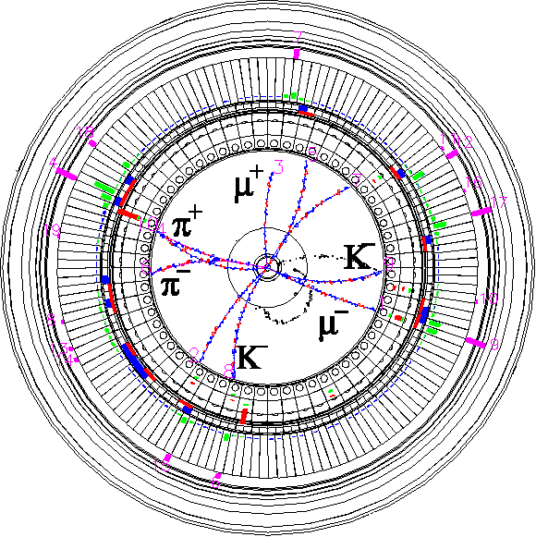


Vacuum
Collimator will be presented by Ishibashi_san (14th Dec.)
The 26th KEKB Accelerator Review Committee
13th Dec. 2022
Kyo Shibata
On behalf of KEKB Vacuum Group
Inter-University Research Institute Corporation High Energy Accelerator Research Organization (KEK)
大学共同利用機関法人 高エネルギー加速器研究機構 (KEK)

Slide 2
Contents
MR
Vacuum System Status
Major troubles (from 2019c to 2022ab*)
DR
DR Vacuum System Status
Vacuum works during LS1
Summary
*
Last vacuum status report was made by Ishibashi_san at 23rd KEKB Review (immediately after 2019ab run).

Slide 3
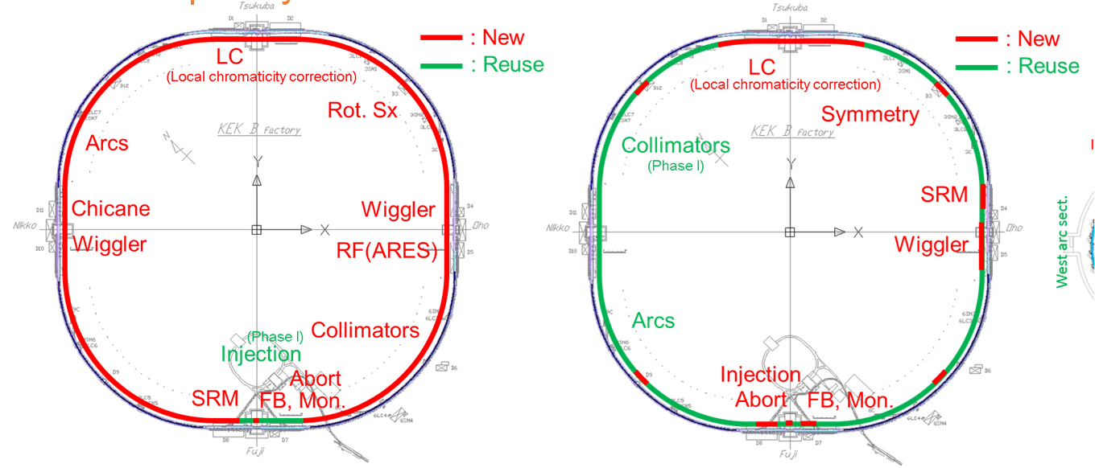
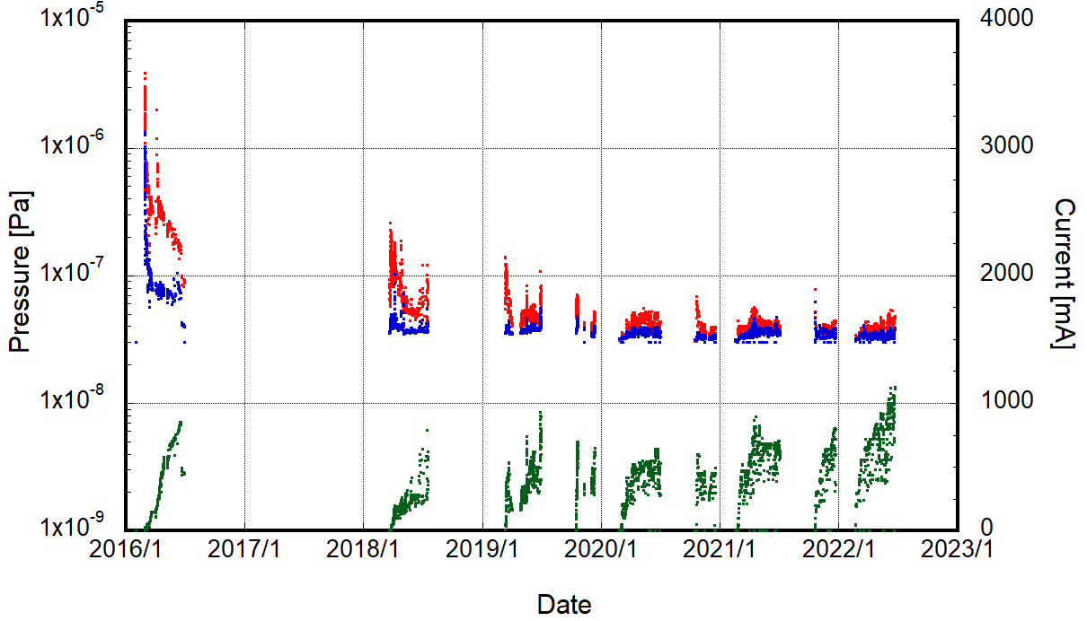
MR : HER pressure and beam current
HER pressure is decreasing steadily although beam current is increasing gradually.
Maximum beam current : 1145 mA
Pressures with beam at the end of 2022ab:
∼5×10⁻⁸ Pa (1145 mA, 2249 bunches)
Base pressure without beam: ∼3×10⁻⁸ Pa (Measurement limit in cold cathode gauges)
Pressure is approaching measurement limit.
Accurate pressure measurement is difficult.
HER pressure is lower than LER pressure due to memory effect.
See following slides.
∼82% of beam pipes, bellows chambers, and pumps were reused.
HER
Arc
Arc
Whole ring
Arc
Arc
Arc sections
∼5×10⁻⁸ Pa
(1145 mA, 2249 bunches)
Beam current
Pressure measurement limit
1145 mA
Phase1
Phase2
2019ab
2019c
2020ab
2020c
2021ab
2021c
2022ab
Phase3

Slide 4
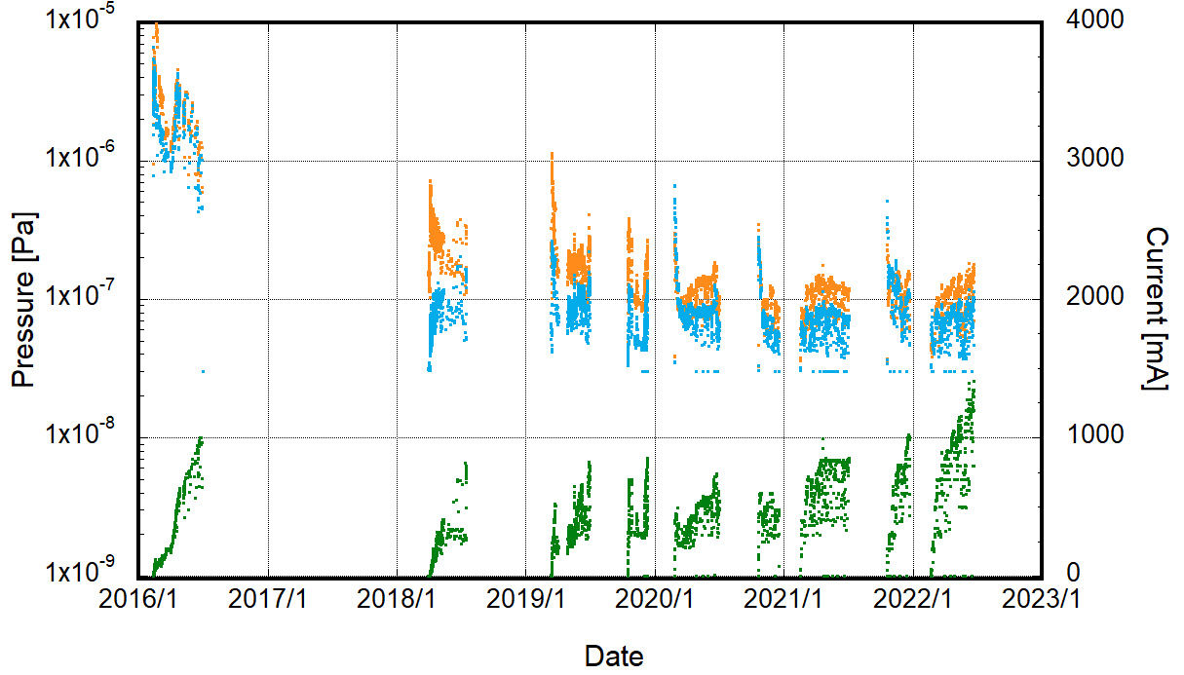
MR : LER pressure and beam current
LER pressure is decreasing steadily although beam current is increasing gradually.
Maximum beam current : 1455 mA
Pressures with beam at the end of 2022ab:
∼2×10⁻⁷ Pa (1.455 mA, 2249 bunches)
Base pressure without beam: ∼3×10⁻⁸ Pa (Measurement limit in cold cathode gauges)
LER pressure is higher than HER pressure.
∼ 93% of beam pipes and bellows chambers, and pumps were renewed. (no memory effect)
More vacuum works have been done in LER than HER.
Arc
LER
Arc
Whole ring
Arc
Arc
∼2×10⁻⁷ Pa
(1455 mA, 2249 bunches)
Arc sections
Pressure measurement limit
1455 mA
Beam current
Phase1
Phase2
2019ab
2019c
2020ab
2020c
2021ab
2021c
2022ab
Phase3

Slide 5
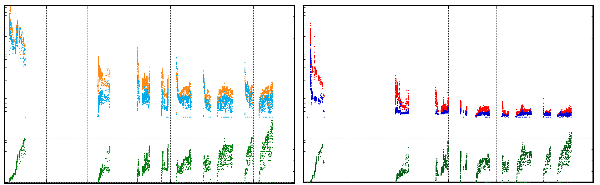
MR : pressure and beam current
Comparison between LER and HER
LER
HER
Whole ring
Whole ring
Arc sections
Arc sections
Beam current
Pressure measurement limit
Beam current
Phase1
Phase2
2019ab
2019c
2020ab
2020c
2021ab
2021c
2022ab
Phase1
Phase2
2019ab
2019c
2020ab
2020c
2021ab
2021c
2022ab
Phase3
Phase3

Slide 6
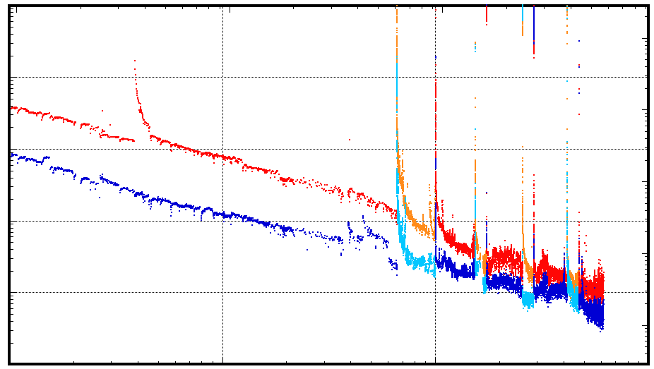
MR : HER vacuum scrubbing
For HER, Δp/ΔI and η show the vacuum scrubbing is progressing steadily.
Δp/ΔI [Pa/A]: pressure rise per unit beam current as function of the beam dose
Δp/ΔI = (3 × p_{measure} – p_{base}) / beam current
p_{measure} : pressure measured by CCG at pumping port
3 × p_{measure} : estimated pressure in beam channel
(3 is conversion factor from pressure at CCG
to pressure in the beam channel)
p_{base} : base pressure (3.0×10⁻⁸ Pa)
η [molec./photon]: photon-stimulated gas desorption rate at arc sections as a function of photon dose
η [molec./photon]= 94.7 × Δp/ΔI [Pa/A] × S [m³s⁻¹m⁻¹]
S [m³s⁻¹m⁻¹] : Pumping speed per unit length
(0.03 m³s⁻¹m⁻¹ for HER)
At the end of 2022ab (at 5.7×10²⁵ photons/m), η reached 2×10⁻⁸ molec./photon
Photon dose [photons/m]
HER
10²³
10²⁴
10²⁵
10⁻⁴
10⁻⁴
Δp/ΔI
for whole ring
10⁻⁵
10⁻⁵
10⁻⁶
Phase2
2019c
2020c
2021c
10⁻⁶
Δp/ΔI [Pa/A]
η @Arc sect. [molec./photon]
10⁻⁷
Phase1
10⁻⁷
Δp/ΔI & η
for arc sections
10⁻⁸
2×10⁻⁸
2019ab
2020ab
10⁻⁸
2021ab
2022ab
10⁻⁹
10¹
10²
10³
10⁴
Beam dose [Ah]

Slide 7
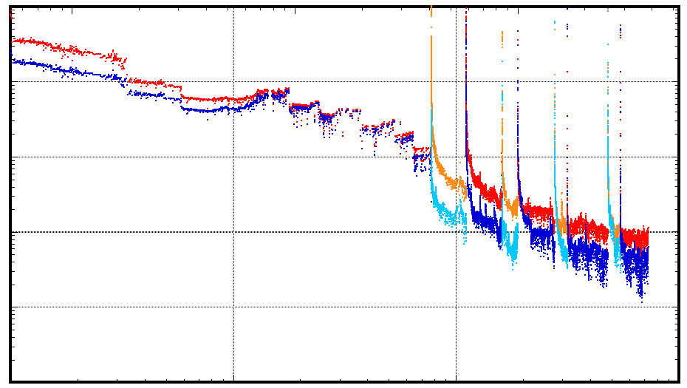

MR : LER vacuum scrubbing
For LER, Δp/ΔI and η show the vacuum scrubbing is progressing steadily, but still much larger than those for HER.
η [molec./photon]: photon-stimulated gas desorption rate at arc sections as a function of photon dose
η [molec./photon]= 166 × Δp/ΔI [Pa/A] × S [m³s⁻¹m⁻¹]
S [m³s⁻¹m⁻¹] : Pumping speed per unit length
(0.06 m³s⁻¹m⁻¹ for LER)
At the end of 2022ab (at 3.9×10²⁵ photons/m), η reached 4×10⁻⁷ molec./photon
Δp/ΔI evaluation by fitting curve:
Δp/ΔI [Pa/A] = 5.3×10⁻⁵×(beam dose)^{-0.8}
At 1×10⁴ Ah, Δp/ΔI [Pa/A] will reach 3.3×10⁻⁷ Pa/A.
Photon dose [photons/m]
LER
10²³
10²⁴
10²⁵
10⁻⁴
Δp/ΔI
for whole ring
Phase2
10⁻⁵
2019c
2020c
2021c
10⁻⁴
10⁻⁶
10⁻⁵
Δp/ΔI [Pa/A]
Δp/ΔI & η
for arc sections
η @Arc sect. [molec./photon]
Phase1
10⁻⁷
10⁻⁶
4×10⁻⁷
2019ab
3.3×10⁻⁷
10⁻⁸
2020ab
10⁻⁷
2021ab
2022ab
10⁻⁹
10⁻⁸
10¹
10²
10³
10⁴
Beam dose [Ah]
$$\frac{∆p}{∆I}=5.3×{10}^{−5}×{\left(Beam dose\right)}^{−0.8}$$

Slide 8
MR : vacuum scrubbing
Comparison between LER and HER
10⁻⁴
10⁻⁴
LER
HER
10⁻⁵
10⁻⁵
10⁻⁶
10⁻⁶
Δp/ΔI [Pa/A]
Δp/ΔI [Pa/A]
10⁻⁷
10⁻⁷
10⁻⁸
10⁻⁸
10⁻⁹
10⁻⁹

Slide 9
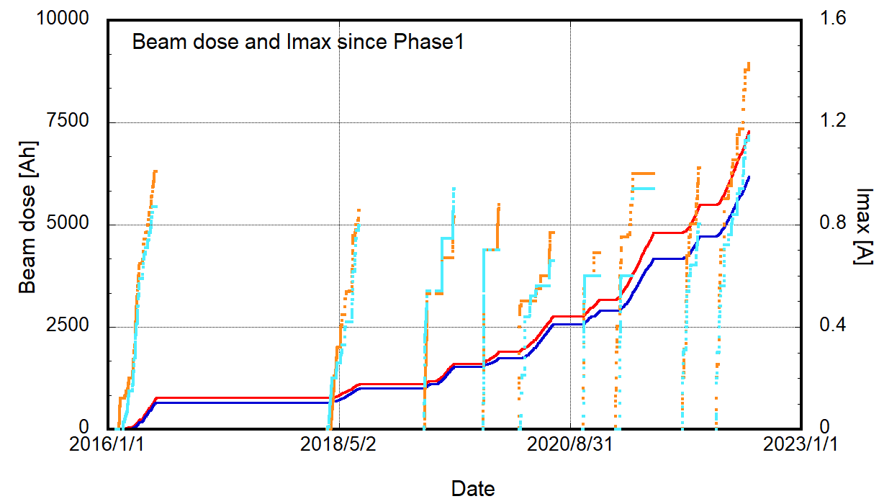

MR : maximum beam current and beam dose
2022ab
Beam dose during Phase3 2022ab
HER : ∼1450 Ah
LER : ∼1800 Ah
∼122 days
∼ 2.3×10⁻³ months/Ah
It will take ∼2.3 months to accumulate 1000 Ah more.
It will take ∼6.2 months more to accumulate 10⁴ Ah in total and reach ∼3.3×10⁻⁷ Pa/A.
LER I_{max} : 1455 A
∼1800 Ah during 2022ab
HER I_{max} : 1145 A
∼1450 Ah during 2022ab
LER total beam dose : ∼7300 Ah
Phase1
Phase3 2019ab
2021ab
2021c
HER total beam dose : ∼6200 Ah
2019c
Phase2
2020ab
2020c
For LER
More 6.2 months are required to accumulate 10⁴ Ah in total.
10⁻⁴
LER
10⁻⁴
10⁻⁵
10⁻⁵
η @Arc sect. [molec./photon]
10⁻⁶
10⁻⁶
Δp/ΔI [Pa/A]
10⁻⁷
10⁻⁷
3.3×10⁻⁷
10⁻⁸
10⁻⁸
10⁻⁹
10¹
10²
10³
10⁴
Beam dose [Ah]

Slide 10
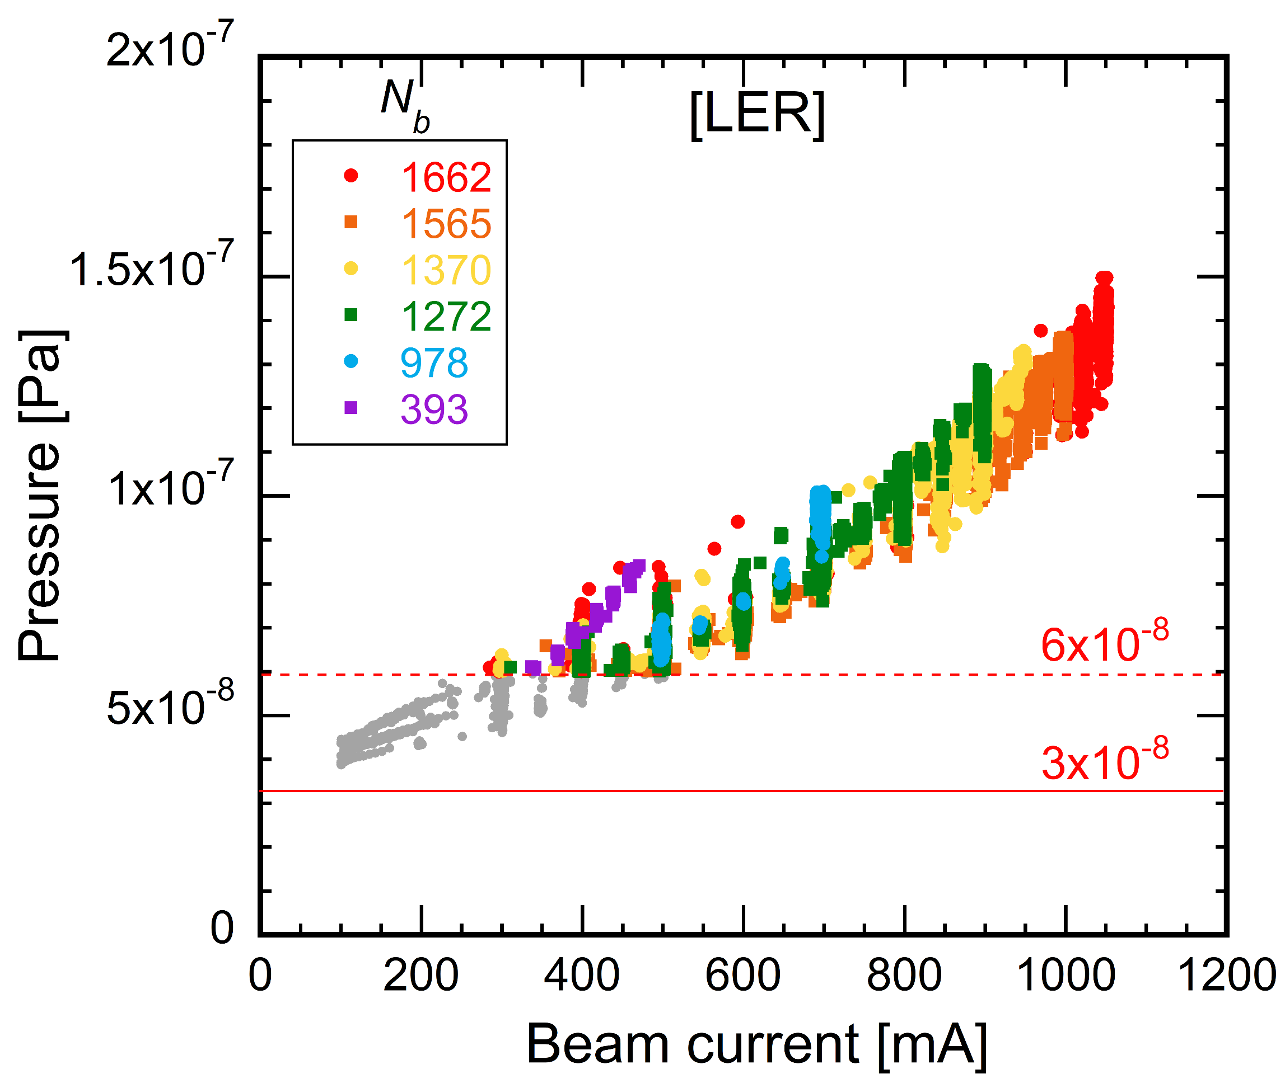
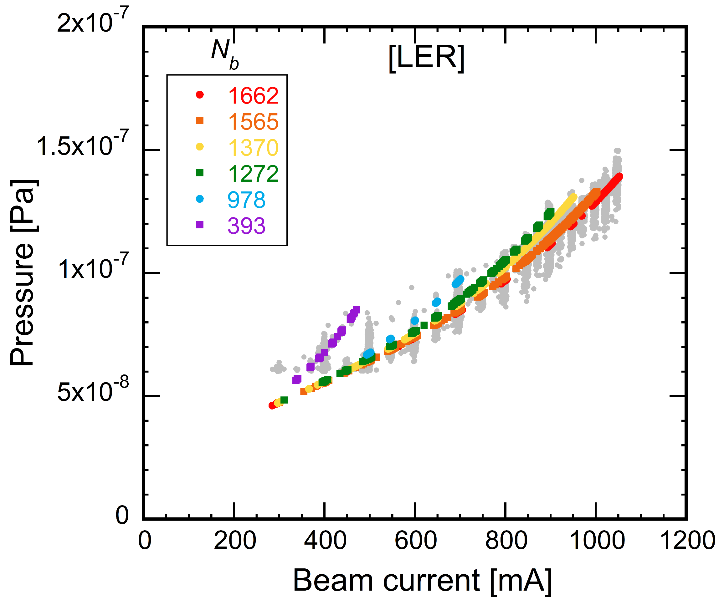
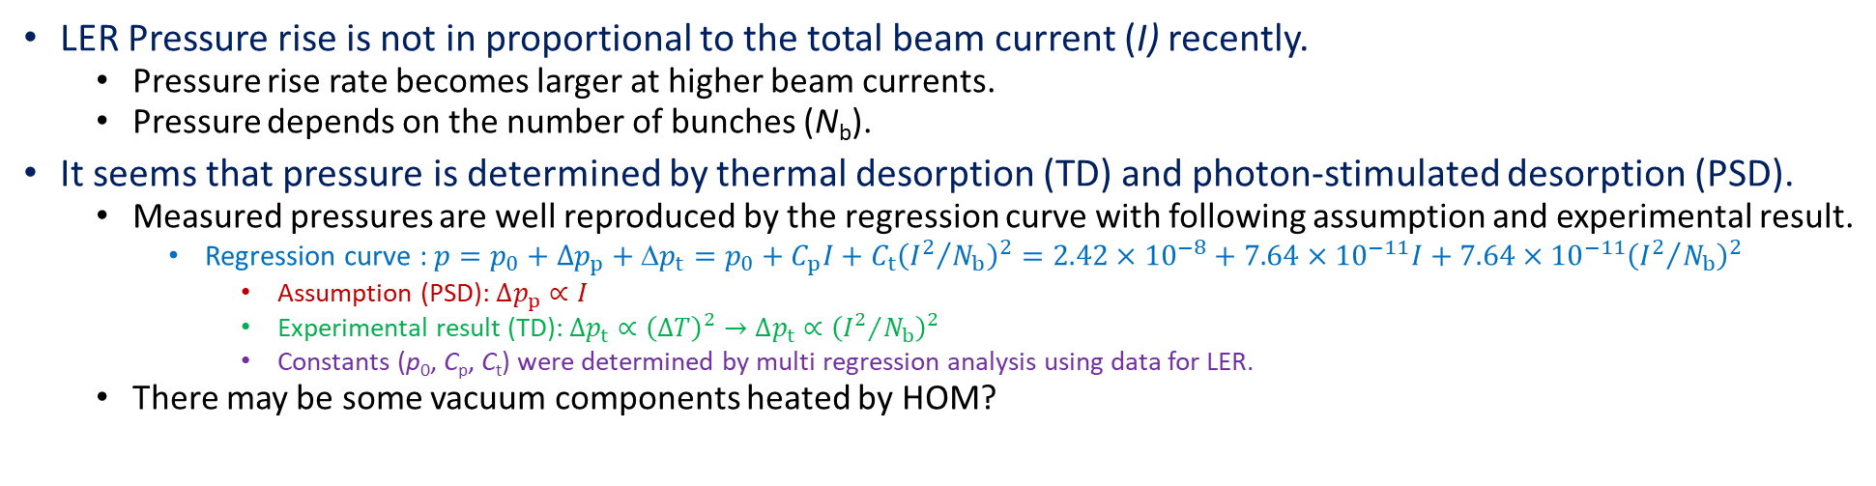
MR : beam current dependence of pressure
LER Pressure rise is not in proportional to the total beam current (I) recently.
Pressure rise rate becomes larger at higher beam currents.
Pressure depends on the number of bunches (N_{b}).
It seems that pressure is determined by thermal desorption (TD) and photon-stimulated desorption (PSD).
Measured pressures are well reproduced by the regression curve with following assumption and experimental result.
Regression curve : $p=p_{0}+∆p_{p}+Δp_{t}=p_{0}+C_{p}I+C_{t}{\left({I^{2}}/{N_{b}}\right)}^{2}=2.42×{10}^{−8}+7.64×{10}^{−11}I+7.64×{10}^{−11}{\left({I^{2}}/{N_{b}}\right)}^{2}$
Assumption (PSD): $∆p_{p}∝I$
Experimental result (TD): $∆p_{t}∝{\left(∆T\right)}^{2}→$ $∆p_{t}∝{\left({I^{2}}/{N_{b}}\right)}^{2}$
Constants (p₀, C_{p}, C_{t}) were determined by multi regression analysis using data for LER.
There may be some vacuum components heated by HOM?
Measurement
Calculation by regression curve
Y. Suetsugu

Slide 11
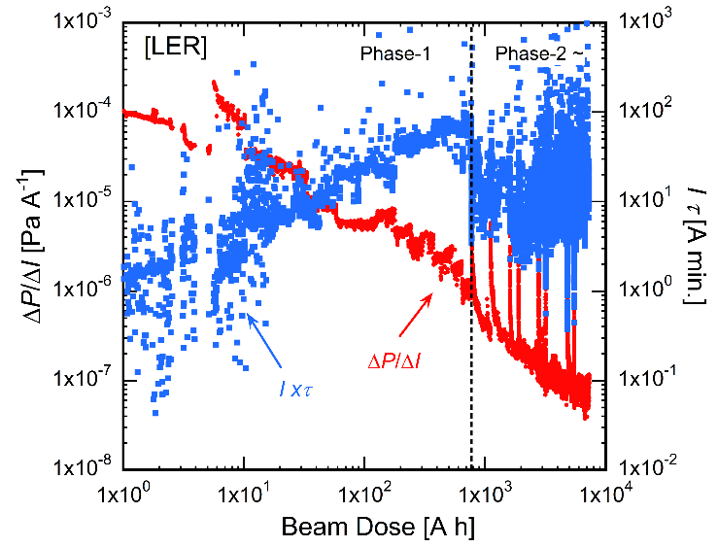
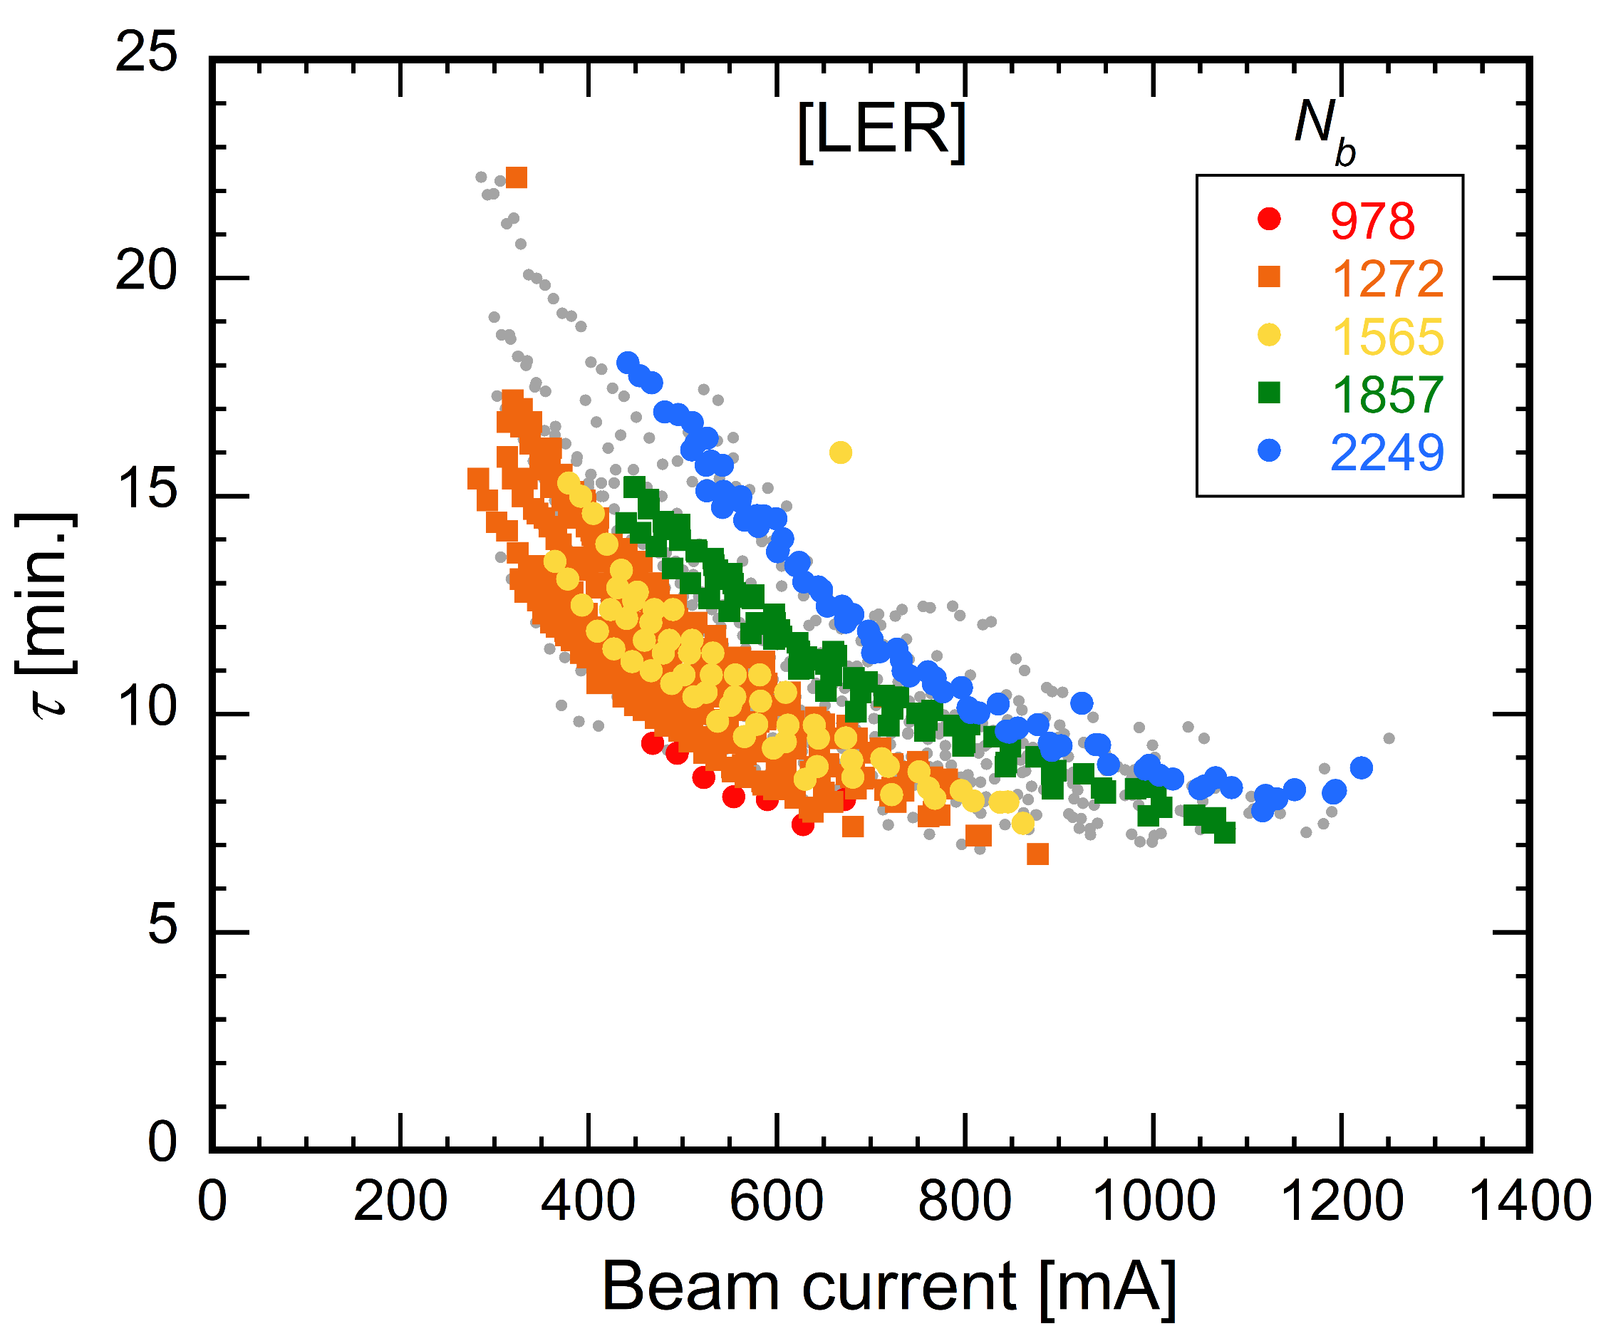
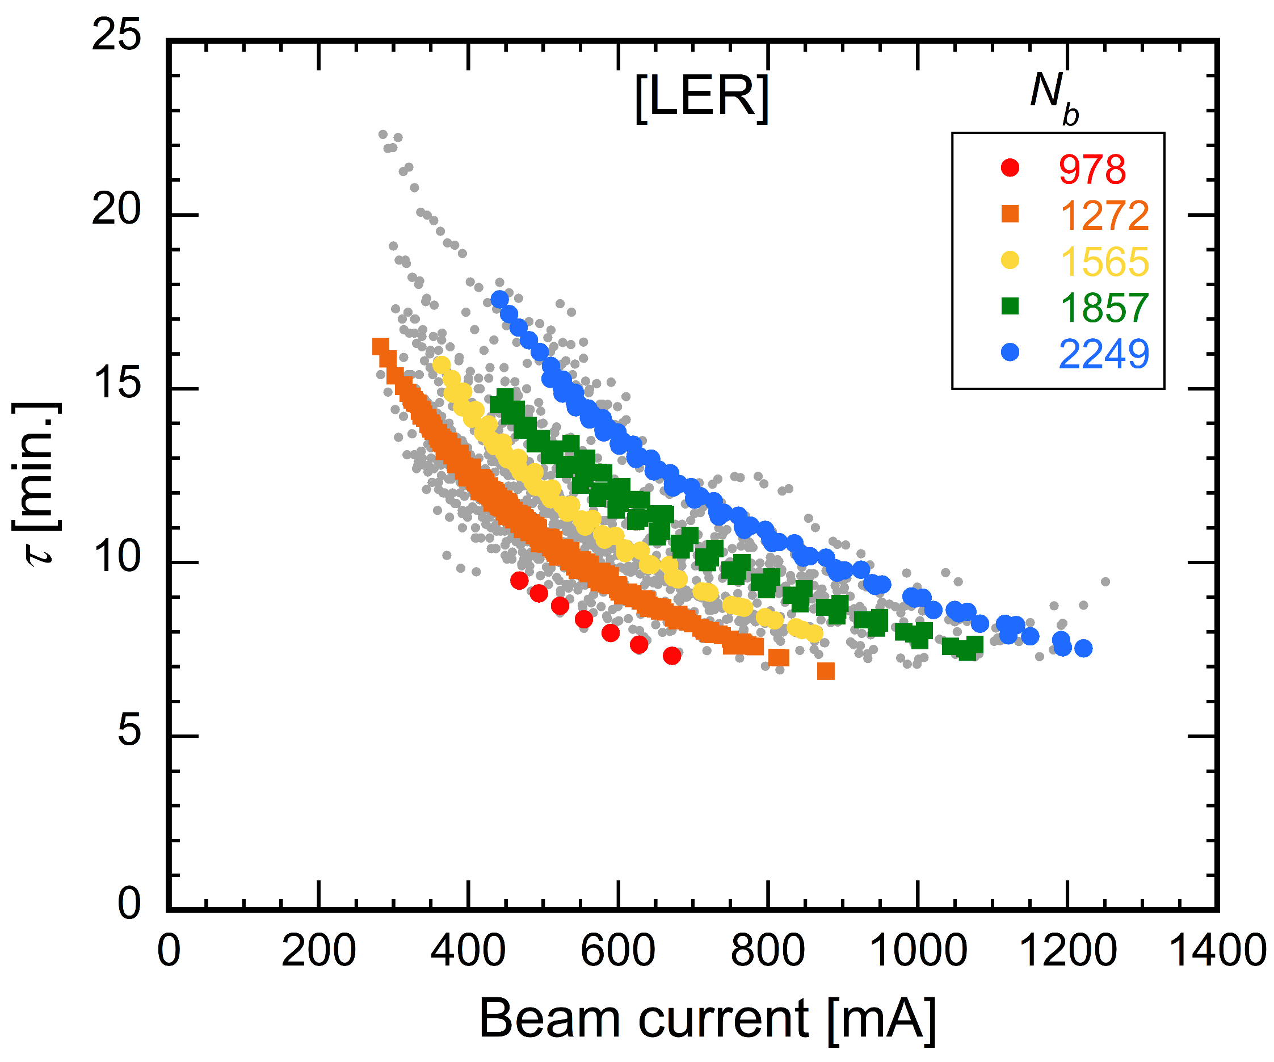
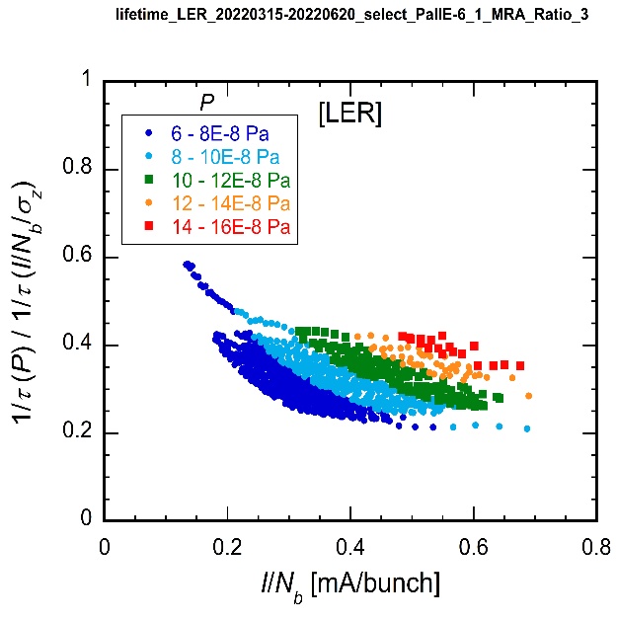
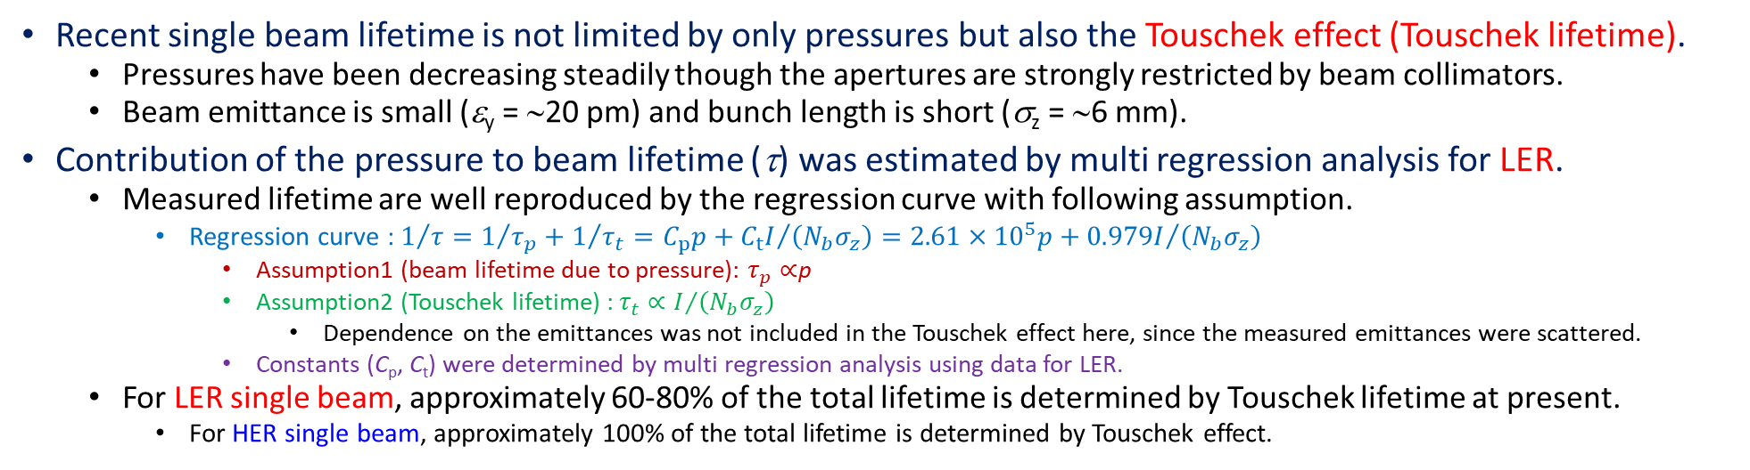
MR : contribution to beam lifetime
Recent single beam lifetime is not limited by only pressures but also the Touschek effect (Touschek lifetime).
Pressures have been decreasing steadily though the apertures are strongly restricted by beam collimators.
Beam emittance is small (ε_{y} = ∼20 pm) and bunch length is short (σ_{z} = ∼6 mm).
Contribution of the pressure to beam lifetime (τ) was estimated by multi regression analysis for LER.
Measured lifetime are well reproduced by the regression curve with following assumption.
Regression curve : $1/τ=1/{τ_{p}}+1/{τ_{t}}=C_{p}p+{C_{t}I}/{\left(N_{b}σ_{z}\right)}=2.61×{10}^{5}p+{0.979I}/{\left(N_{b}σ_{z}\right)}$
Assumption1 (beam lifetime due to pressure): $τ_{p}∝$p
Assumption2 (Touschek lifetime) : $τ_{t}∝I/{\left(N_{b}σ_{z}\right)}$
Dependence on the emittances was not included in the Touschek effect here, since the measured emittances were scattered.
Constants (C_{p}, C_{t}) were determined by multi regression analysis using data for LER.
For LER single beam, approximately 60-80% of the total lifetime is determined by Touschek lifetime at present.
For HER single beam, approximately 100% of the total lifetime is determined by Touschek effect.
ΔP/ΔI and Iτ vs. beam dose
τ vs. I for different N_{b}
Ratio of 1/τ_{p} to 1/τ_{t} vs. bunch current
Y. Suetsugu
Measurement
Calculation by regression curve

Slide 12
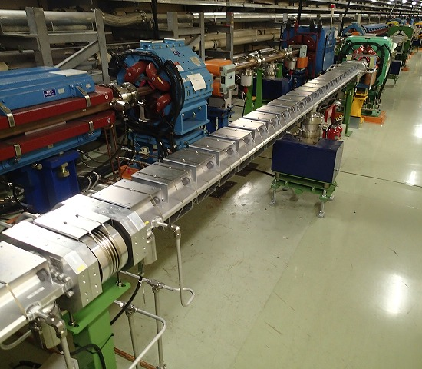
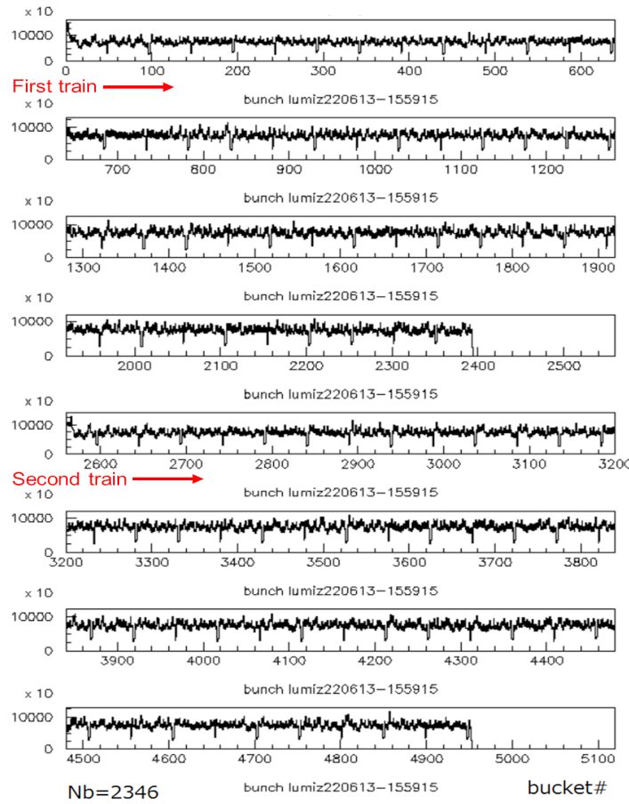
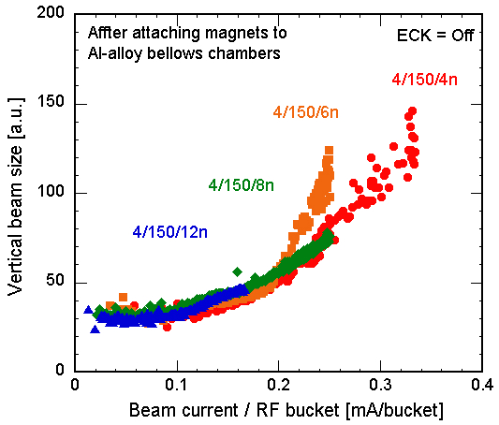
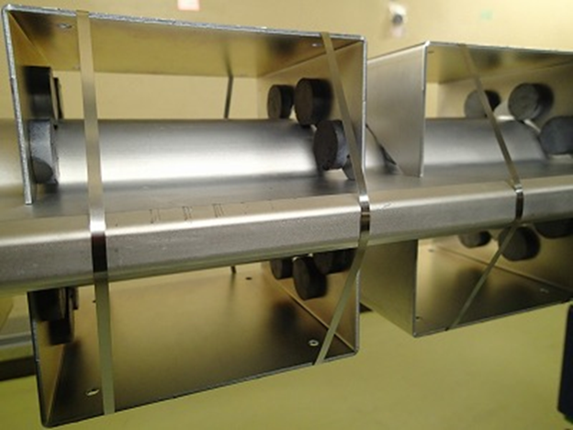
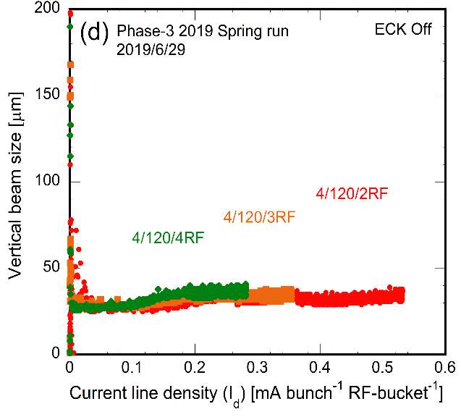
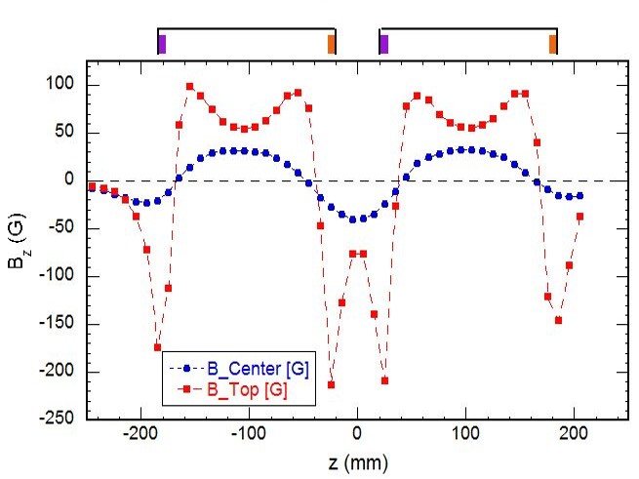
MR : electron cloud effect
At present, any obvious signs of electron cloud effect are not observed in usual collision experiments.
Current linear density is now over 0.53 mA/bunch/RF-bucket
Bunch by bunch luminosity along a train by ADLM (S. Uehara)
Magnet units attached to beam pipes
Y. Suetsugu
Vertical beam size vs. current density in Phase-1
Vertical beam size vs. current density in Phase-3
Phase-1
Phase-3
>0.53
~0.2

Slide 13
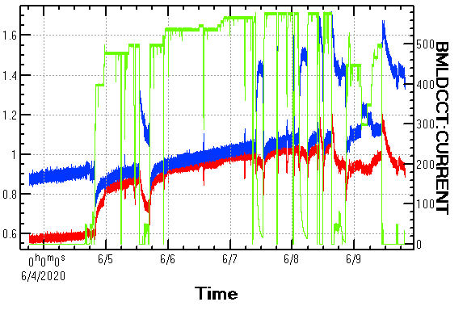
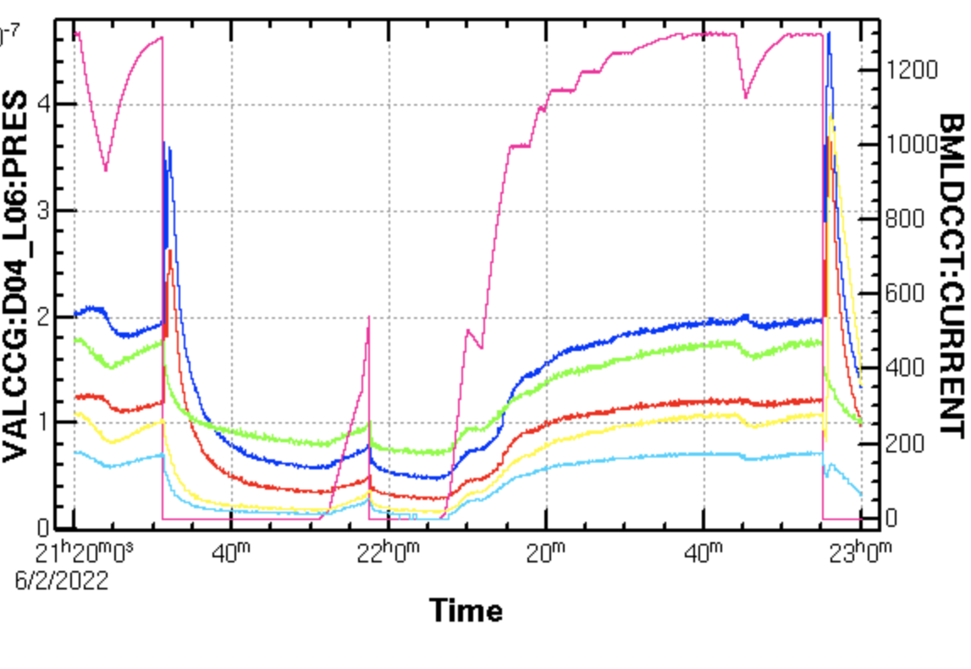
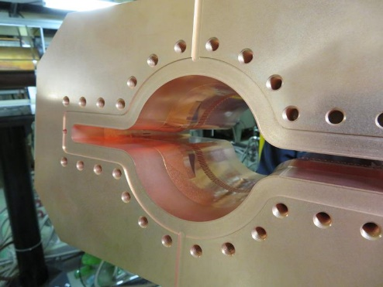
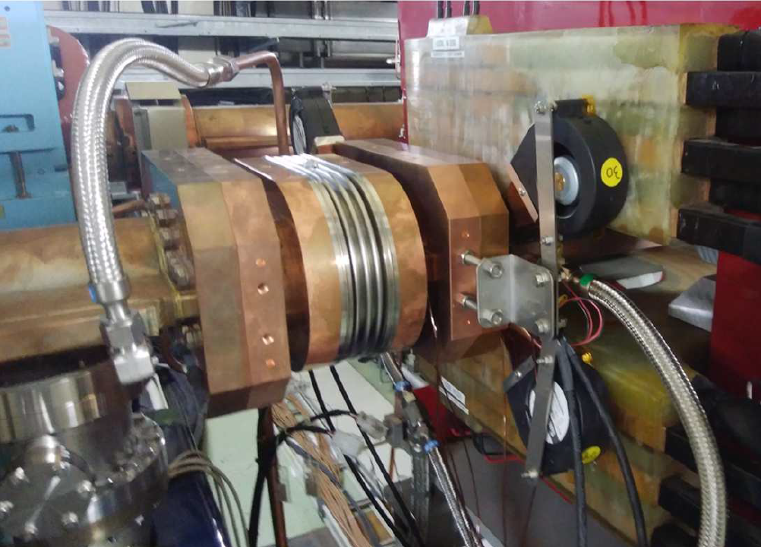
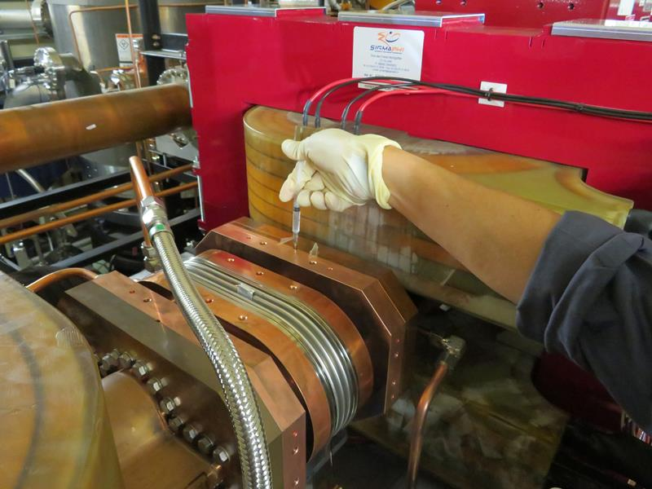
MR : major troubles #1
Beam current
Beam current
Vacuum leak (from 2019c) #1&2:
Vacuum leaks at LER D04 wiggler sections (2020ab, 2022ab)
Abnormal pressure rises due to vacuum leak were observed immediately after beam abort.
Possible cause was thermal expansion due to strong SR irradiation.
Pressure was still low enough to continue beam operation.
Vacuum leak was stopped by “flange refastening” and “Vac seal injection”.
We tried refastening the suspect flanges without identifying the leak location on maintenance day.
It was confirmed that vacuum leakage had occurred at flange connection.
Vac seal was injected into the flange connection.
Countermeasure
Bellows chambers were replaced to new ones with SR masks.
Air and water cooling were reinforced.
See page 24.
pressure
pressure
Pressure [×10⁻⁷ Pa]
Beam current [mA]
Pressure [×10⁻⁷ Pa]
Beam current [mA]
Vacuum leak during 2020ab
Vacuum leak during 2022ab
SR mask
Air cooling fan
Vac seal injection
Bellows chamber w/ SR masks
Air cooling reinforcement

Slide 14
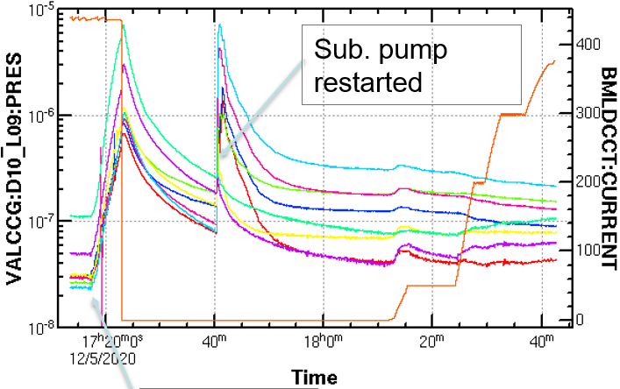
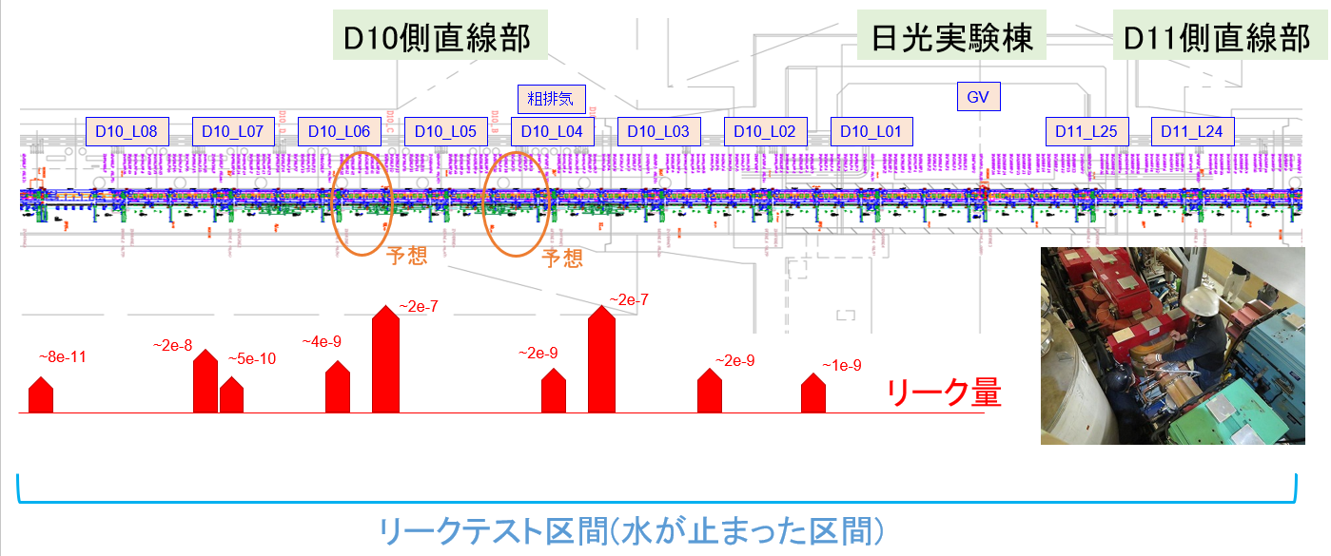
MR : major troubles #2
Vacuum leak (from 2019c) #3:
Vacuum leaks at LER D10 wiggler section (2020c)
Cooling water stopped due to pump failure, but beam operation was continued for a few minutes.
“Low water flow” alarm did not issue beam abort request because flow meters often failed.
At final, beam abort was requested by “high temperature & low water flow” alarm.
After cooling water flow was made by sub pump, beam operation was resumed.
Some vacuum gauges at D10 wiggler section showed higher pressures than usual.
Pressures were still low enough to continue beam operation.
Leak test was performed on the next maintenance day.
It was found that vacuum leaks occurred at 9 flange connections.
Vacuum leaks were stopped by “flange refastening” and “Vac seal injection”.
Countermeasure
Interlock modification
When several “Low water flow” alarms are issued simultaneously, beam abort is requested.
Water flow rate of main pipe was newly monitored by vacuum group.
When cooling water flow rate of main pipe drops, beam abort is requested.
Beam current
Pressure [Pa]
Beam current [mA]
Pump failed
D10 wiggler section
D11 wiggler section
beam
Nikko Lab.
Suspected leak point
Leak rate
[Pam³s⁻¹]
Cooling water stopped
Y. Suetsugu

Slide 15
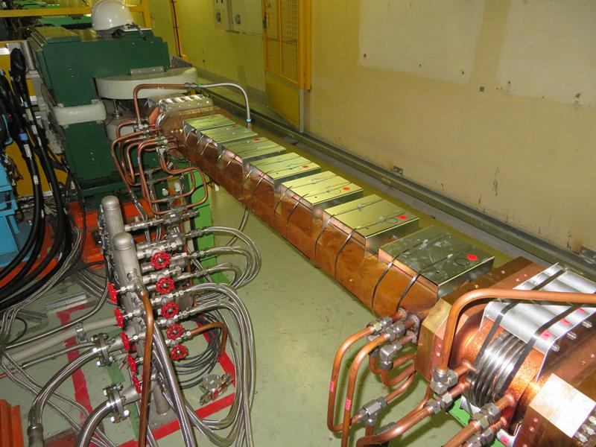
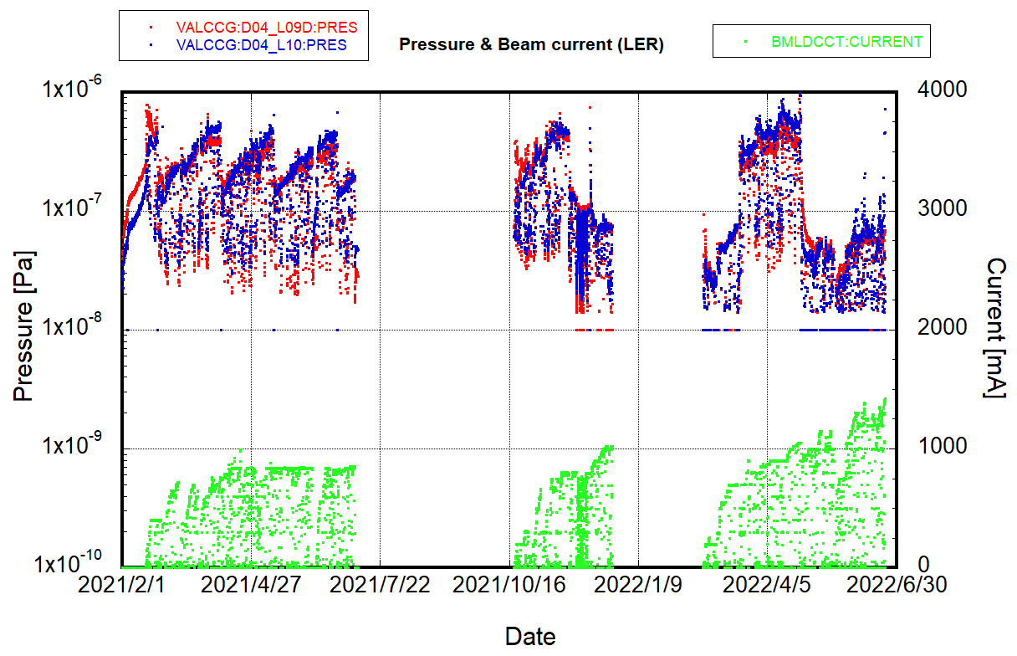
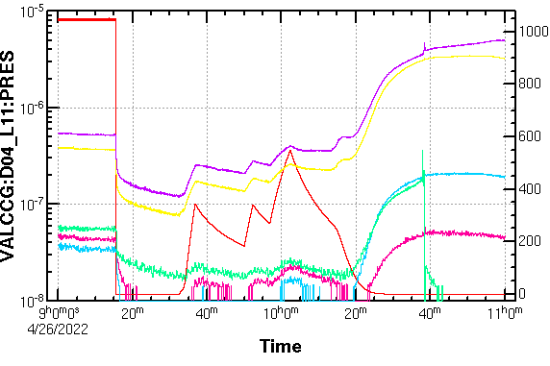
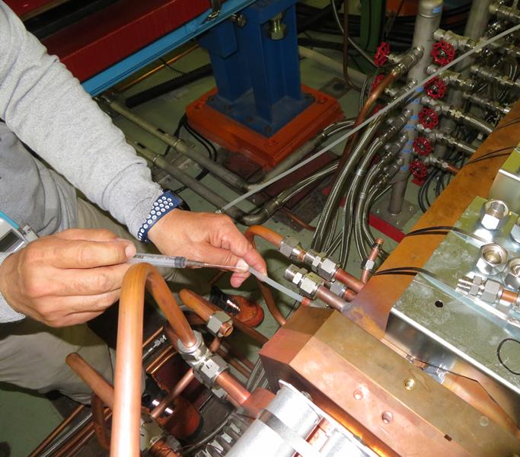
MR : major troubles #3
NEG conditioning
Water drain
Re-increase
Vac seal
Vacuum leak (from 2019c) #4:
Gradual pressure increase at LER D04 weak bend section
Pressure increase had been observed since the start of 2021 run.
NEG pump conditioning was effective to temporarily reduce pressure, but pressure gradually increased again.
Vacuum leak test had been carried out several times, but no vacuum leak had been detected.
Pressure dropped when cooling water was drained from cooling channel for leak test.
Leak test showed no vacuum leaks from the cooling channel.
Abnormal pressure increase stopped after that.
Abnormal pressure re-increased during 2022ab.
Vacuum leak from cooling channel at LER D04 weak bend section
Large pressure increase was observed with low beam current during 2022ab.
At final, vacuum leak from the cooling channel was detected.
“Vac seal” was injected into the cooling channel by an injector.
Beam current
Beam current
pressure
Vac seal injection
Pressure [Pa]
Beam current [mA]

Slide 16
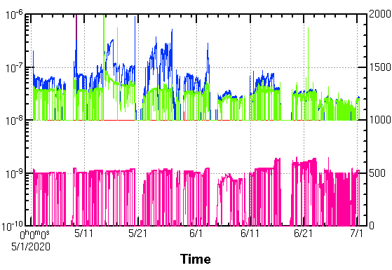
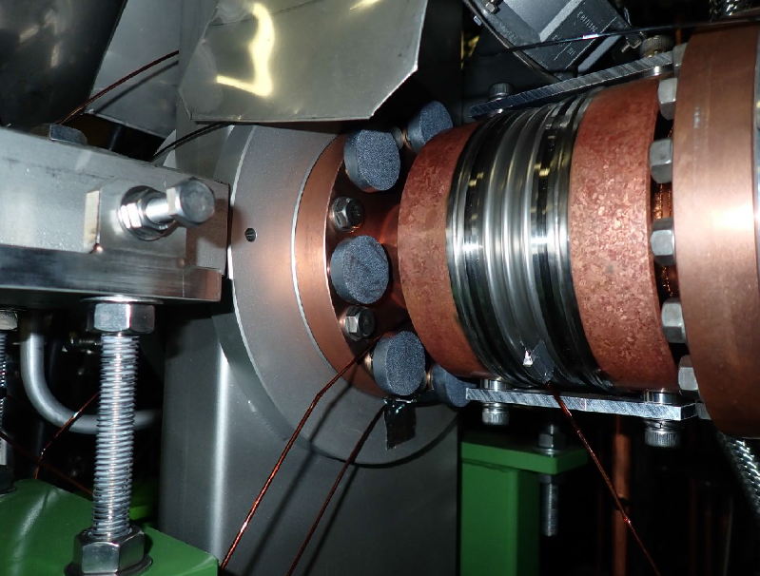
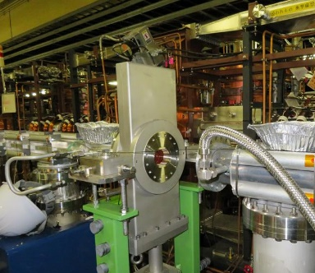
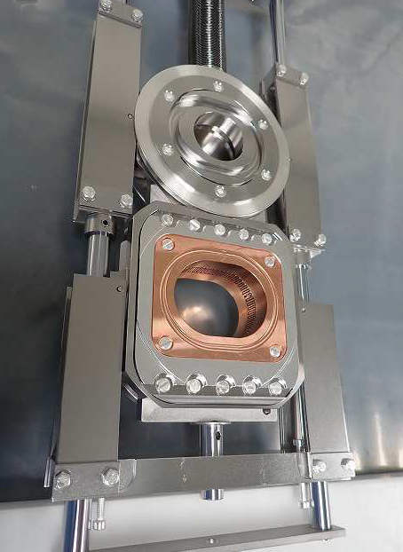
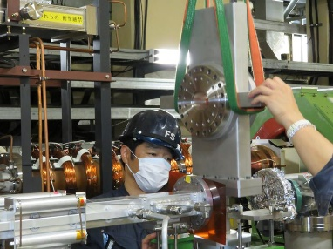
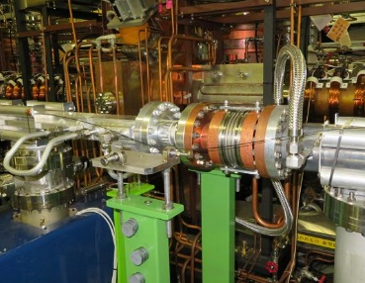
MR : major troubles #4
Abnormal pressure rise #1
Abnormal pressure rise near gate valve was observed at HER inj. section (2020ab).
Pressure did not depend on beam current.
Abnormal pressure rise seemed to have improved.
Cause of improvement is still unknown.
Countermeasures were taken, but their effects were not clear.
Permanent magnets to suppress multipactor effect.
Air cooling reinforcement
Possible cause of abnormal pressure rise is abnormal heating of gate valve.
During summer shutdown after 2020ab run, the suspected gate valve was replacement with dummy pipe.
No abnormal pressure rise has been observed after that.
Removed gate valve was disassembled and checked, but no obvious abnormality was found.
Is there small gap at opening and closing mechanism of gate valve? (See next slide)
Air cooling fan
Pressure [Pa]
Beam current [mA]
Beam current
Permanent magnet
Disassembled gate valve

Slide 17
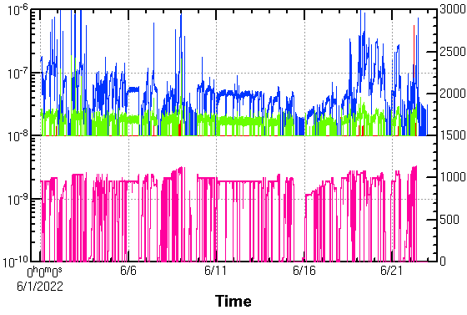
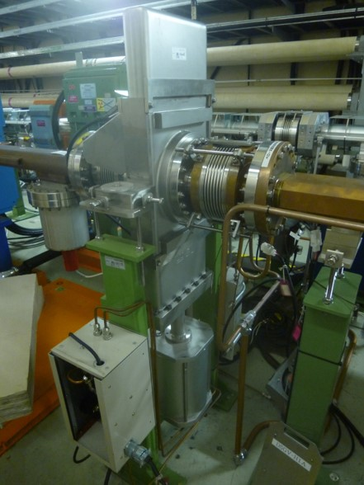
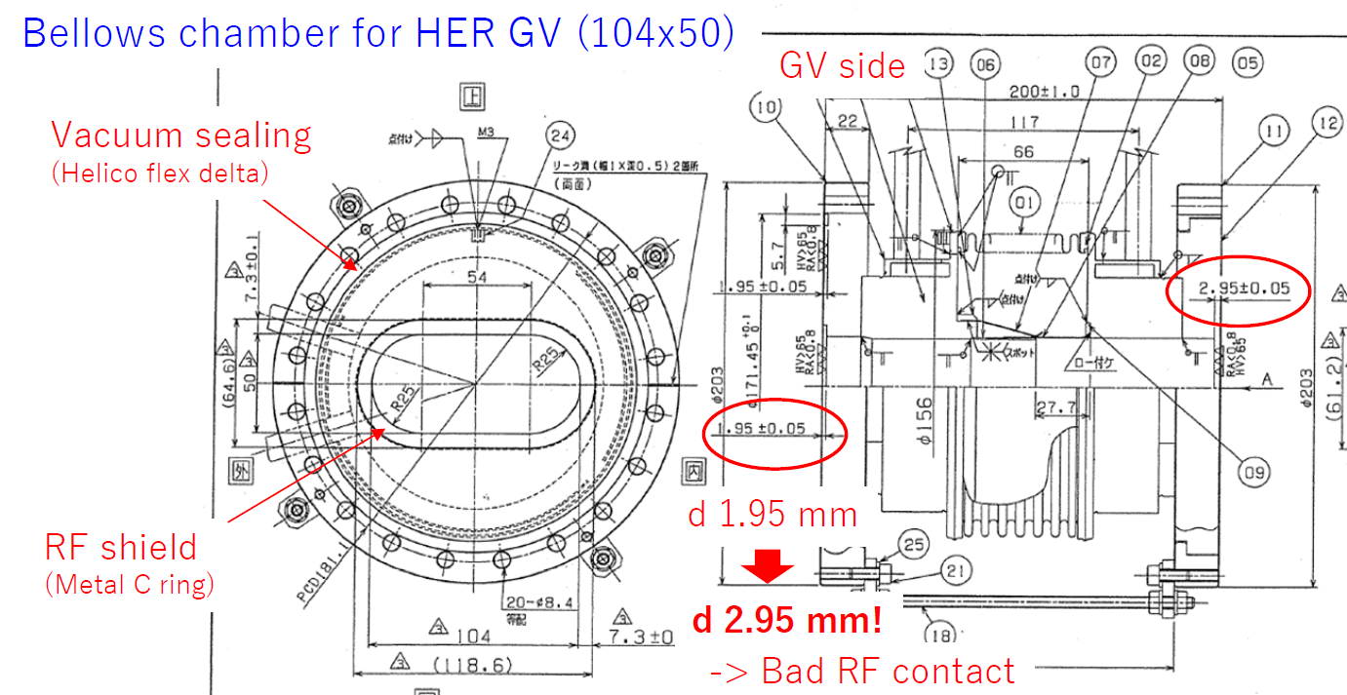
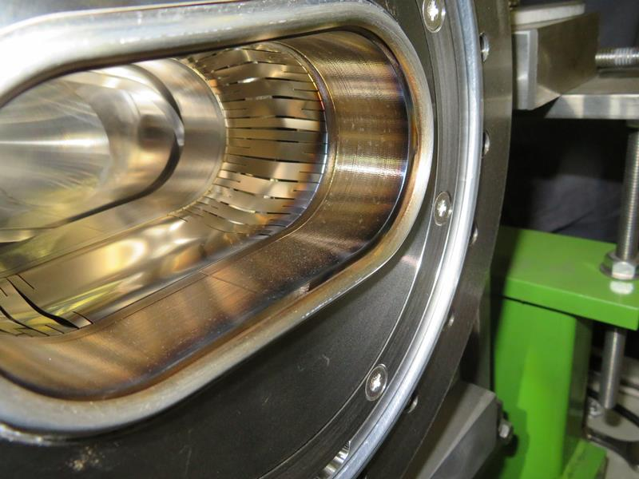
MR : major troubles #5
Abnormal pressure rise #2:
Abnormal pressure rise near gate valve was observed at HER D12 arc section (2022ab).
Abnormal temperature rise of gate valve was also observed.
During LS1, bellows chambers connected to the gate valve were disassembled for internal check.
It was found that some parts were discolored probably due to heating and/or discharge.
RF shield of the gate valve
RF contact installed between the gate valve and bellows chamber
It was also found that groove for the RF contact on the bellows chamber was 1 mm deeper than design.
Possible cause is small gap due to poor contact between gate valve and bellows chamber.
Gate valve and bellows chamber were replaced with new ones.
It was confirmed that the groove for the RF contact on the bellows chamber is correct.
It was confirmed that the pressure and temperature of other HER gate valves are normal.
Pressure at this gate valve was a little similar to pressure at the gate valve at HER inj. section. (see previous page)
Gate valve at HER inj. Section had a similar problem?
M. Shirai
Gate valve
Pressure [Pa]
Beam current [mA]
Beam current
Bellows chamber
RF contact
Vacuum seal
Y. Suetsugu

Slide 18
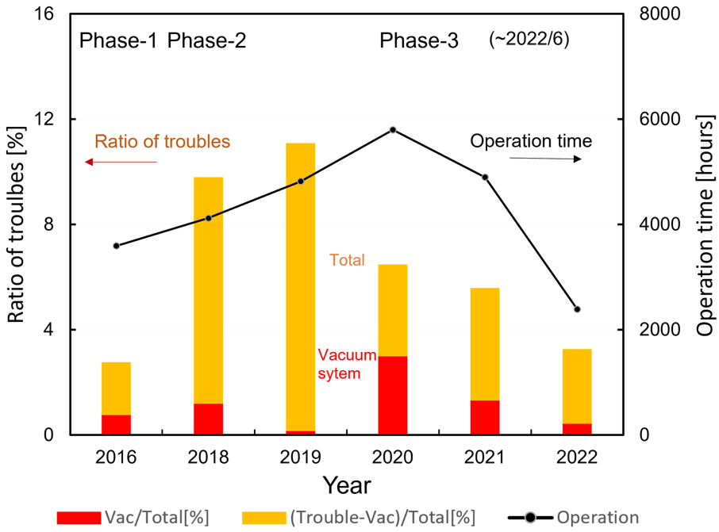
MR : major troubles #6
Troubles of vacuum system are decreasing:
The ratio of troubles of vacuum system was less than 4%.
Main troubles are repairs of vacuum leaks and exchanges of damaged vacuum components.
Total operation time, the ratio of no-operation time resulted from troubles to the total operation time, and those related to vacuum system
Y. Suetsugu

Slide 19
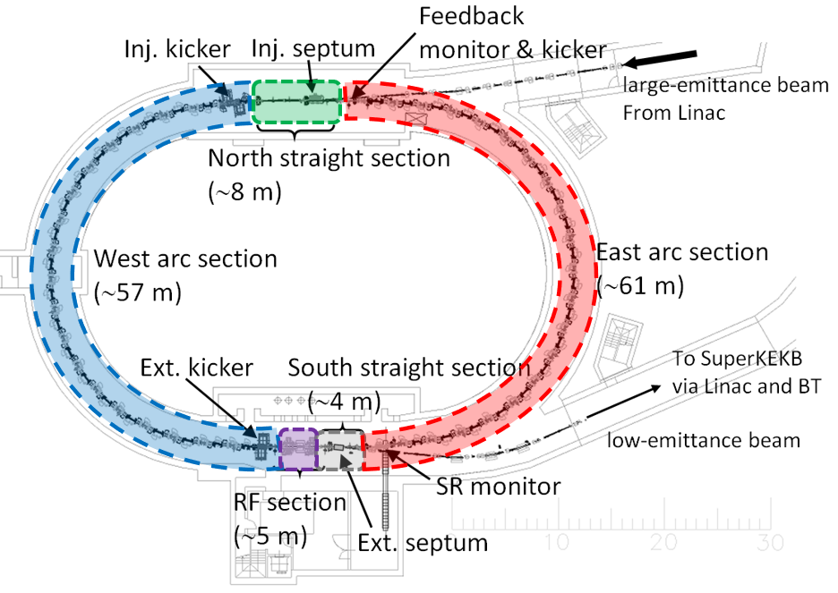
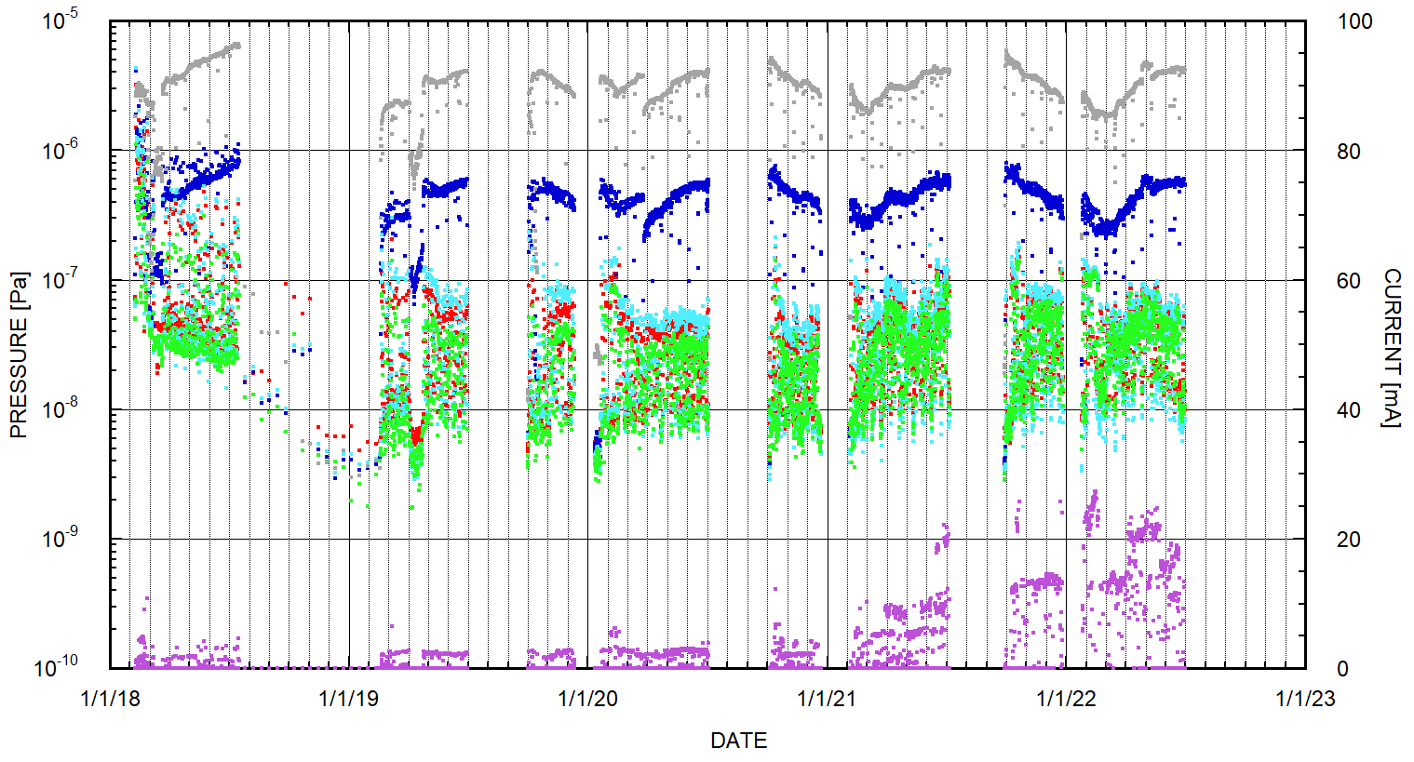
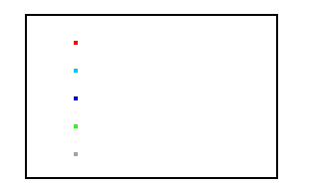
DR : vacuum status
Average pressure of the two arc sections and two straight sections since Phase2(excluding RF section).
The pressures in the arc sections are sufficiently low.
In the west arc section, 2 beam pipes are temporarily disassembled for Ext. kicker works during LS1.
High pressures near the RF section indicate higher pressure in the RF section, but it is still acceptable.
Elastomer gaskets in the RF section were replaced with metal gaskets during LS1 by RF group.
East arc section
West arc section 1 *
West arc section 2 **
North straight section
Sough straight section
Beam current
* Average over all IPs
** Average over IPs excluding one
near RF sect.
Phase2
2019ab
2019c
2020ab
2020c
2021ab
2021c
2022ab

Slide 20
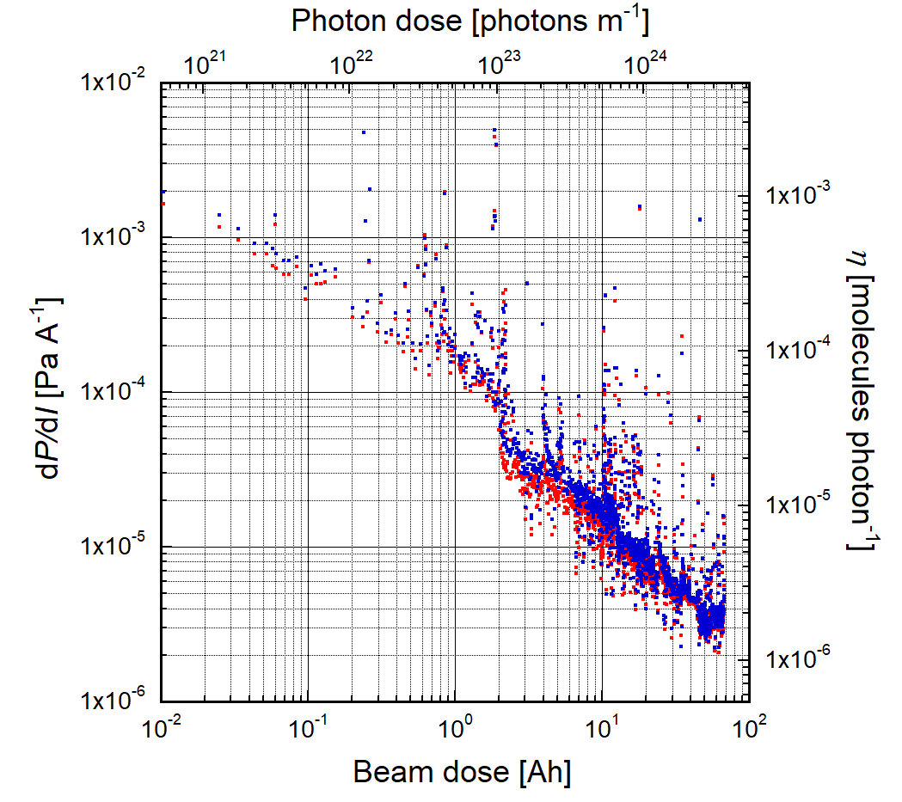
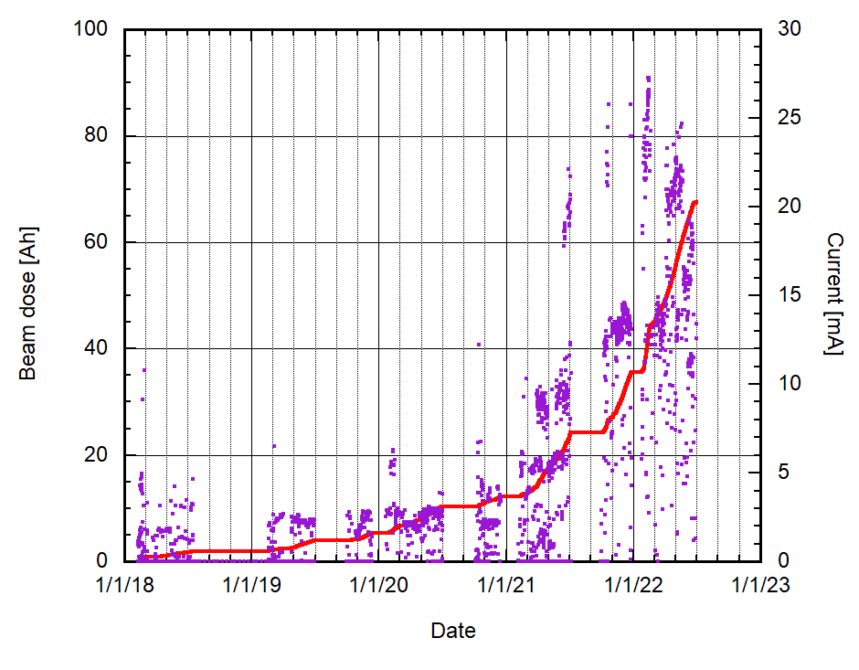
DR : vacuum scrubbing
Δp/ΔI and η for arc sections show the vacuum scrubbing is progressing steadily.
At the end of 2022ab:
Total beam dose : 67.6 Ah (photon dose : 3.5×10²⁴ photons/m )
η : 2×10⁻⁶ molec./photon
DR Vacuum scrubbing status
East arc
west arc
∼28 mA
67.6 Ah
Beam dose
Beam current
2×10⁻⁶

Slide 21
Vacuum works during LS1
Collimator head replacement
(D02V1)
HER
Collimator head replacement
(D01V1)
LER
Collimator relocation
(D03V1 -> D05V1)
Gate valve & bellows chamber replacement (GV_D01H3)
Installation of new bellows
to suppress temperature rise
Collimator head replacement
(D09V1)
NLC (D05V1)
Collimator head replacement
(D06V1, D06H3)
Collimator relocation
(D06H1 -> D06H4)
Magnetic field measurement in K1 and K2 ceramic chambers
Injection chamber replacement

Slide 22
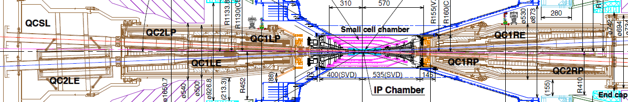






Major vacuum works during LS1 #1
Vacuum work at IR:
IP bellows chambers will be replaced with new ones of the same design.
Fiberscope observations show that RF shield fingers are discolored but appear to be healthy.
More detailed check will be done after removing IP chamber. (March 2023?)
Front cap (R-side) and front plate (L-side) of QCS cryostat will be replaced with new one with a different material.
For background noise reduction, material will be changed from W to SUS.
Tip of QCS-R cryostat will be smaller to allow more space for Belle II cables.
For this work, it is necessary to disassemble QCS cryostat and QCS beam pipes.
QCS cryostat
Y. Arimoto
Current front cap
New front cap

Slide 23







Major vacuum works during LS1 #2
Vacuum works for NLC:
Beam pipe replacement are required within a range of ∼50 m.
Removal : 16 beam pipes & 18 bellows chambers
10 Wiggler-mag. beam pipes with electron clearing electrode, 5 Q-mag. beam pipes, 1 taper pipe, 1 straight pipe, 18 bellows chambers
Installation : 1 collimator, 13 beam pipes, 22 bellows chambers
1 Collimator (relocation from D03V1), 2 new beam pipes, 2 modified beam pipes, 4 reused beam pipes, 15 spare beam pipes, 22 bellows chambers
TiN coating & baking at laboratory:
TiN coating: 2 new beam pipes, 2 modified beam pipes
Baking : 19 beam pipes excluding 4 reused beam pipes
Others:
New chamber support, Cooling water piping, Pb radiation shield, concrete shield removal and installation, etc.
Schedule
Production & modification : ∼ March/2023
Wiggler-Mag beam pipes removal : done
Collimator installation : ∼ March/2023
Beam pipe baking and TiN coating at laboratory : Nov./2022∼ May/2023
Beam pipe installation : May/2023 ∼ July/2023?
S. Nakamura
∼ 50 m

Slide 24





Major vacuum works during LS1 #3
Vacuum work at LER wiggler sections:
Replacement of bellows chambers
From bellows chamber w/o SR masks to w/ SR masks : 9 chambers
From bellows chamber w/ SR masks to w/o SR masks : 8 chambers
As a countermeasure against temperature rise of beam pipes downstream of the wiggler sections
Beam current will be increased after LS1.
Magnetic field of wiggler magnets will be increased by the amount of decreased wiggler magnets.
Strong SR should be absorbed by SR masks in the bellows chambers.
Bellows chambers w/ SR masks installed in locations where strong SR would not be irradiated were replaced with bellows chambers w/o SR masks
Air and water cooling of the bellows chamber with SR masks were also enforced.
70
Oho wiggler section (D04, D05)
@1400 mA
Bellows chamber replacement
60
Wiggler removal
50
Temp [°C]
w/o → w/ SR masks
40
30
20
w/ → w/o SR masks
beam
70
Nikko wiggler section (D10, D11)
@1400 mA
60
50
Temp [°C]
40
30
20
beam
SR mask

Slide 25



Major vacuum works during LS1 #4
Vacuum work at HER injection section:
3 beam pipes are replaced with new ones to increase injection rate.
Orbit clearance from chamber wall is enlarged by changing wall position along beam axis.
Wall length along the beam axis is shorten as much as possible.
Pumping port will be removed to shorten wall length if possible.
New BPM for injected beam is installed for precise injection tuning.
Schedule
Production : JFY2022 (∼ March/2023)
Beam pipe replacement : JFY2023 (April/2023 ∼)
M. Kikuchi
wall
too small clearance
New wall
Y. Suetsugu

Slide 26
Summary
MR and DR vacuum systems have been working mostly well.
Vacuum scrubbing progressed steadily.
Troubles of vacuum system are decreasing.
No clear indication of ECE has been observed.
Recent behaviors of pressure against beam current are explained including thermal desorption (heating by wall current and HOM) as well as PSD.
Recent single beam lifetime is mostly limited by the Touschek effect rather than pressure (the Rutherford scattering).
Large vacuum works are ongoing during LS1.
NLC construction at LER D05
IR vacuum works for modification of Belle II detector and QCS cryostat.
Installation of bellows with SR masks at LER D04 and D10
Replacement of HER injection chambers
Many collimator works (not mentioned in this talk)
Etc.

Slide 27
Fin.
Thank you for your attention.
Inter-University Research Institute Corporation High Energy Accelerator Research Organization (KEK)
大学共同利用機関法人 高エネルギー加速器研究機構 (KEK)

Slide 28
Backup

