Slide 1
BT
M. Tawada, K. Kikuchi, K. Kodama, T. Mimashi, T. Mori,
T. Naito, T. Takasaki, S. Terui and T. Ueda
(BT group)

Slide 2
Contents
To improve injection efficiency
BT hardware issues and updates
Upgrade plans in BT
Summary

Slide 3
1. To improve injection efficiency
Injection orbit changes and re-alignment at BT ARC4
Field quality improvement of HER Septum 1
Injection aperture improvement for HER

Slide 4
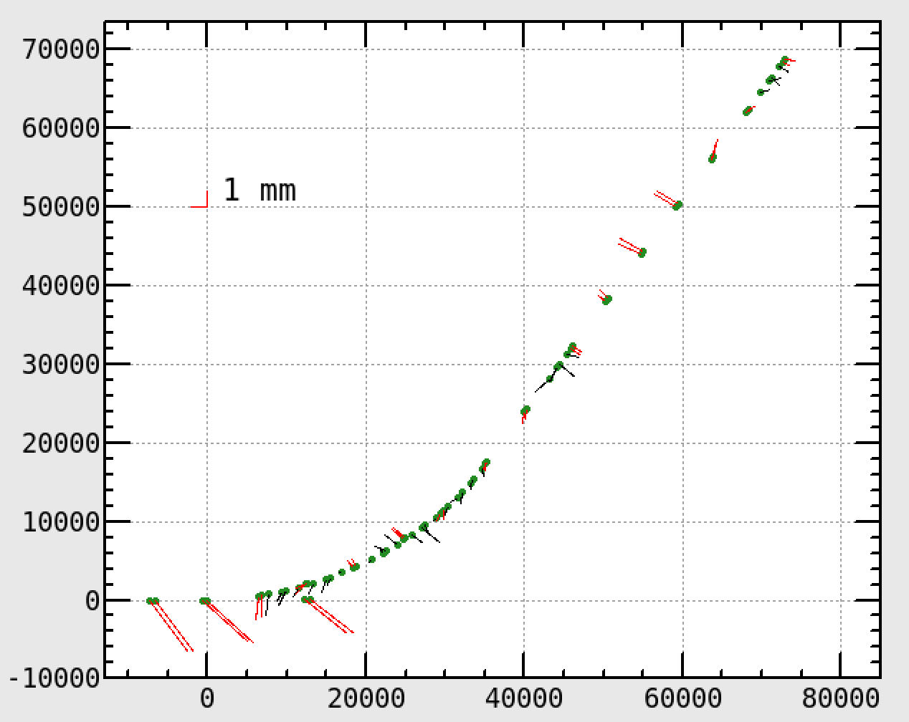
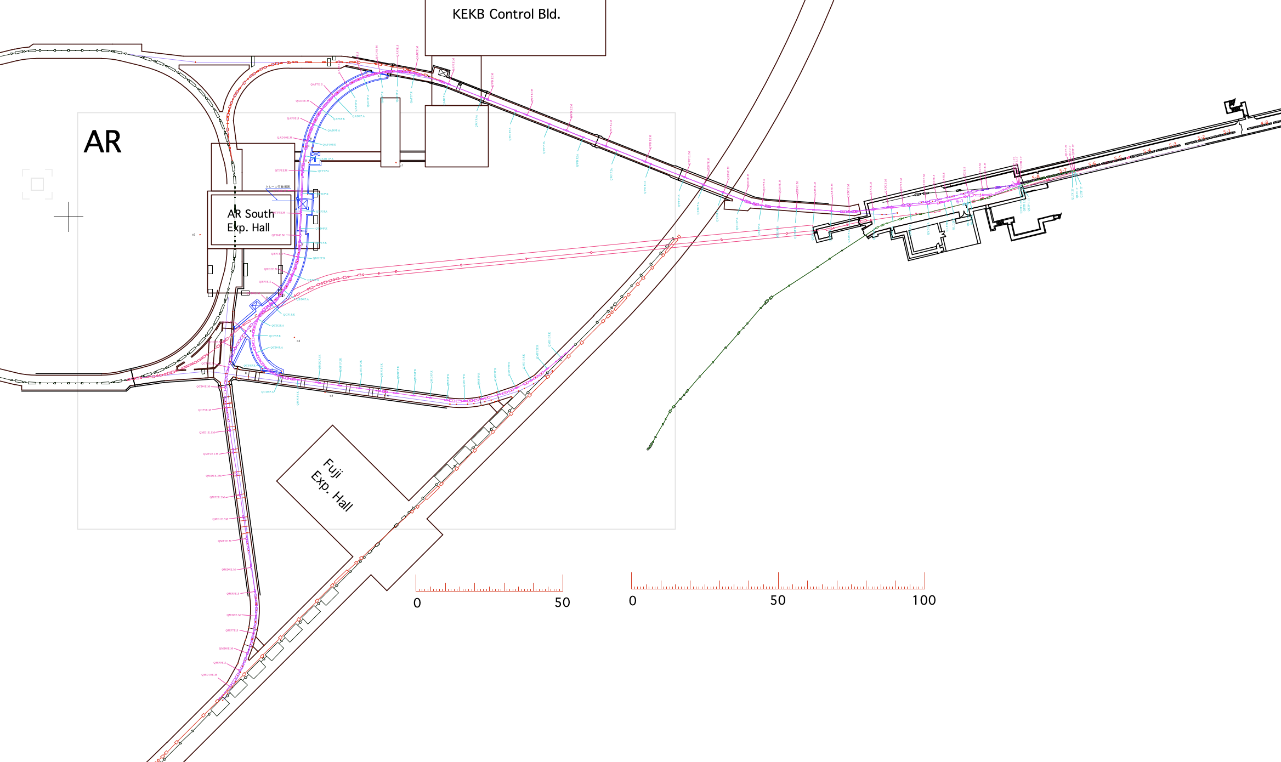



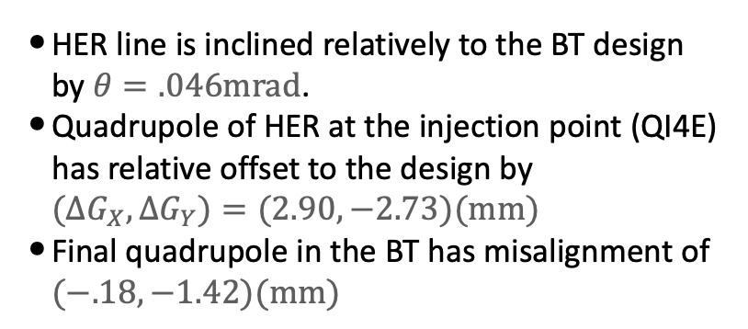

Injection orbit changes and re-alignment of BT e ARC4 (Kikuchi)
Survey results for magnets of the Electron BT and HER quadrupoles in the injection region (2018)
Green: design
Red: misalignment of quads
Blue: misalignment of bends
Slope
Findings:
HER line is inclined relatively to the BT design by $θ=.046mrad$.
Quadrupole of HER at the injection point (QI4E) has relative offset to the design by $(ΔG_{X},ΔG_{Y})=(2.90,−2.73)(mm)$
Final quadrupole in the BT has misalignment of $(−.18,−1.42)(mm)$
e-
$$G_{Y}(mm)$$
ARC4
QI4E
0.046 mrad
HER
$$G_{X}(mm)$$
Countermeasure:
Septum angles were adjusted to absorb the relative misalignment to the current HER line.
During LS1, re-alignment will be performed for the four quadrupoles which have large misalignment greater than 1 mm.
Example of septum angle adjustment
$$X_{inj}=36mm$$
$$Px_{inj}=2.44mrad$$
 | mrad | mrad | SKB-design
SE1 | 38.60 | 44.59 | 39.49
SE2 | 37.82 | 28.08 | 35.35
SE3 | 36.01 | 37.5 | 37.5
SE4 | 35.24 | 37.5 | 37.5
Sum | 147.69 | 147.69 | 149.84

Slide 5
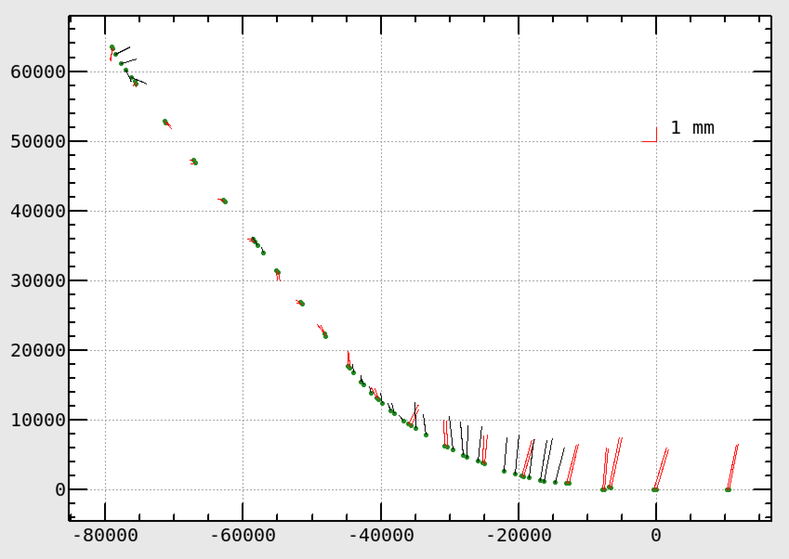



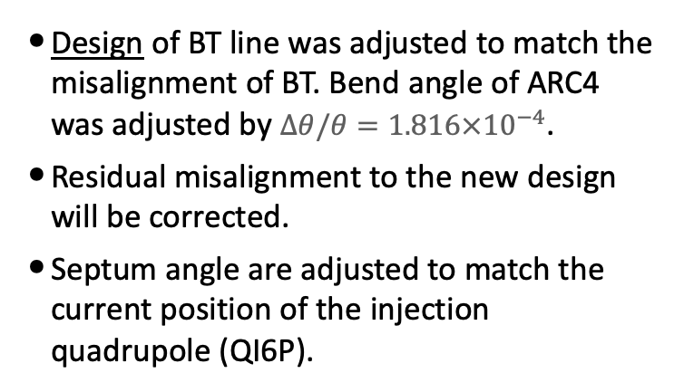
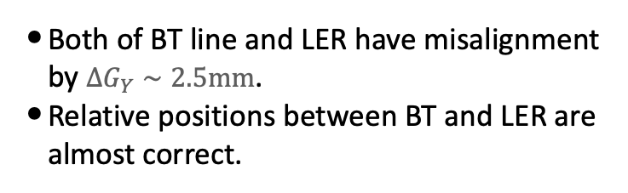


Injection orbit changes and re-alignment of BT p ARC4 (Kikuchi)
Survey results for magnets of the Positron BT and LER quadrupoles in the injection region (2018)
Green: design
Red: misalignment of quads
Blue: misalignment of bends
Slope
Findings:
Both of BT line and LER have misalignment by $ΔG_{Y}∼2.5mm$.
Relative positions between BT and LER are almost correct.
$$G_{Y}(mm)$$
e+
ARC4
QI6P
Countermeasure:
Design of BT line was adjusted to match the misalignment of BT. Bend angle of ARC4 was adjusted by $Δθ/θ=1.816×{10}^{−4}$.
Residual misalignment to the new design will be corrected.
Septum angle are adjusted to match the current position of the injection quadrupole (QI6P).
$$G_{X}(mm)$$
LER
Septum angle adjustment
$$X_{inj}=34.1mm$$
$$Px_{inj}=4.10mrad$$
 | mrad | SKB-operation July 2021*)
SP1 | 53.105 | 54.057
SP2 | 44.129 | 44.090
Sum | 97.234 | 98.147
*) $X_{inj}=32.76mm,Px_{inj}=5.535mrad$

Slide 6
HER Septum 1: Field quality improvement (1) (Mori)
It has been found that a fringe field near the septum plate has a sizable multipole component. A tracking simulation shows multipoles induces a vertical non-Gaussian tail, which could be a cause of a beam background as well as a bad injection efficiency.
Adjustment of Q-magnets at upstream of the BT line for optics matching does not work completely for non-linear components.
Improving the field quality of HER septum 1, which is nearest one to the injection point is important for injection efficiencies and backgrounds.
Field quality would be improved by (1) reducing the pulse width of 300 → 257 μs by changing power supply’s main capacitor and (2)Fine tuning of shim shape for the reduced pulse width.
HER injection amplitude could be reduced from 11 to 8 mm in total.
2mm (by field improvement of septum magnet) + 1mm (by injection aperture improvement) could be reduced.

Slide 7
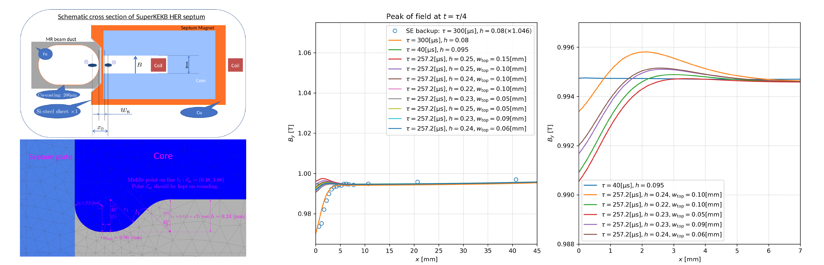
HER Septum 1: Field quality improvement (2) (Mori)
Simulation studies are performed and we decided shim shape as shown in the lower left figure: the flat top width h=0.24 mm, wtop=0.06mm.
Issue for fabrication
We noticed the silicon steel plate ( JFE 0.35mm inorganic coating) used so far are not available any more. Another candidates (0.15 mm inorganic coating or 0.35 mm organic coating) are found but it must be evaluated for punching accuracy and outgas performance.
Therefore, the fabrication is delayed and installation will be scheduled in summer 2024.

Slide 8
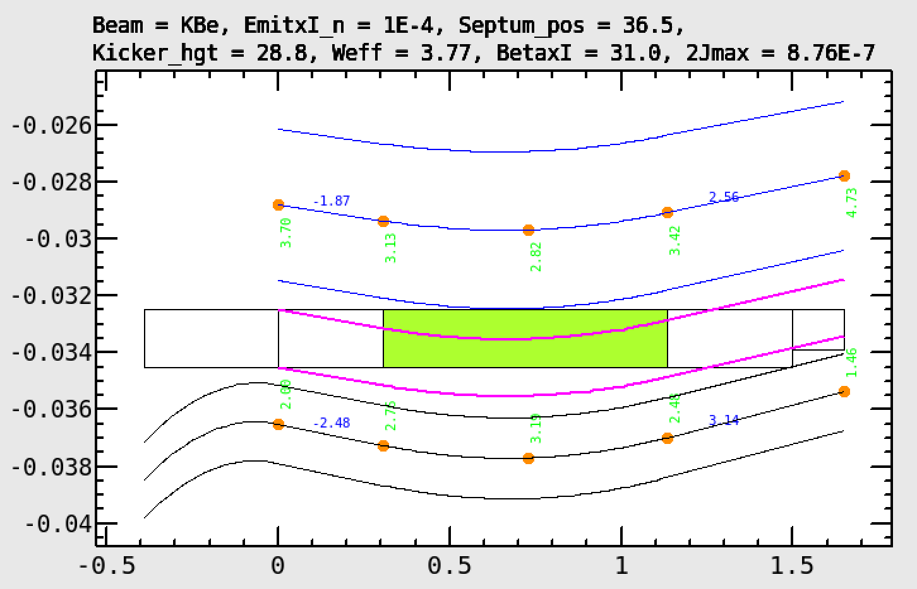
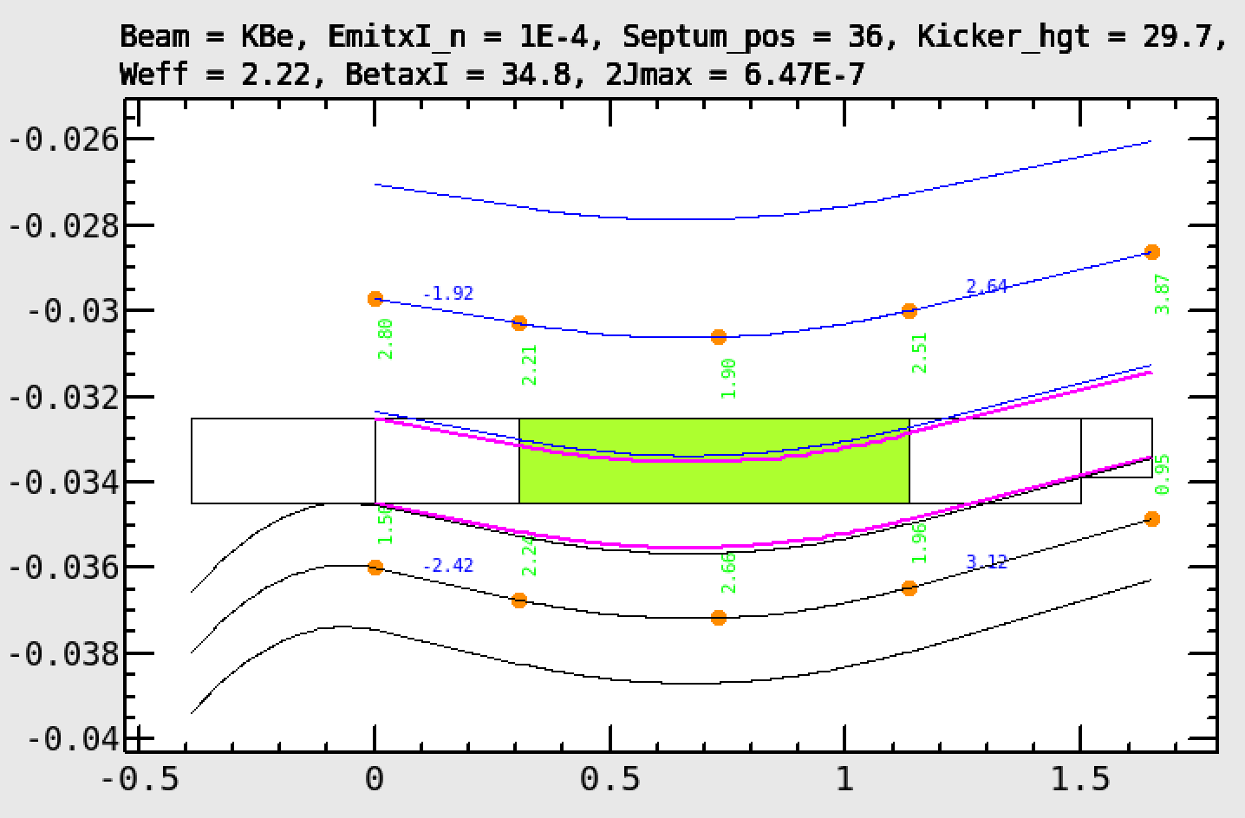
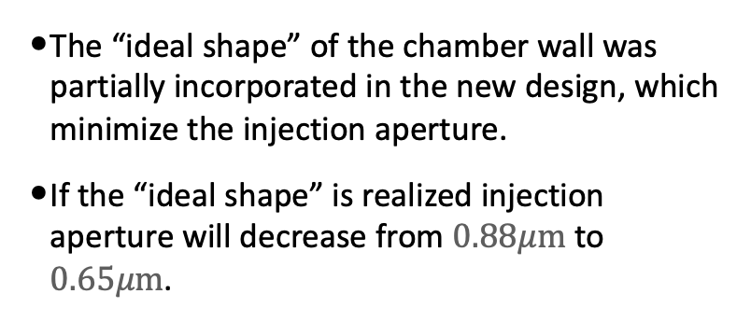
Injection aperture improvement for HER (Kikcuhi)
HER injection orbit and the chamber wall
In the current configuration the injected beam is expected to touch the quad chamber before it touches the septum wall.
Very high residual radiation-activity, which was found at the flange of the “Injection BPM” chamber, supports this hypothesis.
Kicker orbit changes cannot avoid this geometrical conflict because it interferes with the constraint from the abort orbit.
A new chamber for QI4E was designed which has enough clearance to the injected beam (see Vac-group report).
QI4E
Stored beam
Injection Slit
Septum
Injected beam
Injection BPM
Ideal wall shape to minimize the injection amplitude
The “ideal shape” of the chamber wall was partially incorporated in the new design, which minimize the injection aperture.
If the “ideal shape” is realized injection aperture will decrease from $0.88μm$ to $0.65μm$.

Slide 9
2. Hardware issues and updates
LER kicker issues
Leakage of LER injection bump orbit
self-firing troubles of thyratron tube
DR extraction kicker stability issue
DR kicker temperature stability improvement
Temperature stability improvement of facility cooling water
Fast kicker for 2nd bunch in RTL
Monitor upgrades
BT-BPM
Radiation profile monitors (BT-SRM, Screen)
CSR monitor

Slide 10
LER Kicker: Leakage of LER injection orbit bump (Kodama and Mimashi)
Ti coating: 1.5 um
Ti coating: 5.0 um
Expand wave
K1(left) and K2(right) duct shape
Additional inductance effect for K1 CT wave
Additional inductance effect for BOR
Leakage of LER injection orbit bump was observed by BOR while kicker’s current waveforms are almost same between K1 and K2. The horizontal oscillation is coupled to the vertical. This may cause the luminosity degradation.
Leakage kick might comes from the differences of ceramic duct shape and Ti coating thickness.
We have tried to expand K1 current waveform with additional inductance of 550 nH in series. But the leakage couldn’t be reduced as we expected.
Need to manufacture new K2-type ceramic ducts and replace K1 ducts to new one in 2024. (The budget was not allowed in 2022.)

Slide 11
LER kicker: Self-firing troubles and coutermeasure (Kodama, Naito and Mimashi)
Self-firing troubles in 2021-2022
By using the thyratron which had been stocked for a long time but new one, self-firing had been occurred several times.
Self-firing of new thyratrons recently purchased had also occurred.
Countermeasure for self-firing
Prepare test stand for incoming inspection and aging of thyratrons.
R&D of the double kicker driven by one thyratron unit.
Double kicker has different output between K1 and K2 due to different cable length to make the time delay. K1:K2 ratio will be fixed for the double kicker. If optics accepted this condition, we will continue to design double kicker system.
Thyratron unit
Transmission line
23 m
7 m
T_{delay} = 80 nsec
(5 nsec/m)
Kicker1
Kicker2
Simulated Kicker waves for double kicker system⁽¹⁾
Schematic image of double kicker system

Slide 12
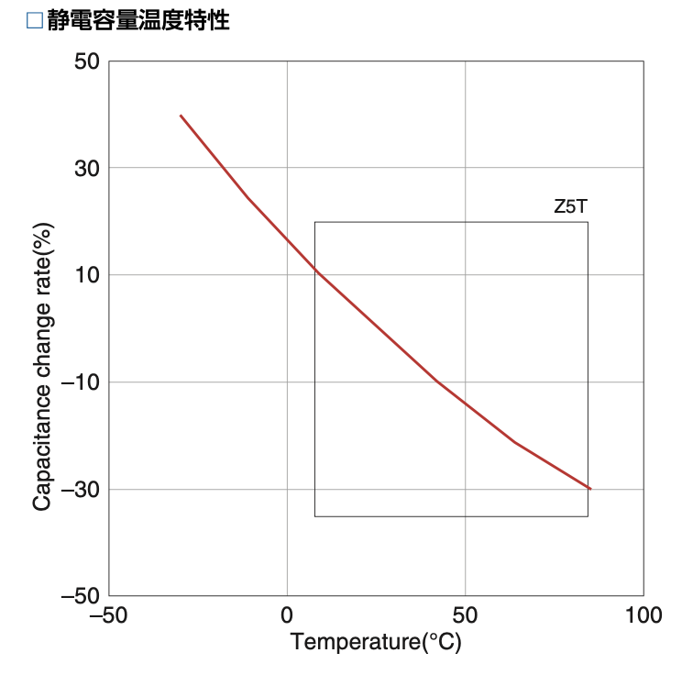
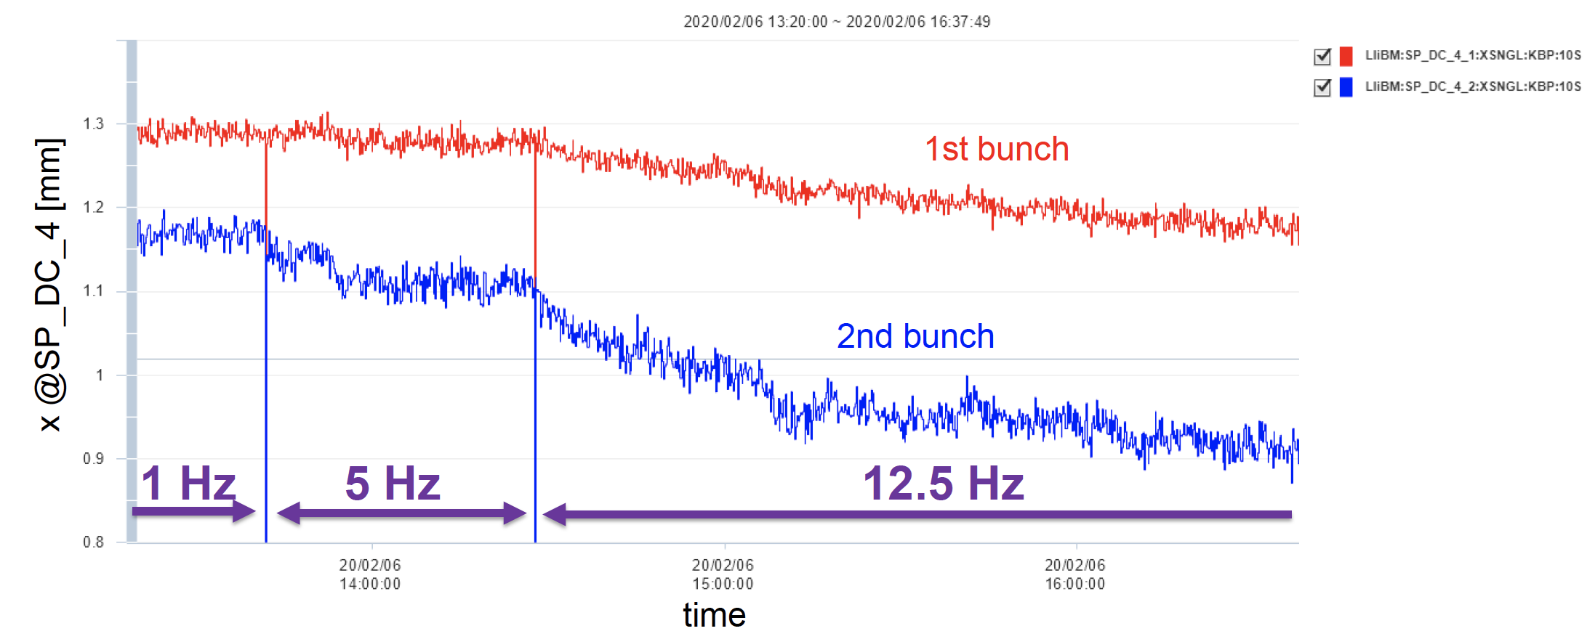
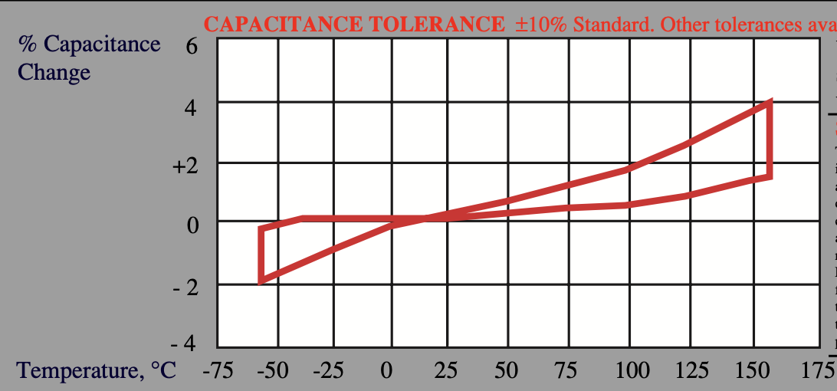
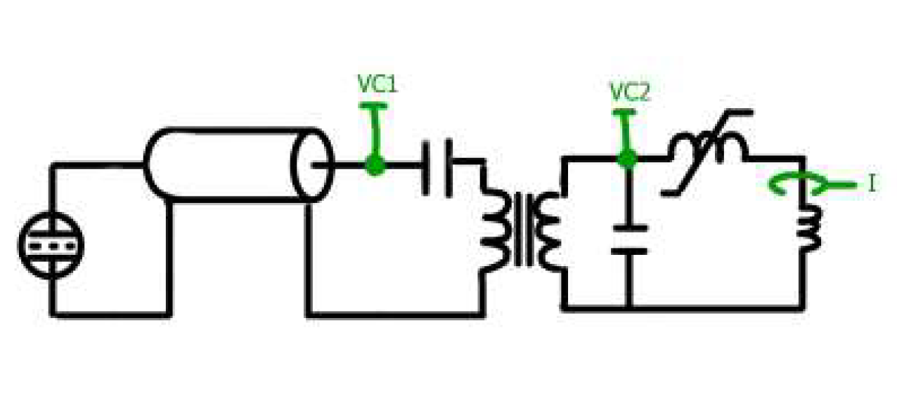
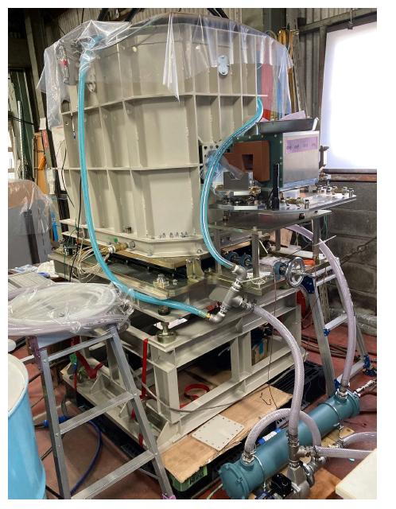
DR ext. kicker stability (Tawada)
Ceramic capacitance
〜0.8%/℃
Mica capacitance
〜100ppm/℃
1 hour
Slow orbit drift was observed at the Linac BPM. These orbit drift changes when the repetition changed, which is more prominent in the 2nd bunch.
It takes long time to reach the equilibrium for the high repetition rate (> 2 hour for 12.5Hz).
This may be due to the temperature dependence both of capacitance and FINEMET core, which is used as a saturable inductance in the magnetics switch and thus determines the fire timing. We will replace the capacitor from a ceramic to a mica type, which is less temperature dependent. And cooling system of FINEMET will be improved by using a water-cooled forced circulating oil.

Slide 13
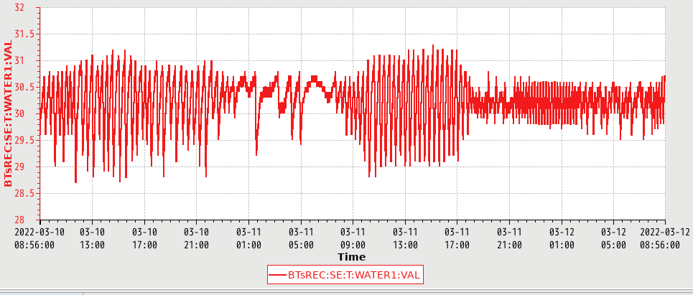
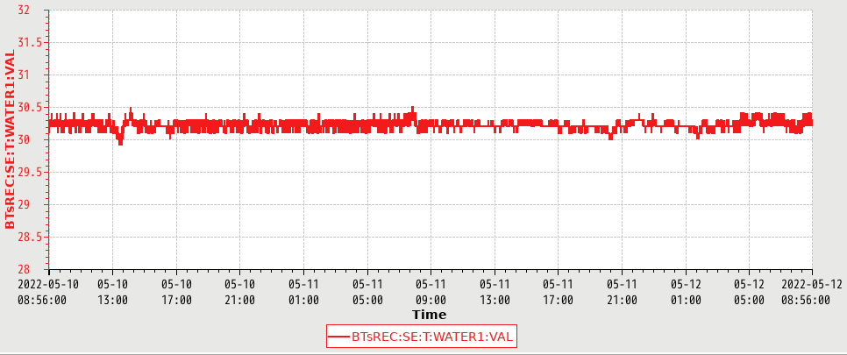
Temperature stability improvements of facility cooling water (T. Naito)
The temperature control parameters of the facility cooling water were optimized. In order to minimize the temperature change, the on/off temperatures of the cooling towers are set to different value and the PID parameters of the three-directional valve are set to the long interval.
DR magnet (M22-B cooling water)
Less than 0.5℃
2℃
Before improvements
After improvements
The temperature change was reduced from 2deg to less than 0.5deg. The most of time, the temperature kept to 0.1 or 0.2 deg.
The other region of the the facility cooling water in BT, KEKB-BT magnet (AS-PWP-5 cooling water) and Septum magnet (FM-PWP-3 cooling water) can be stabilized by using same method.

Slide 14
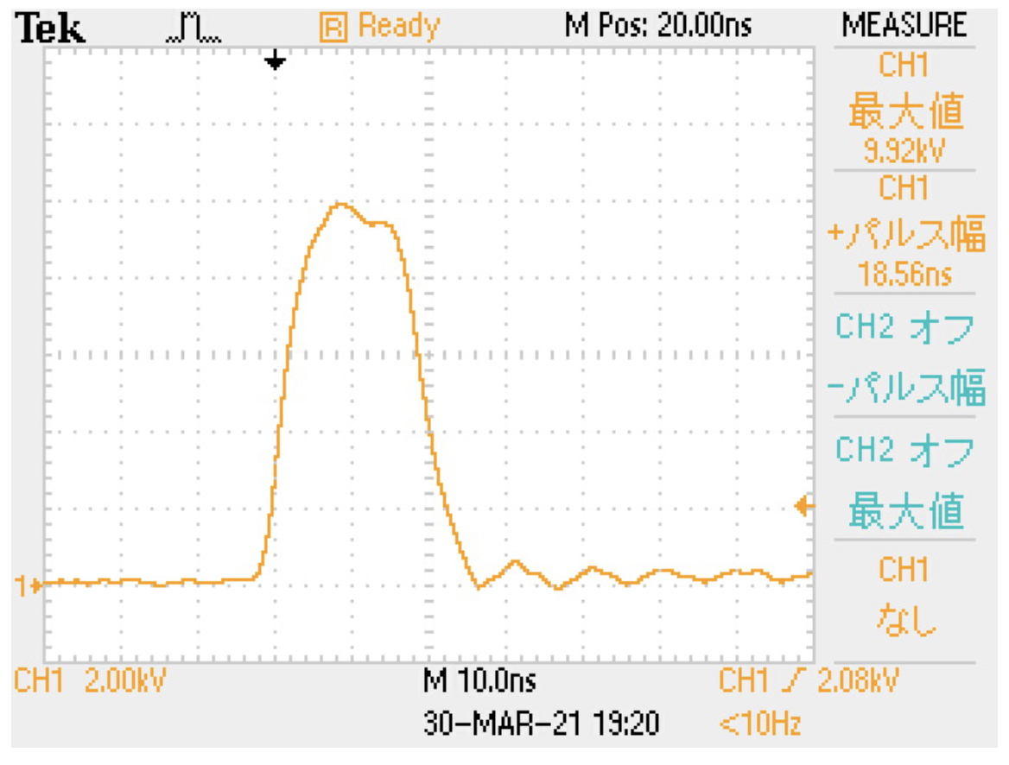
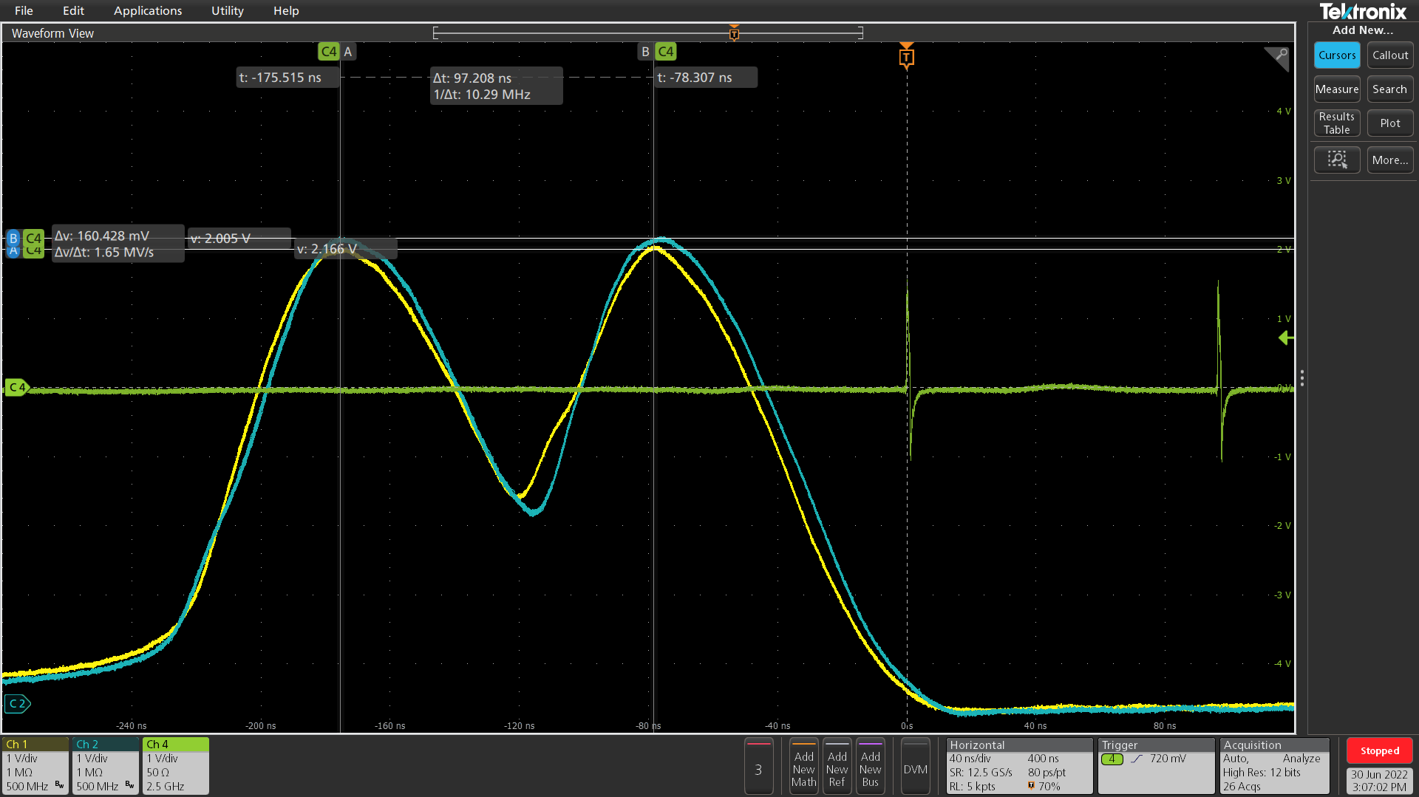
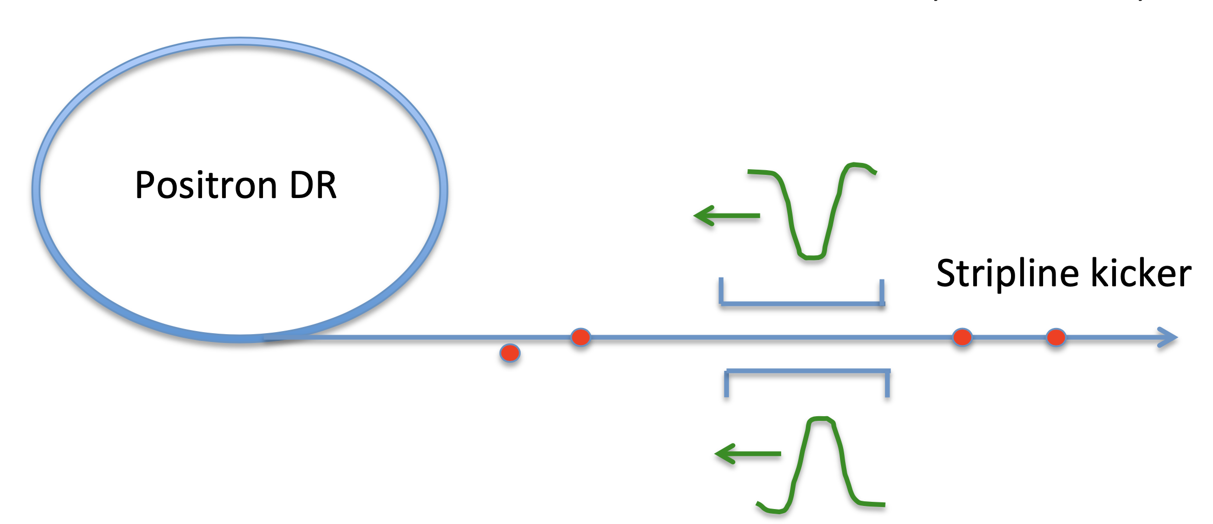
DR-RTL: Fast Kicker (Naito and Kodama)
96ns
20ns
DR extraction kicker
DR-RTL fast kicker
Before EVR change
After EVR change
It takes time to adjust kick angles (〜5mrad) of two bunches extracted from DR, because two successive kicker pulses are overlapped each other and they are interrelated in the fire-timing as well as in the pulse height.
Installed a fast kicker system to kick 2nd bunch only to RTL.
Stripline kicker for ATF (L=0.33m) are reused and PS are newly built.
Kick angle: 0.14 mrad with ±8kV, pulse width:20ns, Horz./Vert.
Kick angle could be larger if longer kicker is used.
with SL kicker
w/o SL kicker
Stripline kicker test with beam

Slide 15
BT-BPM status: (Mori)
Old BT-BPM Oscilloscopes
Eight old oscilloscopes (Tektronix DPO7104, 4-ch, 1 GHz, 8-bit) have been used for BT-BPMs since 2007 and hardware troubles have occurred several times.
Those should be updated and Rhode & Schwarz RTO2014 (4-ch, 2 GHz, 10-bit), which was only one candidate and can work at 50Hz repetition rate but it was sold out last year. We are looking for a oscilloscope or digitizer which meets the required specifications.
Some BPM must be re-cabled not to make the 2nd bunch signals overlapped each other.
Libera SPE
Libera SPE will be ready for BPMs at BT end of e-/e+ lines, which have direct cables , during next run.
It can receive EVR data buffers and change parameters by event code (31=e-/41=e+) and mark it by ShotID.
Switching of e-/e+ is performed by RF switch, which is prior to Libera SPE.

Slide 16
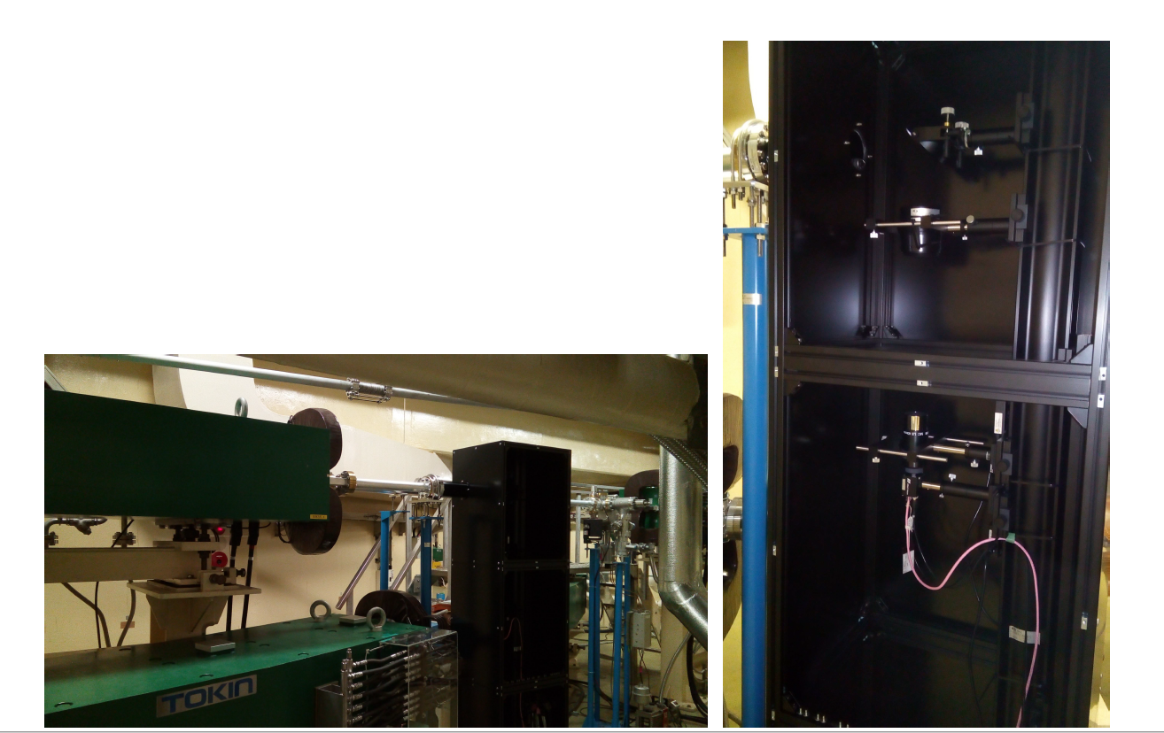
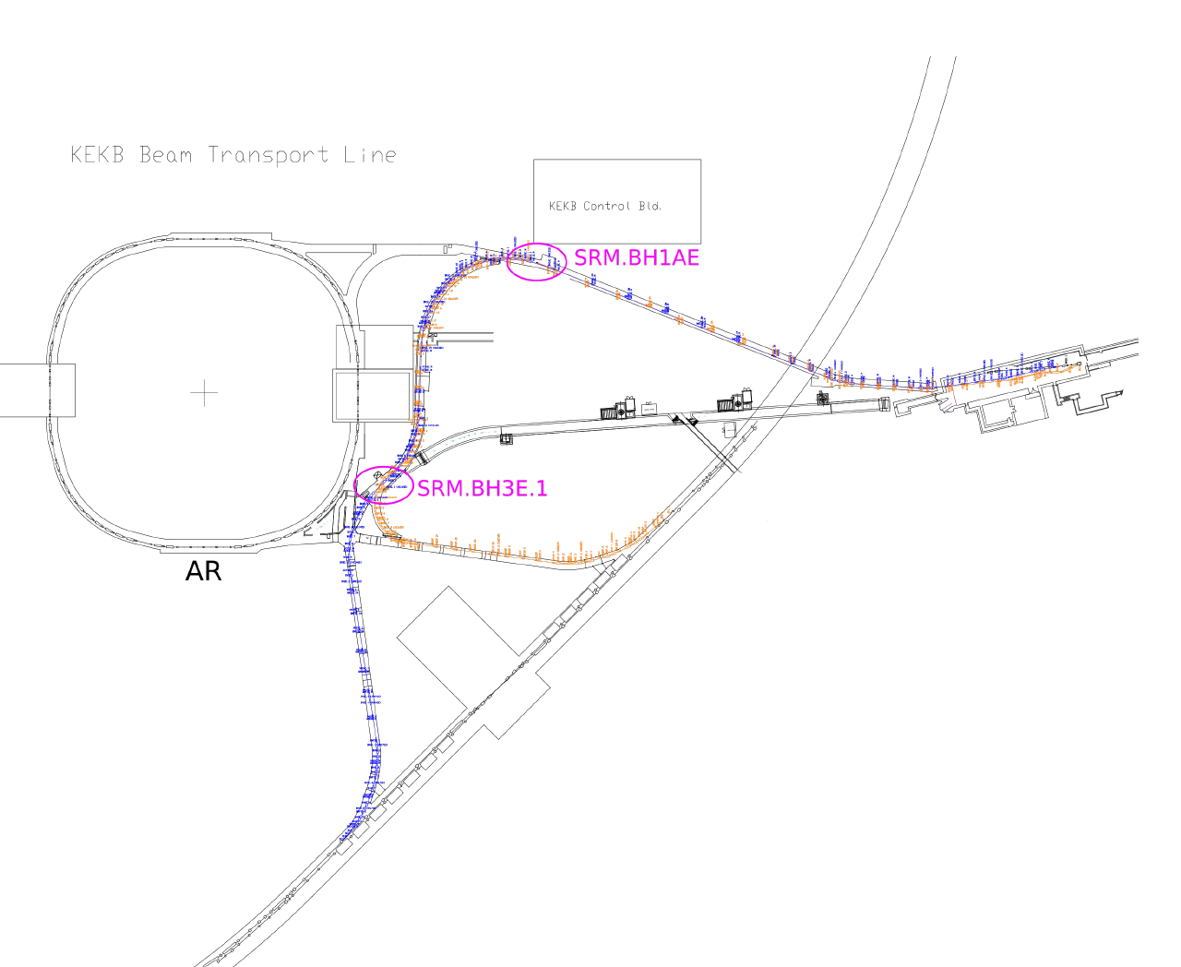
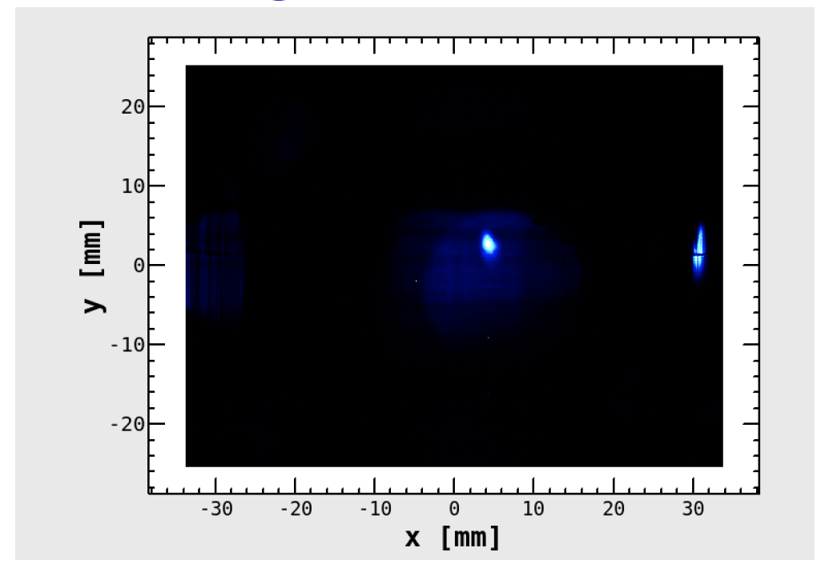
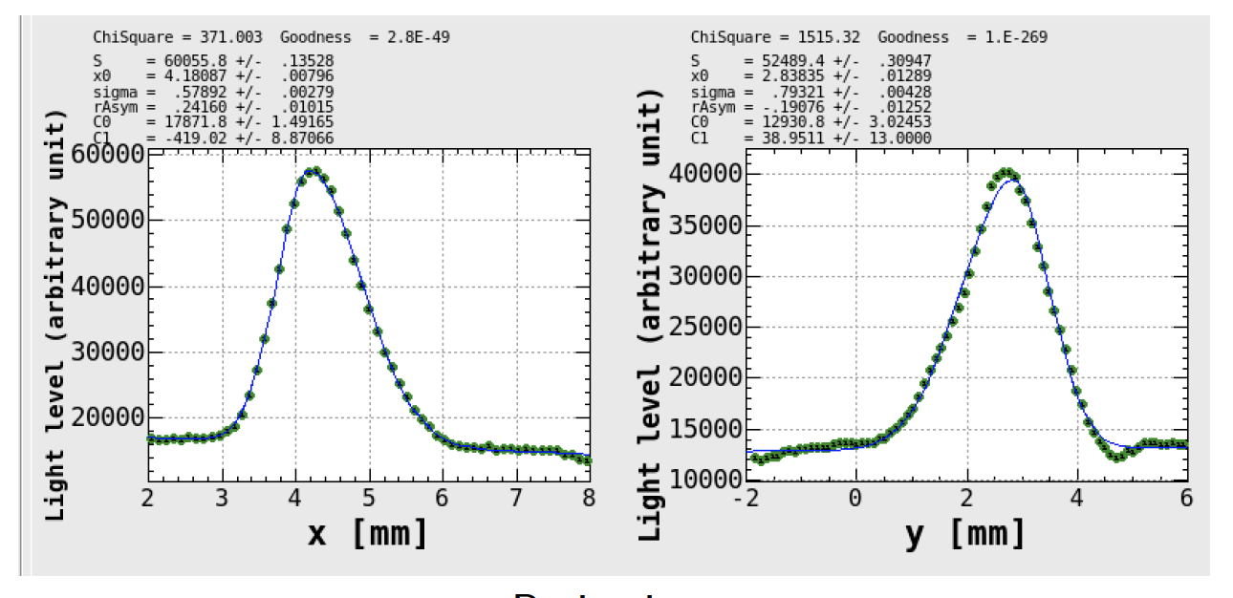
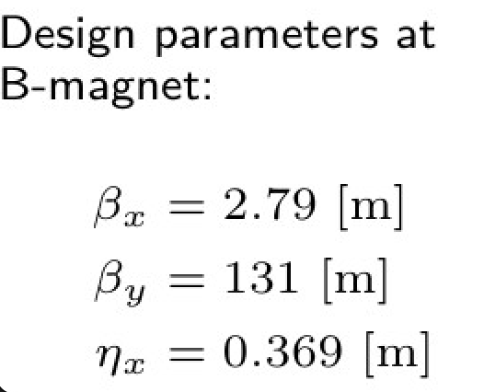
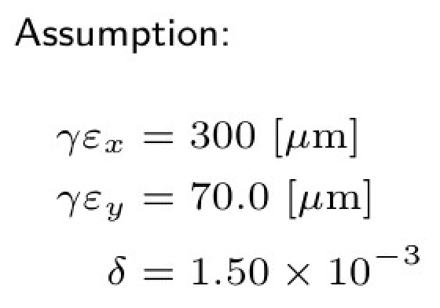
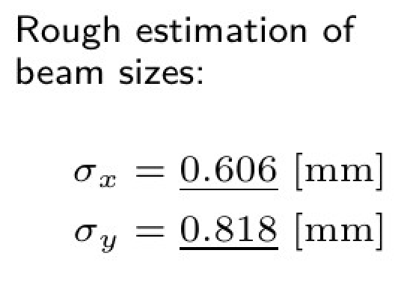
BT-SRM (Synchrotron Radiation Monitor): (Mori)
SRM for e- was installed at the beginning of ARC3 (BH3E.1) and second one will be installed at ARC1 (BH1AE).
We have just started to measure the beam profile. The measured beam sizes are good agreement with the rough calculation. But it is still preliminary and the further check is needed.
SRM@BH3E.1

Slide 17
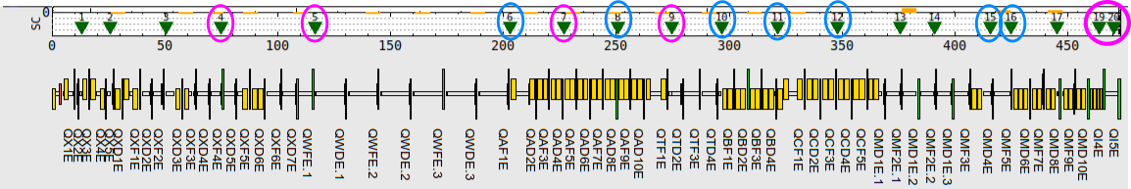
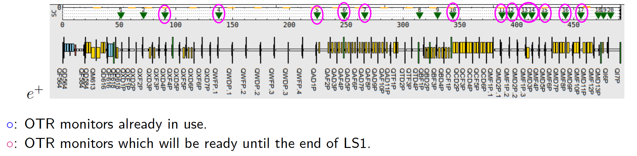
BT-OTR monitors : (Mori)
Changing fluorescent screen monitors to OTR monitors in BT e±-lines.
Will measure the bunch-by-bunch beam profiles by using an imaging intensifier (Hamamatsu C14245), which can control gate width with accuracy of a few ns.
The beam profile data can be related to BPM’s position data by using ShotID or event timing.
Locations of OTR monitor at BT line
Linac END
BT End
e⁻

Slide 18
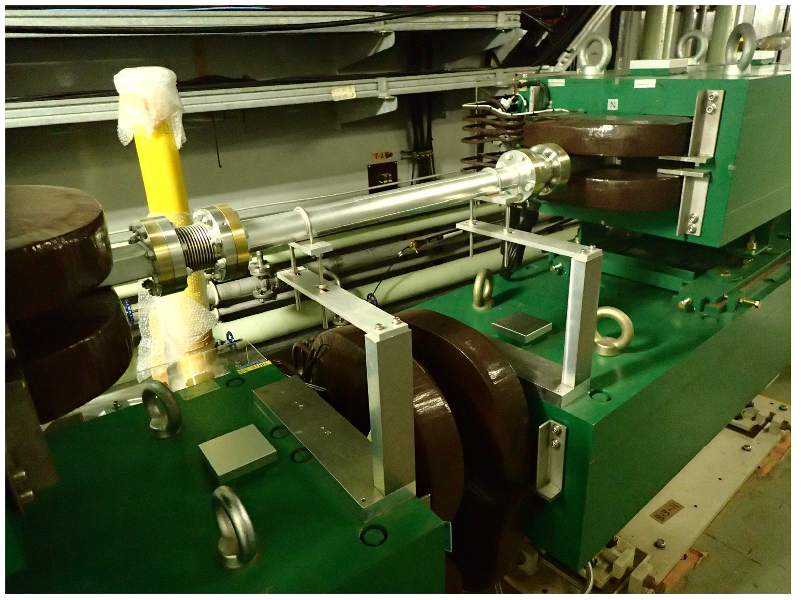
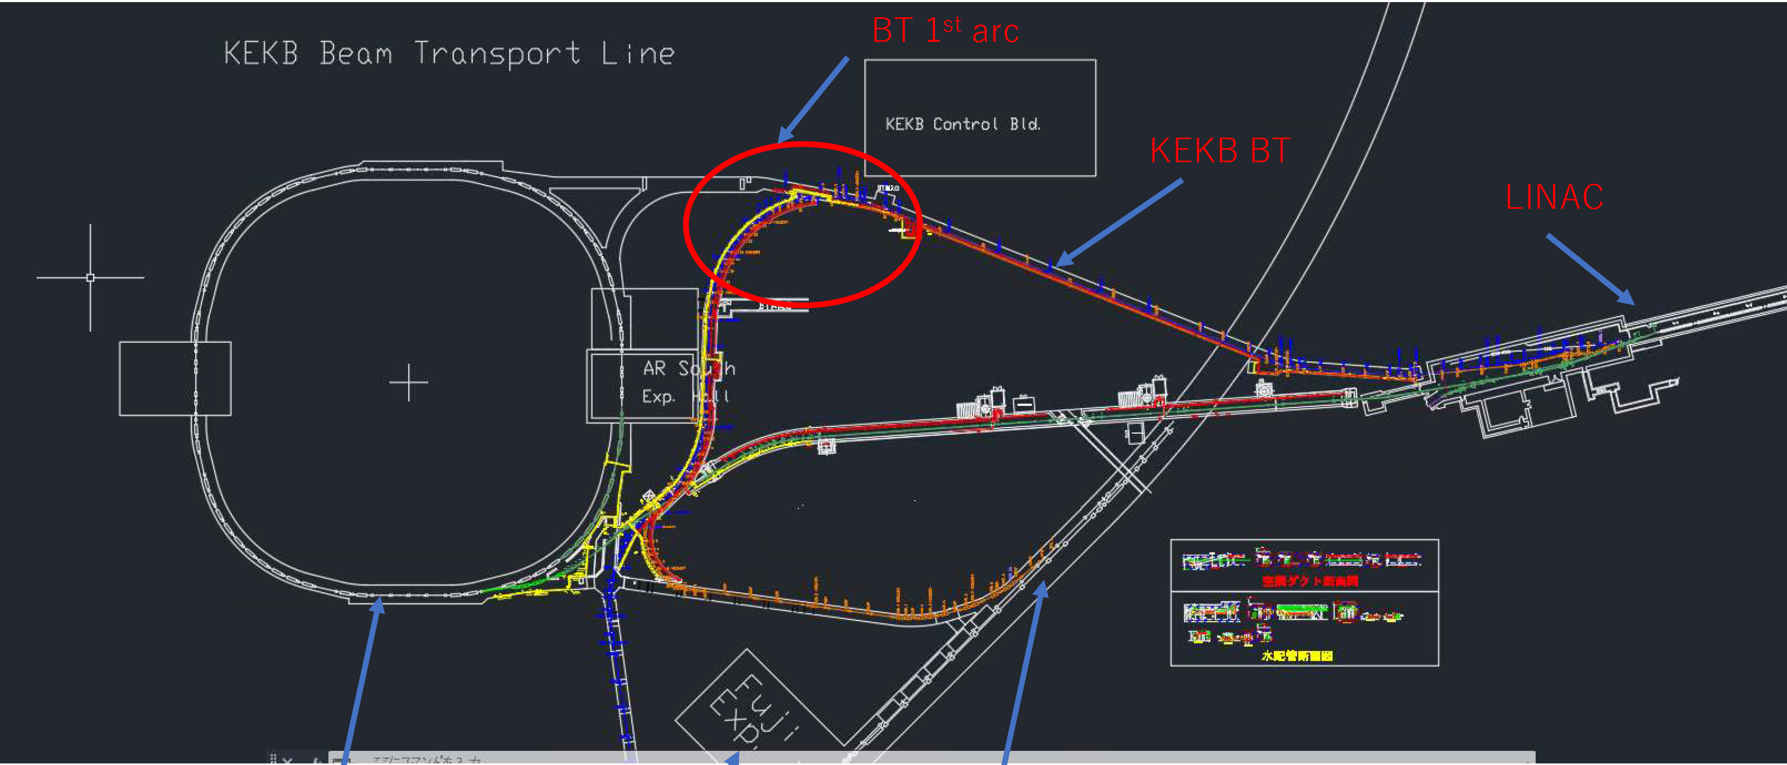
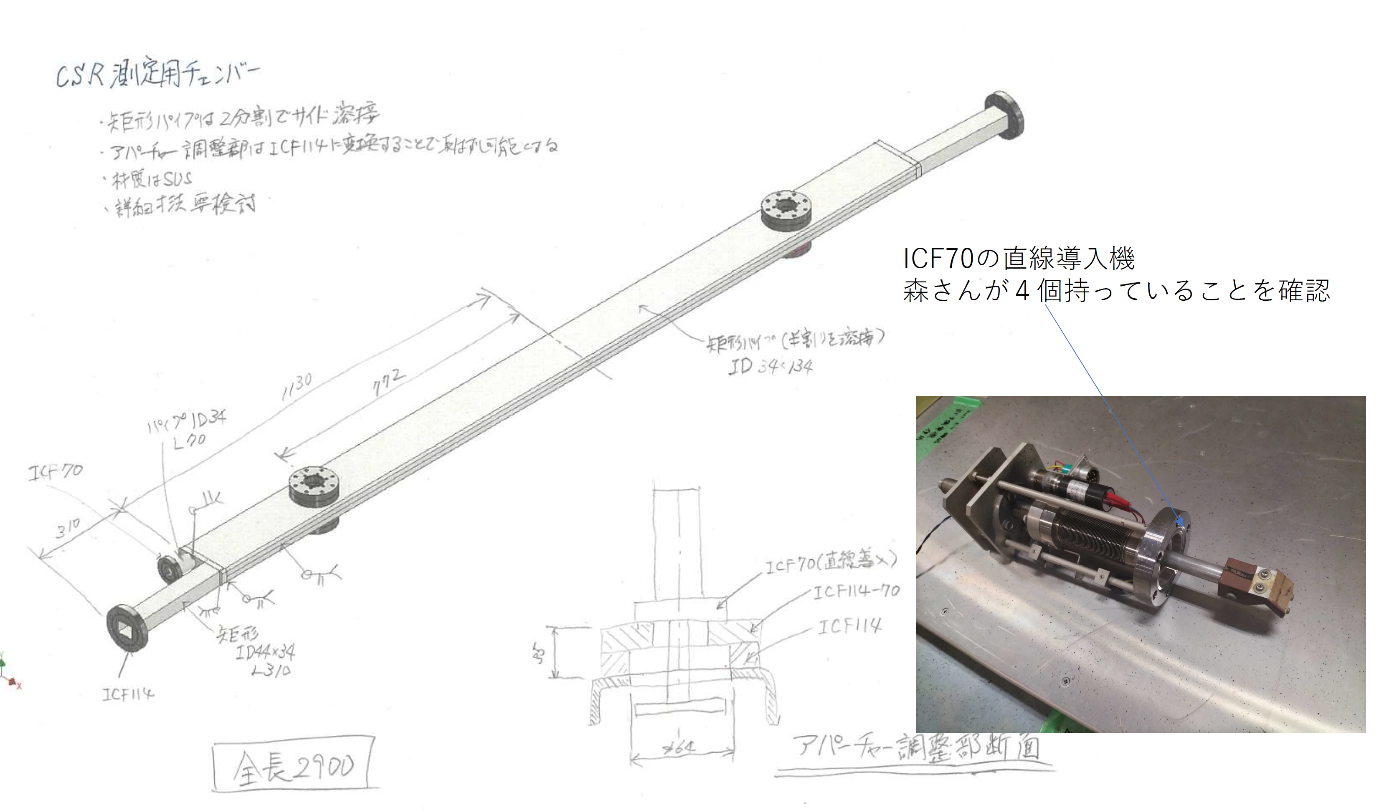
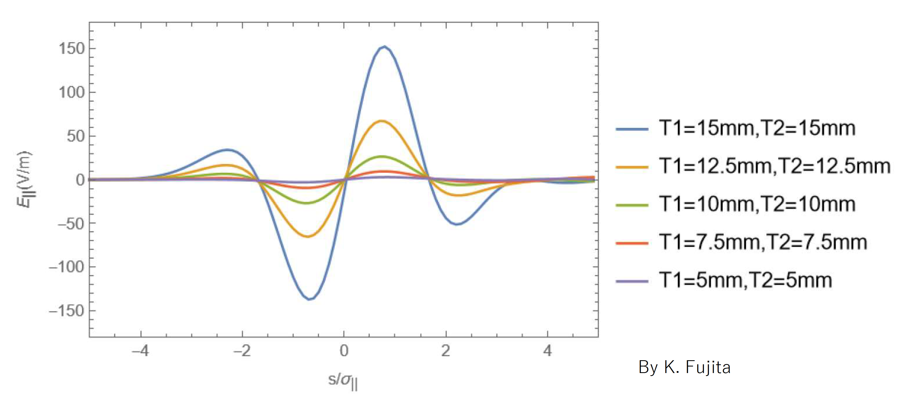
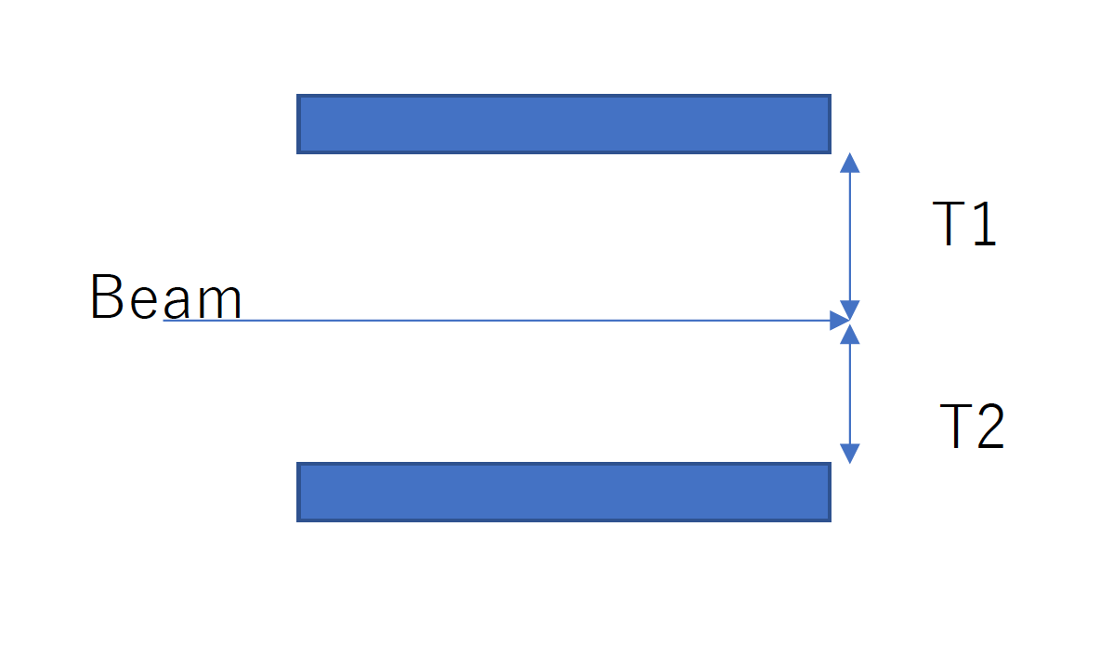
Emittance growth: CSR monitor (Terui)
BTp: BH1P.9
Plan to replace one vac. chamber of BTp 1st arc bending magnet with a branch pipe to monitor CSR. (No space for BTe.)
Gap height of vac. chamber can be changed.
Simulations for infinite parallel plates with various gap height are also on-going by Fujita-san. Smaller gap height is preferable to reduce CSR effect.

Slide 19
Upgrade plans in BT
BT e- ECS by Linac group
New BT e- Line for HER

Slide 20
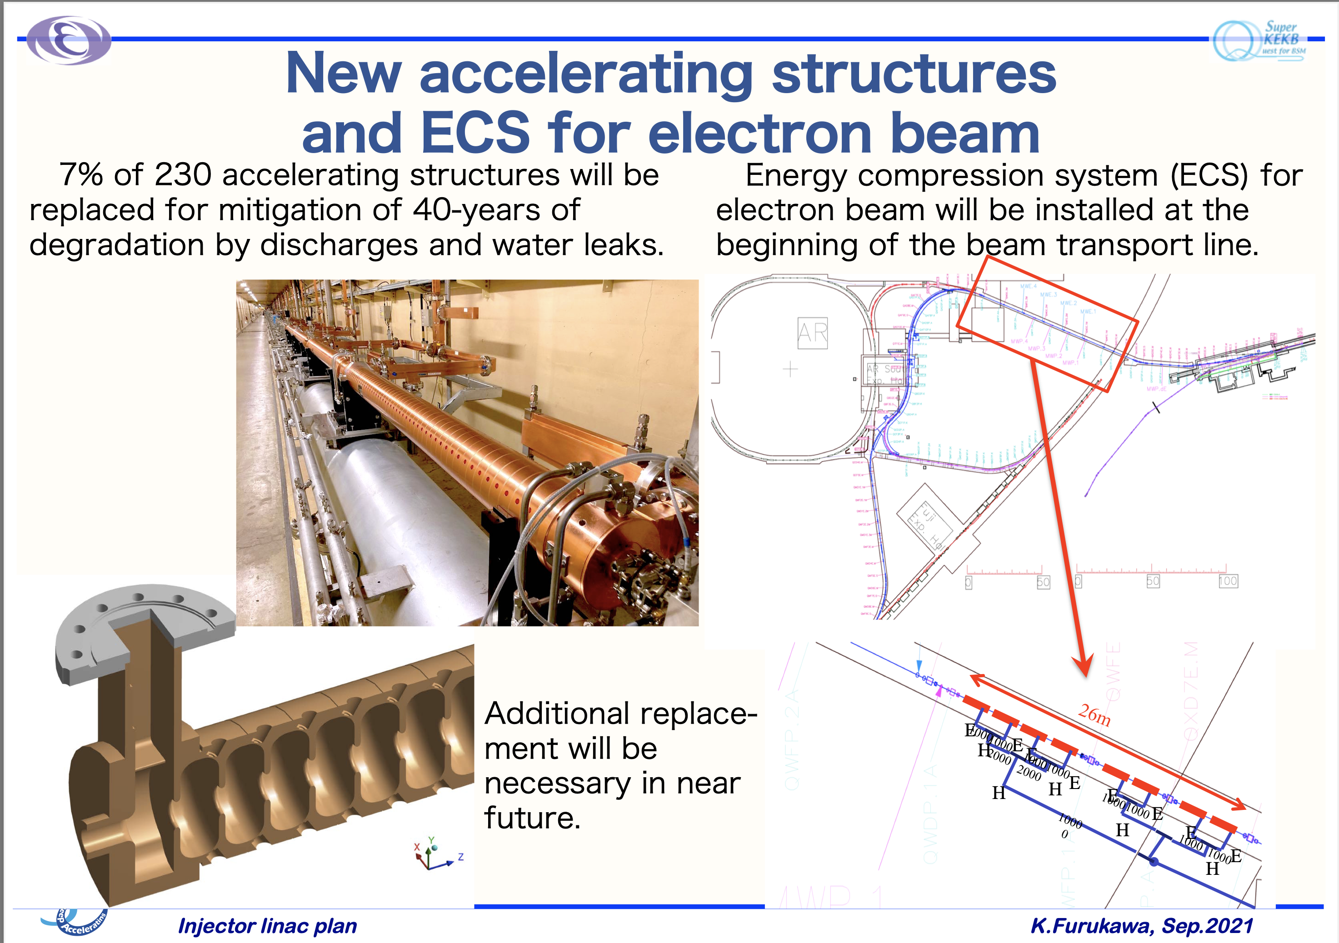
BT e- ECS
Because the budget of 1.7 oku-yen (1.25M$) for e- ECS fabrication had been already approved, the e- ECS components and the facility cooling water system must be fabricated in three years.
Linac group has just started the study of the effectiveness and feasibility of e- ECS, including beam loss rates.
Because BT tunnel has poor radiation shields (0.4 m of concrete + 1.1 m of soil) for public area, additional radiation shields might be needed to incorporate e- ECS but it will be problems with maintainability.
The Twenty-Fifth KEKB Accelerator Review Committee

Slide 21
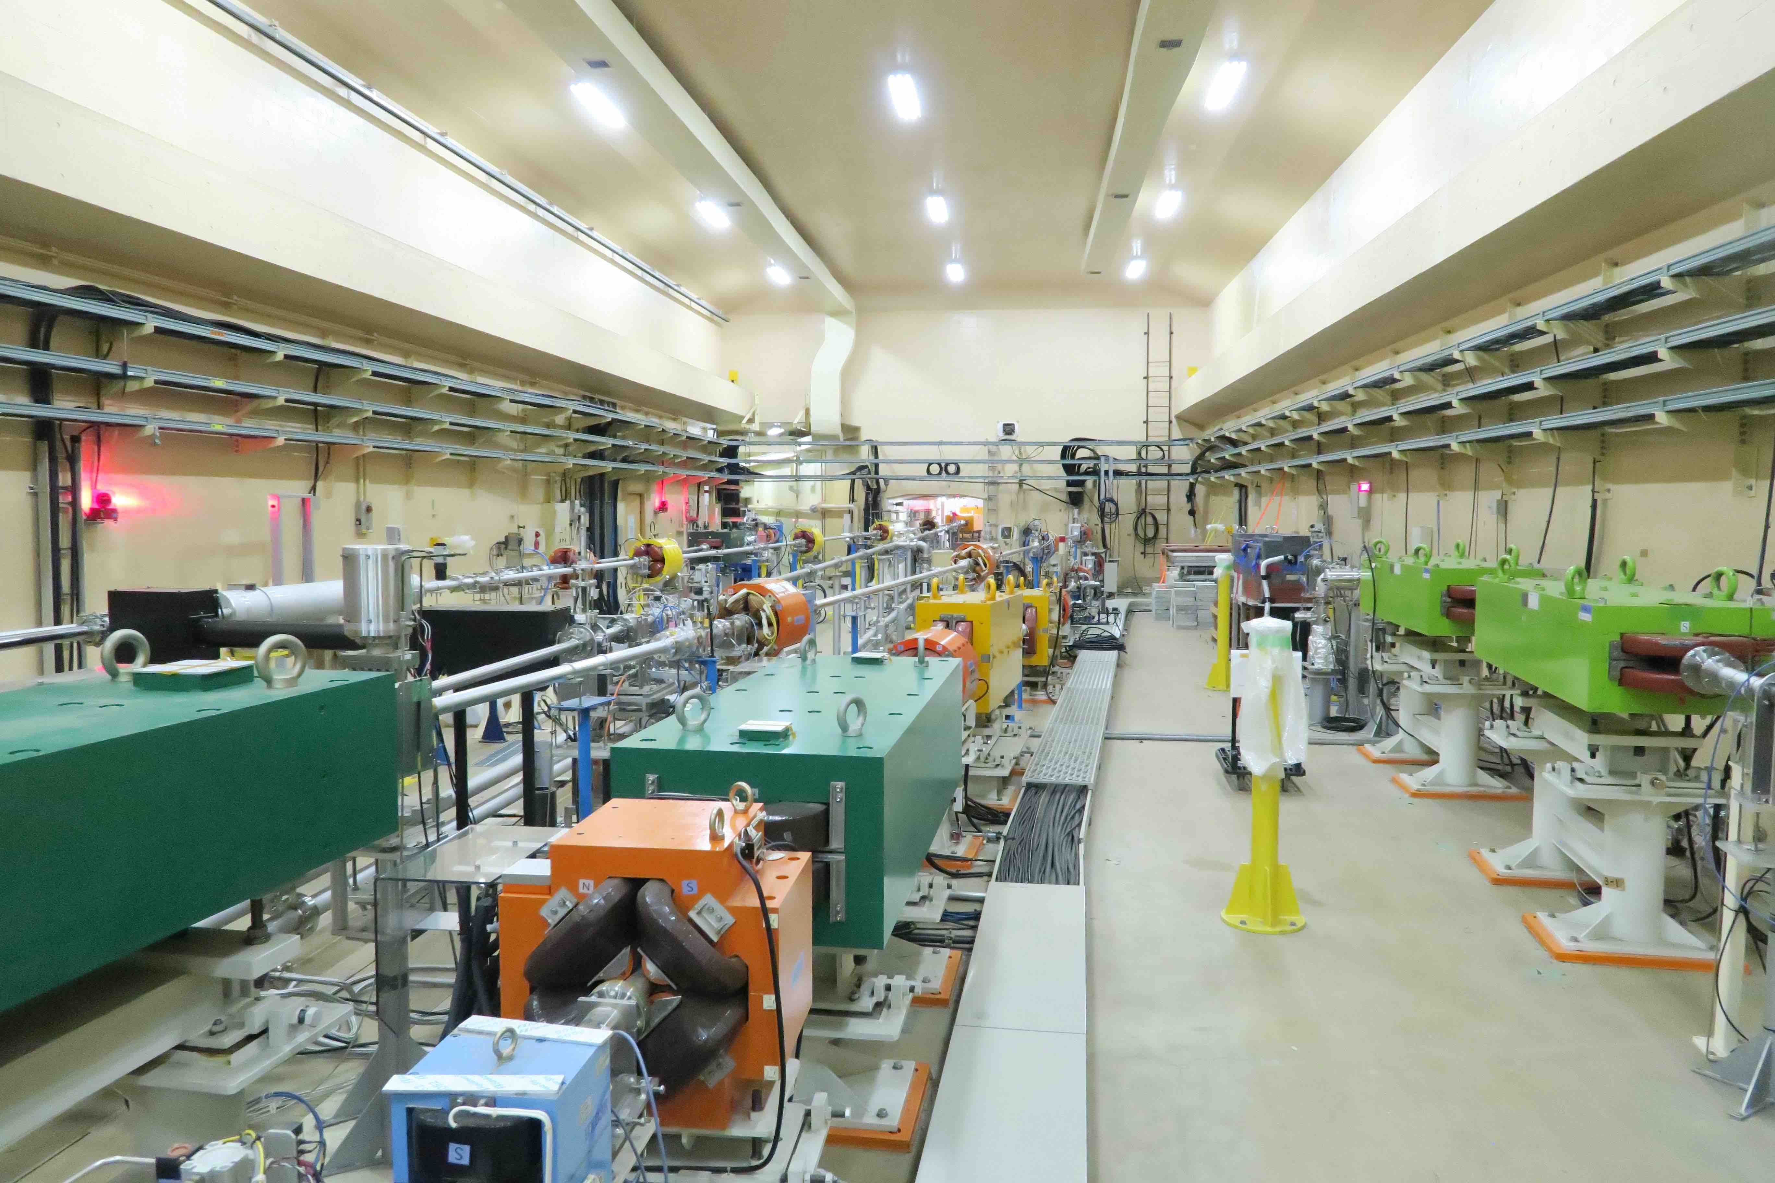
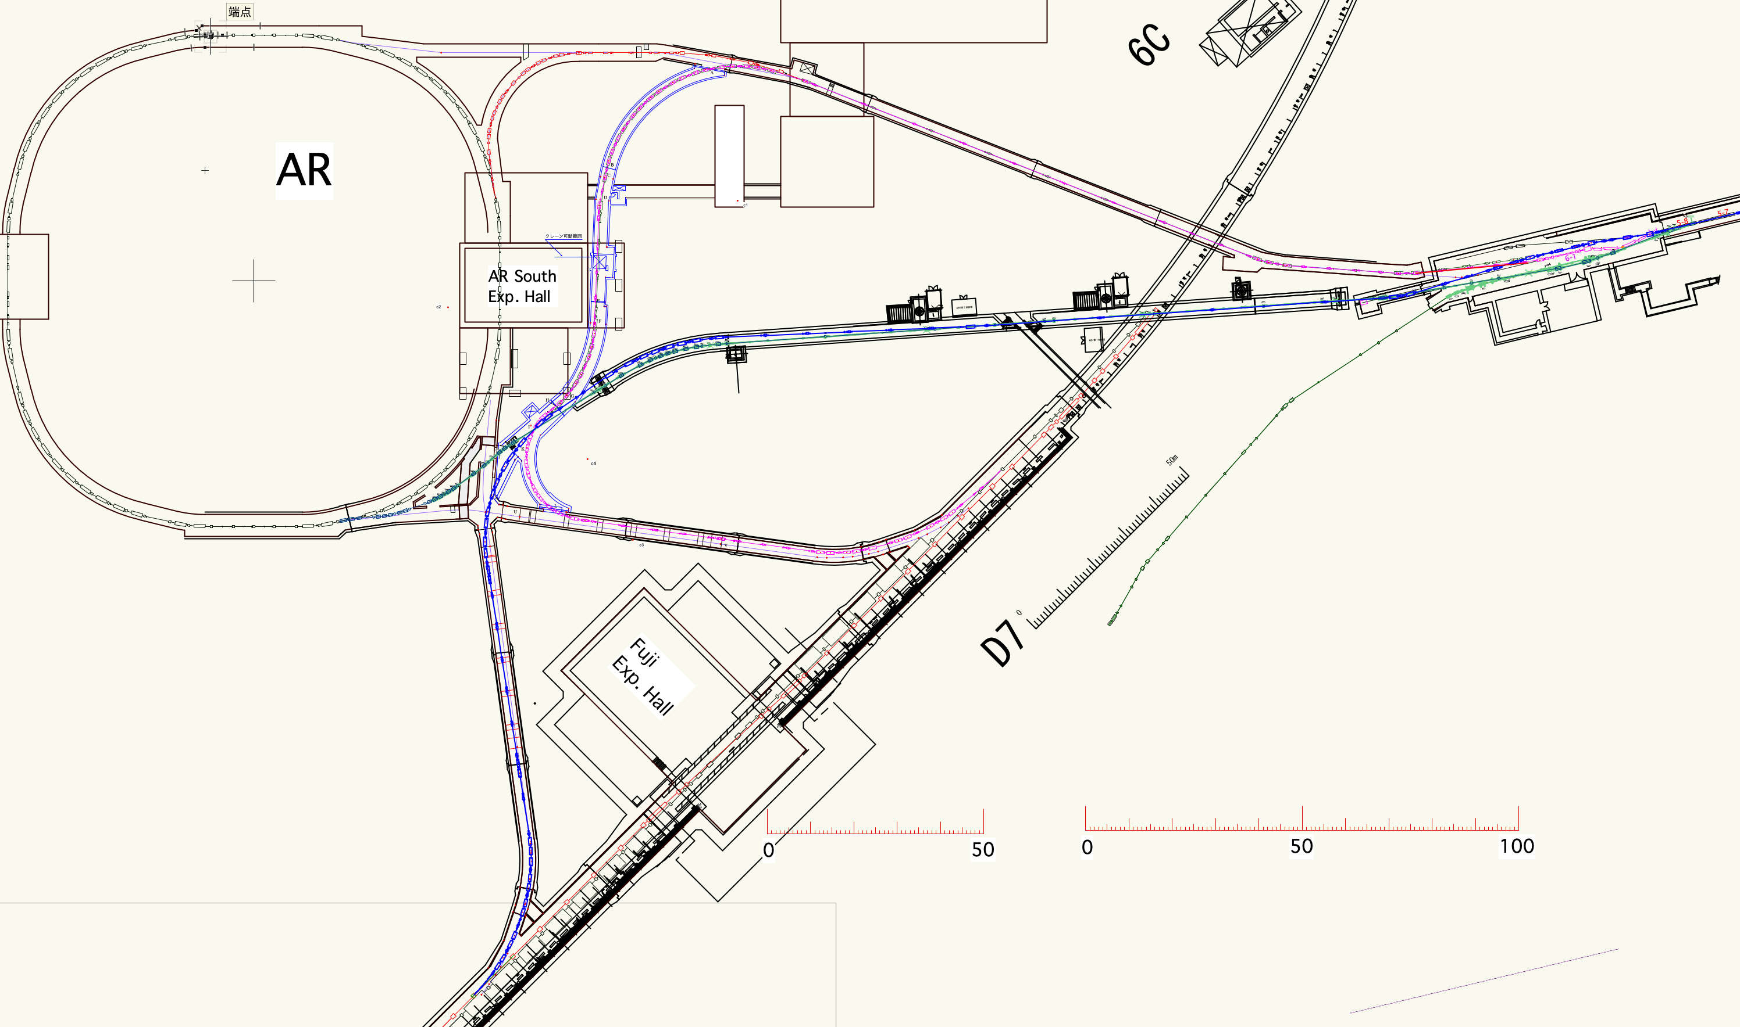
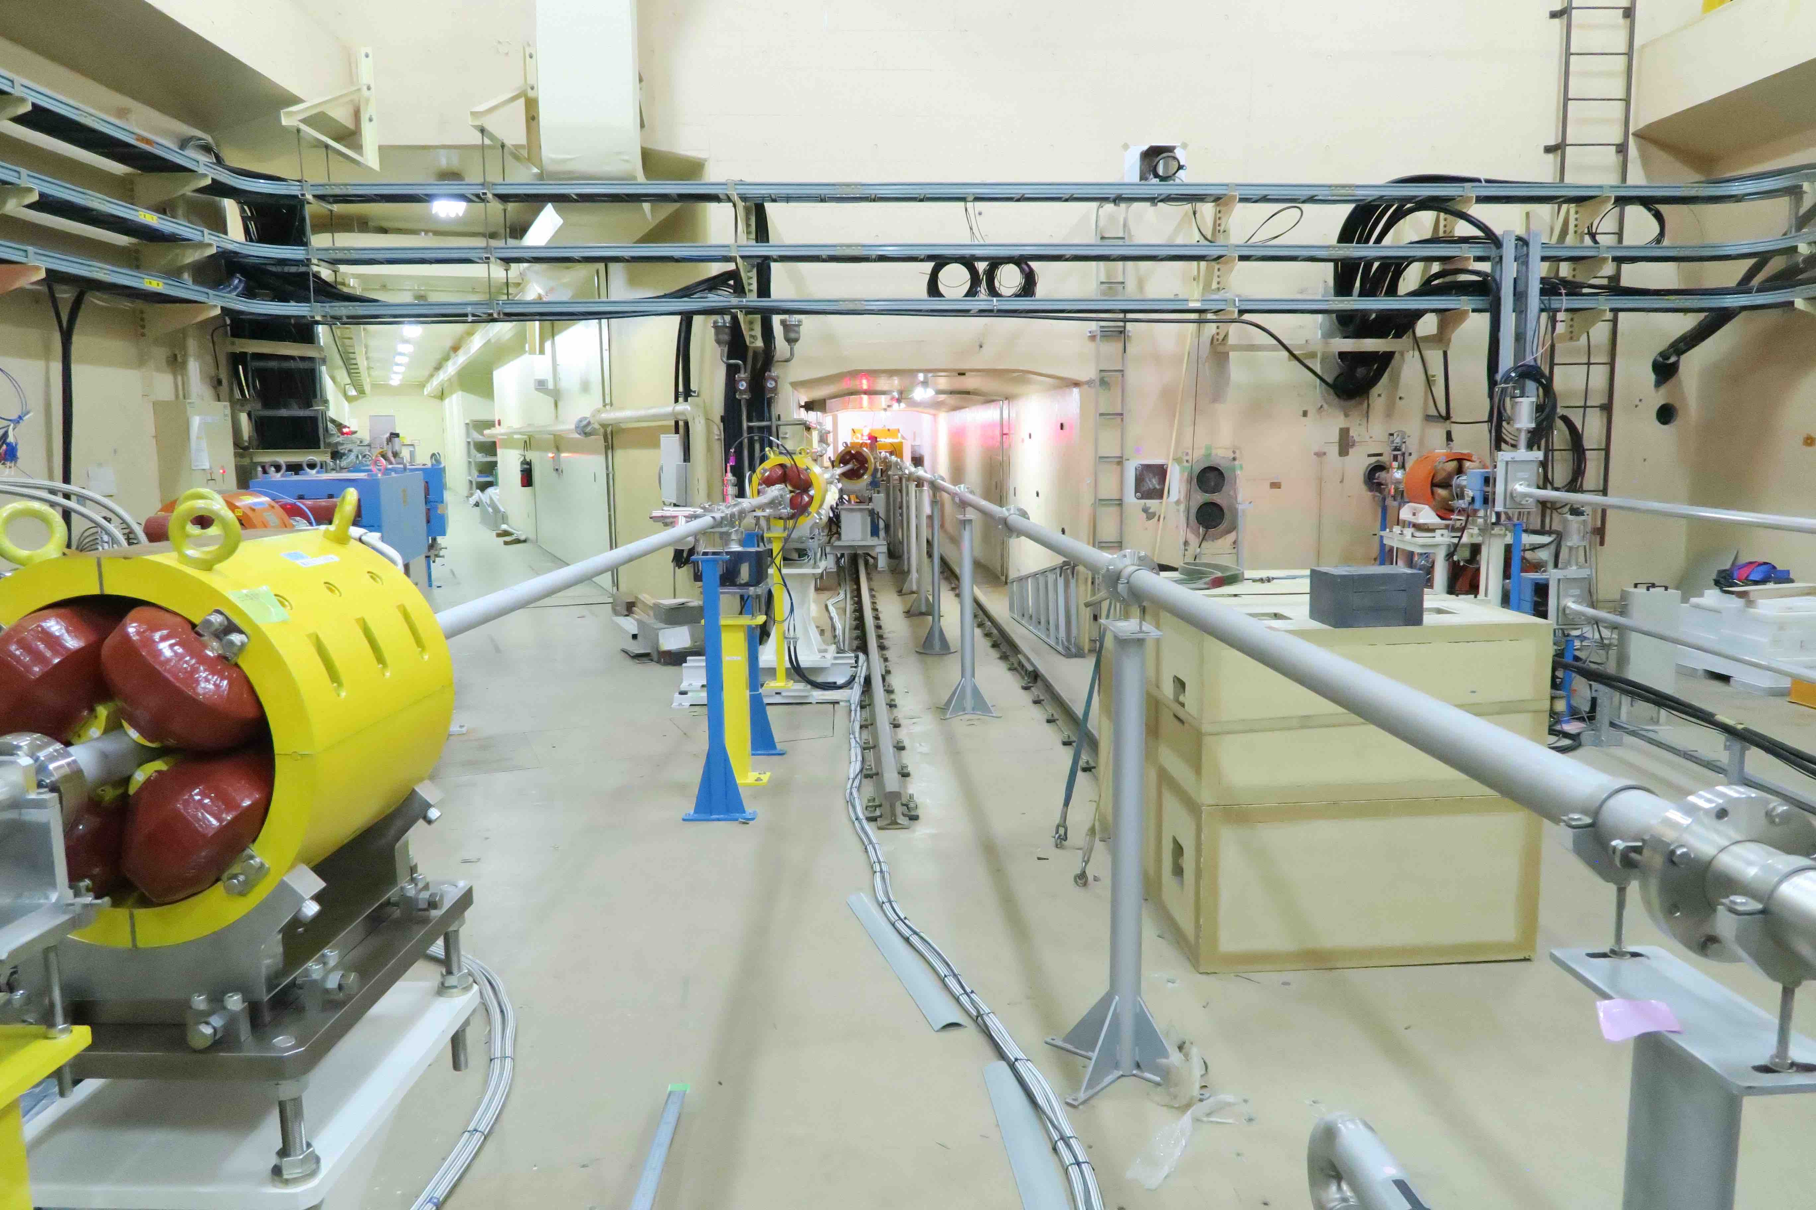
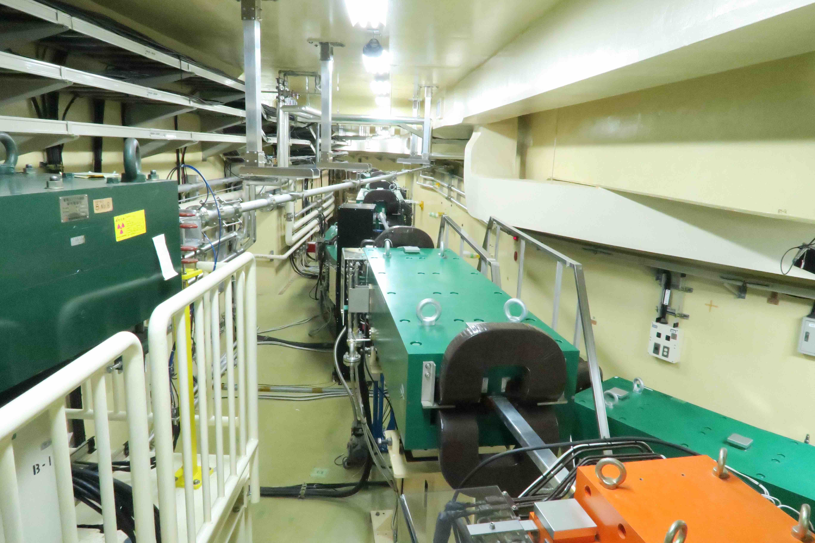
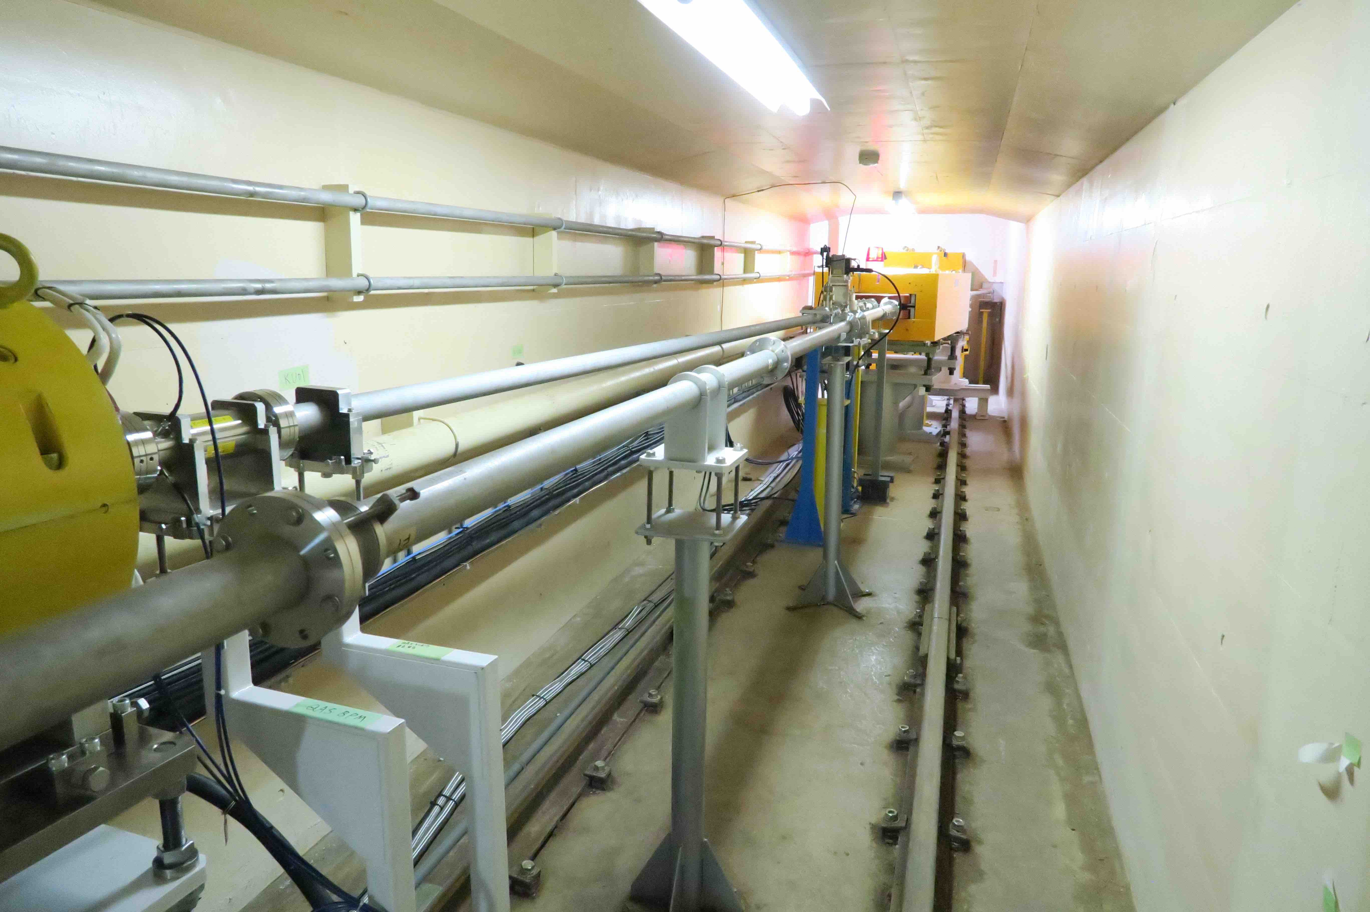
New BT line for HER (Kikuchi)
New BT line for the HER has been proposed, that envisages ease of the CSR/ISR emittance growth.
New line share the tunnel in part with PF-AR transport line.
If we preserve the current BT e- line and can switch the beam pulse-by-pulse, the current line could be used for beam diagnosis.
①
Current HER transport line
②
Linac
①
②
③
④
New HER transport line
④
③

Slide 22
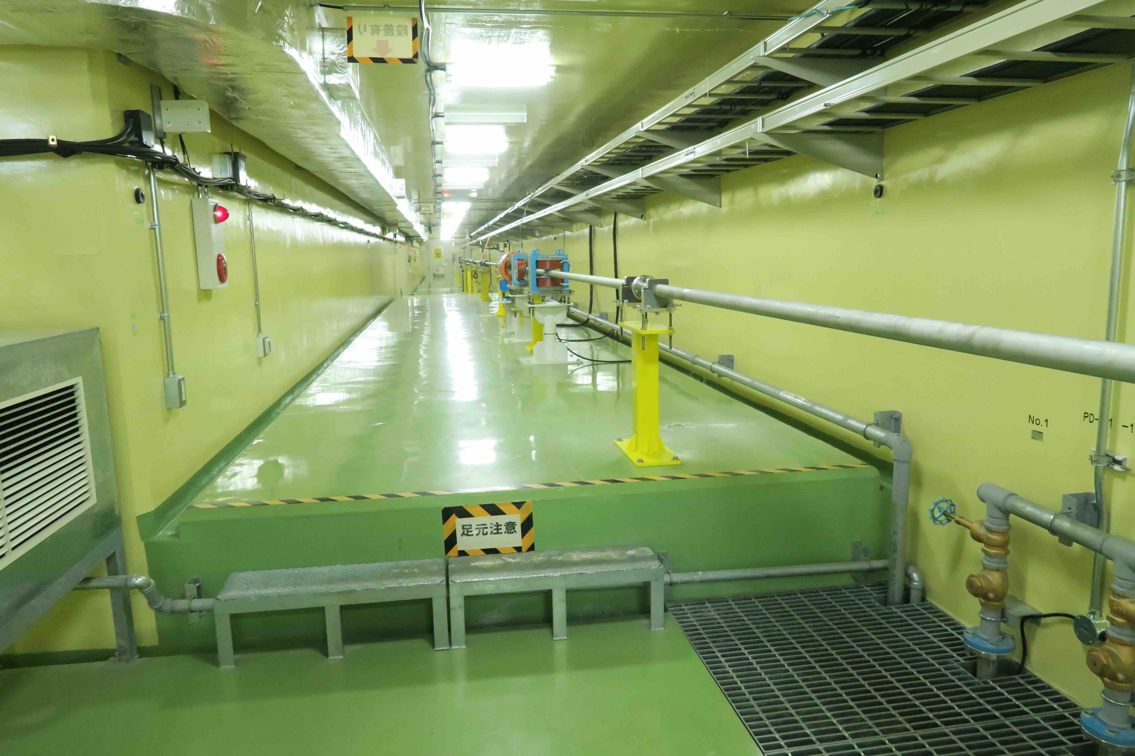
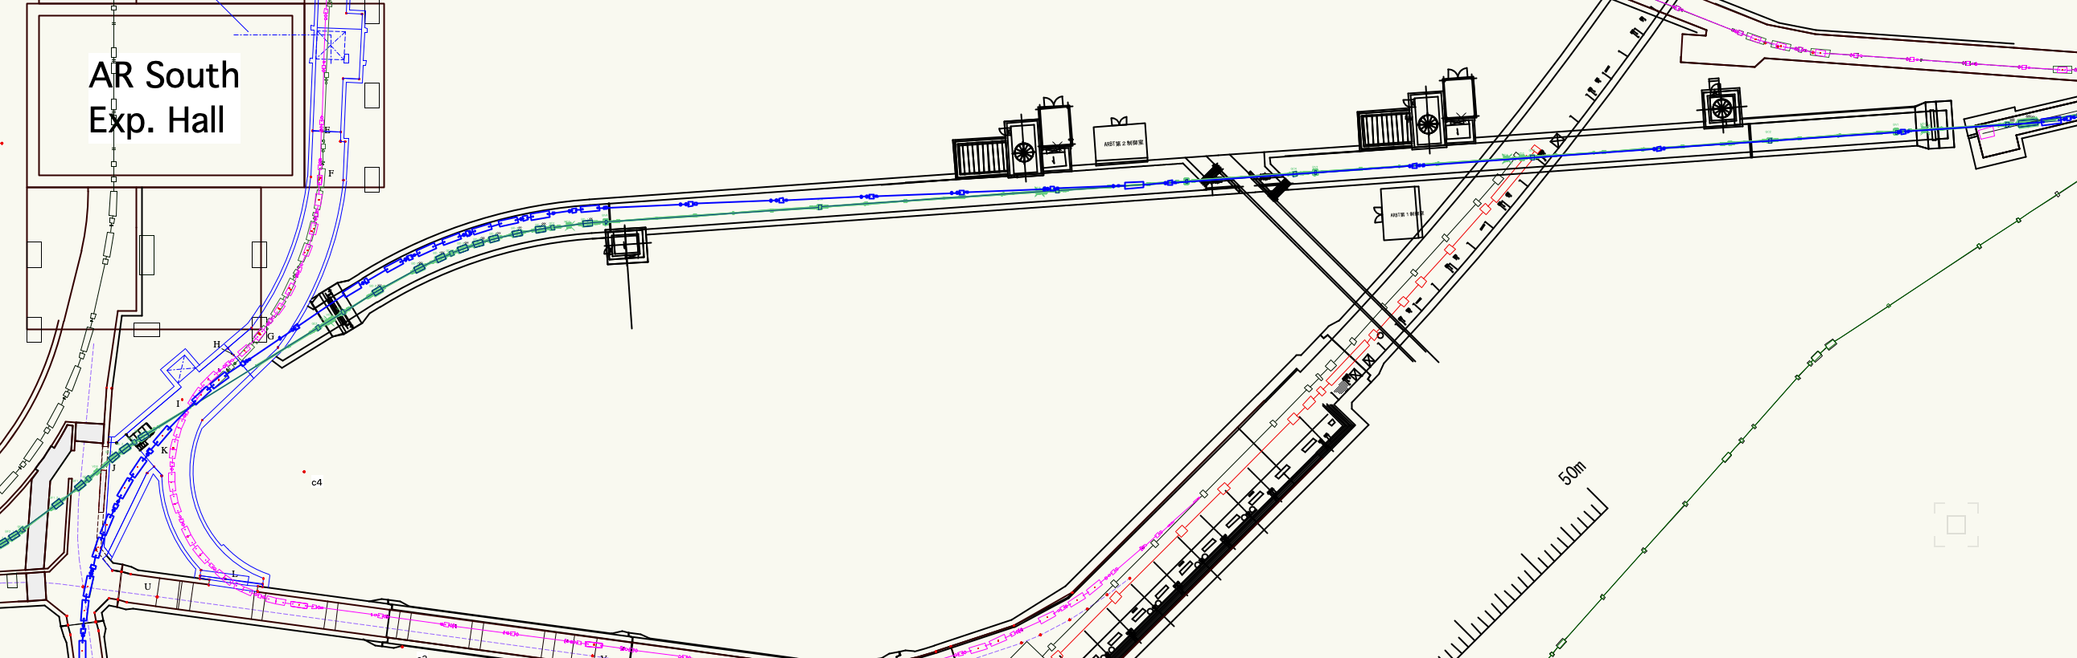
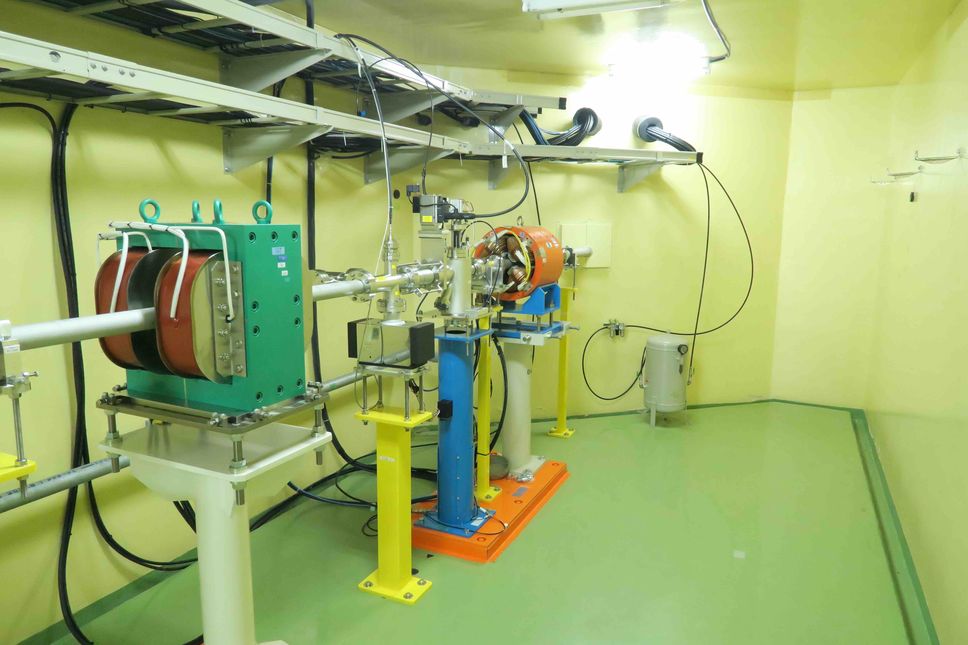
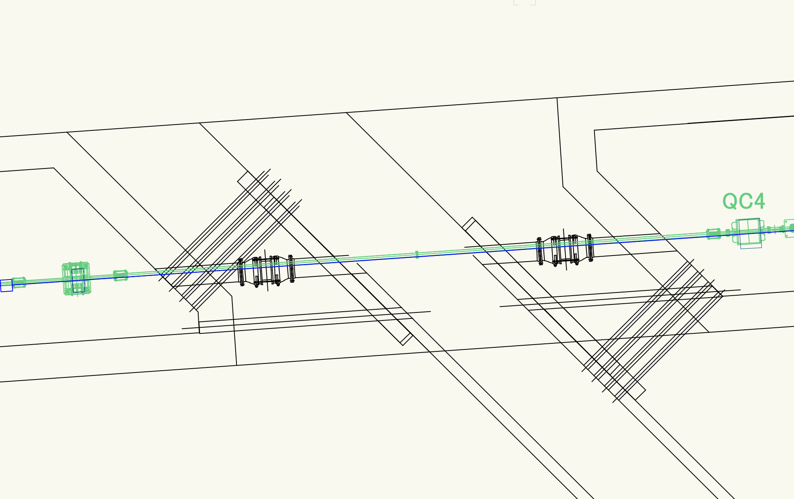
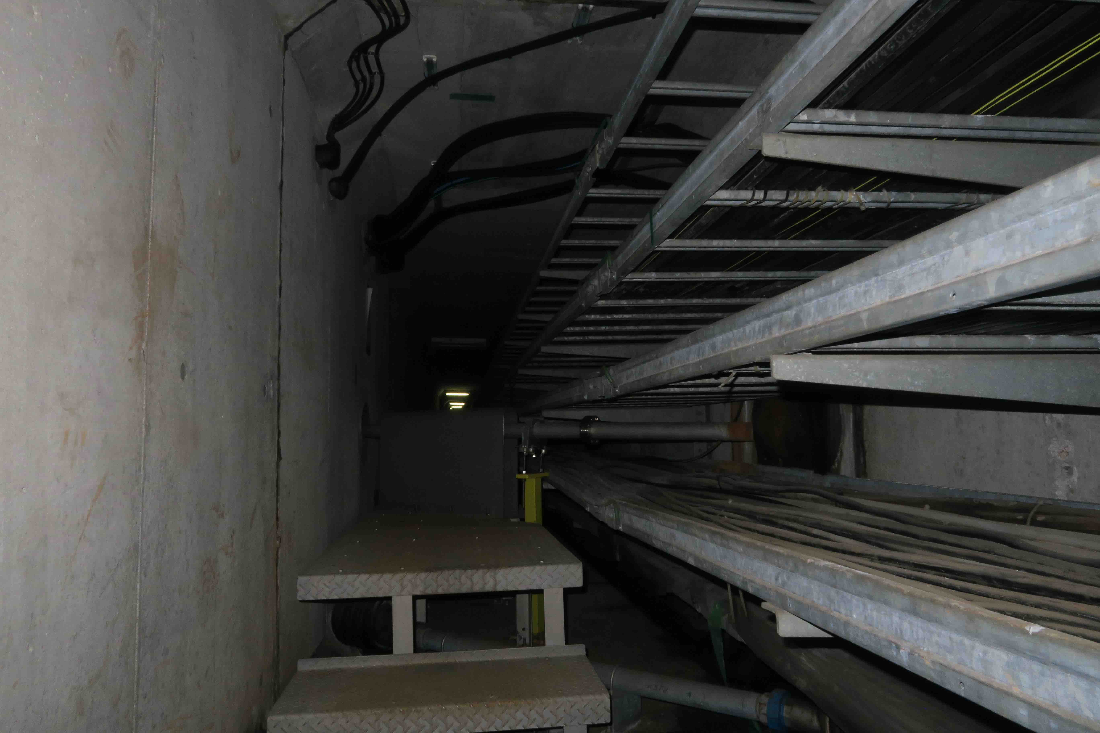
New BT line for HER (Kikuchi)
①
Tunnel structure
Junction with the utility tunnel
②
①
③
Upstream tunnel
Downstream tunnel
Above the MR tunnel, floor level is elevated by 50 cm.
②
The tunnel of PF-AR BT has two independent tunnels. They are loosely connected to the utility tunnel via bellows pipes which are embedded in soil. Beam pipes pass through the bellows pipes.
The junction part has to be excavated to construct the new HER BT line.
The utility tunnel houses many cable-ladders inside, and the BT line has to avoid collision with them; the beam pipe should pass in between the cable ladders, adjusting beam height with vertical translation.
Junction part
SOIL
SOIL
Upstream tunnel
Downstream tunnel
③

Slide 23
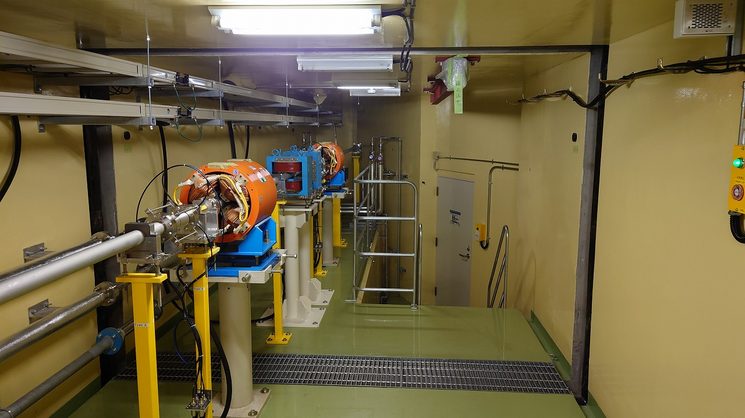
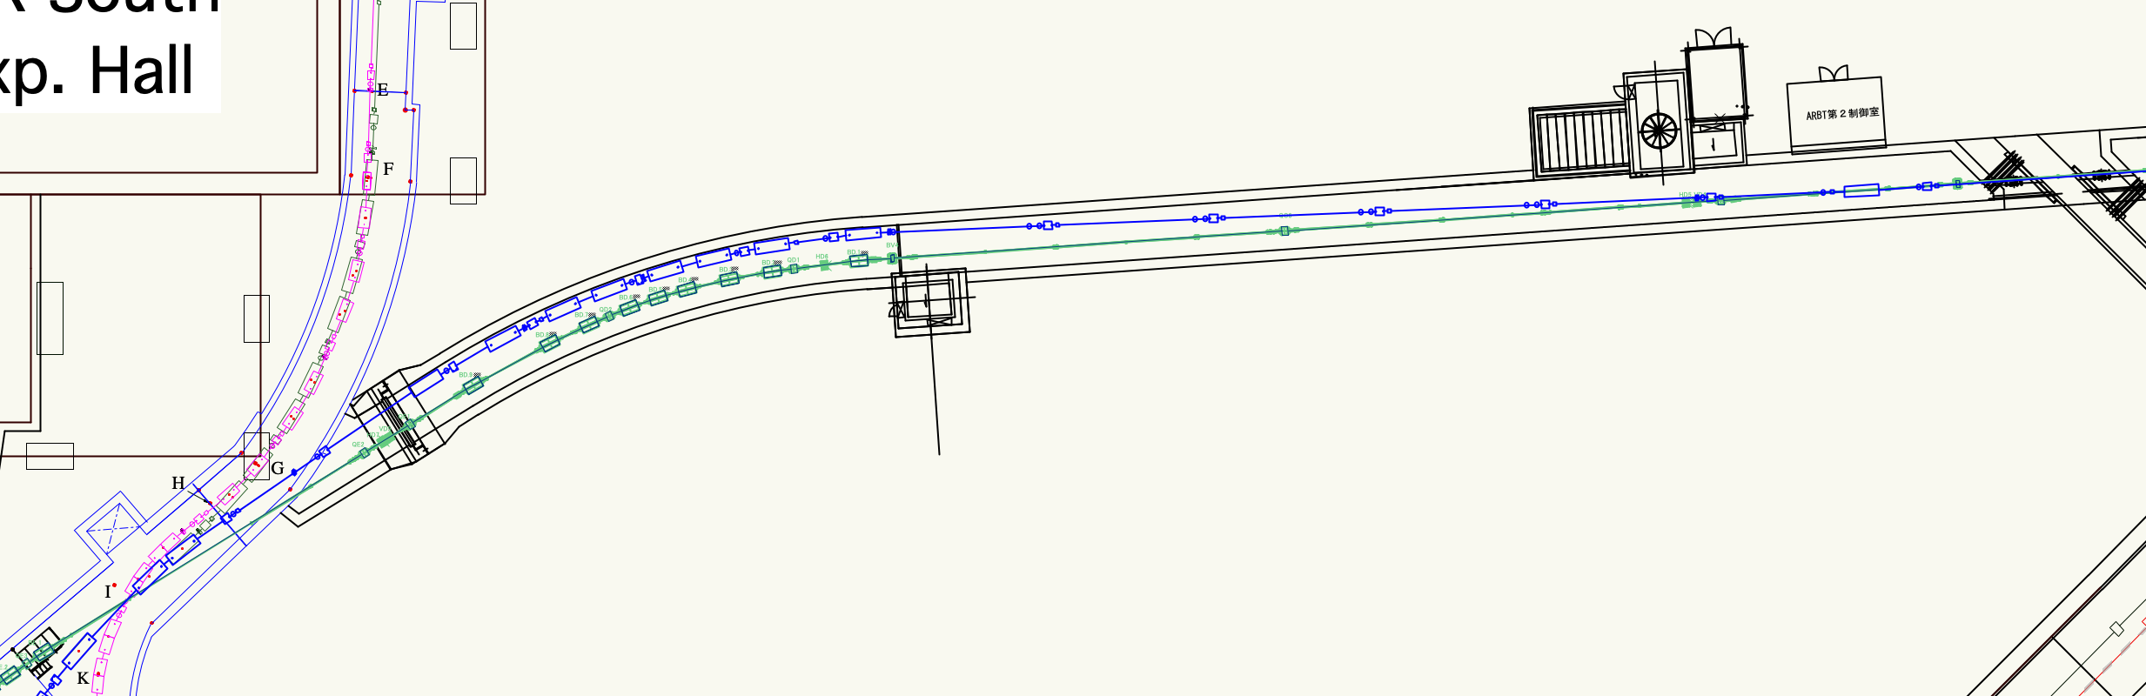
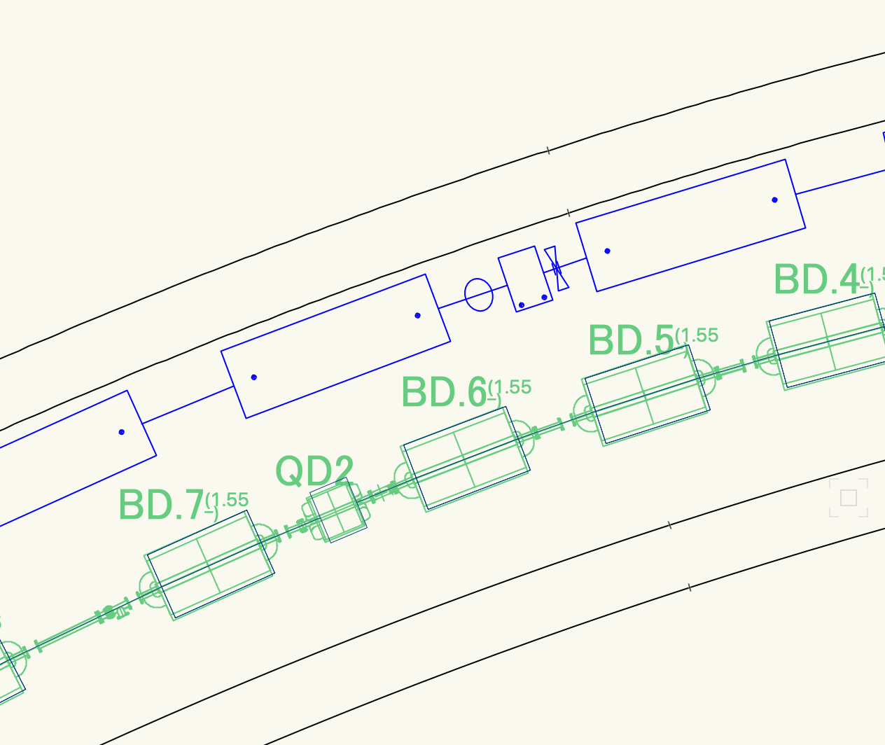
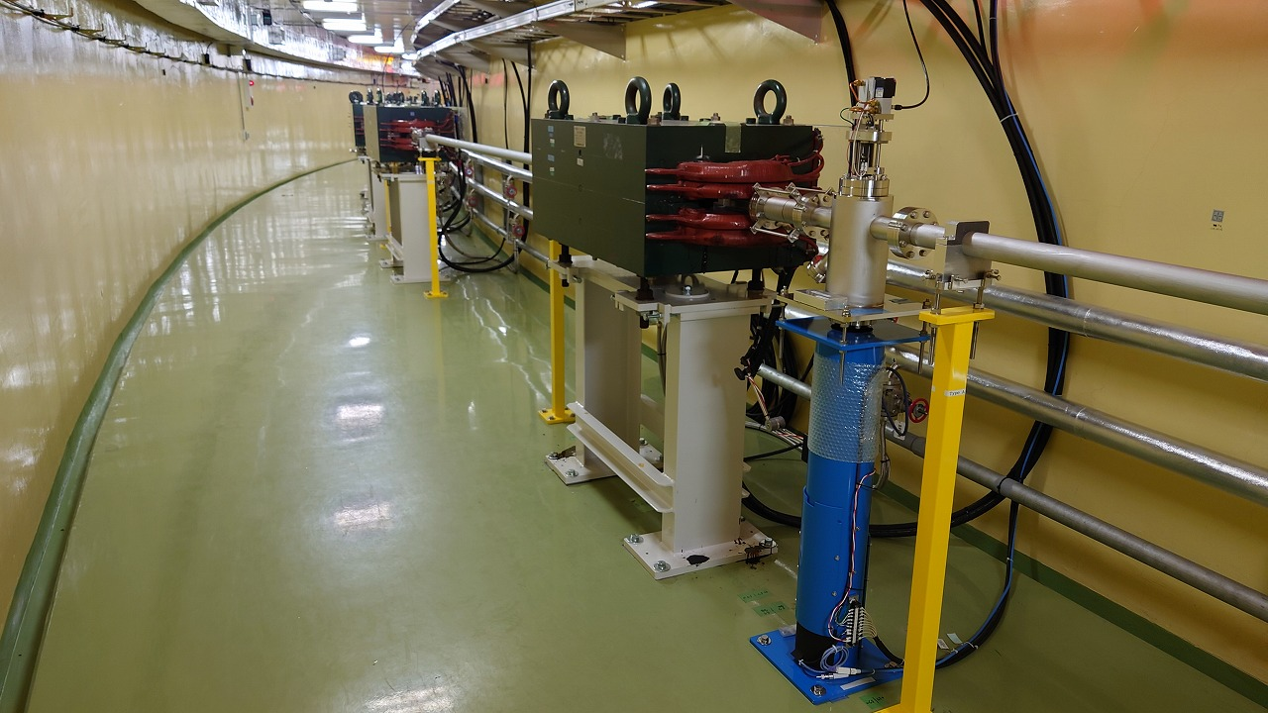
New BT line for HER (Kikuchi)
Beam line
①
New ARC1
ARC2
②
PF-AR BT line
①
ARC1 part is located side by side with the PF-AR line in the present plan .
Beam level of the new line is 0.6 m lower than the PF-AR line.
Transverse free space between the magnets of two lines are 0.5 m at minimum, which will make the maintenance work difficult.
Bend angle is smaller than current ARC1. Since longer bend is preferable for the CSR we plan to reuse the bend in the ARC2, or to fabricate new bend that has smaller width.
②
New ARC1
PF-AR BT line

Slide 24
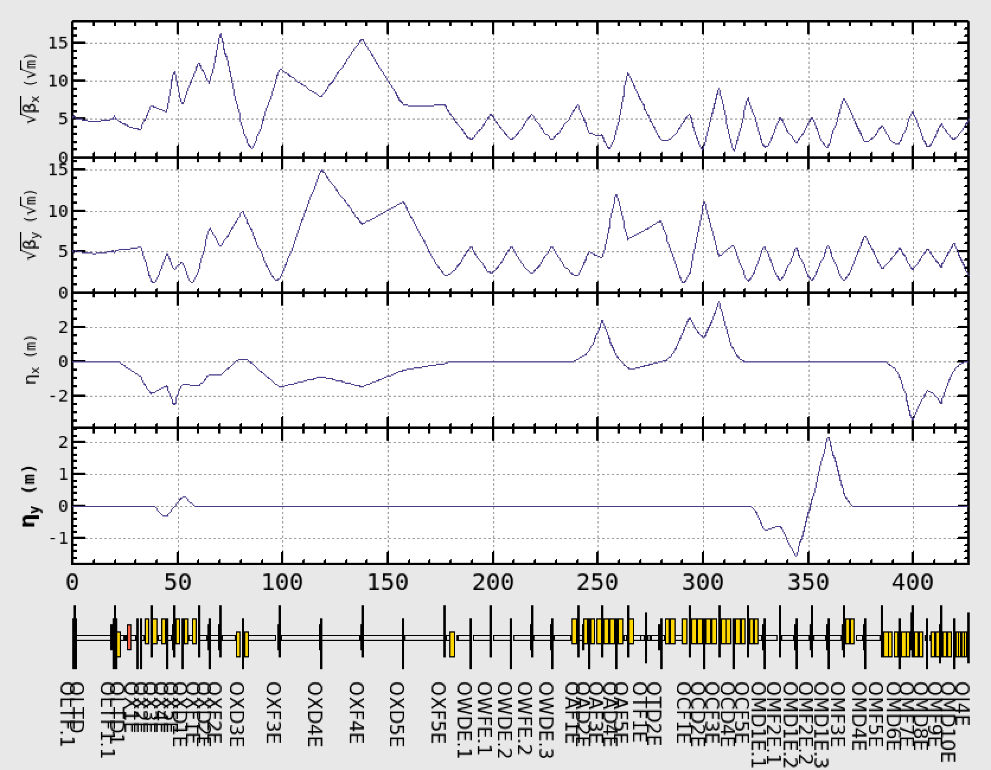










New BT line for HER (Kikuchi)
Emittance at Injection
Optics
Emittance growth due to ISR
Results of tracking simulation are fitted to
, where,
(New BT line)
(Current BT line)
New ARC1
ARC3
ISR induced emittance growth $ε_{q}$ of the new BT line decreases to 1/3 of that in current BT line
New BT line
Current BT line
$$ε(μm)$$
$$ε(μm)$$
$$ε_{i}(μm)$$
$$ε_{i}(μm)$$

Slide 25
Summary
For better injection efficiency, a few countermeasures will be performed.
Some hardware have issues to be solved. The countermeasures are also in progress.
The budget for e- ECS has already approved and the fabrication of ECS components are on-going. The effectiveness and feasibility study of e- ECS should be performed as soon as possible.
New BT e- line for HER has just started to study. No apparent showstopper is found so far.
Need to consider a consistent upgrade plan including e- ECS and New BT e- line for HER.

Slide 26
backup

Slide 27


Injection orbit changes and re-alignment of BT e ARC4 (Kikuchi)
We have also found some mysterious discrepancy in the design
In design of SKB, alignment of BT line in the KEKB era was preserved except for septum magnets.
But we have found discrepancy in the design between SKB and KEKB:
At the entrance ofSE4 SKB design has $(ΔG_{Y},Δχ_{1})=(−2.5mm,2.08mrad)$ relative to KEKB design.
Considering misalignment of $ΔG_{Y}=−2.73mm$ for QI4E, net effect is a translation in $G_{Y}$ for both of BT and HER by $ΔG_{Y}∼2.5mm$
Official Design of HER line in the KEKB era

Slide 28

BT-BPM updates: (Mori)

Slide 29

BT-BPM updates: (Mori)

Slide 30
DR-RTL: Fast Kicker (Naito and Kodama)
BITF_20220603_Iida
入射効率に関しては、小玉さんより物言い有り

Slide 31




HER/LER Abort Kicker : Trigger system
Rising time of abort kicker is less than 200 ns but It needs about 1 μs before the fire the thyratron by using Teledyne E2V triggering system.
Will replace the trigger system to new one. (1 μs → 250 ns)

