Slide 1
Injector Overview
Masanori Satoh (Acc. Lab. Div. V, KEK)
on behalf of Injector Linac Group and Linac Commissioning Group

Slide 2
Contents
Injector outline
e- beam status and issue
e+ beam status and issue
Upgrade work and progress during LS1
Summary

Slide 3
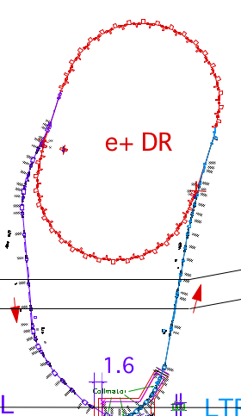
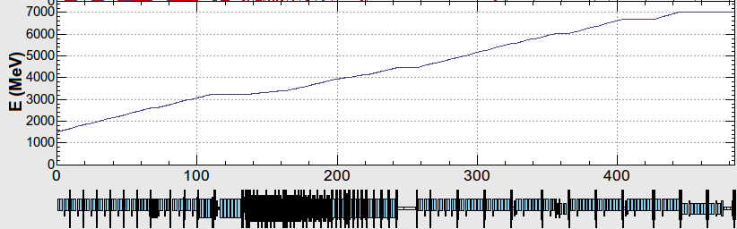
Injector Linac Layout
Outline
・Two electron sources:
RF gun: HER injection
Thermionic DC gun: LER, PF, PF-AR
・Sector 3-5:
All magnets are pulsed magnets.
Continuous orbit feedback
・DC magnet settings are same for different beam mode
・Simultaneous top up injection for SuperKEKB and light sources since 2018
60 klystron units
240 accelerating structures (S-band 2-m-long)
8 Sectors (A-C,1-5)
Energy Knob
Thermionic gun
1.1 GeV e+
Damping Ring
Photocathode
RF gun
J-ARC
B
A
1.5 GeV
BCS
C
ECS
PF
1 2 3 4 5
PF-AR
ECS
chicane
LER
e+
target
e+ capture section
Energy Knob
HER
Acceleration
HER 7GeV
4.2 GeV
PF-AR 6.5 or 5 GeV
e-
Stand-by
LER 4 GeV e+
1.1 GeV
Deceleration
PF 2.5 GeV
e+ target
e+
Acceleration
1.5 GeV
C
1
2
3
4
5
Beam energy variation for each beam mode along the beam line after J-ARC
3

Slide 4
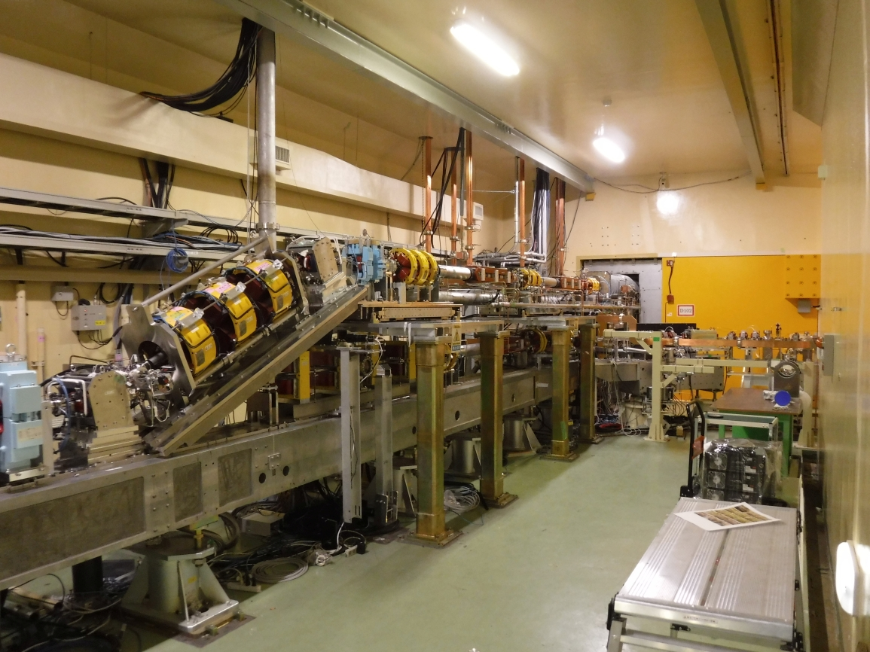
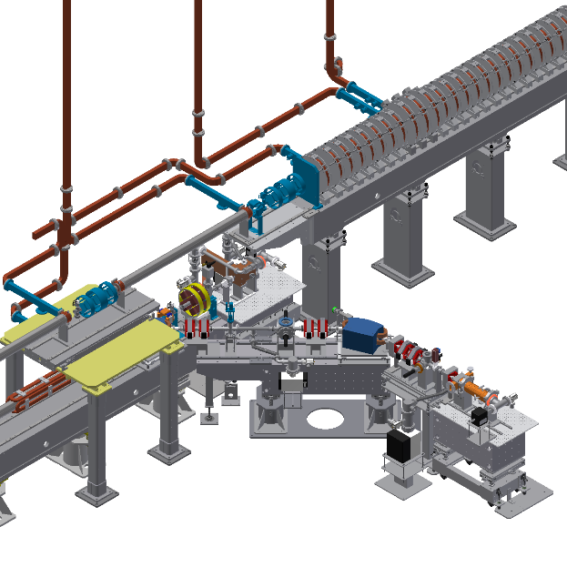
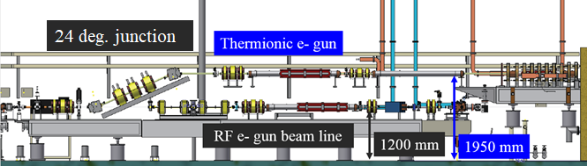
Pulse to pulse beam switching:
rf e- gun/thermionic e- gun
In injector section
(double decker beam line)
Outline
Thermionic DC e- gun (GU_AT)
w/ 2 subharmonic bunchers (114 MHz, 571 MHz) and 2 bunchers.
・e+ production e-: 10 nC (for LER injection)
・e- study/HER injection: 1 nC
・PF injection: 0.1 - 0.3 nC
・PF-AR injection: 0.1 - 0.3 nC
RF e- gun
（GR_A1 for HER injection）
Pulsed bend
Schematic side view
Notes:
入射部では24度垂直偏向パルスベンドを用いて，熱電子銃，RF電子銃を切り替えて運転している．
熱電子銃は，陽電子生成用10 nC電子ビーム，PF,PF-AR入射用 0.3 nCビームを生成している．
RF電子銃は，HER入射用低エミッタンス電子ビームを生成している．（レーザー両打ち，IrCeカソード）電子銃からは，最大2～3 nC出る．

Slide 5
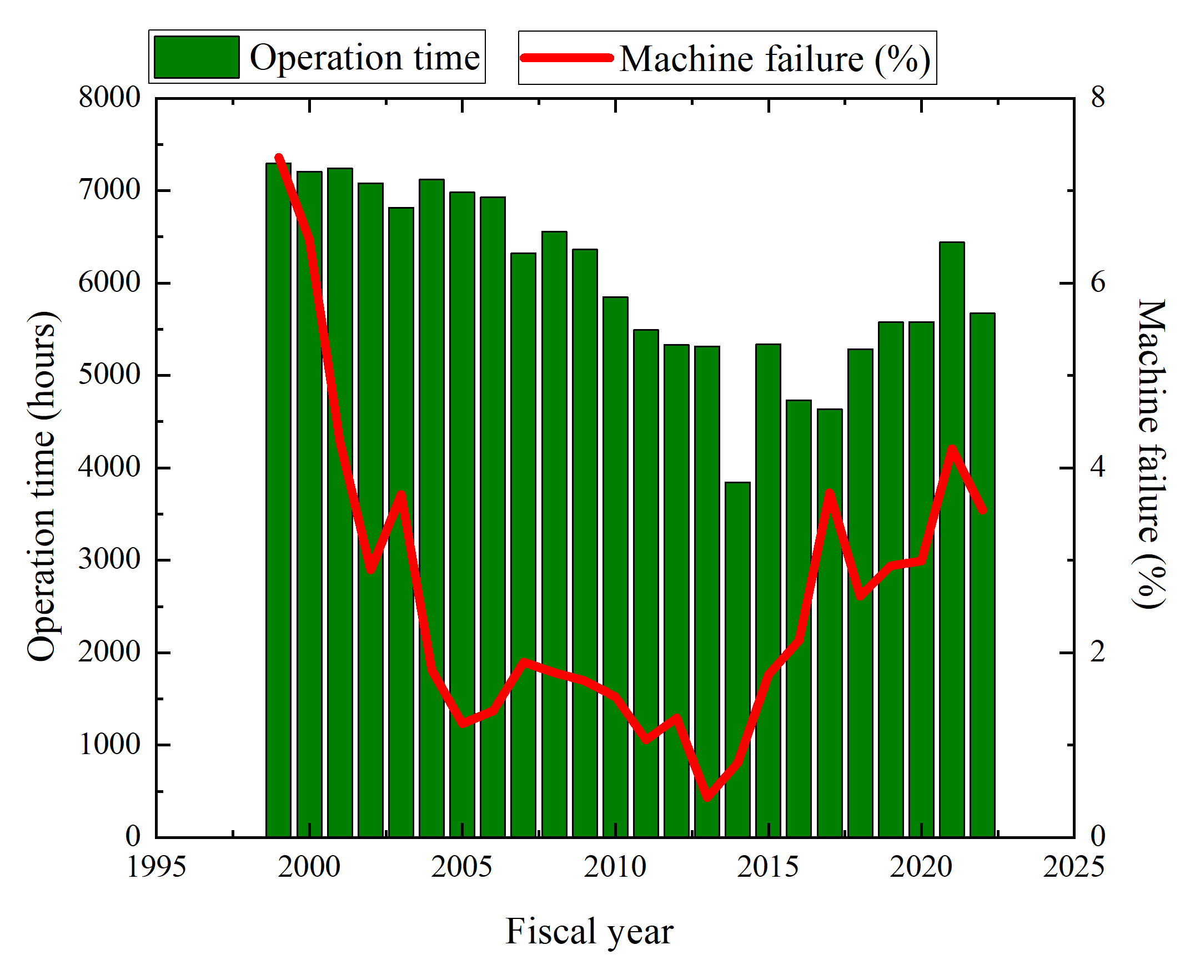
Injector operation statistics
Outline
KEKB
SuperKEKB

Slide 6
Injector beam loss time statistics
(FY2020 – FY2022)
Outline
FY2020: 1.58%
FY2021: 1.83%
FY2022: 0.81%
Beam operation could be interrupted by some different reasons. (RF, magnet powers supply, control software failure, …)
Beam loss time ratio is less than 2%.
Most beam loss time are caused by RF and e- gun related troubles.
In FY2022, beam loss time is less than 1%.
  In 2022b, 2022c, 2023a, SuperKEKB was not in operation because of LS1.
  Linac klystron operation mode was changed from 50 Hz to 25 Hz.
In FY2022, most of beam loss time are caused by magnet trouble.
  Pulsed magnet controller problem.

Slide 7
e- beam status and issue

Slide 8
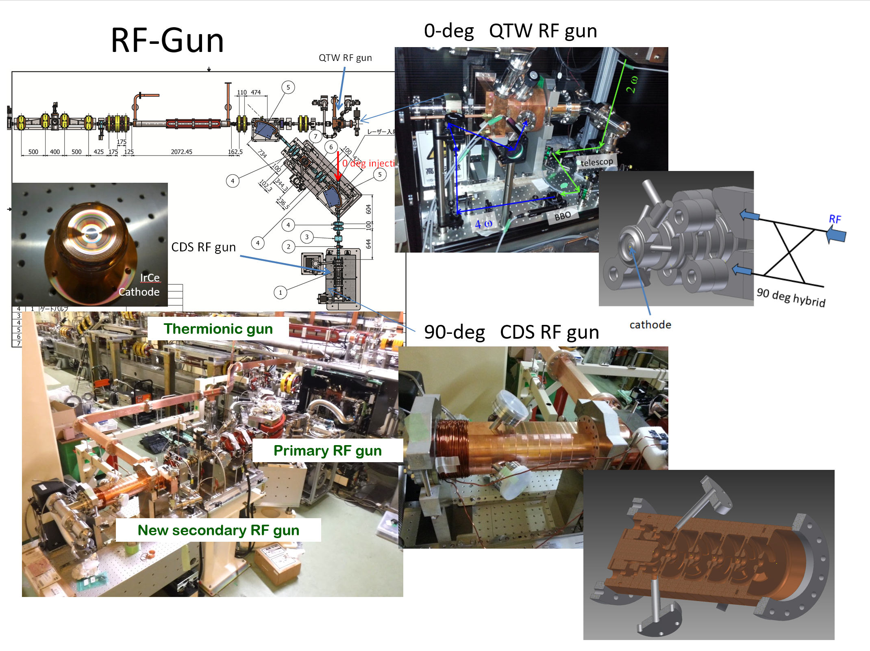
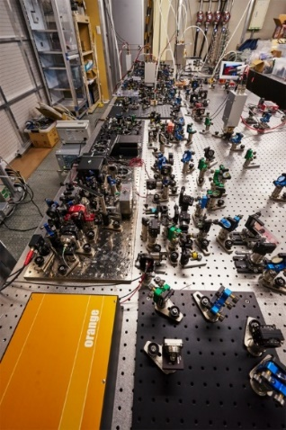
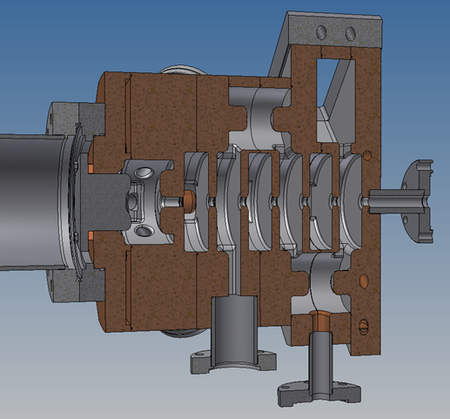
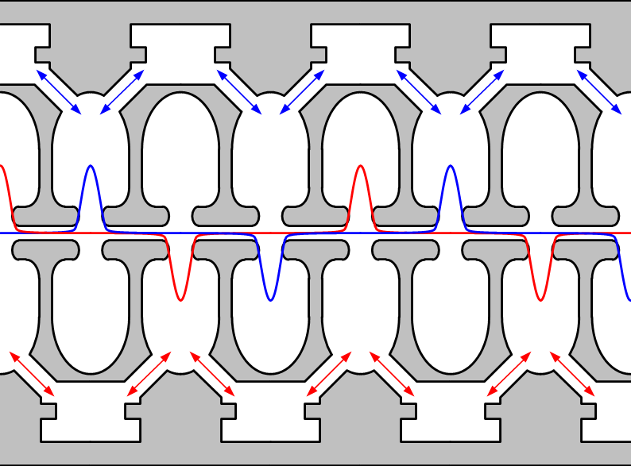
RF e- gun
Low emittance photocathode rf e- gun
e- beam status
QTW RF gun or operation (0 deg. Line)
Photocathode
(metal
Ir7Ce2 cathode
Laser system
Photocathode: Ir7Ce2
Cavity: QTWSC (Quasi Travelling Wave Side Coupler)
  Strong focusing electric field
CDS RF gun
for backup (90 deg. Line)
short drift space
Secondary RF gun
for test and backup
M. Yoshida et al.

Slide 9
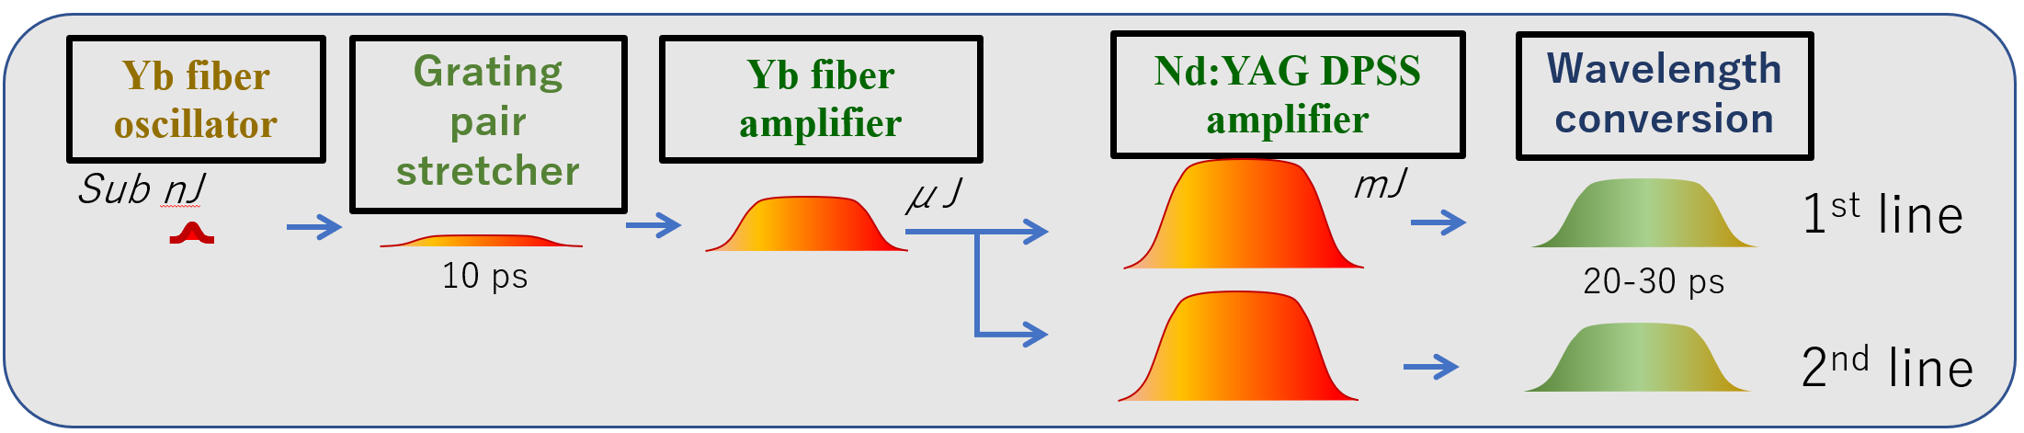
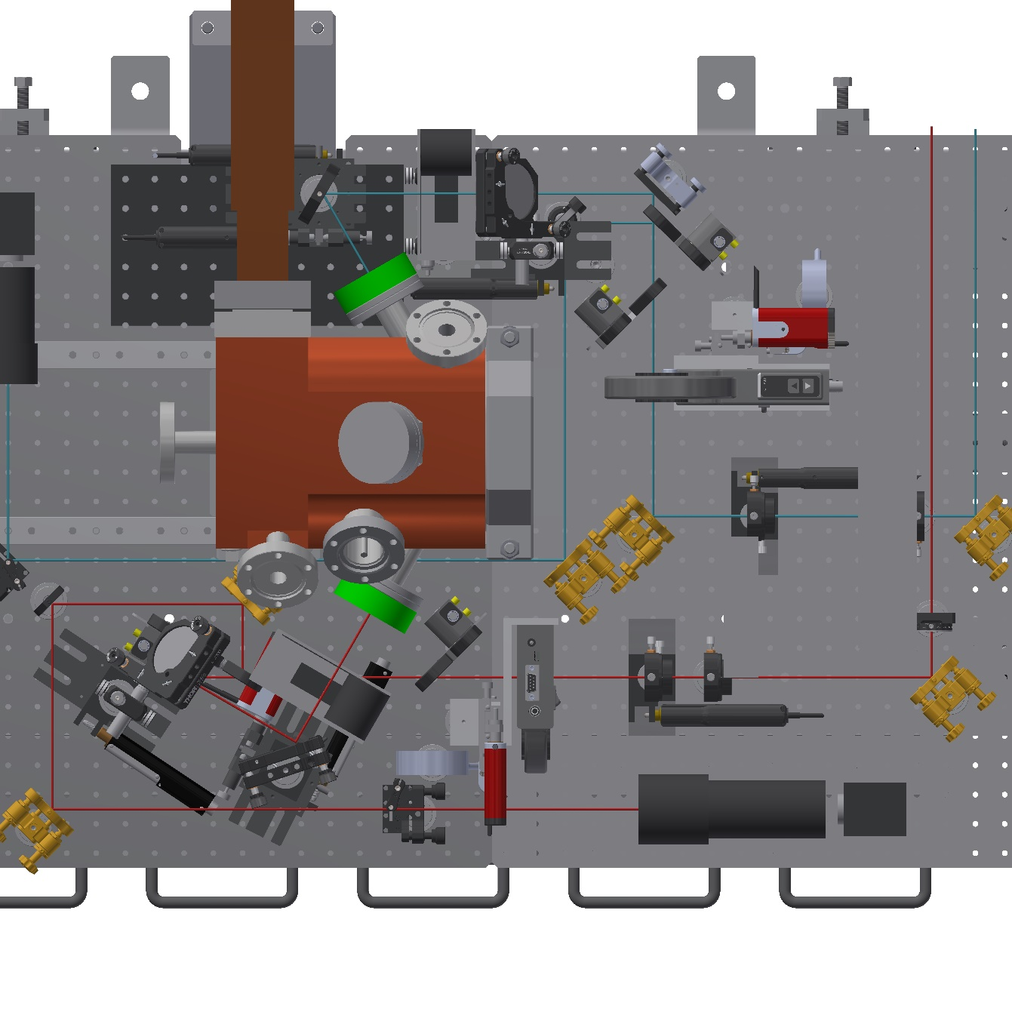
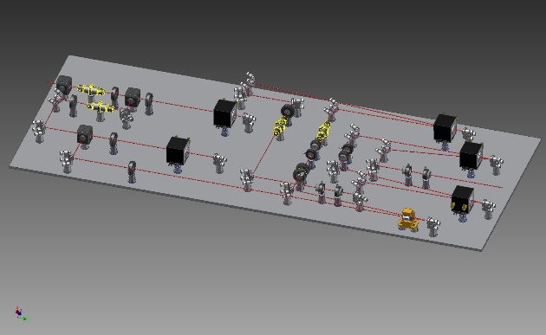
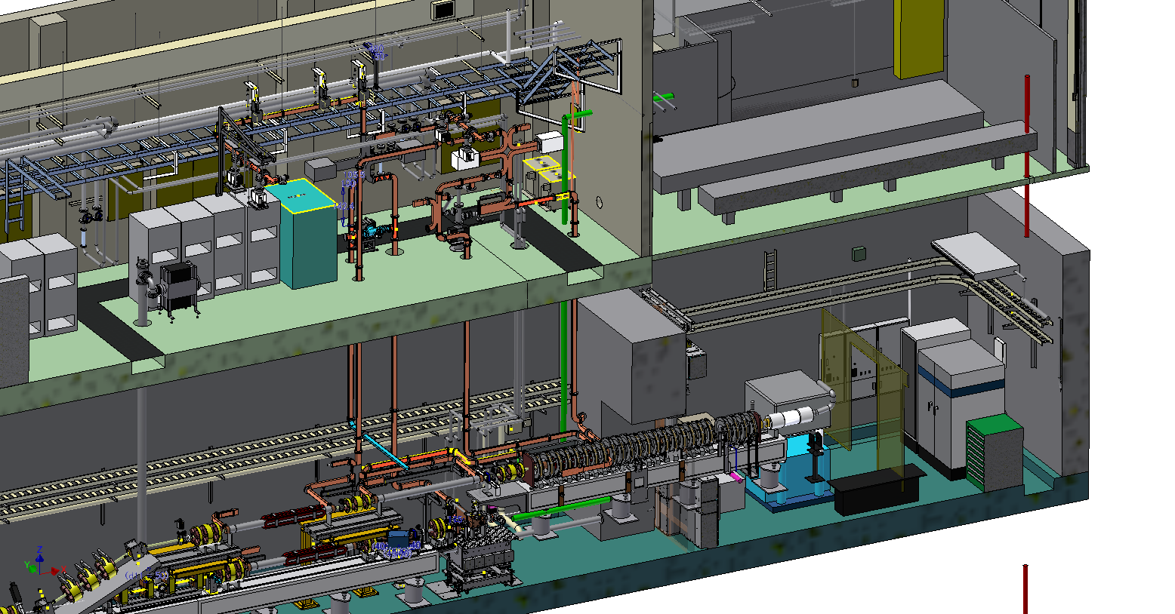
Hybrid laser system for rf e- gun
e- beam status
Yb doped fiber and Nd:YAG DPSS module Amplifier
Output Power:
ω (1064 nm): 30 mJ
2ω ( 532 nm): 15 mJ
4ω ( 266 nm): 1 mJ
1st laser
2nd laser
KLY Gallery
Laser room on the ground
virtual cathode diagnostics
Laser line to RF-Gun
Tunnel
RF-Gun
R. Zhang,
X. Zhou et al.
Laser transport line
Optics layout in the tunnel

Slide 10
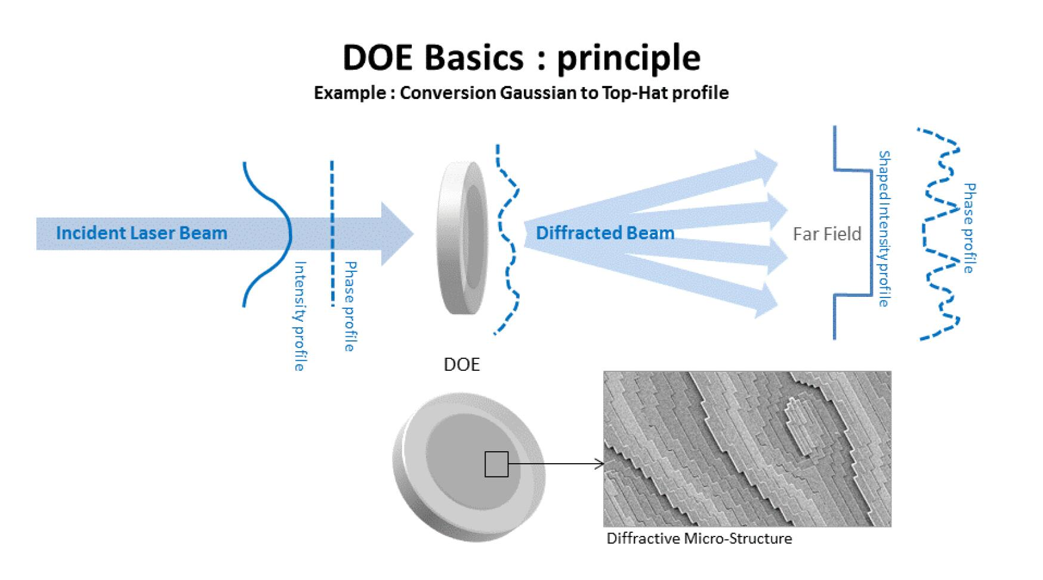
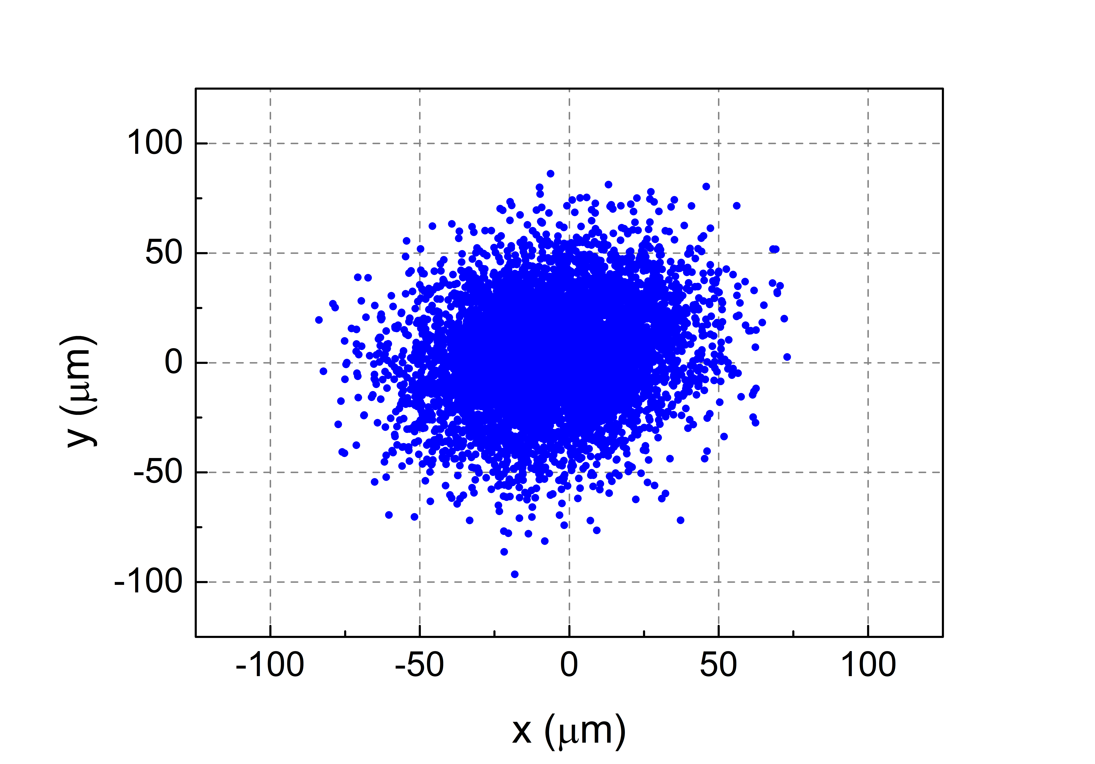
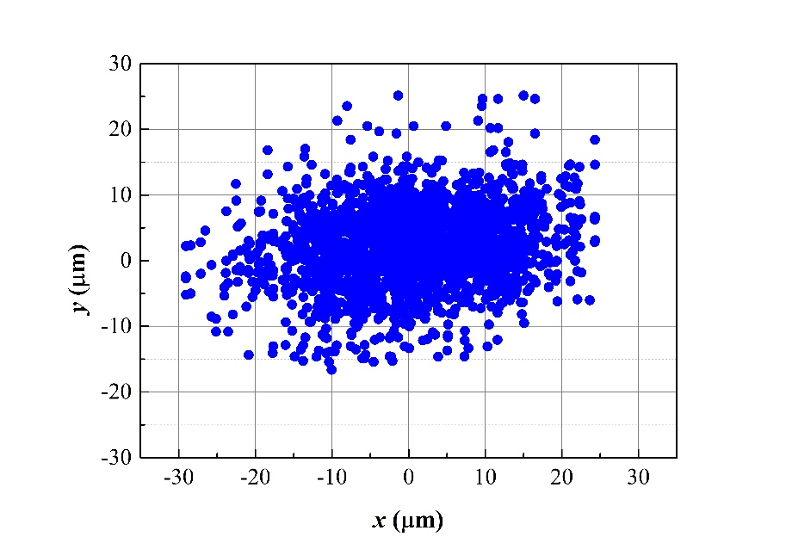
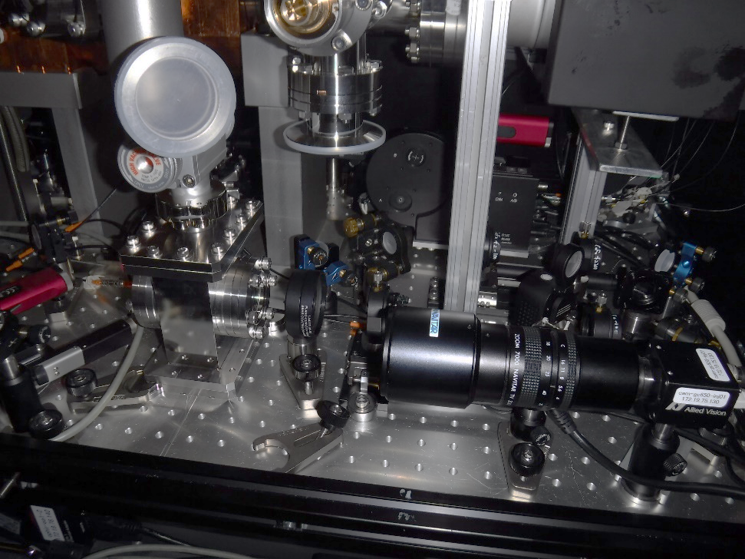
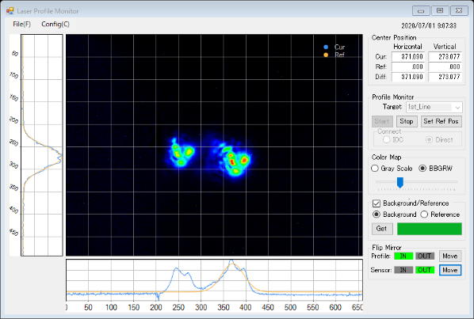
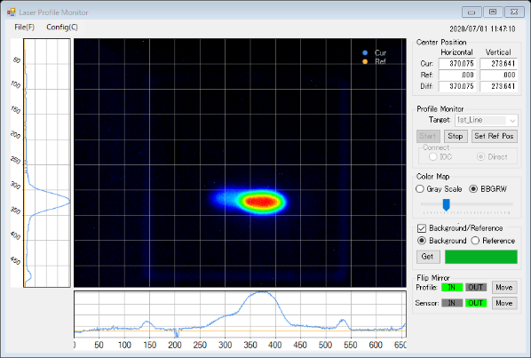
DOE for reshaping of laser spatial distribution
e- beam status
2019.06 without DOE & beam position sensor
2021.06 with DOE & beam position sensor
H 2σ: 48.04±0.51, V 2σ: 46.08±0.69
H 2σ: 24.30±3.06, V 2σ: 10.08±0.46
Pointing stability can be improved.
DOE (diffractive optical element) were installed at 1st /2nd (in summer ‘20/‘21) line laser: Laser beam homogenizer for low emittance beam with the high intensity bunch charge.
DOE is installed in vacuum chamber filled with Argon gas.
DOEs were replaced by new one (Φ8 mm from Φ6 mm) for high bunch charge operation.
For
world first DOE application in UV laser
R. Zhang

Slide 11
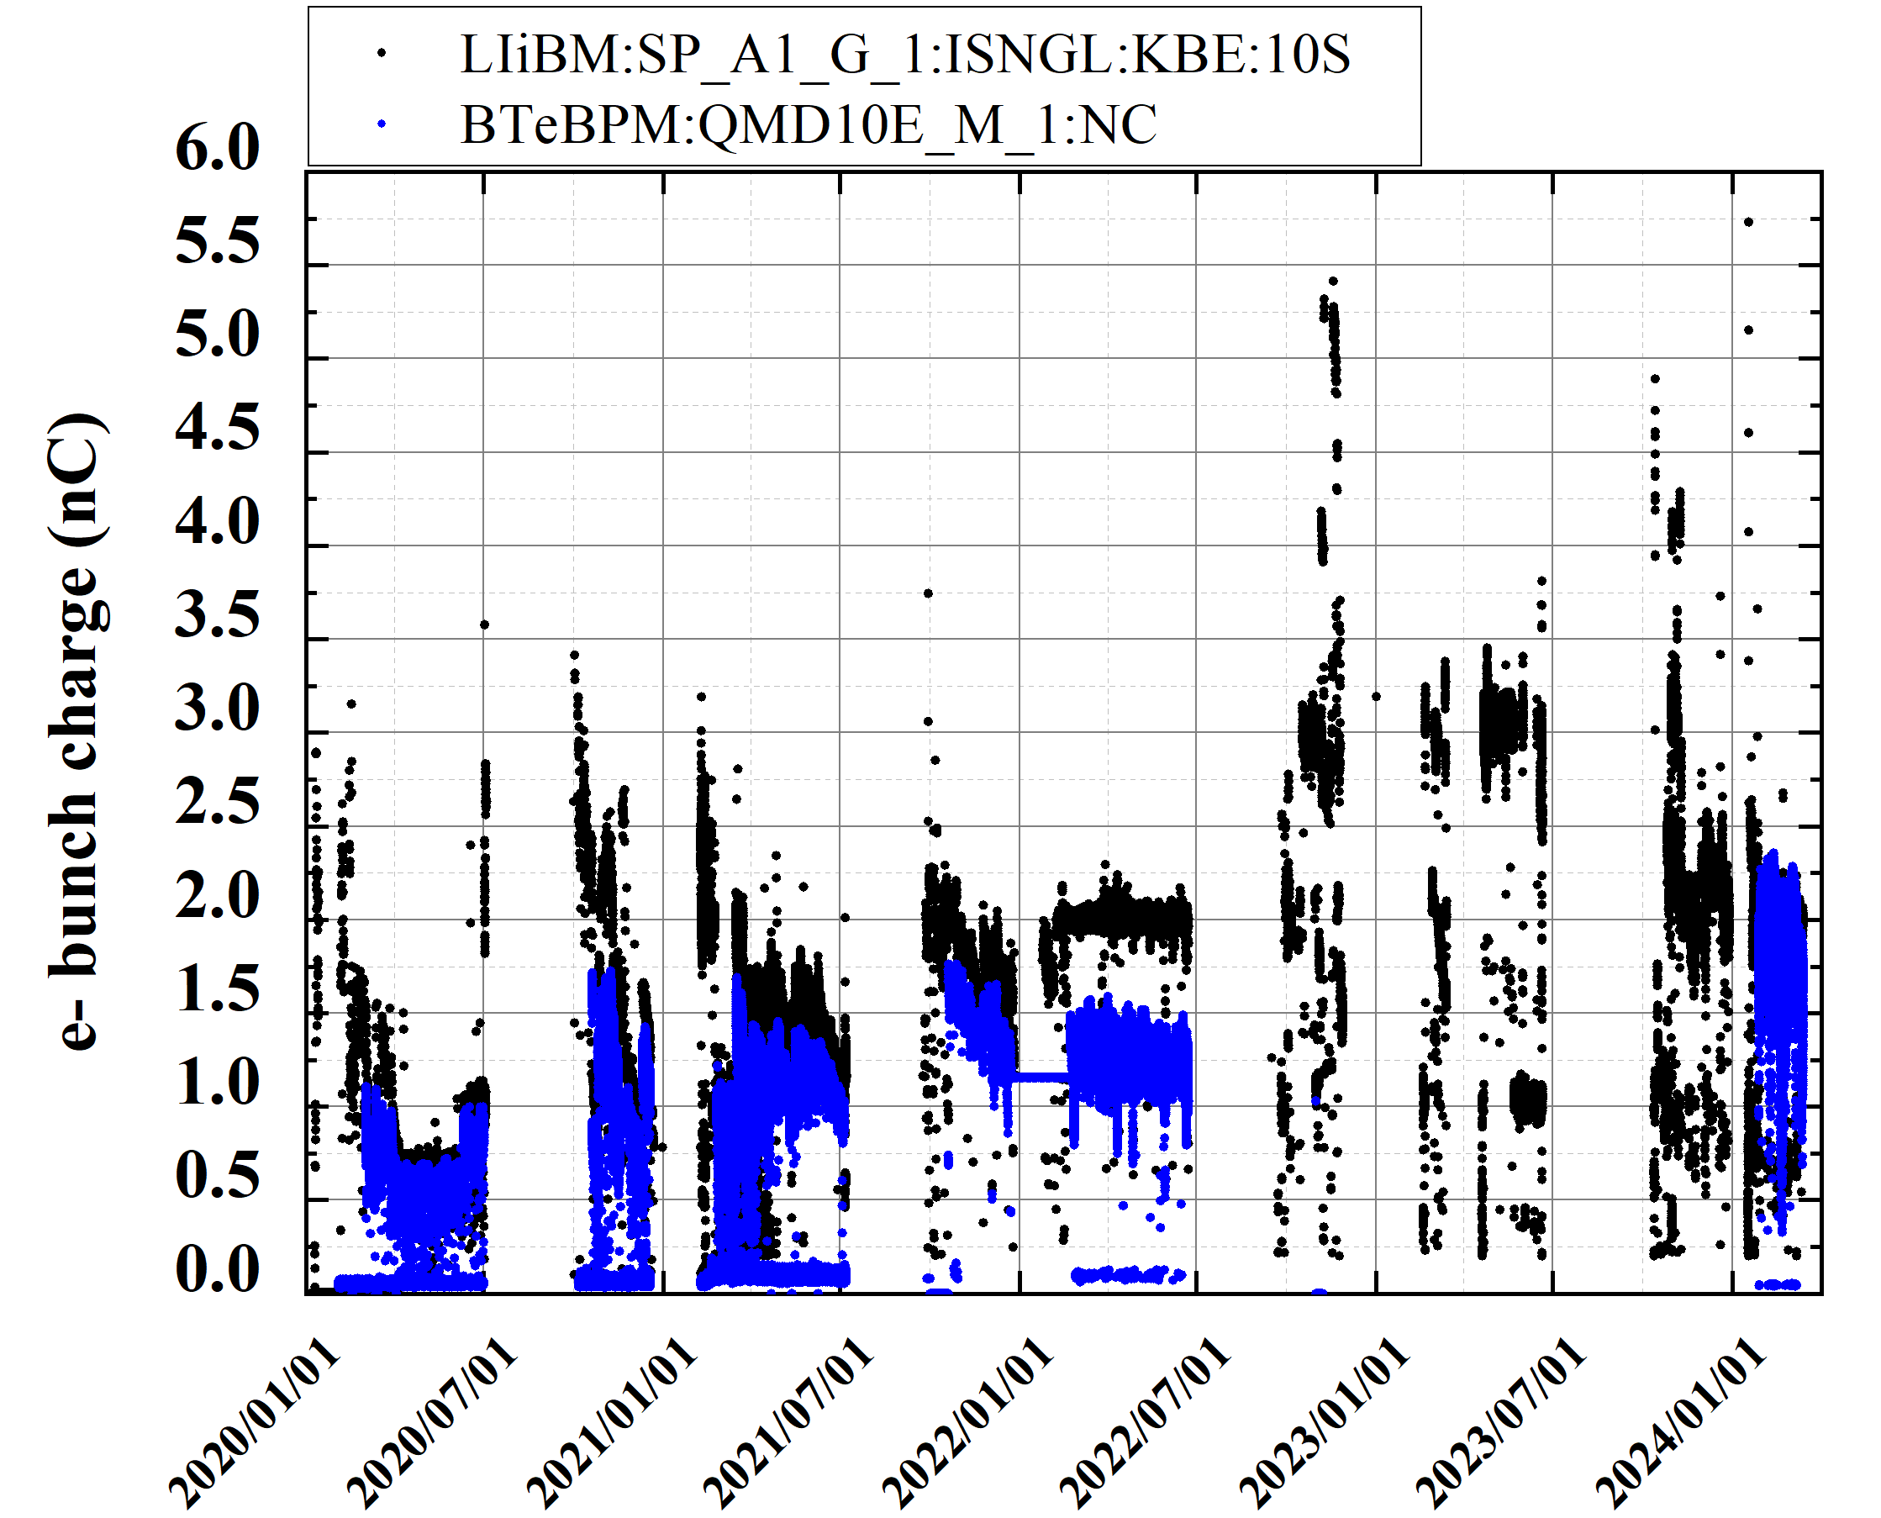
e- bunch charge history (2020a to 2024a)
e- beam status
(from rf gun)
(BT end)
2020a,b
2020c
2021a,b
2021c
2022a,b
2022c
2023a,b
2023c
2024a
High bunch charge study
LS1
discharge

Slide 12
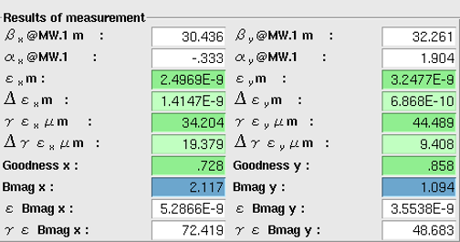
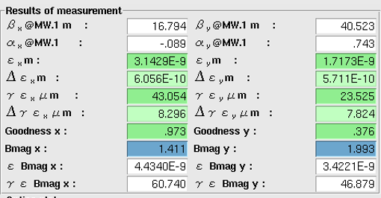
e- beam summary and issue
e- beam issue
Thermionic DC e- gun has worked fine for light source (PF, PF-AR) injection and e+ production primary e- beam (10 nC).
Photocathode rf e- gun
  Laser system and the new DOE (Φ8 mm) element have worked fine without any significant trouble.
Increase of bunch charge
  High bunch charge of 5 nC e- from gun was demonstrated w/ previous DOE (Φ6 mm).
  Further high bunch charge e- beam study will be conducted w/ new DOE.
Issue
  Breakdown rate of rf gun cavity gradually increased. New cavity should be installed in the near future.
  Best emittance at the linac end and BT1 (before Arc1) is almost satisfied the final goal while bunch charge (2 nC) is less than final goal (4 nC).
  However, emittance at BT2 is increased due to ISR, CSR, and some other reasons.
  Increase of 2nd bunch injection efficiency and improvement of its stability are important issues.
    In this run 2024a, 2nd bunch emittance is improved. It is almost comparable to 1st bunch one. Two bunch injection will be tested soon.
Emittance measured
on Mar. 10th, 2024
e- emittance
Measured εnx,nxy (2 nC) : 20/20 μm (at BT1)
Goal: εnx,nxy (4 nC) : 40/20 (H/V) μｍ
1st bunch @ BT1
2nd bunch @ BT1

Slide 13
e+ beam status and issue

Slide 14
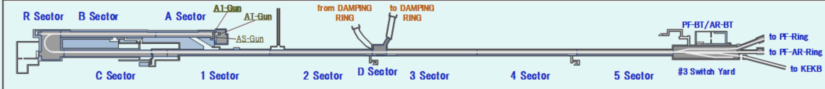
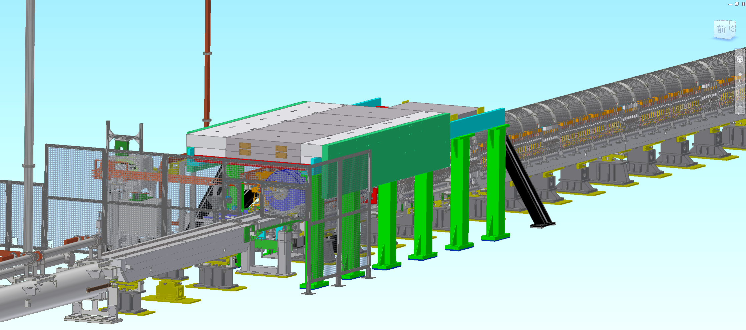
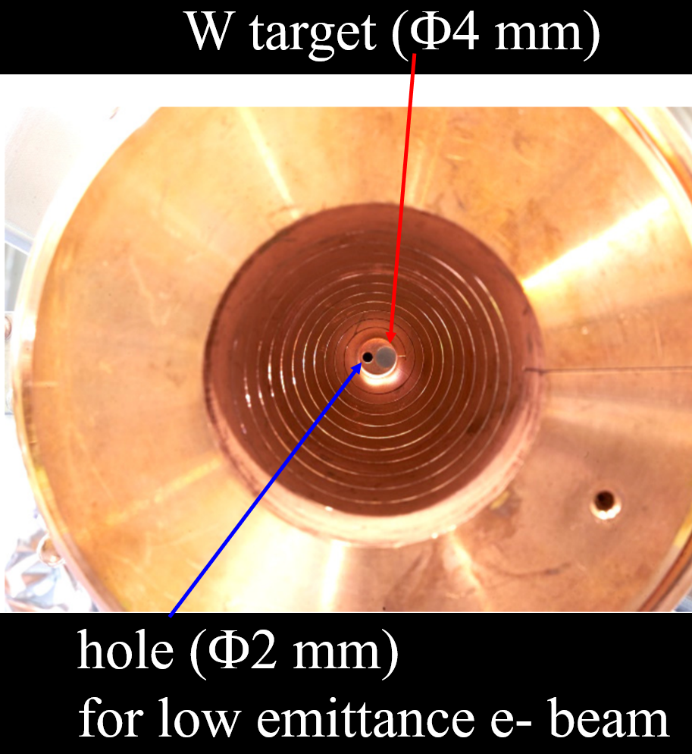
Positron source setup at Sector1
e+ beam status
Positron target and capture section
DC solenoid
Large aperture S-band acc. Structures (x10)
W target + flux concentrator (FC)
Y. Enomoto et al.

Slide 15
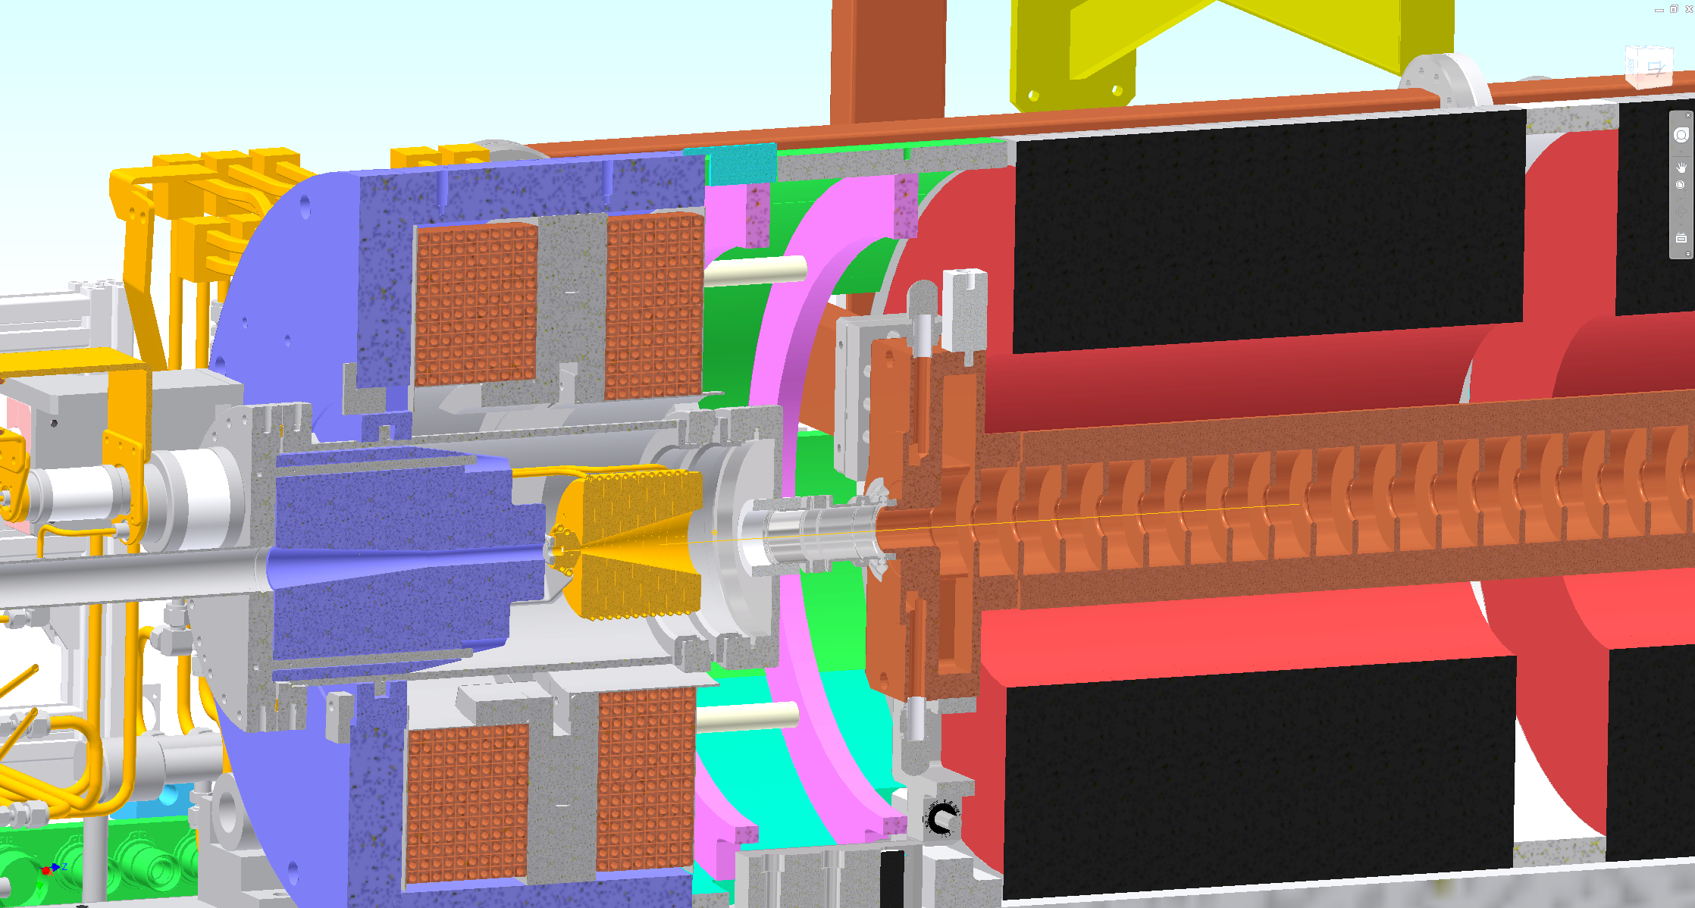
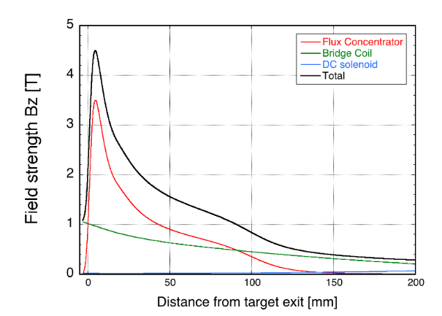
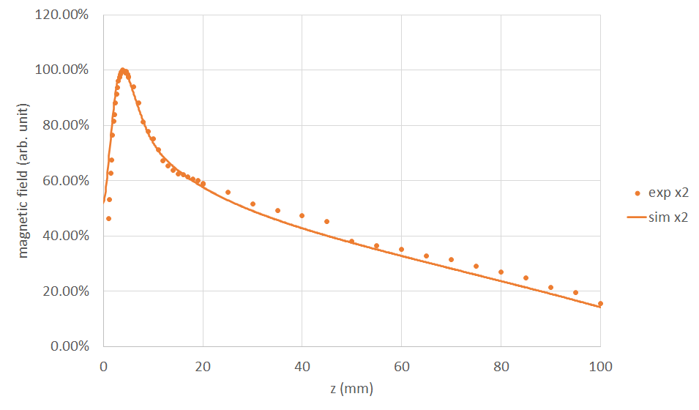
e+ beam status
Positron Capture Section: Flux concentrator, bridge coil, solenoid
Large Aperture S-band acc. structure (LAS)
Bridge Coil (BC)
Solenoid
Tungsten target
3.5 GeV e- beam
Flux Concentrator (FC)
Cu-alloy (NC50: Cu-Si-Ni)
I_{FC}= 12 kA
Y. Enomoto et al.

Slide 16
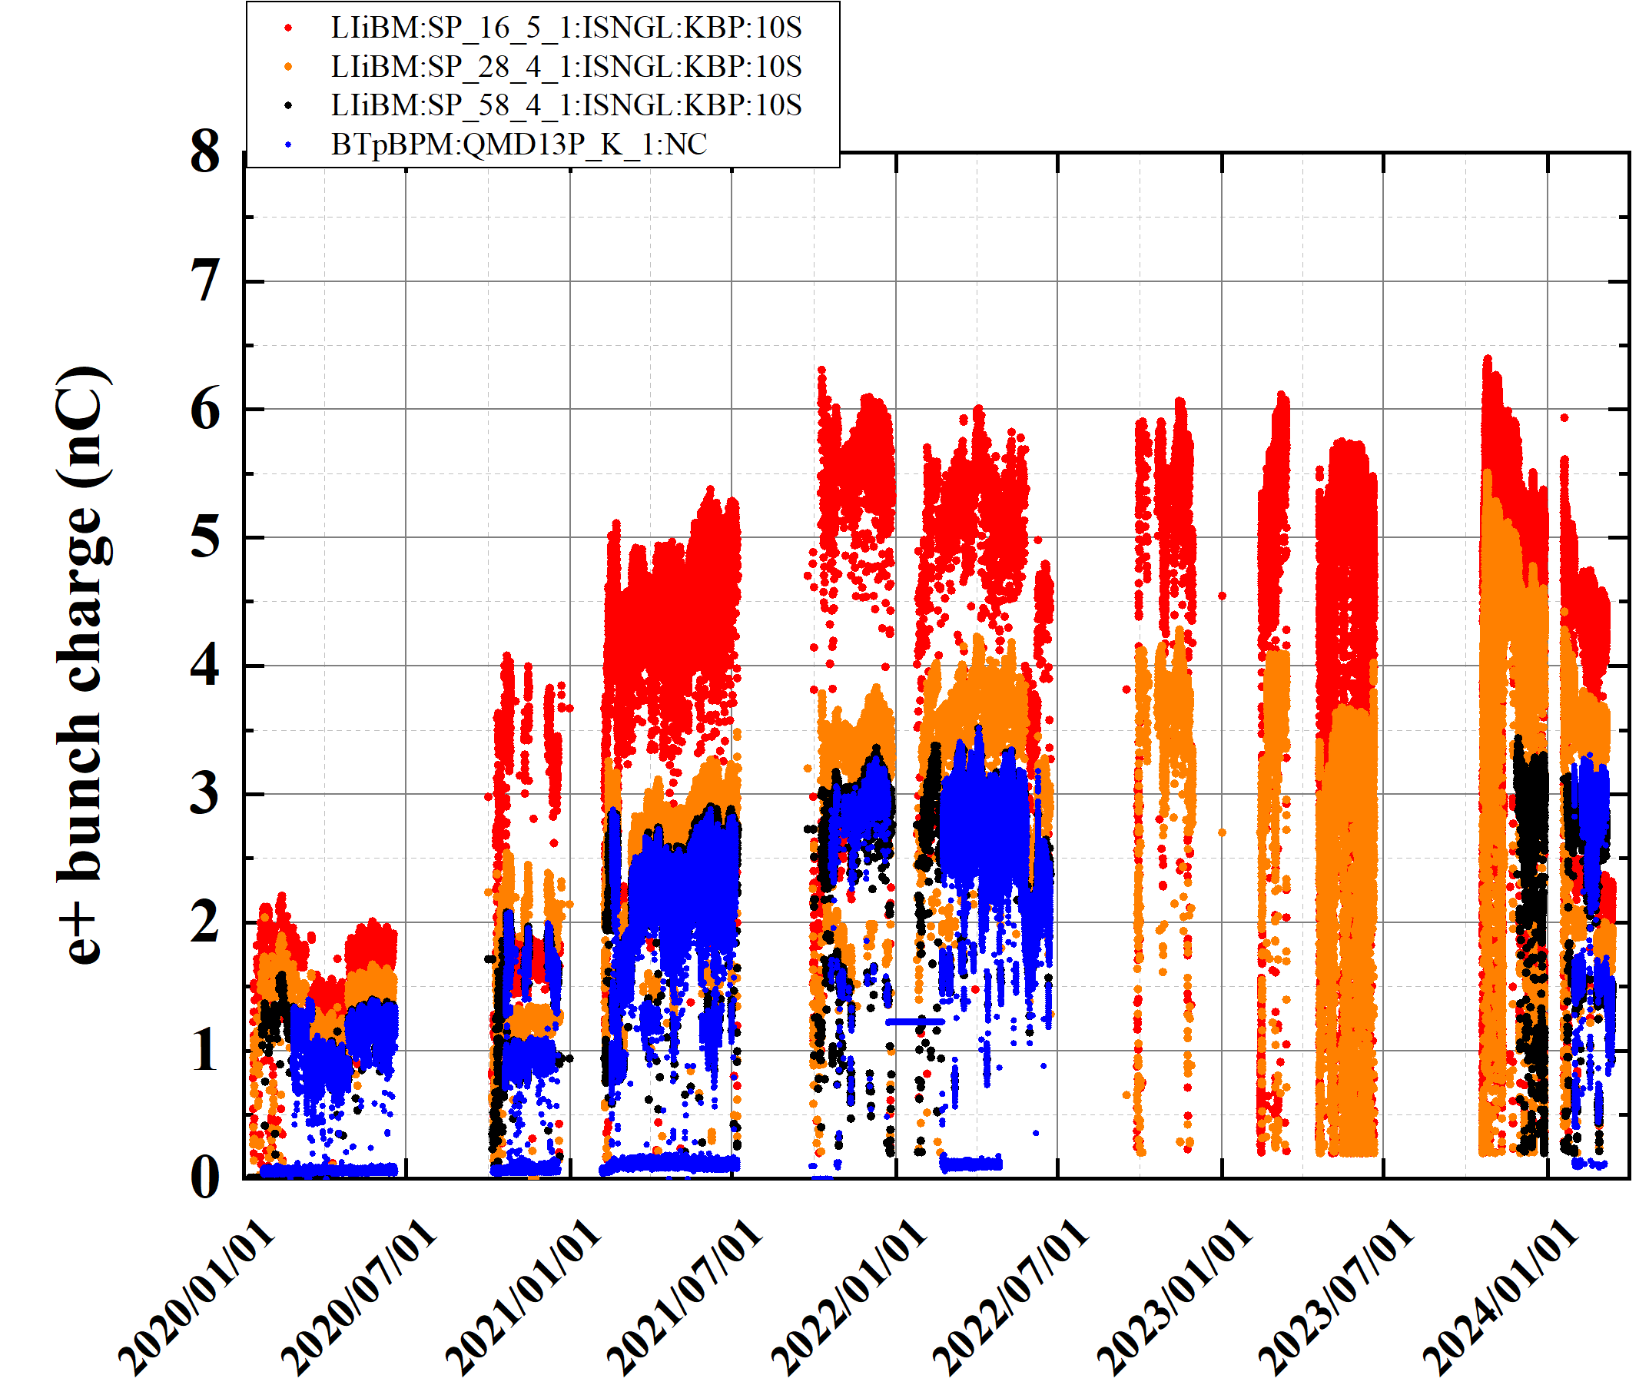
e+ bunch charge history (2020a to 2024a)
e+ beam status
(after e+ target)
(before DR)
・Solenoid current (SL_16_)optimization
・beam tuning (primary e- bunch charge ↑)
(Linac end)
(BT end)
2020a,b
2020c
2022c
2023a,b
2023c
2024a
2021a,b
2021c
2022a,b
LS1
・beam tuning
・Steering, BPM
in Unit 1-5, 1-6
・beam tuning
・New FC
・Solenoid current↑
・decrease bunch charge
(MR request)

Slide 17
e+ beam summary and issue
e+ beam issue
e+ bunch charge is almost achieved (final target: 4 nC)
  3.5 nC at linac end and BT
  Machine learning based automatic tuning can help to increase the e+ bunch charge at end of Sector2 (up to around 5.5 nC).
  Measured e+ production efficiency (65%) is comparable to the simulation result (60%).
  Flux concentrator operation has been very stable.
Issue
  Emittance at linac end and BT1 (before Arc1) are almost satisfied the final goal.
  However, emittance at BT2 is increased. It could be caused by some magnetic errors.
  (“Injection” report by T. Yoshimoto san)
  Horizontal emittance after DR is larger than design value. Low emittance DR optics will be tested after LS1.
e+ emittance
Measured εnx,nxy (3 nC) : 103.5/4.7 μm (at BT1)
Goal: εnx,nxy (4 nC) : 100/15 (H/V) μｍ

Slide 18
Upgrade work and progress
during LS1

Slide 19
Upgrade work and progress during LS1
Upgrade during LS1
Pulsed Quads
  at J-ARC
  at Sector1, 2
  Control software upgrade
Fast kicker for 2nd bunch orbit control (J-ARC, linac end, e- BT)
New accelerating structure
Automatic beam tuning

Slide 20
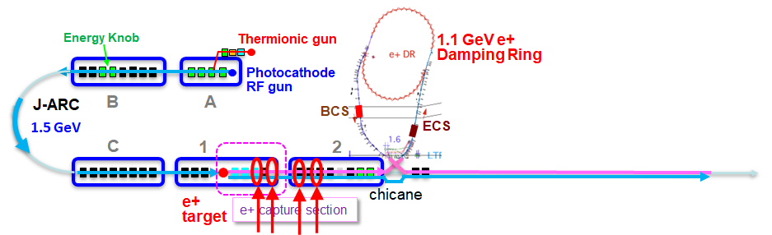
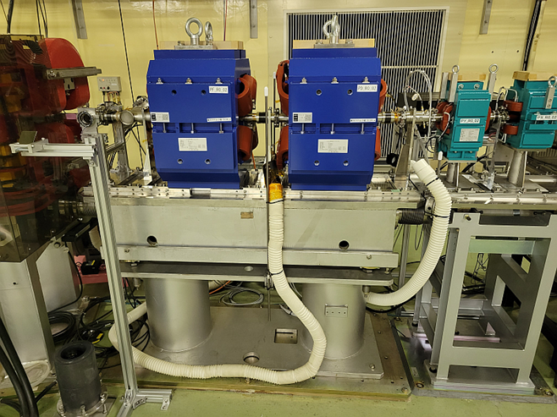
Pulsed Quads at J-ARC and Sector1, 2
Upgrade during LS1
Additional pulsed quads at J-ARC and Sector1, 2 were installed in 2023 summer maintenance.
  J-ARC: dedicated beam matching for each injection beam (HER/LER/PF/PF-AR)
  Sector1, 2: low beta optics for HER injection beam (mitigate emittance growth)
At J-ARC, newly designed pulsed quad (K. Yokoyama) and pulsed power supply driver (T. Natsui) were installed in the 2023 summer maintenance.
Seven pulsed quads were installed.
Four DC quads were replaced by pulsed one.

Slide 21
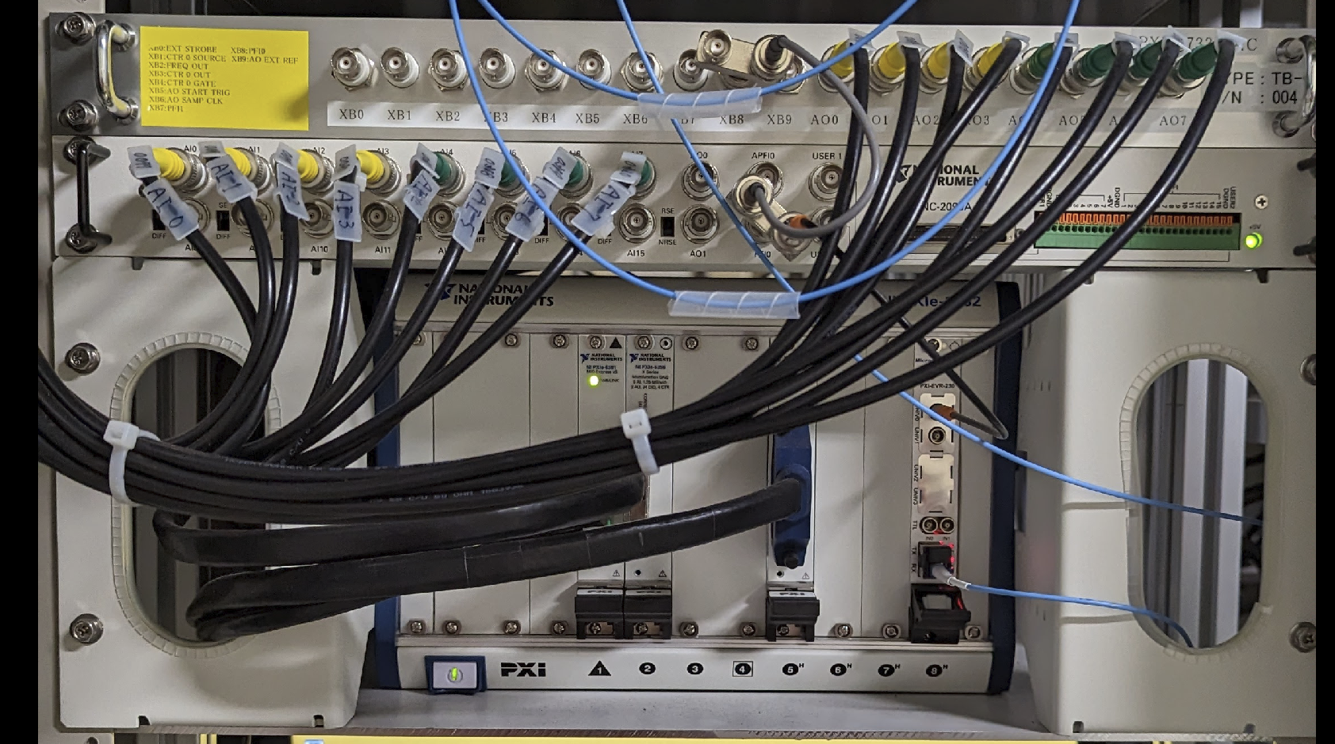
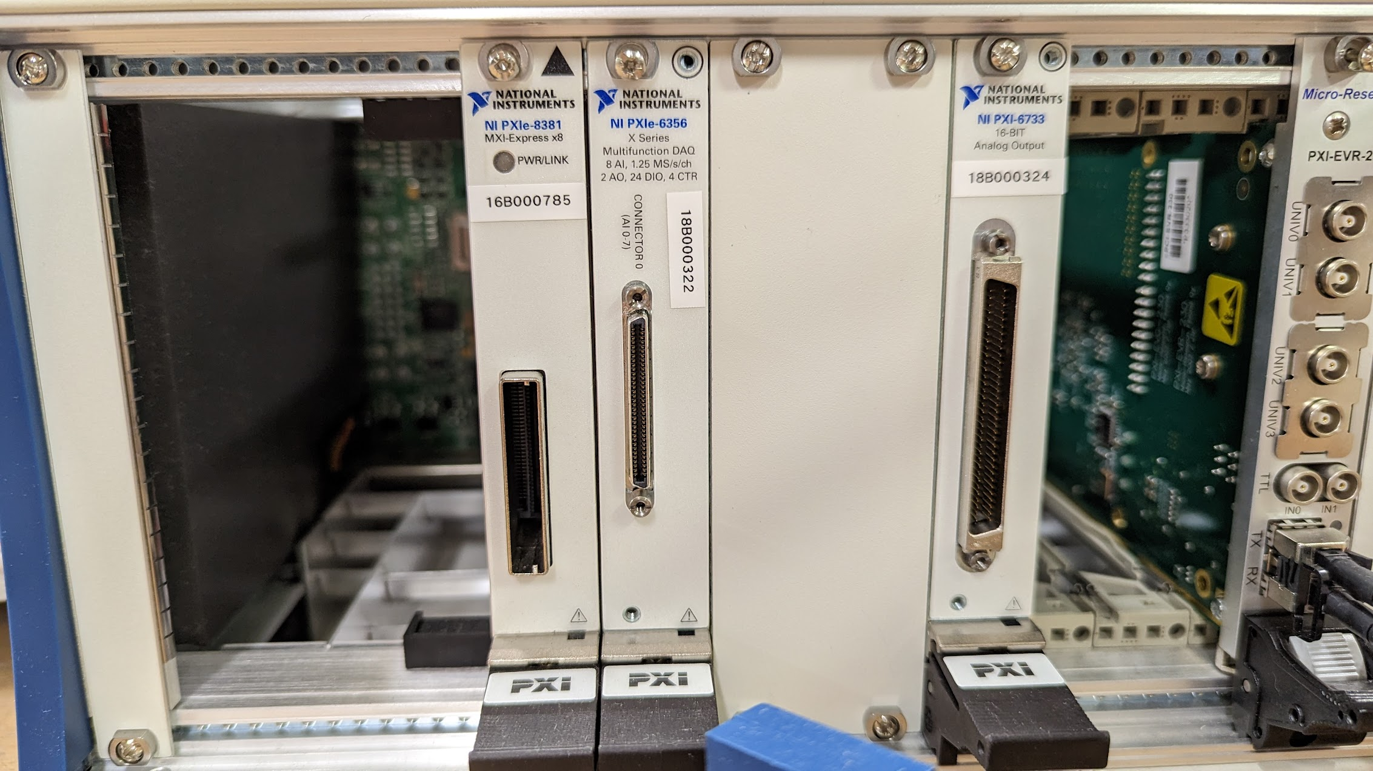
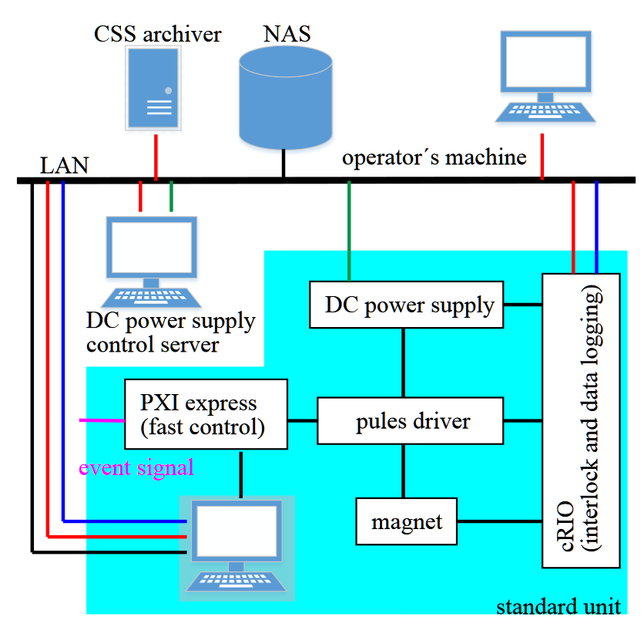
Pulsed magnet control system (1)
Upgrade during LS1
=== PXI-based controller ===
PCIe-8381 & PXIe-8381, PXI Remote Control Module
PXI 6733 DAC
PXIe 6356 ADC
MRF EVR-230
=== cRIO ===
Interlock system
Data logging
ADC
DAC
EVR
Di Wang et al.

Slide 22
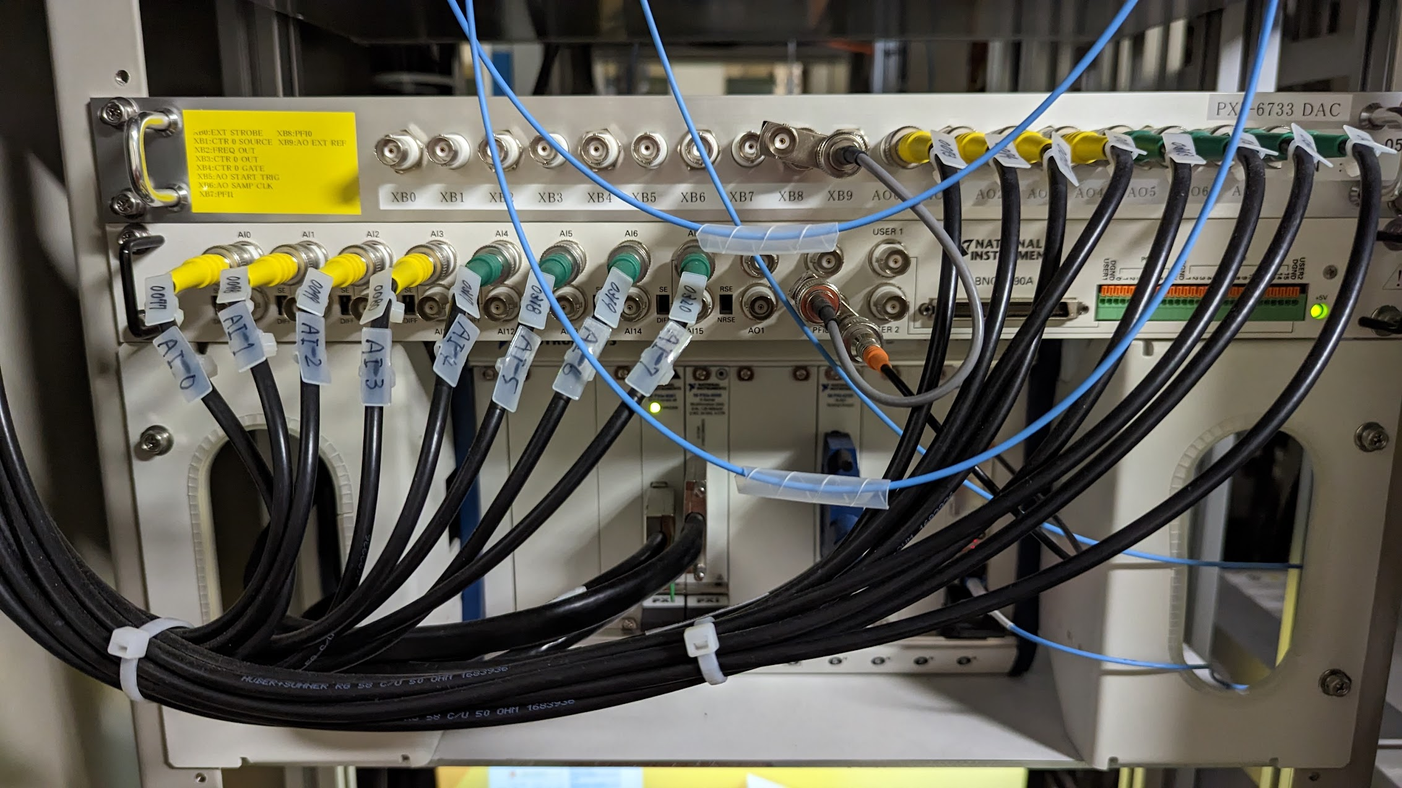
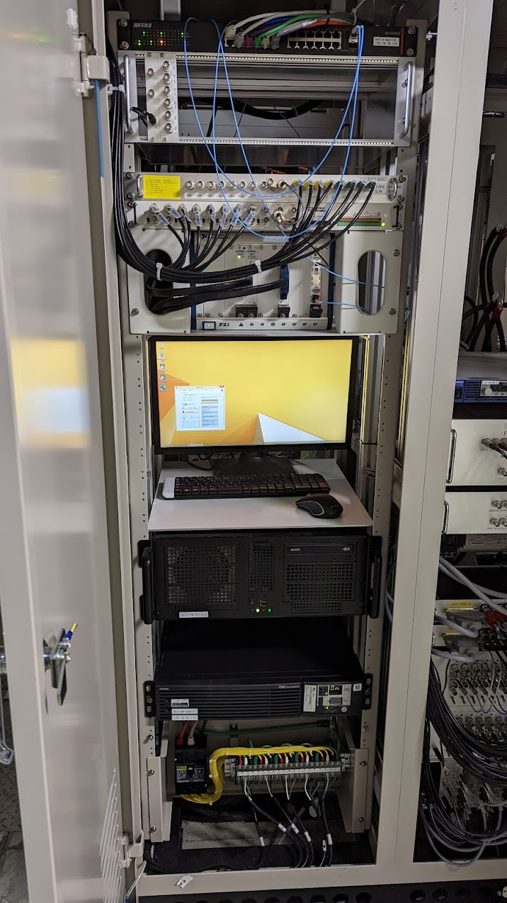
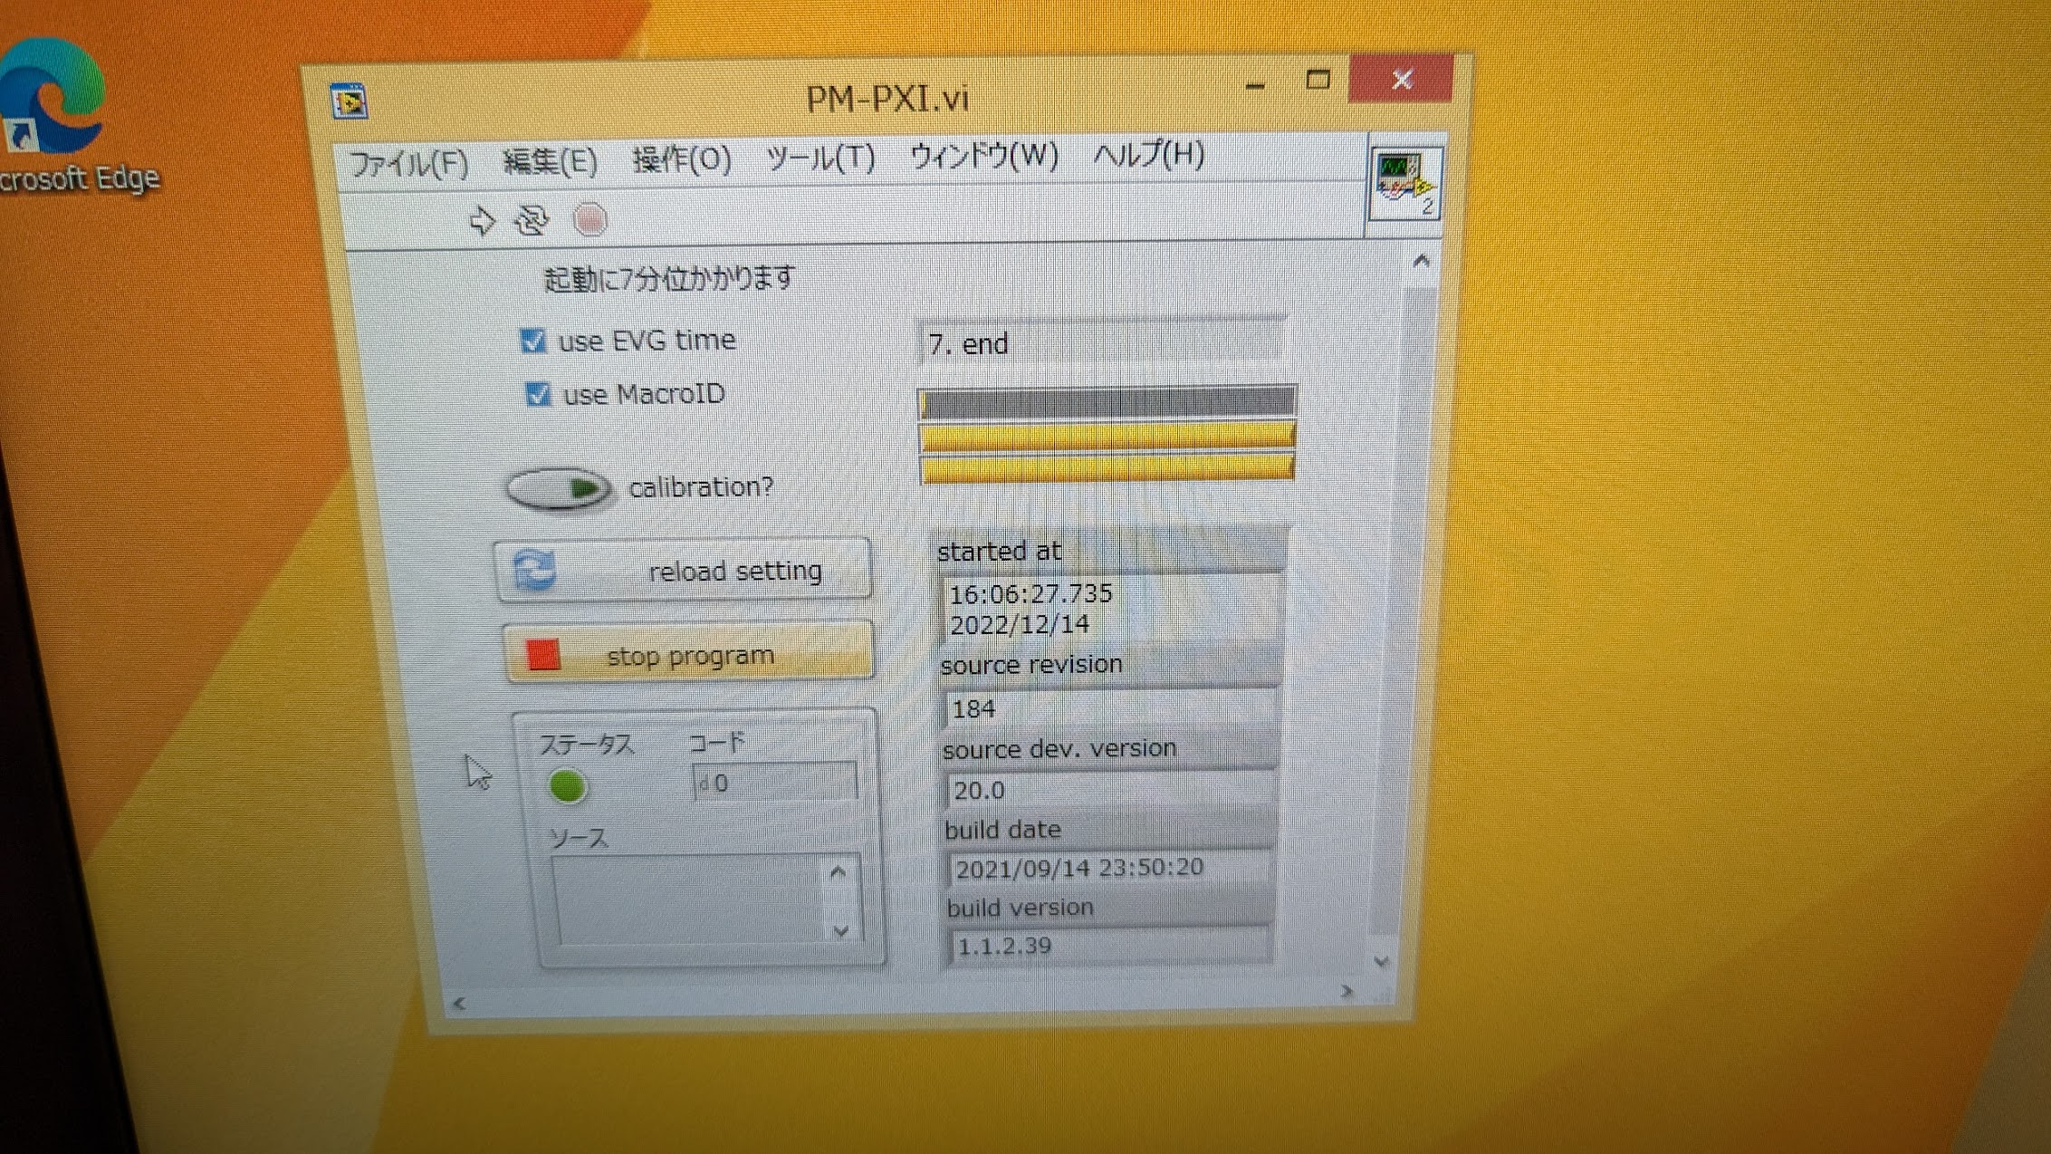
Pulsed magnet control system (2)
Upgrade during LS1
Windows/LabVIEW/PXI system
  Started since 2017
  Sometimes control PC or LabVIEW program freeze.
  It takes 20 minutes for restarting system. (Large # of variable should be initialized in LabVIEW software)
Development history
  Decided to migrate to Linux/EPICS IOC (2022/12)
  NI DAC&ADC driver (2023/02)
  EVR driver (2023/03)
  EPICS IOC (2023/04)
  OPI & Monitoring (2023/05)
  Experiment (2023/06)
  Revision (2023/07)
  Stability test (2023/07)
8 of 17 control system were replaced by new software since 2023c.
  They have worked well w/o trouble.
  In this summer maintenance, remaining system also will be replaced by new one.
DAC
ADC
EVR
Di Wang et al.

Slide 23
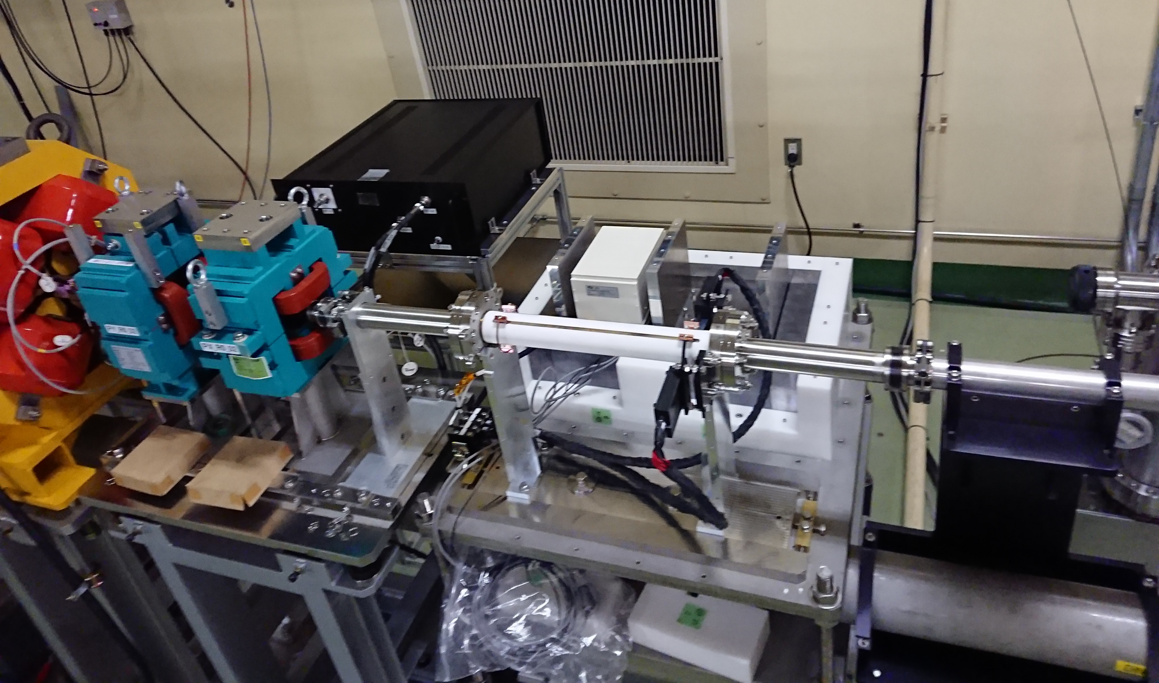
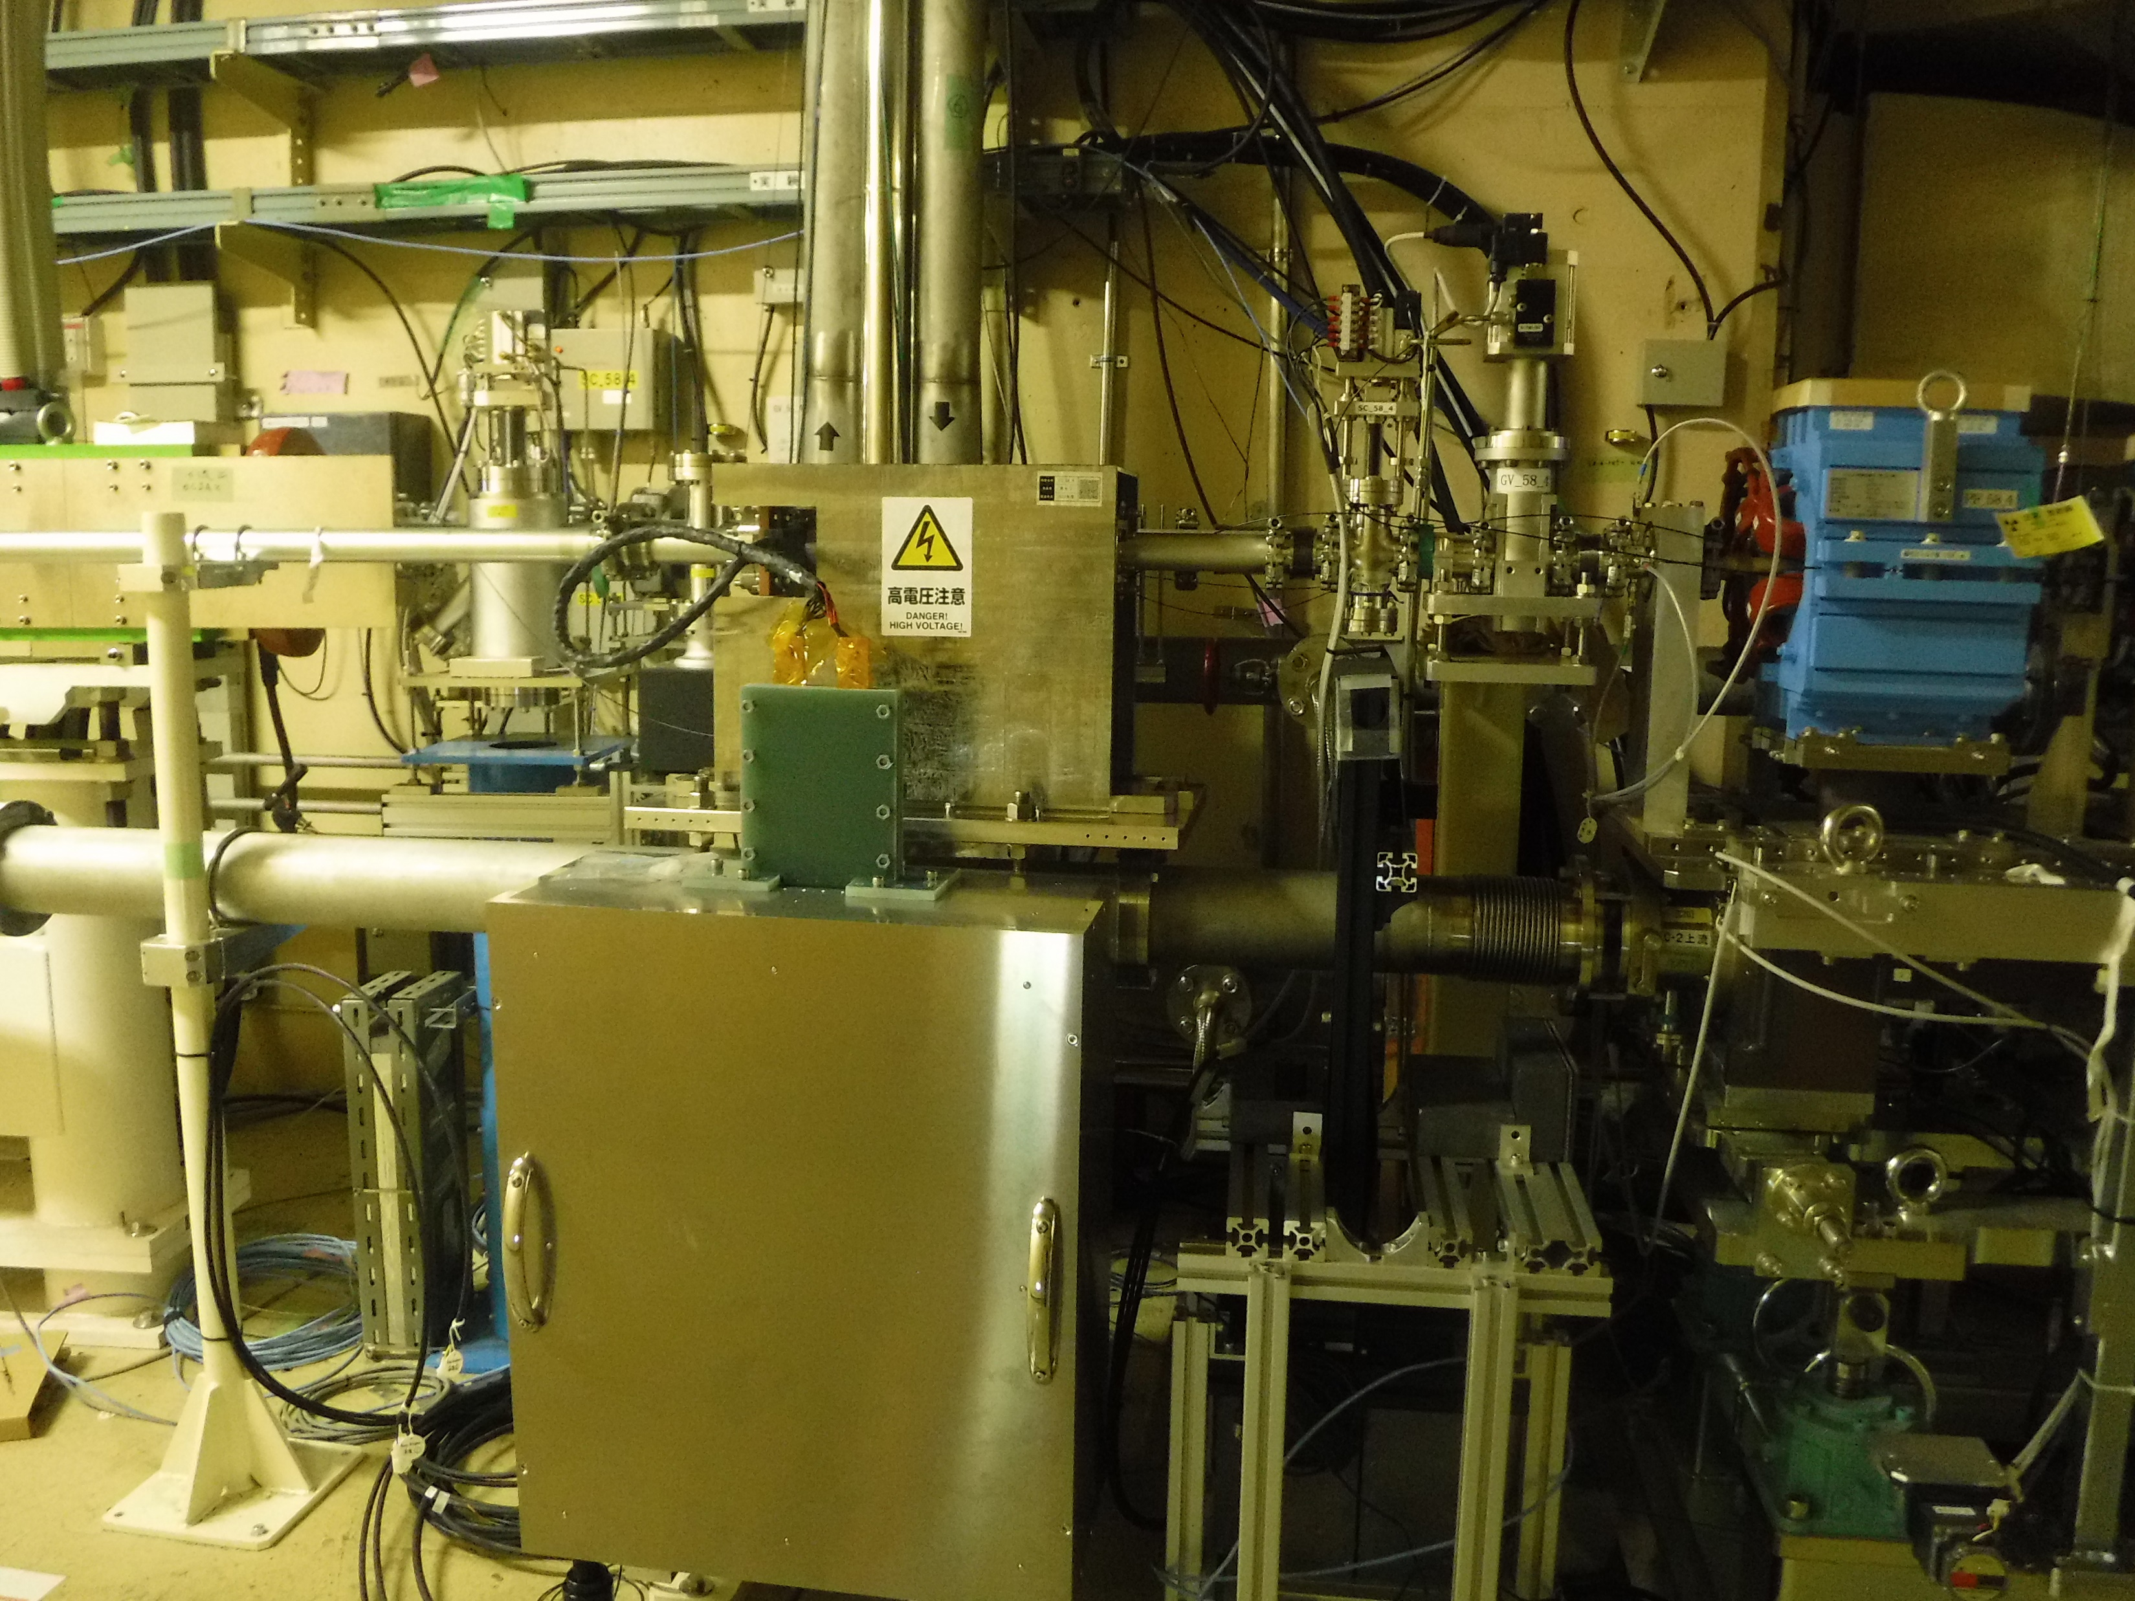
Fast kicker for 2nd bunch orbit correction
Upgrade during LS1
Based on “ceramics chamber with integrated pulsed magnet“ developed by C. Mitsuda (PF)
J-ARC (’22 summer), end of linac and e- BT (‘23 summer/winter) for 2nd bunch orbit correction
It could help to increase the injection efficiency of e- 2nd bunch.
Fast kicker
(linac end)
Fast kicker (J-ARC)
PF (Mitsuda, Shinohara, Naito)，Linac (Kamitani, Okayasu, Y. Enomoto, Natsui)

Slide 24
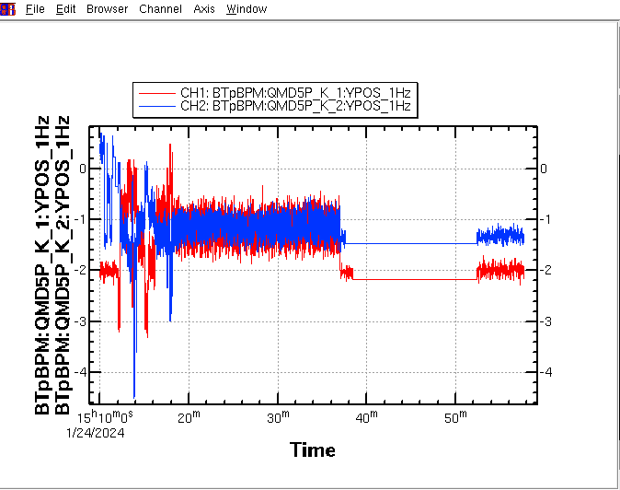
e+ beam test w/ fast kicker (linac end)
Upgrade during LS1
Fast kicker can correct the 2nd bunch beam position and reduce the orbit difference (1st and 2nd bunch).
However, it increase the beam position jitter. It should be corrected for beam operation.
e+ BT vertical beam position at BPM QMD5P
(1st bunch)
(2nd bunch)
Fast kicker OFF
Fast kicker ON

Slide 25
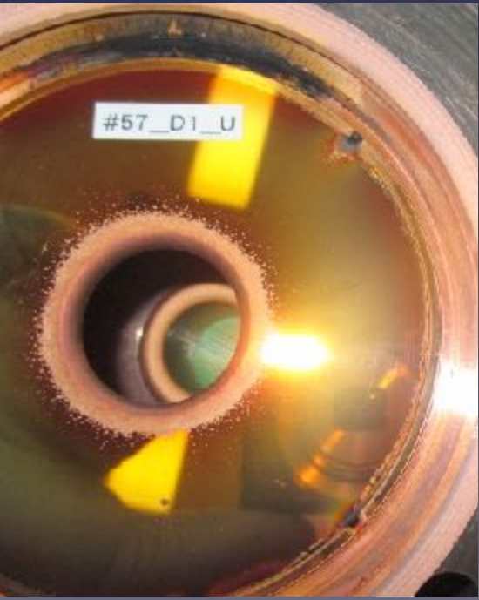
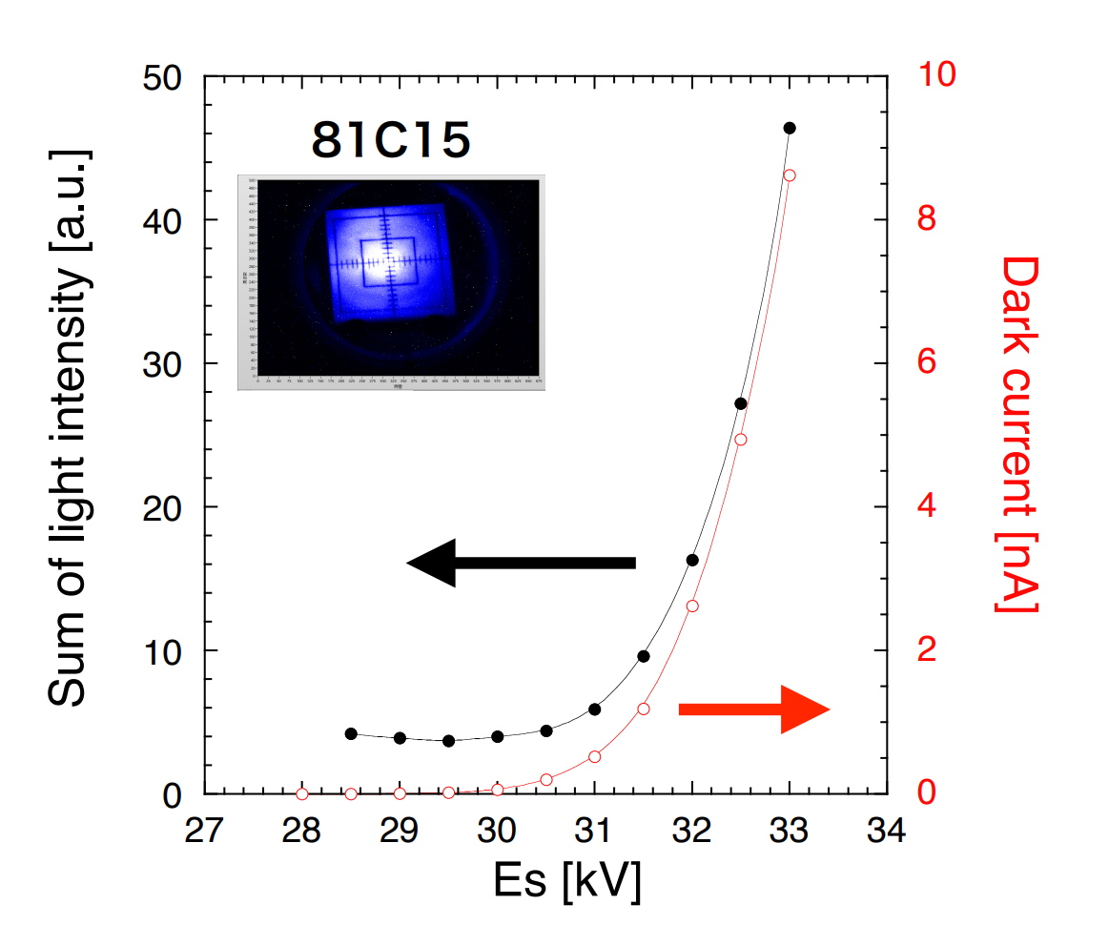
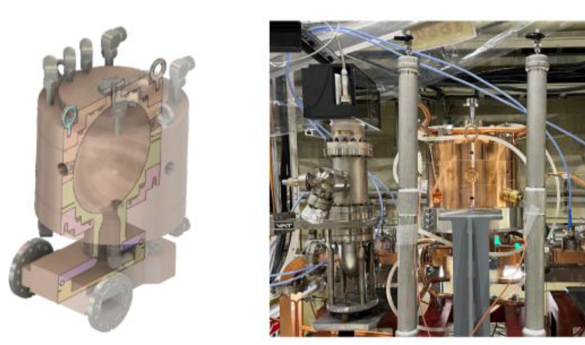
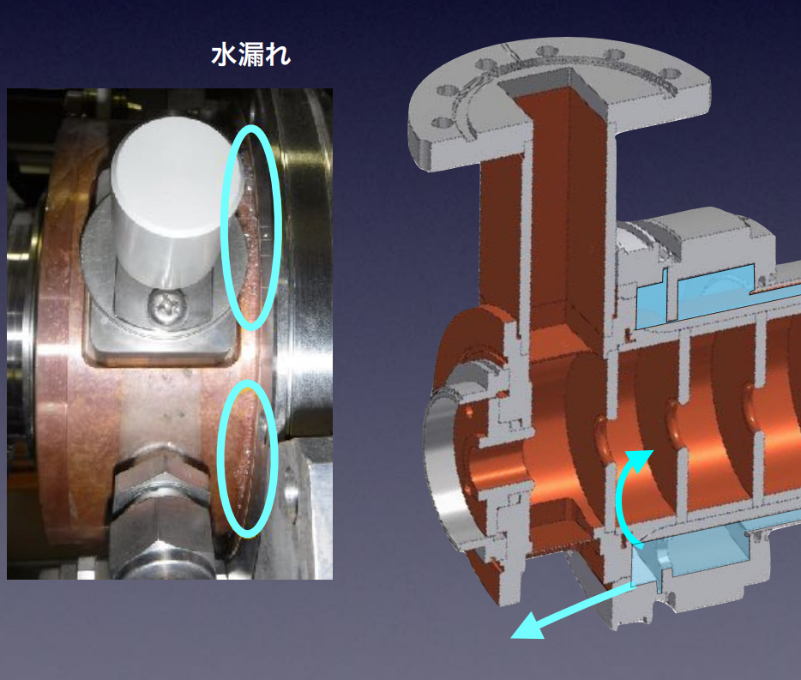
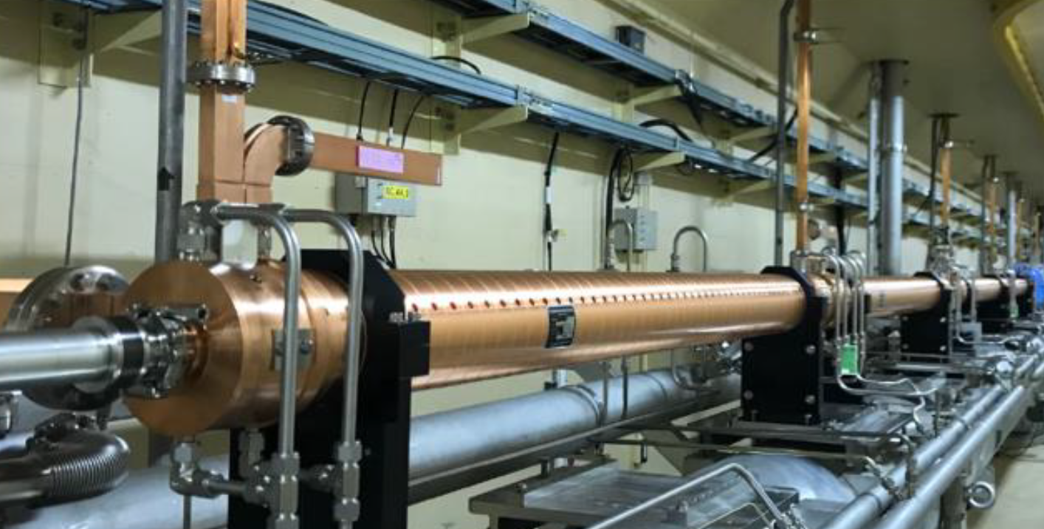
New accelerating structure
Upgrade during LS1
Mitigation of accelerating structure failures
  Originally designed for 8 MeV/m (PF injector), but used at 20 MeV/m (KEKB upgrade)
  Degradation is leading to high field emission rate and discharges.
  Water leaks, field emission , discharge in waveguide, and so on (29 of 60 units have some problems)
  Not only future Y(6S) but even Y(4S) could be suffered
5-year upgrade plan to fabricate and install new accelerator structures (FY2018 – FY2022)
  4 units (16 acc. structures) have been replaced by new one.
  New acc. structure: acc. gain ↑7%, surface field ↓20% (reduce breakdown)
  New pulse compressor (SCPC) was also developed and installed in Unit#44.
Damaged iris
Colling water leakage
New S-band 2-m-long TW acc. structure
New pulse compressor
Spherical-Cavity Pulse Compressor (SCPC)
H. Ego

Slide 26
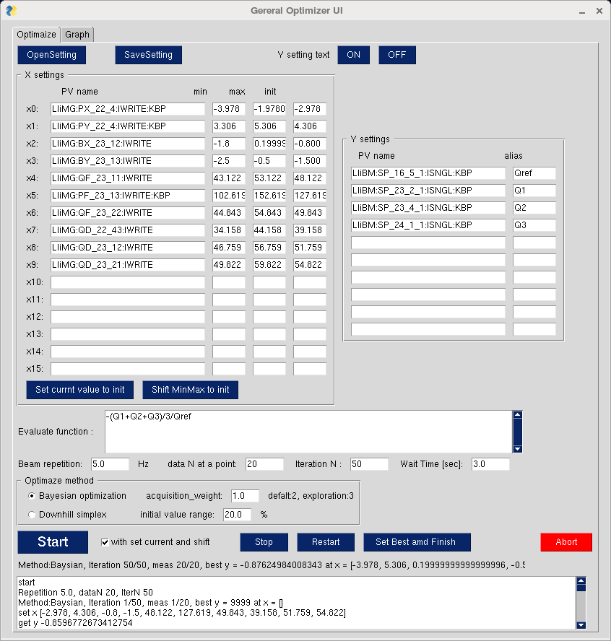
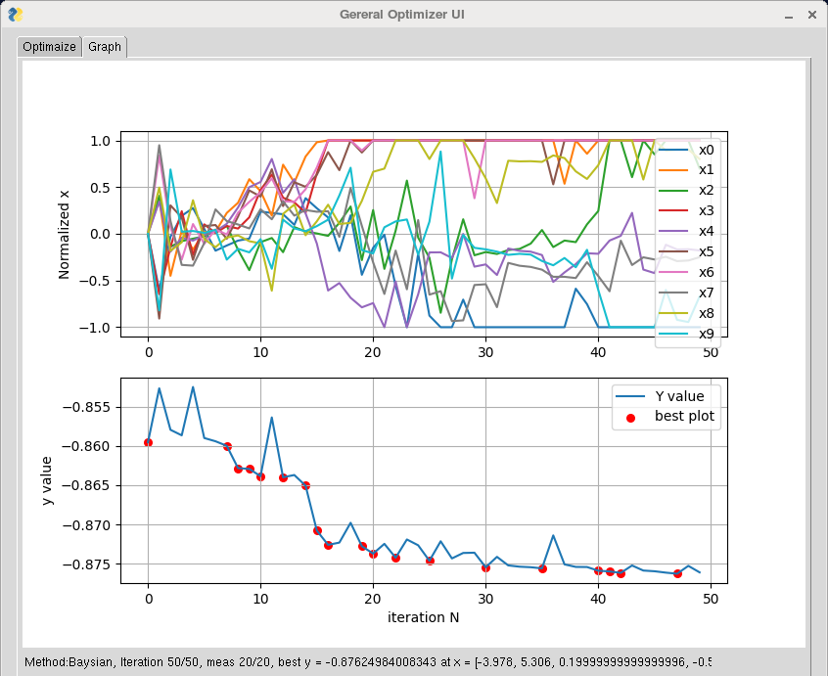
Automatic beam tuning
Upgrade during LS1
Automatic beam tuning approach with machine learning is recent trend in accelerator operation.
Bayesian Optimization approach is now under test by using the beam of injector Linac.
  Implementation using GPyOpt Python library (T. Natsui) / In-house developed implementation (G. Mitsuka, S. Kato)
Automatic beam tuning test started in 2022c.
Both of Bayesian optimization and downhill simplex method are available.
Preliminary test was started by using only 4 control variables (pulsed steering magnets) to improve e+ bunch charge.
After continuous study and software improvement, the number of control variables increased to around 16.
This automatic tuning is also applied to dispersion correction at J-ARC .
Currently, any linac operators can easily used this automatic beam tuning software.
Automatic tuning GUI
# of trial

Slide 27
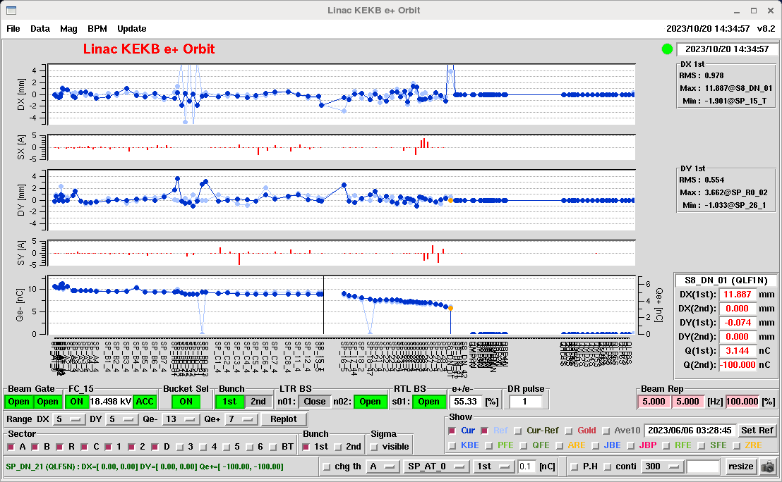
Beam orbit and bunch charge during automatic tuning
RTL
LTR
Hor.
(mm)
Ver.
(mm)
I
(nC)
e+
target (W)

Slide 28
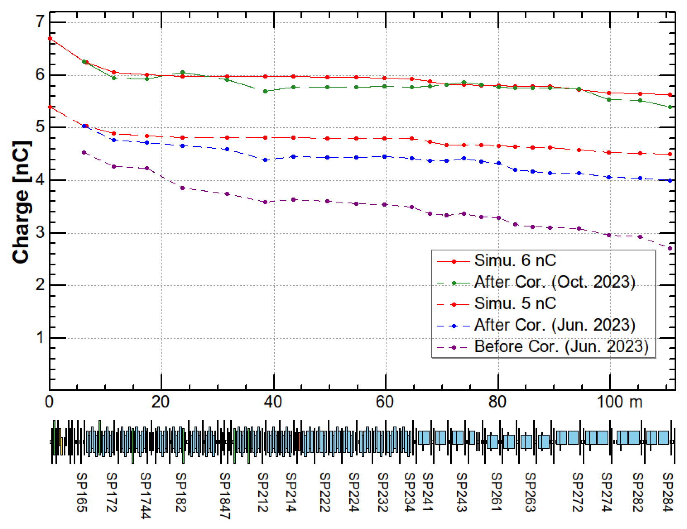
Automatic tuning for increasing e+ bunch charge
Measured data (Oct. 25the, 2023) of e+ bunch charge in Sector2 almost agree with the simulation result.
Pulsed Quads at J-ARC (installed in 2023 summer) and automatic beam tuning software can help to increase the e+ bunch charge.
simulated e+ bunch charge
measured e+ bunch charge
e+ 1st bunch charge
Simulation by Y. Seimiya

Slide 29
Summary
Simultaneous top up injection has been successfully conducted.
e- beam
  Laser system has worked fine without any significant trouble.
  New DOEs (Φ8 mm) have been installed at both of 1st and 2nd laser, and they have worked fine.
  5 nC from gun was demonstrated w/ previous DOE (Φ6 mm). Further beam study will be conducted w/ new DOE.
e+ beam
  e+ generation system (flux concentrator, power supply, DC solenoid) has worked fine.
  e+ bunch charge of 3.5 nC at BT end are archived (final design 4 nC).
  Machine learning based automatic tuning can help to increase the e+ bunch charge at end of Sector2 (up to around 5.5 nC).
Upgrade work and progress during LS1
  Pulsed quads at J-ARC and Sector1, 2 have been successfully installed and worked fine.
  New control software for pulsed magnet
  New accelerating structure
  Fast kicker for 2nd bunch orbit correction (J-ARC, Linac end, e- BT)
  Automatic beam tuning is deployed for daily operation.
Issues
  Emittance growth at end of BT for both of e- and e+ beam (Injection report)
  Low e- injection efficiency of 2nd bunch so far. Fast kicker system could help to improve it.
  Increase the e- bunch charge while keeping small emittance w/ new DOE.

