Slide 1
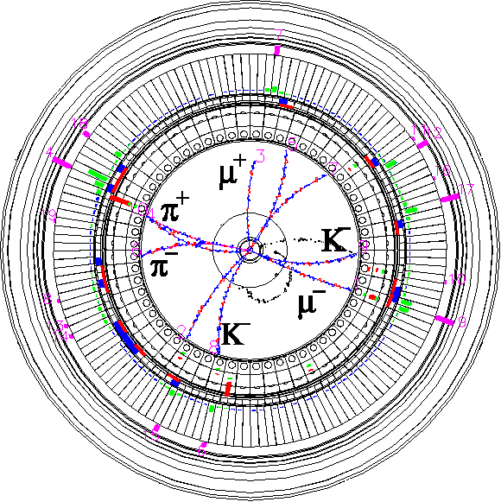


Vacuum
The 27th KEKB Accelerator Review Committee
26th March 2024
Kyo Shibata
On behalf of KEKB Vacuum Group
Inter-University Research Institute Corporation High Energy Accelerator Research Organization (KEK)
大学共同利用機関法人 高エネルギー加速器研究機構 (KEK)

Slide 2
Contents
Introduction
Major Vacuum works during LS1
MR works
Collimator works & status
DR works
MR vacuum status after LS1
DR vacuum status after LS1
Summary

Slide 3
Vacuum works during LS1 at a glance (MR)
: Area open to dry nitrogen or atmosphere
LER
Collimator head replacement (D02V1)
Collimator head replacement (D01V1)
Collimator relocation
(D03V1 -> D05V1)
HER
IR works
IR works
Gate valve & bellows chamber replacement
Temporary countermeasure against vacuum leak from beam pipe welding line
NLC (D05V1) system construction
Collimator head replacement
(D05V1)
Bellows chamber replacement
(vacuum leak)
Installation of new bellows chambers with SR masks
Ion pump feedthrough replacement
(Abnormal discharge, Vacuum leak)
NEG pump feedthrough replacement (Vacuum leak)
Collimator head replacement
(D06V1, D06H3)
Installation of HOM absorber chamber
Collimator head replacement
(D09V1)
Collimator head replacement
(D06H3, D06H4)
Removal and reinstallation of kicker ceramic chambers for magnetic field measurement
Collimator relocation
(D06H1 -> D06H4)
Injection septum & chamber replacement

Slide 4
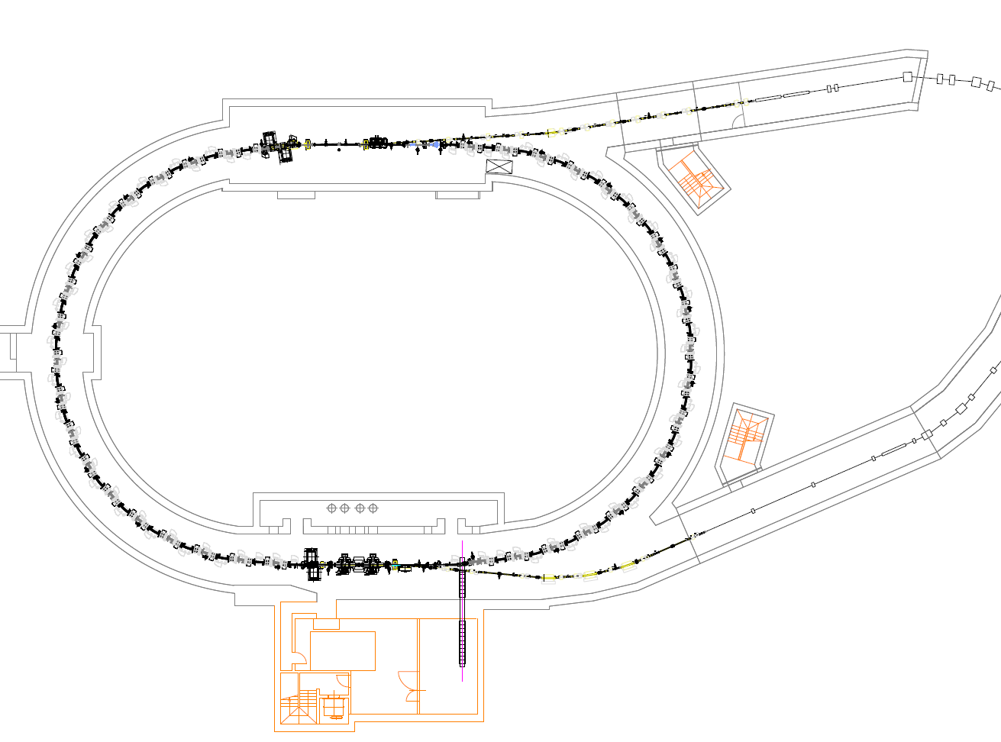
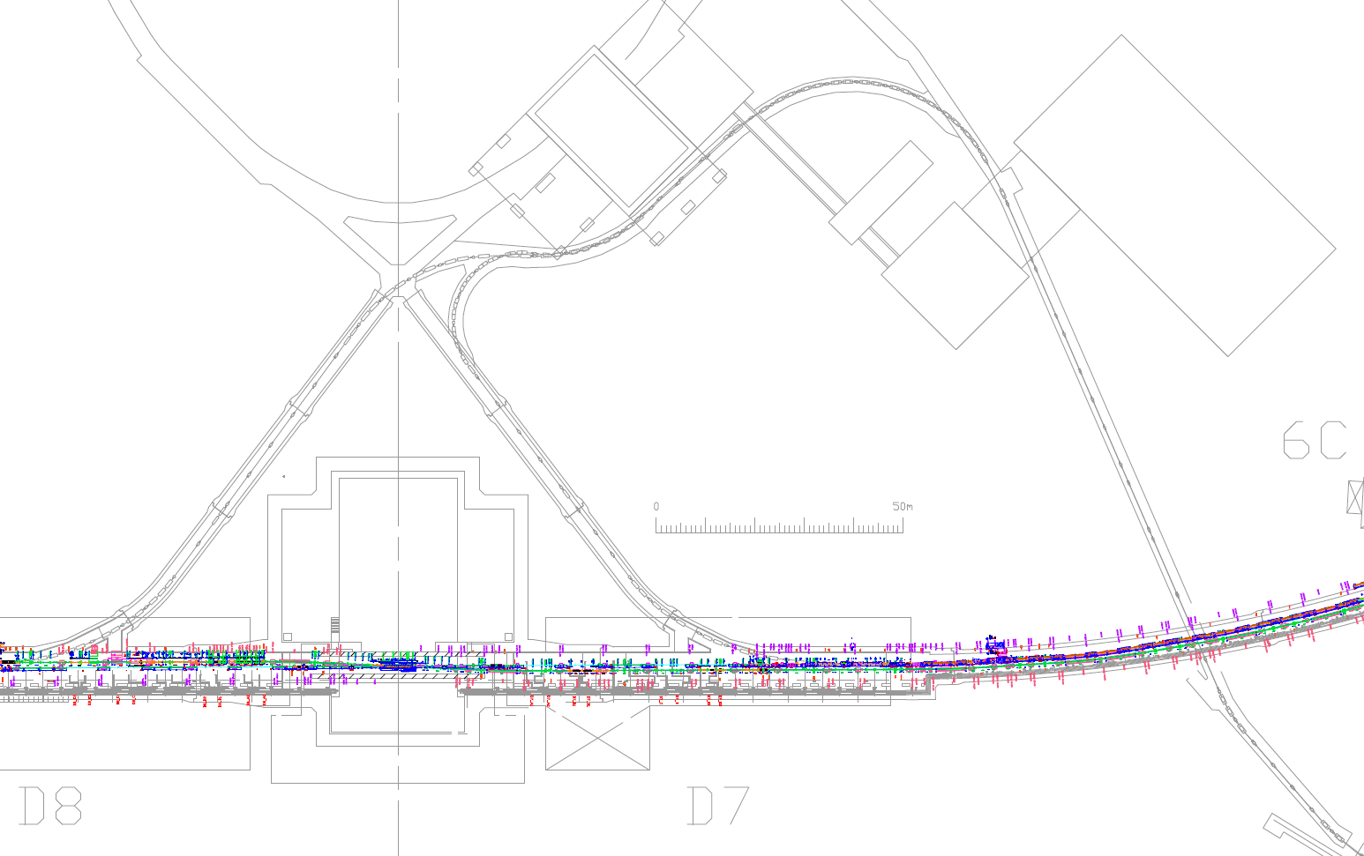
Vacuum works during LS1 at a glance (BT&DR)
: Area open to dry nitrogen or atmosphere
BT
Installation of V-offset bellows chambers (BTp)
Installation of CSR monitor chamber (BTp)
DR
Installation of OTR screen monitor (BTp)
RF cavity work (by RF group)
Removal and reinstallation of bellows chambers for magnet alignment (BTe & BTp)
Removal and reinstallation of Ext. kicker chambers for Kicker PS work

Slide 5
List of major works during LS1 (MR)
Vacuum work
IR work (LER&HER)
Replacement of IP bellows chambers
QCS cryostat modification
NLC system construction (LER)
Removal and reinstallation of kicker ceramic chambers for magnetic field measurement (LER)
Replacement of beam pipes at HER Injection point (HER)
Installation of new bellows chamber with SR mask at Wiggler sections (LER)
Countermeasure against vacuum issues
NEG pump feedthrough replacement (countermeasure against vacuum leak, LER)
Ion pump feedthrough replacement (x4, countermeasure against abnormal discharge & vacuum leak, HER)
Bellows chamber replacement (countermeasure against vacuum leak, HER)
Temporary countermeasure against vacuum leak from beam pipe welding line (countermeasure against vacuum leak, LER)
Gate valve and bellows chamber replacement (countermeasure against pressure spike, HER)
Collimator works (LER&HER)
Collimator relocation (LER:D03V1 -> D05V1(NLC), D06H1 -> D06H4)
Collimator head replacement (LER:D02V1, D05V1(NLC), D06V1, D06H3, D06H4, HER:D01V1, D09V1)
Installation HOM absorber chamber near D06V1 (LER)
Installation of permanent magnet on SuperKEKB-type horizontal collimators (countermeasure against SBL, LER&HER)
Upgrade of KEKB-type driving mechanism (HER:D09V1, D12V3)
Will be reported in this talk
(works mainly for vacuum system)
Not vacuum work

Slide 6
List of major works during LS1 (BT&DR)
Removal and reinstallation of bellows chambers for magnet alignment (BTe & BTp)
Installation of V-offset bellows chambers (BTp)
Installation of CSR monitor chamber (BTp)
Installation of OTR screen monitor (BTp)
Removal and reinstallation of Ext. kicker chambers for Kicker PS work (DR)
Requirements for vacuum system are less severe.
Will be reported in this talk
(First vacuum work after start of beam operation)
Vacuum work

Slide 7
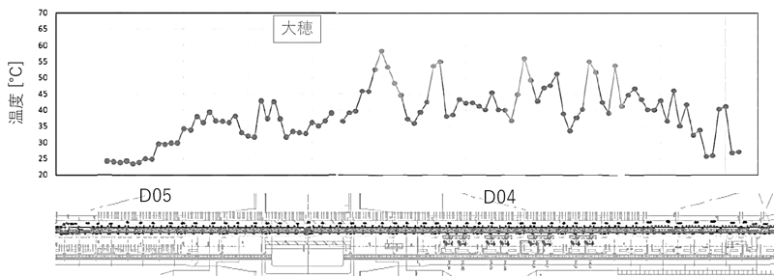
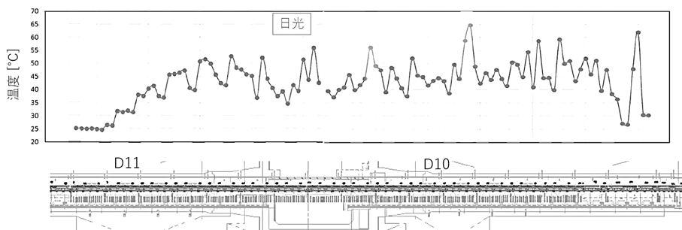
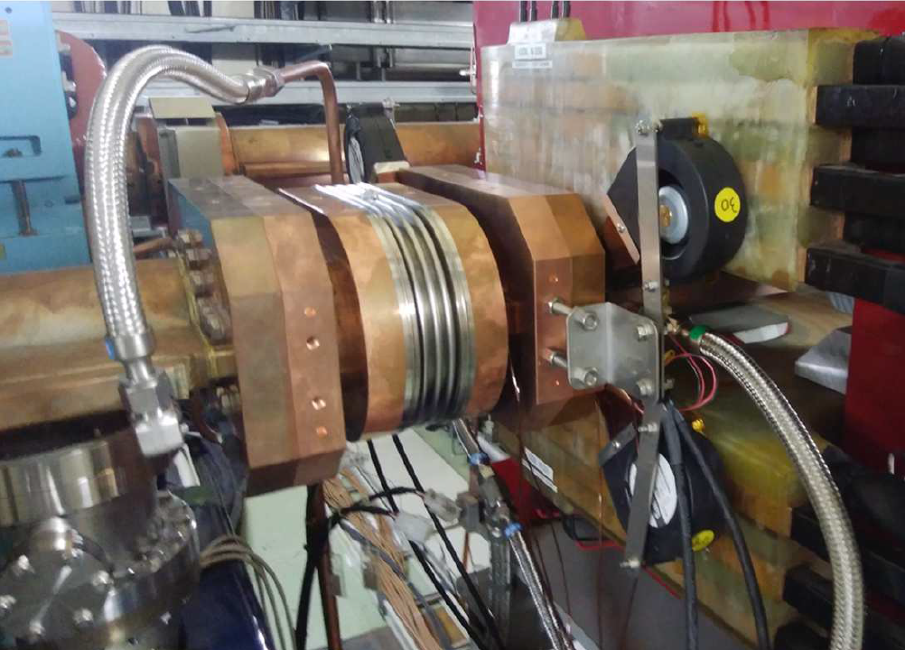
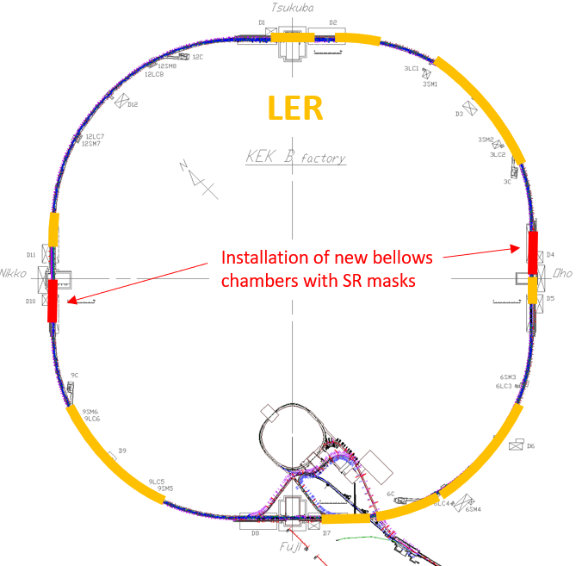
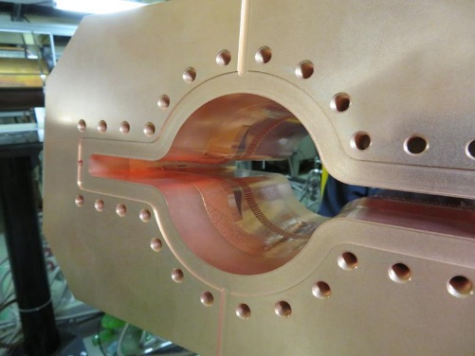
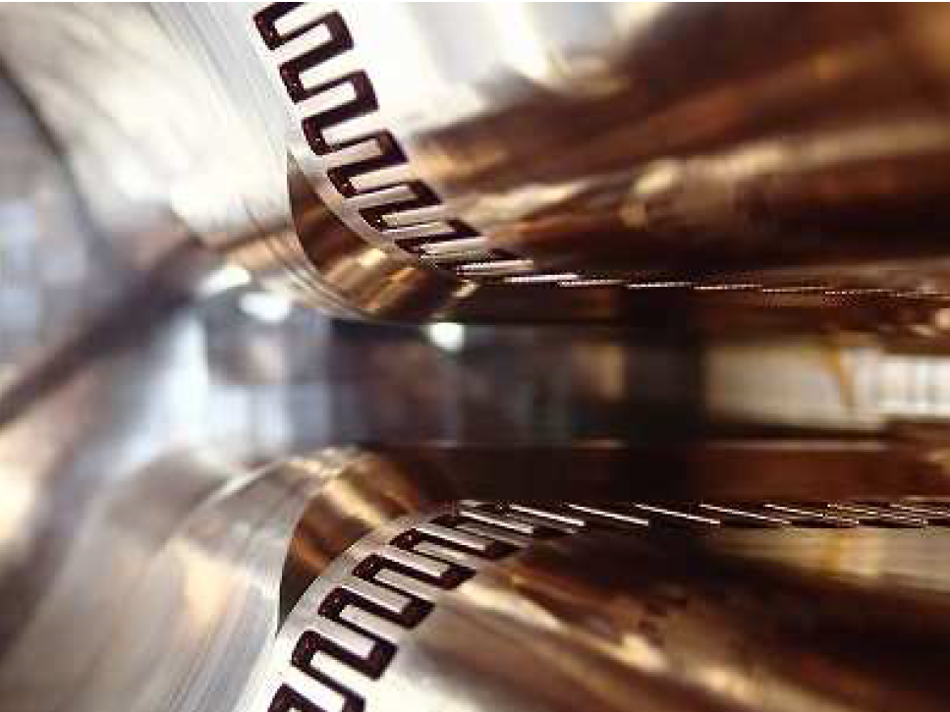
Major vacuum works during LS1 (MR) #1
Vacuum work at LER wiggler sections (LER)
Countermeasure against temperature rise of beam pipes downstream of Wiggler Sections
Beam current will be increased after LS1.
Magnetic field of wiggler magnets might be increased to compensate the reduction due to removed wiggler magnets for NLC system construction.
Strong SR should be absorbed by SR masks in the bellows chambers.
Locations of SR masks were optimized.
Rearrangement of bellows chambers
Larger SR power locations:
From bellows chamber w/o SR masks to w/ SR
masks (9 chambers)
Smaller SR power locations:
From bellows chamber w/ SR masks to w/o SR
masks (8 chambers)
Air and water cooling of the bellows chamber with SR masks were also enforced.
70
Oho wiggler section (D04, D05)
@1400 mA
Bellows chamber replacement
60
Wiggler removal
For NLC
50
Already reported in last KEKB Review
Temp [°C]
w/o → w/ SR masks
40
30
20
w/ → w/o SR masks
beam
70
Nikko wiggler section (D10, D11)
@1400 mA
60
50
Temp [°C]
40
30
20
beam
e+
D11
Installation of new bellows chambers with SR masks
D04
D10
D05
Wiggler sections
NLC
e+
SR masks in bellow chamber

Slide 8
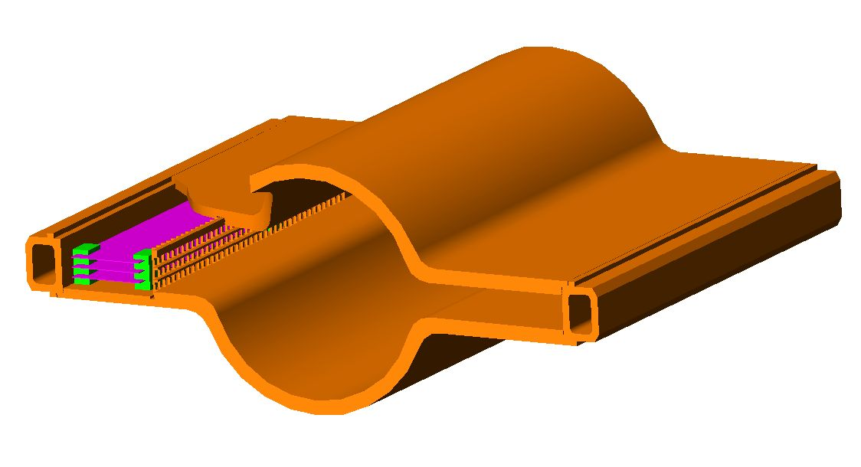
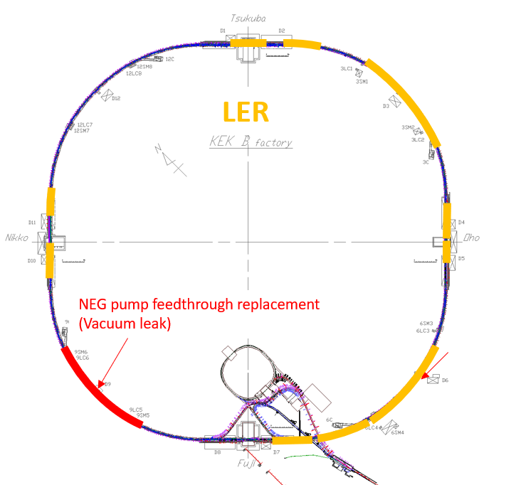
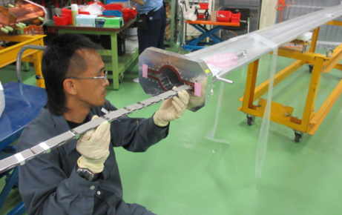
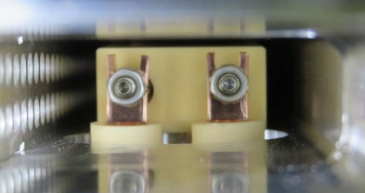
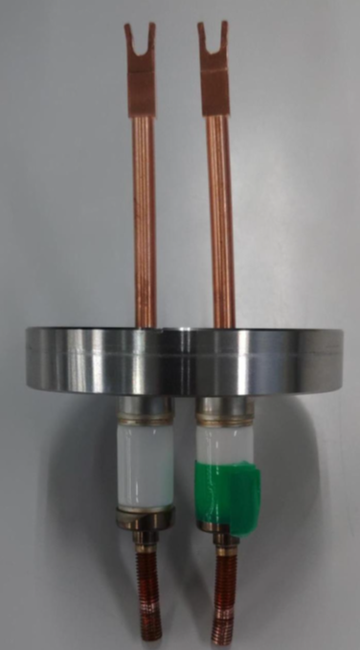
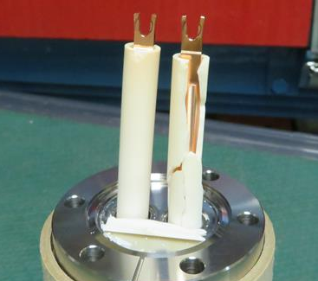
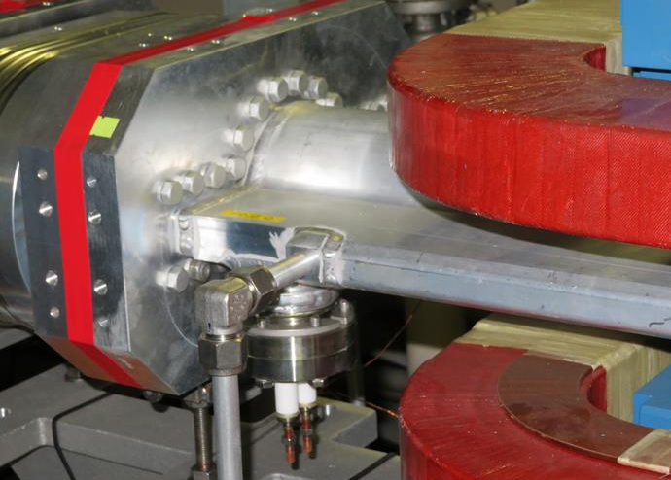
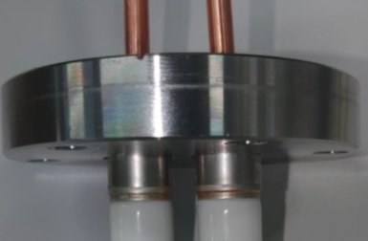
Major vacuum works during LS1 (MR) #2
LER beam pipe
NEG pump feedthrough replacement (LER)
Countermeasure against vacuum leak during LS1
It was found that a vacuum switch at D09 Arc Section in LER indicated abnormally high pressure. (2022/12/28)
Vacuum gauges and Ion pumps were turned off by I/L.
Unfortunately, data logging had been accidentally stopped, so pressure history was unknown.
D09 Arc Section was filled with air up to low vacuum at least.
Vacuum leak from NEG pump feedthrough was detected by vacuum leak test.
Replacement and investigation of NEG pump feedthrough
Faulty feedthrough was replaced with new one.
It was found that vacuum leak was occurred at the brazed part between the ceramic and stainless steel.
Investigation with X-rays revealed a crack in the ceramic part.
Ceramic tube inside vacuum was also broken.
It is still unclear why the ceramic parts were damaged at this time.
No work near this feedthrough & no NEG activation at this time.
Remaining excessive force during installation?
No further countermeasure against this issue
NEG pump
D09
Feedthrough tip
NEG pump
NEG pump is installed behind ceramic part
Broken ceramic tube
NEG pump feedthrough
Leak point

Slide 9
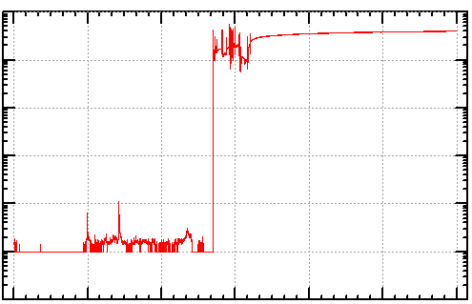
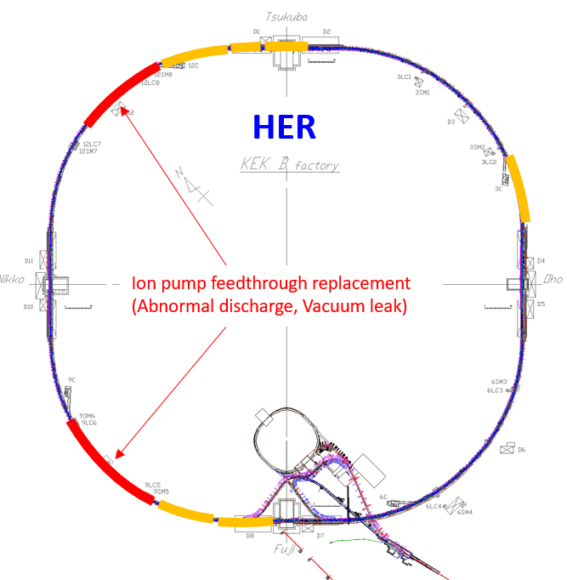
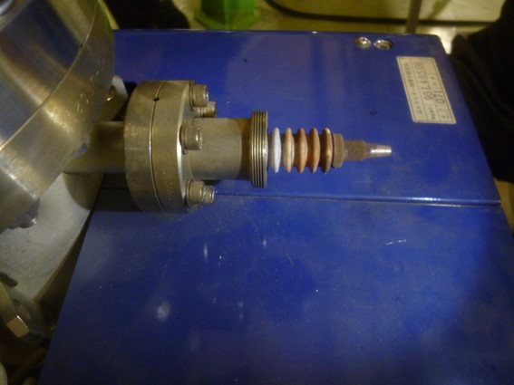
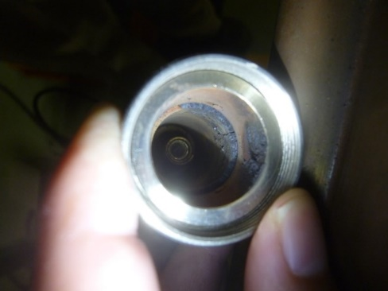
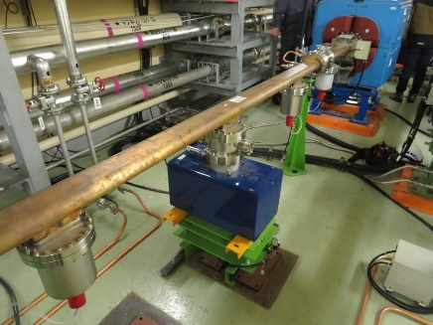
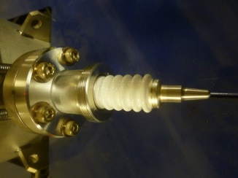
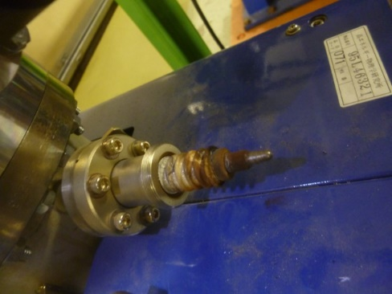
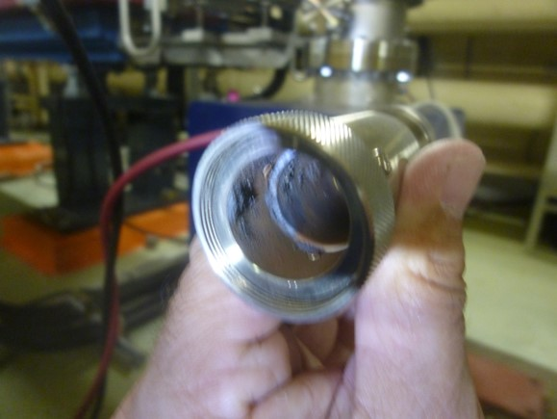
Major vacuum works during LS1 (MR) #3
10⁻³
Ion pump feedthrough replacement (x4, HER)
Countermeasure against abnormal discharge and vacuum leak during LS1
Pressure at D12 Arc Section of HER suddenly increased to ∼10⁻⁴ Pa. (2023/8/25)
It was found that abnormal discharge occurred in HV connector of an ion pump.
There was abnormal sound from it and abnormal high temperature on it.
Discharge in the connector resulted in vacuum leak.
Replacement of HV feedthrough and investigation of other feedthroughs
Faulty feedthrough was replaced with new one. (Vacuum work)
Feedthroughs and connectors of other ion pumps were checked.
It was found that abnormal discharge occurred in some connectors at D09 & D12 Arc Sections.
Three feedthroughs in D09 & D12 Arc Sections were replaced with new ones. (Vacuum work)
Others were reused after cleaning. (Not vacuum work)
Similar issues occurred during LS1 although they did not result in vacuum leaks fortunately.
Similar issues has occurred several times over the past 20 years.
They may be due to an increase in humidity due to the air conditioner stopping.
Further countermeasures:
R&D of humidity-resistant HV feedthrough and connector was started.
Since the feedthrough is no longer in production and difficult to obtain, alternative feedthrough must be developed.
10⁻⁴
D12
10⁻⁵
Vacuum leak
Pressure [Pa]
10⁻⁶
10⁻⁷
10⁻⁸
10⁻⁹
0:00
8/26
0:00
8/27
0:00
8/28
D09
0:00
8/25/2023
12:00
12:00
12:00
Ion pump feedthrough (discharged)
Connector (discharged)
Ion pump feedthrough (healthy)
Ion pump
Ion pump feedthrough (discharged)
Connector (discharged)

Slide 10
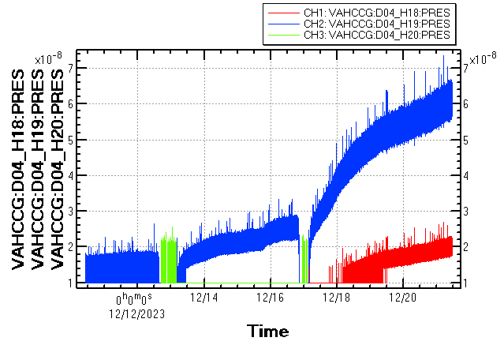
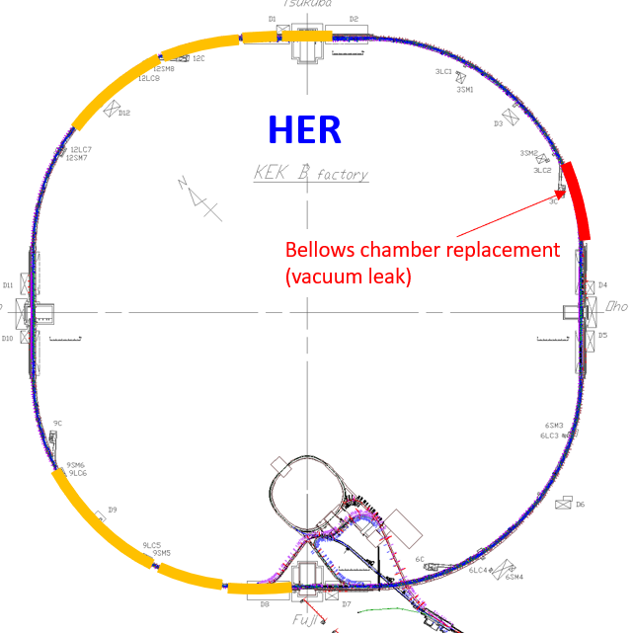
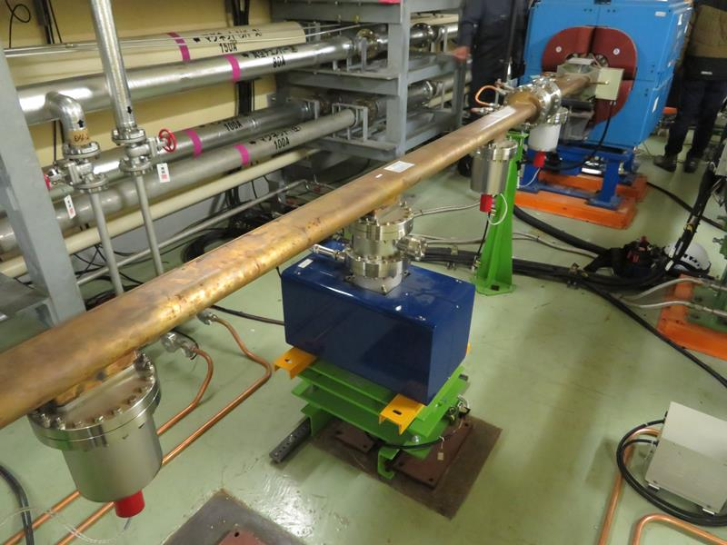
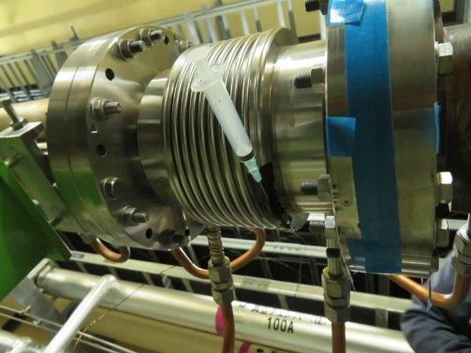
Major vacuum works during LS1 (MR) #4
Bellows chamber replacement (HER)
Countermeasure against vacuum leak during LS1
Pressure at D03 Arc Section of HER gradually increased to ∼7×10⁻⁷ Pa. (from 2023/12/13)
Leak test revealed that a vacuum leak occurred at the brazing line of a bellows chamber.
Faulty bellows chamber was replaced with new one.
It was installed into KEKB in 1997.
Still unclear why the vacuum leak occurred at this bellows chamber at this time
If vacuum leak occurs at other bellows chamber, it will be replaced with spare bellows chambers.
There are spare bellows chambers.
×10⁻⁷
7
6
D03
5
Pressure [Pa]
4
3
2
1
0:00
12/12/2023
12/14
12/16
12/18
12/20
Leaked bellows chamber
He gas was sprayed with a syringe to locate the leak point

Slide 11
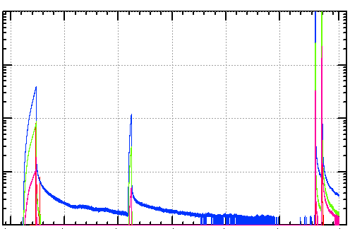
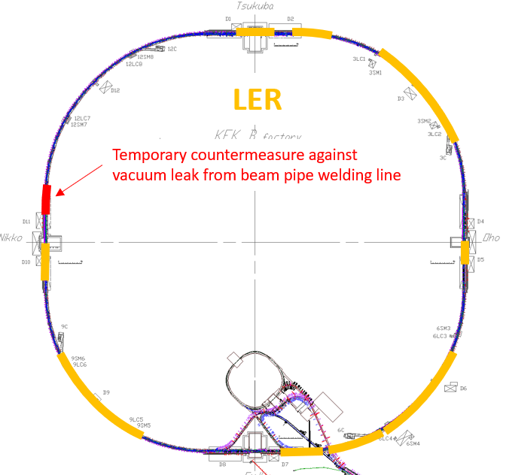
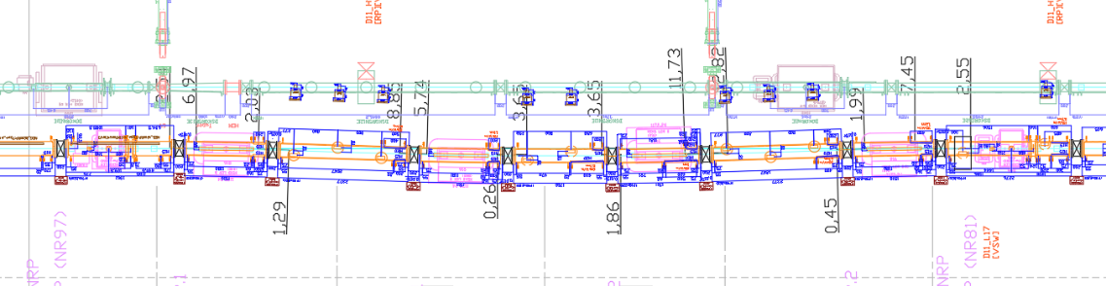
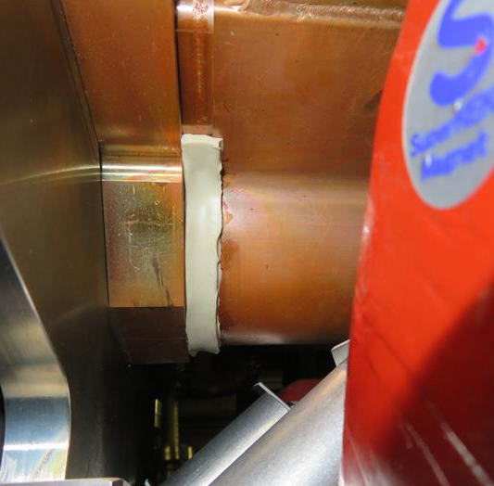
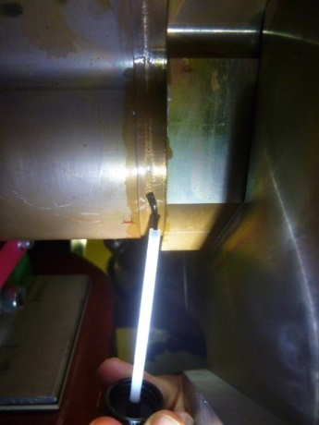
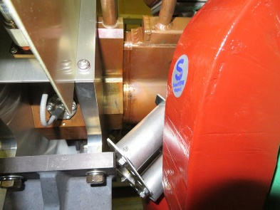
Major vacuum works during LS1 (MR) #5
Temporary countermeasure against vacuum leak from beam pipe welding line (LER)
Re-alignment of beam pipes in Nikko Chicane Section (not vacuum work)
To make orbit length the same as before removal of wiggler magnets in NLC section, beam pipes in Nikko chicane section were moved horizontally by up to 24 mm.
The BPM block of the Q-chamber, which had not been fixed for unknown reason, was fixed to the Q-magnet. (2023/4/28)
Vacuum leak occurred from the welding line of the BPM block. (2023/6/3)
Leak rate was ∼10⁻⁹ Pam³/s at this point.
This chamber was deformed during TiN coating process and repaired before installation into the SuperKEKB.
Stress due to repair work might be a cause of the vacuum leak.
Countermeasure against vacuum leak:
At first, the vacuum leak was stopped by “Vac seal”, however it could not be stopped by “Vac seal” in the end.
The vacuum leak was stopped by “Vacuum bag sealant tape”.
Further countermeasure
New beam pipe is currently being fabricated and is scheduled to be delivered on 27th March (tomorrow).
10⁻⁴
Leak rate : ∼10⁻⁹ Pam³/s
Vac bag sealant tape
10⁻⁵
Vac seal
D11
Nikko chicane
Pressure [Pa]
10⁻⁶
10⁻⁷
10⁻⁸
0:00
6/1/2023
6/11
6/21
7/1
7/11
7/21
8/1
e⁺
24 mm
Vacuum bag sealant tape
Vac seal
BPM Block
Q-mag.
BPM support
BPM block is fixed to Q-magnet by BPM support

Slide 12
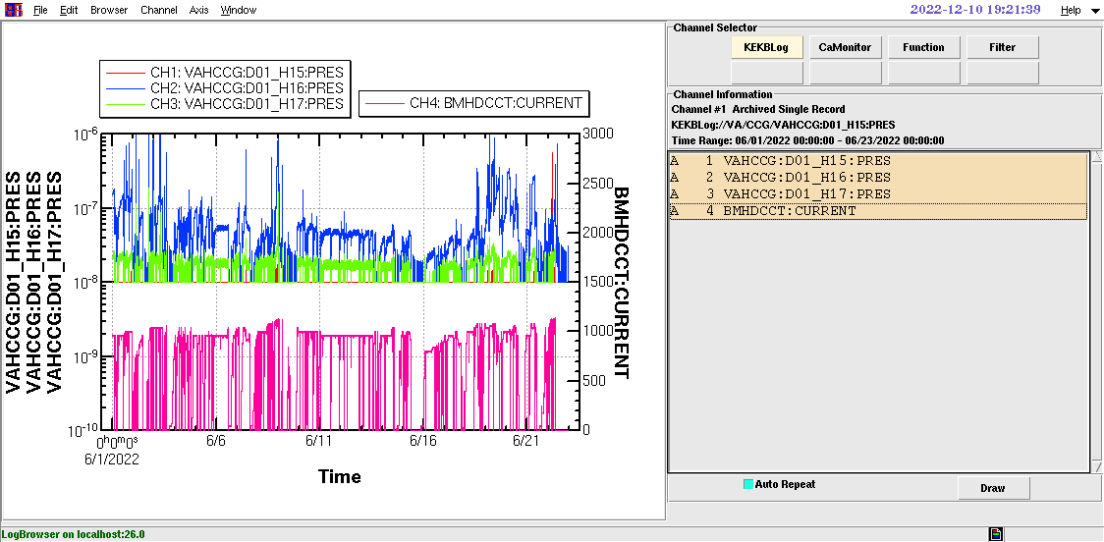
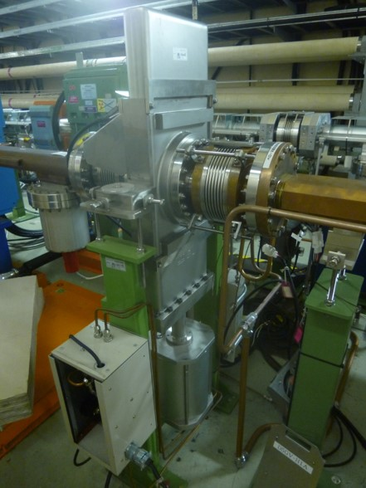
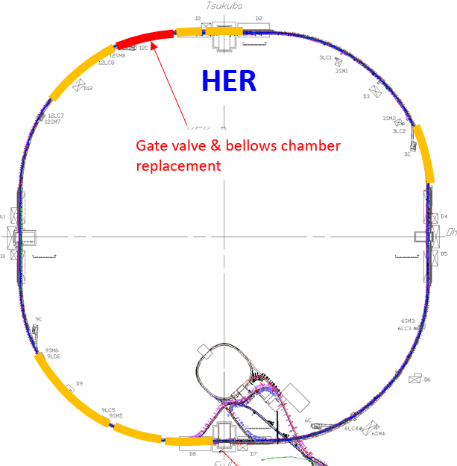
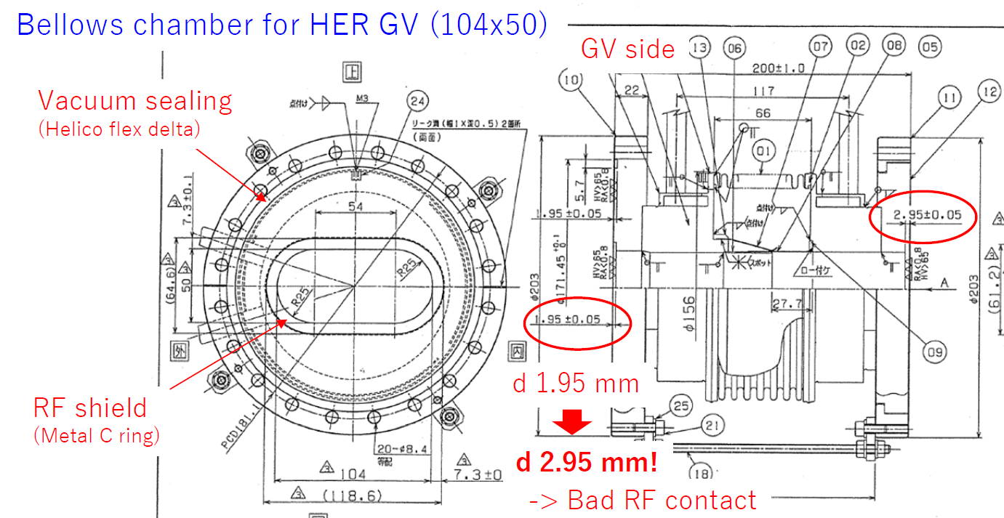
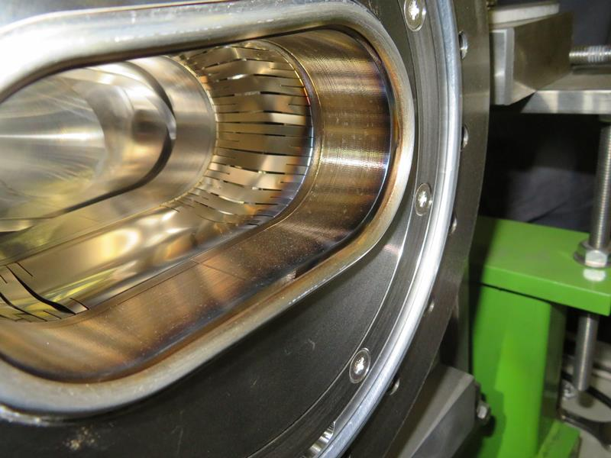
Major vacuum works during LS1 (MR) #6
Replacement of gate valve and bellows chamber (HER)
Countermeasure against abnormal pressure spike
Abnormal pressure spikes near a gate valve were observed at HER D12 Arc Section (2022ab).
Abnormal temperature rise of the gate valve was also observed.
Internal visual check revealed that the groove for the RF contact of the bellows chamber connected to the gate valve was 1 mm deeper than designed. (Vacuum work)
Possible cause is discharge at small gap due to poor contact between gate valve and bellows chamber.
Gate valve and bellows chamber were replaced with new ones.
It was confirmed that the depth of the groove for the RF contact of installed bellows chamber was designed value.
It was also confirmed that the pressures and temperatures of other HER gate valves were normal.
The depth of the other bellows chamber grooves seems to be as designed.
M. Shirai
Gate valve
Already reported in last KEKB Review
Beam current [mA]
Pressure [Pa]
Beam current
Bellows chamber
D12
Y. Suetsugu
RF contact
Vacuum seal

Slide 13
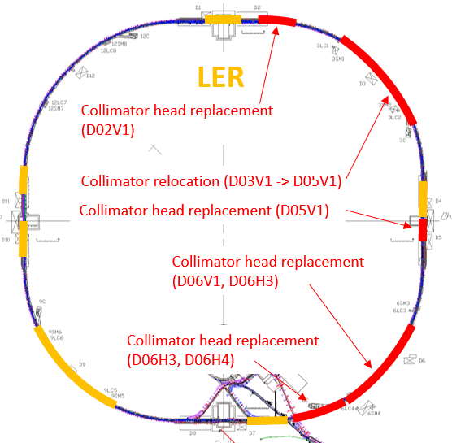
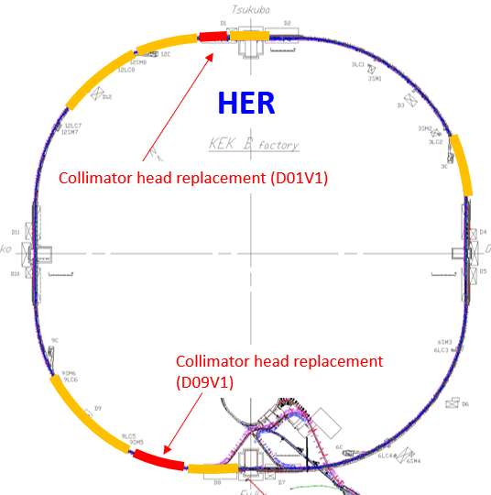
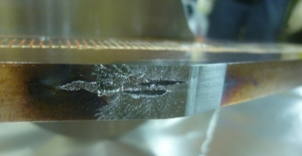
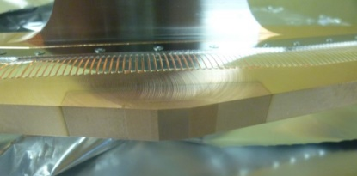
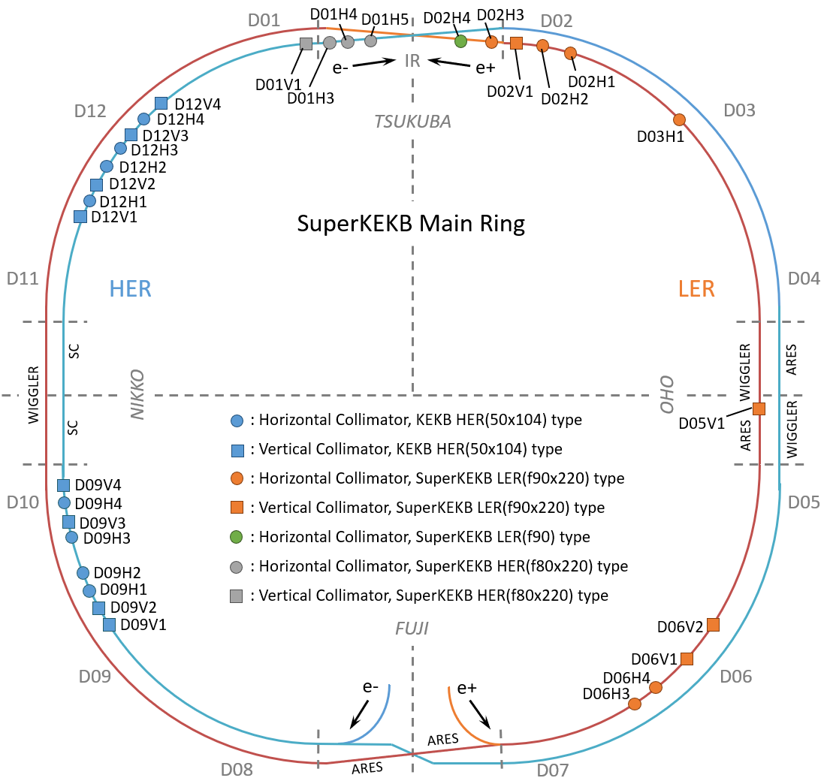
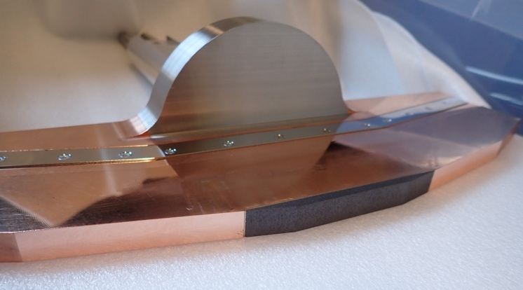
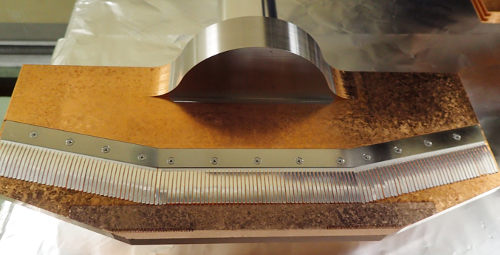
Collimator works during LS1 #1
M. Shirai
D02
D01
Collimator relocation and head replacement:
Replacement of damaged heads of vertical collimators
LER : D02V1, D06V1
HER : D01V1, D09V1
Relocation and head replacement for NLC
LER : D03V1 -> D05V1(NLC)
Head was replaced with shorter one (Ta, 5 mm) for scratch resistant
D06V1 (Ti, 10 mm) can be used as a spoiler for SBL
Countermeasure against injection kicker accidental firing (Horizontal collimators)
LER : D06H3
Head was replaced with Low-Z one (C, 16mm) for robustness
Spoiler against inj. kicker accidental firing.
LER : D06H1(upstream of D06H3) -> D06H4 (downstream of D06H3)
W head was replaced with Ta head (10mm) to suppress dust generation when damaged.
Absorber against inj. kicker accidental firing.
LER Inj. Kicker accidentally mis-fired several times in 2024a run, and Low-Z collimator seemed to work as expected.
Damaged head
D03
D05
D06
D09
New head with Cu coating
T. Ishibashi
Carbon head
(Before Cu coating)
S. Terui
Carbon head
(After Cu coating)
e-
HER
e+
LER

Slide 14
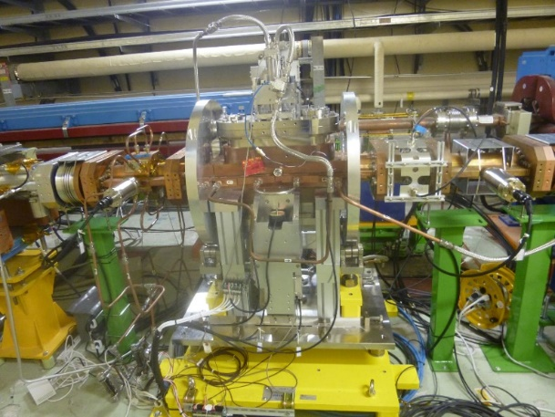
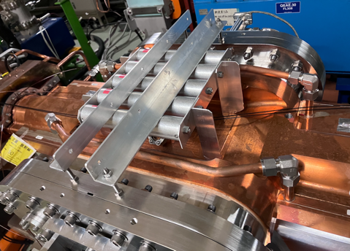
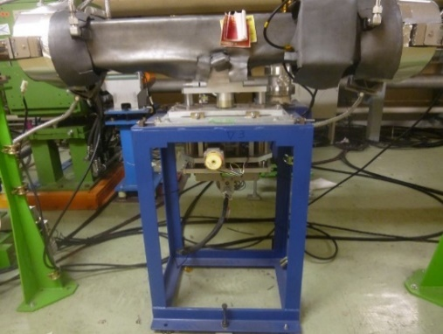

Collimator works during LS1 #2
D06V1
Other collimator related works:
Installation of HOM absorber chamber (LER)
Beam pipe with HOM absorbers was installed near D06V1 collimator in LER.
For future high current beam operation.
HOM generated at collimator have not been serious issues so far.
Installation of permanent magnet on SuperKEKB-type horizontal collimators (LER&HER)
For suppression of electron cloud which may be the cause of SBL.
All SuperKEKB-type horizontal collimators have permanent magnets on it.
Precise alignment of collimators by Magnet Group.
For SuperKEKB-type Vertical collimators whose heads were replaced during LS1
HER : D01V1
LER : D02V1, D05V1, D06V1
Upgrade of KEKB-type driving mechanism
For more precise and stable position control
HER : D09V1, D12V3
M. Shirai
HOM absorber chamber
Permanent magnet
T. Ishibashi
Conventional driving mechanism
New driving mechanism
M. Shirai

Slide 15
Status of LER collimator after LS1
T. Ishibashi
Vertical collimator
Name | Type | Tip Material | Cu coating | Tip condition
D02V1 | SuperKEKB | Ta (160 mm) | 〇 | 〇
D05V1 | SuperKEKB | Ta (4 mm) | 〇 | 〇
D06V1 | SuperKEKB | Ti (10 mm) | 〇 | 〇
D06V2 | SuperKEKB | Hybrid (3 mm) | 〇 | 〇
Horizontal collimator
Name | Type | Tip Material | Cu coating | Tip condition
D02H1-H4 | SuperKEKB | W (10 mm) | × | 〇
D03H1 | SuperKEKB | W (10 mm) | × | 〇
D06H3 | SuperKEKB | C (160 mm) | 〇 | 〇
D06H4 | SuperKEKB | Ta (10 mm) | × | 〇
Remarks
D06H3 and D06H4 work as spoiler and absorber against inj. kicker accidental firings.
All collimator heads are healthy (Not damaged).
All vertical collimator heads are coated with Cu.
All horizontal collimator have permanent magnets.

Slide 16
Status of HER collimator after LS1
Vertical collimator
T. Ishibashi
Name | Type | Tip Material | Cu coating | Tip condition
D01V1 | SuperKEKB | Ta (10 mm) | 〇 | 〇
D12V1, V2 | KEKB | Ti (40 mm) | 〇 | ×
D12V3, V4 | KEKB | Ti (40 mm) | 〇 | 〇
D09V1-V4 | KEKB | Ti (40 mm) | 〇 | 〇
Horizontal collimator
Name | Type | Tip Material | Cu coating | Tip condition
D01H3-H5 | SuperKEKB | W (10 mm) | × | 〇
D12H1, H3 | KEKB | Ti (40 mm) | × | 〇
D12H2 | KEKB | Ti (40 mm) | 〇 | ×
D12H4 | KEKB | Ti (40 mm) | 〇 | 〇
D09H1-H4 | KEKB | Ti (40 mm) | 〇 | ×
Remarks
Drive mechanism of some KEKB-type collimators has been upgraded for precise and stable adjustment.
D09V1, D12V1, D12V3, D12V4

Slide 17



Major vacuum works during LS1 (DR)
Two beam pipes were disassembled and reinstalled for Ext. Kicker PS work.
First vacuum work after DR construction
West Arc Section was filled with dry nitrogen.
Ceramic beam pipe for Ext. kicker and a beam pipe next to it were disassembled to remove Kicker PS.
These two beam pipes were filled with dry nitrogen and reinstalled into DR about 10 months later.
Remaining area of West Arc Section was also filled with dry nitrogen for about 10 months.
Other sections covered by Vacuum Group were kept in vacuum.
East Arc Section
North Straight Section
Sought Straight Section
RF Group also performed vacuum work at RF section during LS1
Vacuum system of RF section is covered by RF Group.
Pressure of RF section was improved by this work.
Pressures of West Arc Section and Sought Straight Section were also improved by this work.
DR
Removal and reinstallation of Ext. kicker chambers for Kicker PS work
RF cavity work (by RF group)
Ext. kicker and its PS
Disassembled beam pipes

Slide 18



Beam dose & Maximum beam currents (MR)
Beam dose integrated in 2024a run (1/29 ∼ 3/23)
HER : 308 Ah
LER : 358 Ah
No more dedicated vacuum scrubbing is required.
Max. beam current in 2024a run (1/29 ∼ 3/23)
HER : 640 mA
LER : 800 mA
HER
Whole ring
Arc sections
Pressure measurement limit
Beam current
1145 mA
640 mA
LER
Max. beam current so far
HER : 1145 mA
LER : 1455 mA
Whole ring
Arc sections
Pressure measurement limit
Beam current
1455 mA
800 mA
2019c
2020c
2021c
LS1
Phase1
Phase2
2019ab
2020ab
2021ab
2022ab
2024ab
Phase3

Slide 19




Vacuum scrubbing status (MR)
Vacuum scrubbing is proceeding steadily in both rings.
Δp/ΔI is decreasing steadily as beam dose increases.
Δp/ΔI is higher in LER than HER.
Less memory effect in LER
More vacuum works in LER during LS1
LER
HER
2024ab (This run)
2024ab (This run)
Whole ring
Whole ring
Arc sections
Arc sections
I_{max}
I_{max}
Whole ring
Arc sections
2022ab (Previous run)
Whole ring
I_{max}
Arc sections
2022ab (Previous run)
I_{max}

Slide 20


Vacuum scrubbing status (MR)
Vacuum scrubbing status from Phase-I to Phase-III 2024ab run (∼3/22)
LER
HER
Δp/ΔI
for whole ring
Phase2
Δp/ΔI for whole ring
Phase2
2019c
2020c
2024ab
2021c
2019c
2024ab
2020c
2021c
Phase1
Phase1
Δp/ΔI & η
for arc sections
η @Arc sect. [molec./photon]
η @Arc sect. [molec./photon]
Δp/ΔI & η
for arc sections
2019ab
2020ab
2019ab
2021ab
2022ab
2020ab
2021ab
2022ab

Slide 21



Beam dose & Pressure (DR)
Beam dose (until 3/22 0:00)
73.0 Ah (from start of beam operation)
5.4 Ah (after LS1)
Pressure
RF Section work during LS1 has significantly reduced the average pressure in West Arc Section and South Straight Section.
East Arc Section
West Arc Section
(Vacuum work during LS1)
North Straight Section
Sough Straight Section
RF Section
(Vacuum work during LS1
by RF Group)
Average pressure measured by ion pumps
Sough Straight Section
Beam dose
West Arc Section
East Arc Section
North Straight Section
Current
Current
Current

Slide 22


Vacuum scrubbing status (DR)
Vacuum scrubbing of West Arc Section is proceeding steadily after LS1.
To eliminate the influence of pressure in RF section, average pressure measured by ion pumps excluding one near RF Section was shown as West Arc Section.
Δp/ΔI is decreasing steadily as beam dose increases.
Δp/ΔI of West Arc Section is still higher than that of East Arc Section
Gap between West Arc Section and East Arc Section is narrowing.
Impact of long vacuum work in West Arc Section on the beam operation is not large.
DR
After LS1
West Arc Section
West Arc Section
East Arc Section
East Arc Section
Removal and reinstallation of Ext. kicker chambers for Kicker PS work
RF cavity work (by RF group)
Beam Dose after LS1 [Ah]

Slide 23






Other activities
Investigation on beam pipe deformation due to SR heating in SLY section.
Measurement of deformation of beam pipes due and displacement of BPM and Q-magnet in SLY section
Simulation of deformation of beam pipes and displacement of BPM and Q-magnet in SLY section
Fabrication of new BPM supports to isolate BPM block from Q-mag.
They will be installed near future.
Development of pressure anomaly detection method applying machine learning
Trial operation of pressure anomaly detection program from this month (March 2024).
Collimator R&D
R&D of more robust head material such as MoGr
R&D of collimator with revolver heads
And so on.
M.L. Yao
S. Terui

Slide 24
Summary
A lot of vacuum works were done during LS1, and mainly vacuum works related to the vacuum system and collimator were reported.
Installation of new bellows chambers with SR mask at Wiggler Sections
NEG pump feedthrough replacement
Ion pump feedthrough replacement
Bellows chamber replacement
Temporary countermeasure against vacuum leak with vacuum sealant tape
Gate valve and bellows chamber replacement
Collimator relocation
Collimator head replacement
Installation HOM absorber chamber
Removal and reinstallation of Ext. kicker chambers (DR)
All vacuum works planned during LS1 were successfully completed.
Vacuum scrubbing is proceeding steadily.
No more dedicated vacuum scrubbing is required.
Vacuum system is ready for higher beam current operation!!

Slide 25
Fin.
Thank you for your attention.
Inter-University Research Institute Corporation High Energy Accelerator Research Organization (KEK)
大学共同利用機関法人 高エネルギー加速器研究機構 (KEK)

Slide 26


Backup
Vacuum Bag Sealant Tape
https://www.generalsealants.com/vacuum-bag-sealants/#1568264193156-000f6158-0e49

