Slide 1
Linac control monitors
-- First direct measurement of electron and positron bunch characteristics at the positron source of the SuperKEKB B-Factory --
Tsuyoshi Suwada (tsuyoshi.suwada@kek.jp)
Accelerator Laboratory, KEK

Slide 2
Introduction
In 2020, the positron (e+) source of the SuperKEKB (SKEKB) B-Factory was upgraded to increase the positron yield.
  Countermeasure against electric discharge for the AMD, installations of steering magnets, and beam diagnostics.
There are three difficulties to install any beam diagnostics,
  in radiation hard environment, almost no space to install them, and difficult technique to simultaneously and separately detect both secondary e- and e+ bunches with very short time interval.
A wideband beam monitors (WBMs) were successfully installed in the e+ source.
In this report, the motivation for introducing WBMs, and their detection technique, and some results are presented.

Slide 3
The SKEKB e+ source
SLs 0.4T, Acc.G 14-20 MV/m@unit1-5
SLs 0.5T, Acc.G 10 MV/m @unit1-6
14mm-thick W
Ee+~120MeV
Ee-~3.5 GeV
Qe-~10 nC
3.5 T
1.5 T
1. Secondary e+e- bunches are immediately captured in the transverse phase space by applying strong pulsed and DC magnetic fields. On the other hand, in the longitudinal direction they are captured by applying electromagnetic fields in accelerating structures. The e- bunch is stopped by a beam stopper at a chicane and the e+ bunch passes through it. The bunch charges are first measured by a standard BPM after the chicane.
2. One of the important issues for beam diagnostics is to simultaneously and separately detect parallel travelling e+e- bunches with very short distances by two WBMs in the capture section.
How can we detect simultaneously and separately these secondary e- and e+ bunches?
Which detection technique is suitable, in time domain or frequency domain?
What kinds of bunch characteristics for a single bunch are measurable?

Slide 4
e- and e+ capture process in the e+ capture section through dynamical phase-slip process
rear e+
front e-
front e+
rear e-
Reverse process
The line order for the e- and e+ bunches are generated with very short time intervals (Δt~ 0 - 300 ps) depending on the capture phase.
To understand the dynamical capture process, it is required to precisely measure the time interval Δt between these two bunches.

Slide 5
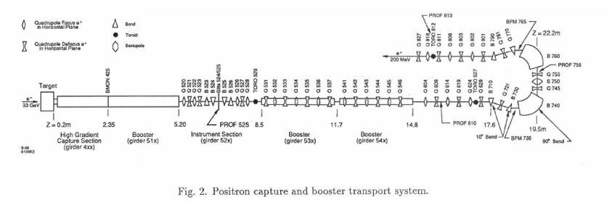
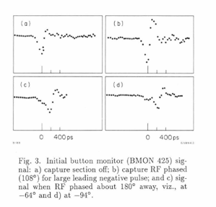
Historical detection technique in time domain at the SLC e+ sources
e+ capture section
e+ production target
Ee- ~ 33 GeV
Ne- ~ 5x10^10 e-/pulse
button pickup
e+
e-
400ps
1. Referred by J. E. Clendenin, et al., “SLC positron source startup”; Procs. of 1988 Linear Accelerator Conf, Williamsburg, Virginia, USA.
2. The commissioning of the e+ source began in early September of 1986.
We can barely recognize both e- and e+ bunches, for which the signals were obtained by a button pickup. The bunch separation is not very good in time domain.

Slide 6
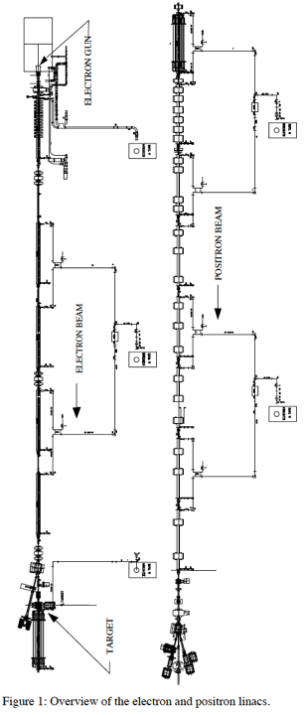
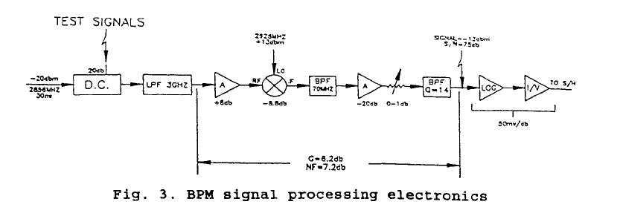
Historical detection technique in frequency domain at the APS e+ sources
e+ production target
e-
e+
e-
Ee-~200 MeV
Qe-~50 nC/pulse
e+
e-
e+ capture section
without any e+e- separator
1. Referred by R. Fuja and Y. Chung, “APS linac beam position monitors and electronics”
2. The linac commissioning began in early October of 1993.
Conventional heterodyne technique with a fundamental 2856 MHz for e- and e+ 30-ns pulsed beams for a stripline bpm
It is difficult to separately detect both e- and e+ bunch characteristics.

Slide 7
Choice from the viewpoint on the pros and cons for detection techniques
To the best of my knowledge in 2018,
1. Based on the detection technique in time domain,
  Any high frequency signal losses for all rf components, transmission lines and signal pickups should be fully corrected in sufficient wide bandwidth.
  Is such a correction scheme possible in time domain?
  How much bandwidth is required at minimum?
  This technique gives a great advantage in comparison with that in frequency domain?
2. Based on the detection technique in frequency domain,
  any fundamental frequency is not a characteristic frequency for a single bunch,
  and a heterodyne technique is not so advantageous for a single bunch in comparison with a pulsed beam,
  and it is difficult to separately detect both e- and e+ bunch characteristics.

Slide 8
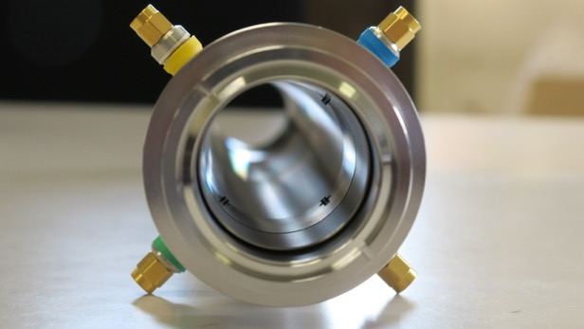
Wideband beam monitor (WBM)
38mm
Protrusion length of 1mm for SMA feedthrough
antenna from the inner surface
Simultaneous and separate detection for both e- and e+ bunches is possible in time domain with any rf loss corrections for all rf components and transmission lines.
Fundamental bunch characteristics, bunch interval, charges, transverse positions, and bunch lengths can be separately measured for both e- and e+ bunches in time domain.

Slide 9
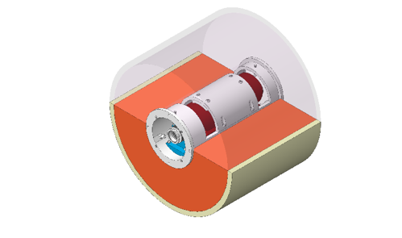
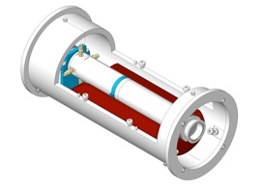
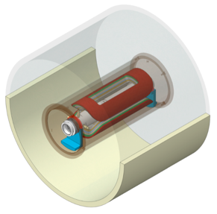
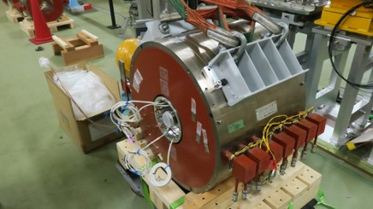
Integrated WBM and steering magnets in a frame
Dipole magnets and WBM fixed in a frame
Fixing structure of the frame in a solenoid coil
Frame inserted in a solenoid coil
e+@e-e+, e+@e+e-

Slide 10
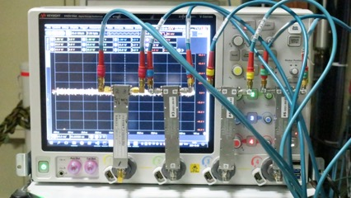
Signal detection system
All rf components should be corrected in suitable frequency region by using a vector network analyzer.
Coax. cables, rf combiners, and rf loss in pickups
pickups
coaxial cables
rf combiners
Any rf signal loss corrections are available with normal and inverse FFT procedures based on “de-embedding technique”.
The cut-off frequency was fixed to 9.1 GHz in the inverse FFT procedure.
Any signal waveforms can be corrected in frequency domain and displayed pulse-by-pulse in time domain.
Wideband oscilloscope
Keysight Tech., BW13.5GHz, 40GSa/s.

Slide 11
Results of the signal detection in time domain
Raw signal
Differential signal
Raw signal (ch#1)
1) with rf-loss correction,
2) at φ_15=0 deg in nominal e+ operation,
3) 2 WBM signals combined,
4) 2 bunch acceleration with the time interval of Δt₂=96 ns
1st @SP15-25
1st @SP16-25
1st e-
wakefield
2nd @SP15-25
1st e+
2nd @SP16-25
Integrated signal
4ch-sum integrated signal
Integrated signal
for beam position calculation,
4ch-sum Integrated signal
for bunch length (pulse width),
arrival timing (peak timing), and bunch charge (pulse area) calculation.
1st e+
1st e+
1st e-
1st e-

Slide 12
Variations during the dynamical phase-slip process for both the e+e- bunches depending on the capture phase
capture phases φ15
(1) The separate detection for e-e+ bunches in time domain was successfully performed.
(2) The travelling order of e-e+ bunches is reversed at certain capture phases through the dynamical phase-slip process.
(3) Some satellite bunches can be identified which are 350ps apart from the main bunch. The generation of satellite bunches is caused by spill-over from the longitudinal phase space.
(4) The results show that quite symmetric dynamical behaviors for both the bunch characteristics were observed.
(5) The ringing waves following from the bunch signals are due to wakefields from upstream accelerator structures.
main e+
main e+
main e-
main e-
350 ps
satellite e-
satellite e+

Slide 13
Time interval measurements as a function of the capture phase
1st bunch@SP15-25/SP16-25
2nd bunch@SP15-25/SP16-25
e+@e-e+
dec. e+
e+@e+e-
acc. e+
Tsuyoshi Suwada, “Direct Observation of Positron Capture Process at the Positron Source of the SuperKEKB B-Factory”; Scientific Reports 12, 18554 (2022). Published online 2022 Nov. 03. https://doi.org/10.1038/s41598-022-22030-5.

Slide 14
3D plots in the bunch characteristics as functions of time interval, capture phase, and bunch intensity for e+e- bunches
e+
e+
e+
e-
e+
e-
1st bunch@SP15-25/SP16-25
2nd bunch@SP15-25/SP16-25

Slide 15
e+e- bunch characteristics depending on the capture phase
e- decelerating region
e- accelerating region
e+ accelerating region
e+ decelerating region
Time interval
Time interval
Bunch length (rms)
Bunch length (rms)
X
X
Y
Y
Charges
Charges
Capture phase
Capture phase
Capture phase
Capture phase
1st e-@e-e+,
1st e-@e+e- at SP15-25,
Step phase Δφ15=Δφ16=10º
1st e+@e-e+,
1st e+@e+e- at SP15-25
1st e-@e-e+,
1st e-@e+e- at SP16-25
1st e+@e-e+,
1st e+@e+e- at SP16-25

Slide 16
Plots for both the e+e- bunch positions at SP15-25 and SP16-25
1st e-
1st e+
e-@e-e+, e-@e+e-
e+@e-e+, e+@e+e-
Offset target
Offset target
2mm
2mm
2mm
2mm
・ It can be found that there are no characteristic differences in the transverse positions depending on the capture phase under the nominal operation condition and those giving the maximum charges.
・ It is interesting that the cluster for each bunch rotates in the transverse plane owing to their cyclotron motion in the longitudinal direction between SP15-25 and SP16-25.

Slide 17
Correlation plots for the time interval and bunch charges of both e+e- bunches at SP15-25 and SP16-25
e-@e-e+
e+@e-e+
e-@e+e-
e+@e+e-
1st e-
1st e+
Accelerating e- (blue), e+ (green), decelerating e- (brown), e+ (red)
・The time interval correlation is based on a 45º inclined line.
・This result means that the dynamical phase slip process was completed at the first WBM (SP15-25).
・The maximum charges are generated at the maximum time intervals even for the different bunches, Δt~-268 ps (Δt~-268 ps)@ acc. e- (acc. e+), Δt~-264 ps (Δt~253 ps)@ dec. e- (dec. e+), respectively.

Slide 18
Correlation plots for the bunch length and bunch charges of both e+e- bunches at SP15-25 and SP16-25
e-@e-e+
acc. e-
e+@e+e-
acc. e+
e-@e+e-
dec. e-
e+@e-e+
dec. e+
1st e-
1st e+
・Although the dynamical phase-slip process was fixed at the front WBM (SP15-25), the dynamical exchange of particles in the longitudinal direction inside the bunch may be caused, called bunch lengthening (or shortening).
・ The correlation seems to be based on a 3rd-order polynomial function in the accelerating phase region, and on the other hand, that shows a bunch shortening in the decelerating phase region.
・The maximum bunch charges are generated at the maximum bunch length.

Slide 19
Variations in e+e- bunch charges as a function of the capture phase at SP15-25 and SP16-25
acc. e-@e-e+
acc. e-@e-e+
acc. e+@e+e-
acc. e+@e+e-
ope. point
ope. point
dec. e+@ e-e+
dec. e+@ e-e+
dec. e-@e+e-
dec. e-@e+e-
・ The present operation point is not on an optimized point.
・ The e+e- bunch charges in the accelerating phase region are greater than those in the decelerating phase region in the capture section.
・ The e+ yields at the peak points in the acc. and dec. phase regions are 122% and 84% greater than that at the nominal operation point, respectively.

Slide 20
Conclusions
Direct simultaneous measurements of the secondary e+e- bunch characteristics were successfully performed with WBMs at the e+ source of the SuperKEKB B-factory.
Longitudinal and transverse bunch characteristics were obtained for each bunch as a function of the capture phase to investigate their dynamical capture process under two-bunch acceleration scheme.
The results show that quite symmetric behaviors in the e−e+ bunch characteristics were observed.
Such wideband detection techniques could be applied to conventional and advanced e+ sources in future accelerator projects.
Based on this technique, the e+ intensity could be systematically optimized in multidimensional parameter spaces towards high-intensity e+ sources.

Slide 21
Backup files

Slide 22
Variations in the e+ bunch charges as a function of the capture phase at SP15-25, SP16-25, and SP16-5
・ It is clear that the present operation point is not on an optimized point.
・ The e+ yield at the maximum point obtained by a BPM after the capture section is only ~5% greater than that at the nominal operation point.
・ The capture phase at the max. e+ yield in the capture section is shifted from that after the capture section.
・ The results show that only the e+ yield measurement at the location after the capture section is not sufficient in the optimization procedure. More detailed parameter tunings may be required.
acc. e+@e+e-SP1525
dec. e+@e-e+
SP1525
acc. e+@e+e-
SP1625
dec. e+@e-e+
SP1625
e+@SP165

Slide 23
Layout of the e+ source of the SKEKB injector linac
new(e-)
e+/e- separator
BPM
new(e+)
new (e-)
new (e+)
・Total length of the capture section ~15 m
・Primary Ee- = 3.5 GeV, ~10 nC (single-bunch)
・Ee+ ~ 120 MeV after the capture section
・ e+ target 14mm-thick W
・Solenoidal fields of FC/BC 3.5/1.5 T
・Solenoidal fields of DC SLs 0.4 T(unit1-5) /0.5 T(unit1-6)
・LAS Acc. gains 14-20 MV/m (unit1-5) / 10 MV/m (unit1-6)
・Wideband monitors (new for e+) and conventional BPMs (new for e-)

Slide 24
Super KEKB Accelerator Complex
The SuperKEKB B-Factory: an electron-positron collider with asymmetric energies
e⁺ E = 4 GeV
e⁻ E = 7 GeV
3km
500m
100m

Slide 25
References
Tsuyoshi Suwada, Muhammad Abdul Rehman, and Fusashi Miyahara, “First simultaneous detection of electron and positron bunches at the positron capture section of the SuperKEKB factory”; Scientific Reports 11, 12751 (2021). https://doi.org/10.1038/s41598-021-91707-0.
Tsuyoshi Suwada, “Modal Analysis of Electromagnetic Couplings between SMA-Feedthrough Electrode and Beam for Wideband Beam Monitor”; Poster presented at the 10th International Beam Instrumentation Conference (IBIC2021), Video meeting hosted by PAL, Korea, Sep. 13-16, 2021, pp. 392-395 (JACoW Publishing, 2021) [ISBN 978-3-95450-230-1, doi:10.18429/JACoW-IBIC2021-WEPP12].
M. A. Rehman and T. Suwada, “Observation of Wakefireld Effects with Wideband Feedthrough-BPM at the Positron Capture Section of the SuperKEKB Injector Linac”; Proceedings of the 10th International Beam Instrumentation Conference (IBIC2021), Pohang, Rep. of Korea, Sep. 13-16, 2021, pp. 52-55 (JACoW Publishing, 2021) [ISBN 978-3-95450-230-1, doi:10.18429/JACoW-IBIC2021-MOPP10].
M.A. Rehman, T. Suwada, and M. Miyahara; “First synchronous measurement of single-bunched electron and positron beams with a wideband feedthrough-BPM at the positron capture section of the SuperKEKB inejctor linac”; Proceedings of the 2021 Particle Accelerator Conference (IPAC’21), hosted by the Brazilian Center for Research in Energy and Materials (CNPEM), Campinas, Brazil, May 24-28, 2021, pp.557-560 (MOPAB163); ISBN: 978-3-95450-214-1, ISSN: 2673-5490, doi:10.18429/JACoW-IPAC2021-MOPAB163.
T. Suwada, “Characteristic Analysis of Wideband Beam Monitor with High Frequency Pickups”; Rev. Sci. Instrum. 93, 093301 (2022) [DOI: 10.1063/5.0087321].
Tsuyoshi Suwada, “Direct Observation of Positron Capture Process at the Positron Source of the SuperKEKB B-Factory”; Scientific Reports 12, 18554 (2022). Published online 2022 Nov. 03. https://doi.org/10.1038/s41598-022-22030-5.
T. Suwada, “First direct measurement of electron and positron bunch characteristics at the positron source of the SuperKEKB B-Factory”; AIP Advances 13, 045021 (2023); [DOI: 10.1063/5.0145776].

Slide 26
Frequency characteristics for the bunch characteristics
Time interval Δt between e- and
e+ bunches, f_{c} ~10 GHz
systematic error
σ_{Δt} = Δt (20 GHz) - Δt (10 GHz)
f_{c} ~10 GHz
Bunch lengths le- and le+
f_{c} ~10 GHz
systematic error
σ_{l} = l (25 GHz) - l (10 GHz)
Bunch charges Qe- and Qe+
f_{c} ~20 GHz
systematic error
σ_{Q} = Q (25 GHz) - Q (20 GHz)
Tsuyoshi Suwada, Muhammad Abdul Rehman, and Fusashi Miyahara, “First simultaneous detection of electron and positron bunches at the positron capture section of the SuperKEKB factory”; Scientific Reports 11, 12751 (2021). Published online 2021 June 17. https://doi.org/10.1038/s41598-021-91707-0.

Slide 27

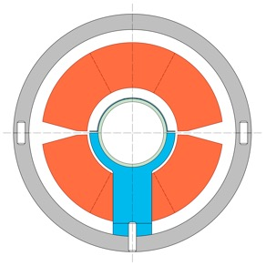
Installation of WPM into a frame
Frame for dipole and WBM
WBM support（upstream）
WBM support（center）
STX/STY magnets
210mm
430mm
Notes:
1

Slide 28
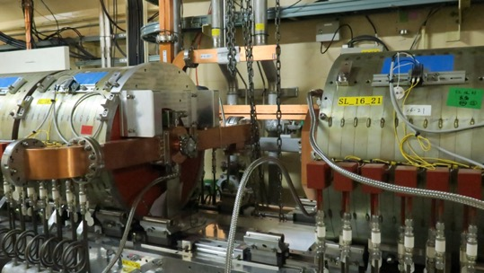
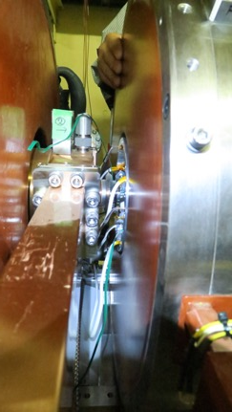
Installation of solenoid coil into the e+ source
(upper) e+ capture section
Cable extraction
(left) Solenoid coil installed the frame

Slide 29
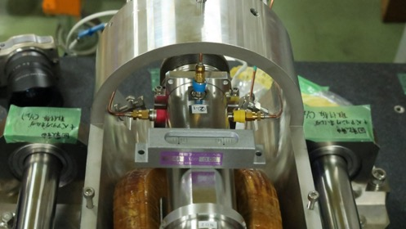
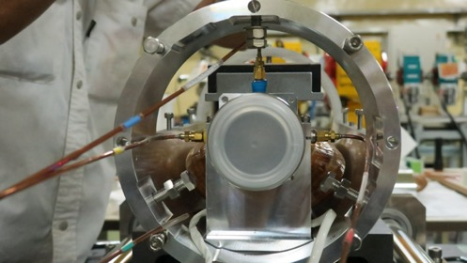
Dipole magnet and WBM fixed in a frame
Inserting a WBM and dipole magnet in an aluminum frame
Extracting coax. cables with a bending angle of 90º in the forward direction.

Slide 30
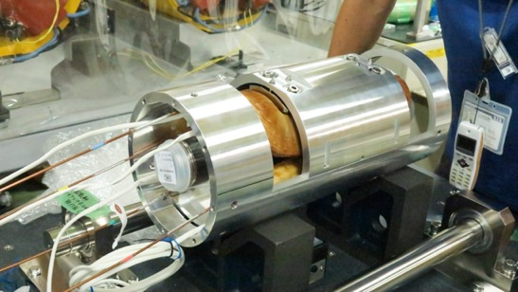
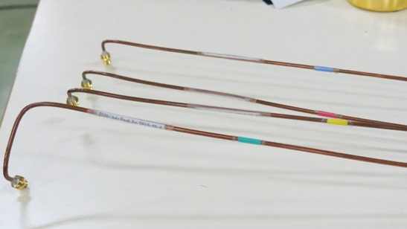
Integrated WBM and semi-rigid coaxial cables filled with PEEK as an insulator
Integrated aluminum frame fixed with WBM and dipole magnet
2m-long signal-extraction coax. cable filled with an insulator made of PEEK

Slide 31
Typical measurement results of there different coax. cables connected in series/amplitude and phase data
S21 amplitude
S21 phase
T. Suwada, “Characteristic Analysis of Wideband Beam Monitor with High Frequency Pickups”; Rev. Sci. Instrum. 93, 093301 (2022) [DOI: 10.1063/5.0087321].

Slide 32
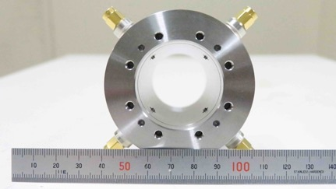
RF loss correction technique for pickups (I)
rf induced technique by which S21 between channels is measurable by a VNA
T. Suwada, “Characteristic Analysis of Wideband Beam Monitor with High Frequency Pickups”; Rev. Sci. Instrum. 93, 093301 (2022) [DOI: 10.1063/5.0087321].

Slide 33
RF loss correction technique for pickups (II)
Equivalent circuit model of WBM taking into account electromagnetic couplings between feedthrough electrodes. The couplings for different modes are shown with different colors.
Typical measurement results of amplitude S21 between electrodes No. 1 and No. 2 (blue) [also No. 1 and No. 3 (red)].

Slide 34
Electromagnetic coupling analysis
Detection principle
Figure 3:
(a) Schematic drawing of electromagnetic couplings
between SMA feedthrough and coaxial structure.
(b) Electromagnetic couplings between SMA feedthrough and a thin ring beam. Inner radius of the coaxial structure: a = 19 mm, ring-beam radius: b, radii of the SMA inner and outer conductor: bi = 0.9 mm, bo = 2.05 mm, and the characteristic impedance of the SMA is Z₀ = 50 𝛀.
Figure 4: Equivalent circuit of electromagnetic couplings between SMA feedthrough and coaxial structure. The arrows indicate the couplings between TEM (blue), TE (red), and TM (green).
Tsuyoshi Suwada, “Modal Analysis of Electromagnetic Couplings between SMA-Feedthrough Electrode and Beam for Wideband Beam Monitor”; Poster presented at the 10th International Beam Instrumentation Conference (IBIC2021), Video meeting hosted by PAL, Korea, Sep. 13-16, 2021 (WEPP12).

Slide 35
Numerical results
Calculations of input impedances for TEM+TE and TEM+TM modes
Figure 5:
Variations in the input impedance (TEM+TE modes) as a function of frequency and the beam size.
(b) Variations in that (TEM+TM modes) as a function of frequency and the beam size.
The subscripts n and maximum m are fixed to 1 and 5, respectively.
The extruding length is fixed to 1 mm.
Figure 6:
Variations in the coupling strengths between the TEM modes as a function of frequency and the beam size.
Figure 7:
Variations in the coupling strengths between the TEM modes as functions of frequency and the length. The transverse charge distribution of 𝛔_{b} = 4 mm is fixed.
Tsuyoshi Suwada, “Modal Analysis of Electromagnetic Couplings between SMA-Feedthrough Electrode and Beam for Wideband Beam Monitor”; Poster presented at the 10th International Beam Instrumentation Conference (IBIC2021), Video meeting hosted by PAL, Korea, Sep. 13-16, 2021 (WEPP12).

