Slide 1
Damping Ring
M.Tawada
On behalf of DR group

Slide 2
Contents
Introduction
Status & Issues
Work on DR during LS1
Summary

Slide 3
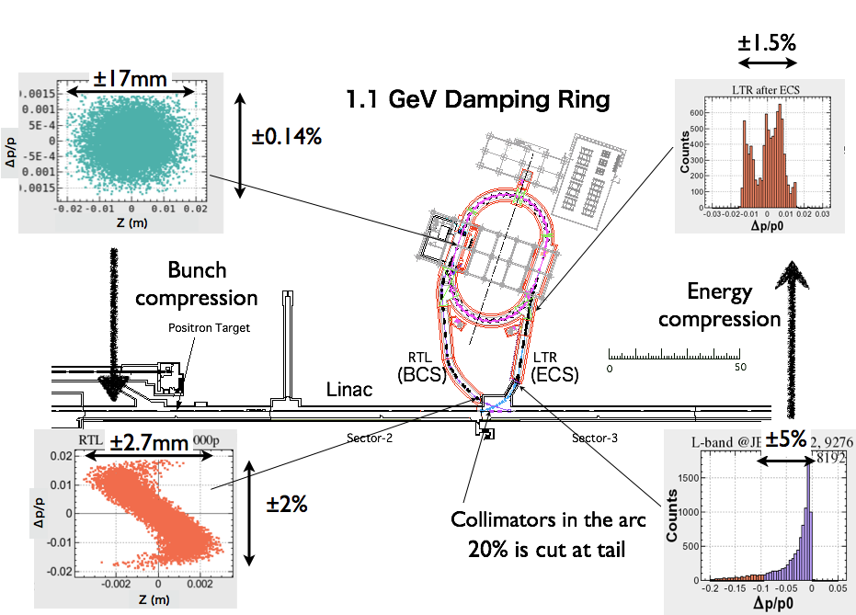
1. Damping Ring

Slide 4
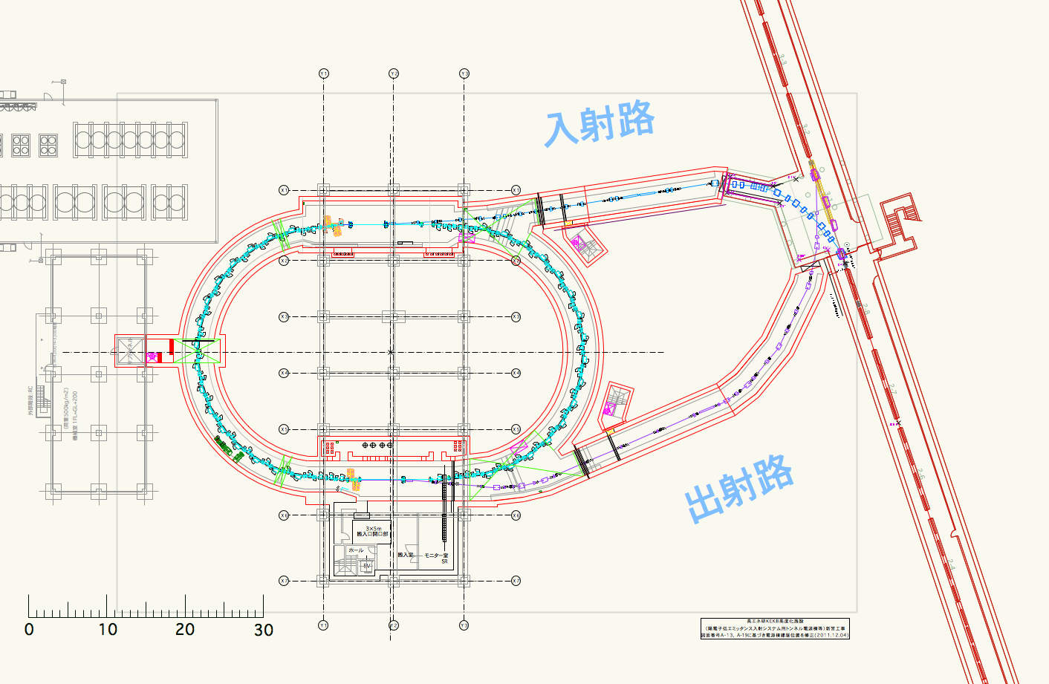
1. Damping Ring Layout
Collimation system
Injection
ECS
C = 135m
BCS
RF Cavity
Extraction

Slide 5
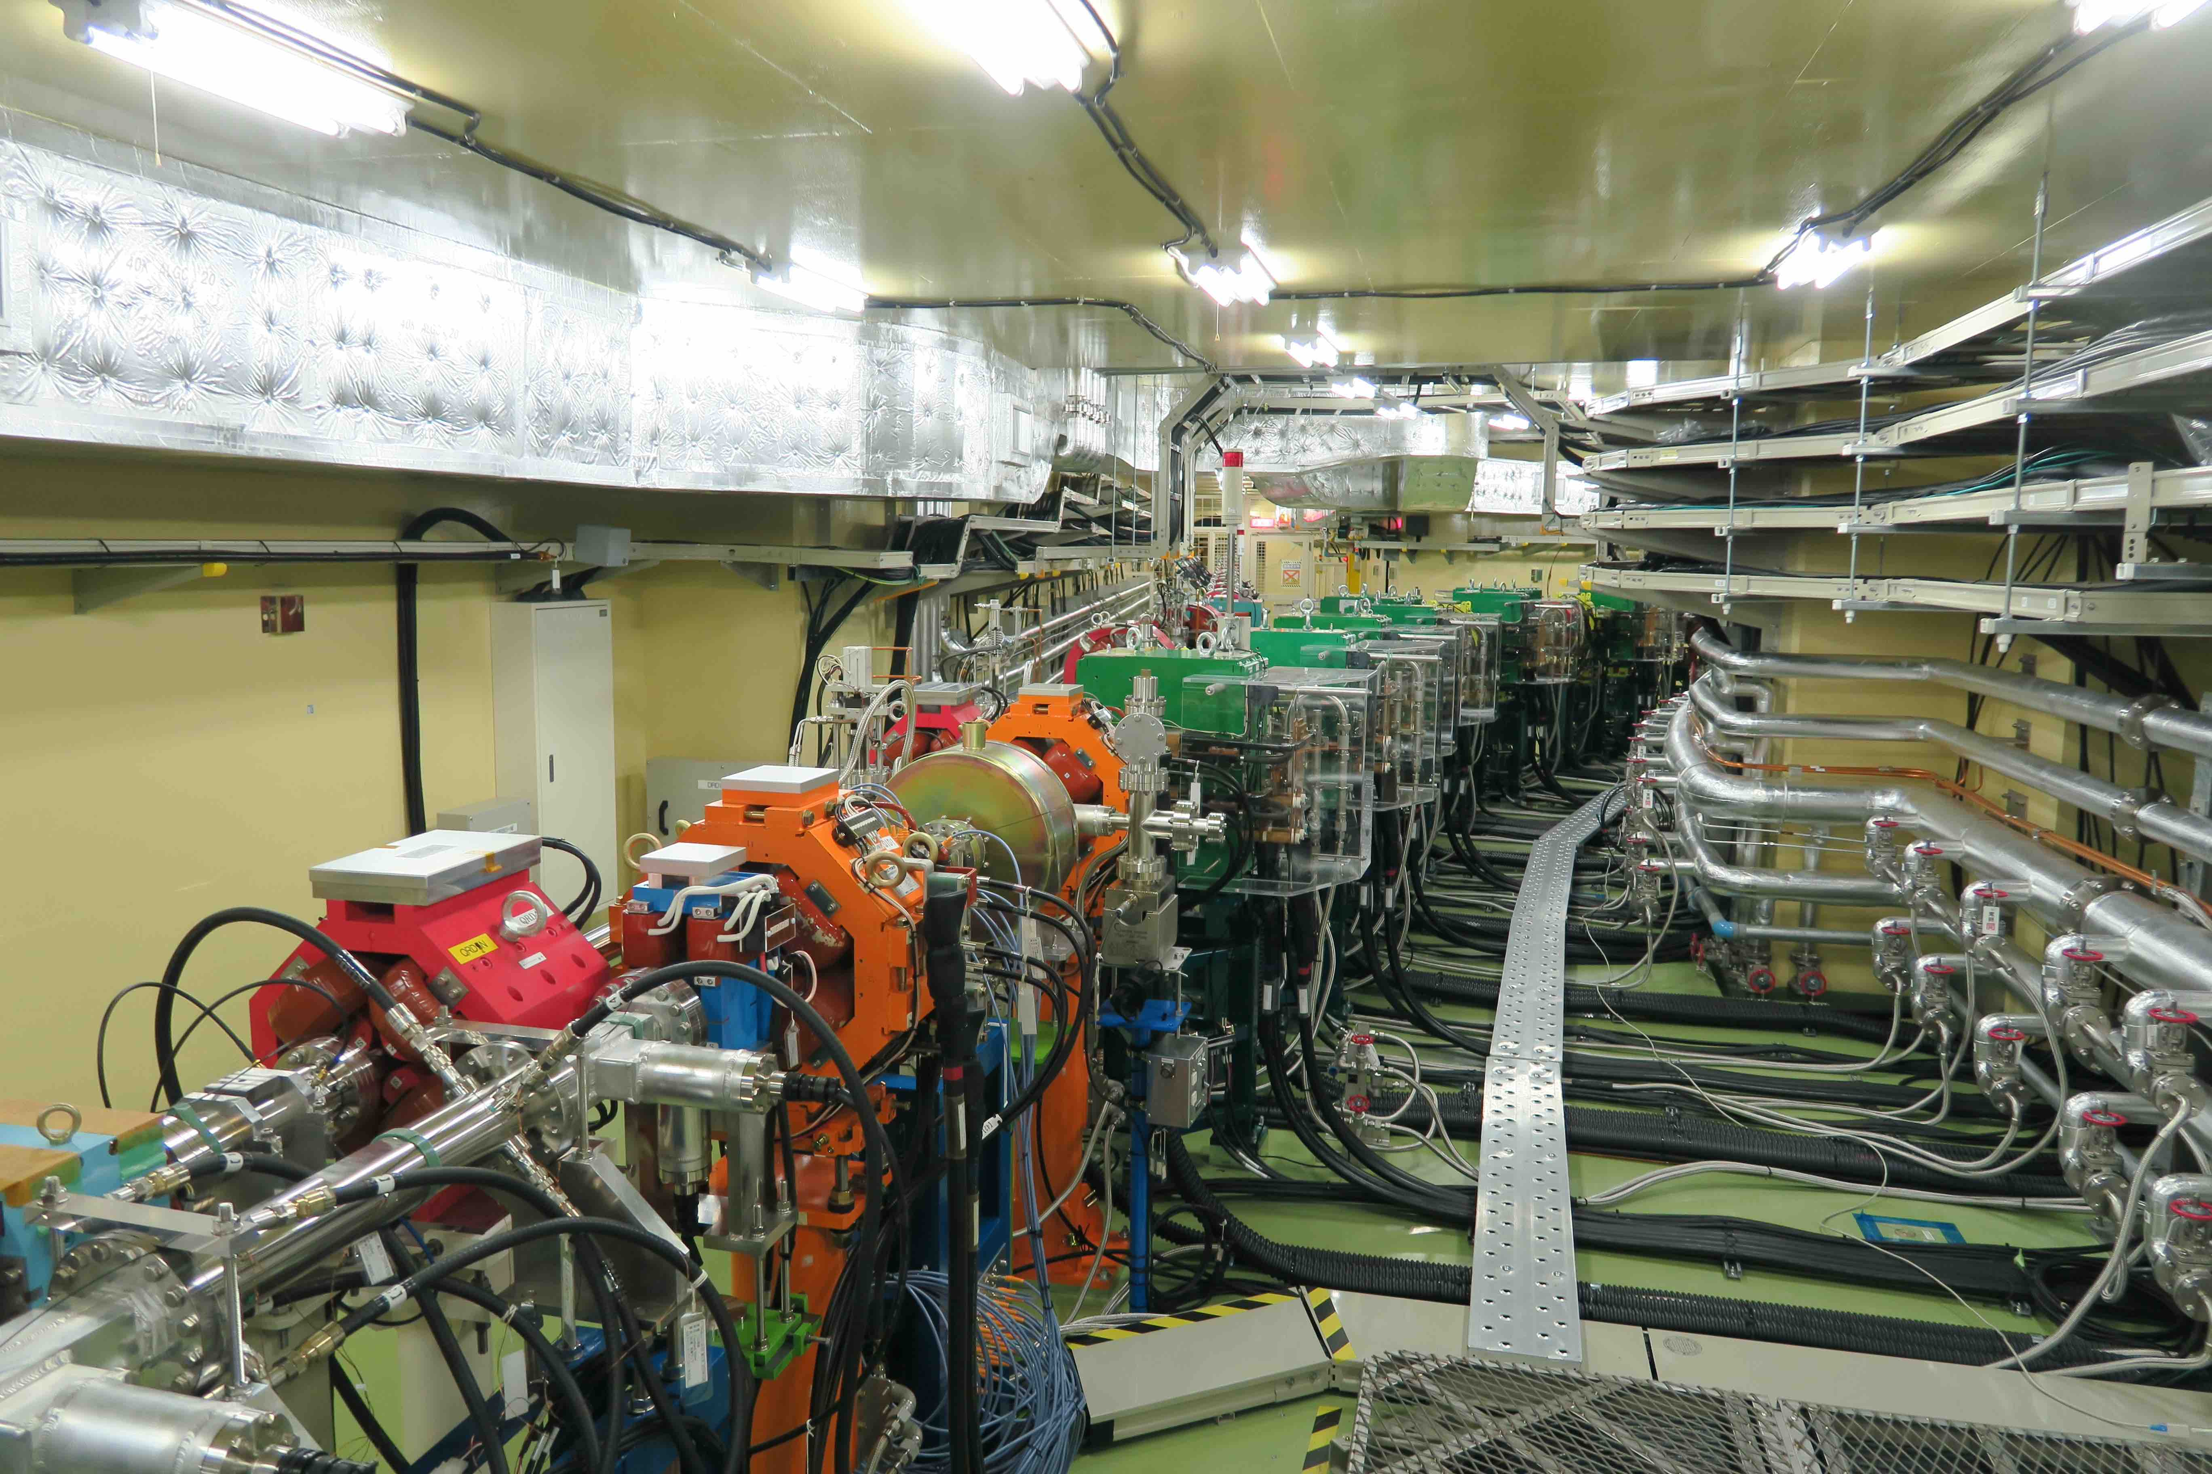
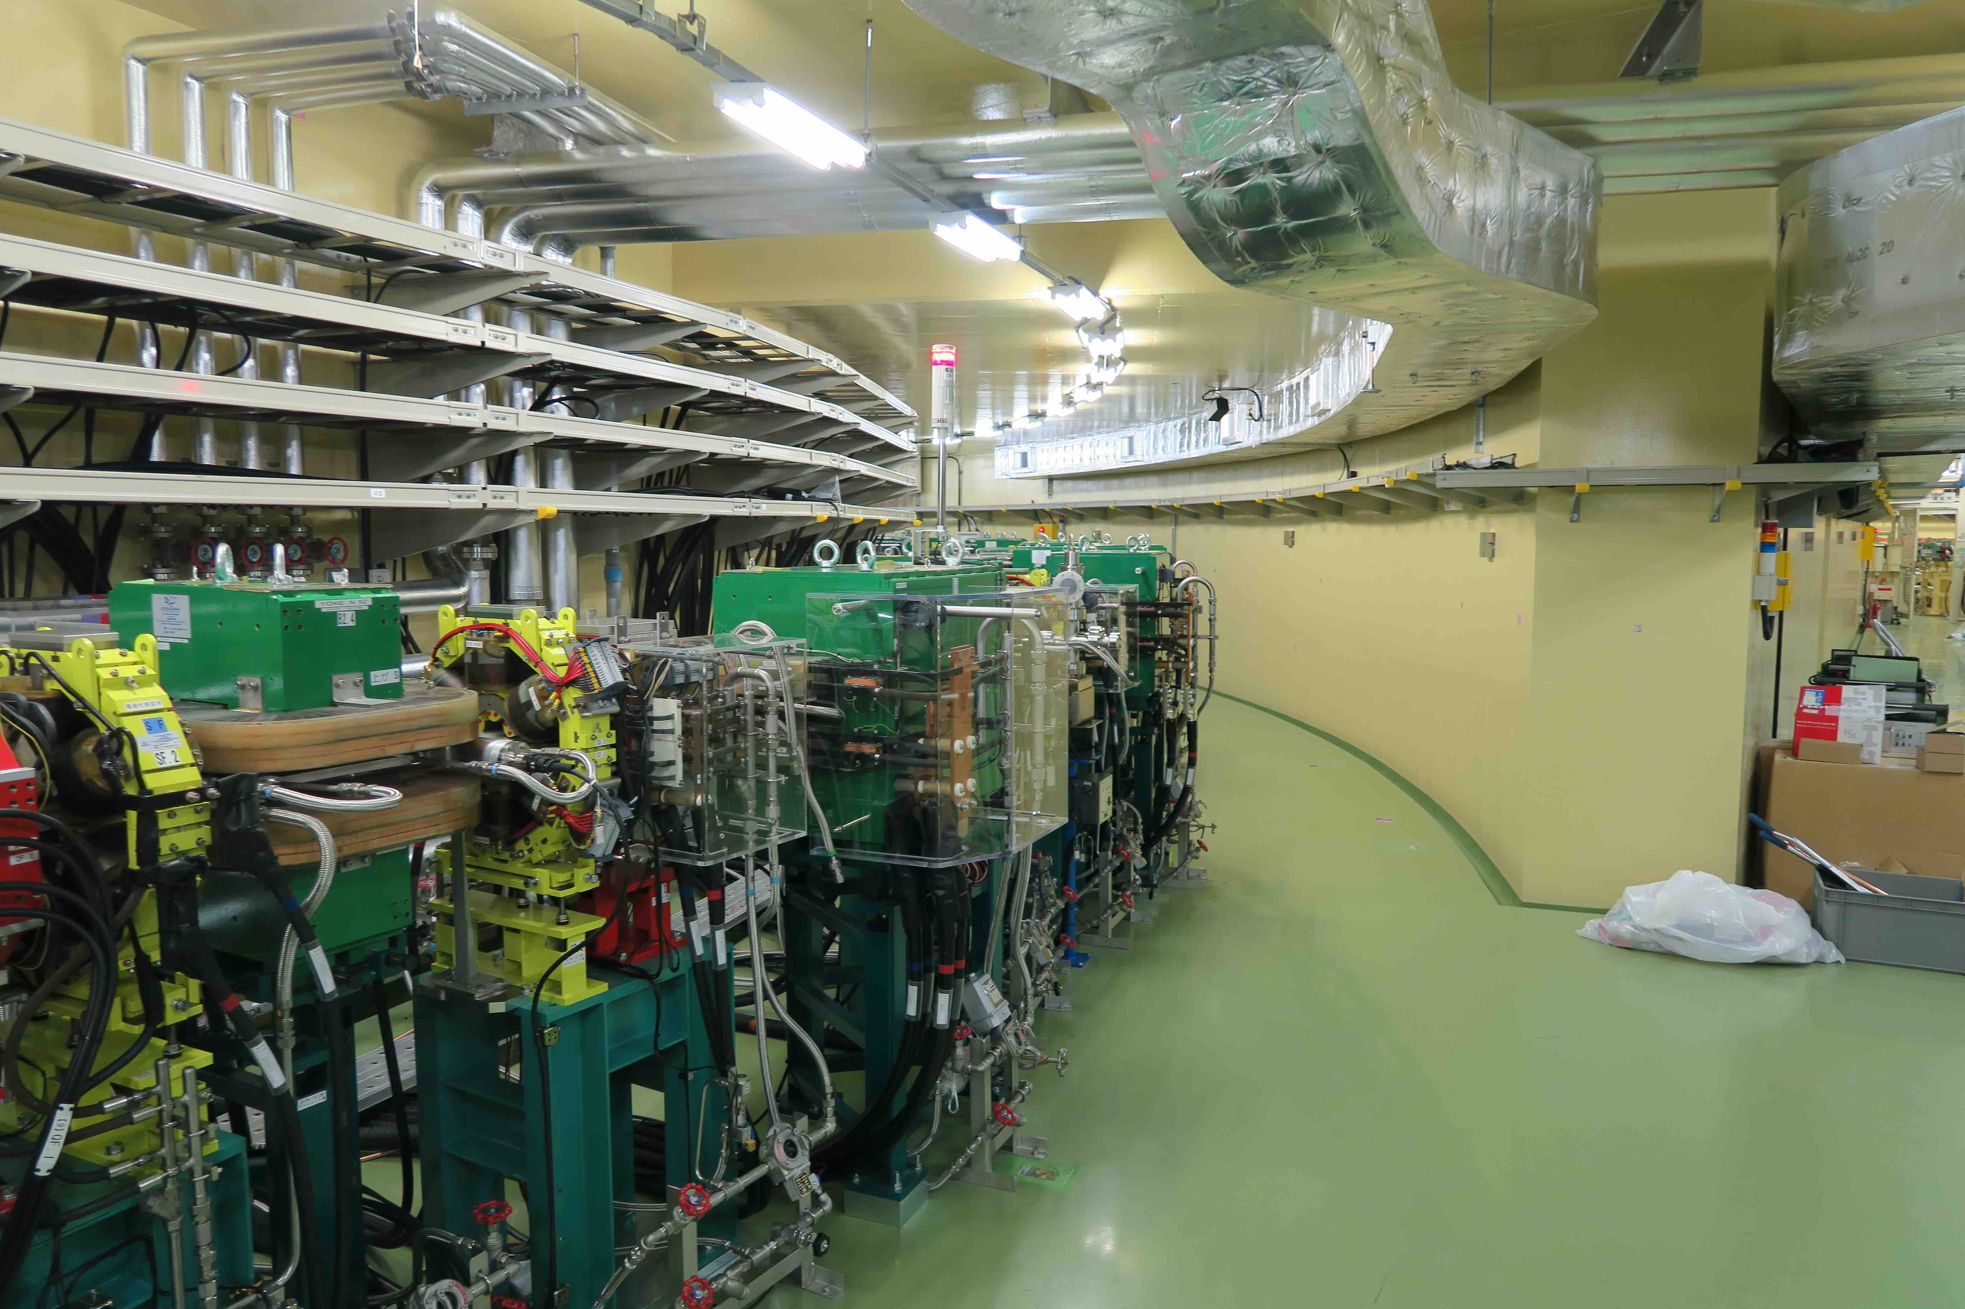
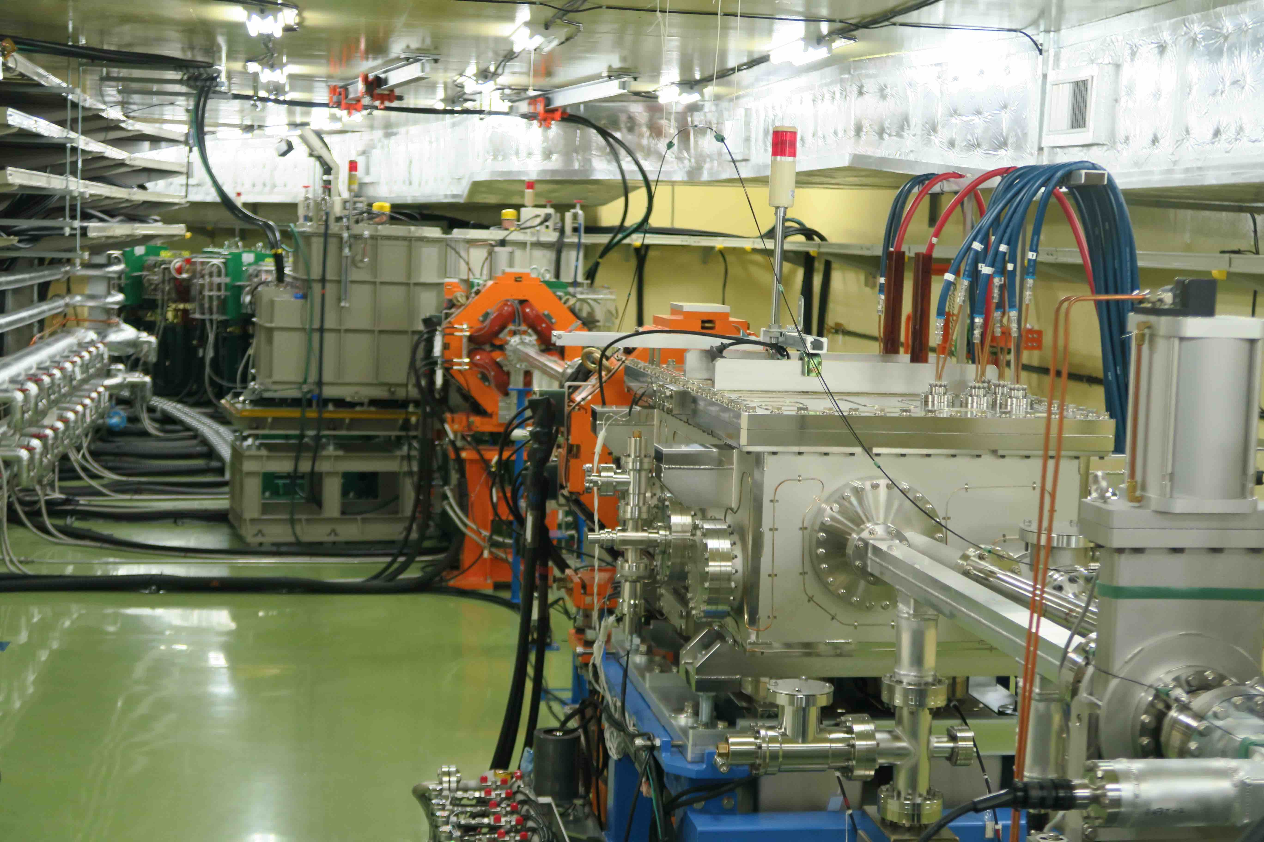
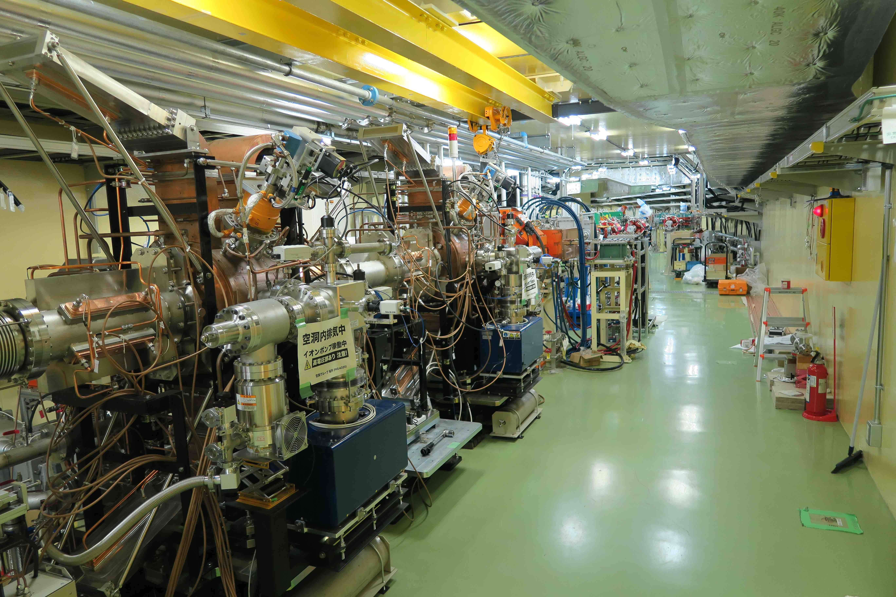
1. Pictures of DR
Normal Bend
LTR
DCCT
Quadupole & Sextupole
FB Kicker
Reverse Bend
Injection Kicker PS
RTL
Injection Septum
RF Cavities

Slide 6
1. Features of the DR
Large aperture enough to accept the Linac positron beam
FODO with reverse-bend ensuring fast damping time of 12 ms, with lower bend field.
Two pulses with 2 bunches each can be stored.
Kickers with fast rise and fall-time of less than 100 ns and no ringing.
Beam pipes with antechamber to accommodate photon masks, enabling very low transverse impedance.
TiN coating in the vacuum chambers to mitigate electron cloud effect.
HOM-damped, high-voltage RF cavities to ensure a large energy acceptance and high bunch charge.
Collimation system installed at the switching yard in the Linac to cut the energy and emittance tails.

Slide 7
1. Parameters of DR
Parameters
Energy | 1.1 | GeV
Number of bunch trains | 2
Number of bunches /train | 2
Circumference | 135.498 | m
Max. stored current | 70.8 | mA
Energy loss per turn | 0.0847 | MV
Damping time (τ_{x}/τ_{y}/τz) | 11.5/11.7/5.8 | ms
Injected beam emittance | 1400 | nm
Equilibrium emittance (ε_{x}/ε_{y}/ε_{z}) | 29.2/1.5/3630 | nm
nx/ny/nz | 8.83/6.28/-0.018
Energy spread | 5.5 x 10⁻⁴
Bunch length | 6.6 | mm
Momentum compaction factor | 0.01
Cavity voltage | 1.0 | MV
RF frequency | 509 | MHz
The target equilibrium horizontal emittance of 30 nm has been nearly achieved.

Slide 8
2. DR status & Issues
DR commissioning stated in Feb. 2018.
The Operation of DR is ongoing smoothly without any major trouble after LS1.
Issues
Due to unexpected emittance growth after DR and small dynamic aperture of LER, lower emittance of the DR is required. However, several attempts at lower emittance operation have failed.
Beam orbit drifts and fluctuations in the DR, making optics corrections challenging.
Extracted beam orbit drifts are observed, stemming from the temperature dependence of output current of extraction kickers.

Slide 9
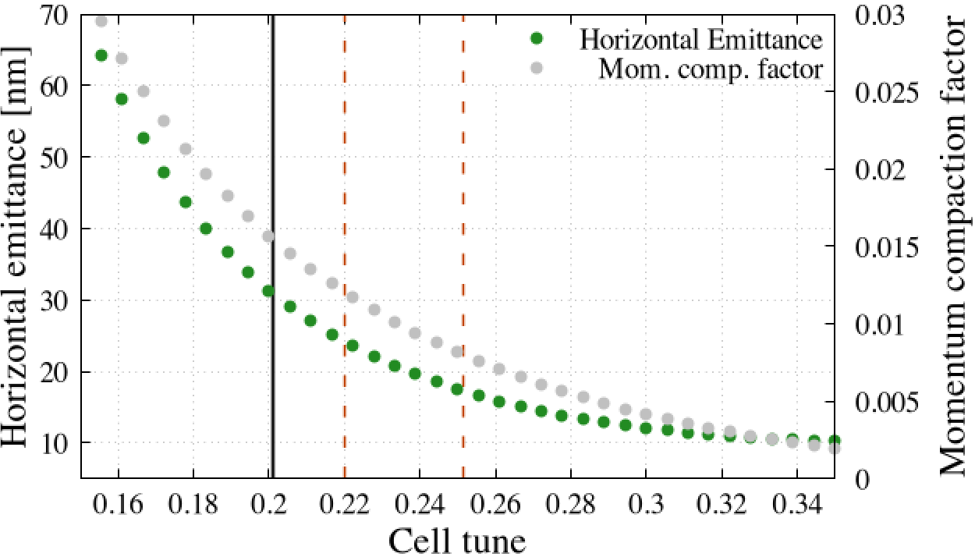
(1) Lower emittance optics
H. Sugimoto
Thanks to the FODO cell with reversed-bend, DR is capable of lower emittance operation by increasing arc cell tunes and lowering momentum compaction factor.
Several attempts at lower emittance operation were conducted.
These attempts failed due to unexpected large optics distortion, resulting in beam losses during beam injection.
Low emittance optics
Nominal operation point

Slide 10
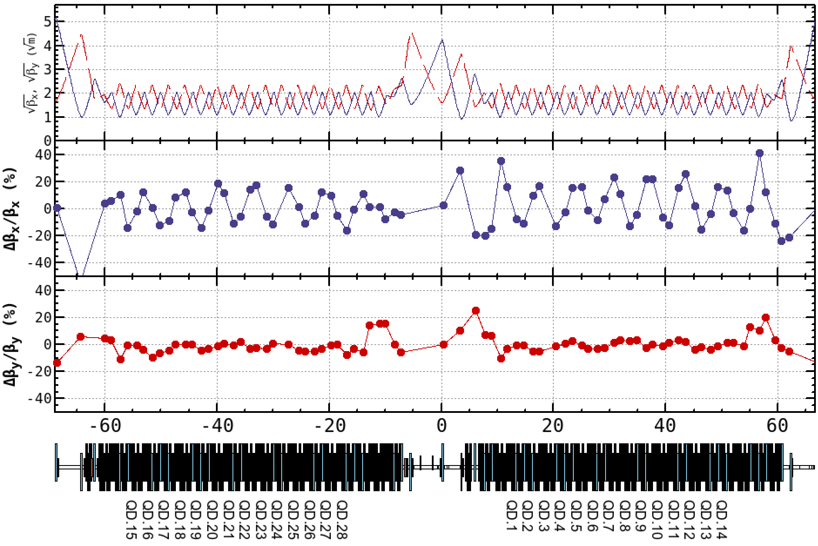
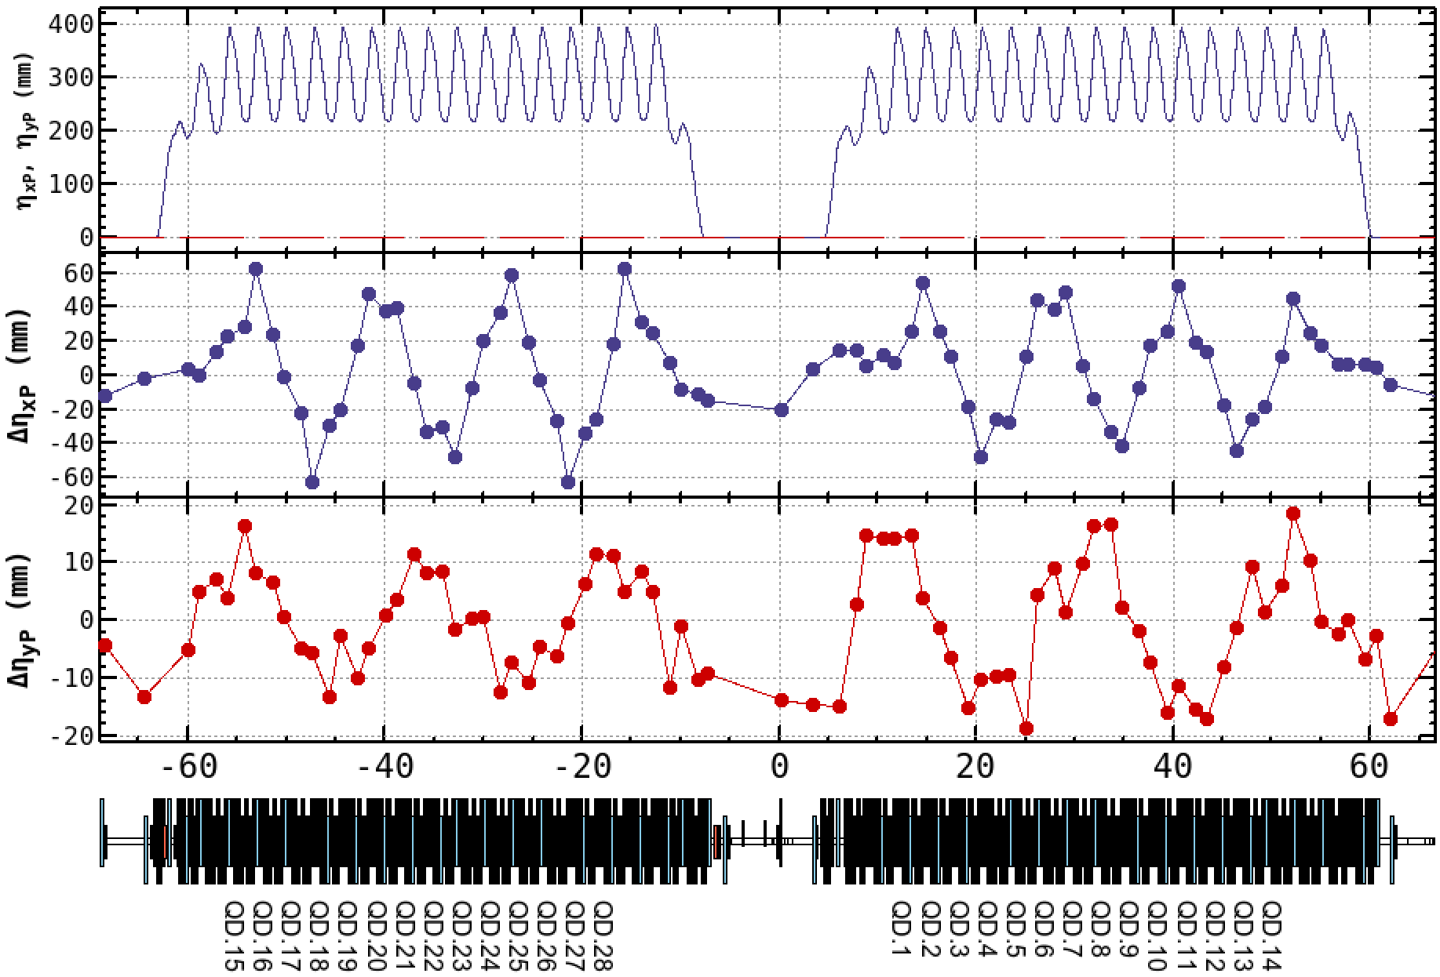
(1) Lower Emittance Operation Trials
H. Sugimoto
Several trials failed due to unexpected large optics distortion.
The optics distortions could not be corrected by the quadrupole families.
Adjustment of main bending magnets may improve the situation. (Not tried yet.)
Beta Beating
Residual Dispersions

Slide 11
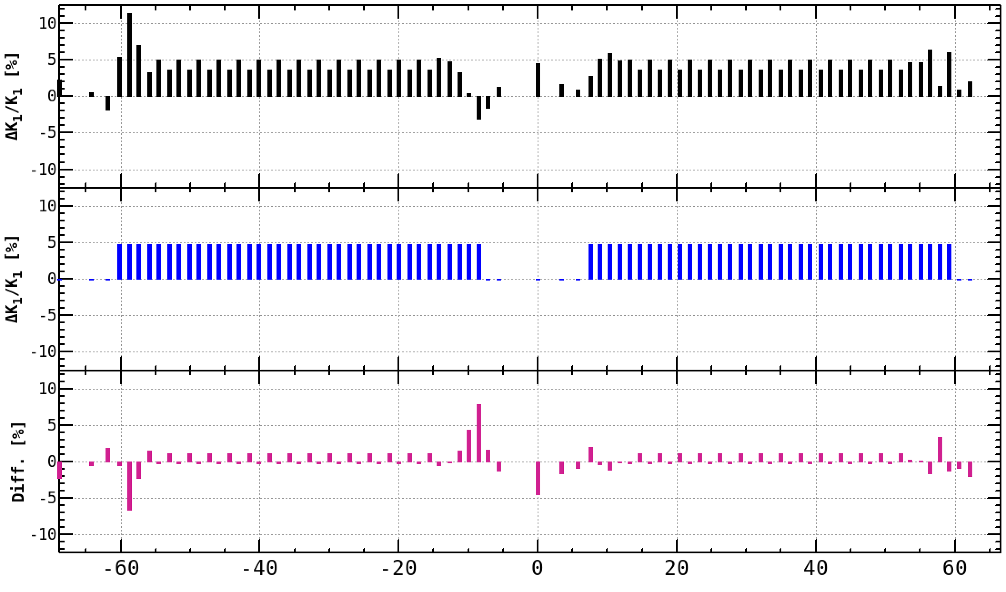
(1) Lower Emittance Operation Trials
H. Sugimoto
Uncertainty of the implemented excitation curves in the magnet system - Last year, It was reported that there was a mistake in the calculation of the excitation curve of arc quadrupole magnets. - The report is consistent with the correction factors identified by optics corrections. -Using these correction factors, we attempted lower emittance operation again, but unfortunately, it still didn’t succeed.
(1) Correction factors applied in the operation (Determined by optics corrections)
(2) Correction factors anticipated due to the mis-implementation of the excitation curve.
(3) = (2) - (1)

Slide 12
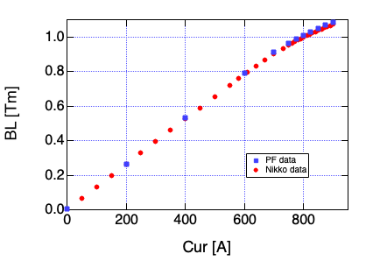
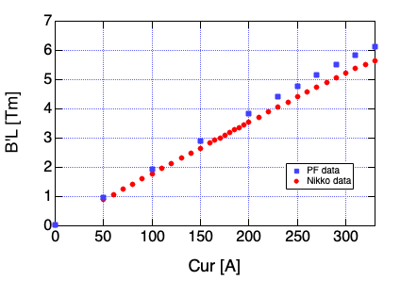
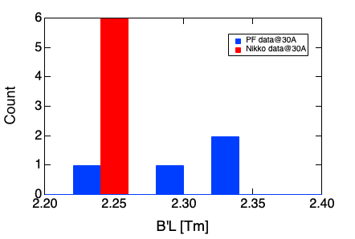
(1) Magnetic field measurement data comparison
Re-measurements of the spare magnets using different measurement system indicate significant correction factors, a few % for bending magnet and 5 -10 % for quadrupole magnets.
For quadrupole magnets, there is also a significant variation in implemented excitation curves.
We intend to re-measure the remaining spare magnets using an alternative system and replace excitation curves.
DR main dipole
DR-Arc Quad
RTL-Quad @30A
■ data in use
●re-measured data

Slide 13
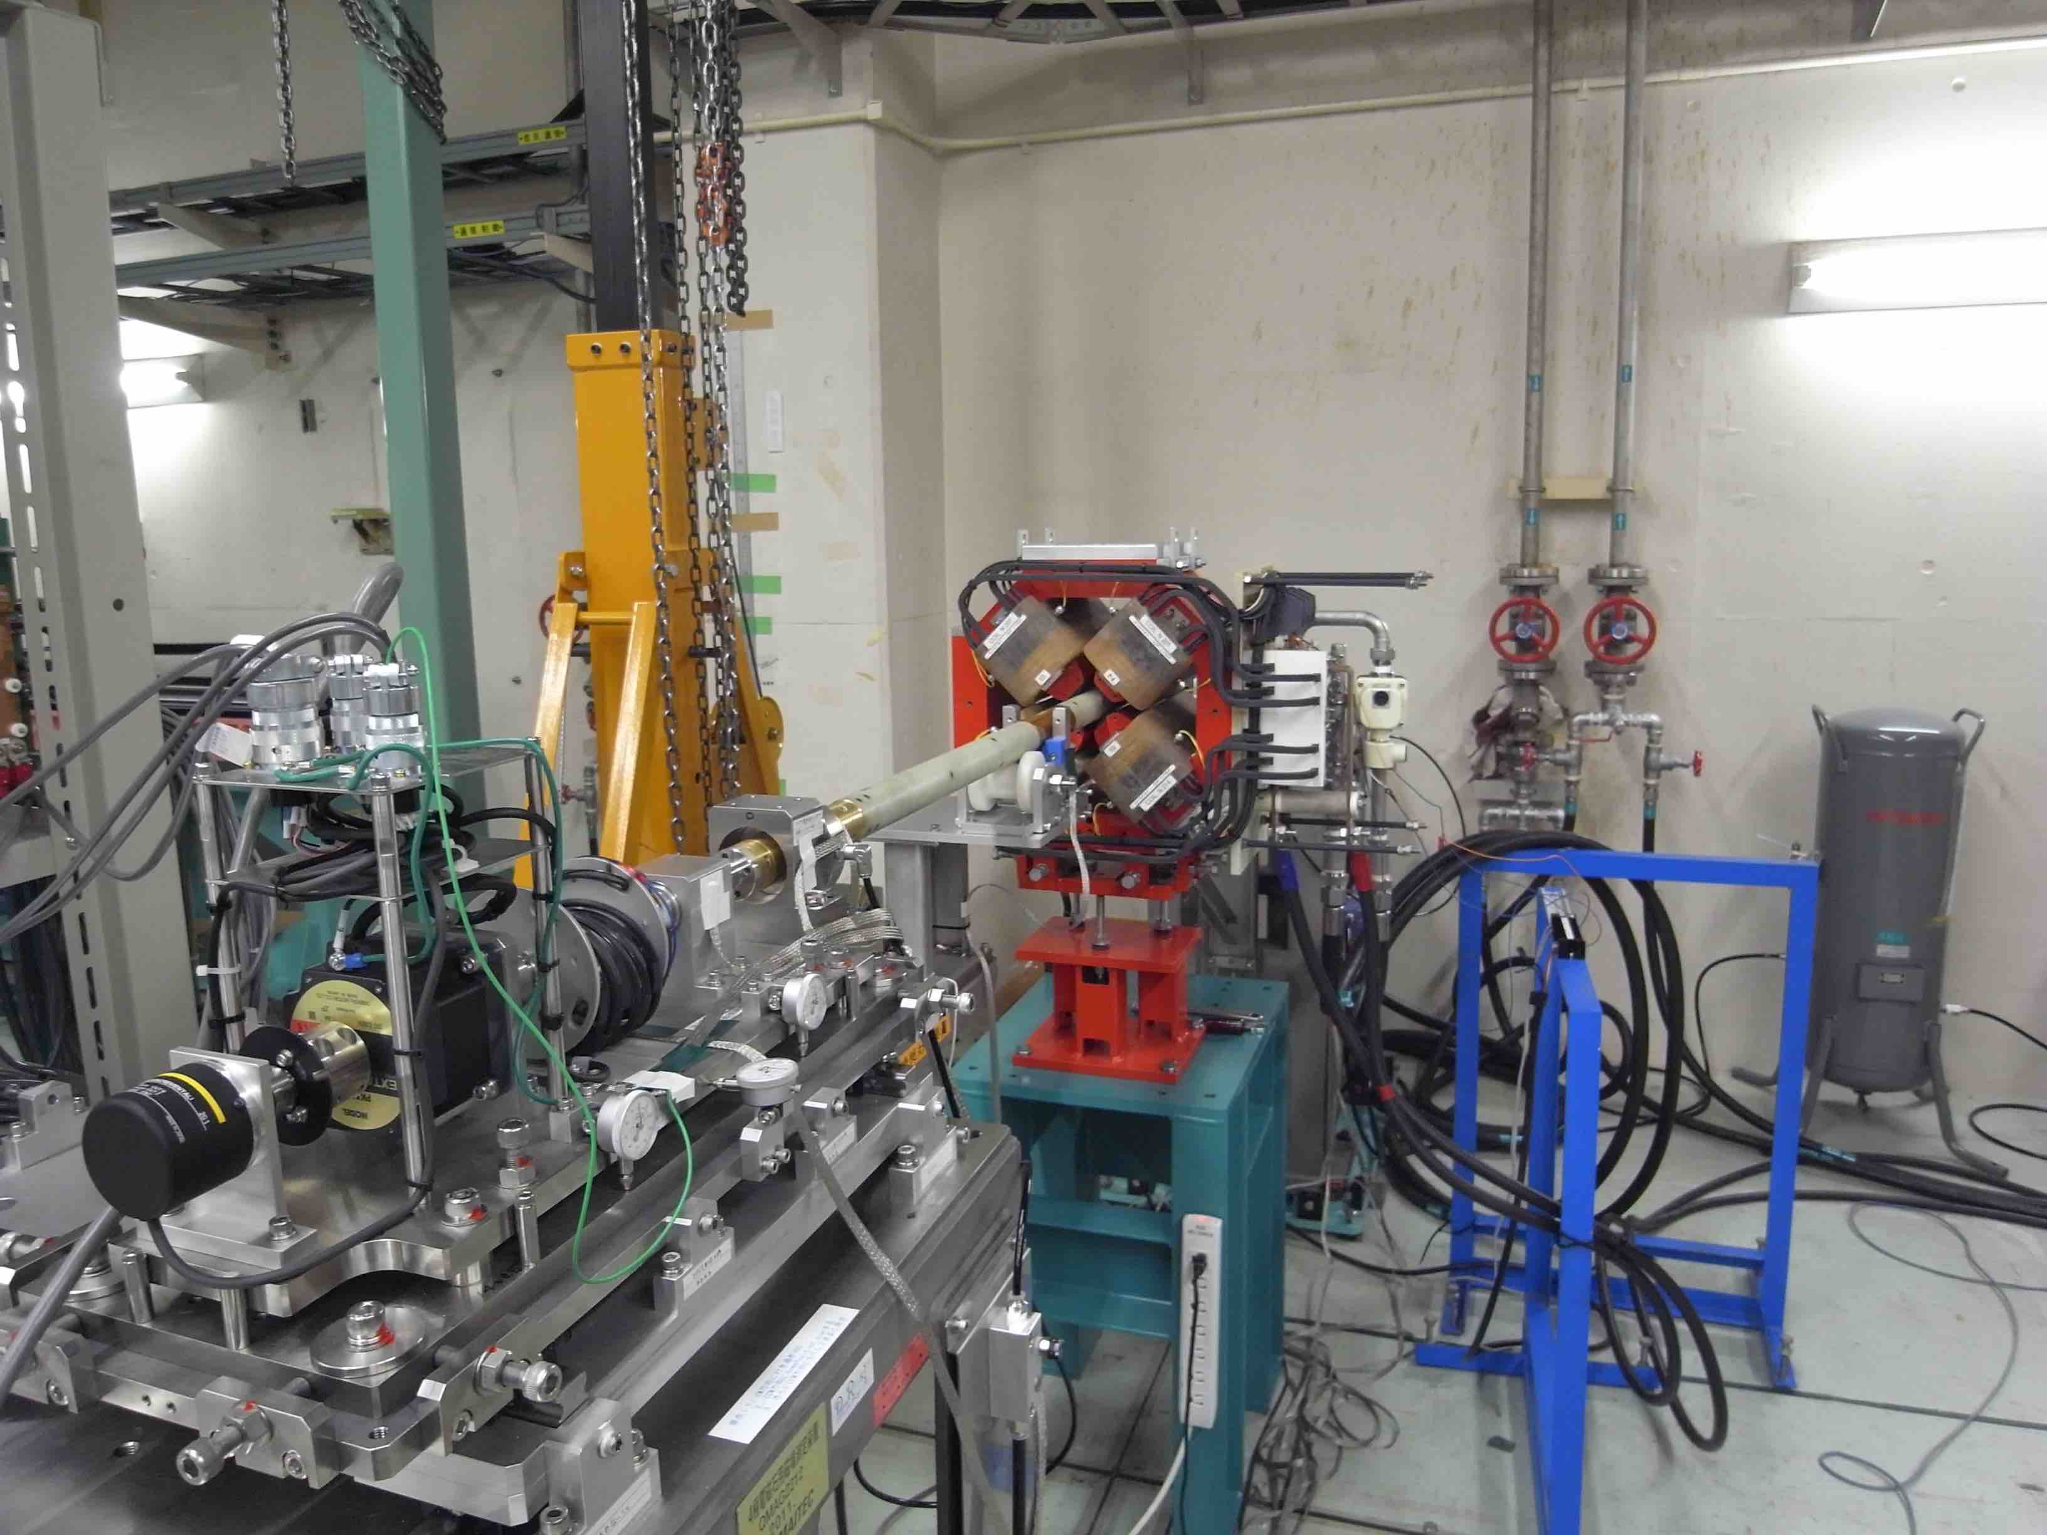
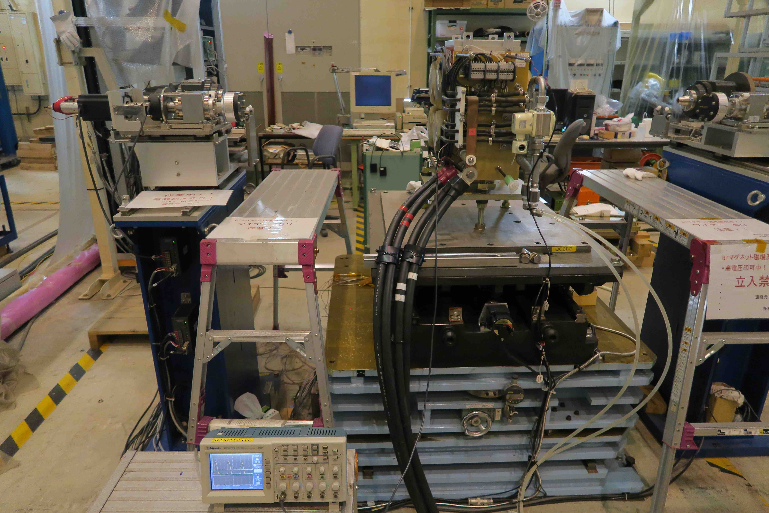
Magnetic field measurement devices
Implemented data were measured by using this harmonic coil.
Rotating stretched-wire coil as an alternative measurement device

Slide 14
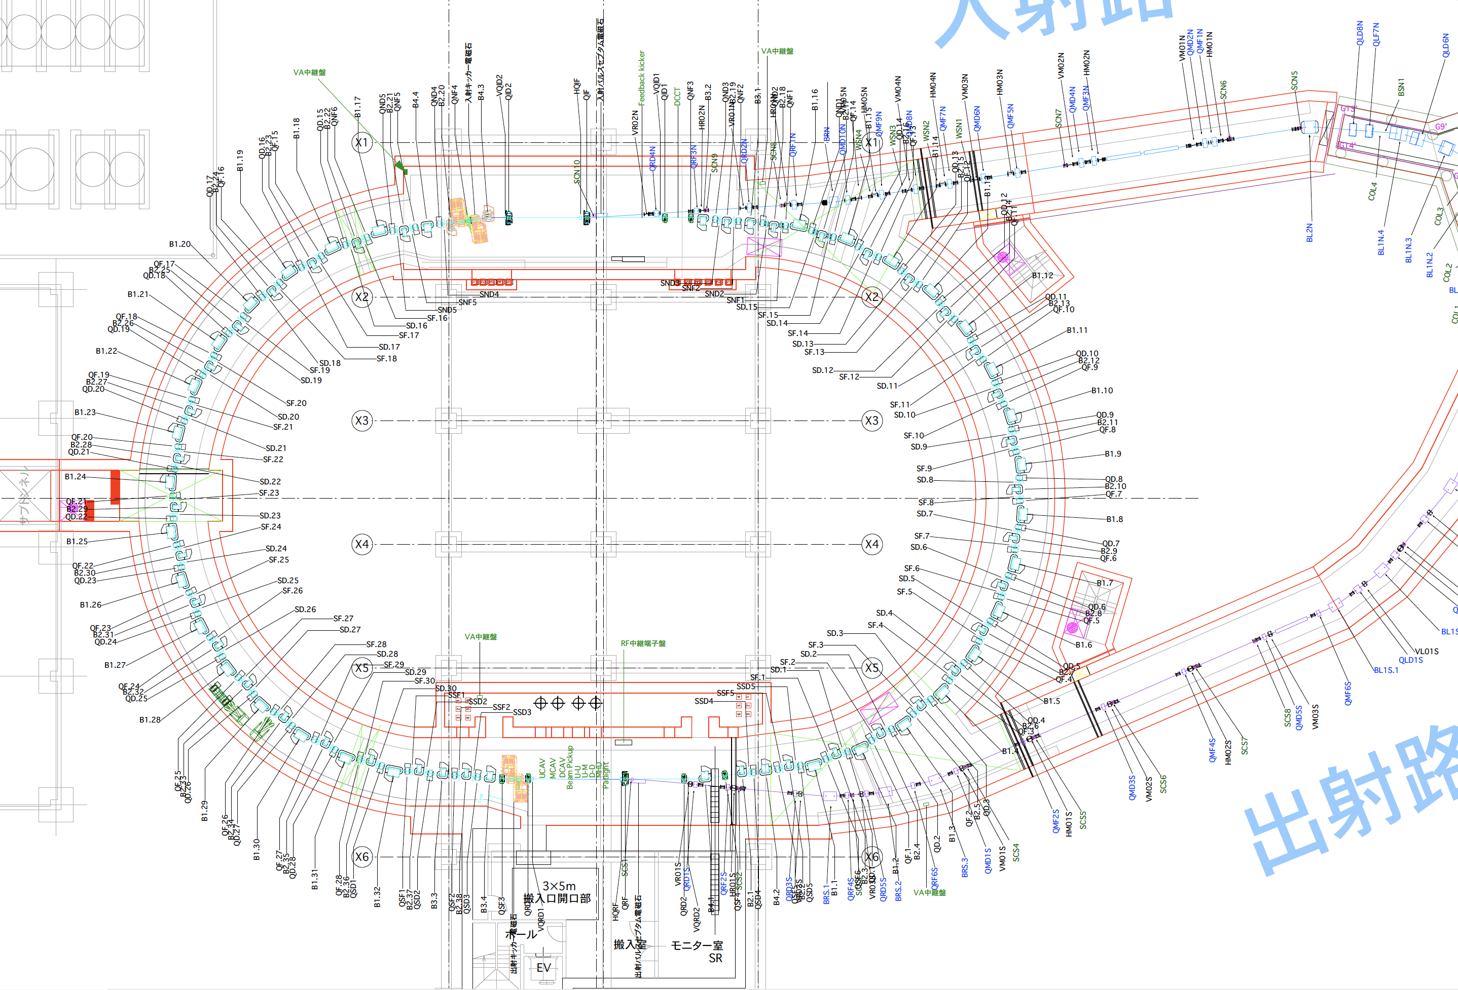
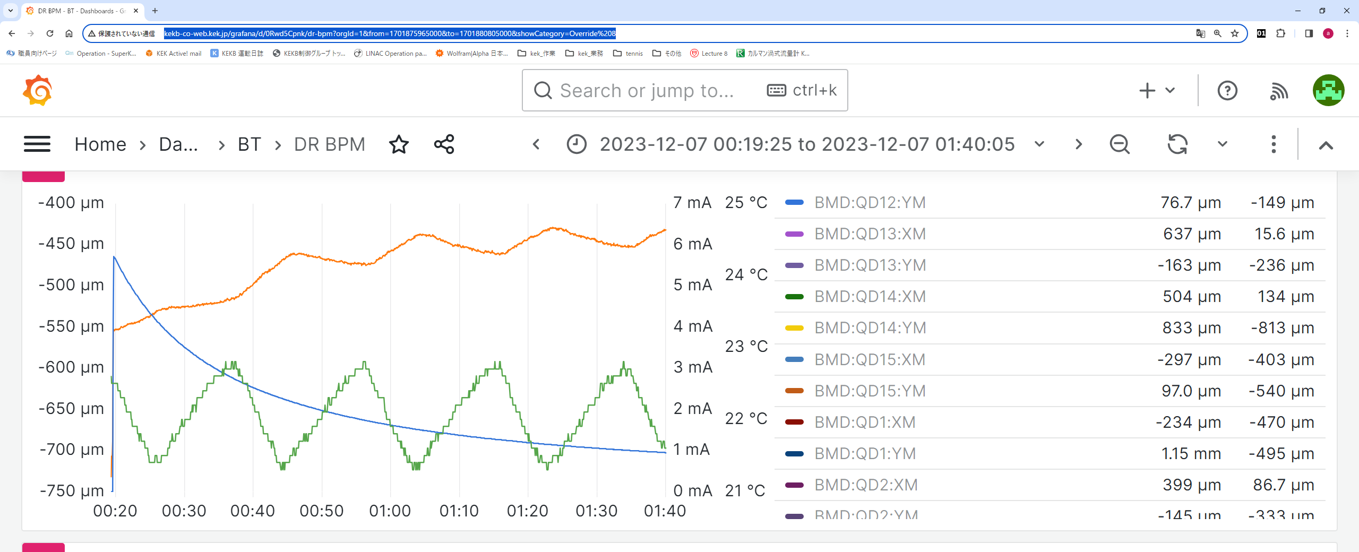
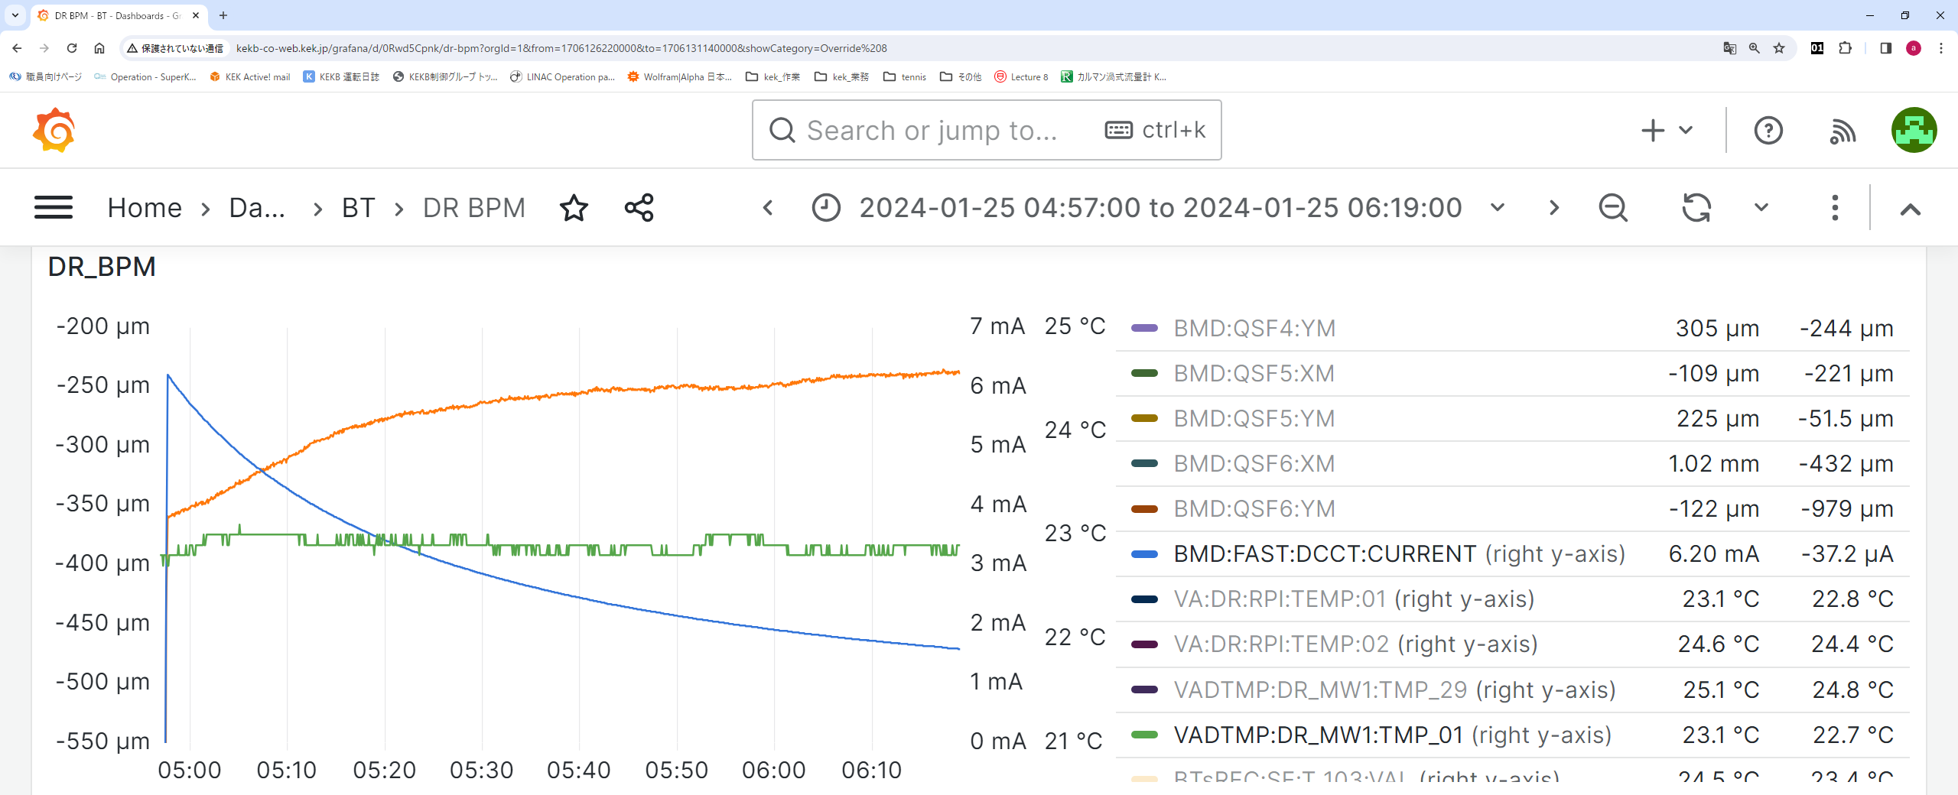
(2) Orbit drift problem
QD11
T. Ueda
Beam orbit fluctuations and drifts were observed in a decay mode in the DR. The fluctuations depend on the temperature of vacuum chamber, which is cooled by the water chiller system.
Narrowing the temperature setting range of the cooling water chiller unit decreased the orbit fluctuations. However, slow orbit drifts are still observed depending on the beam currents.
Beam position(QD11:horizontal)
Beam current
Chamber temperature
0.4℃
1.5℃
Before improvements
After improvements

Slide 15
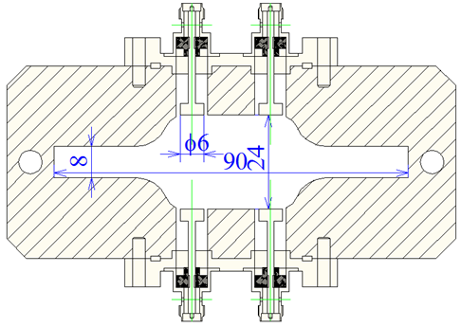
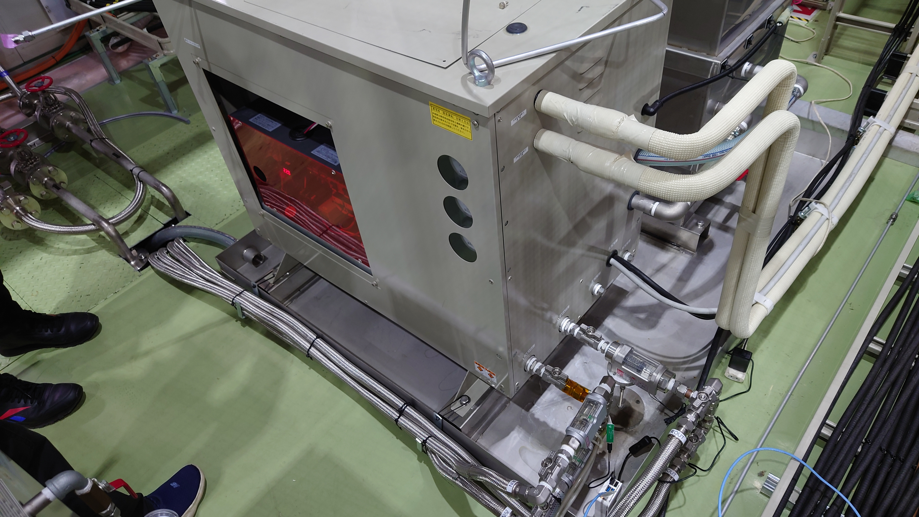
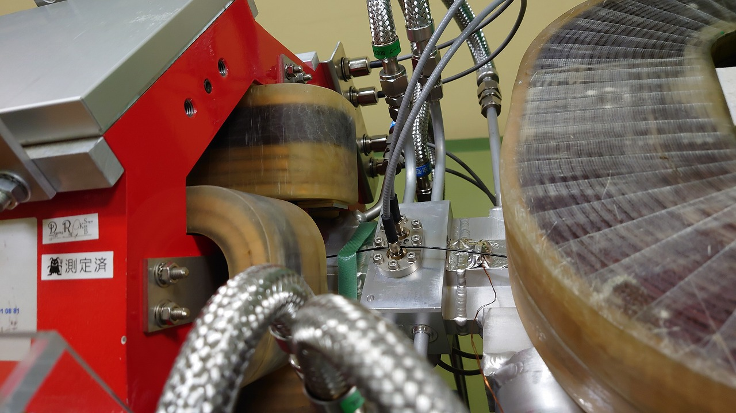
(2) Orbit drift problem
T. Ueda
Cooling water channel
BPM
Cooling water
Temperature sensor
Water Chiller unit for vacuum chamber
（Installed in power supply building）
BPM blocks, which are fixed to the Q-magnets.

Slide 16
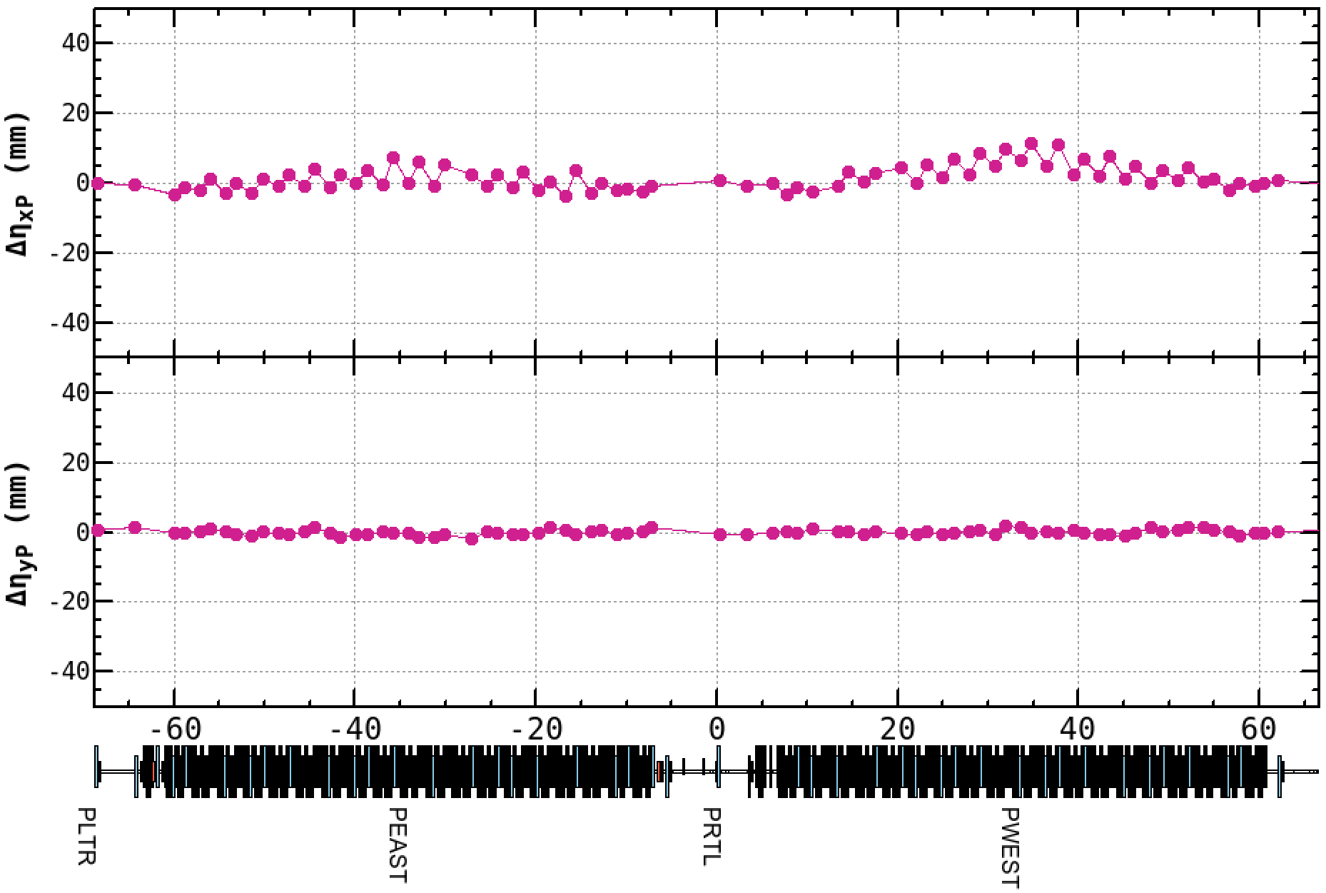
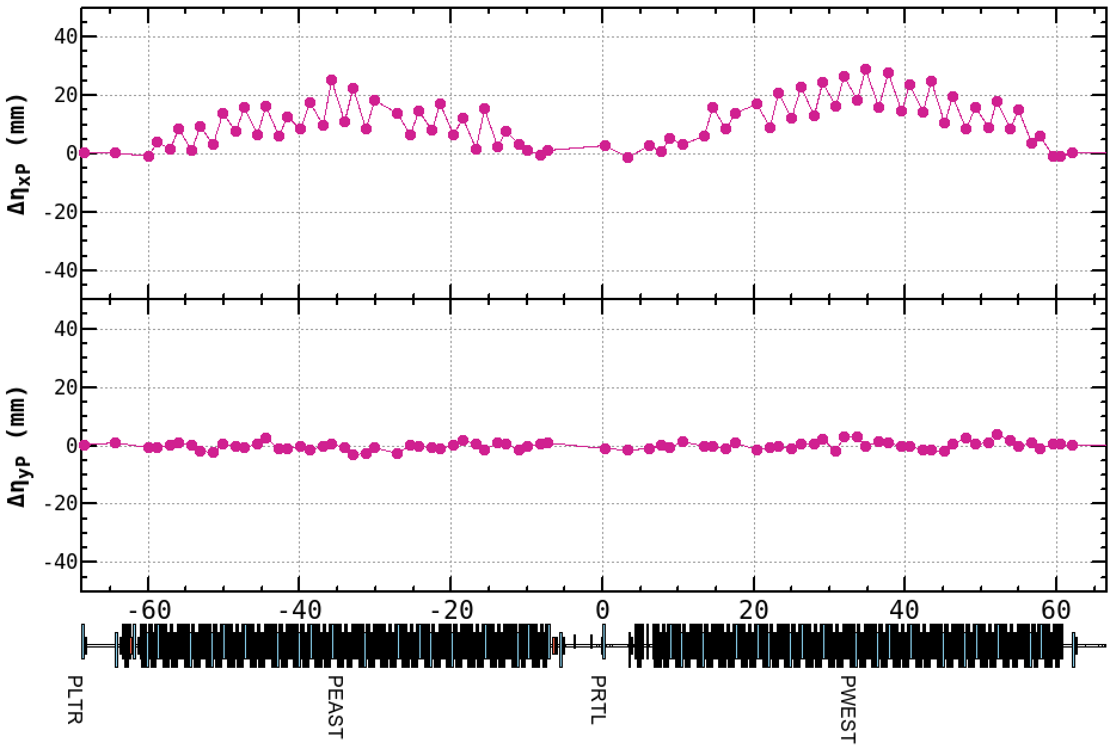
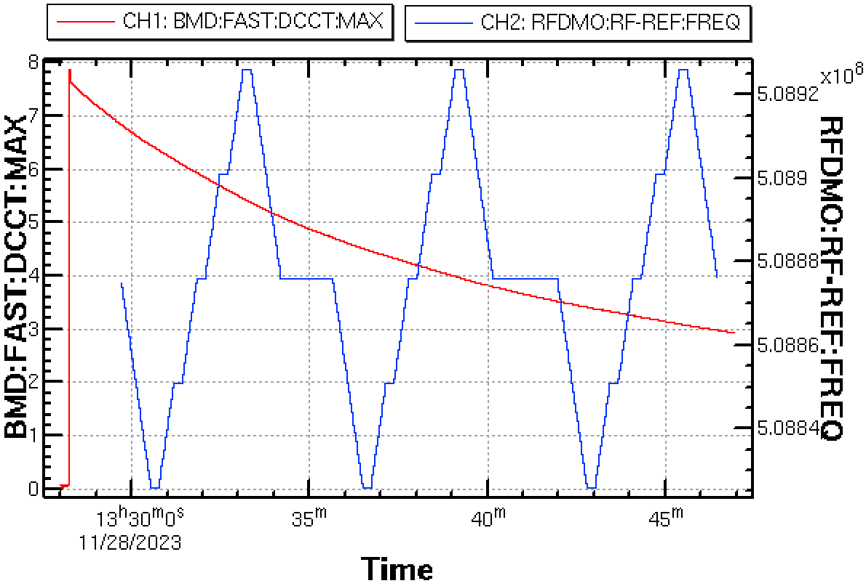
(2) Orbit drift problem on DR Optics Control
H. Sugimoto
Beam current-dependent (apparent?) dispersion function - BPM reading depends on beam current, especially when RF frequency is changed. - Three consecutive dispersion measurements show systematic dispersion changes.
Red: Beam current
Dispersion #2- #1
Dispersion #3- #1
Blue: RF frequency
#1
#2
#3

Slide 17
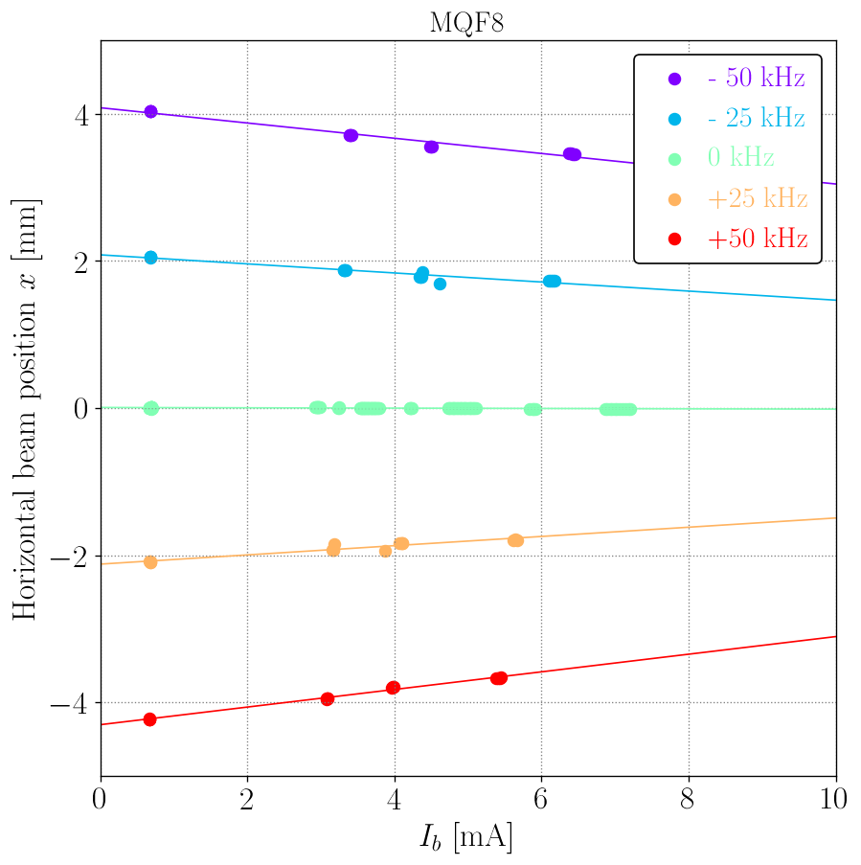
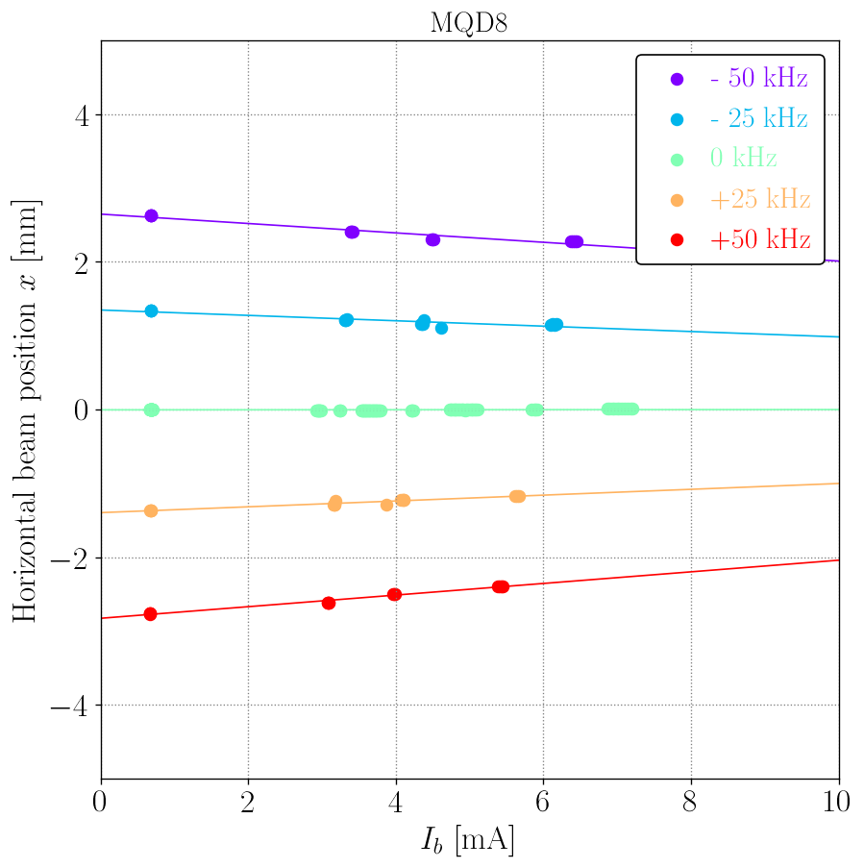
(2) Orbit drift problem on DR Optics Control
H. Sugimoto
Two examples of BPM readings vs beam current with different RF frequencies. - The beam current dependency depends on RF frequency. - A hundred-micron difference in beam position at frequencies of +-50KHz results in a 10 mm difference in the measured dispersion functions. - What is the best way to extract the dispersion function for optics correction?

Slide 18
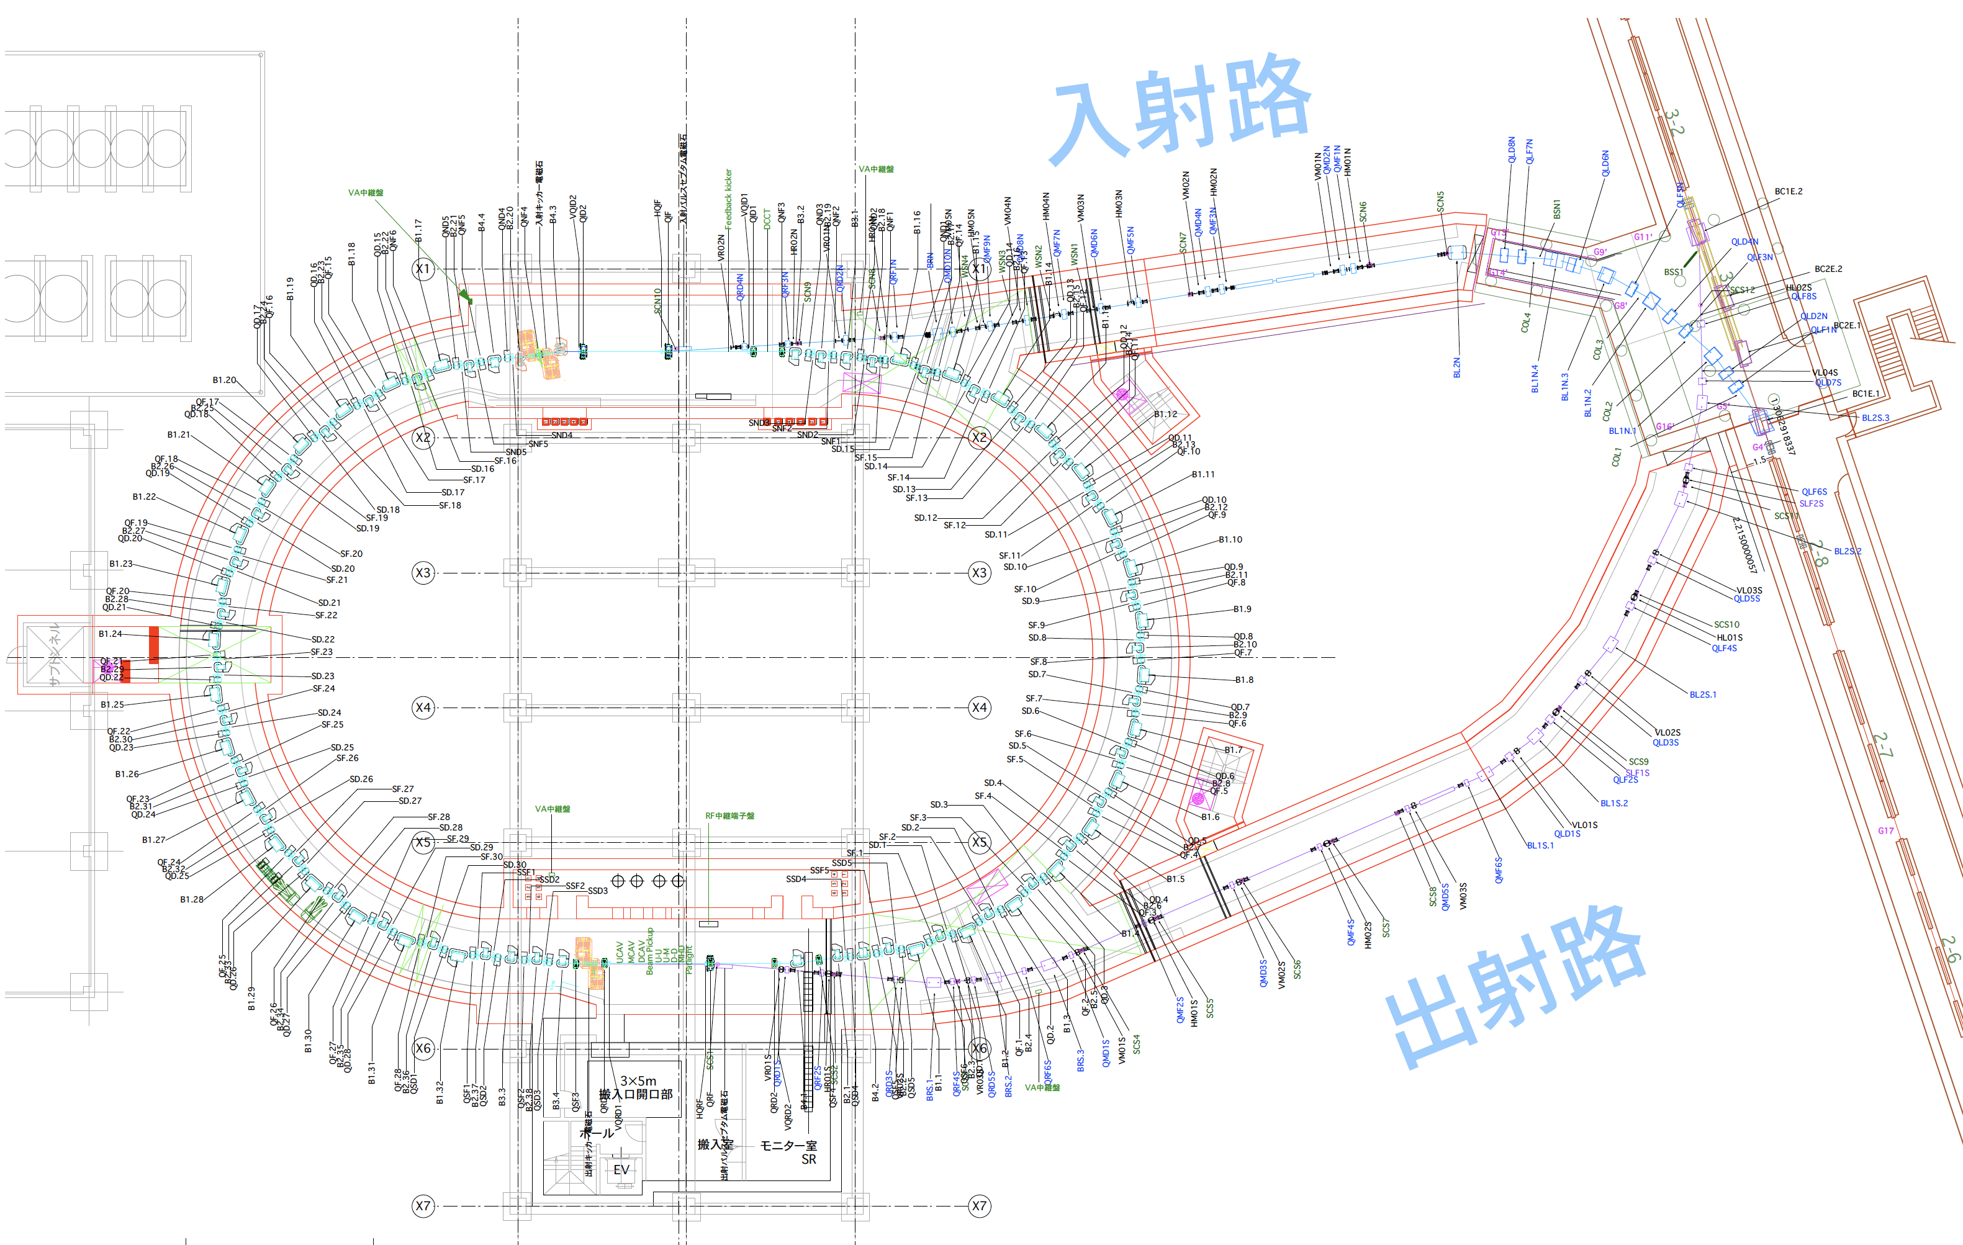
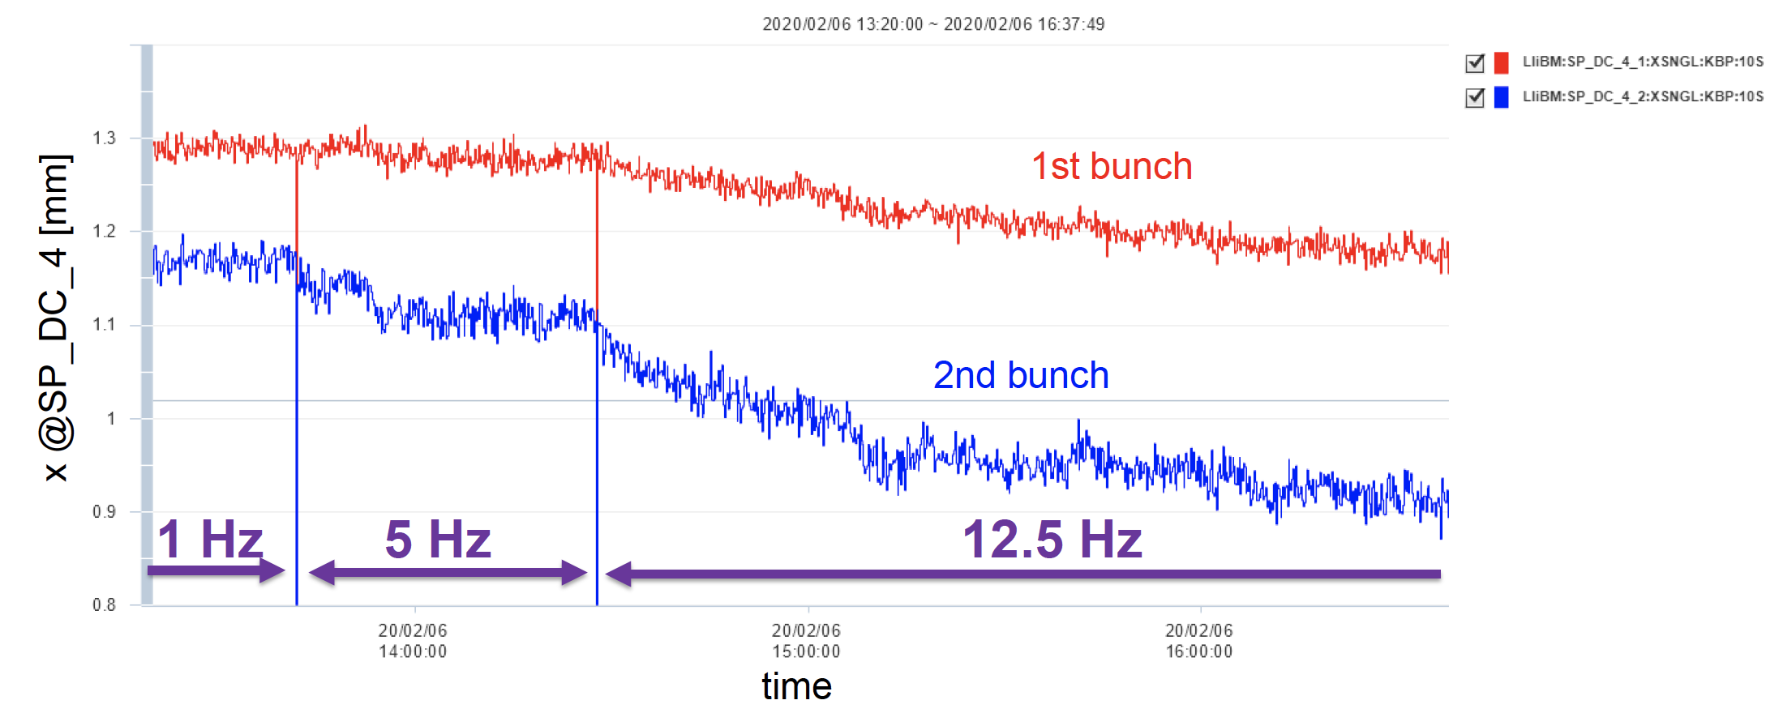
(3) Extracted Beam Orbit Drift Issue
S. Miyahara
A slow orbit drift of extracted beam was observed at the Linac BPM. These orbit drift changes when the repetition changed, which is much clearer for the 2nd bunch.
It takes a long time to reach equilibrium for the high repetition rate (> 2 hour for 12.5Hz).
The cause is identified as the temperature dependence of the output current of the extraction kicker.
Linac BPM SP_DC_4
1 hour
DR ext. kicker
0.1 mm
RTL

Slide 19
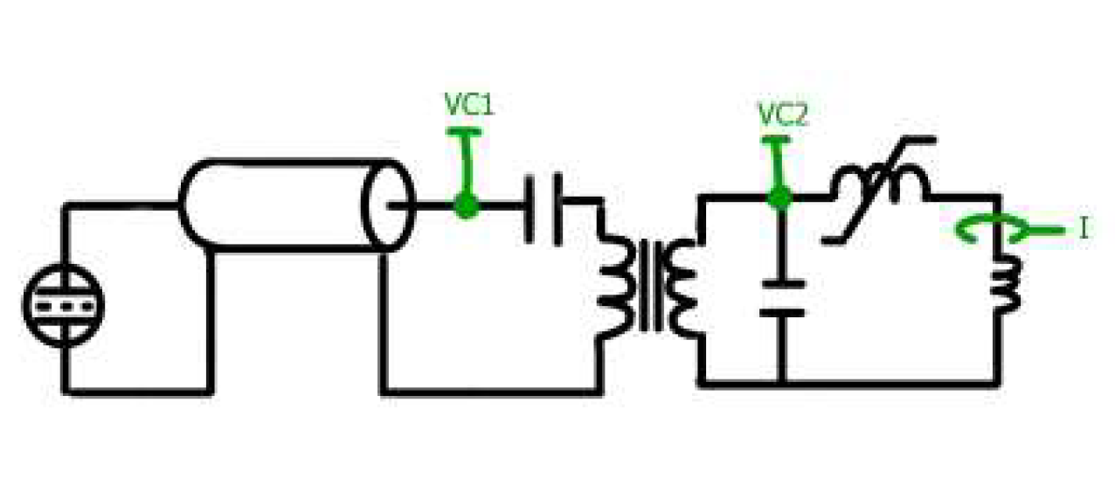
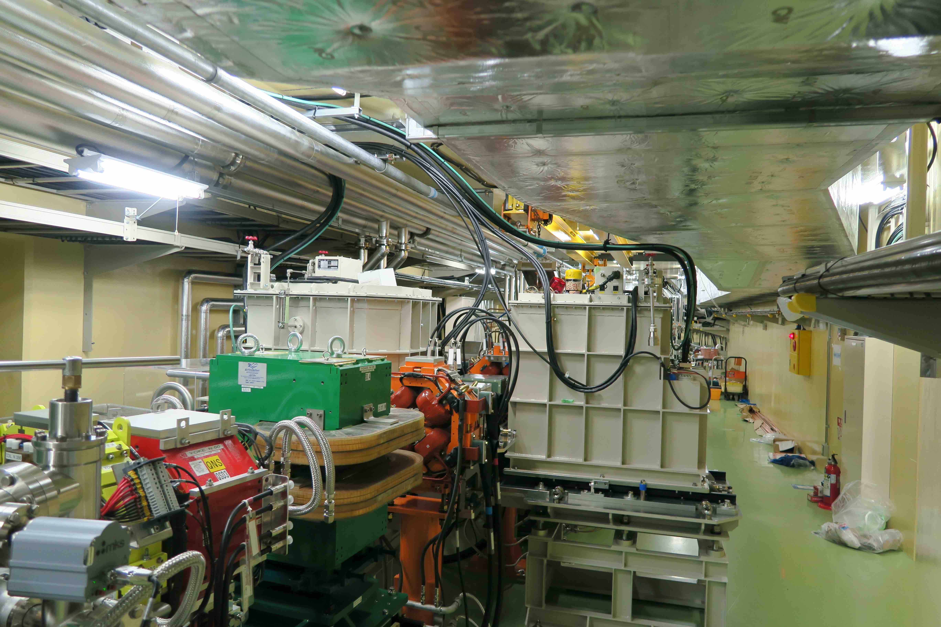
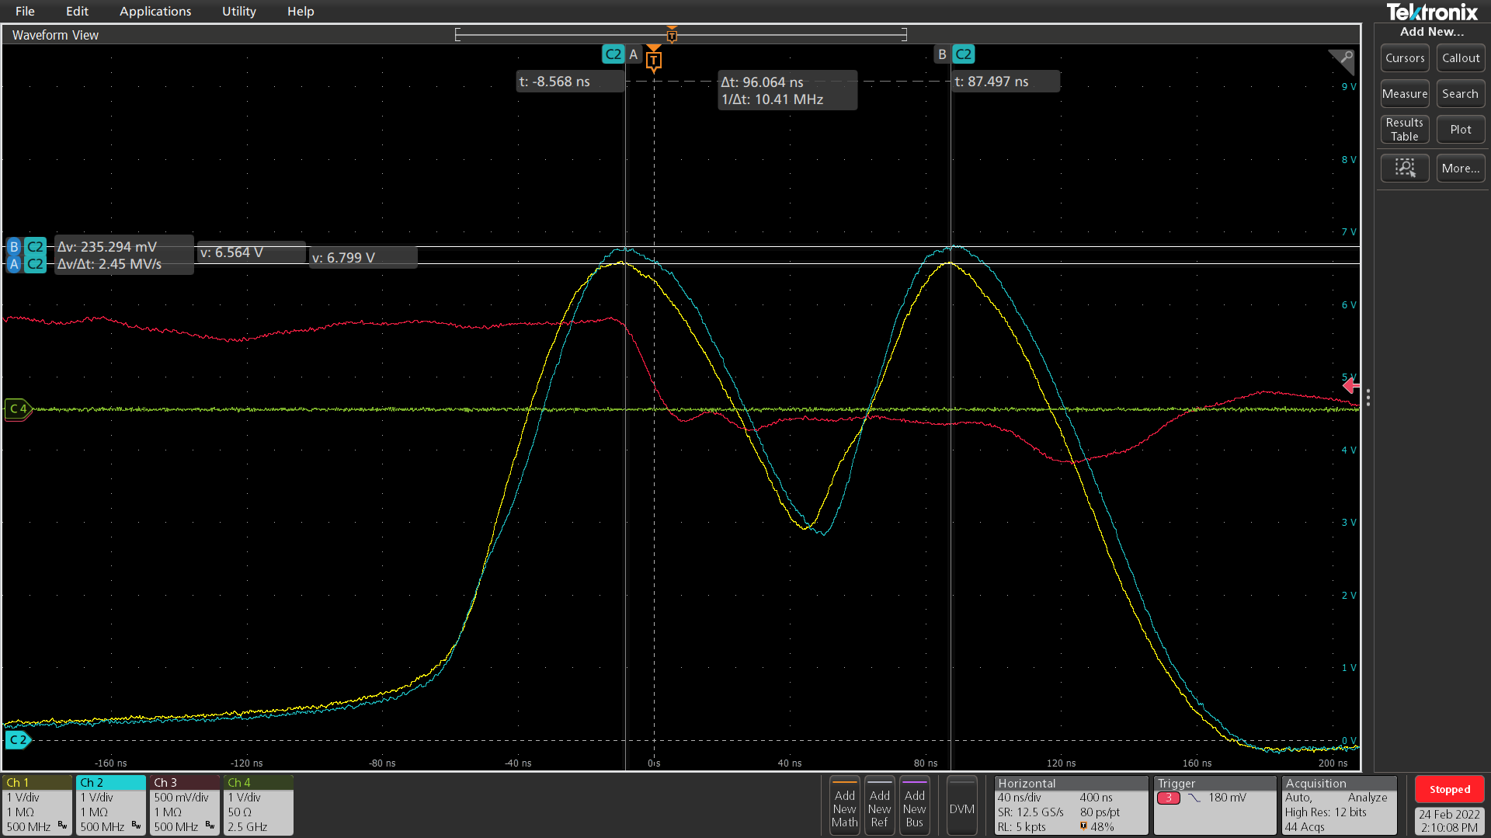
(3) DR extraction kickers
No. of magnets: 2
Deflection angle: 4.7 mrad
Pulse shape: double half sine
Pulse width: < 300 ns
Rise /Fall time: < 100 ns
Peak currents: 1546 A
Thyratron
C1
in the tunnel
in the tunnel

Slide 20
(3) R&D for reducing temperature dependence
The temperature dependence has decreased to about 1/3 by
Using mica capacitors in stead of ceramic capacitors,
Switching from natural oil cooling to forced oil cooling.
Successfully operated it for over 100 hours at rated voltage using mica capacitors.
However, the test didn’t meet the installation deadline, unfortunately.

Slide 21
(3) R&D for reducing temperature dependence
Ceramic | Capacitor temp. (℃) | C1-C2 time (s) | C2-time (s) | C1Volt ( kV) | C2 Volt (kV) | Output Cur(A)
Start time | 24.5 | 3.36E-07 | 1.877E-07 | 27.24 | 36.3 | 1044
End time | 30 | 3.337E-07 | 1.851E-07 | 27.245 | 36.545 | 1023
ΔT | 5.5 | -2.3E-09 | -2.6E-09 | 0.005 | 0.245 | -21
ΔI(%) |  | -0.685% | -1.385% | 0.018% | 0.675% | -2.011%
ΔI/ΔT(%) |  | -0.124% | -0.252% | 0.003% | 0.123% | -0.366%
mica | Capacitor :temp. (℃) | C1-C2time (s) | C2-time (s) | C1 Volt (kV) | C2 Volt (kV) | Output Cur (A)
Start time | 11.5 | 3.196E-07 | 2.131E-07 | 27.242 | 35.79 | 724
End time | 26.1 | 3.202E-07 | 2.114E-07 | 27.265 | 35.74 | 736.5
ΔT | 14.6 | 6.000E-10 | -1.700E-09 | 0.023 | -0.05 | 12.5
ΔI(%) |  | 0.19% | -0.80% | 0.08% | -0.14% | 1.73%
ΔI/ΔT(%) |  | 0.013% | -0.055% | 0.006% | -0.010% | 0.118%
Temp. depedendence
Stability specification is < ±0.1%.
To further reduce temperature dependency, it is crucial to enhance the cooling of the saturable reactor.

Slide 22
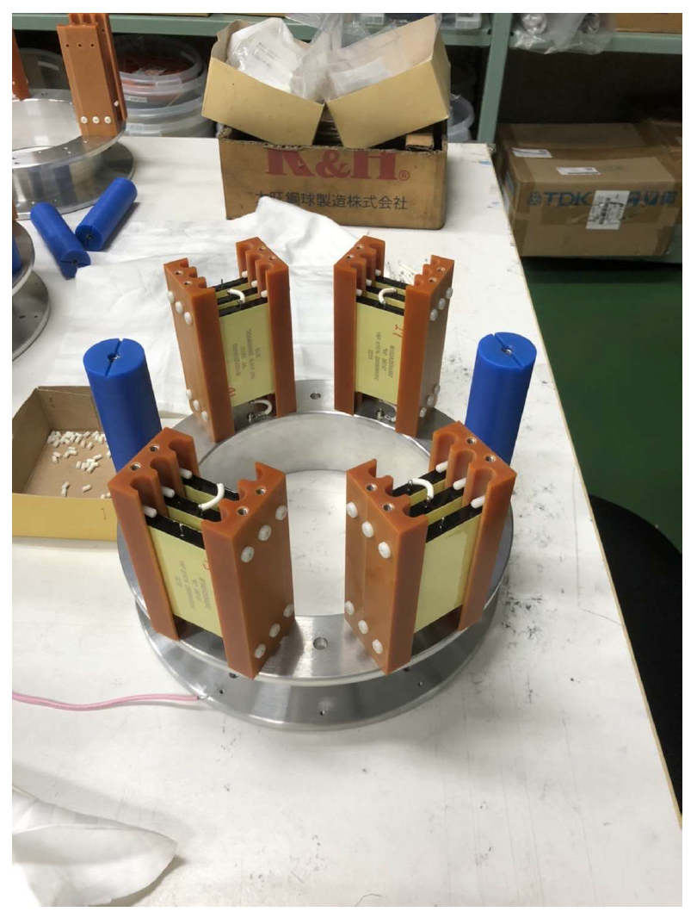
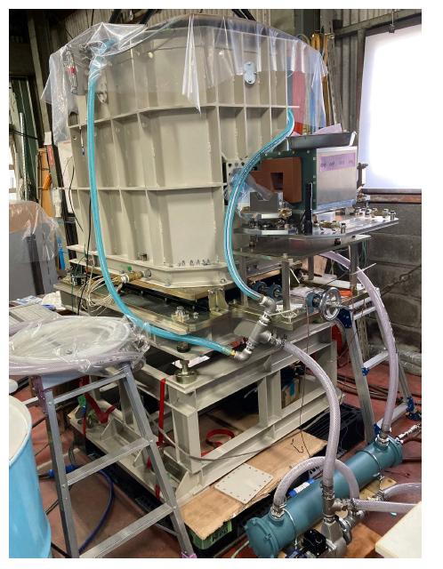
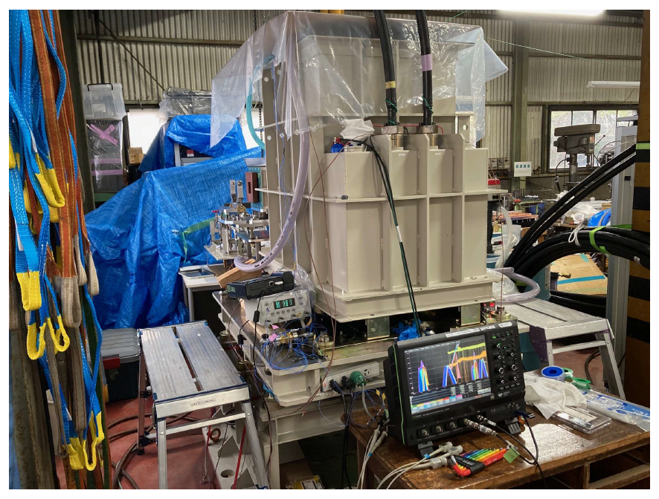
(3) R&D for reducing temperature dependence
Mica capacitors
Force oil cooling system

Slide 23
3. Work on DR during LS1
During LS1, two tasks were carried out.
Change the material of the vacuum seal from Viton to metal. It will be reported later.
Repair of minor oil leaks in the magnetic switch tanks of the extraction kickers.

Slide 24
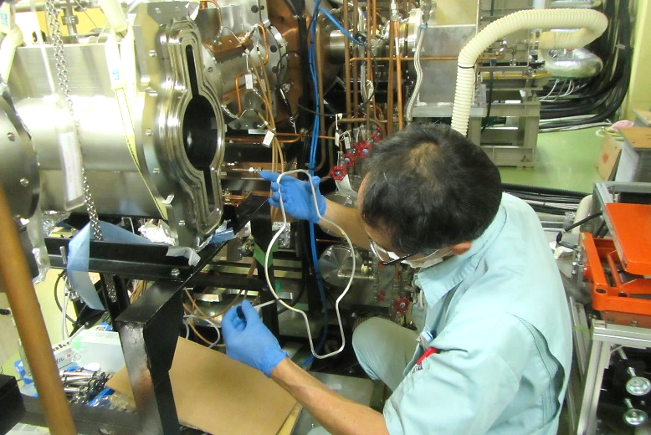
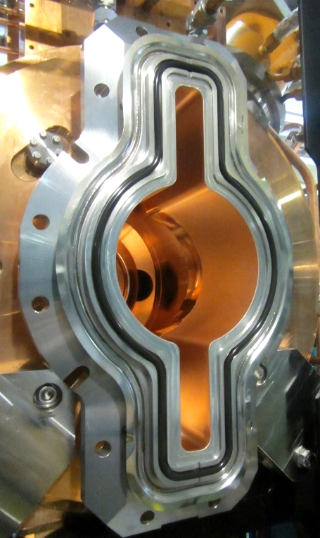
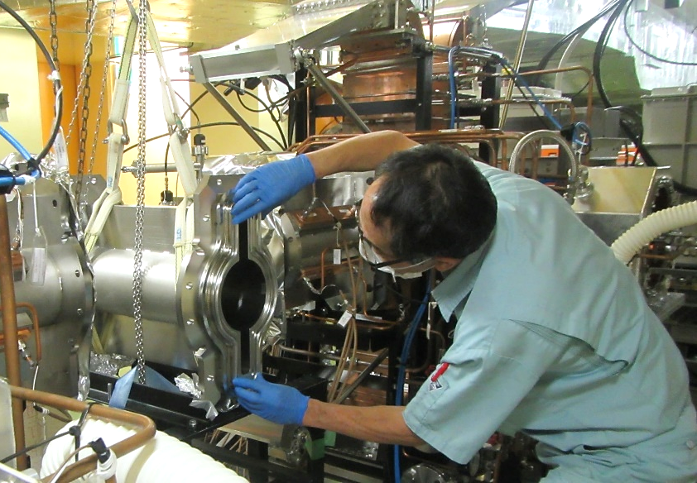
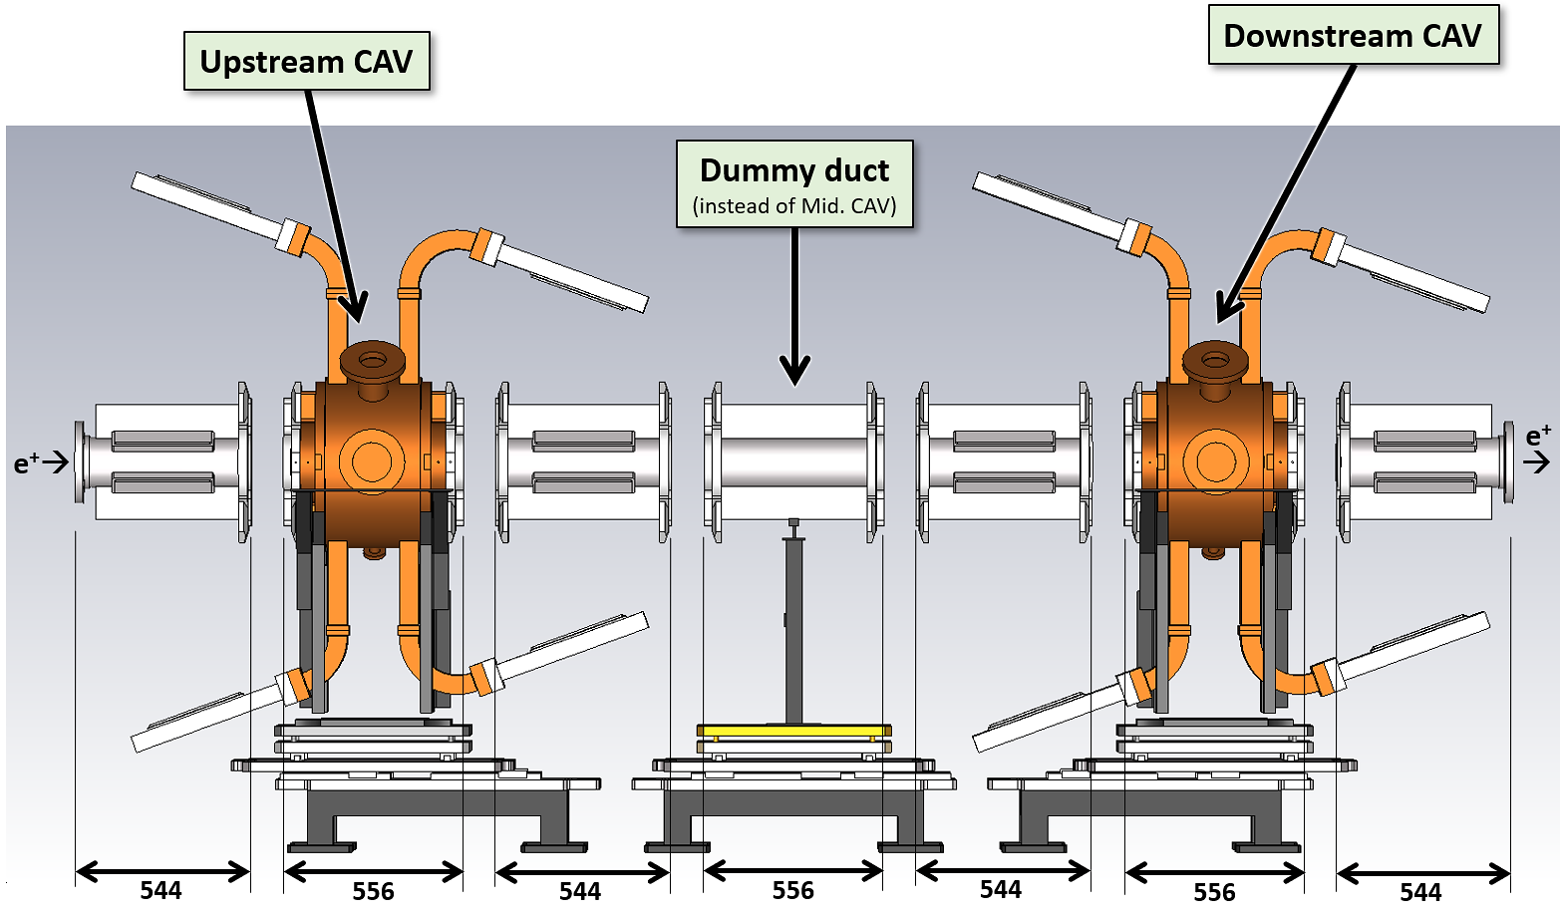
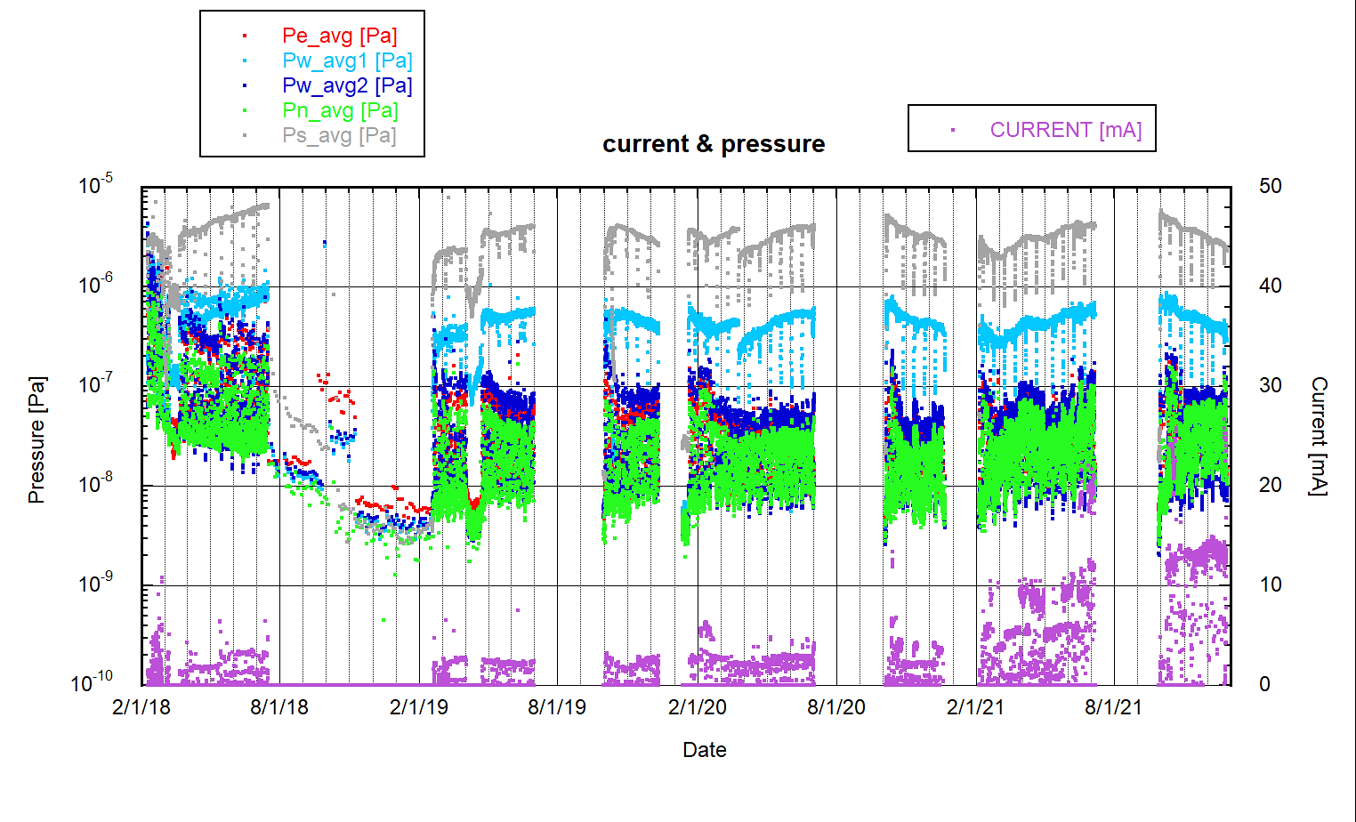
DR / RF Vacuum improvement by O-ring replacement during LS1
T. Abe
for the six connections between the cavities and beam ducts
Metal O-ring
Viton O-ring
Changing from Viton O-rings to metal seals improved vacuum levels significantly.
More details will be reported by Abe-san later.
(~1e-5 Pa in the RF section before LS1 using both IPs and TMPs
~1e-7 Pa in the recent RF section using IPs only
Vacuum improvement in the DR / RF section
by two orders of magnitude
during DR beam operation
IP: sputter-Ion Pump (400L/s)
TMP: Turbo-Molecular Pump (300L/s)

Slide 25
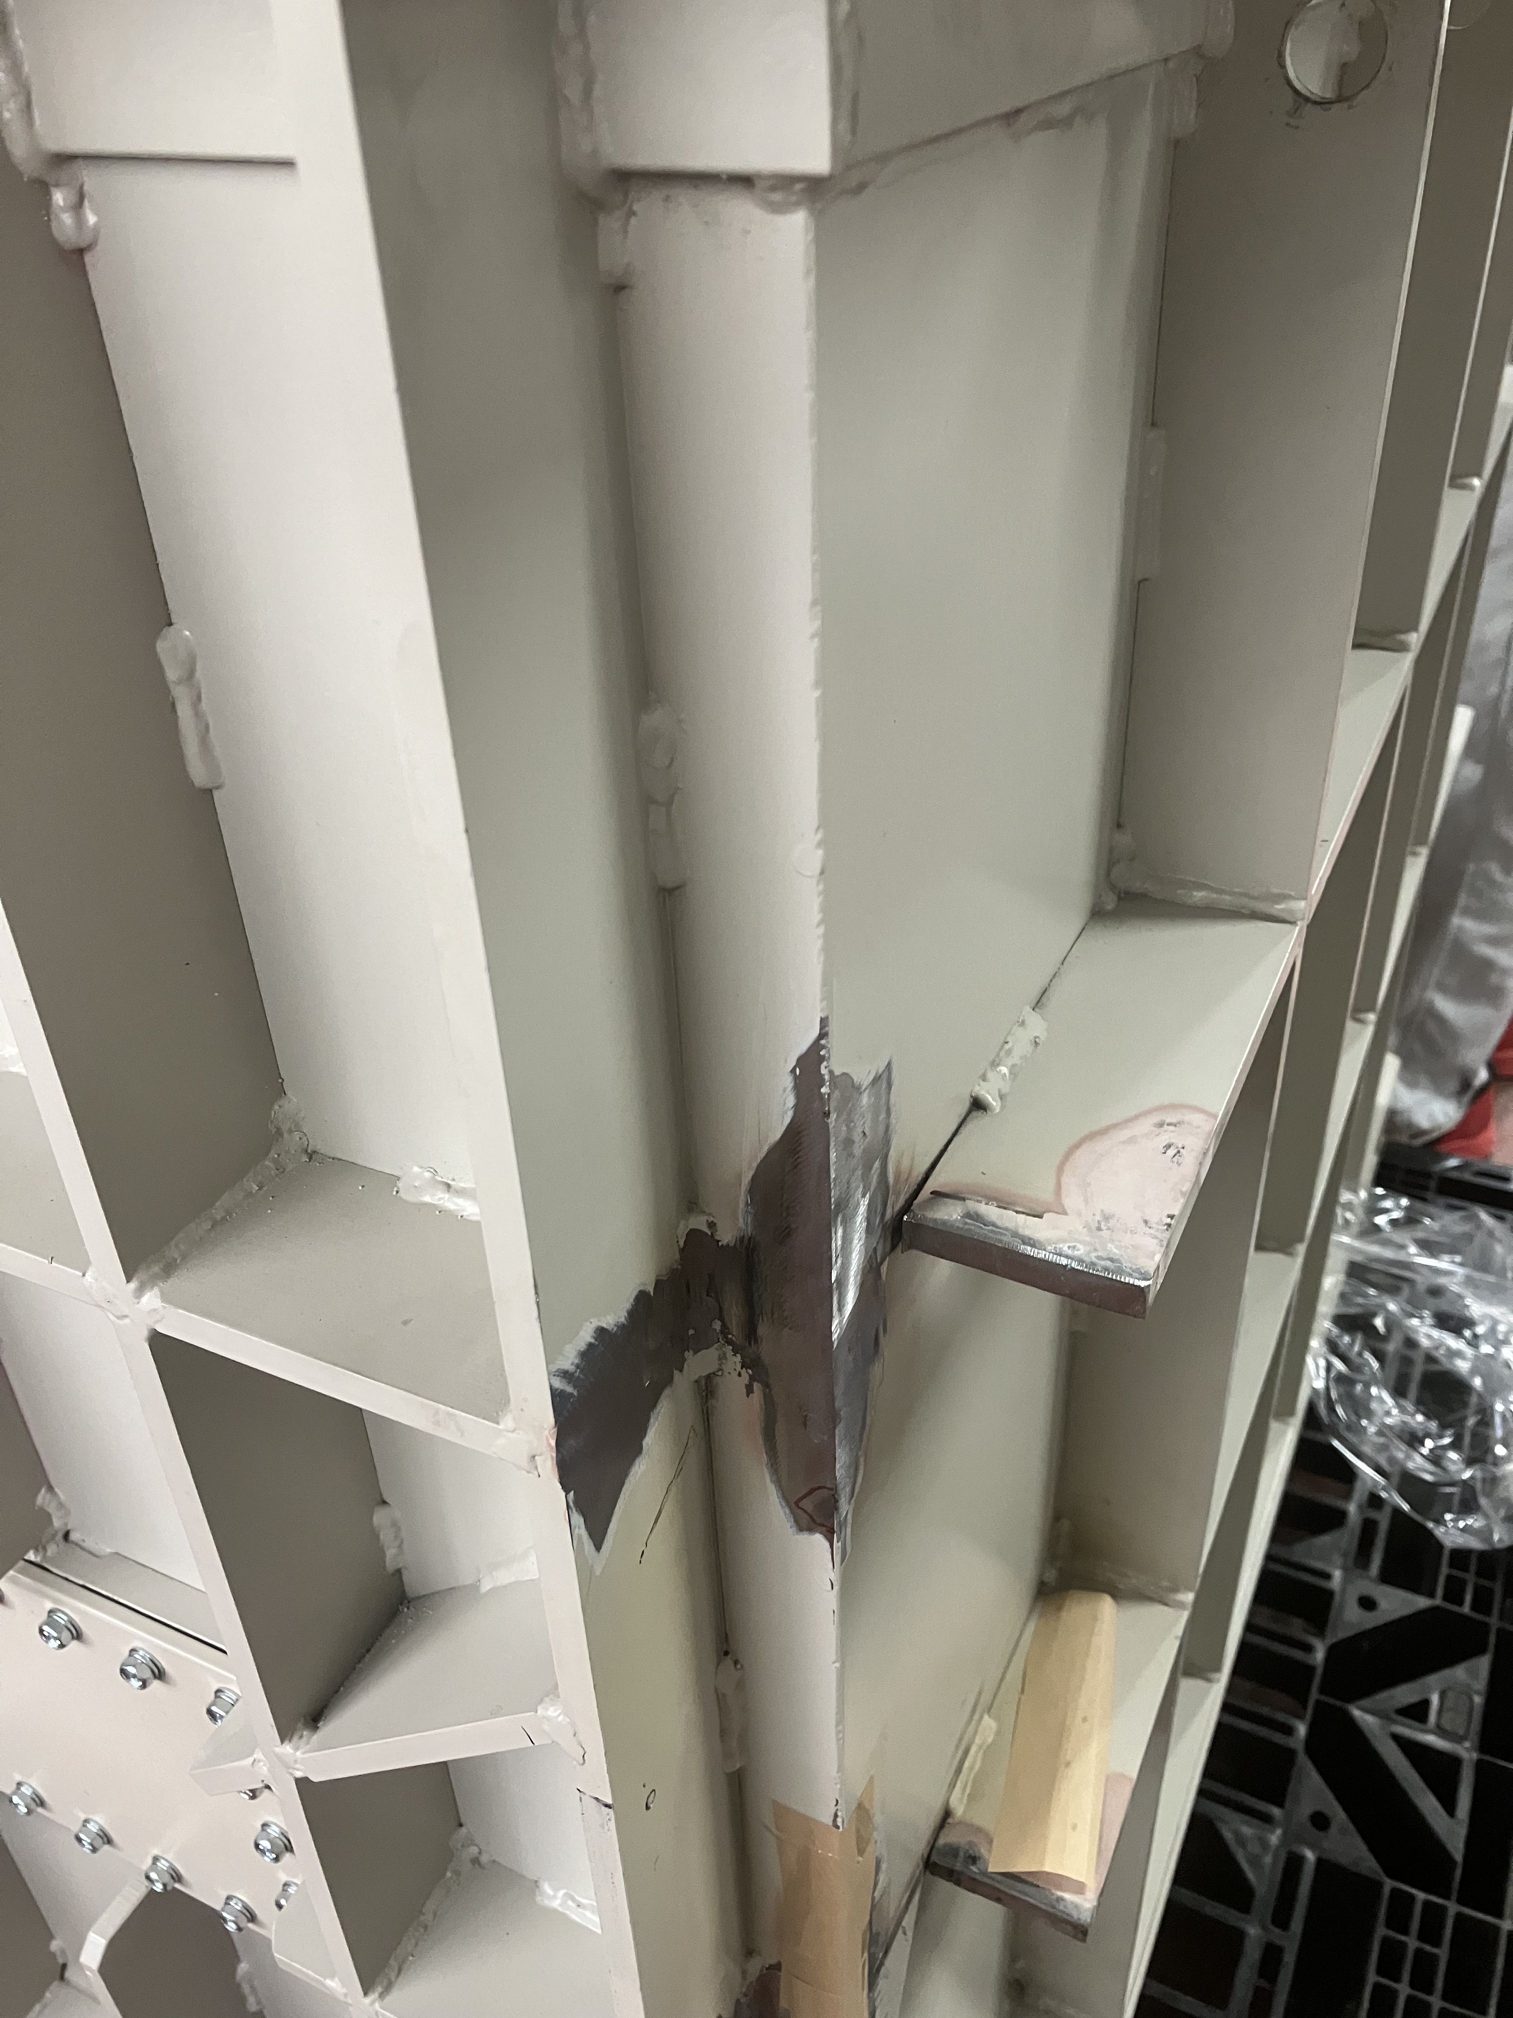
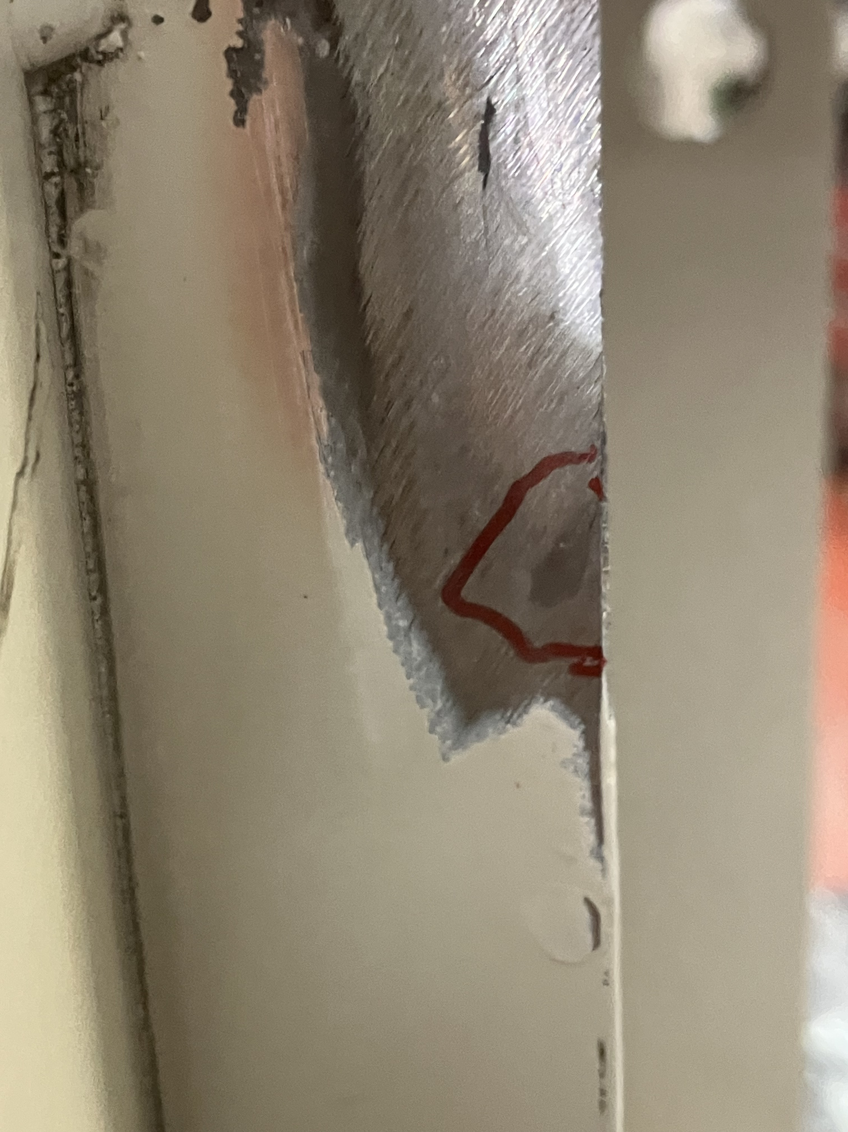
Fixing oil leaks from welded bead
Minor oil leaks were detected in the magnetic switch tanks of the extraction kicker.
The exact leak location couldn’t be identified in the tunnel.
Tanks were removed from the tunnel for repair during LS1 and subsequently reinstalled.

Slide 26
4. Summary
DR operation is ongoing without any major trouble.
We will attempt lower emittance optics again by replacing excitation curves.
Due to the temperature dependence of the beam orbit, optics corrections have become challenging.
The vacuum level of the RF cavity has ben significantly improved.
To enhance reliability of kickers, we are conducting further tests using a mica capacitor at higher voltages for a longer durations.

