Slide 1
Brief report of nonlinear collimator study (The study is not yet finished, so this is a progress report.)
G. Broggi, Y. Funaoshi (Study leader), N. Iida, T. Ishibashi, H. Koiso, Q. Liu, A. Morita, Y. Mulee, I. Nakamura, A. Natochii K. Uno, K. Oide, Y. Ohnishi, H. Sugimoto, S. Tanaka, S. Terui, B. Urbschat,
The 27th KEKB Accelerator Review Committee
24th Mar. 2024
Notes:
I’m Shinji Terui from KEKB vacuum group.
Today, I'm going to talk about brief report of NLC study

Slide 2
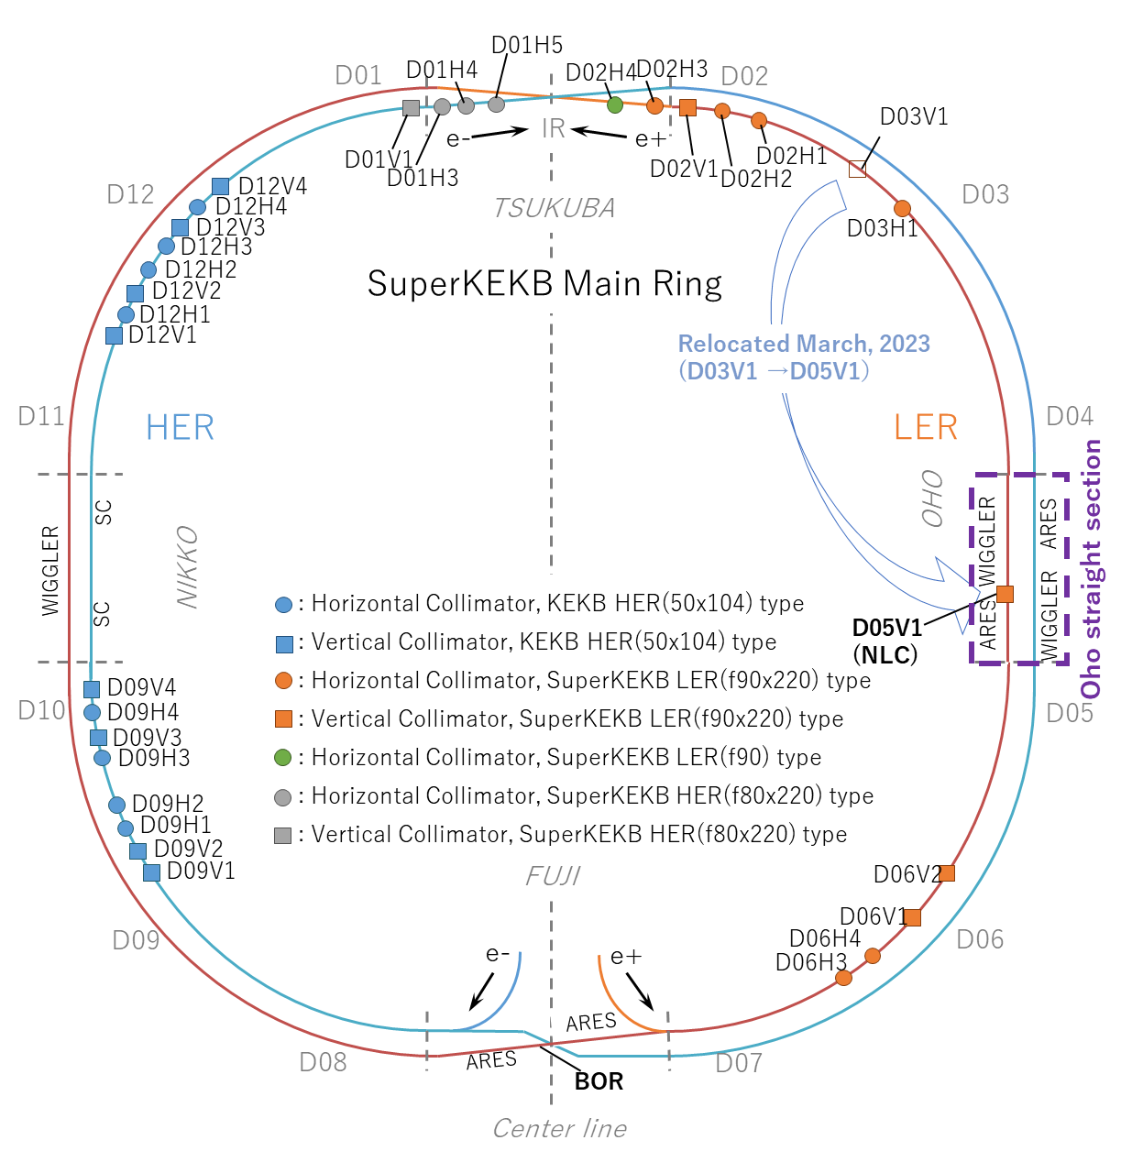
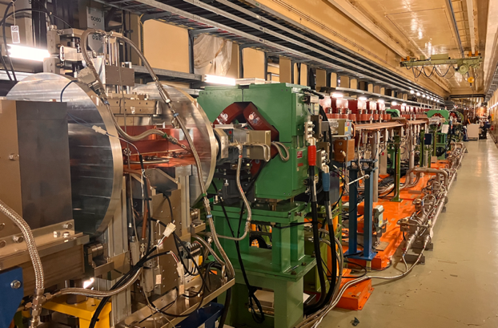
Outline
2
Introduction
Report of nonlinear collimator(NLC) study
Summary
Photo of nonlinear collimator section at OHO
By T. Ishibashi
SNAP.1 (Skew sextupole)
D05V1
Notes:
First slide is outline. My presentation is divided into 3 parts. I’ll start with talking about introduction. Then, report of NLC study. Finally summary.
This figure shows collimator location. NLC located at Oho straight section. This photo shows nonlinear collimator section. This is first skew sextupole called SNAP.1 .

Slide 3
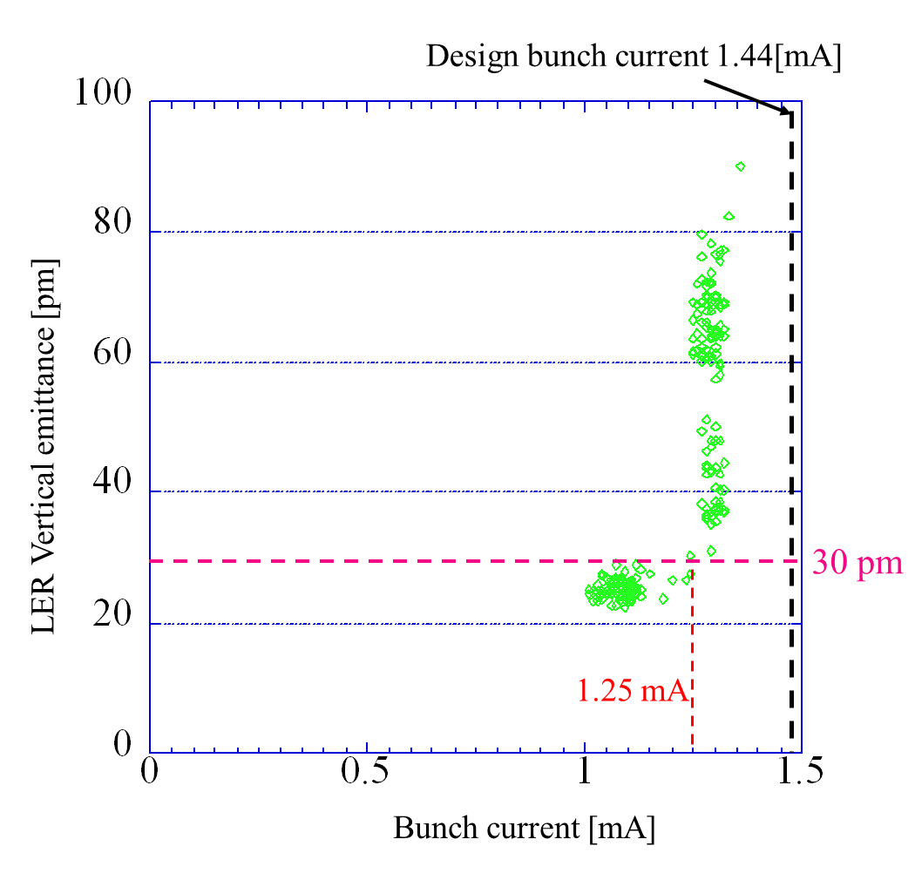
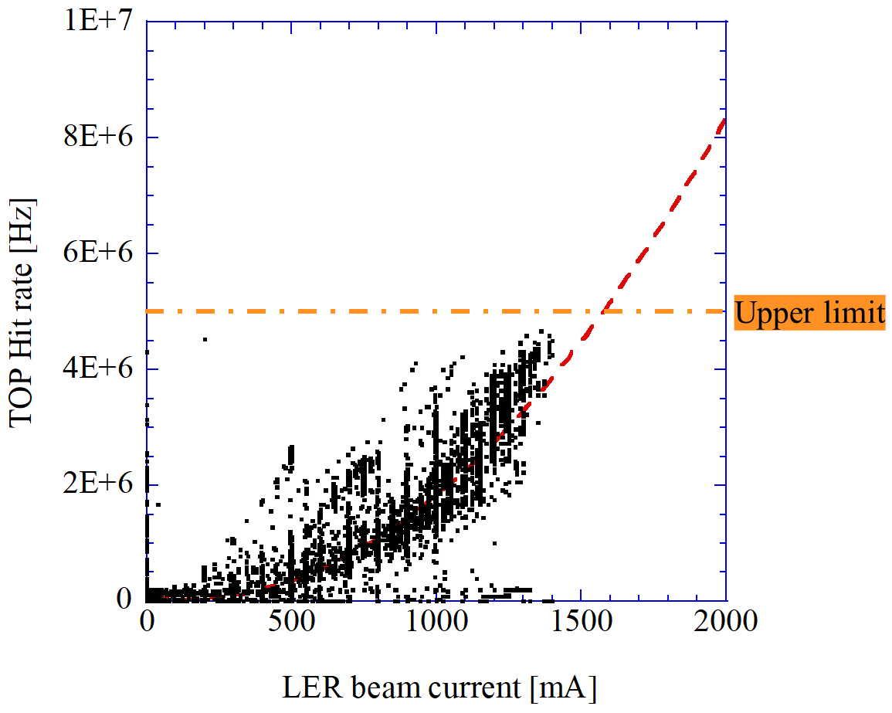
Introduction (Motivation of NLC installation)
As the beam background noise (BG) is reaching its upper limit, further beam current increase requires a BG reduction.
To increase the bunch current while avoiding LER vertical beam size blow-up, the impedance needs to be reduced.
Use NLC as a countermeasure to sudden beam loss ( not included in this presentation).
3
One of the causes of this beam size blow-up is impedance.
More information on this beam size blow-up can be found in Ref (Study for -1 Mode Instability in SuperKEKB Low Energy Ring by Ohmi-san).
Without NLC, the design bunch current cannot be reached while keeping the LER vertical emittance low.
2022ab run
By*1mm
Notes:
First, a brief discussion of the motivation for the NLC installation.
This figure indicates that as the beam background noise (BG) is reaching its upper limit, further beam current increase requires a BG reduction. Without NLC, the design bunch current cannot be reached while keeping the LER vertical emittance low.
One of the causes of this beam size blow-up is impedance.
More information on this beam size blow-up can be found in Ref (Study for -1 Mode Instability in SuperKEKB Low Energy Ring by Ohmi-san).

Slide 4
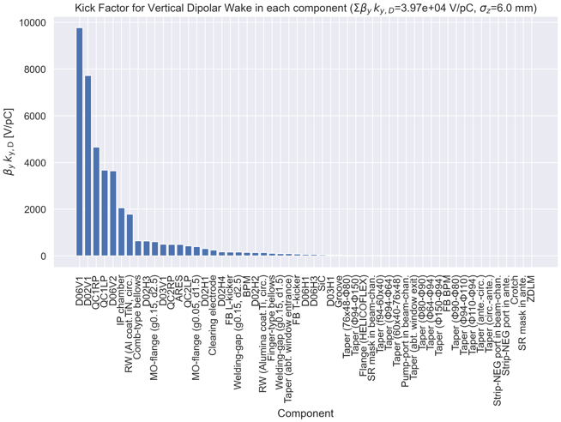
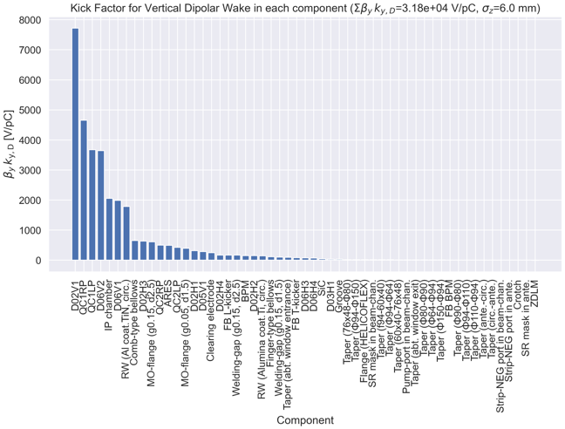
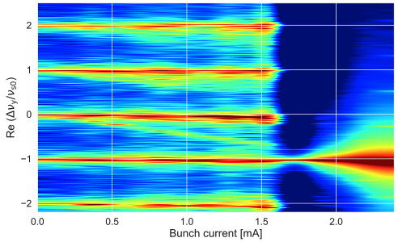
Introduction (Motivation of NLC installation)
By T. Ishibashi
4
2021c physics run
After LS1
(β_{y}*=1 mm, β_{x}*=80 mm)
(β_{y}*=1 mm, β_{x}*=80 mm)
It is estimated that the D05V1, with a half-aperture of about 4-5 mm and β_{y} =4.05 m, can have comparable background performance to the D06V1.
→ If D05V1 could be used instead of D06V1, the vertical impedance of the ring could be reduced.
D06V1
D06V1
D05V1
Σβ_{y}k_{y} decreases from 3.97×10⁴ to 3.18×10⁴ V/pC. The TMCI threshold increases from ~1.8 mA to ~2.1 mA.
If it turns out that the D05V1 will completely replace the D06V1 in the next commissioning, there is a possibility that we will remove the D06V1 from the LER in the future, in which case further impedance reduction could be expected.
Notes:
In case of using NLC, Sum vertical beta times vertical kickfactor decreases.

Slide 5
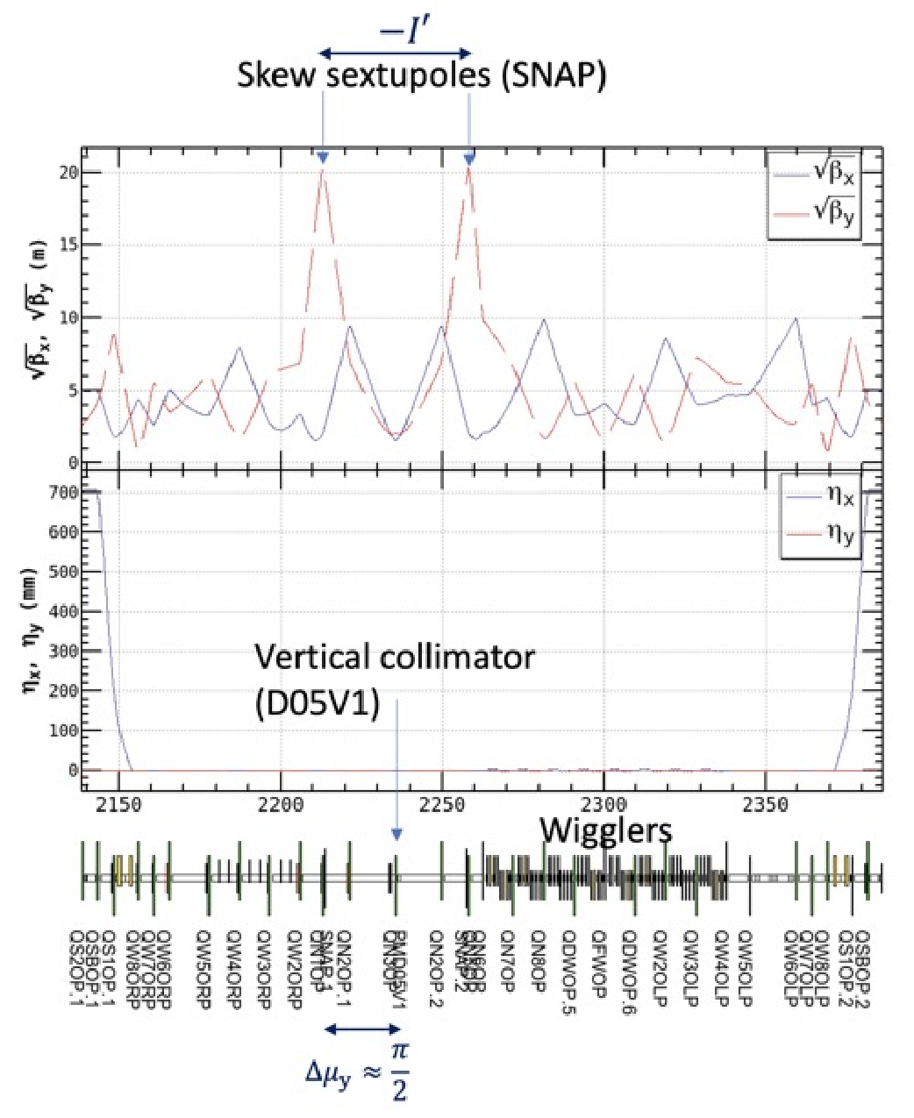
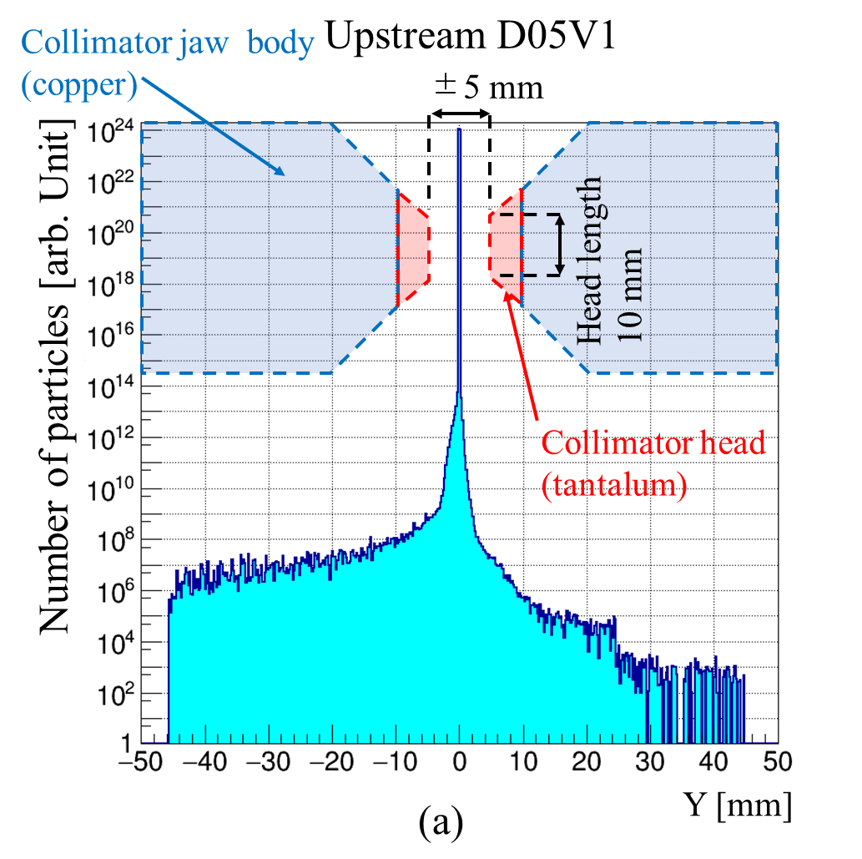
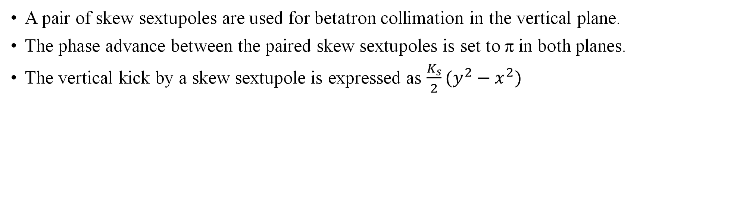
Introduction (NLC concept)
5
A pair of skew sextupoles are used for betatron collimation in the vertical plane.
The phase advance between the paired skew sextupoles is set to π in both planes.
The vertical kick by a skew sextupole is expressed as $\frac{K_{s}}{2}(y^{2}−x^{2})$
Image of Skew sextupole kick
By A. Natochii
Notes:
Next, I talk briefly about the concept of SuperKEKB NLC.

Slide 6
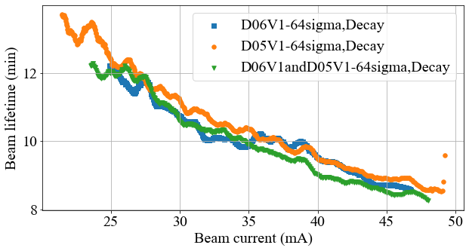
Report of nonlinear collimator(NLC) study
6
The studies performed on 8 Mar. and 14 Mar. checked whether D05V1 (NLC) would be a substitute for D06V1, which had been very much relied upon until previous runs.
By*1mm, crab waist=0
Assumption: Bunch length=6 mm, V emittance = 20 pm
Under the conditions described below, the lifetime was almost the same.
Beam lifetime
This table shows the collimator gap at the time of measurement.
14 Mar.
Name | Time | Beam current | # of bunch | D06V1 gap | D06V2 gap | D05V1 gap | D02V1 gap | D06V1 σ | D06V2 σ | D05V1 σ | D02V1 σ
D06V1-64σ | 21:11:50 | 50 | 94 | 2.375 | 8 | 14 | 1.1 | 64 | 394 | 128 | 71
D06V1D05V1-64σ | 21:26:40 | 50 | 94 | 2.375 | 8 | 3.5 | 1.1 | 64 | 394 | 64 | 71
D05V1-64σ | 21:41:00 | 50 | 94 | 8 | 8 | 3.5 | 1.1 | 218 | 394 | 64 | 71
Notes:
Blue is the narrowest setting with D06V1, orange is the narrowest setting with D05V1, and green is the narrowest setting with both D05V1 and D06V1.

Slide 7
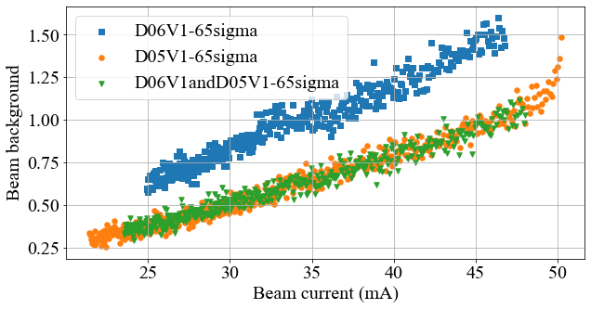
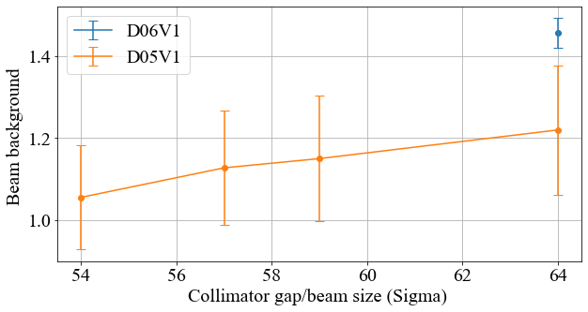
Report of nonlinear collimator(NLC) study
7
Storage beam background: *D05V1 is more capable of storage BG reduction than D06V1.
*The better collimation performance of D05V1 compared to D06V1 is expected. NLC is much closer to the IP than D06V1, so scattered particles between D06V1 and D05V1 can now be stopped by D05V1 before they hit the IR.
*The storage BG was also observed to decrease when the D05V1 gap was closed.
Storage beam background
Notes:
This figure shows the beam current on the horizontal axis and the BG on the vertical axis.
This graph shows the collimator gap on the horizontal axis and the BG on the vertical axis.

Slide 8
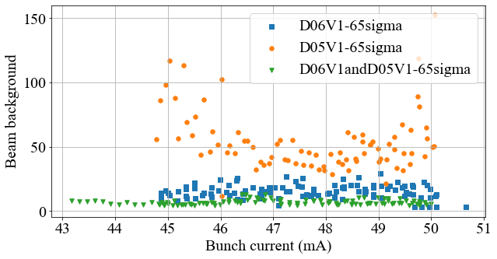
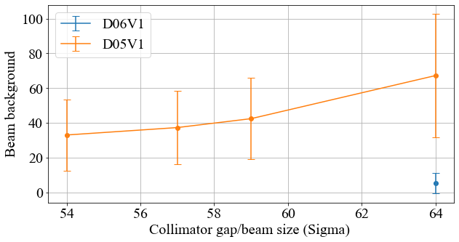
Report of nonlinear collimator(NLC) study
Injection beam background
8
Injection beam background: *The injection BG reduction capability of D05V1 is significantly less than that of D06V1. When both D06V1 and D05V1 are used, the injection BG reduction capability is higher than that of D06V1 alone.
Vertical kick = $\frac{K_{s}}{2}(y^{2}−x^{2})$
We expect that D05V1 is less effective for injection BG reduction because of this term.
Even with a narrower gap in D05V1, the injection beam background is greater than in D06V1.
This countermeasure is presented in the summary.
Notes:
This figure shows the beam current on the horizontal axis and the injection BG on the vertical axis.
This figure shows that even with a narrower gap in D05V1, the injection beam background is greater than in D06V1.

Slide 9
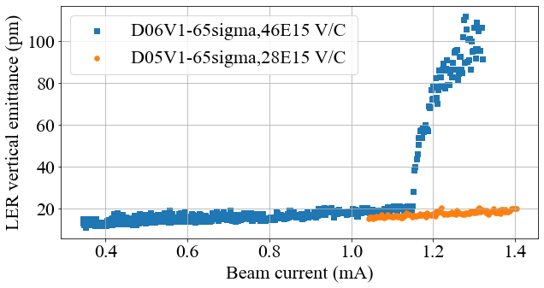
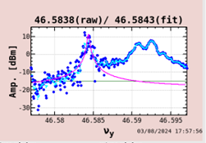
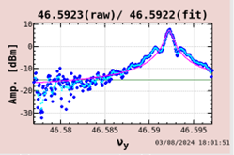
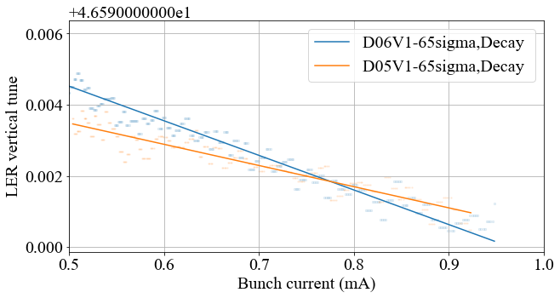
Report of nonlinear collimator(NLC) study
9
LER Pilot bunch vertical spectrum
LER vertical beam size blow-up
No vertical beam size blow-up was observed in the design bunch current when D05V1 was used in its narrowest setting.
1.25 mA
0.82 mA
Mea_D06V1-65sigma(46E15 V/C)=0.0097 /mA
Cal_D06V1-65sigma(46E15 V/C)=0.0092 /mA
Mea_D05V1-65sigma(28E15 V/C)= 0.0059 /mA
Cal_D05V1-65sigma(28E15 V/C)=0.0055 /mA
LER vertical tune shift
Vertical tune shift was nearly consistent in measurement and calculation.
Notes:
We have investigated the bunch current threshold for beam size blow-up.
This figure shows no vertical beam size blow-up was observed in the design bunch current when D05V1 was used in its narrowest setting.
This shows Vertical tune shift was nearly consistent in measurement and calculation.

Slide 10
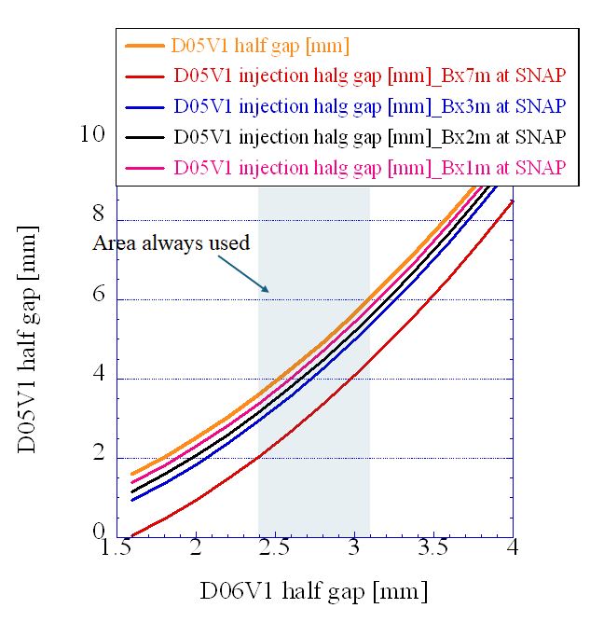
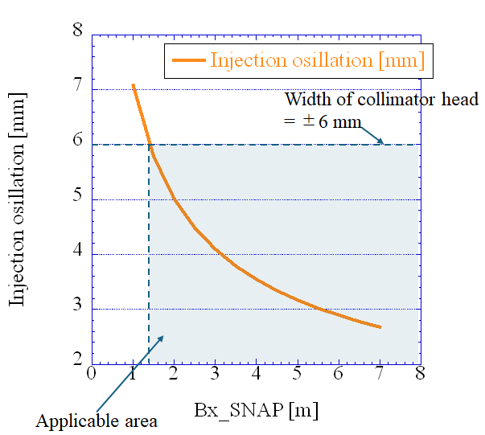
Summary
10
The motivation for the installation of the NLC and the concept of the NLC were briefly explained.
D05V1 is more capable of storage BG reduction than D06V1.
The injection BG reduction capability of D05V1 is significantly less than that of D06V1.( Funakoshi-san suggested to optics group that the βx at the SNAP location could be smaller.)
Experiments confirmed that D05V1 has a smaller impedance than D06V1.
Cut storage BG
Bx at SNAP =7m for cut injection BG
*Currently, the Bx at SNAP is 7m. We can see that to cut the injection BG at this time, the gap of cut injection BG needs to be smaller than the gap of cut of the storage BG.
*Due to the collimator head width constraints, at the next opportunity we plan to do a study with optics with a Bx = 2m at SNAP.
Notes:
This plot takes the D06V1 gap on the horizontal axis and the D05V1 gap on the vertical axis. Currently, the Bx at SNAP is 7m. We can see that to cut the injection BG at this time, the gap of cut injection BG needs to be smaller than the gap of cut of the storage BG. Due to the collimator head width constraints, at the next opportunity we plan to do a study with optics with a Bx of 2m at SNAP.

Slide 11
Back up

Slide 12
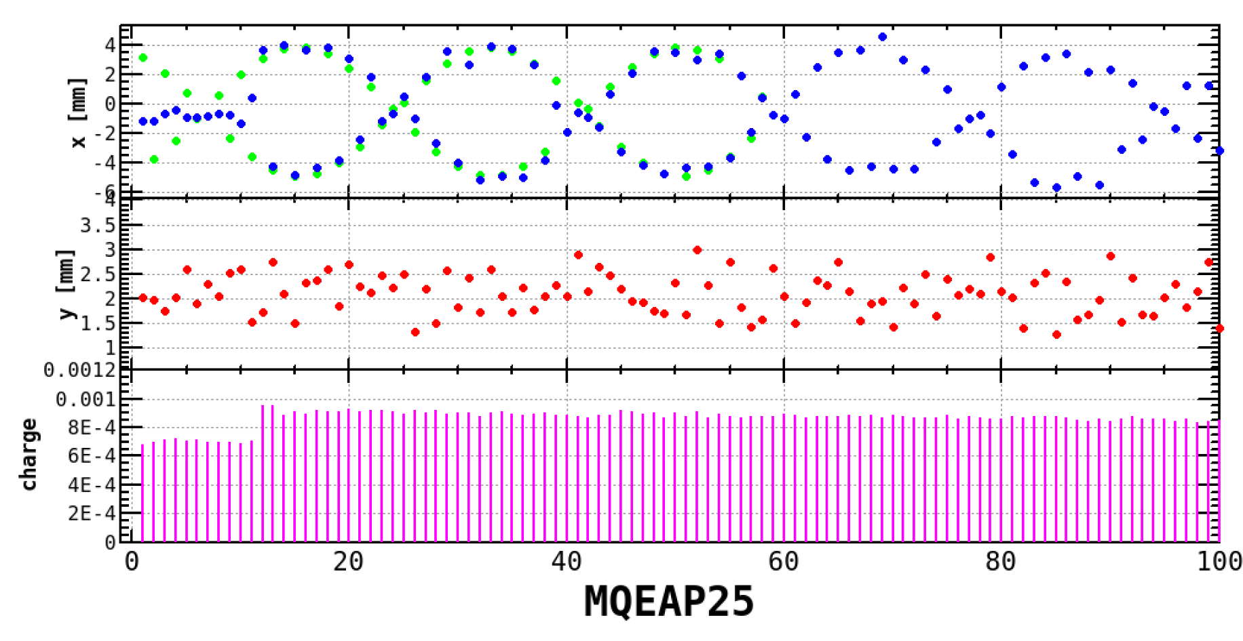
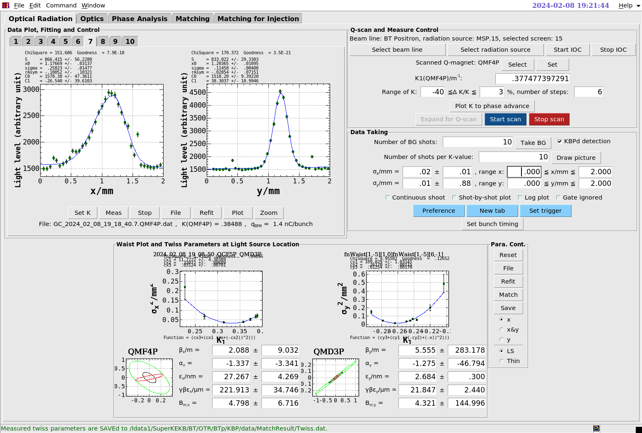
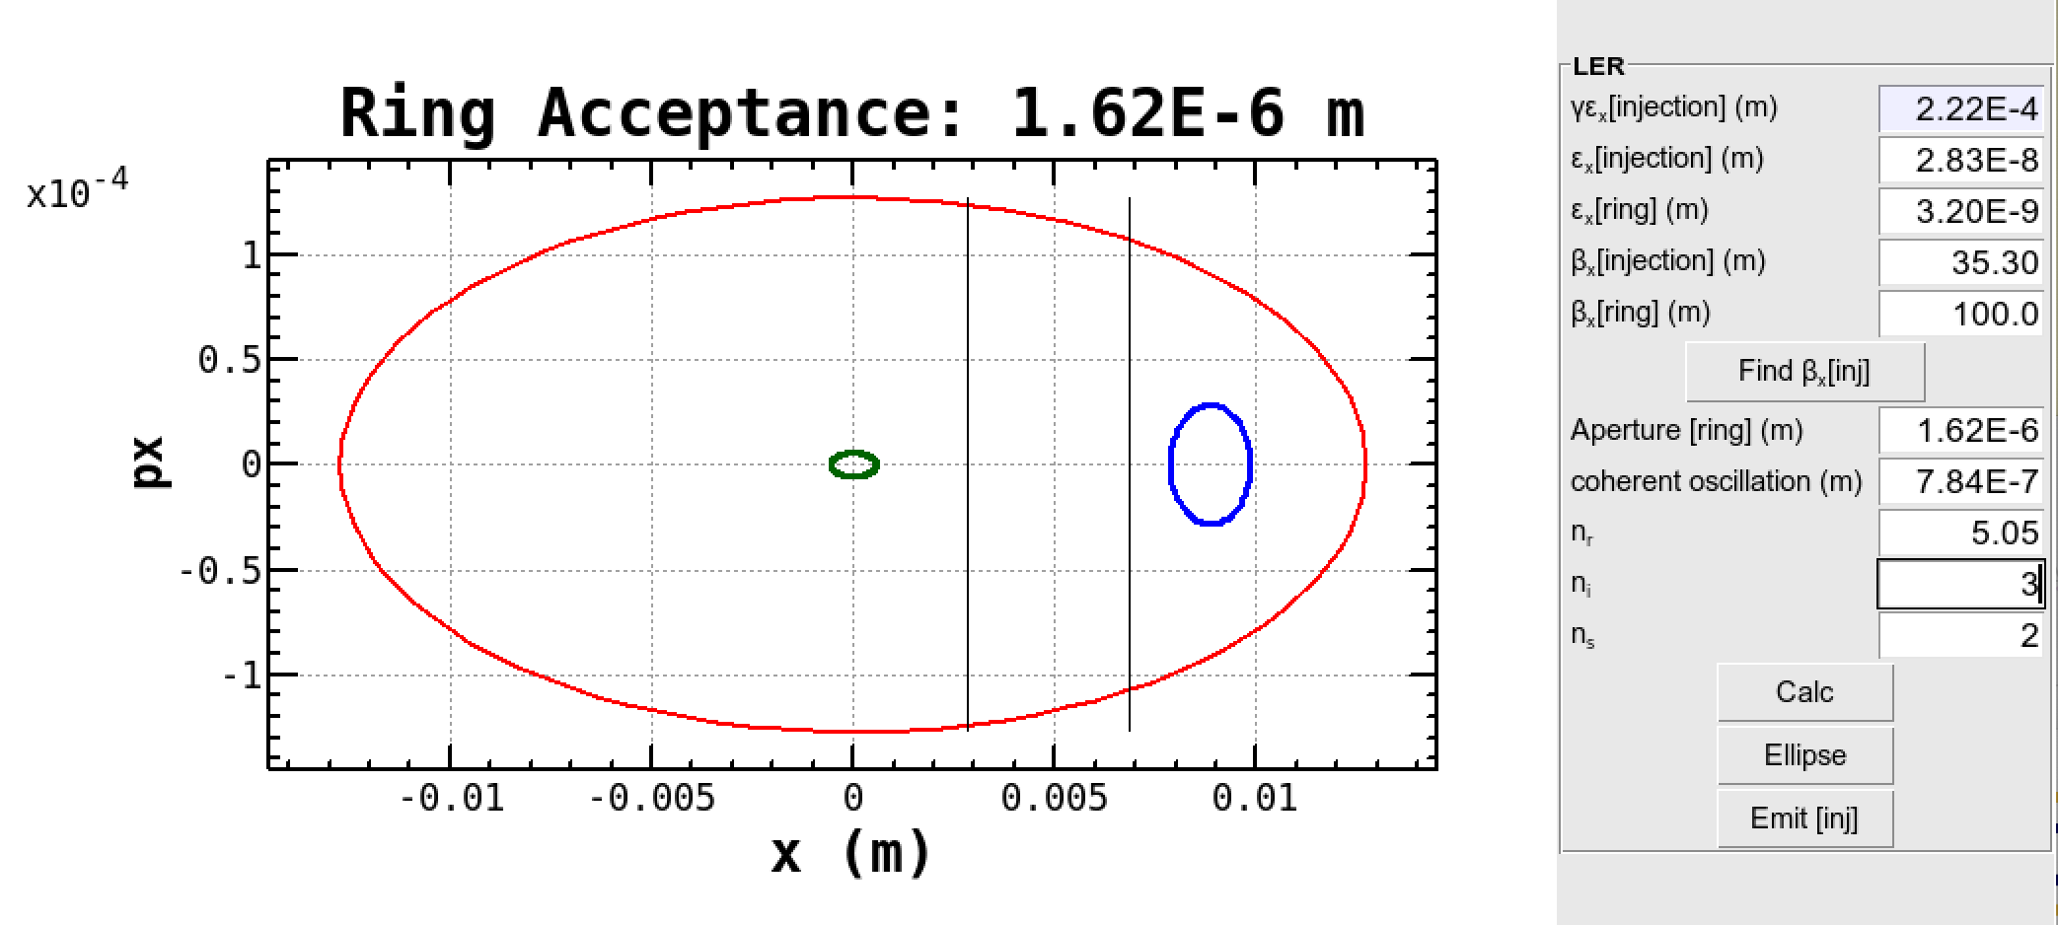
2Jx of injecting beam
Y. Funakoshi
N. Iida
Dipole oscillation
2Jx = 7.84 x 10^-7 m
Beam emittance of injecting beam
γε_{x} = 222±35 mm -> ε_{x} = 2.83 x 10^-8 m
Ring acceptance
2Jx = 1.62 x 10^-6 m (with 3σ_{x,inj}) -> 2Jx = 2 x 10^-6 m (with some margin)
Y. Ohnishi

Slide 13
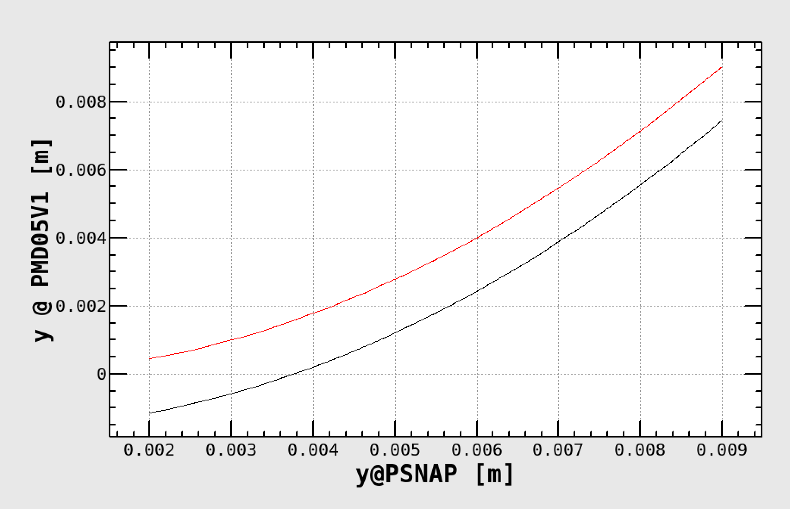
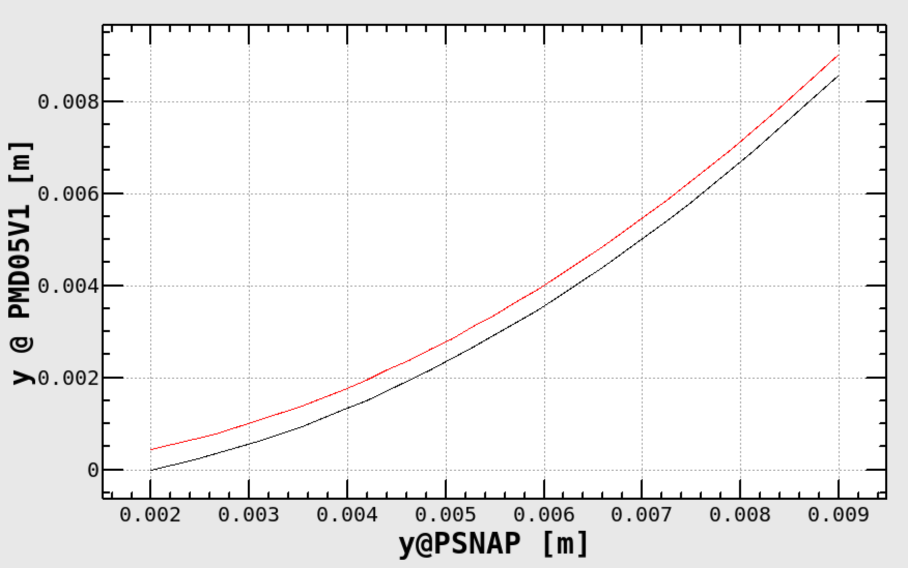
Collimation for storage and injecting beams
Y. Funakoshi
2Jx (injection acceptance) = 2 x 10^-6 m
No x-offset (storage beam)
β_{x,PSNAC.1} = 7.08m
β_{x,PSNAC.1} = 2m
3.47mm
3.47mm
1.88mm
3.01mm
with x-offset (injection beam)

Slide 14
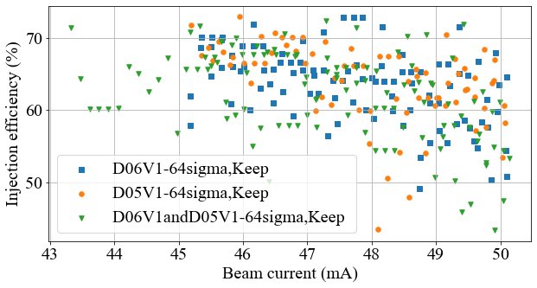
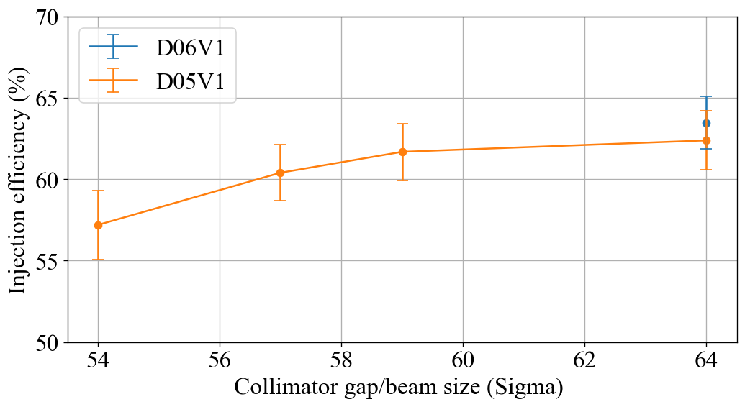
Report of nonlinear collimator(NLC) study
14
Injection efficiency : *The injection efficiency is almost the same when D06V1 is 64σ and when D05V1 is 64σ.
* A slight decrease in injection efficiency was observed when D05V1 was lower than 57σ.
Injection efficiency (%)

Slide 15
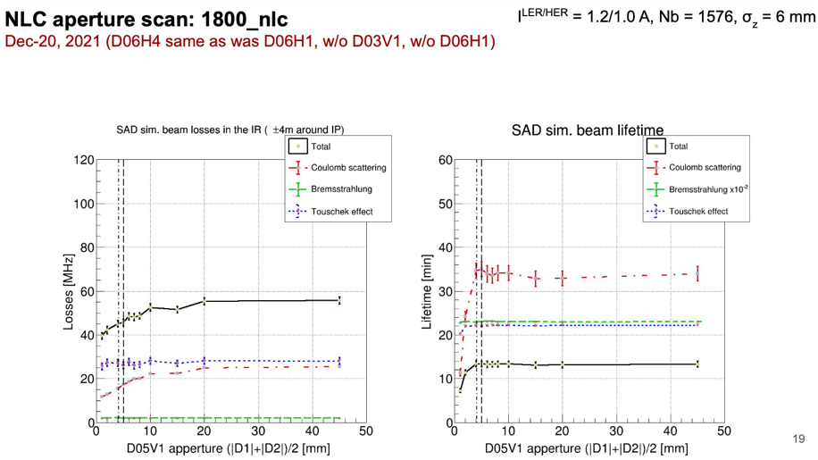
[A. Natochii]

Slide 16
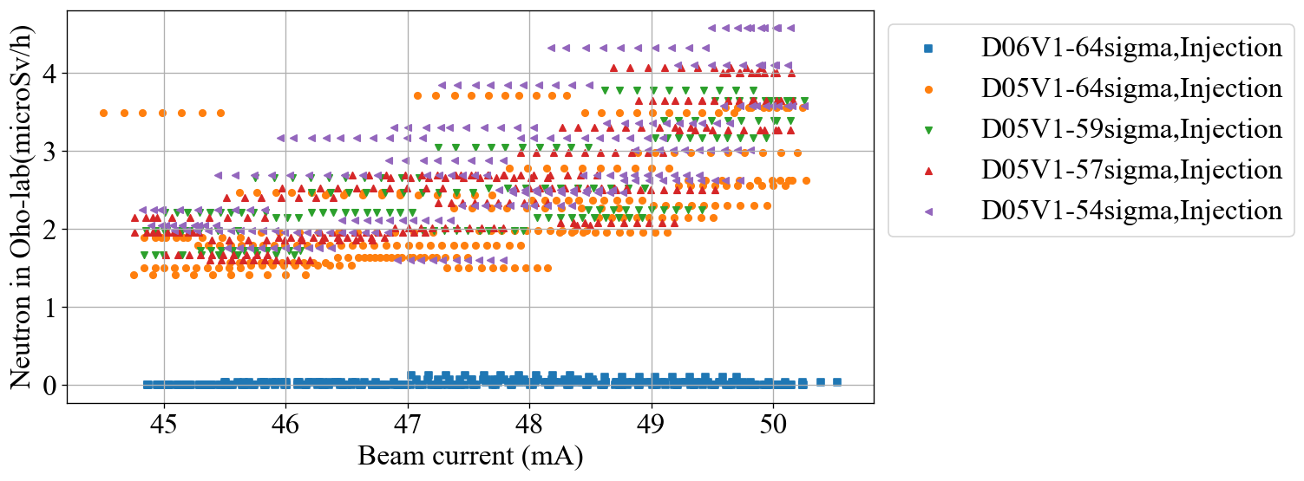
Report of nonlinear collimator(NLC) study
16
94 bunch
FC on
1 Hz
1 bunch injection

Slide 17
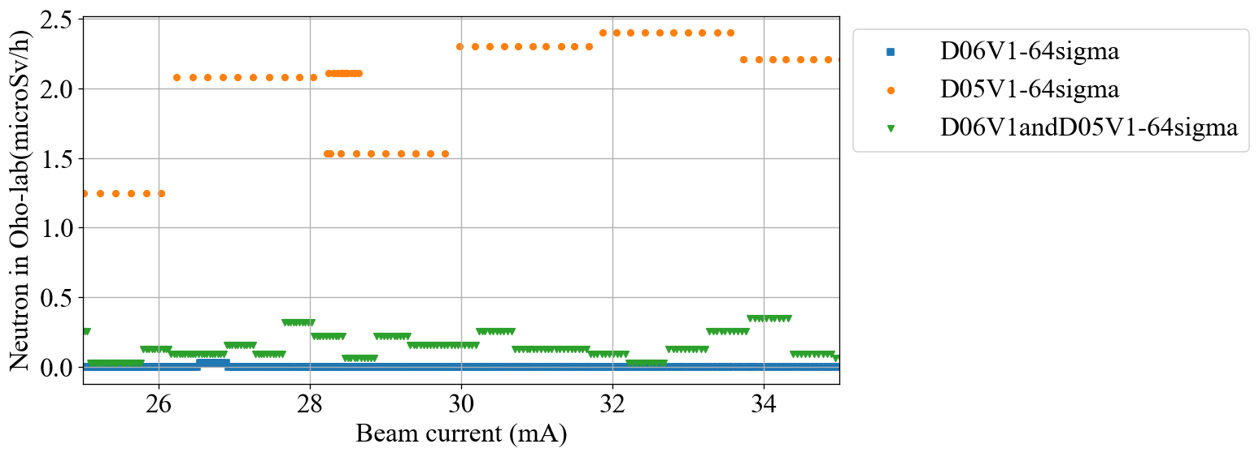

Slide 18
