Slide 1
Welcome and short summary of upgrade work (LS1)
Mika Masuzawa, Hiroyasu Ego, Makoto Tobiyama
KEK Accelerator Laboratory

Slide 2
Emergency Assembly Area

Slide 3
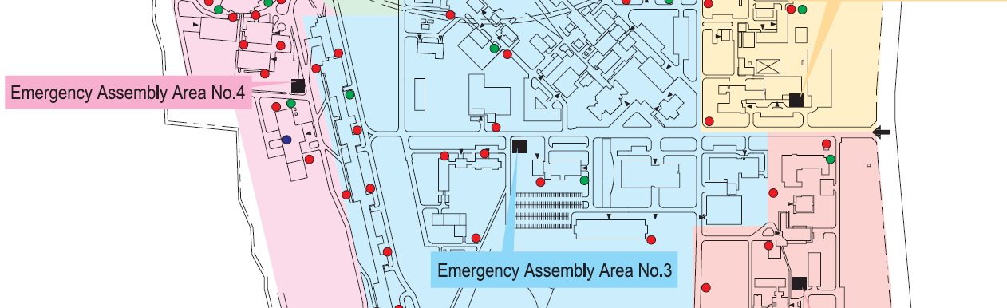
We are here
(3-go-kan)

Slide 4
The 27th KEKB Accelerator Review
25/Mar/2024 – 27/Mar/2024
https://superkekb.kek.jp/event/135/
https://us02web.zoom.us/j/82433765439?pwd=Y0R3V2dpYTI2a2t5cnlvRXFTY2Ztdz09
  Meeting ID 824 3376 5439
  Passcode 3300
A. Hutton*, R. Rimmer, C. Milardi, F. Zimmermann, E. Perevedentsev*, J. Fox,
J. Seeman, P. Craievich, M. Sullivan, P. Chiggiato, Q. Qin, R. Assmann, R. Tomas,
T. Taylor, K. Oide*
  * Remote

Slide 5
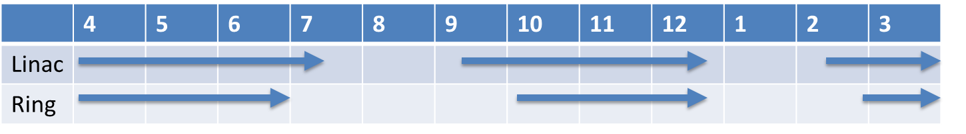
JFY2024 SuperKEKB operation plan
12
1
2
3
Central substation (150MW) switching works.
With the inital budget allocated by MEXT, it seems likely that the rings will only be able to operation for three months until July (due to huge electricity costs).
With additional operating budget by KEK, we will be able to operate the rings after summer, maybe 1.5 month.
If there is a supplemental budget from MEXT, it will be possible to operate in March (and probably in December).

Slide 6
Budget for SuperKEKB Project
Same level as JFY2023
  Budget for JFY2023 was extremely tight, in reality.

Slide 7
Supplemental budget form KEK for anti-aging measures
JFY2023
  Repair of cooling water system, especially inverter system of the pumps.
  Plan have been scaled back and delayed (significantly) due to bidding failures (several times) due to soaring prices and major delays in parts delivery.
  First repairment is scheduled for summer 2024.
JFY2024
  The cost of measure to prevent aging of power supplies and magnets will be taken.

Slide 8
Human resources (JFY2024)
ACCL 3rd (Head: Kyo Shibata)
  Safety, Vacuum, RF system, ARES cavity, SC cavity, Cryogenics
  Prof: 3, Assoc Prof: 6, Assist. Prof. 3 , Technical Staff: 9, Senior Staff: 9 PD: 2
ACCL 4th (Head: Makoto Tobiyama)
  Control, Beam Transport, Beam Instruments, Magnet, SC Magnet, Commissioning
  Prof. 3, Assoc Prof. 7 Assist Prof : 5, Technical staff: 9, Senior Staff: 8
ACCL 5th (Head: Hiroyasu Ego)
  Prof. 6, Assoc Prof. 6, Assist Prof. 5, PD 1, Technical Staff: 7, Senior Staff: 11

Slide 9
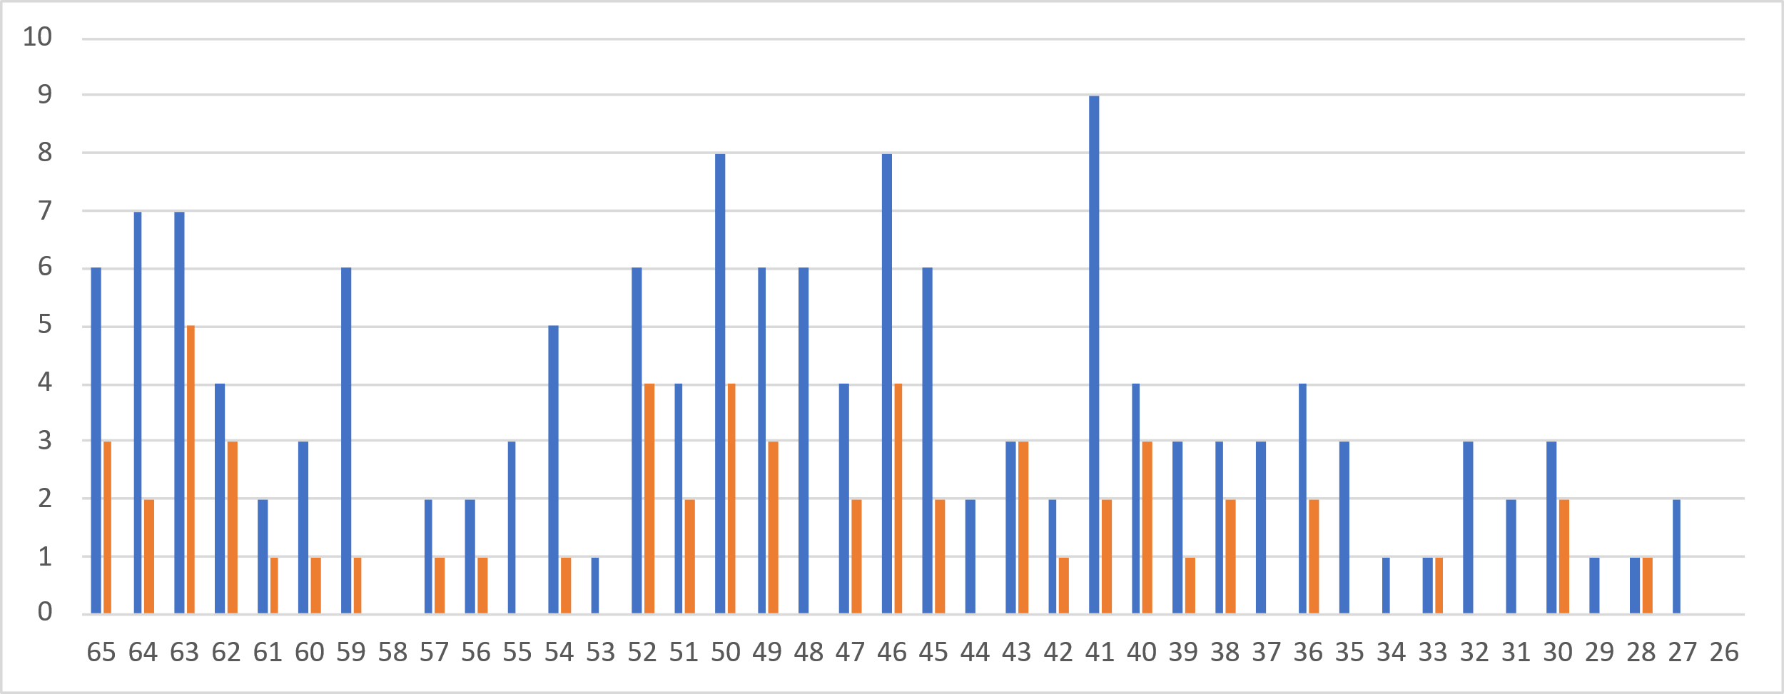
Academic Staff

Slide 10
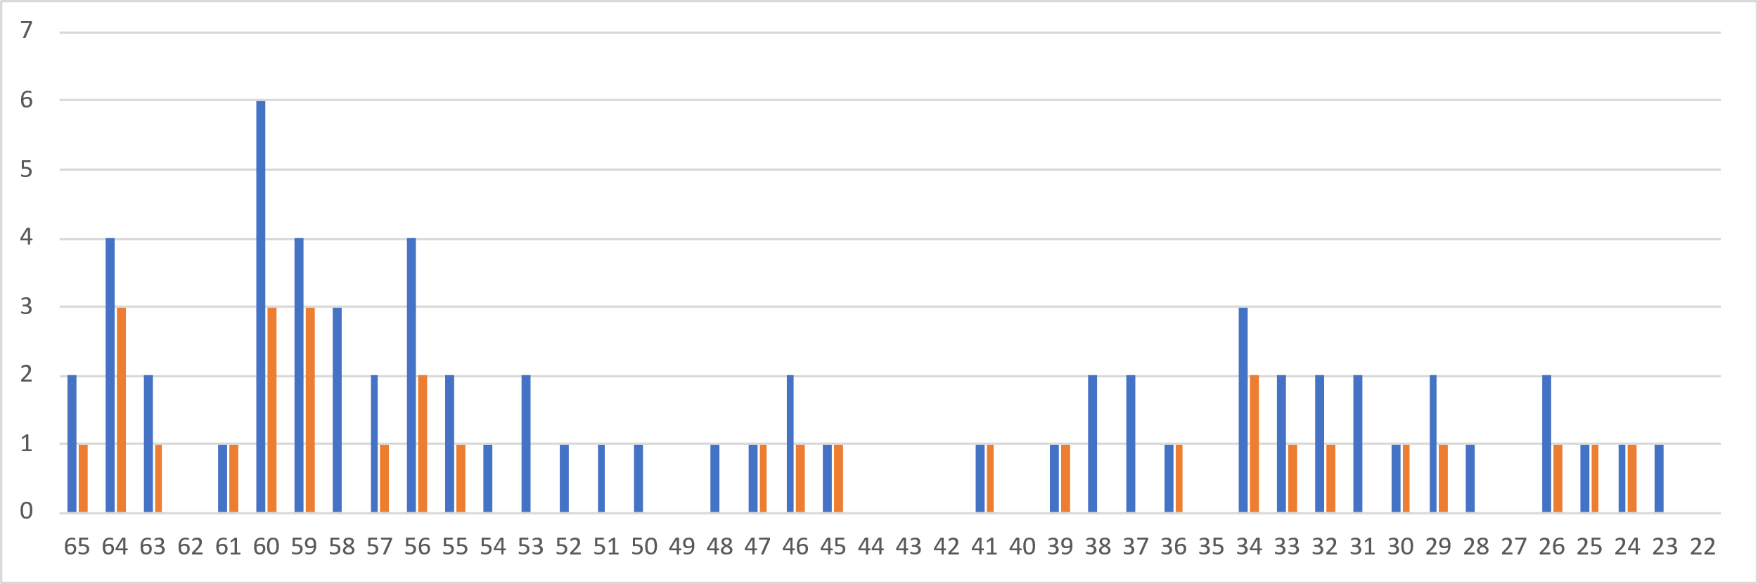
Technical Staff

Slide 11
International Collaboration
MNPP-01 (R&D for high energy colliders)
  SLAC, IHEP, CERN, IJCLab, INFN
US-Japan collaboration
  R&D for SuperKEKB and the next generation high luminosity colliders(SLAC, ANL, BNL, FNAL..)
  Development and Study of Superconducting Magnet Upgrades for SuperKEKB(BNL, FNAL)
  etc..
Many young collaborators have been joined the commissioning of the rings after LS1
  Supported by EAJADE program in EU.
  >15 young scientists have been contributing.

Slide 12


Vacuum works during LS1 at a glance (MR)
: Area open to dry nitrogen or atmosphere
LER
Collimator head replacement (D02V1)
Collimator head replacement (D01V1)
Collimator relocation
(D03V1 -> D05V1)
HER
IR works
IR works
Gate valve & bellows chamber replacement
Temporary countermeasure against vacuum leak from beam pipe welding line
NLC (D05V1) system construction
Collimator head replacement
(D05V1)
Bellows chamber replacement
(vacuum leak)
Installation of new bellows chambers with SR masks
Ion pump feedthrough replacement
(Abnormal discharge, Vacuum leak)
NEG pump feedthrough replacement (Vacuum leak)
Collimator head replacement
(D06V1, D06H3)
Installation of HOM absorber chamber
Collimator head replacement
(D09V1)
Collimator head replacement
(D06H3, D06H4)
Removal and reinstallation of kicker ceramic chambers for magnetic field measurement
Collimator relocation
(D06H1 -> D06H4)
Injection septum & chamber replacement

Slide 13
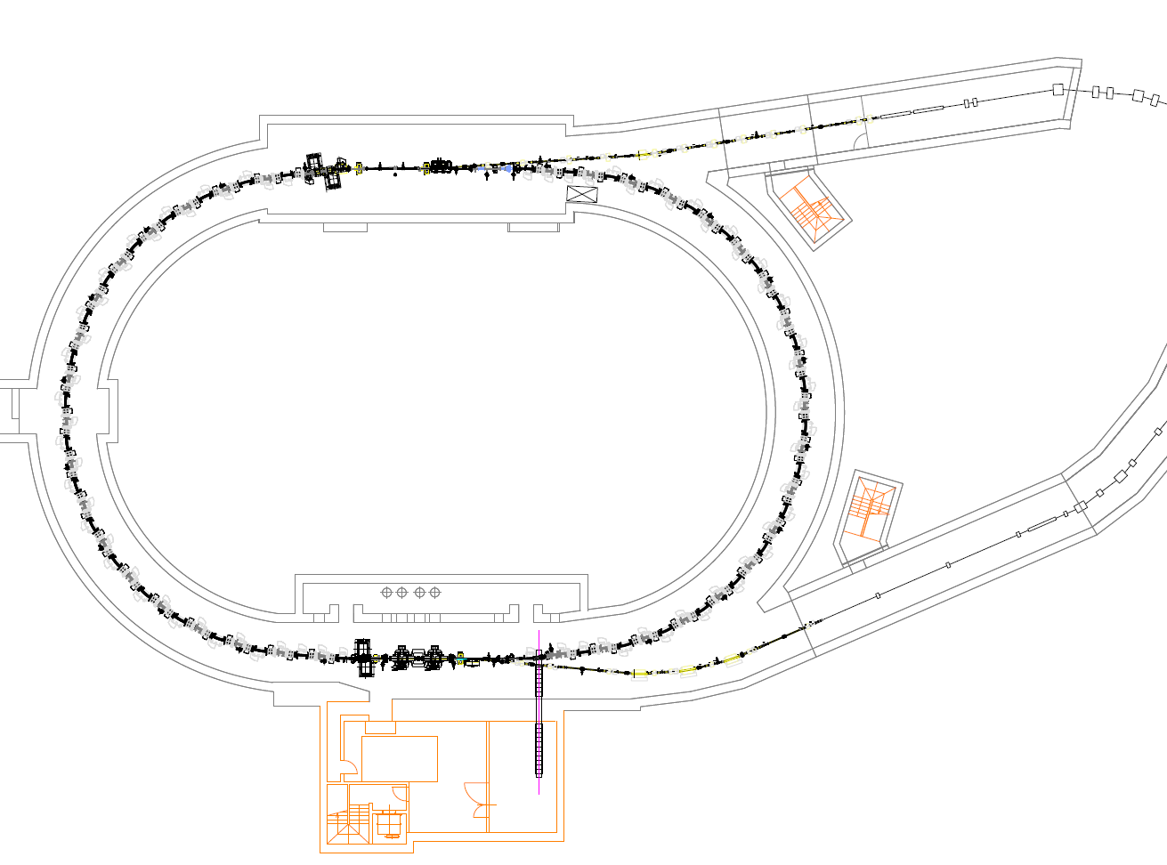
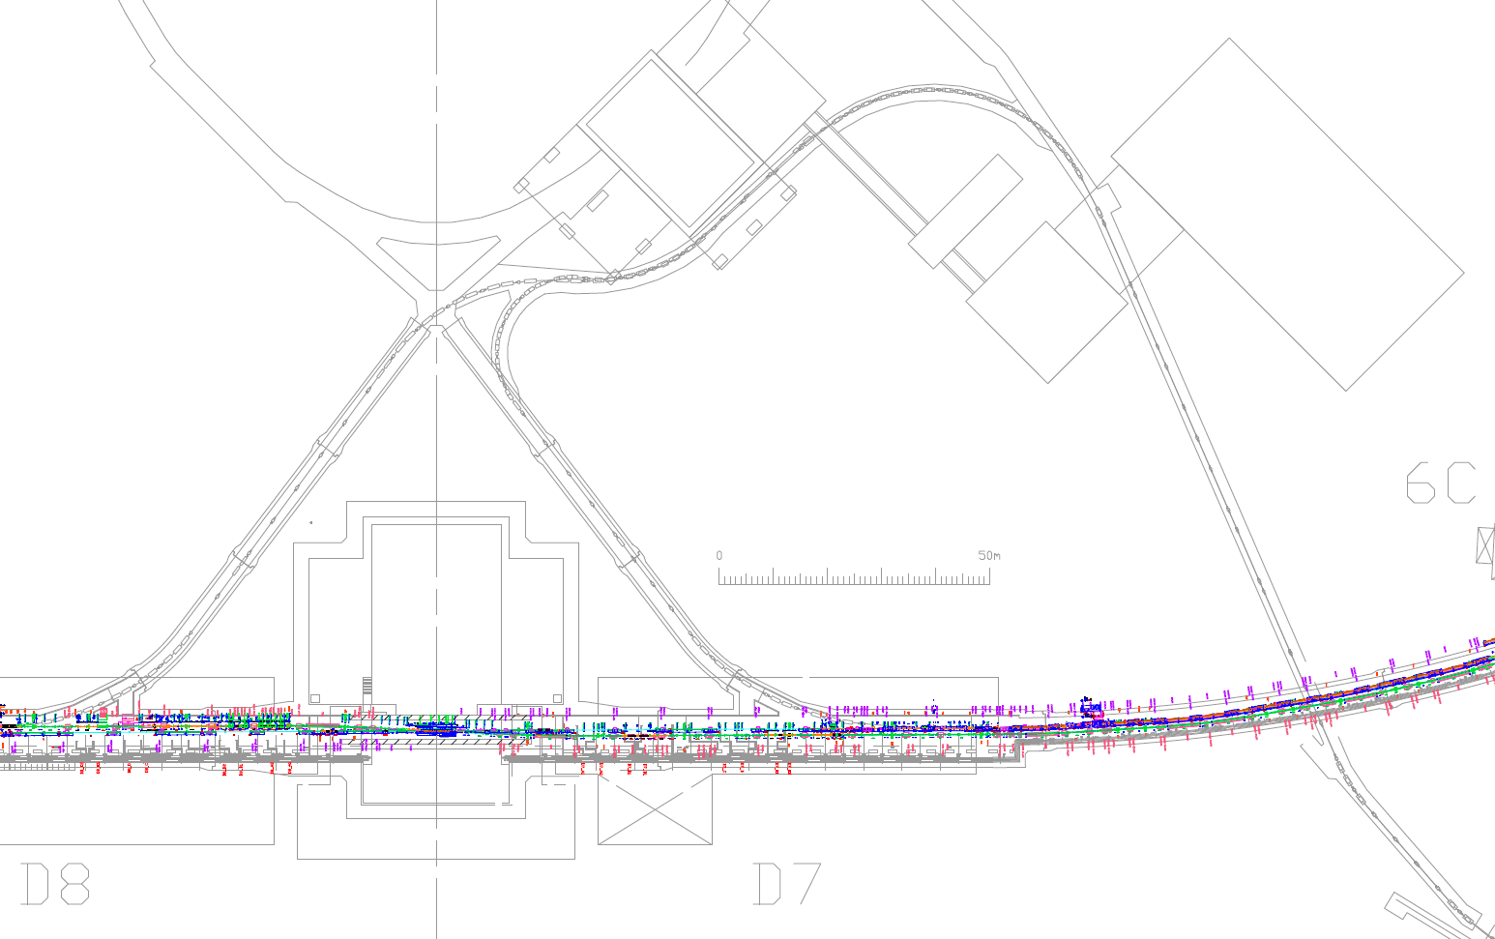
Vacuum works during LS1 at a glance (BT&DR)
: Area open to dry nitrogen or atmosphere
BT
Installation of V-offset bellows chambers (BTp)
Installation of CSR monitor chamber (BTp)
DR
Installation of OTR screen monitor (BTp)
RF cavity work
Removal and reinstallation of bellows chambers for magnet alignment (BTe & BTp)
Removal and reinstallation of Ext. kicker chambers for Kicker PS work

Slide 14
Major upgrade items of LS1
Replacement of damaged collimator heads on both rings.
QCSR cryostat vacuum leak
Aperture enlargement of injection channel and modification of injection final septum of HER.
IR radiation shield modifications.
Non-linear collimator at OHO straight section of LER.
Installment of beam loss monitors/ acoustic sensors/ bunch oscillation monitors to monitor sudden beam loss event.
DR kicker power supply maintenance.
Detailed story will be presented by the individual talks.

Slide 15
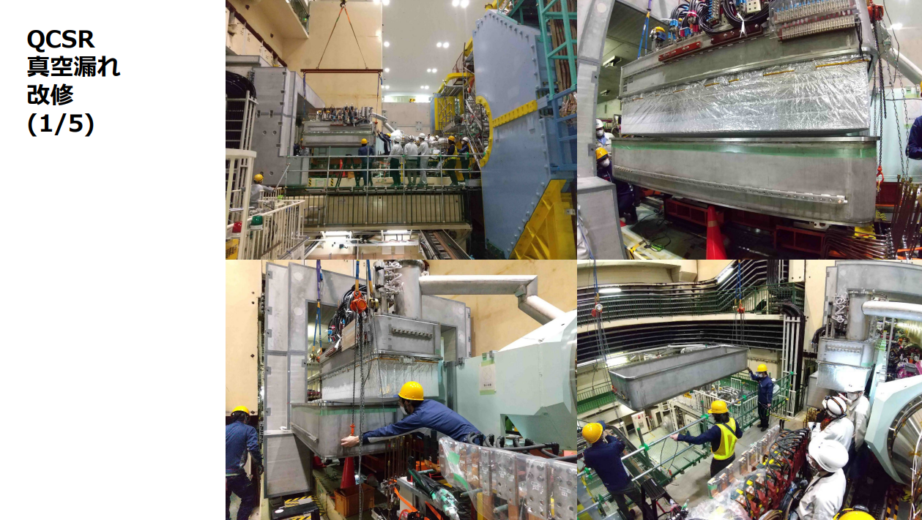
T. Oki

Slide 16
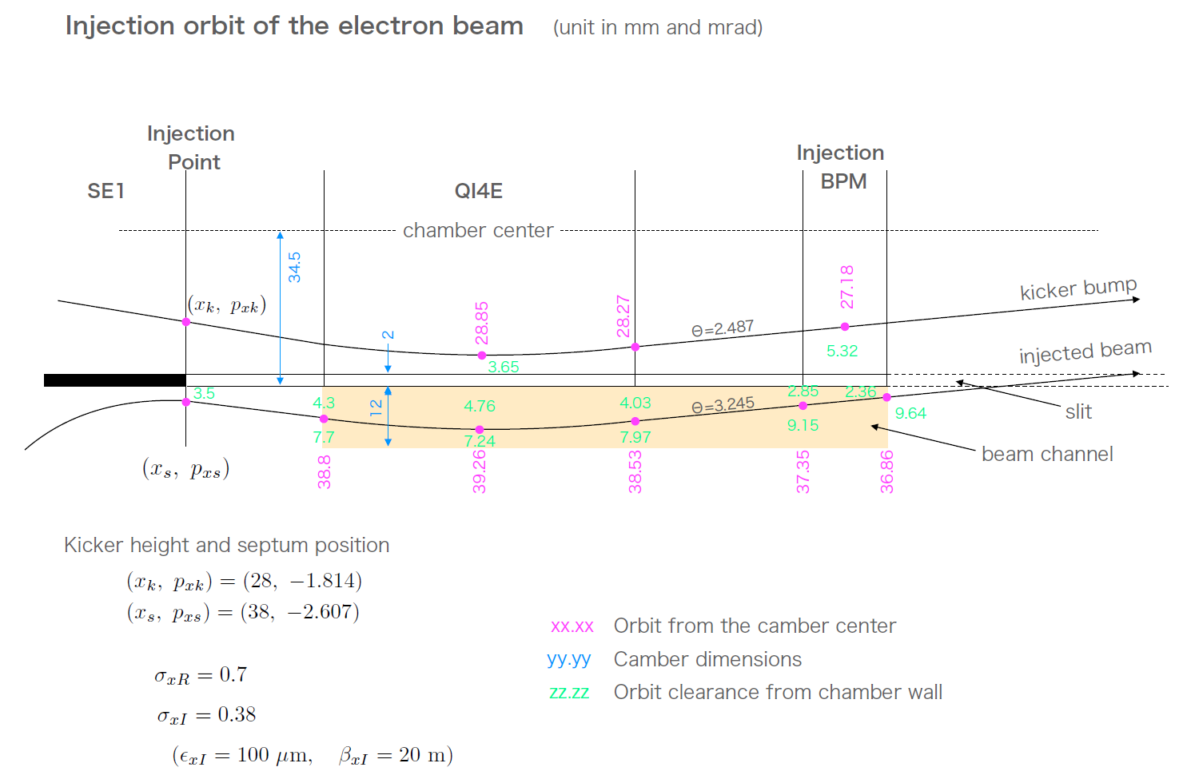
Aperture enlargement of HER injection channel
Problem of HER injection
  Wall can be an obstacle to injection.
    A wall should be placed between beam channels for stored beam and injected beam.
    Injected beam orbit is too close to the wall.
    High levels of radiation detected at the injection BPM chamber indicates that the injected beam hits the wall.
    It is hard to modify the injection beam orbit.
    ⇒ it is necessary to enlarge the horizontal aperture
    of the injection channel.
No enough room
wall
N. Iida (2022.1.21) BITF meeting
  What is planned during LS1
    Replacement of three beam chambers with new ones.
    Update of injection BPM
    ⇒ More precise injection tuning
M. Kikuchi (2021.12.03)
BITF meeting

Slide 17
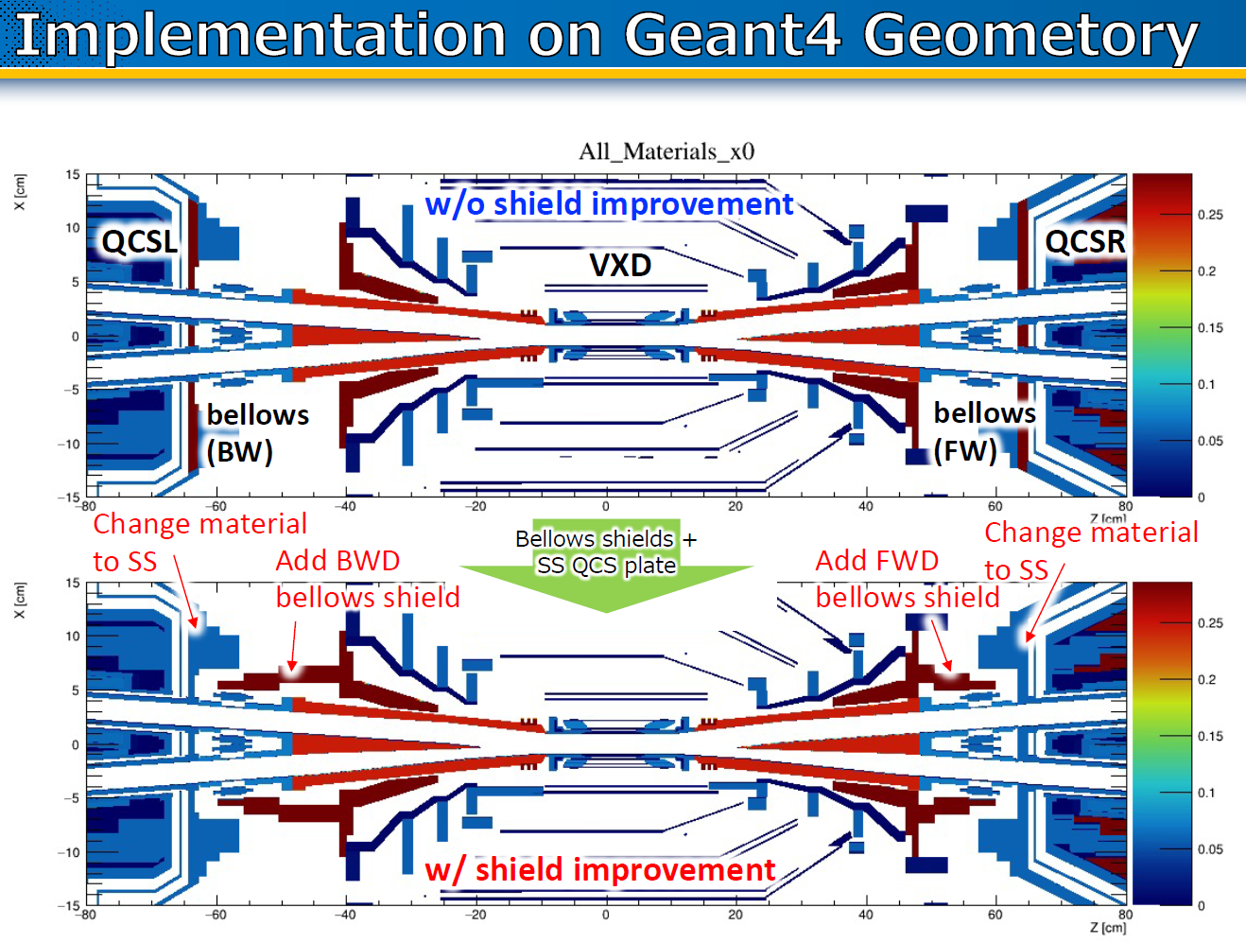
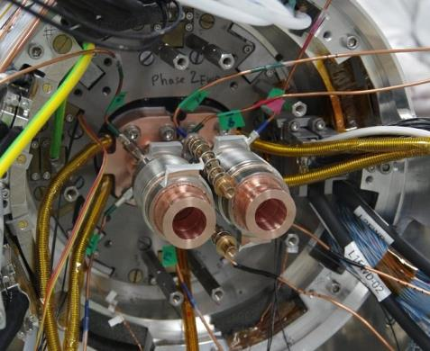
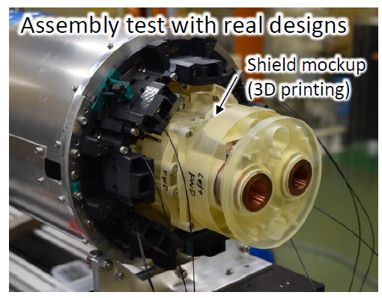
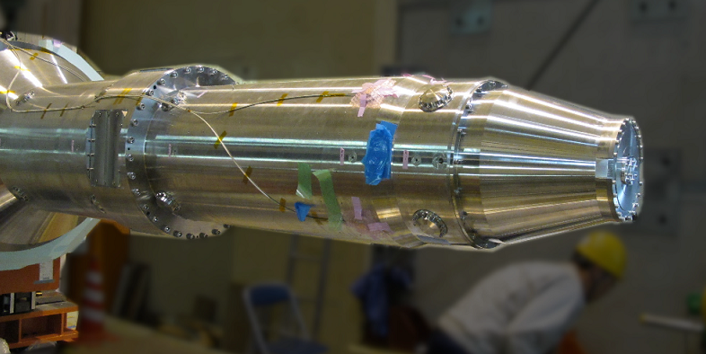
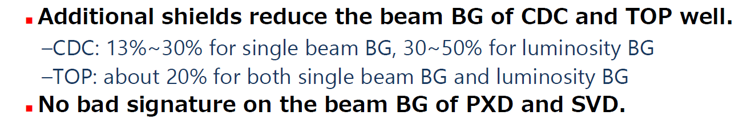
IR radiation shield modification
K. Nakamura
New heavy metal shield on IP bellows
Y. Arimoto
K. Nakamura (2022.02.04) 10th SuperKEKB long-term operation plan meeting
Material change from W to SUS (QCS cryostat front plate)
(Tip of QCS cryostat will be modified to make more space)

Slide 18
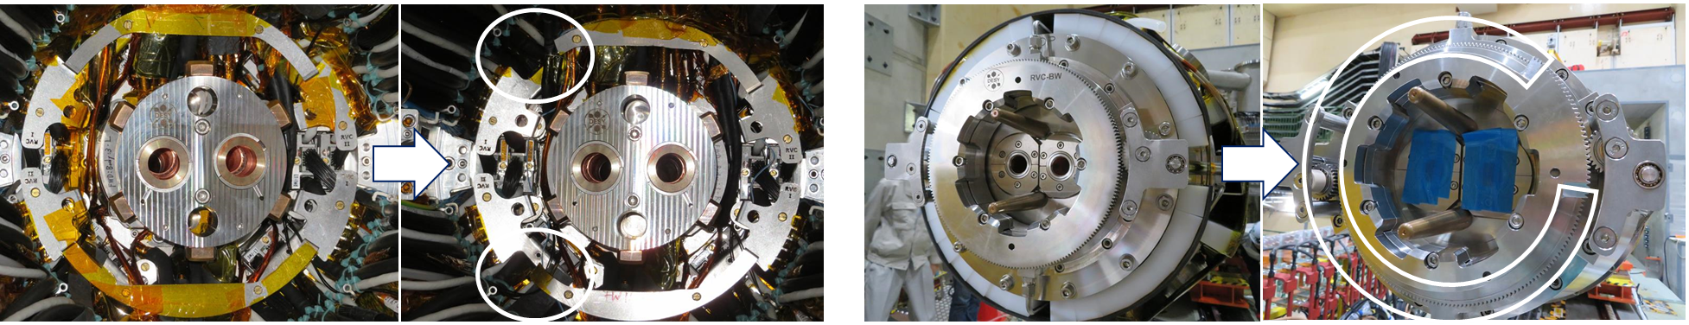
QCS-R re-install
Re-tried on 23/Oct/2023 with
  Modified RVC gear
  Modified VXD cable support
  The QCS supports was carefully advanced by Tanaka-san.
RVC worked very smoothly– no vacuum leak found.

Slide 19
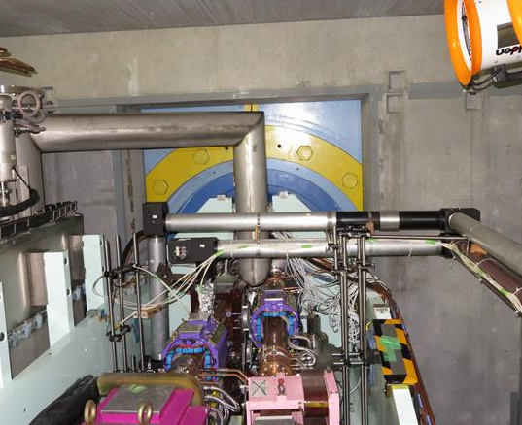
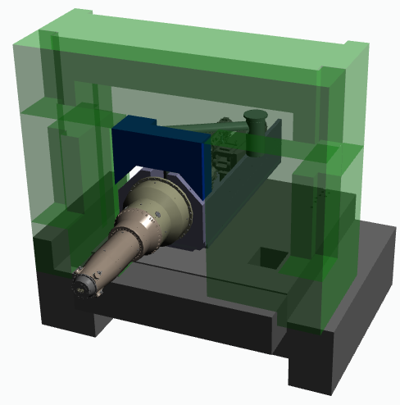
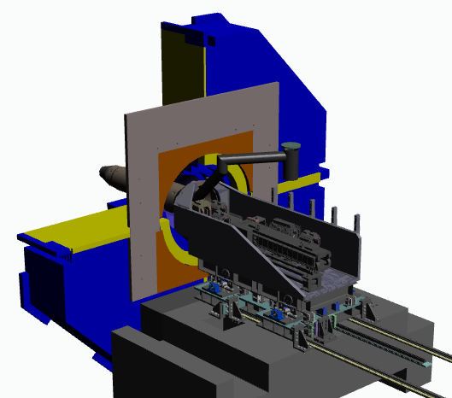
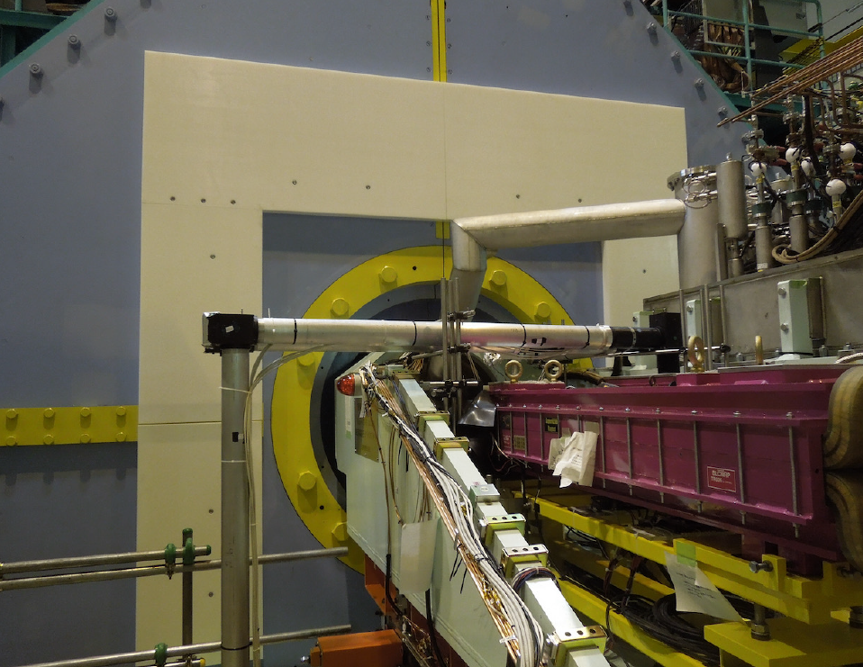
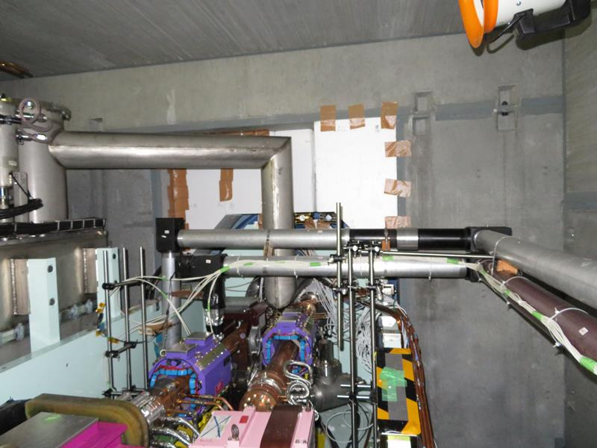
IR radiation shield modification
Additional concrete shield (IR) & polyethylene shield (Belle2)
  For shielding fast neutrons
    New concrete shields and polyethylene (PE) shield will be added to a space that currently has no shield.
    Additional PE shields around QCS are also planed.
Expected effects of shield modification
  Physics run with wider collimator setting
  Physics run with larger total currents and bunch current
Add concrete shields
Add PE shields
shield mockup
PE shield
H. Yamaoka (2021.11.04) IR meeting
H. Yamaoka (2021.11.04) IR meeting

Slide 20
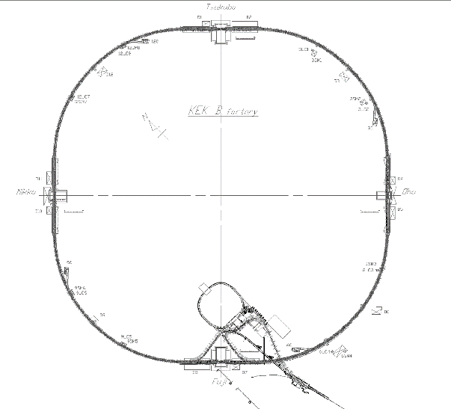
NLC construction
Non-linear collimator (NLC) is being installed in LER Oho straight section.
  Impedance of NLC is much lower than that of conventional collimator due to its large aperture.
  NLC can relax TMCI bunch current limit.
  Oho straight section is the location where the optics satisfies the requirements for NLC.
  A part of wiggler magnets need to be removed.
  New skew sextupole magnets and beam pipes in them need to be fabricated.
  New power supplies, cabling works and new radiation shields are also required.
Tsukuba (Belle II)
Oho lab.
Conventional collimation scheme
D04
Oho
straight section
D05
collimator
Positron beam
Small aperture can make beam unstable.
Non-linear collimation scheme (conceptual diagram)
Quad.
Skew Sext.
collimator
Skew Sext.
Quad.
First Sextupole magnet kicks unwanted beam particles.
Collimator scrapes unwanted beam particles with large aperture.
Second sextupole magnet brings good beam particles back to their original angle.

Slide 21
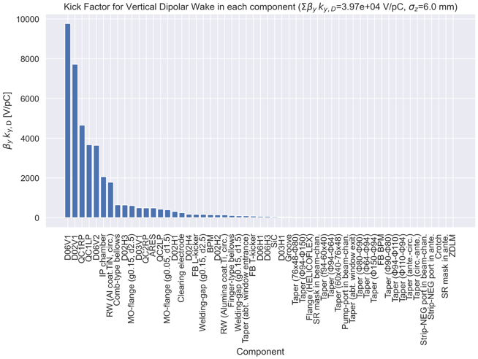
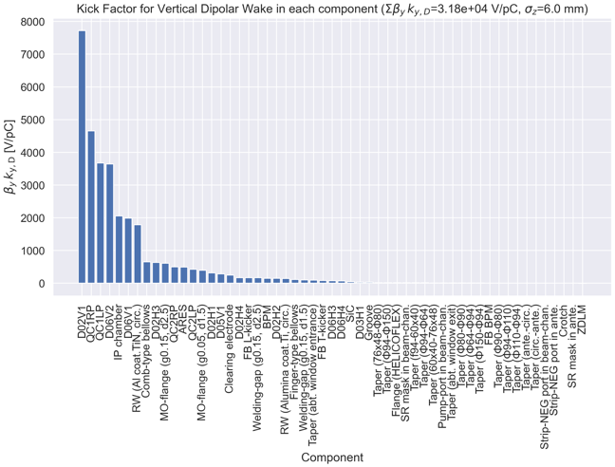
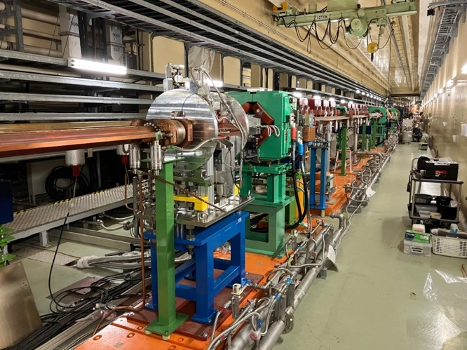
2021c physics run
LS1後
β_{y}*=1 mm
β_{x}*=80 mm
D06V1
D06V1
D05V1
Photo of the non-linear collimator section (2023-05-26)
D05V1
SNAP.1
(not installed yet)
Σβ_{y}k_{y} will reduce from 3.97e4 downto 3.18e4 V/pC
Threshold of TMCI is estimated to increase more than 2.mA/bunch

Slide 22
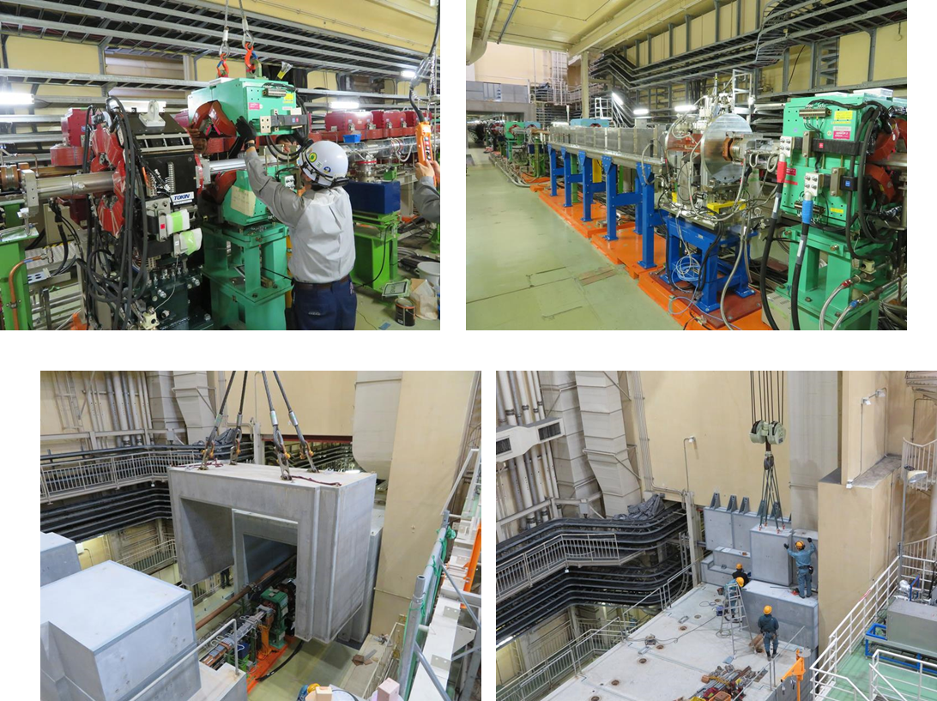
Nonｌinear Collimator

Slide 23
Nonlinear Collimator

Slide 24
Other Collimators
D01
D01H4
D01H5
D02H4
D02H3
D02
e-
IR
e+
D01V1
D02V1
D02H1
D12
D12V4
D01H3
D02H2
D03
D12H4
TSUKUBA
D12V3
D03H1
D12H3
D12H2
D12V2
D12H1
D12V1
SuperKEKB Main Ring
D11
HER
LER
D04
SC
ARES
NIKKO
OHO
WIGGLER
WIGGLER
: Horizontal Collimator, KEKB HER(50x104) type
: Vertical Collimator, KEKB HER(50x104) type
: Horizontal Collimator, SuperKEKB LER(f90x220) type
: Vertical Collimator, SuperKEKB LER(f90x220) type
: Horizontal Collimator, SuperKEKB LER(f90) type
: Horizontal Collimator, SuperKEKB HER(f80x220) type
: Vertical Collimator, SuperKEKB HER(f80x220) type
SC
D05V1
ARES
WIGGLER
D10
D09V4
D05
D09H4
D09V3
D09H3
D09H2
D09H1
D09V2
D09V1
FUJI
D06V2
D09
D06V1
D06
e-
e+
D06H4
D06H3
ARES
D08
ARES
D07

Slide 25
Status of LER collimator
Name | Type | Tip Material (): longitudinal length in mm | Tip Condition | Remarks
D06H3 | SuperKEKB | Cu coated C (160) | healthy | spoiler against inj. kickers’ accidental firings
D06H4 | SuperKEKB | Ta (10) | healthy | absorber against inj. kickers’ accidental firings
D03H1 | SuperKEKB | W (10) | healthy
D02H1 | SuperKEKB | W (10) | healthy
D02H2 | SuperKEKB | W (10) | healthy
D02H3 | SuperKEKB | W (10) | healthy
D02H4 | SuperKEKB | W (10) | healthy
D06V1 | SuperKEKB | Cu coated Ti (10) | healthy
D06V2 | SuperKEKB | hybrid (3) | healthy
D05V1 | SuperKEKB | Cu coated Ta (4) | healthy
D02V1 | SuperKEKB | Cu coated Ta (10) | healthy

Slide 26
Status of HER collimator
Name | Type | Tip Material (): longitudinal length in mm | Tip Condition | Drive Mechanism | Remarks
D09H1 | KEKB | Cu coated Ti (40) | damaged
D09H2 | KEKB | Cu coated Ti (40) | damaged
D09H3 | KEKB | Cu coated Ti (40) | damaged
D09H4 | KEKB | Cu coated Ti (40) | damaged
D12H1 | KEKB | Ti (40) | healthy
D12H2 | KEKB | Cu coated Ti (40) | damaged
D12H3 | KEKB | Ti (40) | healthy
D12H4 | KEKB | Cu coated Ti (40) | healthy
D01H3 | SuperKEKB | W (10) | healthy | -
D01H4 | SuperKEKB | W (10) | healthy | -
D01H5 | SuperKEKB | W (10) | healthy | -
D09V1 | KEKB | Cu coated Ti (40) | healthy | upgraded
D09V2 | KEKB | Cu coated Ti (40) | healthy
D09V3 | KEKB | Cu coated Ti (40) | healthy
D09V4 | KEKB | Cu coated Ti (40) | healthy
D12V1 | KEKB | Cu coated Ti (40) | damaged | upgraded
D12V2 | KEKB | Cu coated Ti (40) | damaged
D12V3 | KEKB | Cu coated Ti (40) | healthy | upgraded
D12V4 | KEKB | Cu coated Ti (40) | healthy | upgraded
D01V1 | SuperKEKB | Cu coated Ta (10) | healthy | -

Slide 27
Spare jaws
Tip Material (): longitudinal length in mm | Collimator to be installed (assumed) | Remarks
HER vertical: Cu coated Ta (10) | D01V1 | Plan to deliver in this fiscal year.
HER vertical: Cu coated Ta (10) | D01V1 | Plan to deliver in this fiscal year.
HER vertical: Cu coated Ti (40) | D09V1-V4, D12V1-V4
HER vertical: Cu coated Ti (40) | D09V1-V4, D12V1-V4
LER vertical: Cu coated Ta (10） | D02V1
LER vertical: Cu coated Ta (10） | D02V1
LER vertical: hybrid (3） | D05V1, D06V1-V2
LER vertical: hybrid (3） | D05V1, D06V1-V2
LER vertical: Cu coated Ta (10) | D02V1, D05V1, D06V1-V2 | Plan to deliver in this fiscal year.
LER vertical: Cu coated Ta (10) | D02V1, D05V1, D06V1-V2 | Plan to deliver in this fiscal year.
LER horizontal: Ta (10） | D06H4

Slide 28
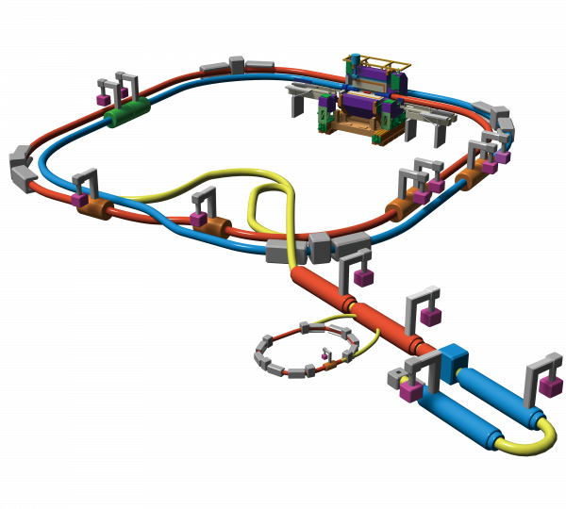
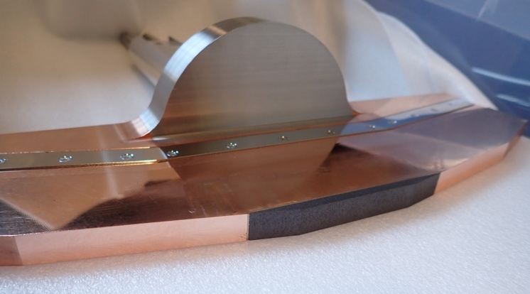
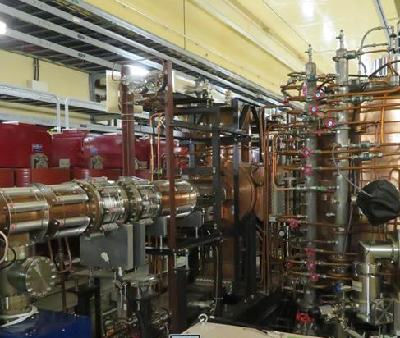
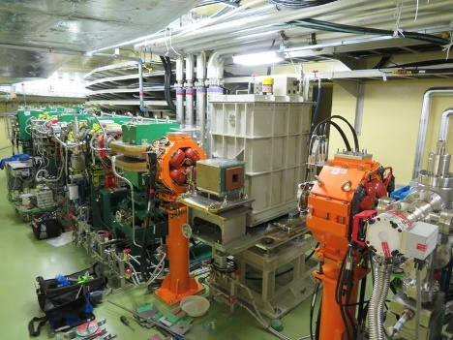
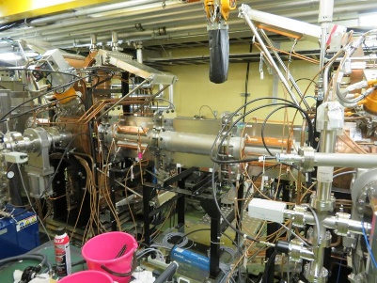
Other major works (excluding Linac)
T. Ishibashi
Robust collimator head (LER)
  As countermeasure against kicker-pulser misfiring and resulting destruction of collimator
    Replacement with carbon head of horizontal collimator D06H3 and relocation from D06H1 to D06H4
    Carbon head production : ∼ March 2023
    Head replacement : Spring ∼ Summer 2023
    Collimator relocation : Spring ∼ Summer 2023
New beam pipes with wider aperture at HER injection point
  For injection efficiency improvement
    New beam pipes with wider aperture & New BPM for precise measurement of injected beam
    Beam pipe production : ∼ March 2023
    Beam pipe replacement : Spring ∼ Summer 2023
    Septum baking : ∼ Summer 2023?
RF cavity modification and replacement (LER)
  For stable operation with larger beam current
    Modification : Input coupler replacement, cooling power enhancement, coaxial line modification, etc. (done)
    Cavity replacement (D05A) : January ∼ February 2023
Vacuum seal replacement at RF section (DR)
  For pressure reduction
    Replacement from elastomer gasket to metal gasket for dummy pipes (done)
DR Extraction kicker power supply modification and repair (DR)
  For stable operation
    Modification : December 2022 ∼ August 2023
And so on…
MR
Carbon collimator head
Y. Suetsugu
Beam pipe at
HER injection point
DR
DR Ext. kicker
DR RF section

Slide 29
Injector Linac
Replaced 16 old accelerating structures with new ones (with larger energy gain).
  Starting fabrication of 12 additional accelerating structures
New fast kickers (kick first and second bunch independently), larger aperture pulsed-Qs have been installed.
  Sucessful beam tuning using machine-learning method (Bayesian optimization)
Study of BT beam blowup
  Rejected the CSR-induced beam blowup in positron line
  Still hunting the cause of blowups.
Next step
  Beam diagnostic line at SY3
  BTe-ECS(2024-2025)
  Beam optimization
  etc..

Slide 31
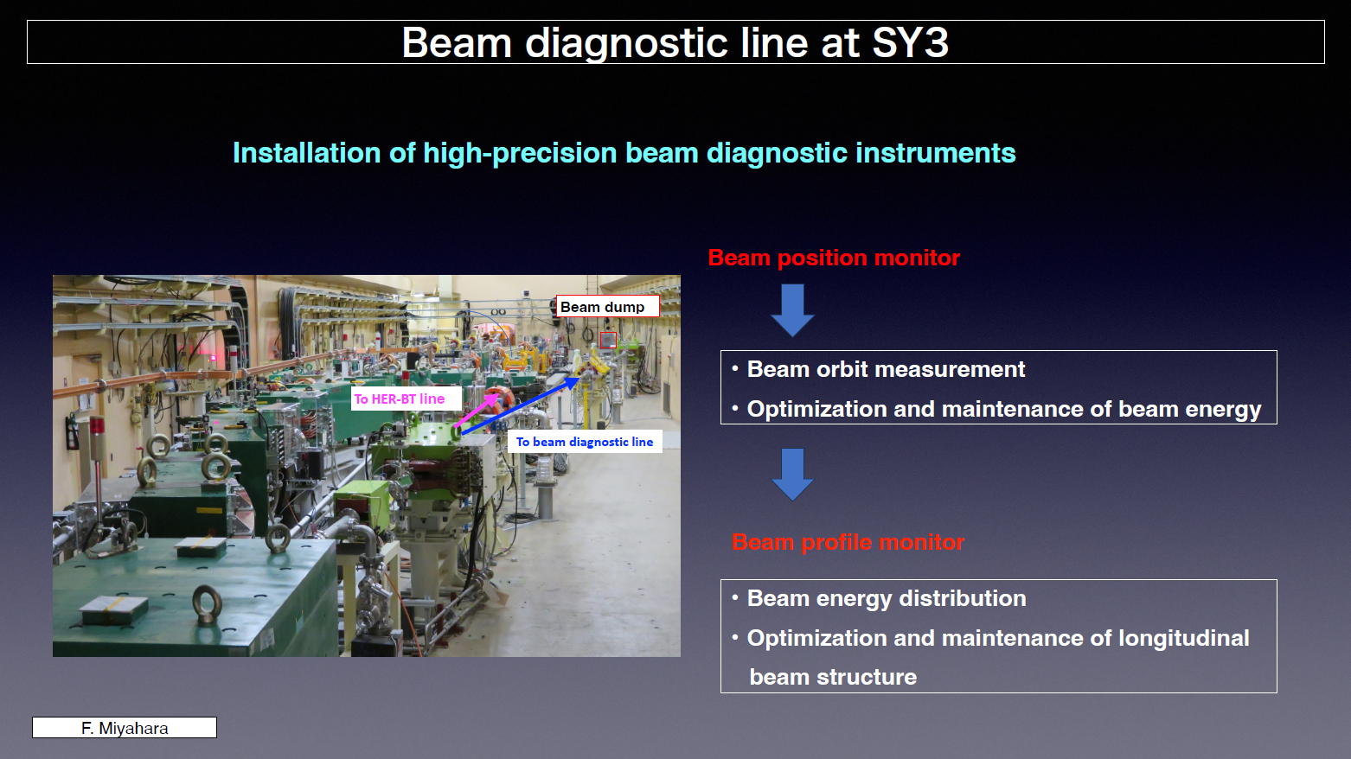

Slide 34
Summary
Thank you so much for your participation in this 27th KEKB Accelerator Review.
We plan to operate SuperKEKB rings at least 4.5 month.
  2024a 29/Jan to 31/Mar, 2024b 1/Apr to 1/Jul. 2024c 9/Oct to end of Nov.??
  Hoping to receive supplemental operation budget to enable longer operation, especially on Mar/2025.
Accelerator works of Long shutdown 1 was completed almost on schedule and resumed the beam operation.
Please refer to the following presentations for the achievements of this LS1.

Slide 35
Backup slides

