Slide 1
Injector Status (1)
Masanori Satoh (Acc. Lab. Div. V, KEK)
on behalf of Injector Linac Group and Linac Commissioning Group

Slide 2
Contents
Injector outline and operational statistics
e- beam status and issue
e+ beam status and issue
Recent progress
Summary
Injector status (2) : M. Yoshida
  Detailed RF gun status and future plan
Injector upgrade plan: F. Miyahara
Beam transport Line: Driss Oumbarek Espinos
Injection tuning: T. Yoshimoto

Slide 3
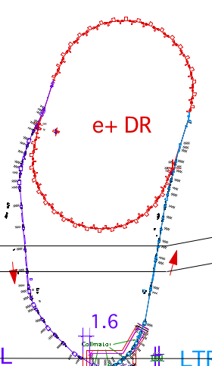
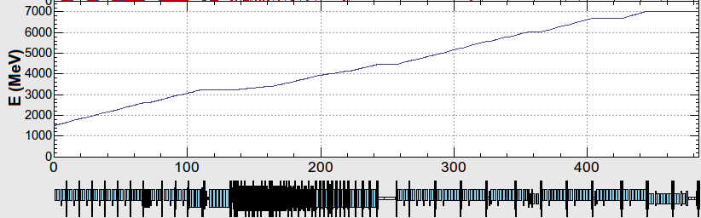
Injector Linac Layout
Outline
・Two electron sources:
RF gun: HER injection
Thermionic DC gun: LER, PF, PF-AR
・Sector 3-5:
All magnets are pulsed magnets.
Continuous orbit feedback
・DC magnet settings are same for different beam mode
・Simultaneous top up injection for SuperKEKB and light sources since 2018
Four rings share 50 Hz beam from injector
60 klystron units
240 accelerating structures (S-band 2-m-long)
Energy Knob
Thermionic gun
1.1 GeV e+
Damping Ring
Photocathode
RF gun
J-ARC
B
A
1.5 GeV
BCS
C
ECS
PF
1 2 3 4 5
PF-AR
ECS
chicane
LER
e+
target
e+ capture section
Energy Knob
HER
Acceleration
HER 7GeV
4.2 GeV
PF-AR 6.5 or 5 GeV
e-
Stand-by
LER 4 GeV e+
1.1 GeV
Deceleration
PF 2.5 GeV
e+ target
e+
Acceleration
1.5 GeV
C
1
2
3
4
5
Beam energy variation for each beam mode along the beam line after J-ARC
3

Slide 4
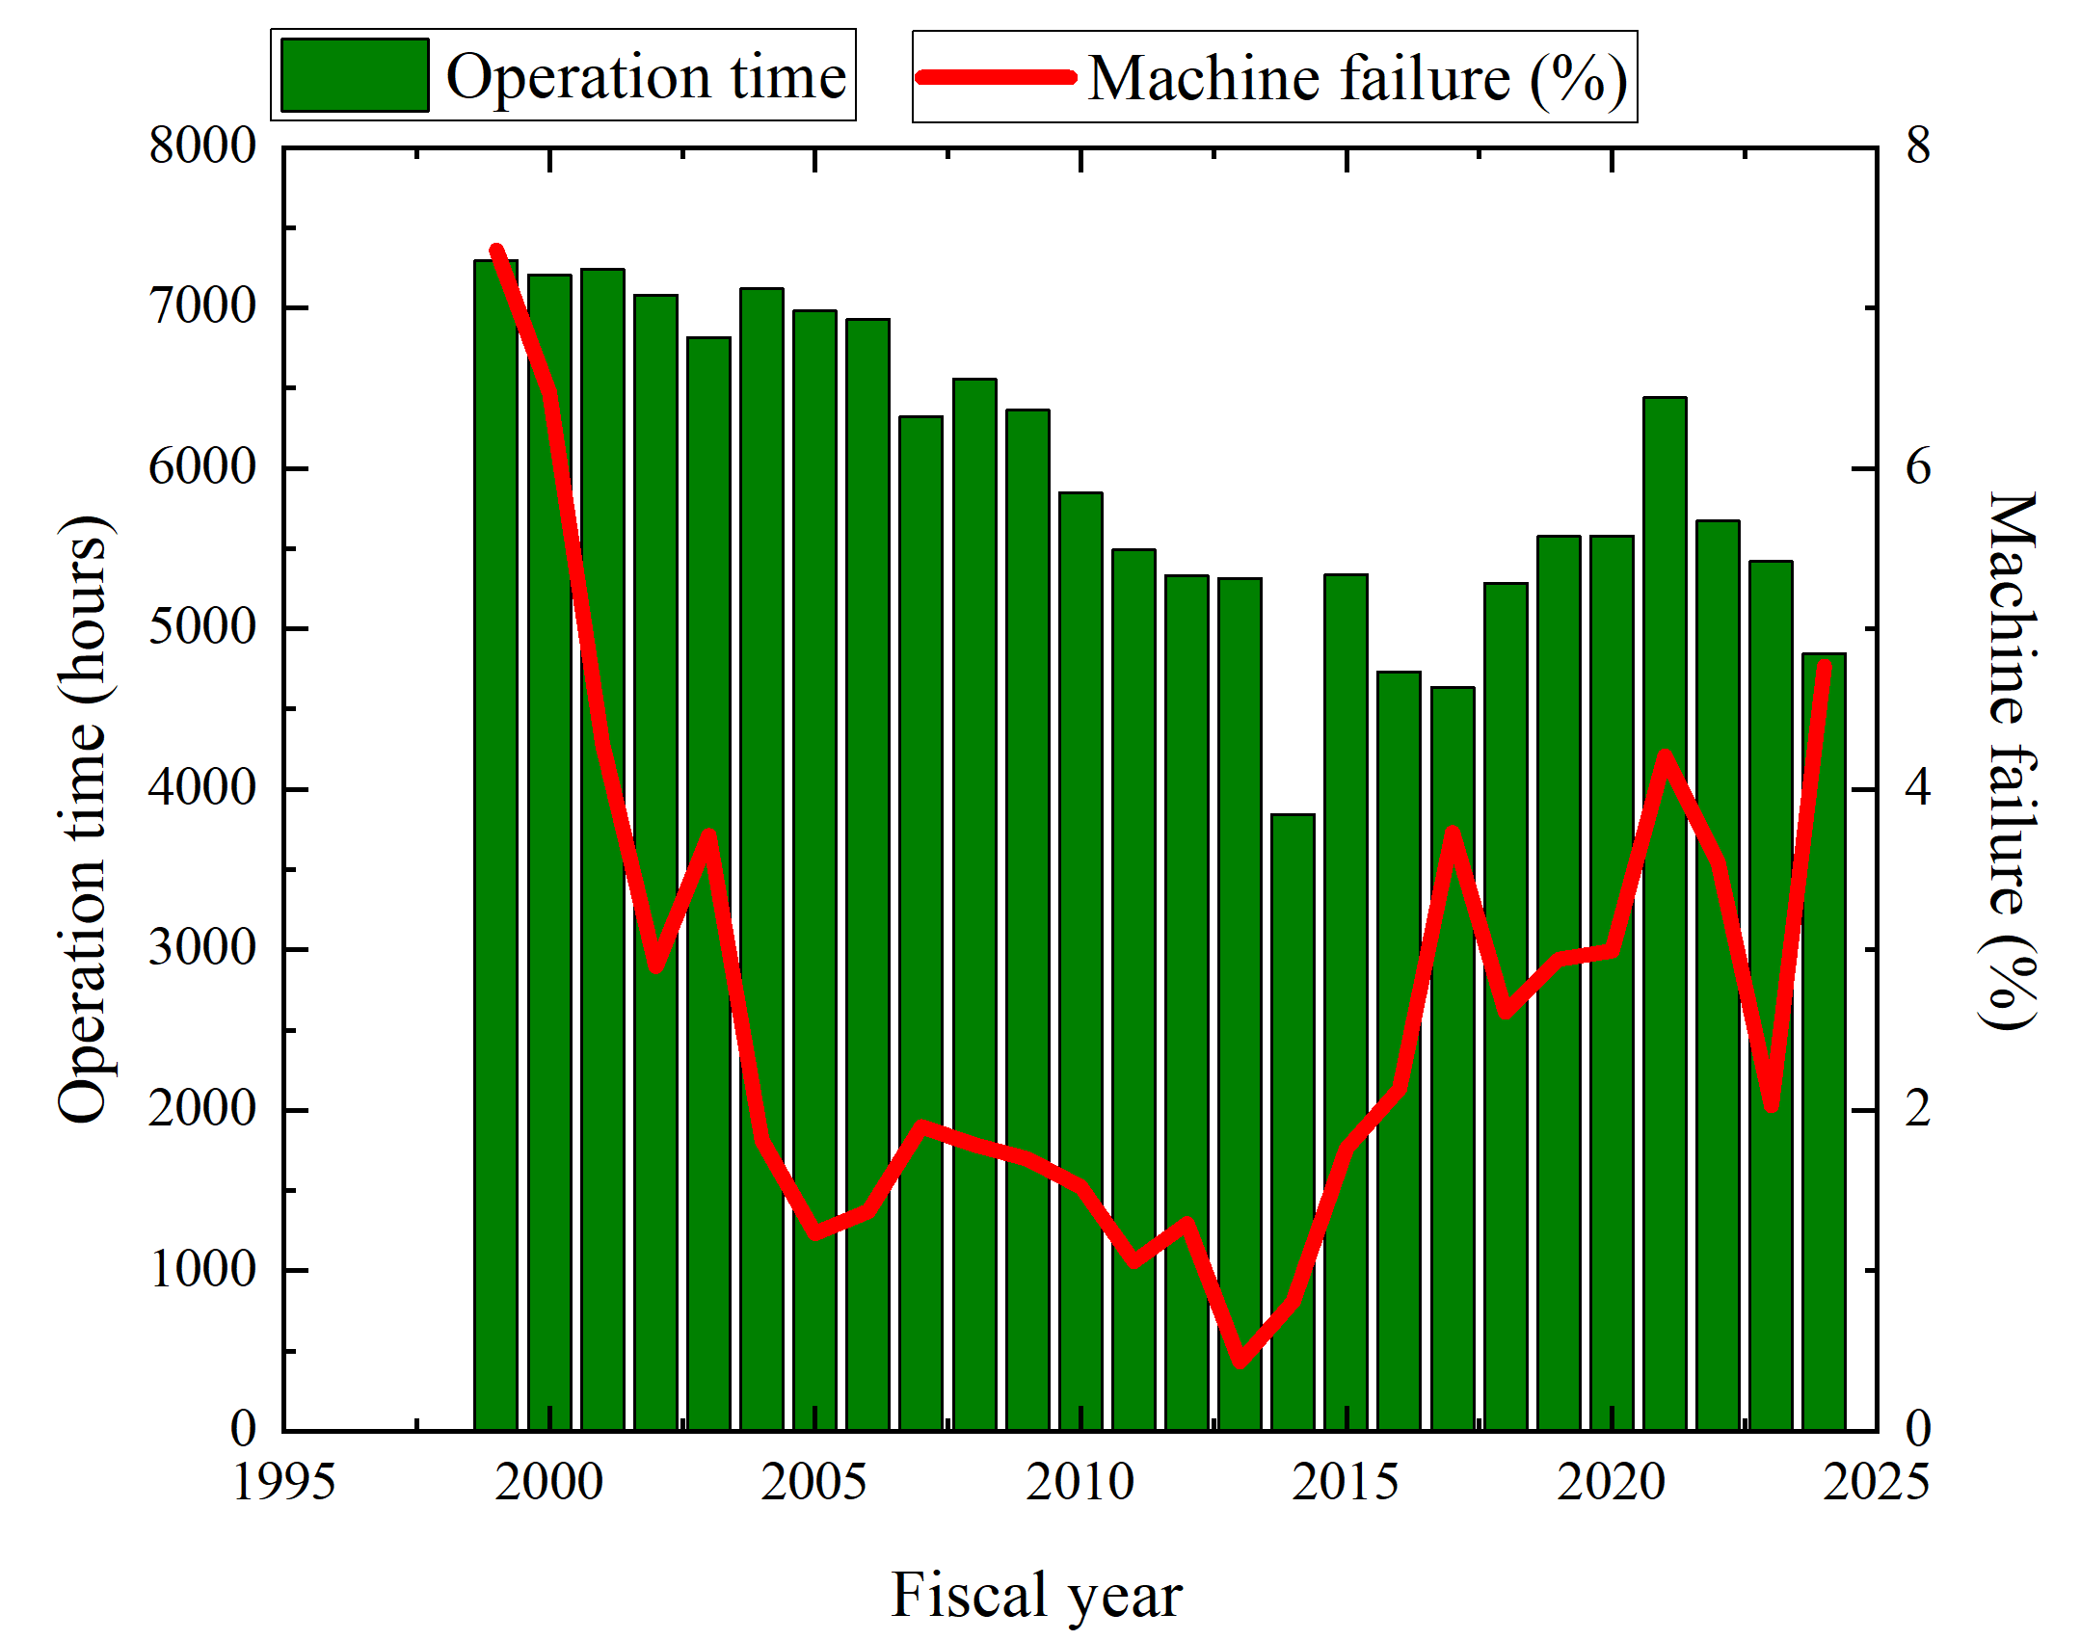
Injector operation statistics
Operation statistics
KEKB
SuperKEKB
New devices
for sKEKB
Operation time has been gradually decrease due to High electricity cost.
Machine failure rate increased from 2% (FY2023) to 4.7% (FY2024)

Slide 5
Injector beam loss time statistics
(FY2020 – FY2022)
Operation statistics
FY2020: 1.58%
FY2021: 1.83%
FY2022: 0.81%
Beam operation could be interrupted by some different reasons. (RF, magnet powers supply, control software failure, …)
Beam loss time ratio is less than 2%.
Most beam loss time are caused by RF and e- gun related troubles.
In FY2022, beam loss time is less than 1%.
  From 2022c to 2023c, SuperKEKB was not in operation due to LS1.
  Linac klystron operation mode was changed from 50 Hz to 25 Hz.
In FY2022, most of beam loss time are caused by magnet trouble.
  Pulsed magnet controller problem.

Slide 6
Injector beam loss time statistics
(FY2023 – Run2024bc)
Operation statistics
FY2023: 0.67%
2024bc: 0.78%
In 2024c, all pulsed magnet control PC and software (18 units) have been replaced by new one.
  It reduced the beam loss time due to the pulsed magnet trouble.
In 2024c, most of gun trouble are caused by cavity discharge.

Slide 7
e- beam status and issue

Slide 8
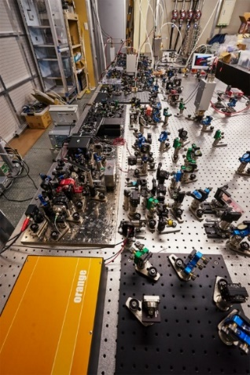
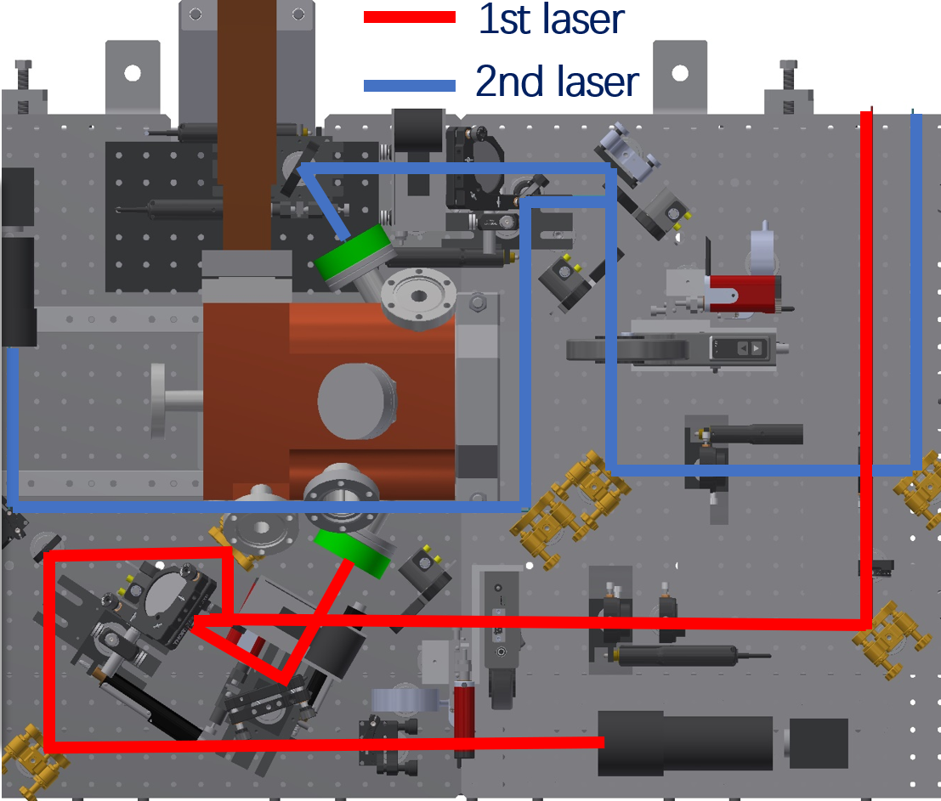
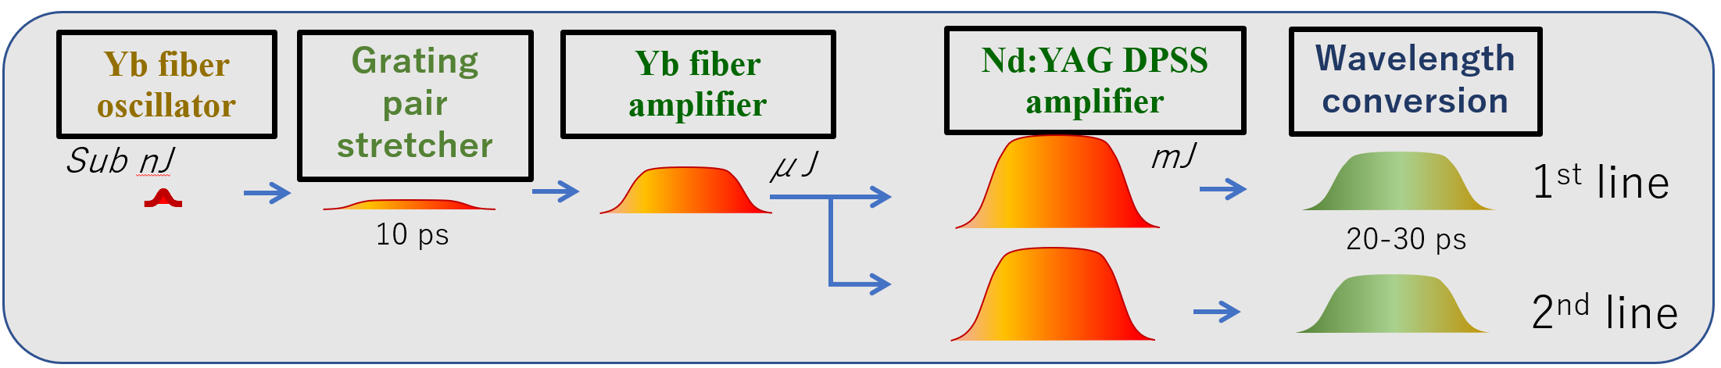
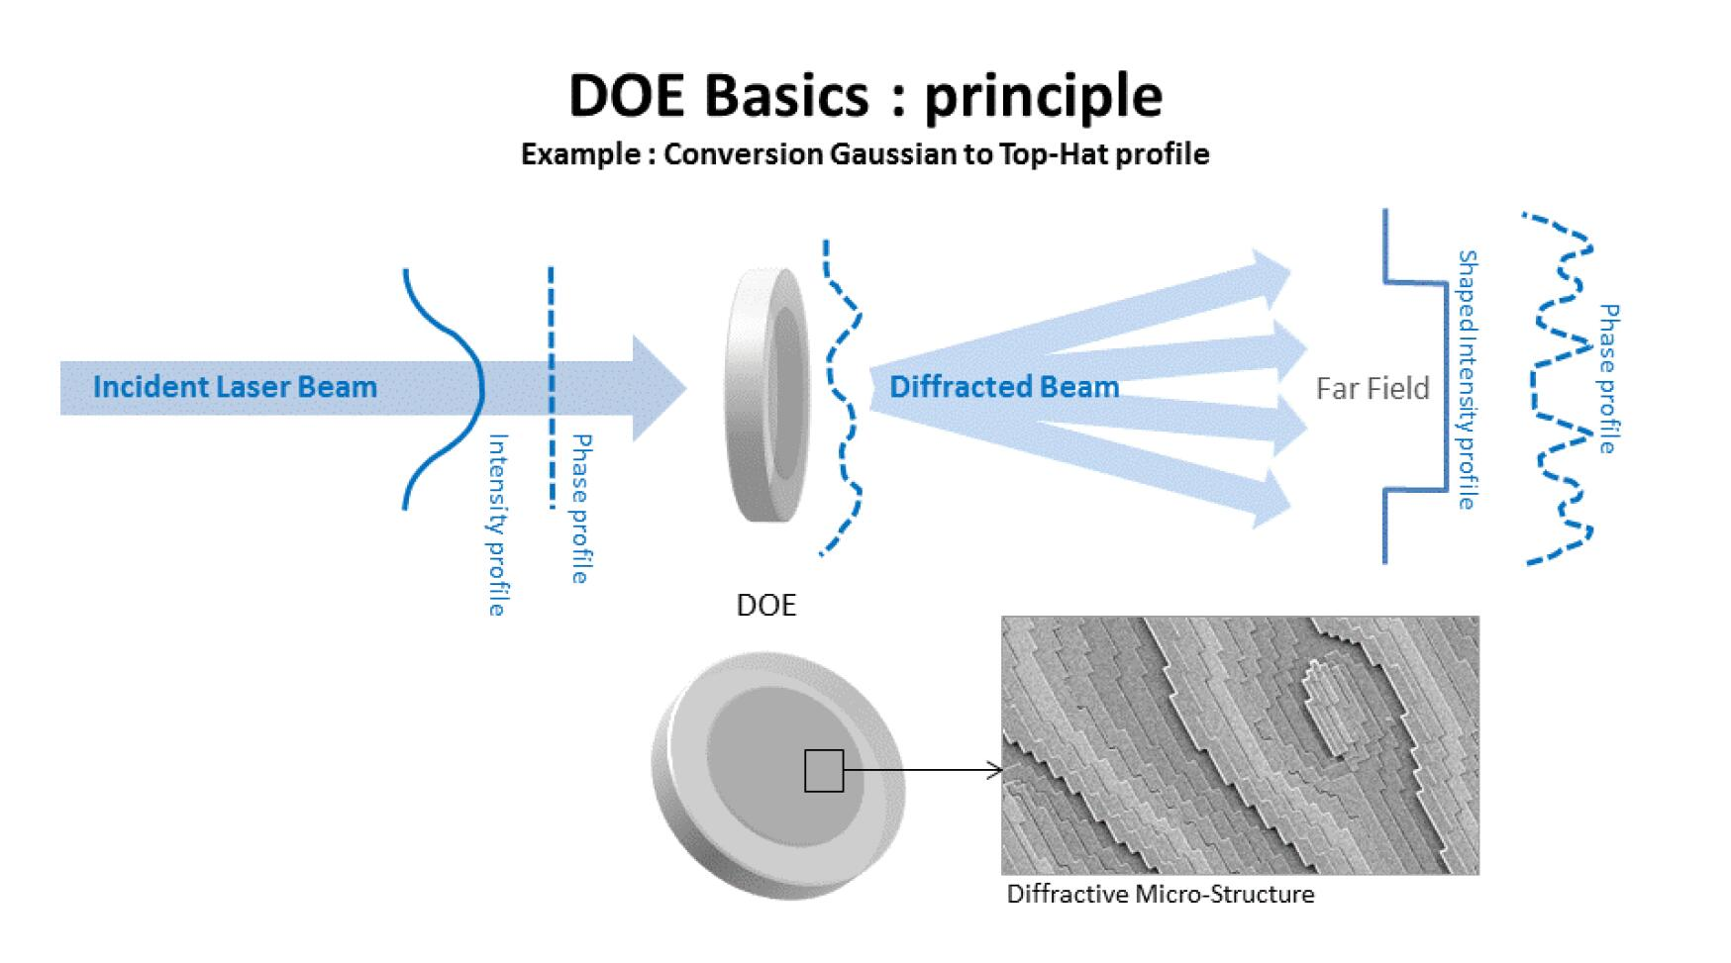
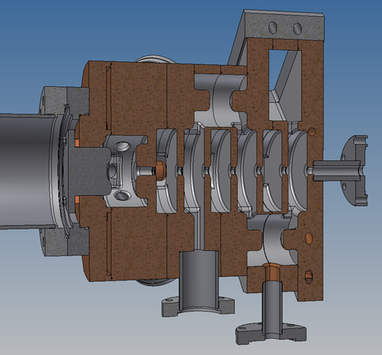
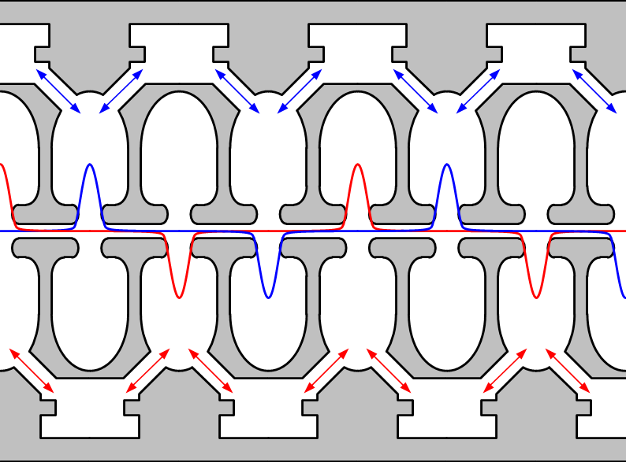
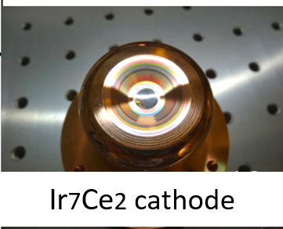
Low emittance photocathode rf e- gun
e- beam status
QTW RF gun or operation (0 deg. Line)
Yb doped fiber and Nd:YAG DPSS module Amplifier
Laser system
Photocathode
(metal
Photocathode: Ir7Ce2
Cavity: QTWSC (Quasi Travelling Wave Side Coupler)
  Strong focusing electric field
CDS RF gun
for backup (90 deg. Line)
short drift space
M. Yoshida, R. Zhang, X. Zhou et al.

Slide 9
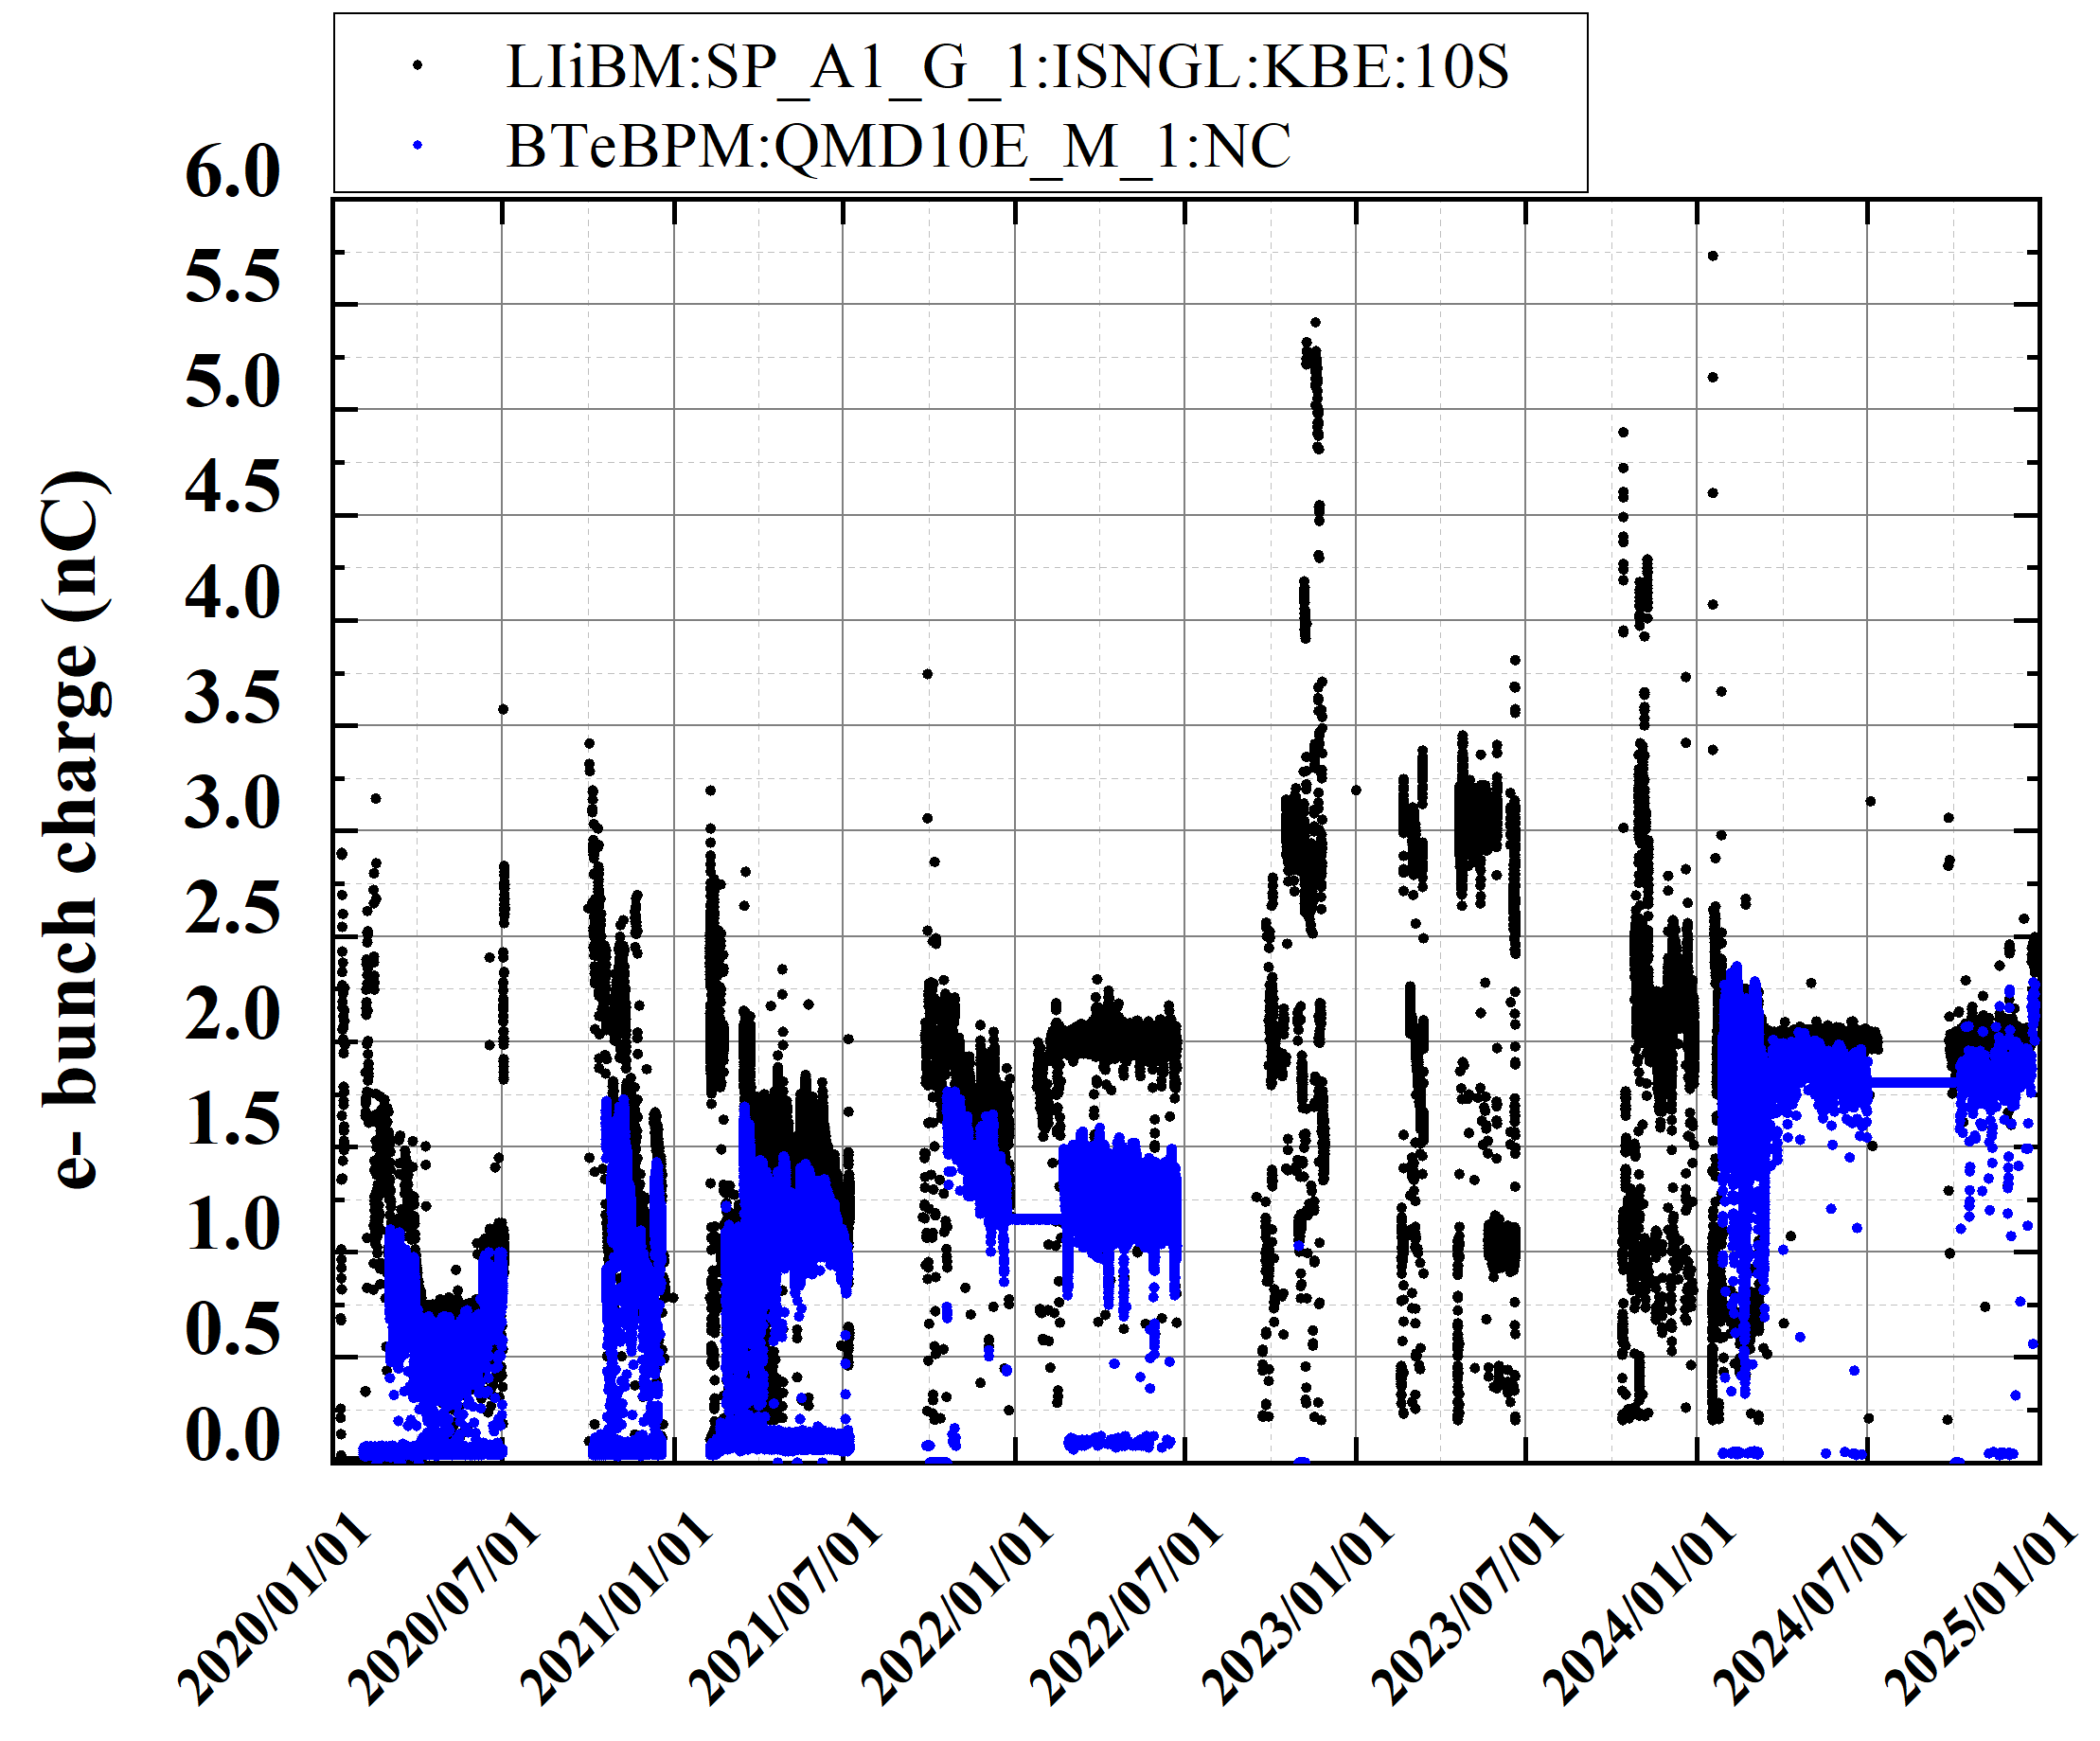
e- bunch charge history (2020a to 2024c)
e- beam status
(from rf gun)
(BT end)
2020a,b
2020c
2021a,b
2021c
2022a,b
2022c
2023a,b
2023c
2024a,b
2024c
High bunch charge study
LS1

Slide 10
e- beam summary
e- beam status
Status
  Photocathode rf e- gun laser system has worked fine without any significant trouble.
  Bunch charge of 2 nC has been stably delivered to BT end w/ bunch charge feedback.
  Laser position feedback has also worked fine.
Issue
  Current rf gun cavity has been in operation since Oct. of 2013. Breakdown rate of rf gun cavity has gradually increased.
  In the previous run 2024c, rf gun down rate increased after the end of Nov. Rf conditioning of cavity was required 2 ～ 3 days to get back to operation.
  Rf gun cavity should be replaced by new one for stable e- beam operation.
  Reproducibility of the beam quality is also issue. Expanding the ML based auto beam tuning and a big data analysis could help this.

Slide 11
RF gun down due to cavity discharge in 2024c
e- beam status

Slide 12
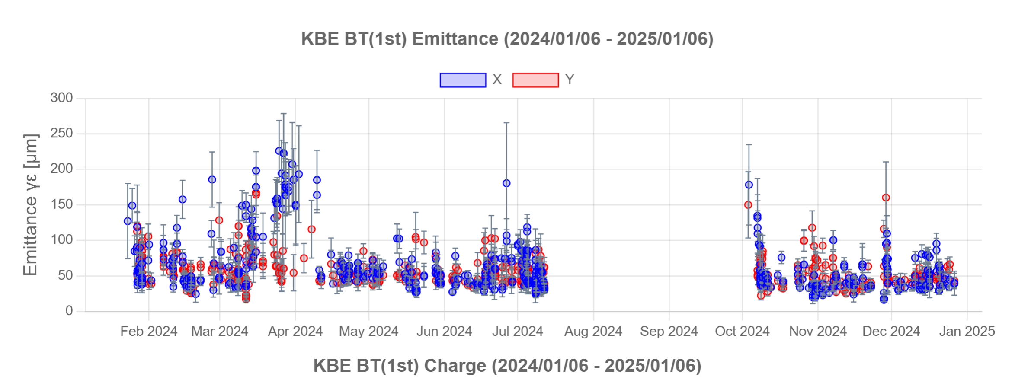
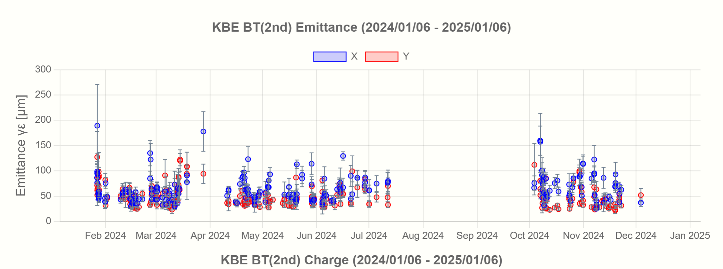
e- beam emittance history at BT1 in 2024abc
e- beam status

Slide 13
e+ beam status and issue

Slide 14
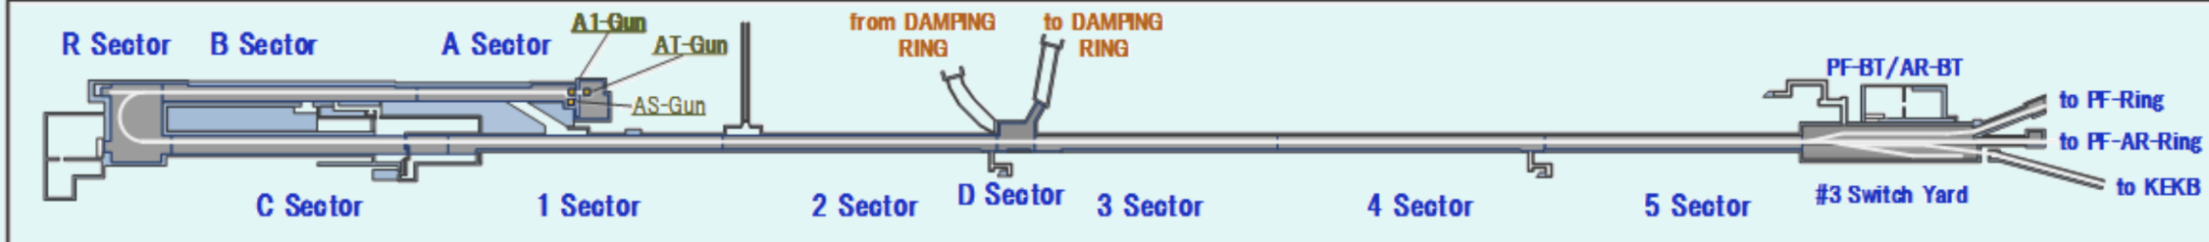
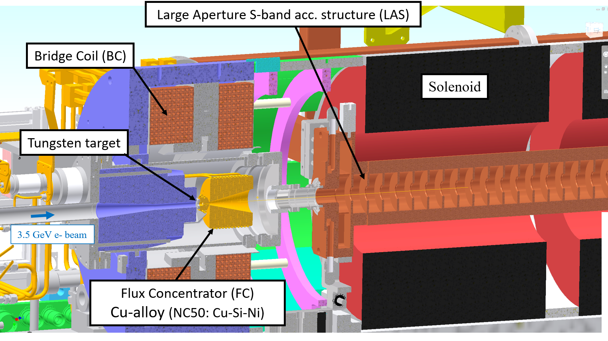
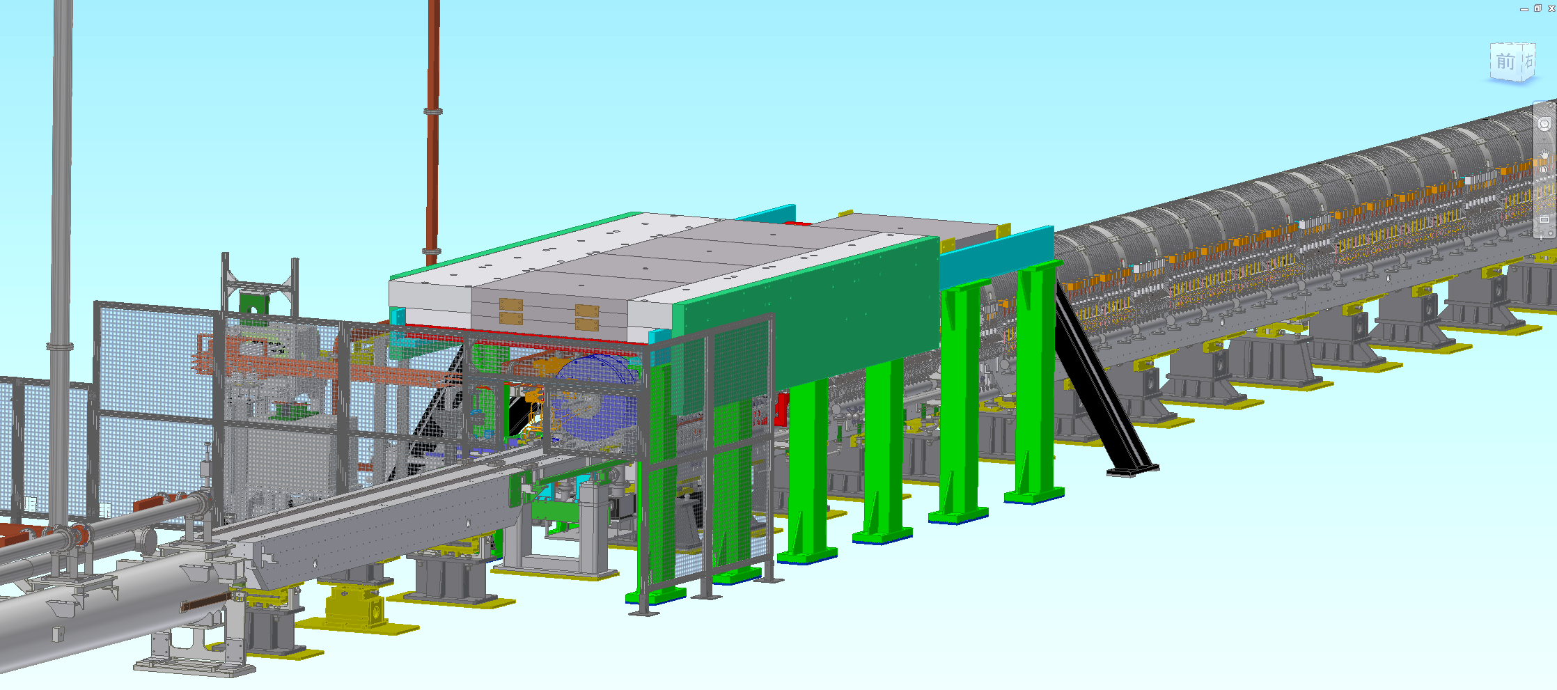
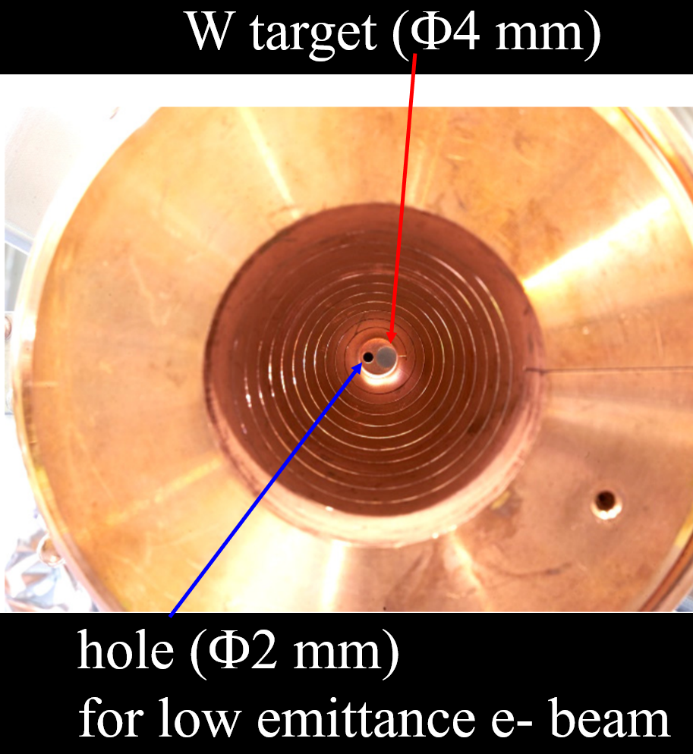
Positron source and capture line at Sector1
e+ beam status
Positron target and capture section
DC solenoid
Large aperture S-band acc. Structures (x10)
W target + flux concentrator (FC)
Y. Enomoto et al.

Slide 15
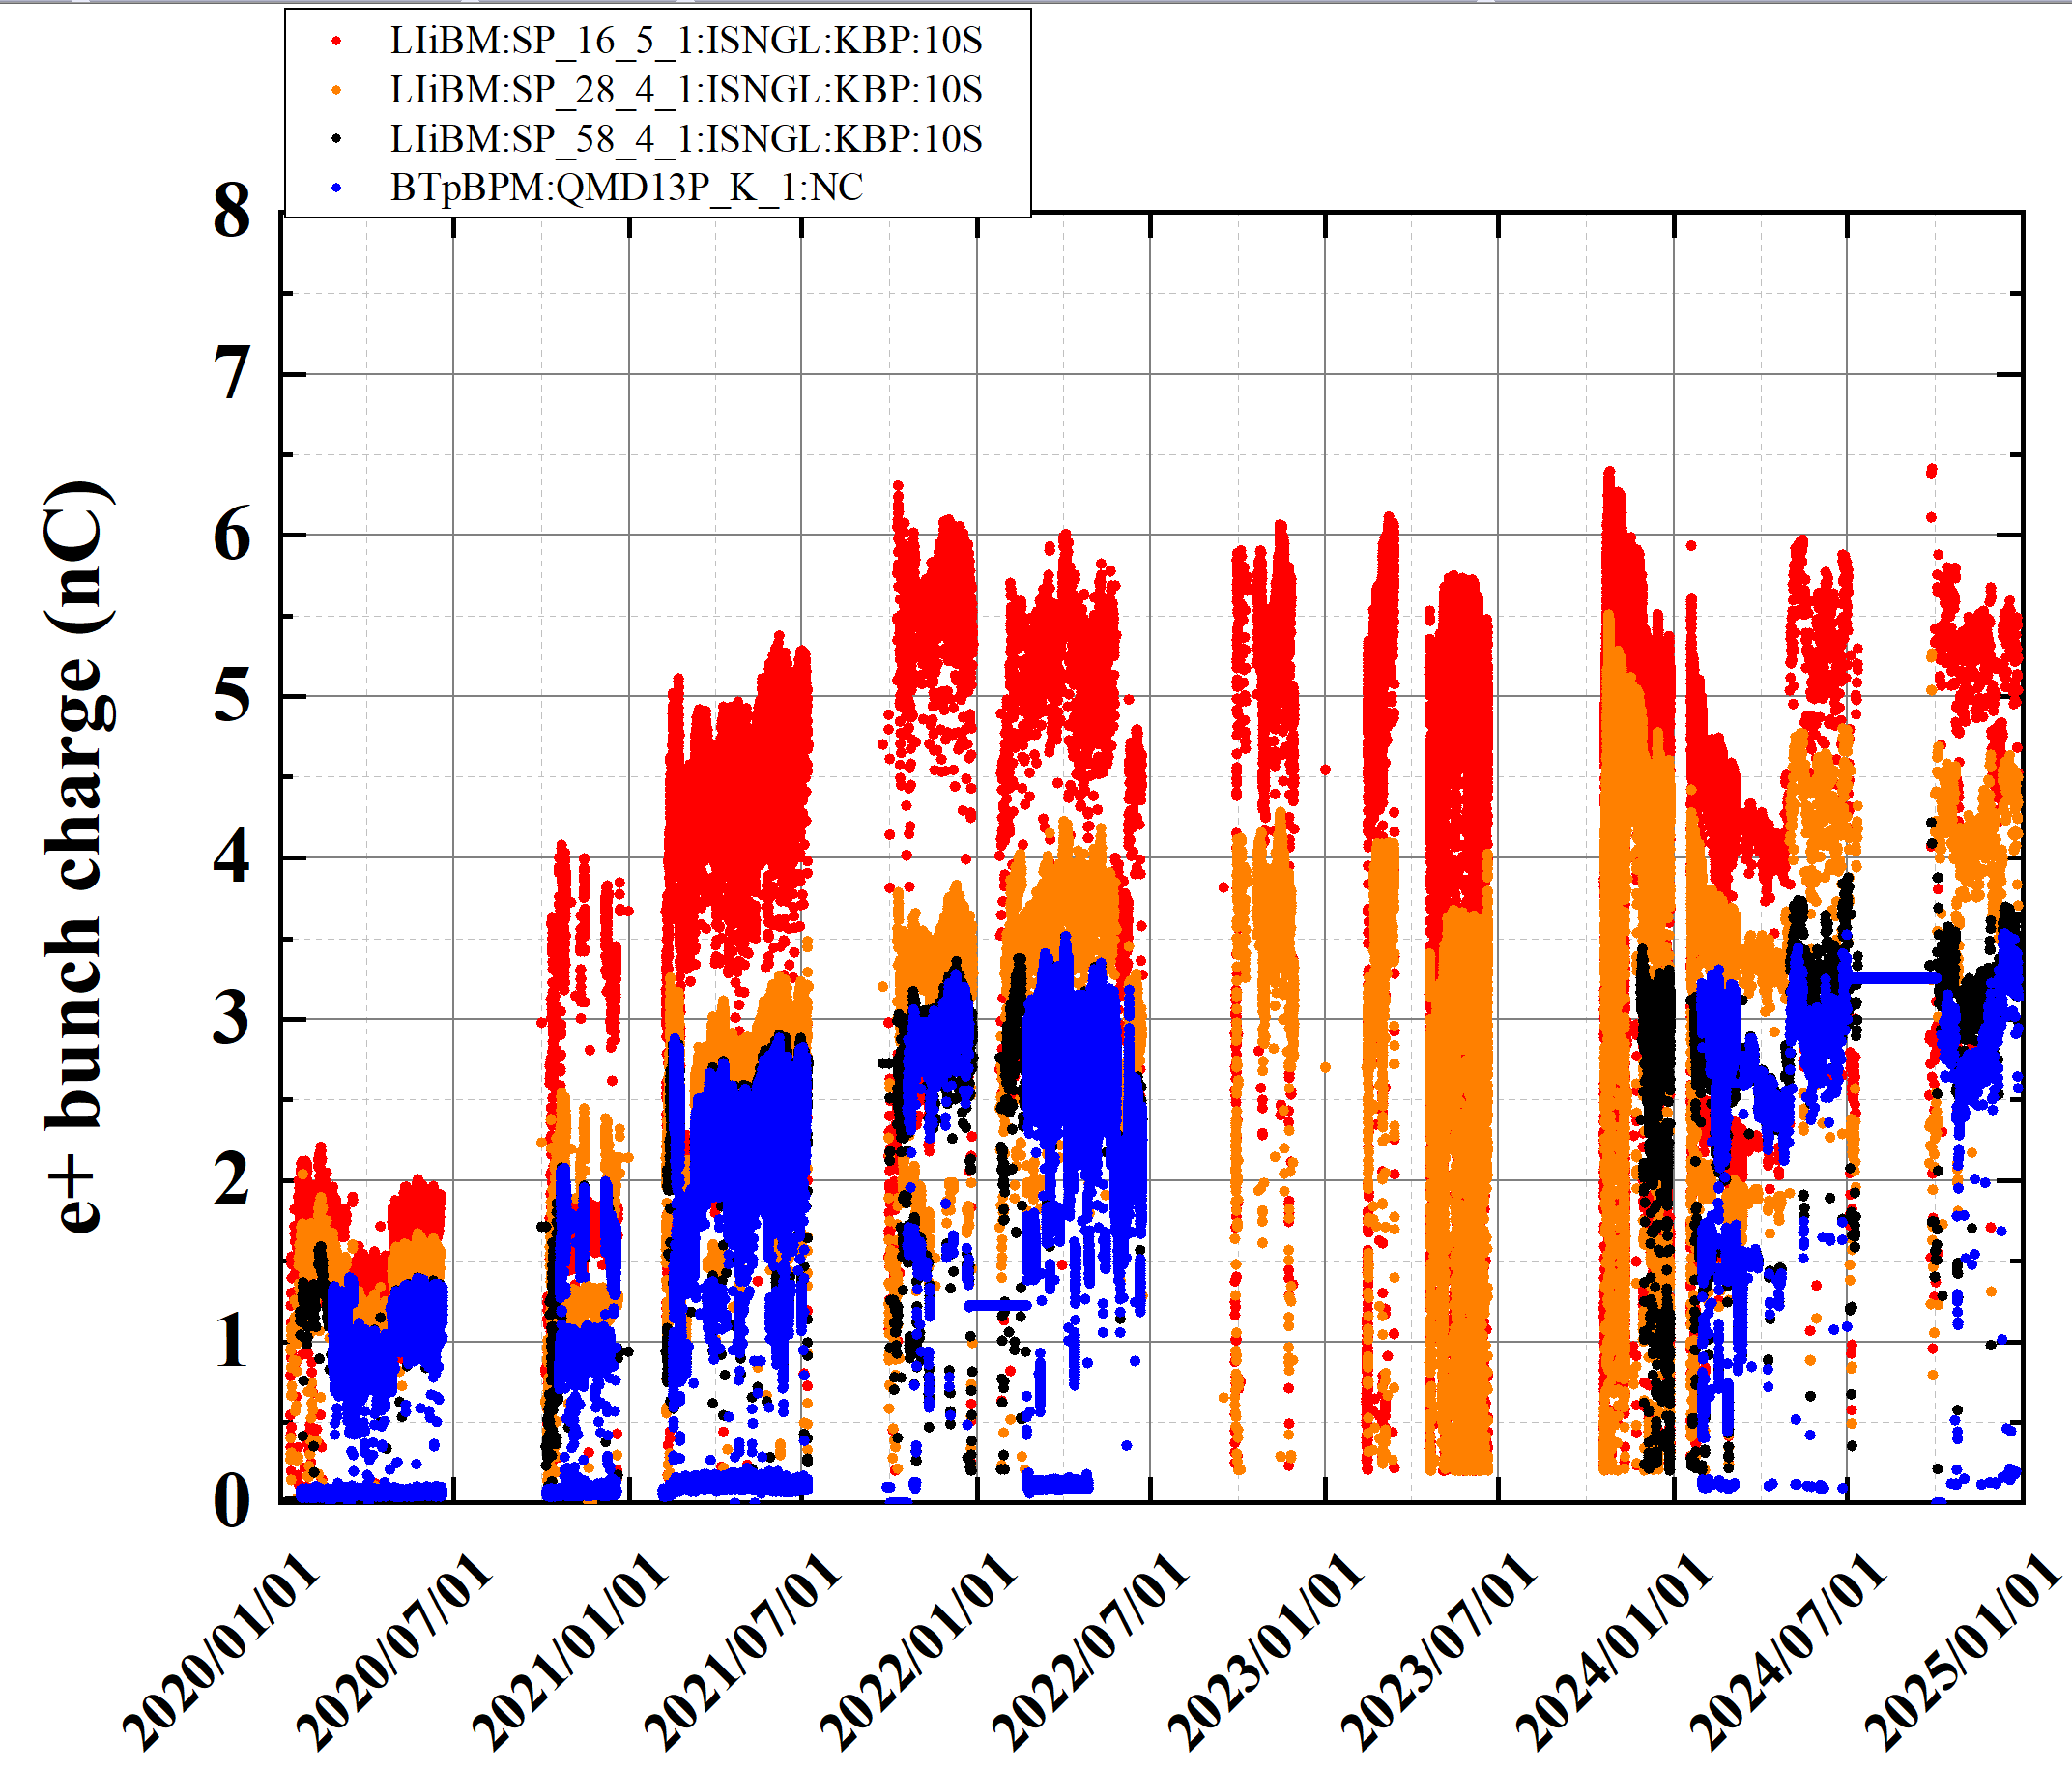
e+ bunch charge history (2020a to 2024c)
e+ beam status
(after e+ target)
(before DR)
・Solenoid current (SL_16_)optimization
・beam tuning (primary e- bunch charge ↑)
(Linac end)
(BT end)
2020a,b
2020c
2021a,b
2021c
2022a,b
2022c
2023a,b
2023c
2024a,b
2024c
LS1
・beam tuning
・Steering, BPM
in Unit 1-5, 1-6
・beam tuning
・New FC
・Solenoid current↑
・decrease bunch charge
(MR request)

Slide 16
e+ beam summary
e+ beam status
Status
  Machine learning based automatic tuning can help to increase the e+ bunch charge (current design goal is 4 nC)
    5.5 nC at the end of Sector2
    4.2 nC at linac end
  DR stored current is limited up to 35 mA (radiation safety). This restriction will be increased in the next run.
  Flux concentrator operation has been very stable.
    A few times HV down due to controller problem (PXI based digitizer).
Issue
  Existing FC control system (Windows/LabVIEW) should be updated to a similar system of pulsed magnet control system (Linux/EPICS IOC).
  Emittance after DR should be decreased to around design value.

Slide 17
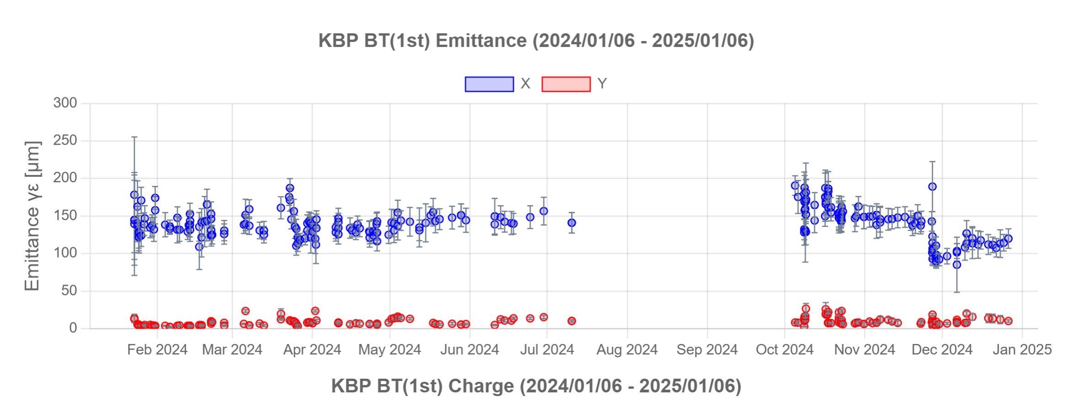
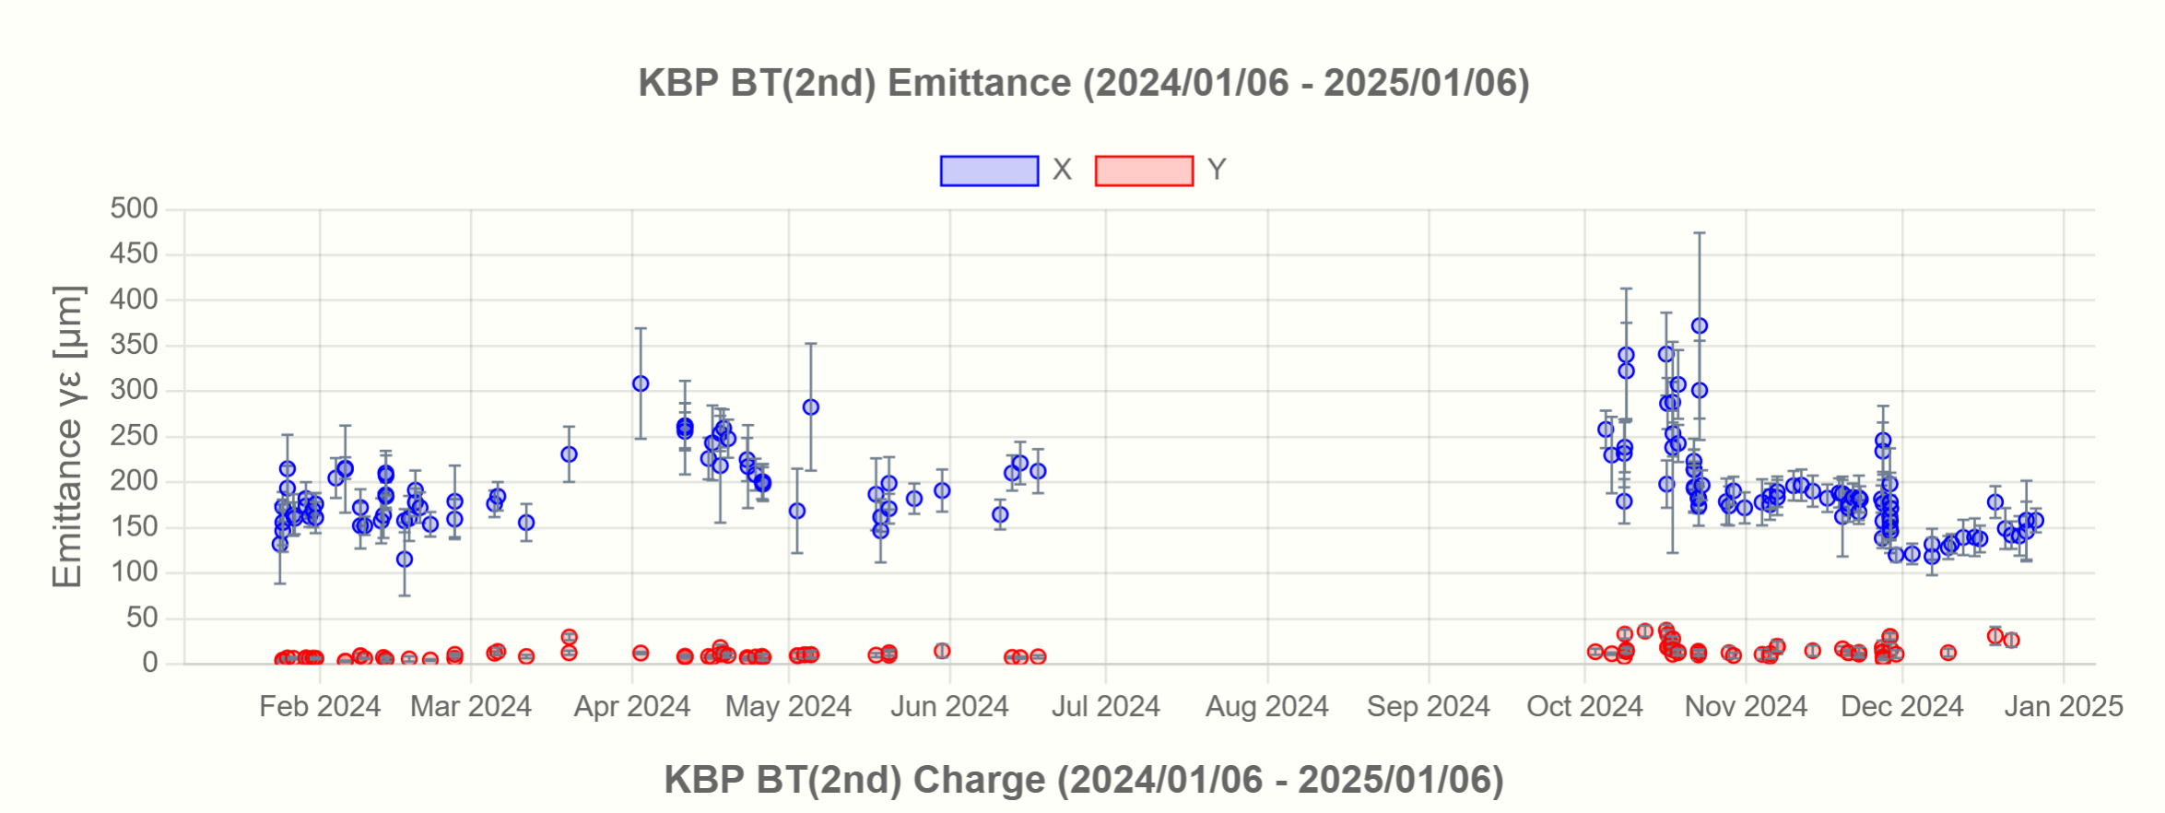
e+ beam emittance history at BT1 in 2024abc
e+ beam status

Slide 18
Recent progress

Slide 19
Recent progress
Recent Progress
Pulsed magnet control system update
  Control PC hardware and software
New accelerating structure
Injector upgrade plan (F. Miyahara)
  Fast Kicker to correct 2nd bunch orbit
  Beam diagnostics Line with pulsed magnets
  Beam tuning programs
  Bigdata analysis
  HER BT Energy Compression System (ECS)

Slide 20
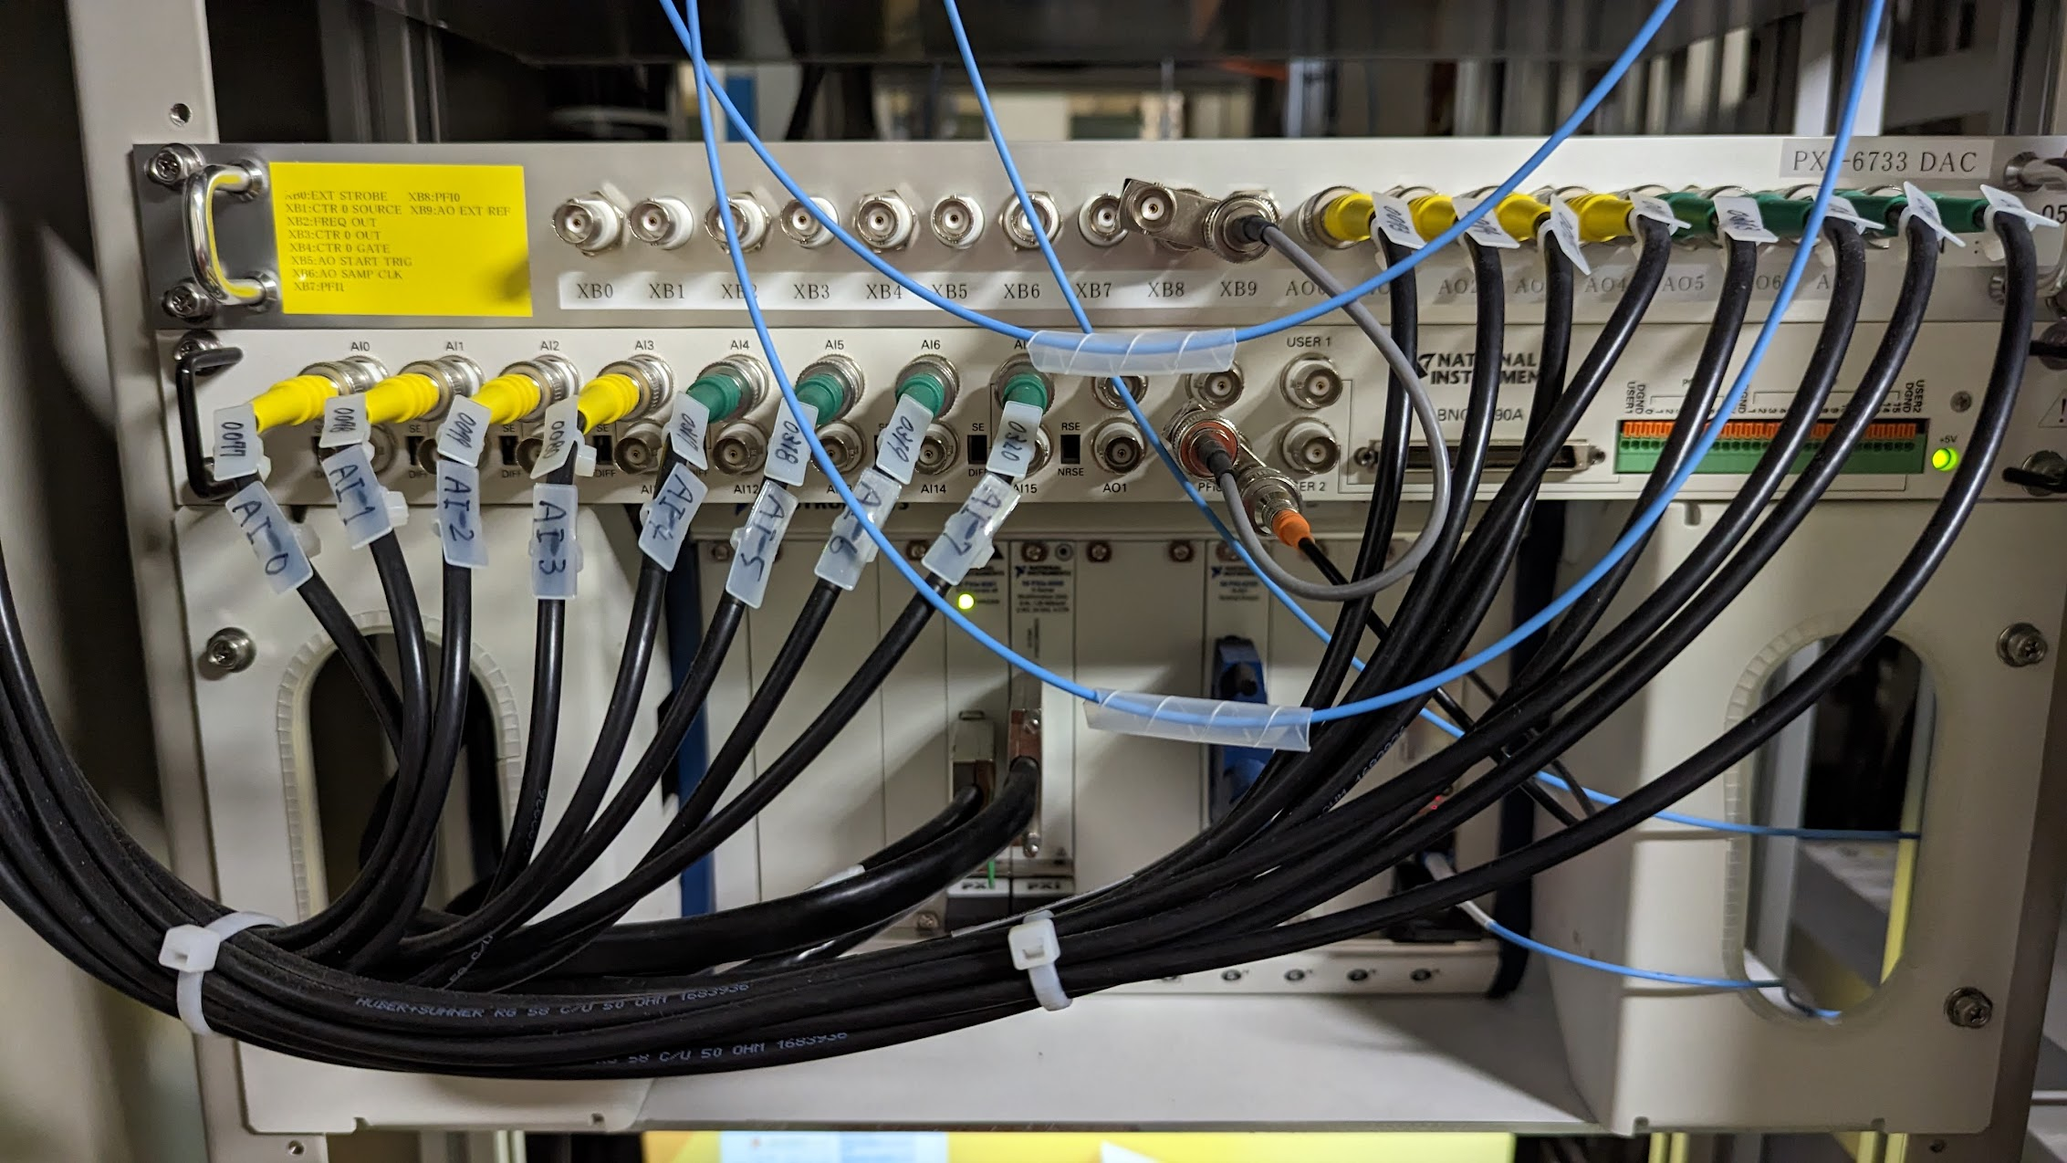
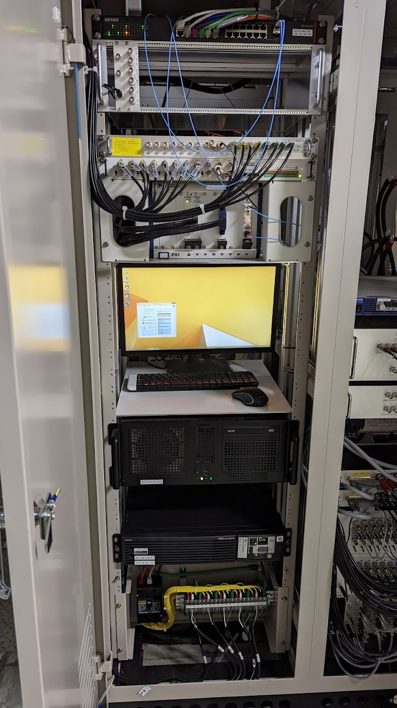
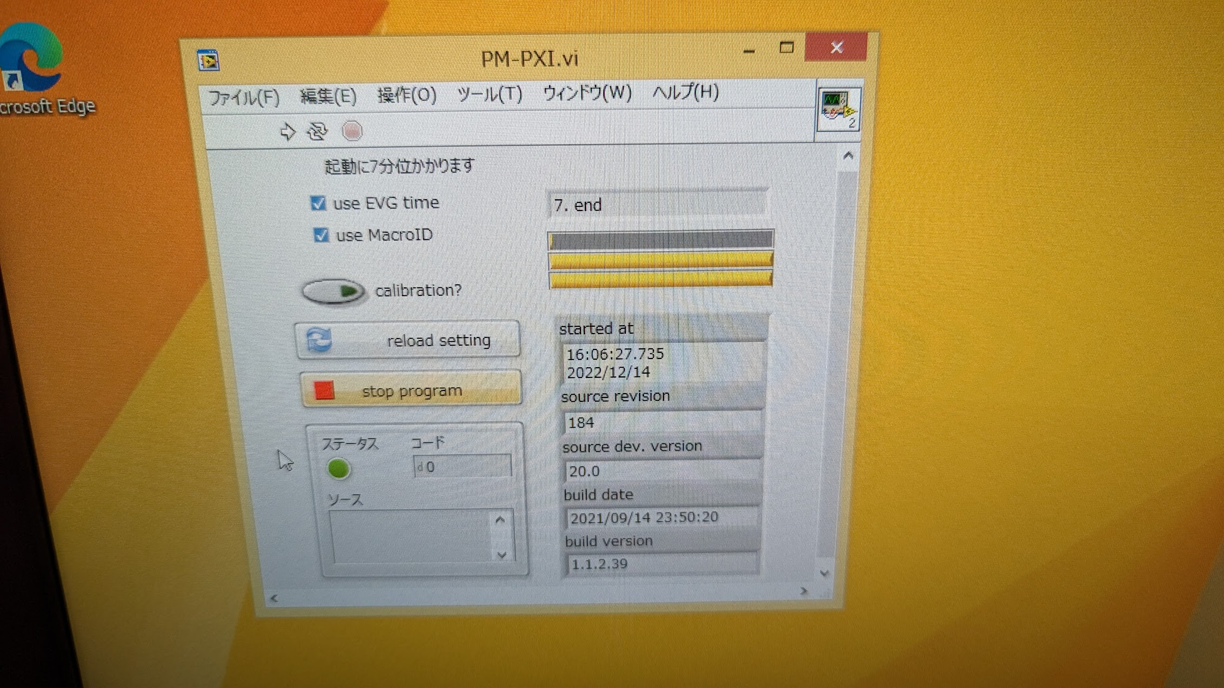
Pulsed magnet control system update
Recent Progress
Windows/LabVIEW/PXI system
  Started since 2017
  Sometimes control PC or LabVIEW program freeze.
  It takes around 10 minutes or more for restarting system.
Linux/EPICS IOC/PXI
  Decided to migrate to Linux/EPICS IOC (2022/12)
  NI DAC&ADC driver (2023/02)
  EVR driver (2023/03)
  EPICS IOC (2023/04)
  OPI & Monitoring (2023/05)
  Experiment (2023/06)
  Revision (2023/07)
  Stability test (2023/07)
All system were replaced by new PC and software in 2024 summer shutdown.
DAC
ADC
EVR
Di Wang et al.

Slide 21
Recent Progress
Windows /LabVIEW
Windows /LabVIEW
+ Linux
All Linux
(*) The PM PC troubles caused by timing system/network packet increase are not included.

Slide 22
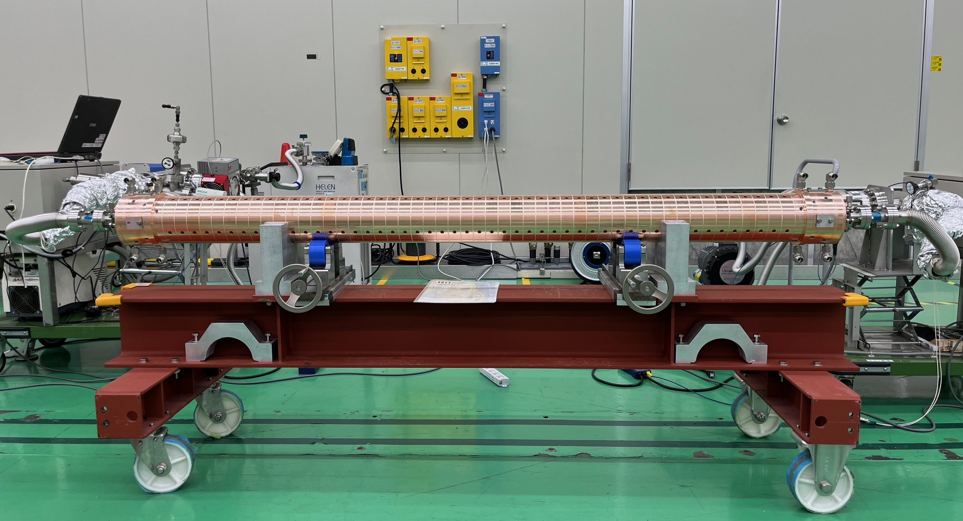
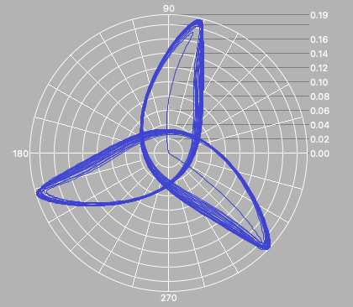
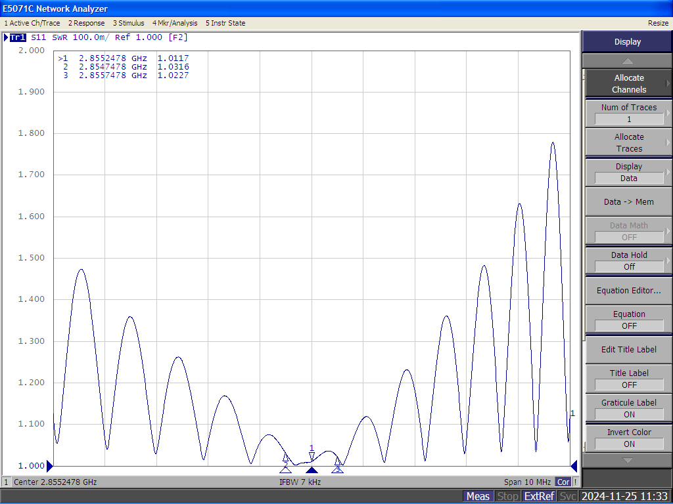
Recent Progress
Production status of new S-band accelerating structures
3-year plan of the S-band structure production (2023-2025)
  Steady production of 6 structures in FY2024
    Four structures completed as designed and ready for RF conditioning
    The other two structures in the process of RF tuning
  The last 6 structures scheduled to be produced in FY2025
Input VSWR : 1.012
Output VSWR : 1.013
Deviation from accelerating phase < 1.7°
New structure under vacuum-leak test after RF tuning
Results of fine RF tuning
H. Ego et al.

Slide 23
Recommendation in MAC 2024
R4.1: Priority should be given to optimize the injector and injection for electron bunches.
  New rf gun cavity could help the stable e- beam operation.
  Sufficient input power into rf gun cavity can realize the high quality (low emittance, small energy spread) beam with high bunch charge from rf gun.

Slide 24
Summary
Operation overview
  Simultaneous top up injection has been successfully conducted.
e- beam
  Laser system has worked fine without any significant trouble.
  Frequent rf gun cavity down due to discharge in the previous run 2024c. Rf gun cavity should be replaced by new one in the near future for stable e- beam operation.
e+ beam
  e+ generation system (flux concentrator, power supply, DC solenoid) has worked fine.
  Machine learning based automatic tuning can help to increase the e+ bunch charge (current design goal is 4 nC)
    5.5 nC at the end of Sector2
    4.2 nC at linac end.
Recent progress and future plan
  Pulsed magnet controller availability has been much improved by replacing new Linux-OS/EPICS IOC based system.
  Fast Kicker, beam diagnostics line with pulsed magnets, beam tuning programs, bigdata analysis, HER BT Energy Compression System (ECS) can help improve the beam operation quality.
  Improvement of the beam quality reproducibility could be helped by AI/ML technology.

