Slide 1
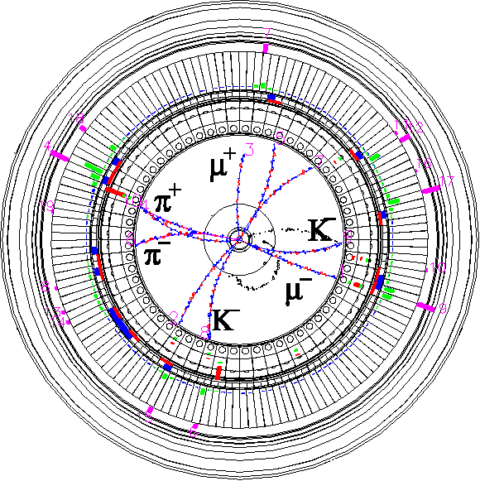


SuperKEKB Near-term Plan
The 28th KEKB Accelerator Review Committee
15th January 2025
Kyo Shibata
Inter-University Research Institute Corporation High Energy Accelerator Research Organization (KEK)
大学共同利用機関法人 高エネルギー加速器研究機構 (KEK)

Slide 2
Contents
Introduction
Long-term plan update
Near-term plan
  2025 run plan
  Work items during shutdown
  Strategy toward milestones
Summary

Slide 3
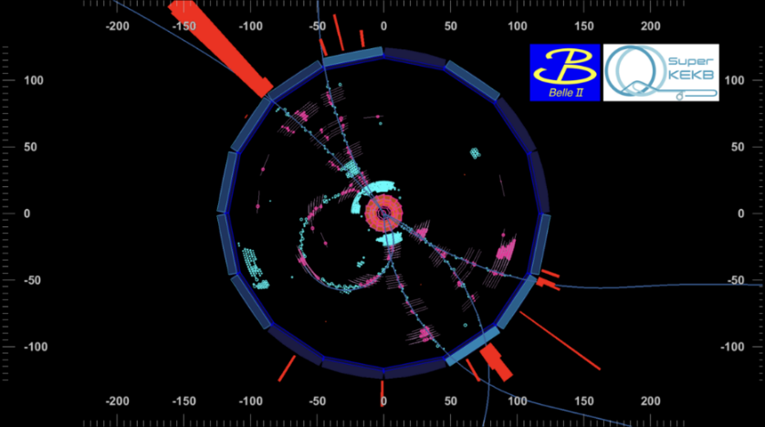
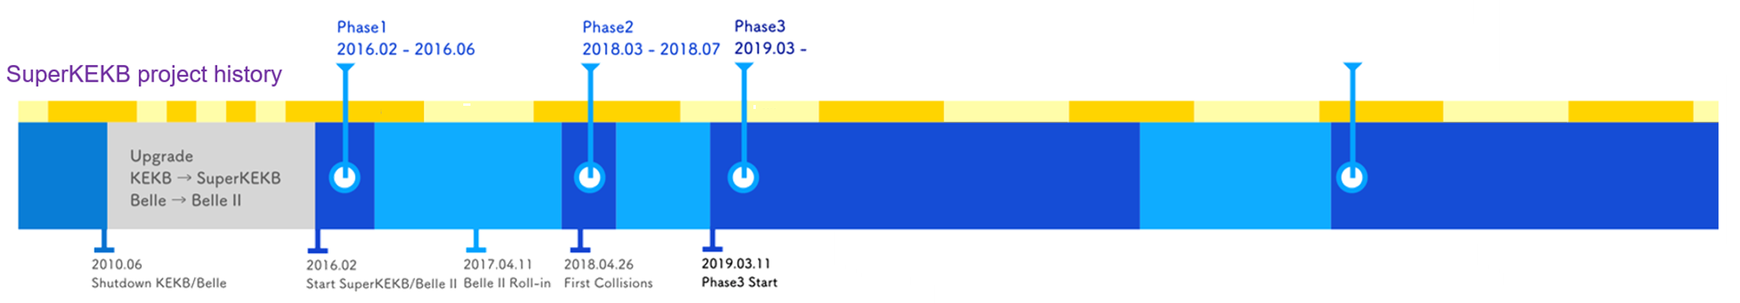
SuperKEKB project history
Phase1 operation (2016.Feb. ∼ June);
  Vacuum scrubbing, low emittance beam tuning, and background study for Belle II detector installation
  w/o final focusing system (QCS) and Belle II detector
Phase2 operation (2018.Mar. ∼ July);
  Pilot run of SuperKEKB and Belle II w/o pixel vertex detector (PXD)
  Demonstration of nano-beam collision scheme
  Study on background larger than at KEKB due to much lower beta functions at IP.
Phase3 operation (2019.March∼);
  Physics run with fully instrumented detector.
  Phase3 Run1 : 2019.10∼2022.7
  Long shutdown 1 : 2022.7∼2024.01
  Phase3 Run2 : 2024.01∼
First hadronic event in the Phase3 2019ab
Phase1
2016.02-2016.06
Phase1
2018.03-2018.07
Phase3 Run1
2019.03-2022.06
Phase3 Run2
2024.01-
2010
2012
2014
2016
2017
2018
2019
2020
2021
2022
2023
2024
2025
2026
Long Shutdown 1
We are here now.

Slide 4
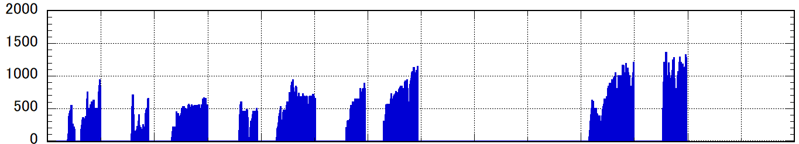
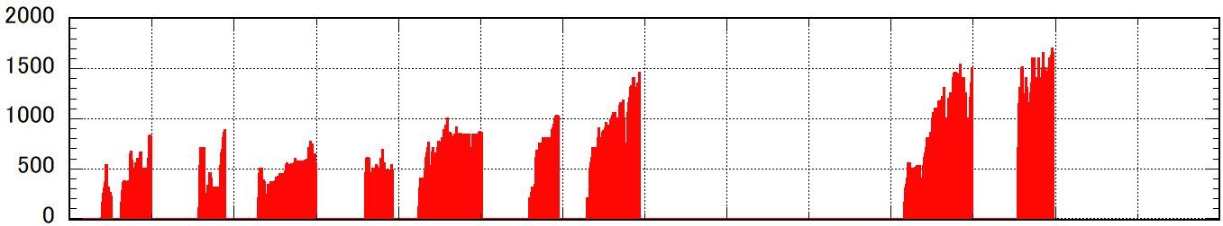
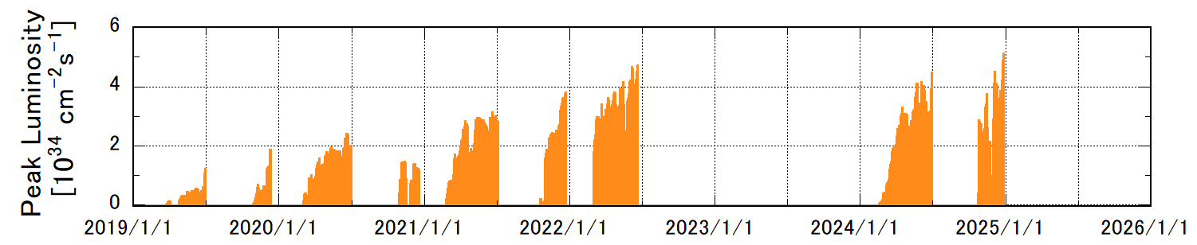
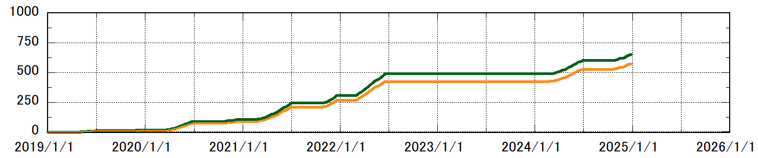
Phase 3 commissioning history
Phase3 operation (2019.March∼);
  Physics run with fully instrumented detector
  Naming rule of Phase3 operation
    “YYYYxx run”
  2019/March-2022/Jun : Run1
    2019c, 2020ab, 2020c, 2021ab, 2021c, 2022ab
    Luminosity (peak/integrated) : 4.7×10³⁴ cm⁻²s⁻¹/424 fb⁻¹
    β_{y}* squeezing : ∼0.8 mm (1 mm for most of the time)
    Maximum beam current : HER/LER = 1145/1455
    Facing various challenges for luminosity improvement
      Severe beam-beam effect, Shorter beam lifetime, Lower bunch current limit, Low machine stability, Low injection efficiency, Sudden beam loss, Aging of hardware and facilities.
  2022-2024 : Long shutdown 1 (LS1)
    Accelerator upgrades
    Belle II reinforcement and maintenance
  2024/Jan.- : Run2
    2024ab, 2024c, ⋅⋅⋅
    Luminosity (peak/integrated) : 5.1×10³⁴ cm⁻²s⁻¹/571 fb⁻¹(total)
    β_{y}* squeezing : ∼0.9 mm (1 mm for most of the time)
    Maximum beam current : HER/LER = 1354/1699
  2032? : Long shutdown 2 (LS2)
Phase 3
2019ab
2019c
2020ab
2020c
2021ab
2021c
2022ab
LS1
2024ab
2024c
March is end of Japanese fiscal year.
a : End of winter shutdown - March
b : April – Start of summer shutdown
ab : End of winter shutdown – Start of summer shutdown
c : End of Summer shutdown – Start of winter shutdown
HER current
1354 mA
1145 mA
Calendar year
I [mA] in HER
LER current
1455 mA
1699 mA
I [mA] in LER
Peak lumi.
4.7×10³⁴ cm⁻²s⁻¹
5.1×10³⁴ cm⁻²s⁻¹
Peak Lumi. [×10³⁴ cm⁻²s⁻¹]
Integrated lumi.
Int. Lumi. [ fb⁻¹]
recorded
424 fb⁻¹
571 fb⁻¹
delivered

Slide 5
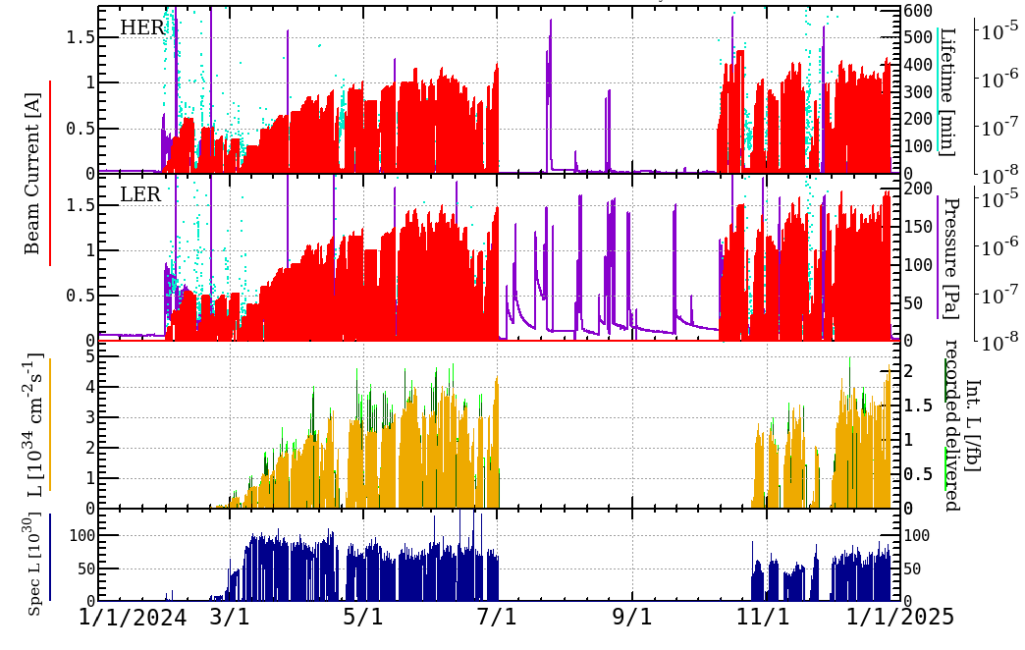
2024ab & 2024c run overview
2024ab run : 2024/Jan./29 – July/1, 155 days
  Start-up after a long shutdown
  First demonstration of the effectiveness of the NLC system
  Peak luminosity : 4.47×10³⁴ cm⁻²s⁻¹
  Maximum beam current : HER/LER = 1210/1539 mA
  βy*-squeezing (Vertical β-function at IP) : ∼0.9 mm
    Mostly operated with βy* = 1.0 mm
  Struggled with Sudden Beam Loss, poor injection efficiency, low machine stability
Summer shutdown
  Upside-down rotation of beam chambers with electron clearing electrodes at Oho wiggler section
2024c run : 2024/Oct./9 – Dec. /27, 79 days
  Target luminosity : 1×10³⁵ cm⁻²s⁻¹
  More time was spent on machine studies than on physics run.
    Verification of SBL measures during summer shutdown
    Machine studies to increase beam currents
    Machine studies to investigate HER vertical beam blowup
  Peak luminosity : 5.1×10³⁴ cm⁻²s⁻¹ (Belle II HV off)
    We updated our record!!
  Maximum beam current : HER/LER = 1354/1699 mA
  β_{y}*-squeezing (Vertical β-function at IP) : 1.0 mm
  Still struggled with SBL
    But, it was found out that the VACseal is a most likely cause of SBL.
2024ab run
Summer shutdown
2024c run
HER Current
LER Current
Upside-down rotation of beam pipes, etc.
Peak Luminosity
Physics run
Machine study
Vacuum scrubbing
Vacuum scrubbing
Beam on
(1/29)
Beam off
(7/1)
Beam on
(10/9)
Beam on
(12/27)
β_{y}* = 8 mm
0.9 mm
β_{y}* = 1 mm
3 mm
1 mm

Slide 6
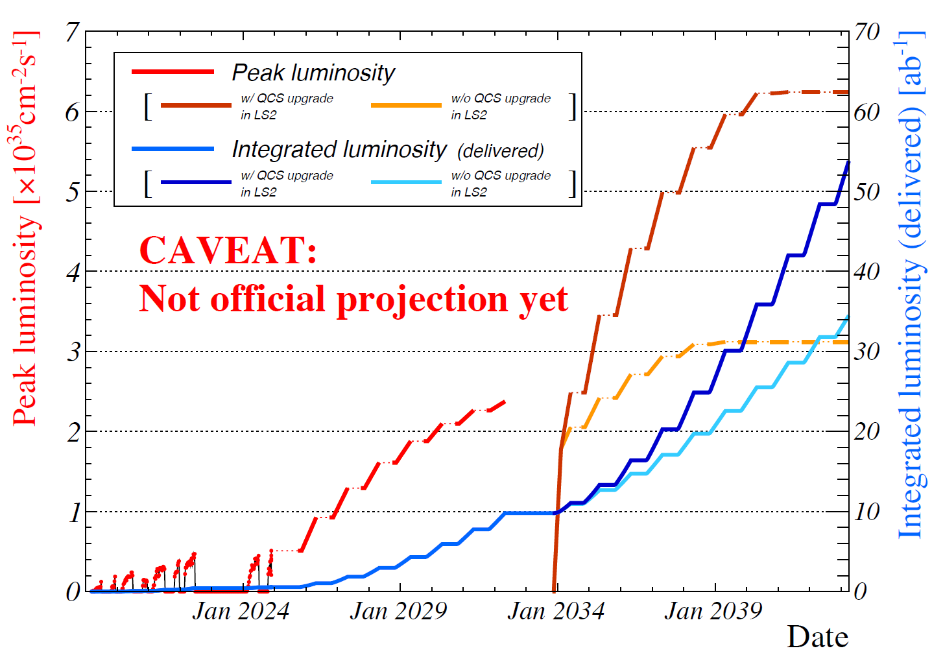
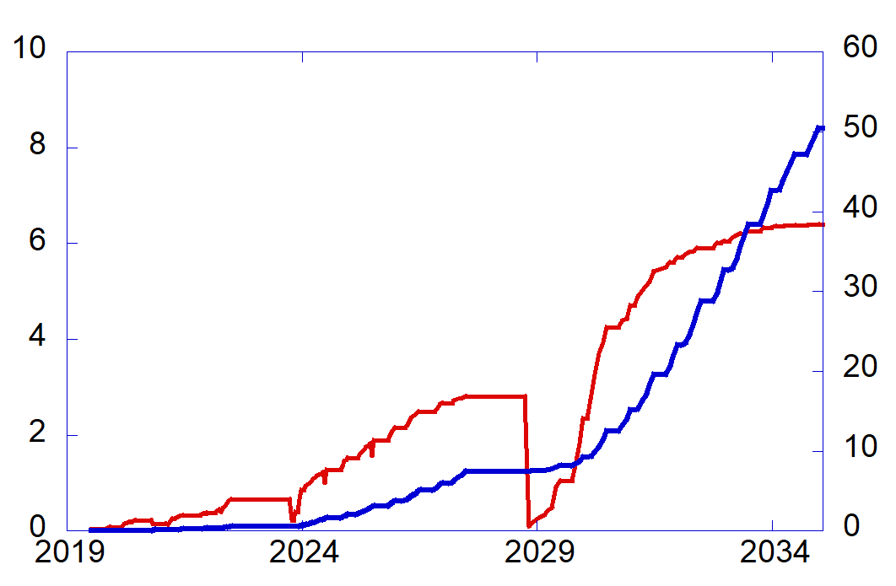
Long-term plan
New long-term plan is currently being created.
  The proposed luminosity projection is under review.
  New plan is expected to be finalized in near future.
Major changes from original plan:
  Long Shutdown 2 (LS2) is moved from 2027 to around 2032.
  After LS2, luminosity projection shows two lines.
    luminosity improvement of x 1.3 is expected due to the beam current increase mainly by the RF reinforcement (beam current increasement).
    IR upgrade is assumed to be able to increase the luminosity much more.
    Technical feasibility of the IR upgrade and the exact luminosity gain remain uncertain.
  Operation needs to be continued by 2042 to deliver 50 ab⁻¹ with IR upgrade.
New luminosity projection (under consideration)
LS2
Original luminosity projection
Integrated Luminosity
LS2
Peak Luminosity [×10³⁵ cm⁻²s⁻¹]
Integrated Luminosity (delivered)
[ab⁻¹]
Peak Luminosity
Update!!
2032
2027
We are here now.

Slide 7
Important milestones before LS2
Integrated luminosity target;
  0.58 ab⁻¹ in JFY2024 (current value)
  1 ab⁻¹ in JFY2025
  2 ab⁻¹ in JFY2026
  5 ab⁻¹ by around 2028-2029
    LHC Run3 results will appear around 2028-2029
Peak luminosity target;
  0.51×10³⁵ cm⁻²s⁻¹ by the end of JFY2024 (current value)
  1.0×10³⁵ cm⁻²s⁻¹
  2.4×10³⁵ cm⁻²s⁻¹ before LS2
New luminosity projection (under consideration)
LS2
2032
We are here now.

Slide 8
2025 run plan
By the end of JFY2024
  Operation is impossible by the end of February due to updating of power receiving equipment.
From the perspective of operation efficiency
  The run period should be as long as possible to make the operation efficient.
    It should be at least 3 months.
  Operation should be avoided in June as it is too hot and will reduce efficiency.
From the perspective of budget
  KEK requested budget for 7 months operation to MEXT.
  MEXT is very supportive for SuperKEKB/Belle II and is asking MOF for increase of the budget.
    However, we cannot expect a significant budget increase under Japanese budget system.
    Assuming a realistic slight budget increase, the expected operation time in JFY2025 would be 3.5 months.
    Supplementary budget for 1.5 months operation for JFY2024 can be carried over to JFY2025.
  Realistically expected operation time in JFY2025 would be 5 months.
Our decision;
  2025ab run will be skipped.
  2025c run and 2026a run will be conducted.
    2025c run will start in November.
    Winter shutdown will be shortened as much as possible. (∼2 weeks)
    2026a run will be continued by the end of JFY2026.
  With more supplementary budget, 2025c or 2026b will be extended.
We are in 10-month shutdown now.
  It is required to prioritize works to increase both peak luminosity and integrated luminosity in the next run.
    Human resources and budget are limited.
MEXT : Ministry of Education, Culture,
Sports, Science and Technology
MOF : Ministry of Finance
 | 4 |  | 5 |  | 6 |  | 7 |  | 8 |  | 9 |  | 10 |  | 11 |  | 12 |  | 1 |  | 2 |  | 3
JFY2024
JFY2025
JFY2026
2024b
2024c
Shutdown ∼10 months
Winter shutdown ∼2 weeks
2026a
Shutdown ∼10 months
2025c
If possible
5 months in total
2026b?
If possible

Slide 9
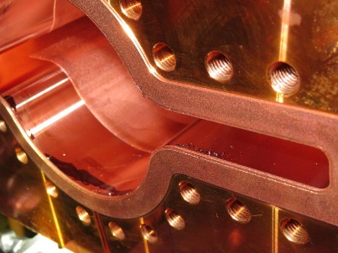
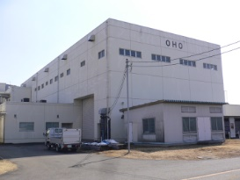
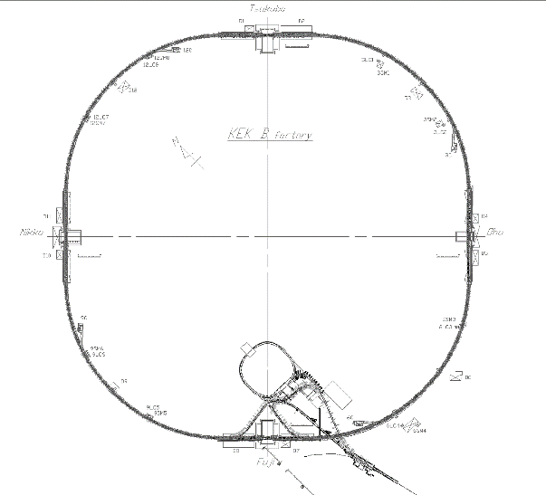
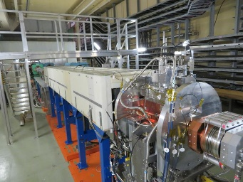
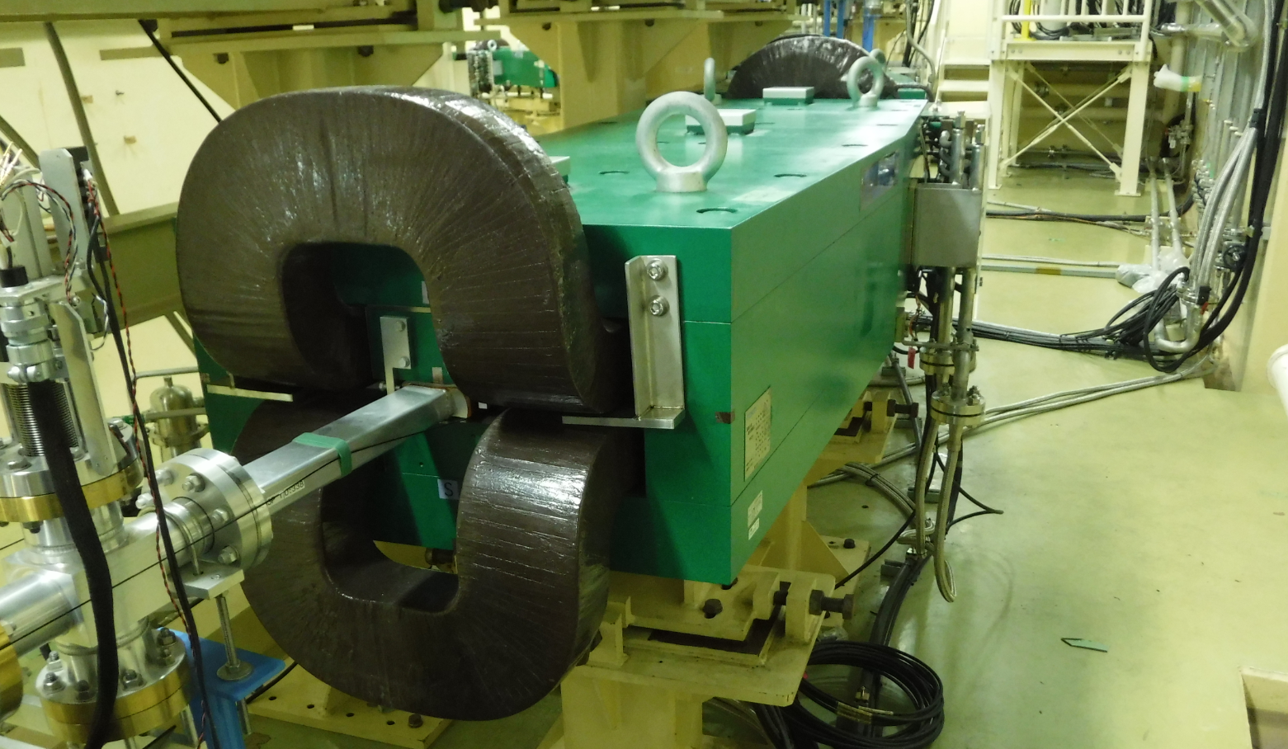
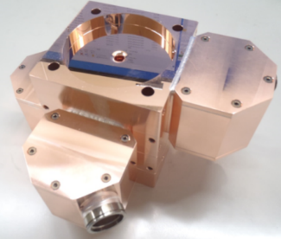
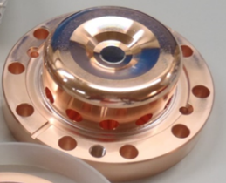
Works during this shutdown 1
Major work items (decided)
  Radiation shielding reinforcement and expanding radiation control area near Oho exp. Hall.
    Required for achieving higher LER beam current using NLC at OHO.
  Linac RF gun replacement
    New RF-gun cathode will be delivered by the end of March and be installed during next summer.
  ECS installation at BTe
    Accelerating structure will be installed at BTe by the end of March and new ECS will be available from 2025c run.
  Bending magnet replacement at BTp
    A few old bending magnets will be replaced during next summer.
  Inner cleaning of beam chambers at LER wiggler sections
    Countermeasure against LER SBL
    Upside-down rotation of beam pipes with electrodes at Nikko wiggler section was canceled.
  Various works carried out by the Plant and Facilities Department
    Roof renovation work in Tsukuba Hall
    Replacement of 6 kV HV power cables
Tsukuba (Belle II)
Oho Experimental Hall
D11
wiggler section
D04
wiggler section
Oho
straight section
Nikko
straight section
D10
wiggler section
D05 NLC section
Bending magnet replacement (BTp)
ECS
NLC
NEW RF-Gun cathode cell

Slide 10
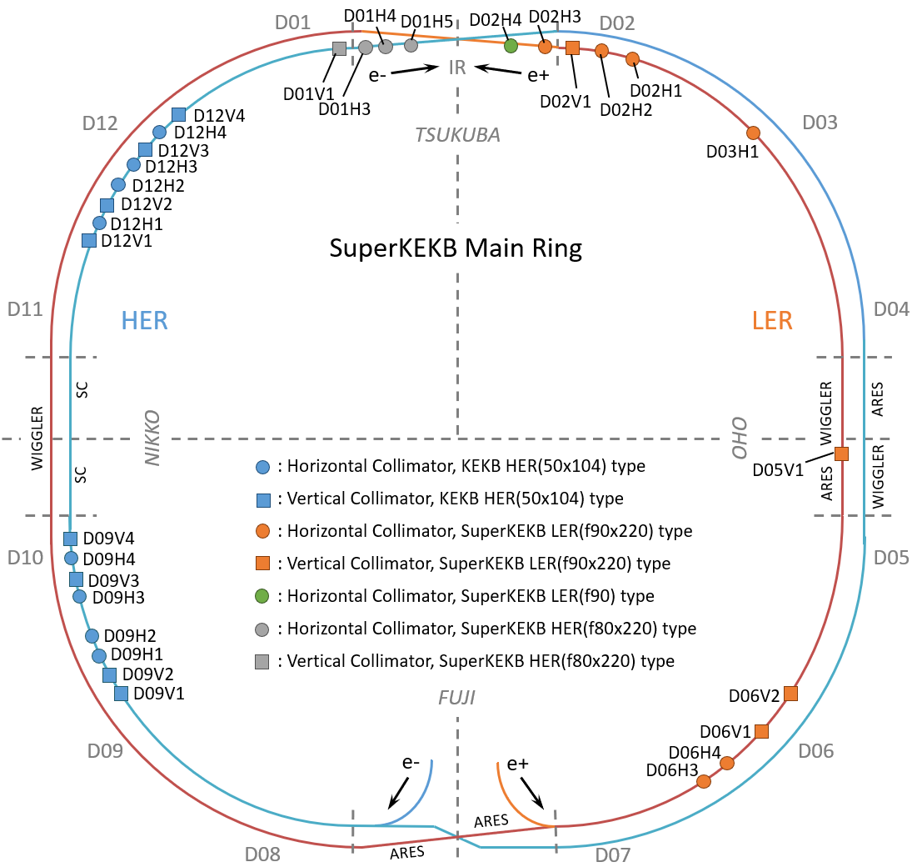
Works during this shutdown 2
Other work items (under consideration)
  LER D06V2 collimator relocation to D03 Arc section
    To protect Belle II and D02V1 collimator from uncontrollable beams
    The best location is currently being determined.
  Countermeasure against HER SBL
    we need to do something, but we don’t have any concrete plans yet.
  And so on.
    We appreciate your suggestions and recommendations!!
Creating a commissioning plan of 2025c&2026a run
  The specific plan is yet to be created.
  Luminosity target;
    Peak luminosity : 1×10³⁵ cm⁻²s⁻¹
    Integrated luminosity : 1 ab⁻¹
Tsukuba (Belle II)
Positron beam
D03V4?
D05V1
Non-linear collimation
D06V2
Positron beam

Slide 11
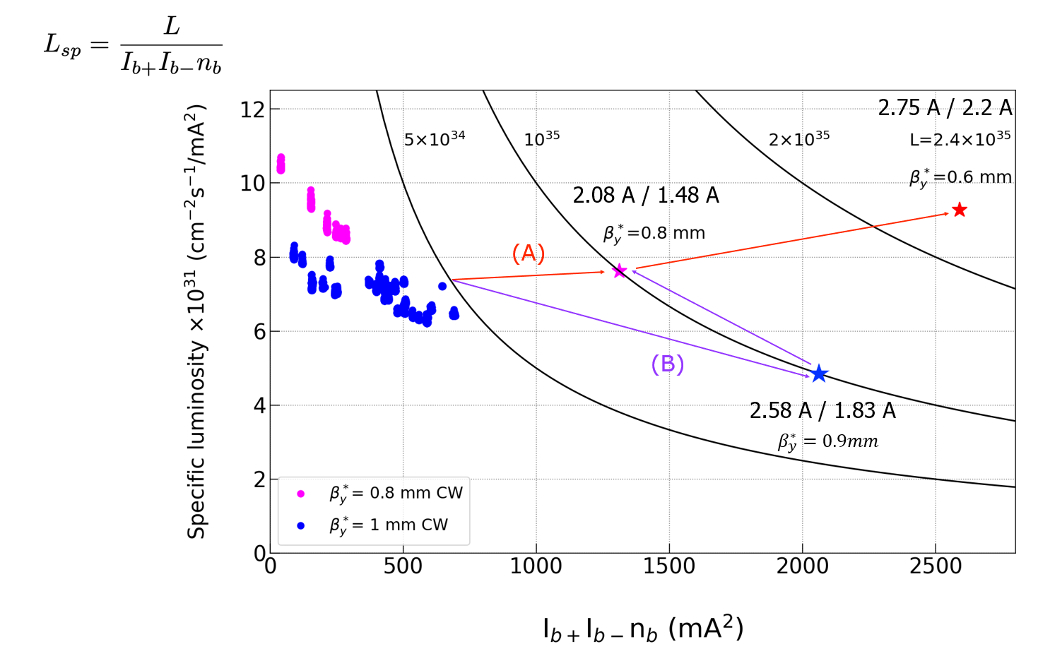
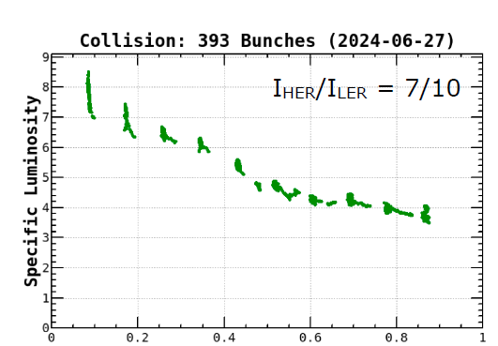
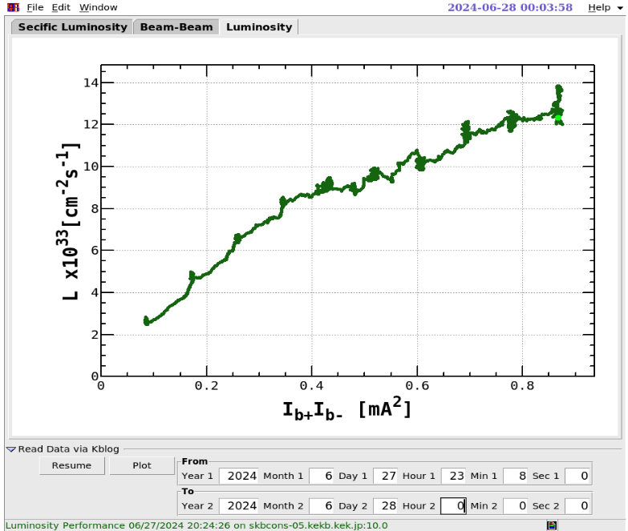
Strategy toward 1.0×10³⁵ cm⁻²s⁻¹
Strategy toward 1.0×10³⁵ cm⁻¹s⁻¹ : Route (B)
  Increase beam current with β_{y}* = 0.9 mm
  Target current : 2.58 A/ 1.83 A
    Improve injection under influence of Beam-Beam interactions
    Reduce injection errors with modified injection scheme
  Required specific luminosity : L_{sp} = 5×10³¹ cm⁻¹s⁻¹ mA⁻²
2024ab results and outlook
  With 393 bunches (Result of high bunch current study)
    L(393 bunches) = 1.38×10³⁴ cm⁻²s⁻¹
    L_{sp}(393 bunches) = ∼4×10³¹ cm⁻¹s⁻¹ mA⁻²
      Degradation due to beam blowup at high bunch current
  With 2346 bunches (outlook)
    L(393 bunches) = 1.38 × 10³⁴ cm⁻²s⁻¹
    × 2346/393 (increase bunches)
    8.27 × 10³⁴ cm⁻²s⁻¹
    × 5/4 ( L_{sp} improvement)
    1.0 × 10³⁵ cm⁻²s⁻¹
Y. Ohnishi
Luminosity with
393 bunches
Specific lumi.
[×10³¹ cm⁻²s⁻²/mA²]
Specific Lumi. with
393 bunches

Slide 12
Strategy toward 2.4×10³⁵ cm⁻²s⁻¹
Strategy toward 2.4×10³⁵ cm⁻¹s⁻¹ : Route (A)
  β_{y}* squeezing down to 0.6 mm :
    Down to 0.6 mm from 0.9 mm (3 steps)
    Dynamic aperture improvement :
      Sextupole optimization
      Off-momentum optics tuning
      Comparison between simulations and measurement
  Increase beam current : 2.75 A/ 2.2 A
  Increase specific luminosity (Beam-beam parameter)
    Up to L_{sp} ∼ 9×10³¹ cm⁻¹s⁻¹ mA⁻²
    Improve prediction accuracy of Beam-Beam simulation
Y. Ohnishi

Slide 13
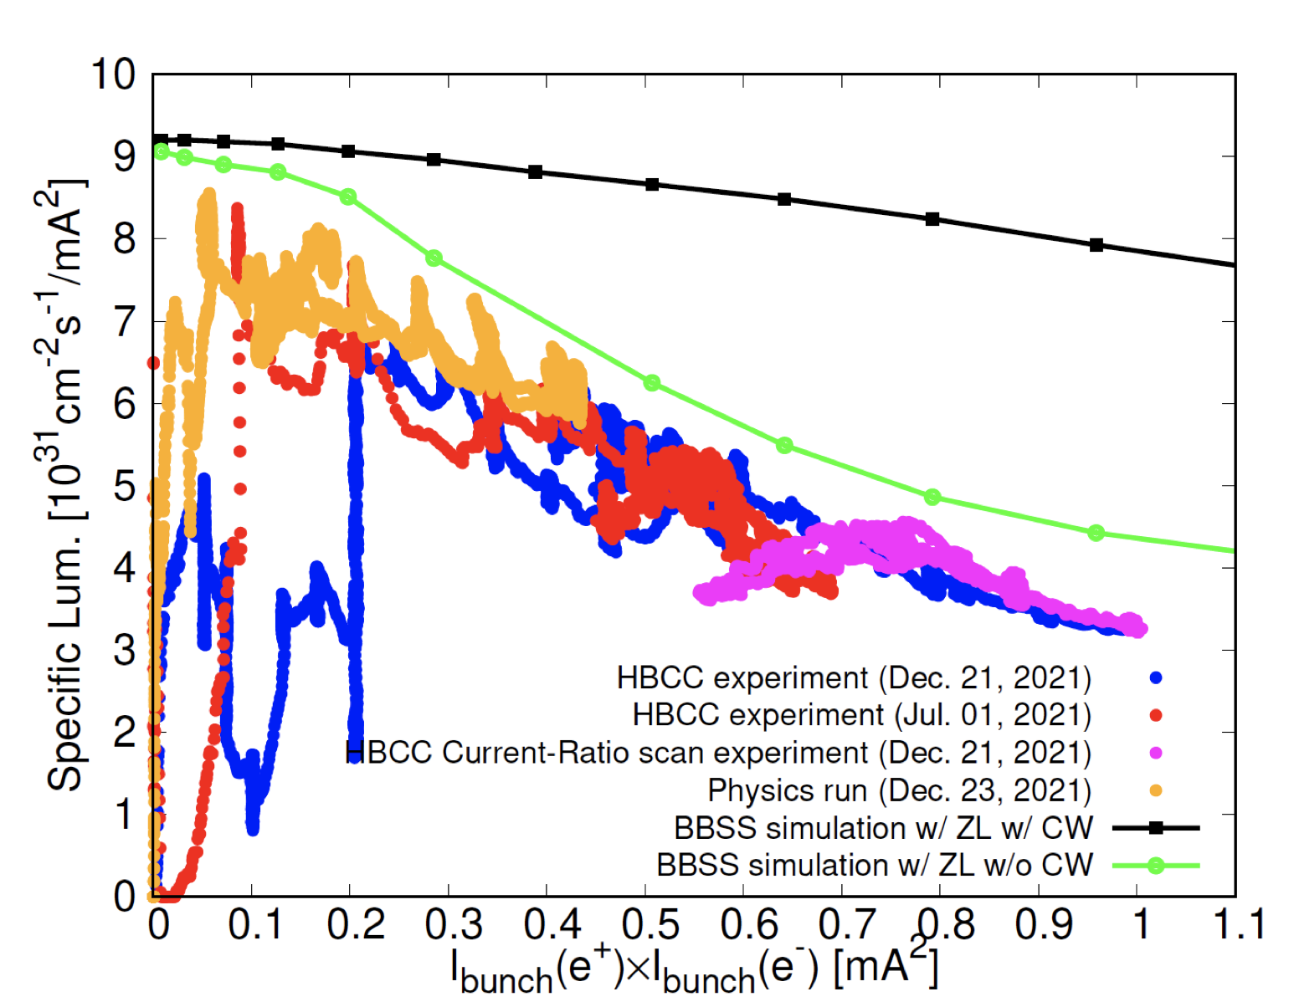
Strategy toward 2.4×10³⁵ cm⁻²s⁻¹
Beam-Beam simulation shows much higher specific luminosity
  It is still unclear why experimental results are much smaller than the simulation.
    Can simulation miss some important factors?
  There should be hints to increase luminosity of SuperKEKB.
    If we identify the cause of the reduction in the luminosity, measures can be taken to improve luminosity.
Important issue not just for SuperKEKB, but for future colliders with nano-beam collision scheme.
Currently working on establishing a framework for international collaboration with CERN, IHEP, etc. especially on Beam-Beam simulations.
  Several researchers will join SuperKEKB beam-beam team for 1-2 years to solve the mystery of SuperKEKB.
Strong-Strong Beam-Beam simulation (D. Zhou)
Simulation
Large discrepancy
Experimental results

Slide 14
Summary
Long-term plan
  New long-term plan is currently being created.
    Operation needs to be continued by 2042 to deliver 50 ab⁻¹ with IR upgrade.
  Major changes from original plan are
    LS 2 is moved from 2027 to around 2032
    After LS2, luminosity projection shows two lines (w/ and w/o IR upgrade)
    Technical feasibility of the IR upgrade and exact luminosity gain remain uncertain.
2025 run plan
  2025ab run will be skipped.
  2025c run and 2026a run will be conducted.
    Winter shutdown will be shortened as much as possible.
    With more supplementary budget, 2025c or 2026b will be extended.
  We are just beginning a 10-month shutdown.
During the 10-month shutdown
  Work items is currently under consideration.
    It is required to prioritize works to increase both peak and integrated luminosity in the next run.
  Specific commissioning plan is yet to be created.
    Luminosity target : 1×10³⁵ cm⁻²s⁻¹ (peak) / 1 ab⁻¹ (total integrated)
    We really appreciate your recommendations and suggestions!!

Slide 15
Fin.
Thank you for your attention.
Inter-University Research Institute Corporation High Energy Accelerator Research Organization (KEK)
大学共同利用機関法人 高エネルギー加速器研究機構 (KEK)

Slide 16
Back up
Inter-University Research Institute Corporation High Energy Accelerator Research Organization (KEK)
大学共同利用機関法人 高エネルギー加速器研究機構 (KEK)

