Slide 1
International collaboration for SuperKEKB
Makoto Tobiyama
KEK Accelerator Laboratory

Slide 2
International collaboration scheme
US-Japan collaboration on High Energy Physics
R&D for SuperKEKB and the next generation high luminosity colliders (M. Tobiyama(KEK), J. Seeman(SLAC)) since 2002
Development of the SuperKEKB Interaction Region Nb3Sn Quadrupole Magnet(Y. Arimoto(KEI), S. Stoynev(FNAL))
Development of superconducting magnets and the quadrupole field vibration measurement system for SuperKEKB upgrade (R. Ueki(KEK), V. Teotia(BNL))

Slide 3
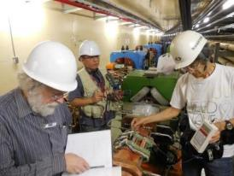
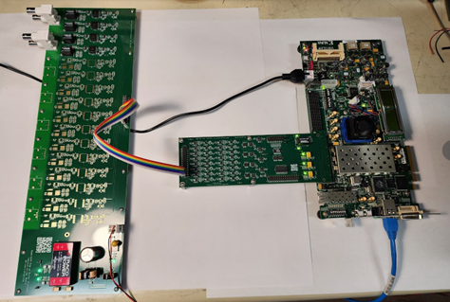
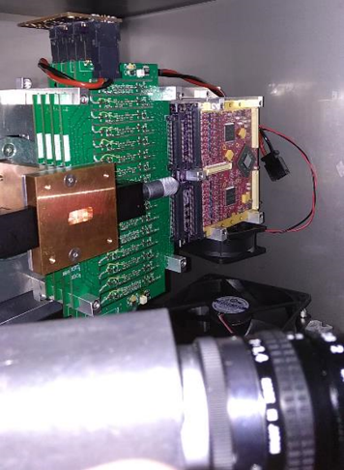
High Luminosity
SuperKEKB commissioning, development of dithering-based IP feedback(SLAC, ANL, KEK)
High speed bunch-by-bunch X-ray beam size monitor diagnostics (XRM) (U. Hawaii, SLAC, KEK)

Slide 4
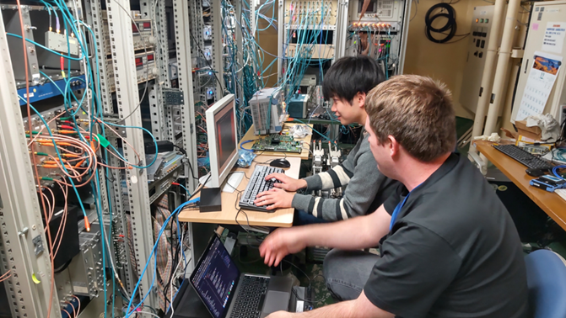
High Luminosity
Fast Diagnostic Electronics (SLAC, KEK)
Study of beam collimation
Study of Electron Cloud Instability
Large Angle Beamstrahlung monitor (Wayne St.)
Accelerator Physics

Slide 5
Nb3Sn Quadrupole magnet
Current IP
IP with new QC1s(Nb3Sn)
Winding design of new QC1

Slide 6
Multi-National Partnership Project
R&D for high luminosity colliders (MNPP-01)
CERN, CNRS/IN2P3, SLAC, IHEP-Beijing, INFN
Visa support, daily life support
Many contributions from IHEP, CERN, LAL and SLAC
IJCLab: Fast luminosity monitor (LumiBelle2)
CERN: Ring Commissioning, Optics measurements
IHEP: Design(Hardware), Optics, Simulations,...

Slide 7
Visiting collaborators in 2024a/b

Slide 8
Visiting collaborators in 2024c-
Dr. Salvesen John Patric (CERN) Dec.2024
Dr. LI Meng(IJCLab) 17/Nov-29/Dec
Dr. Lin Chuntao (IHEP) Mar.2025-

Slide 9
We surely welcome international collaboration to improve performance of the SuperKEKB accelerators. We would be very grateful if you or your colleague could visit KEK and help us.
We would appreciate your consideration of the following points.
Our human resources are under extreme pressure, as you know.
During operation period, commissioning staff are often pressed for time and it can be difficult to respond adequately. Therefore, we may have to decline visits for “educational purposes”.
If you are planning to visit, please consult with the host in charge in advance and submit the required application form.

Slide 10
Application form items
1. Name (Family name, First name, Middle name)
2. Institute:
3. Overview of your research
4. Research plan
5. Research period (YYYY/MM/DD – YYYY/MM/DD)
6. Name of Fund; EAJADE, MNPP-01, US-Japan Co-operative Project, etc
7. Contact person/supervisor at your institute.
8. Contact person/supervisor at KEK, if any.
Remarks: This application form is sent to the international collaboration board for the SuperKEKB project. There, the proposed research is discussed, and a decision is made as to whether the proposal is accepted.

Slide 11
Professor S. Asai, Director General of KEK, have asked several accelerator laboratories, such as CERN, DESY, IHEP, to support SuperKEKB accelerator.

Slide 12
Response
CERN
We have proposed collaboration on “beam-beam simulation”—also received several collaboration items from CERN.
We will have detailed discussion with Frank during this ARC period.
DESY
We have received a proposal for joint research on Linac and BT.
IHEP
They have agreed to send a young beam-beam expert to us for a long-term assignment.

Slide 13

eeFACT2025 (Mar.3-7 2025)
We will have dedicated slot for SuperKEKB challenges in the workshop.

Slide 14
Invitation program
KEK Short term invited fellow (14 days – 90 days)
KEK Long term invited fellow (3 months – 1 year)
Guest Researcher Program (14 days – 1 year)
Normal invitation program
Partial support (such as daily allowance only) is also negotiable.
If you are interested in the collaboration (MNPP-01, US-Japan) or the individual invitation program, please contact related accelerator staff(s) at first.

Slide 15
Summary
We are grateful for the extensive international cooperation in improving the performance of the SuperKEKB accelerators.
It would be so grateful if you could continue to give us your supports in the future.

